Slide 1
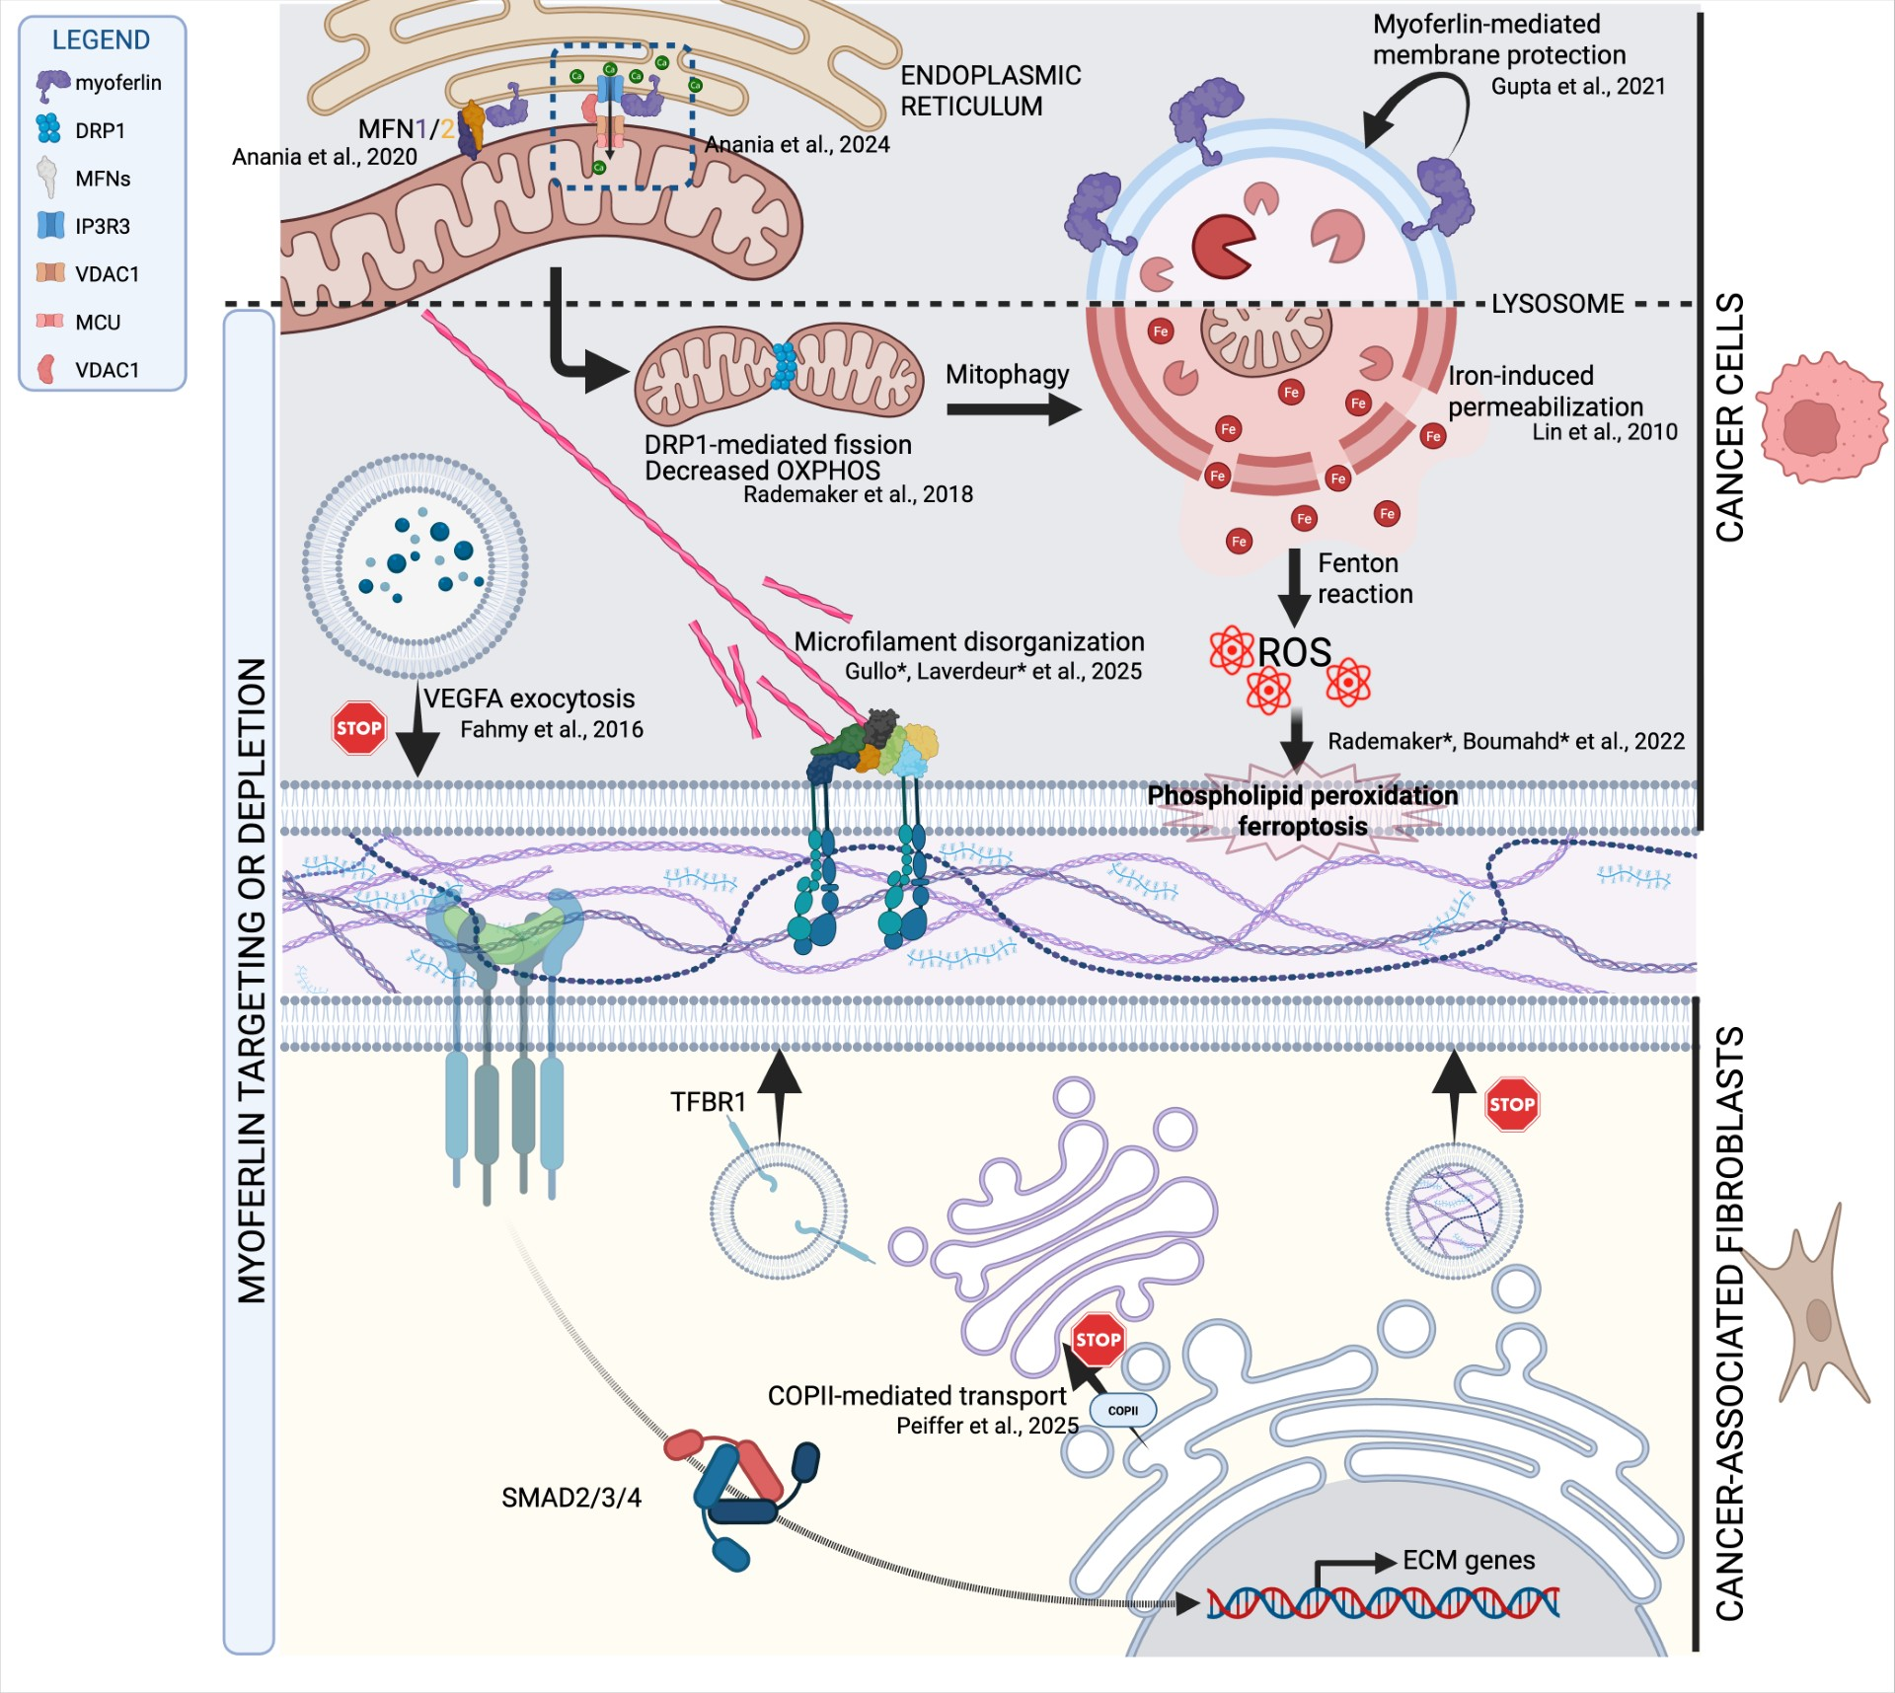
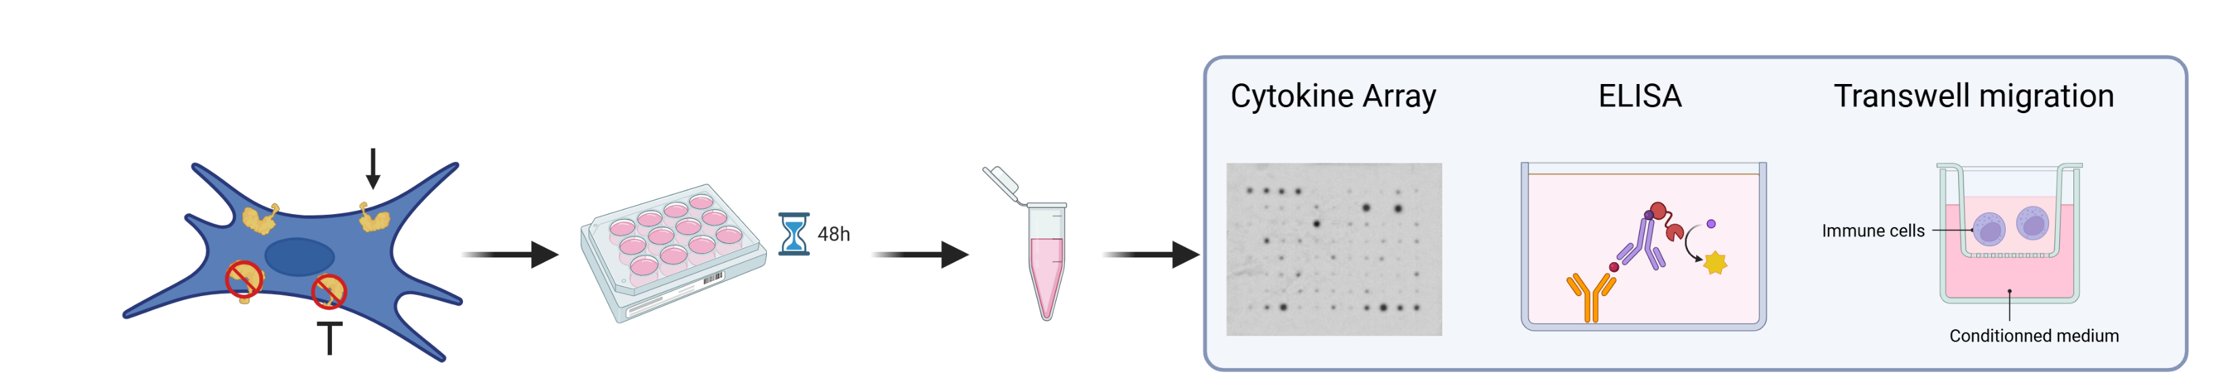

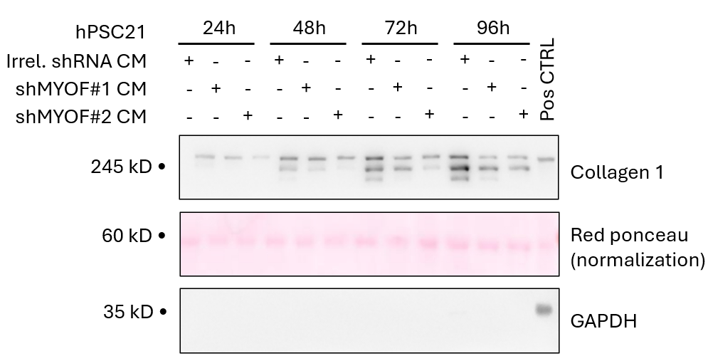
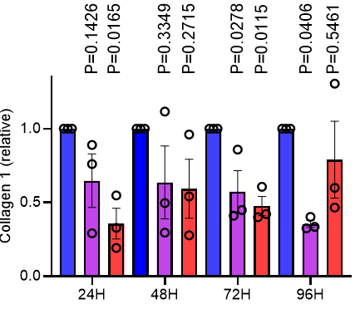
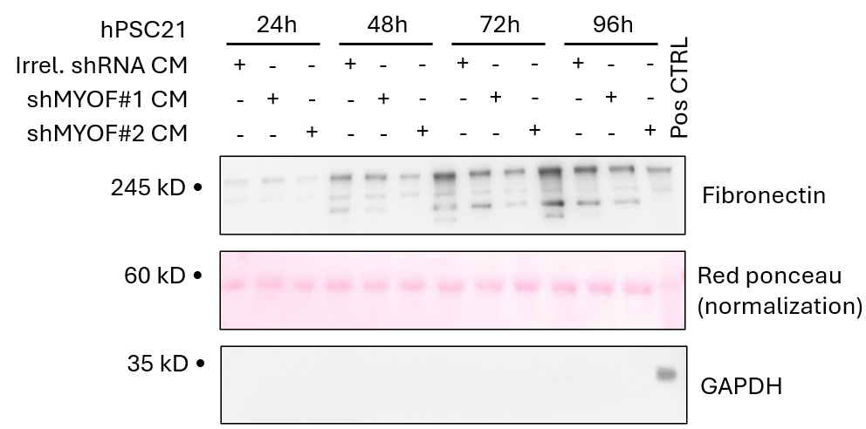
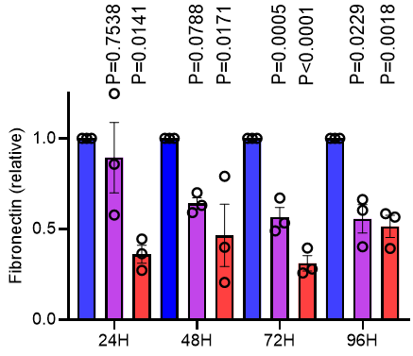
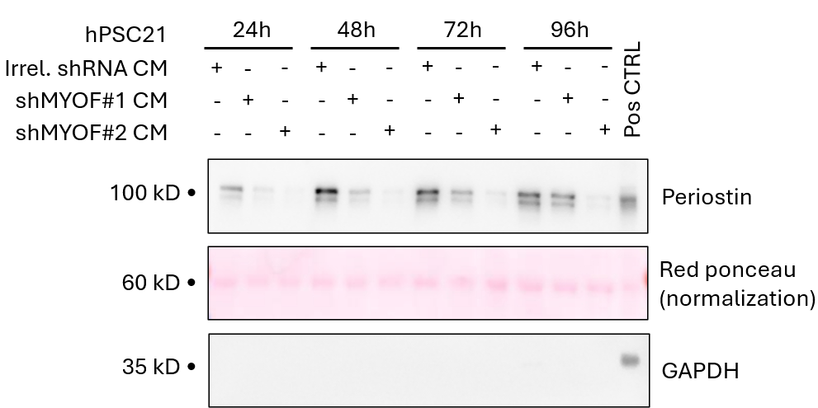
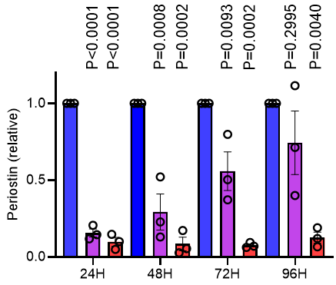
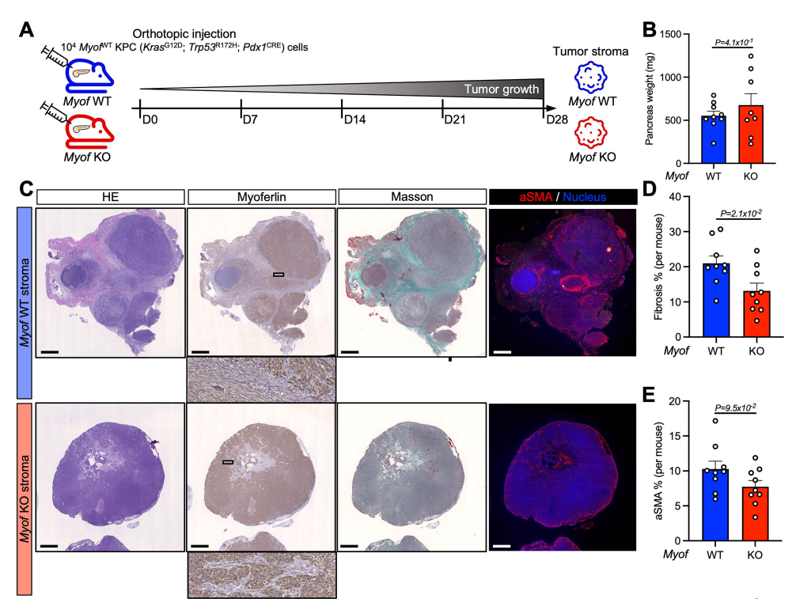

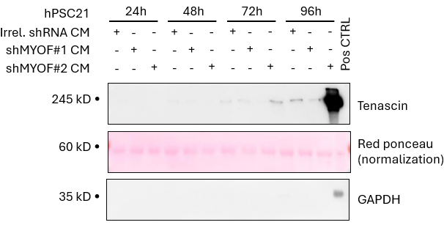
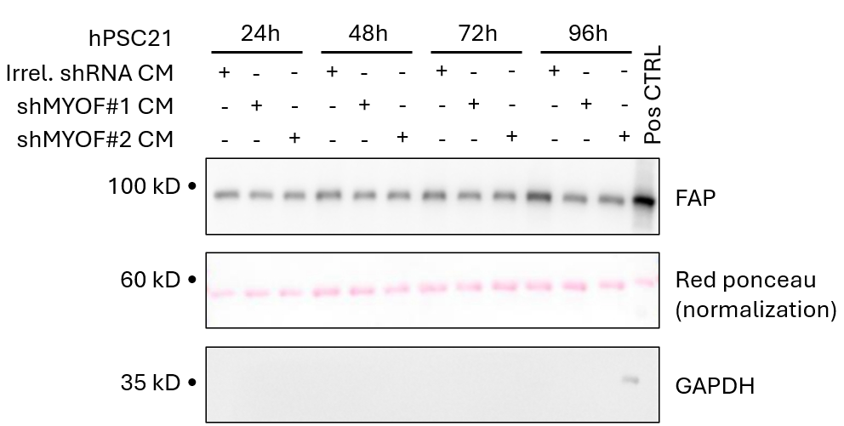
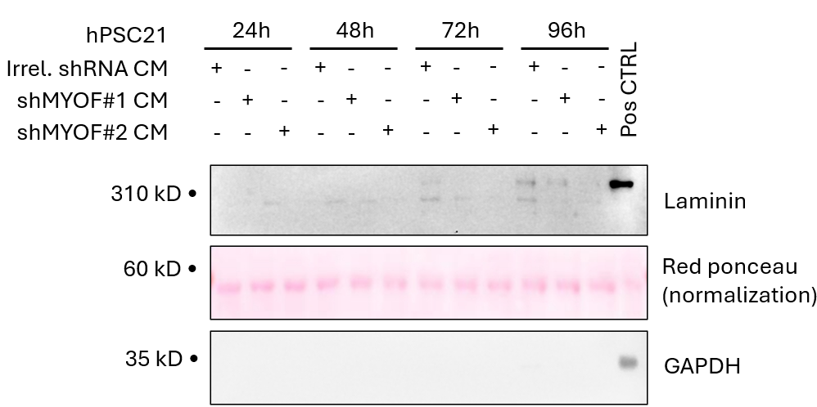
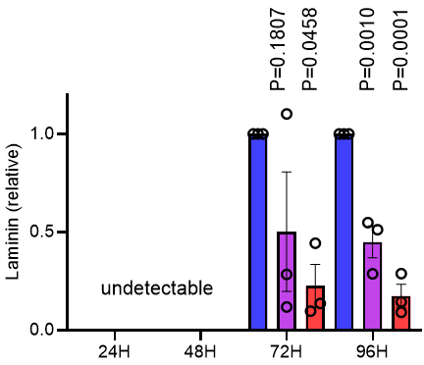
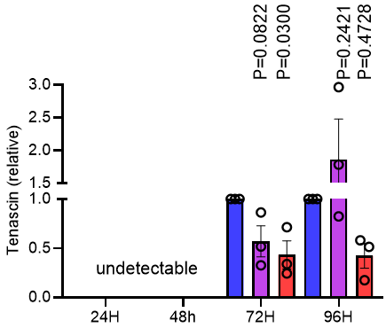
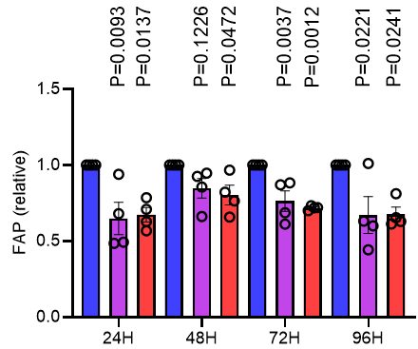
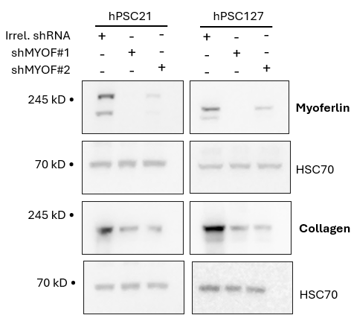
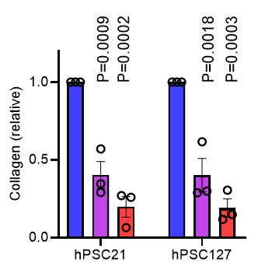
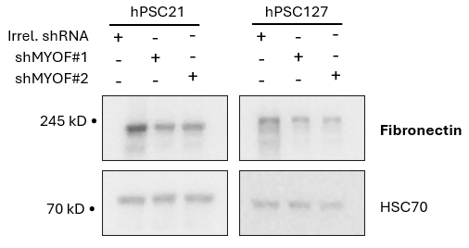
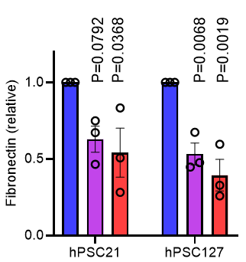
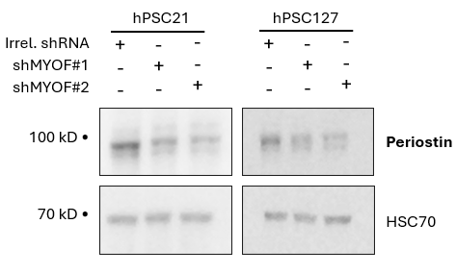
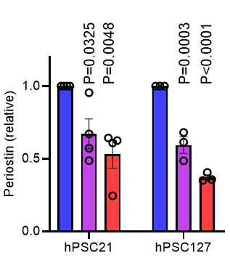
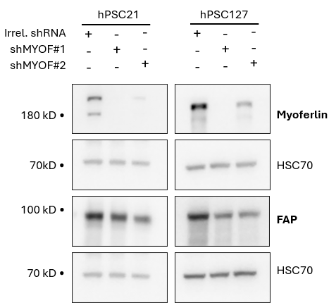
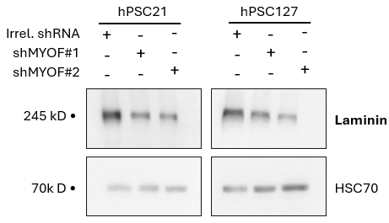
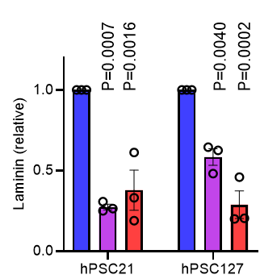
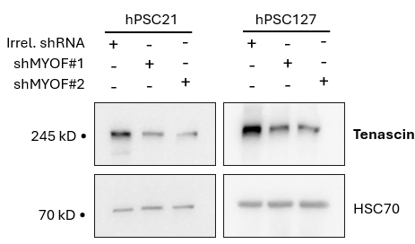
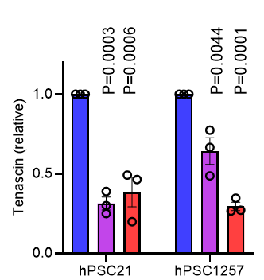
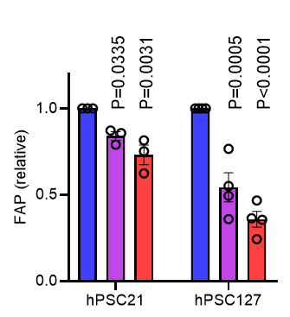
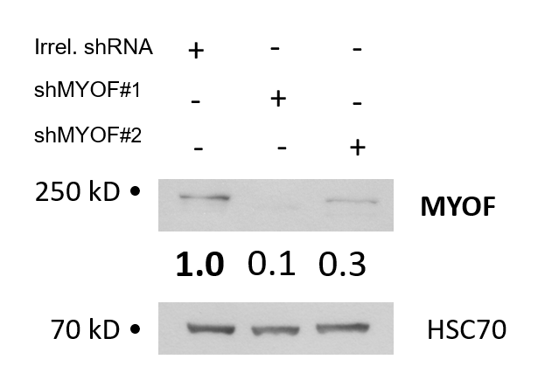
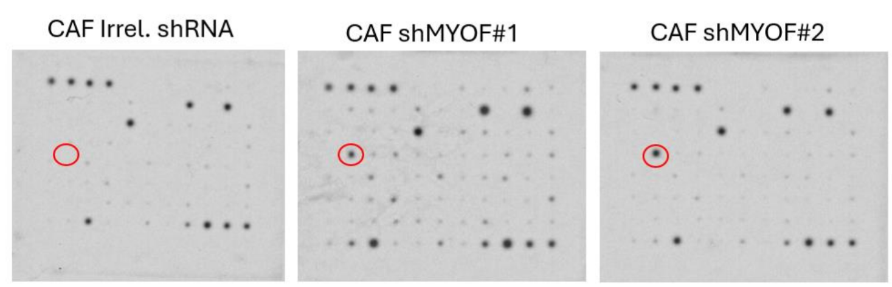
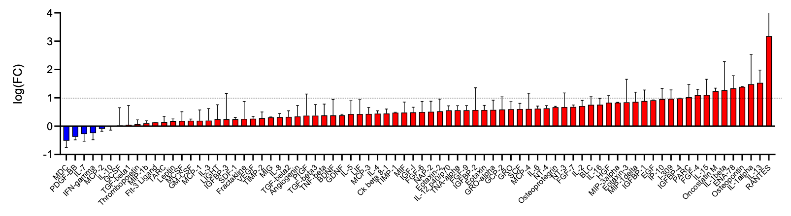
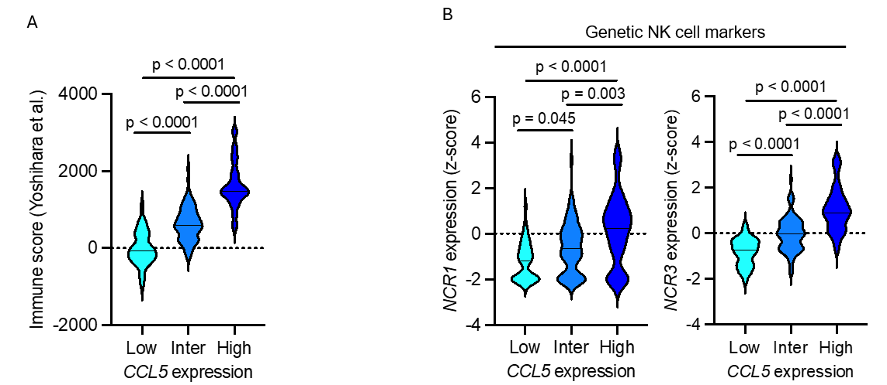



Identification of the role of myoferlin in pancreatic cancer desmoplasia
Emilie Laverdeur¹, Genbauffe Aline¹, Naïma Maloujahmoum¹, Ferman Agirman¹, Raphaël Peiffer^{1,2}, Gilles Rademaker¹, Akeila Bellahcène¹, Olivier Peulen¹
¹ Metastasis Research Laboratory, GIGA-Cancer, GIGA Institute, University of Liège, Belgium - ² Personalized Oncology Division, The Walter and Eliza Hall Institute of Medical Research, Parkville, Australia
Pancreatic dudctal adenocarcinoma (PDAC) remains an extremely aggressive cancer due to late diagnosis associated with early metastatic spread. Myoferlin, a membrane protein, is overexpressed in PDAC and plays a role in several pro-oncogenic functions in pancreatic cancer cells. However, its function extends beyond cancer cells. We have identified specific functions for myoferlin in cancer-associated fibroblasts (CAFs). Myoferlin-depleted CAFs exhibit reduced activity and impaired extracellular matrix (ECM) production, leading to tumors with decreased desmoplasia.
Aim
The purpose of this project is to assess the impact of myoferlin-depletion on desmoplasia and tumor-infiltration of immune cells.
Strategies
Myoferlin
CAFS:
hPSC21 - hPSC127 – hPSC128
Conditioned medium
shRNA
80 000 cells/well/1ml
hPSC 0.5% FBS medium
Proteins
RNA
Results
Myoferlin silencing reduces ECM and non-ECM proteins in conditioned medium
Myoferlin knock-out tackles tumor desmoplasia in orthotopic KPC grafts
Western blot of collagen 1 (250 kDa), fibronectin 1 (250kDa), periostin (90 kDa), laminin a5 (250 kDa), tenascin (250 kDa) and FAP (90 kDa) in hPSC21 CAFs CM transduced with irrelevant shRNA (Irrel. shRNA; n=3) or myoferlin-specific shRNA (shMYOF#1, shMYOF#2; n=3 each).
Myoferlin silencing reduces ECM and non-ECM proteins in whole cell extract
A. Schematic representation of orthotopic KPC allografts into Myof^{WT} or Myof^{KO} C57BL/6 mice.
B. Pancreas weight of Myof^{WT} (n = 8; one mouse succumbed on D27 and tumor was not weighed) and Myof^{KO} (n = 9) mice after resection (D28).
C. IHC and immunofluorescence staining of Myof^{WT} (n = 9) and Myof^{KO} (n = 9) tumor sections. HE = hematoxylin & eosin, Myoferlin, Masson, aSMA = alpha-smooth muscle actin. Scale bar = 1 mm.
D. Quantification of tumor fibrosis (%, Masson-positive area) in Myof^{WT} (n = 9) and Myof^{KO} (n = 9) tumors. Mean ± SEM. Unpaired T test.
E. Quantification of aSMA-positive area (%) in Myof^{WT} (n = 9) and Myof^{KO} (n = 9) tumors.
Mean ± SEM. Unpaired T test.
Myoferlin depletion reduces ECM and non ECM gene expression
RT-qPCR analysis of COL1A1, FN1, POSTN, LAMA5, TNC and FAP mRNA levels of hPSC21 and hPSC127 CAFs transduced with irrelevant shRNA (Irrel. shRNA; n=3) or myoferlin-specific shRNA (shMYOF#1, shMYOF#2;n=3). Mean ± SEM, one-way ANOVA (Tukey’s test).
Western blot of collagen 1 (250 kDa), fibronectin 1 (250kDa), periostin (90 kDa), laminin a5 (250 kDa), tenascin (250 kDa) and FAP (90 kDa) in hPSC21 and hPSC127 CAFs total protein extracts from CAFs transduced with irrelevant shRNA (Irrel. shRNA ; n=3) or myoferlin-specific shRNA (shMYOF#1, shMYOF#2; n=3 each).
Myoferlin silencing alters cytokine secretion by CAFs
A
B
C
D
E
RANTES/CCL-5
A. Western blot of myoferlin (230 kDa) in hPSC127 CAFs transduced with irrelevant shRNA (Irrel. shRNA,) or myoferlin-specific shRNA (shMYOF#1, shMYOF#2).
B. Human cytokine array was performed on conditioned medium from hPSC127 CAFs transduced with irrelevant shRNA (Irrel. shRNA,) or myoferlin-specific shRNA (shMYOF#1, shMYOF#2).
C. Quantification of the cytokine arrays shown in panel C. The relative results (average of MYOF shRNA conditions to irrelevant shRNA condition) are represented as a base 2 logarithm of the fold change (FC).
D. Human CCL5 quantitative ELISA performed on conditioned medium prepared from hPSC21, hPSC127 and hPSC128 CAFs transduced with irrelevant shRNA (Irrel. shRNA,) or myoferlin-specific shRNA (shMYOF#1, shMYOF#2). An ANOVA-1 statistical test followed by a Dunnett's multiple comparison were performed.
E. Relative expression of the CCL5 gene in hPSC21, hPSC127 and hPSC128 CAFs transduced with irrelevant shRNA (Irrel. shRNA,) or myoferlin-specific shRNA (shMYOF#1, shMYOF#2). An ANOVA-1 statistical test followed by a Dunnett's multiple comparison were performed.
Conclusion
Myoferlin silencing profoundly alters stromal protein production, and modulates CCL5 expression and secretion by CAFs. CCL5 could potentially promote NK cell infiltration into the tumor.
Perspectives
A
A. Exploratory data from The Cancer Genome Atlas (TCGA) PAAD dataset illustrating the involvement of CCL5 gene expression in immune cell infiltration. Yoshihara’s immune score of PDAC patients segregated into three groups according to CCL5 expression. PDAC patients expressing the highest levels of CCL5 have the highest immune score. In addition, patients with intermediate CCL5 expression have a higher immune score than patients with the lowest CCL5 expression.
B
B. Expression of genetic NK cells markers (NCR1 and NCR3) in TCGA PDAC patients according to CCL5 expression. Patients with the highest expression of CCL5 have a higher expression of NCR1 and NCR3.
We will investigate the biological role of CCL5, particularly its role in attracting immune cells, particularly NK cells, using a Boyden chamber assay and heterotopic spheroids formed from cancer cells and myoferlin-depleted CAFs.
Contact:
Emilie.laverdeur@uliege.be
Metastasis Research Laboratory,
B23 GIGA, Avenue de l’hôpital, 3, 4000 Liège, Belgium

