Slide 1
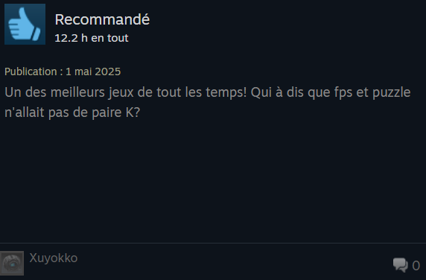


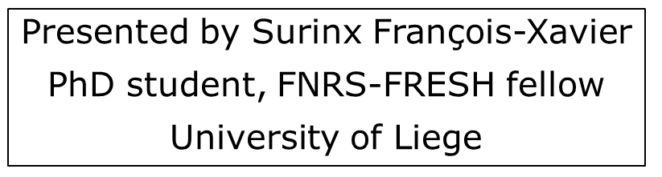


Portal’s generic reception

Slide 2
Presentation’s plan
PhD thesis project
What is Portal ? Where does it come from ?
Methodology and corpus
Analysis of players’ discourses
Conclusions

Slide 3
1. Project
Initially, PhD thesis on the genres used by players online
Problem (among many others): the genre usage is situated on a continuum.
Study of the categorization made by players online
Category: group of at least two works linked by a player’s statement
New question: How and why players categorize videogames ?
Common
Technical

Slide 4

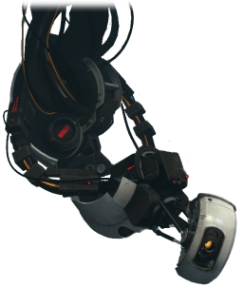
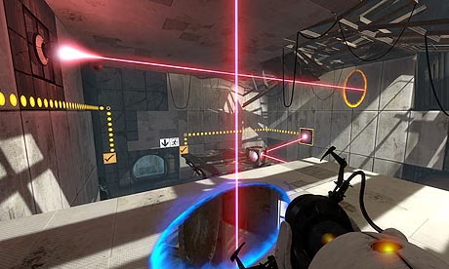
2a. Portal’s gameplay and univers
Story: the avatar (Chell) must pass tests/experiments conducted by GLaDOS.
Tone: dark humor, play with players’ expectations
Structure: multiple rooms/puzzle to solve
View: FPS camera, no HUD (Head-Up Display)
Actions: jump, carry box and use the portal gun

Slide 6
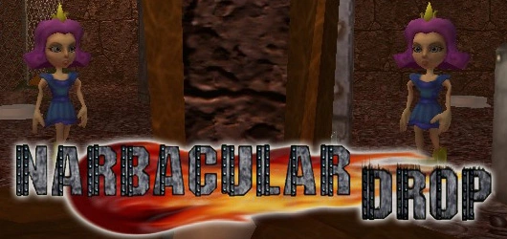
2b. Portal’s inspiration
Developped by Valve
The team behind the game is partially constituted of freshly hired students who previously made Narbacular Drop (2005, Nuclear Monkey Software).

Slide 7
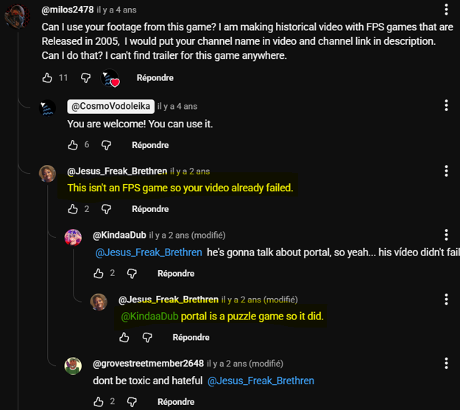

Slide 8
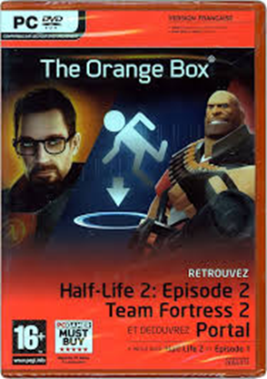
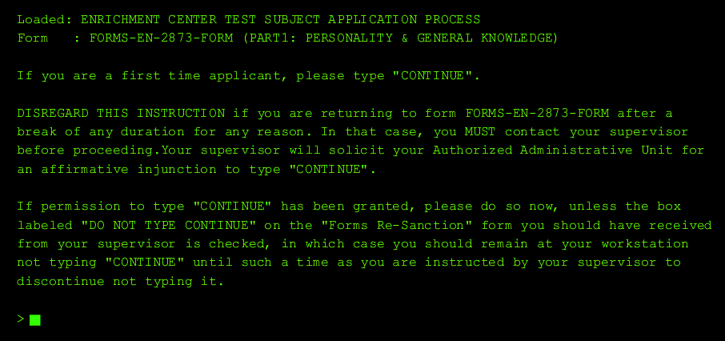
2c. Game marketing
Published by Valve in october 2007 on Windows
The game is originally sell in the « Orange Box » package.
The marketing around the game is cryptic :
a unique website (ApertureScience.com) similar to a DOS terminal ;
some declarations on the filiation with the Half-Life series and the presence of puzzle-oriented gameplay.

Slide 9
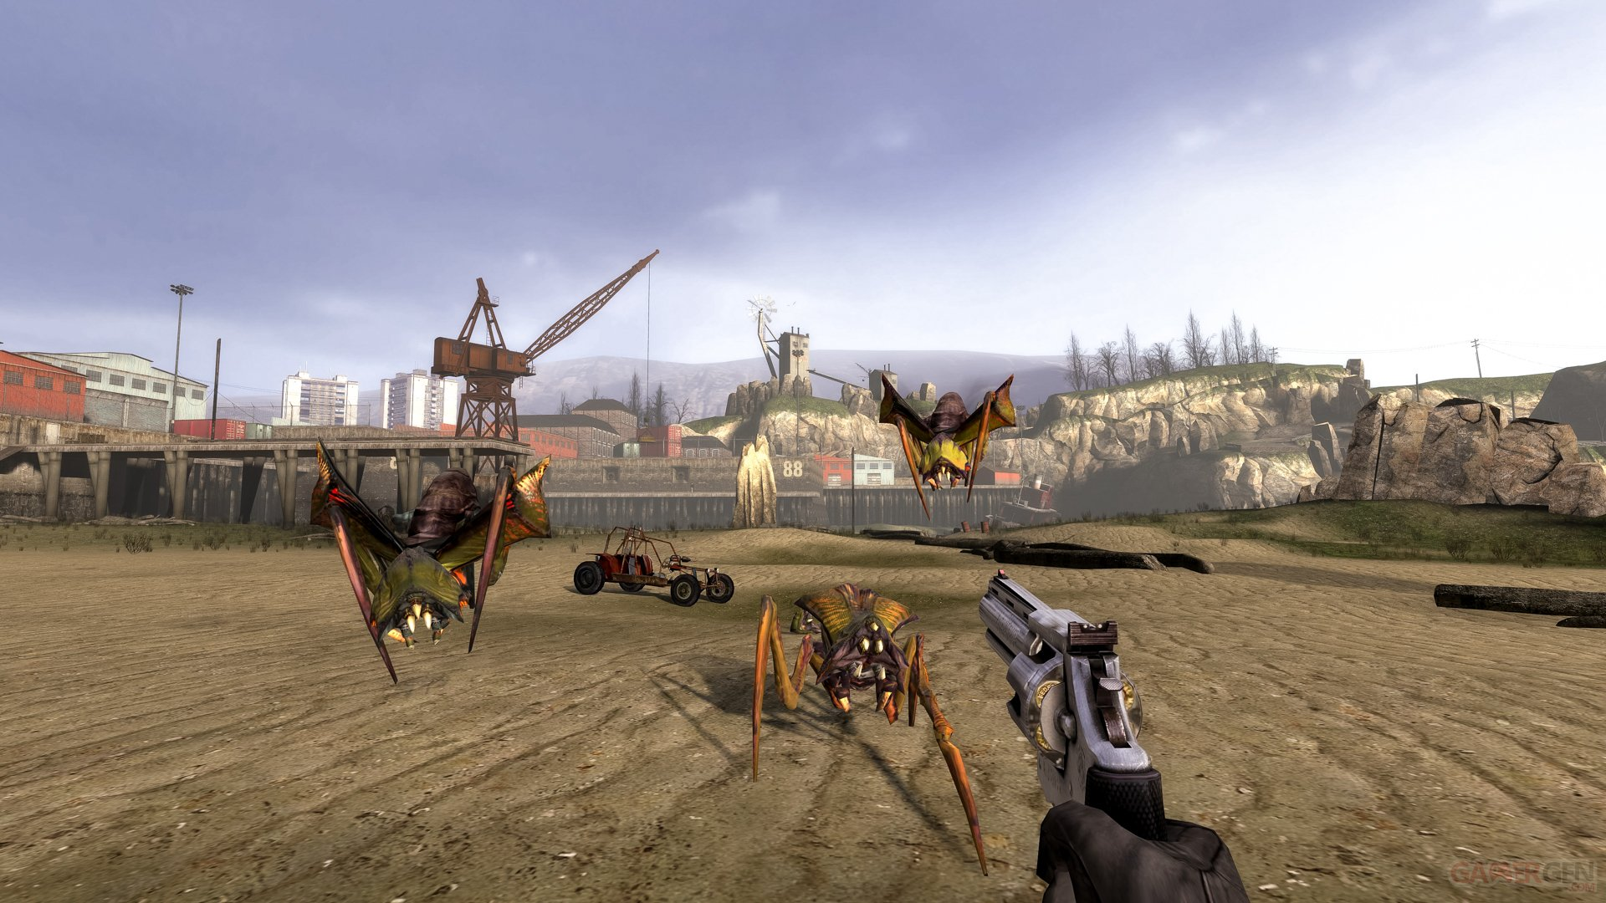
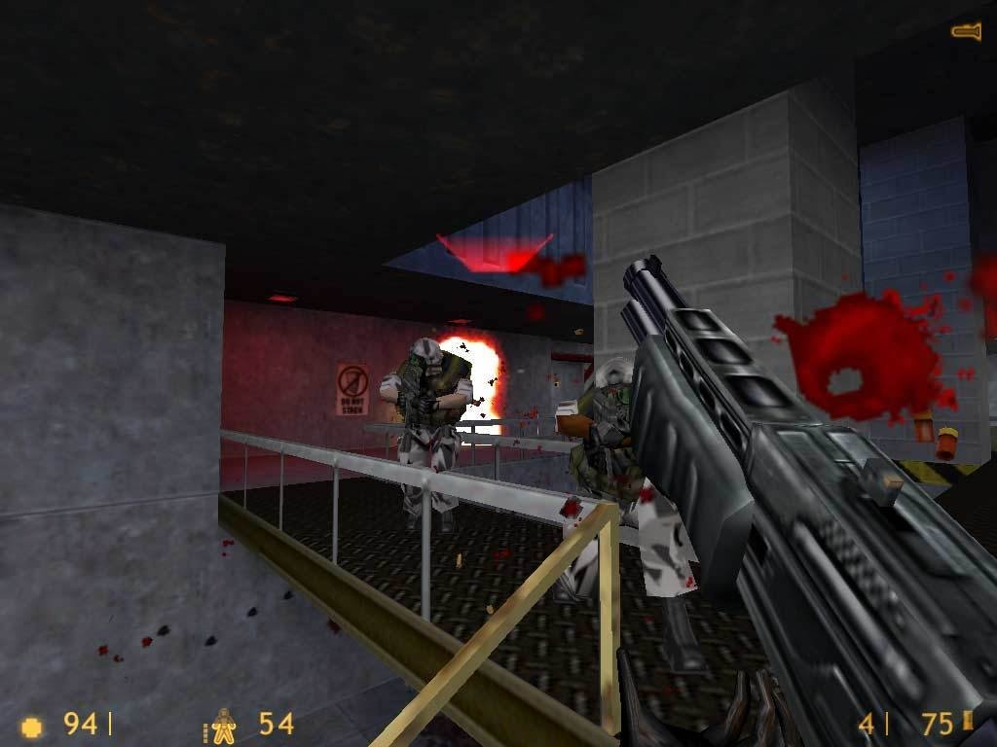
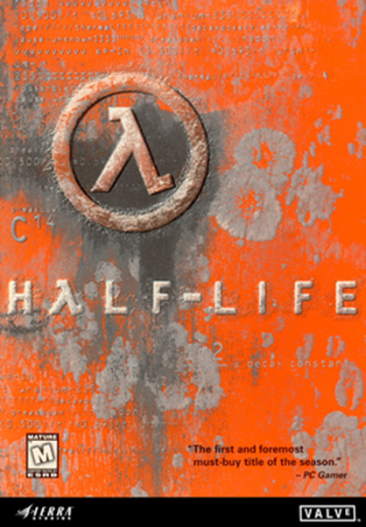

2d. Filiation
Valve is especially known for the Half-Life games, which are often cited as among the best FPS in the early 2000.

Slide 10
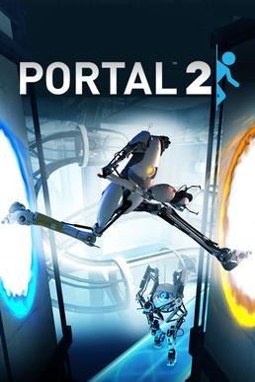
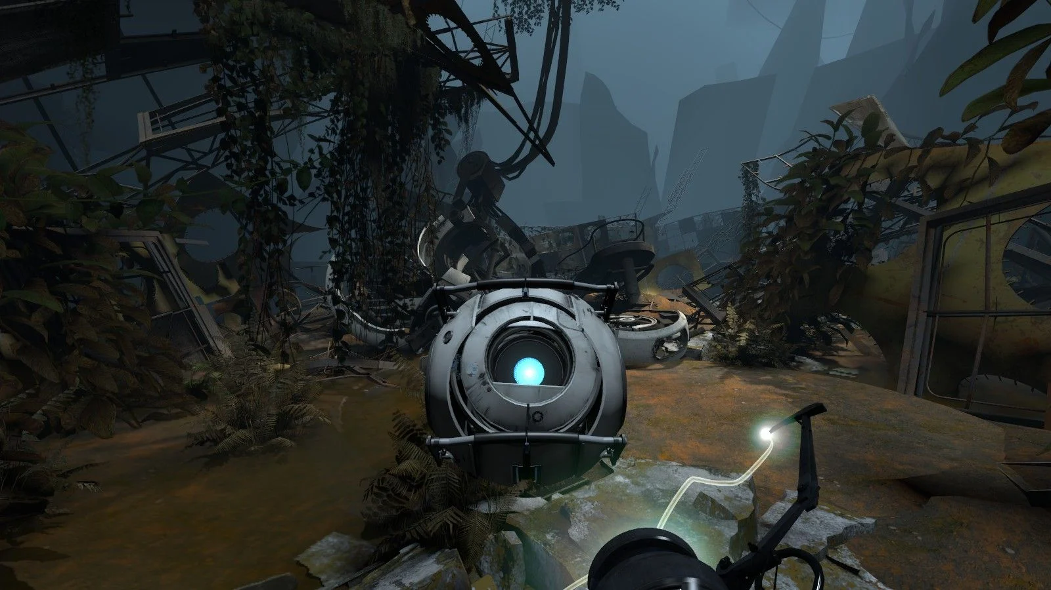
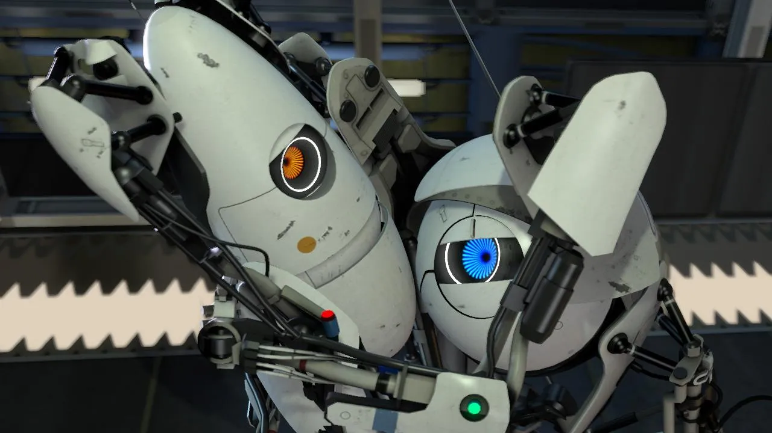
2e: Sequel
Portal 2 (2011), developped and released by Valve
Direct sequel that introduces new mechanics

Slide 11
3. Methodology and corpus
Semiorhetorical analysis
Shows the discursive tactics behind player’s uses
Allows to consider the discursive implications of each studied formats
Presentation corpus
French speaking player’s discourses in two formats (tests and forums) from the JV specialized website (previously Jeuxvideo.com)
Goals
To show some categorizations used by players (and how they manifest hybridity)
To determine why Portal remains difficult to classify

Slide 12
How to determine a category’s saillance/significance [prégnance] ?
Formalization
(See Agha, 2005)
Labelled
(Mètre-étalon)
Comparative
Descriptive/Implicite
In absentia
Frequency
Idiolectal
Sociolectal
Conventional

Slide 13
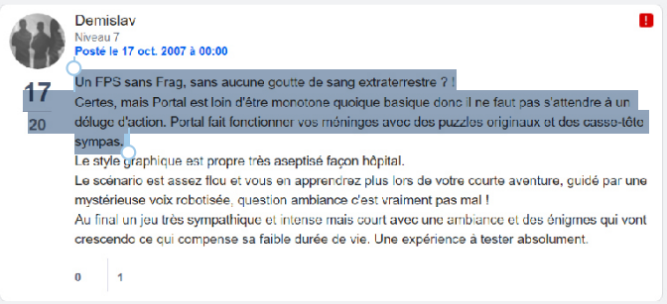
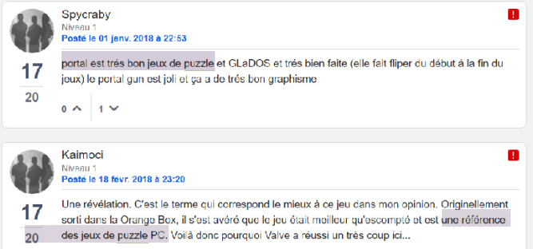
An unquestioned use of common generic terms

Slide 14
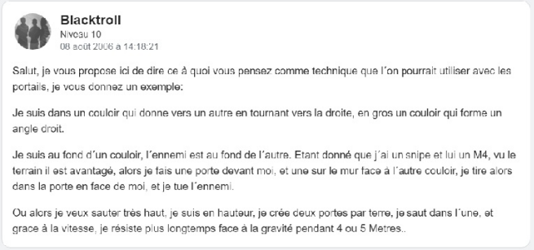
Seems a standard FPS at first view

Slide 15
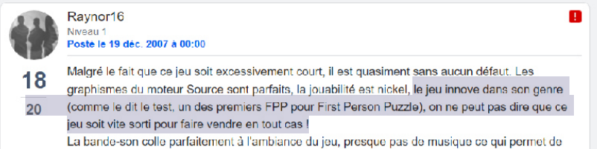
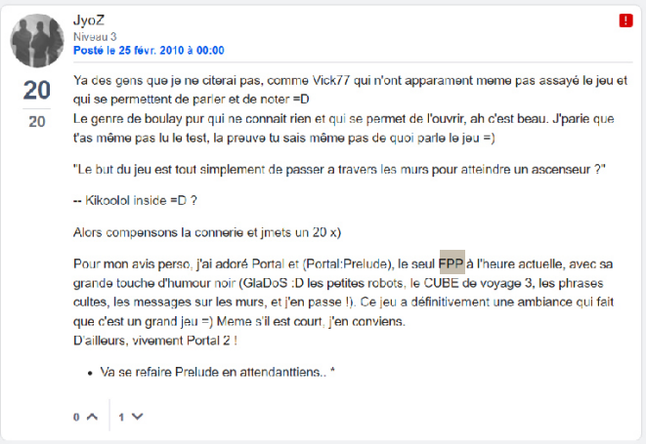
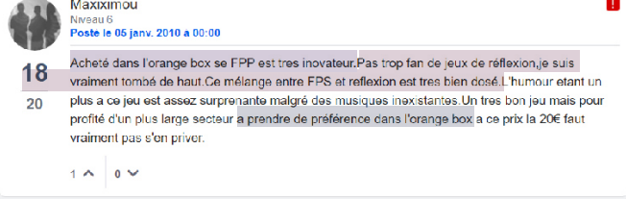
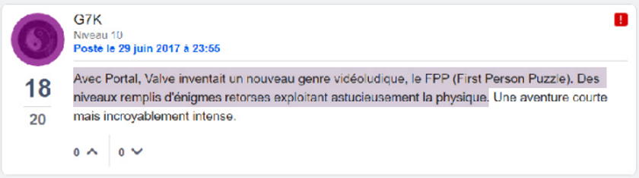
A new genre?

Slide 16
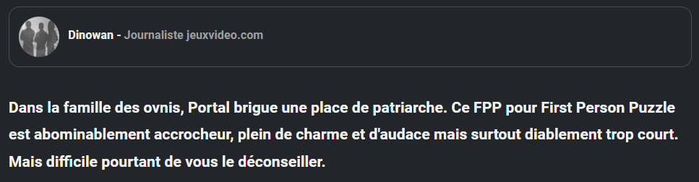
But who is the first to mention the FPP?

Slide 17
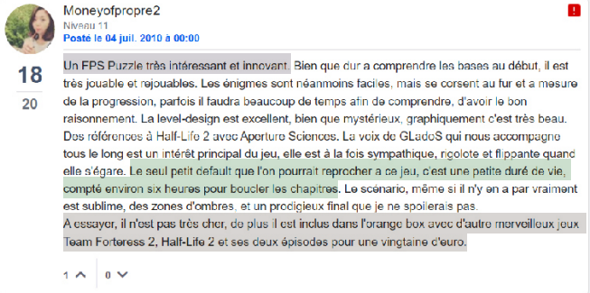
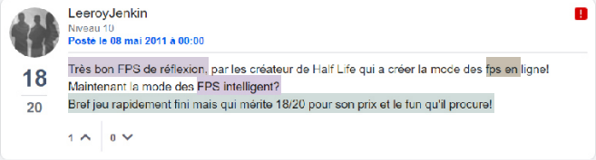
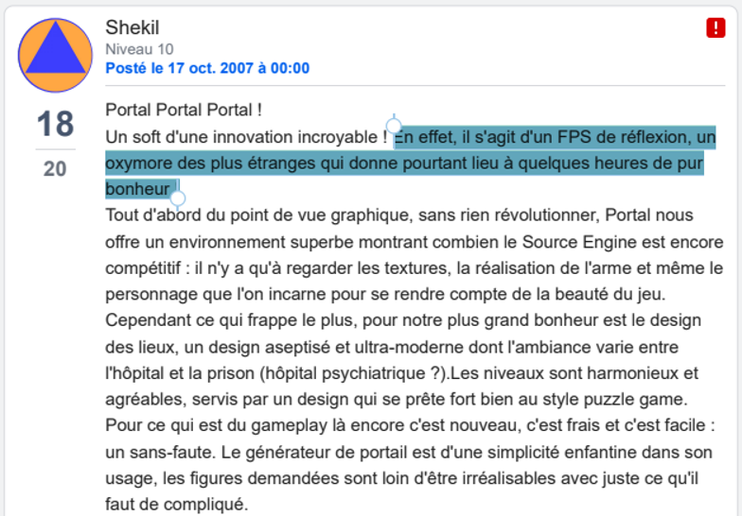
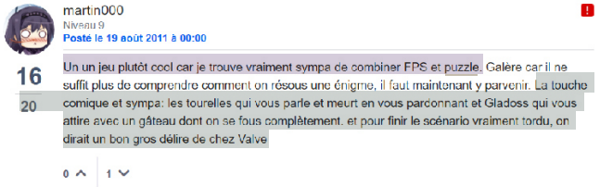
Concurrent labels and descriptions of an hybrid

Slide 18
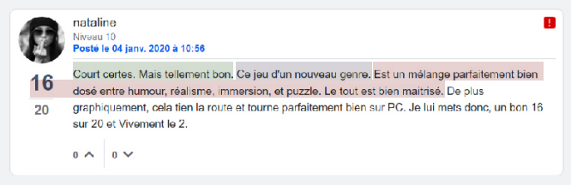
Sometimes, difficulty to identify the right label

Slide 19
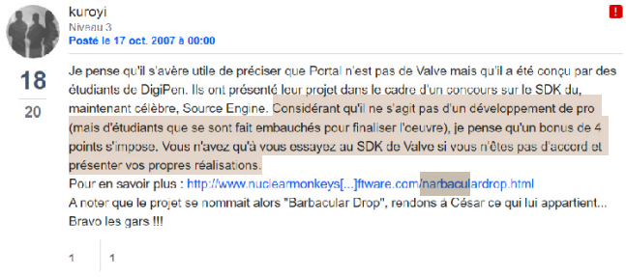
Very few mentions of a precursor

Slide 20
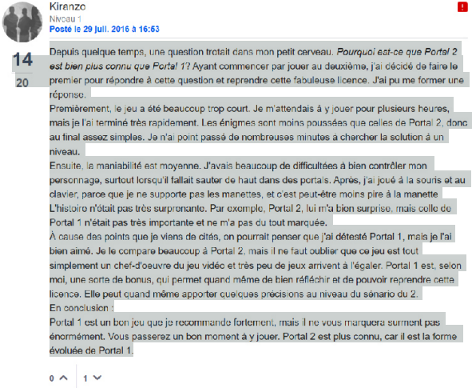
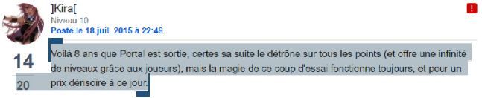
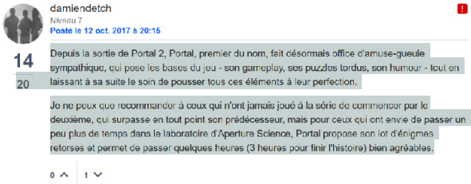
New considerations when the sequel is released

Slide 21
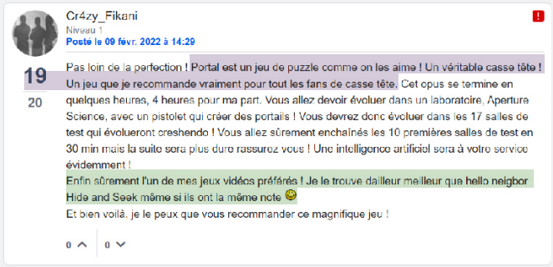
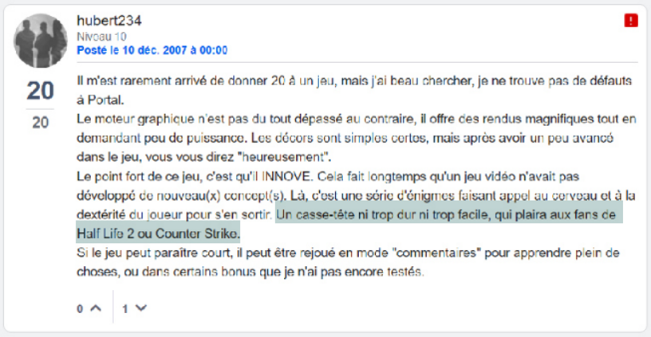
Comparison with other videogames centered on several aspects (but few link with the Half-Life serie, except the lore)

Slide 22
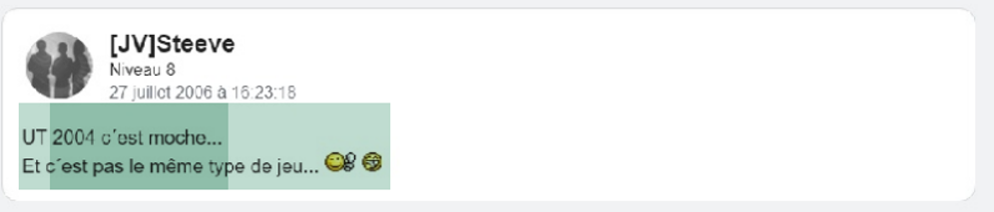

On forums, insistance on thematic particularities (especially the humor)

Slide 23
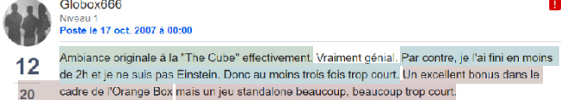

Comparisons with other medias target thematic aspects

Slide 24
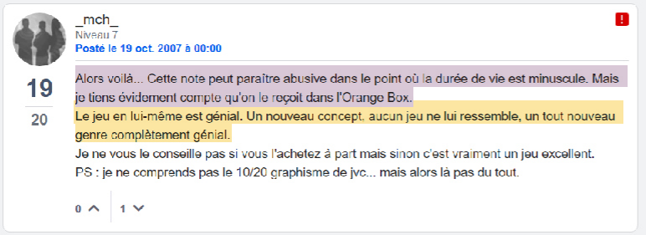
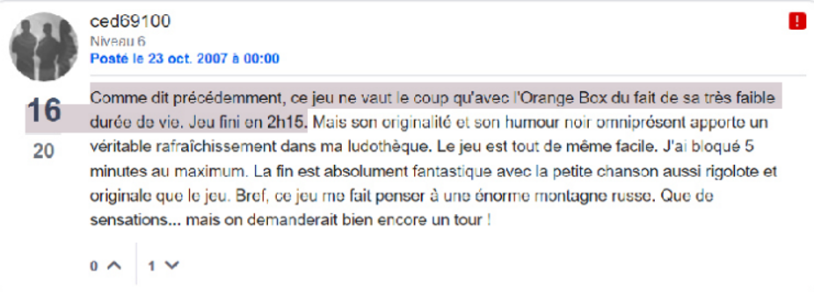
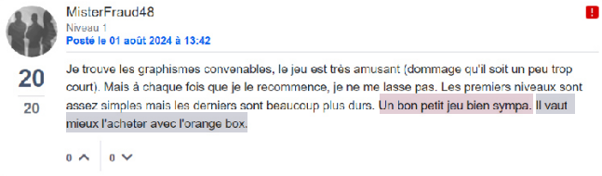
A valuable game… but especially in the Orange Box

Slide 25
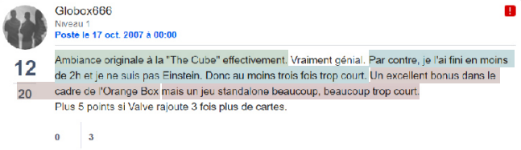
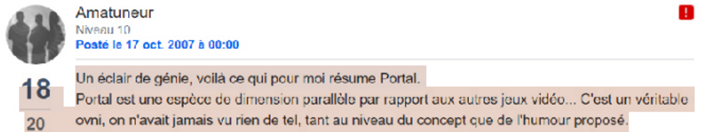
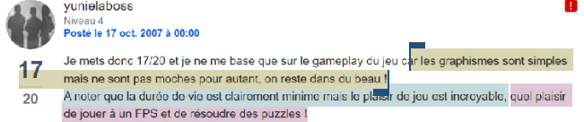
Judgement in regard of a typical/standard gaming experience

Slide 26
Conclusions / summary
Two levels of hybridity (Arsenault, 2011)
Intra-dimensional (« true hybridity »)
Multi-dimensional ➔ Also gives sense to the gaming experience
The sources of hybridity in videogames (Wolf, 2001) are multiple and player’s discourses do not established a hierarchy, but rather a rhizome structure of knowledge (Deleuze et Guattari, 2008) :
Genres labels
Studio
Sequel and related series
Lifespan
- Marketing format
- …
Price
Experience depth
Other medias
Perceived standard experience
Technical accessibility

Slide 27
Conclusions / summary
Why the FPP (first-person puzzle) have not been stabilized in French ?
No well-known precursor to Portal
No imitation vague identified by the audience (Schaeffer, 1989)
➔ The game concept remains minor and too singular (compared to experiences provided by other games)

Slide 28
Conclusions / summary
Necessity to consider reception’s discours
Allow to better understand / reminisce past experiences with works (media archeology)
Empirically show that categorization is not just a matter of time, but of discursive context
Allow to look beyond our scholar preconceptions about genres and categories

Slide 29
References
Agha, A. (2005), « Voice, Footing, Enregisterment », Journal of Linguistic Anthropology, XV, 1, p. 38-59.
Arsenault, D. (2011), Des typologies mécaniques à l'expérience esthétique : fonctions et mutations du genre dans le jeu vidéo, PhD Thesis, University of Montreal.
Deleuze, G. and Guattari, F. (2009), Capitalisme et Schyzophrénie 2. Mille plateaux, Minuit.
Schaeffer, J.-M. (1989), Qu’est-ce qu’un genre littéraire ?, Seuil.
Wolf, M.J.P. (2001), « Genre and the video game », The medium of the video game, University of Texas Press, p. 113-134.

Slide 30
Thank you for your attention !
Contact: fxsurinx@uliege.be

