Slide 1
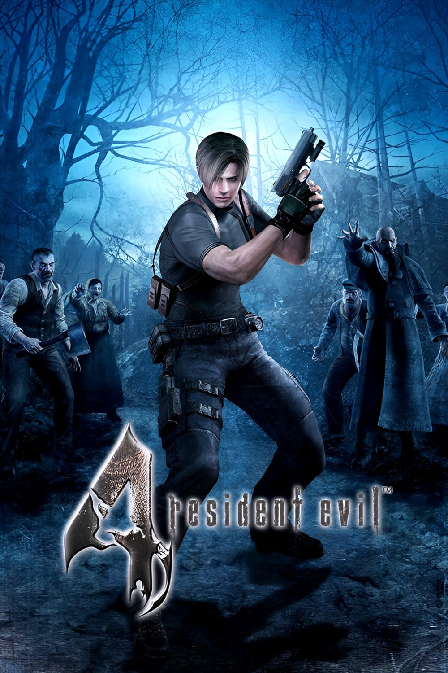





Resident Evil 4’s categorization in players’ online discourses

Slide 2
Resident Evil 4’s categorization in players’ online discourses

Slide 3

Portal’s categorization in players’ online discourses

Slide 4
Original question
How do players use genres (FPS, action, Survival horror…) when they talk about games?
Several problems:
Different labels or expressions to talk about a single category
How to recognize a generic usage of a specific term?
More crucially, what is a genre?

Slide 5
A literary question
Originally, generic studies emerge in literature with Aristotle.
An epistemic legacy:
Heterogen categories + non-hybrid works
Focus on the author’s will (here, model player)
Scholar’s categories presented as neutral and stabilized
We often have an ordinary and irreflective usage of generic terms
We nearly never consider categories used by the actual audience

Slide 6
New question
How and why are games categorized by players in their online discourses?
Category: a group of at least two games that is recognized by a player
Three games observed:
- Wolfenstein 3D (1992, id Software)
Resident Evil 4 (2005, Capcom)
Portal (2007, Valve) ➔ Game difficult to classify

Slide 7
Today, Portal case
Methodology: qualitative analysis
Domain: semiotics and rhetoric
Presentation corpus: « tests » written by French-speaking players on the specialized website JV

Slide 8
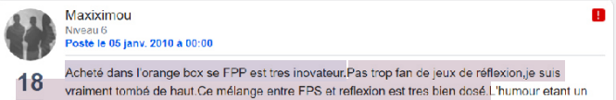


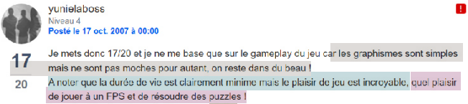
Not a lot of common generic labels
Never problematized
Always mechanical labels

Slide 9
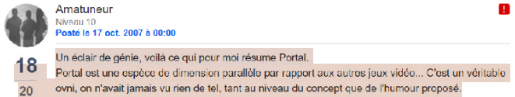
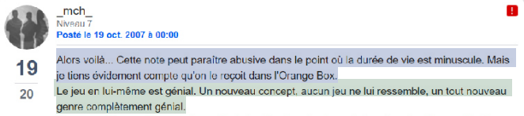
Recurrence of the « OVNI » [UFO] label, separation from a standard experience, or in absentia categorization

Slide 10
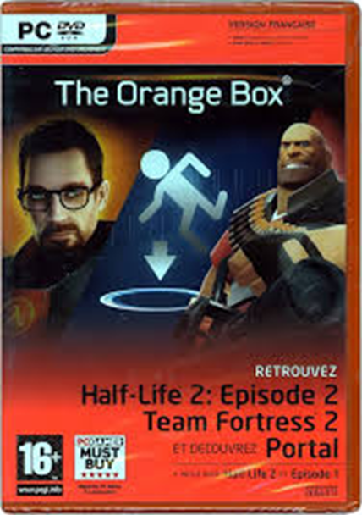
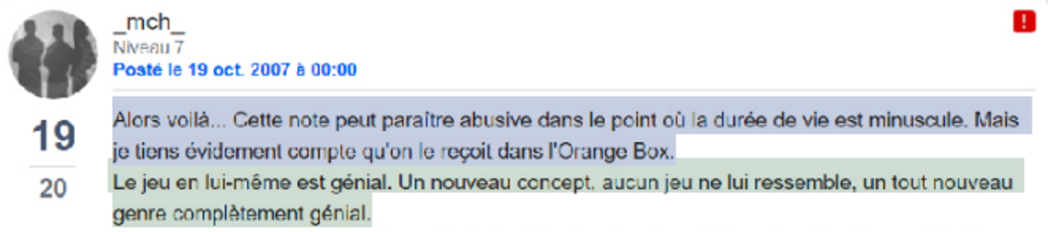


Importance of the « Orange Box » (price/gameplay length)

Slide 11

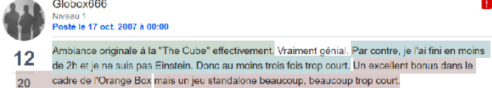
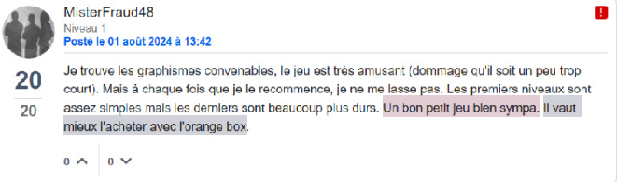
Importance of the « classical » game experience in context

Slide 12
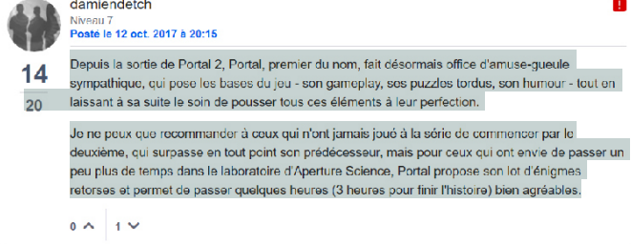
Comparison with Portal 2

Slide 13

Comparison with other medias

Slide 14
All categorizations are not equally salliant/significant
Formalization
The area obtained shows how a category is rooted in usages
Labelled
Mètre-étalon
Comparative
Descriptive/Implicite
In absentia
Frequency
Idiolectal
Sociolectal
Conventional

Slide 15
Players’ discourses must be studied
One way to reconstitute original experience and beliefs about a game (media archeology)
Categories live and die in their discourses: today, players have more tools to influence industries’ uses
Researchers have to acknowledge that their habits are tied to their experience and often don’t reflect common practice

Slide 16
Thank you for your attention !
Contact: fxsurinx@uliege.be

