Slide 1
New ways to identify phraseological patterns : between statistics and AI
New ways to identify phraseological patterns:
between statistics and AI
Dominique Longrée, Université de Liège, UR Mondes Anciens, Laboratoire d’Analyse statistique des langues anciennes (LASLA)
Laurent Vanni, CNRS – Université Côte d’Azur, UMR 7320 – Bases Corpus Langage

Slide 2
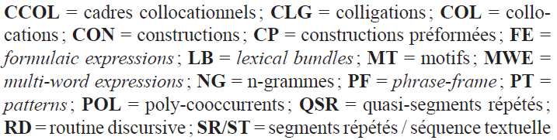
New ways to identify phraseological patterns : between statistics and AI
1. The detection of the so-called “phraseological patterns” : objectives and difficulties
1.1. A variety of “phaseological units” : the concept of an “extended phraseology”
cfr Marion Bendinelli, « Segments phraséologiques et séquences textuelles », Corpus 17 | 2017, 51.
URL : http://journals.openedition.org/corpus/2844 ; DOI : https://doi.org/10.4000/corpus.2844

Slide 3
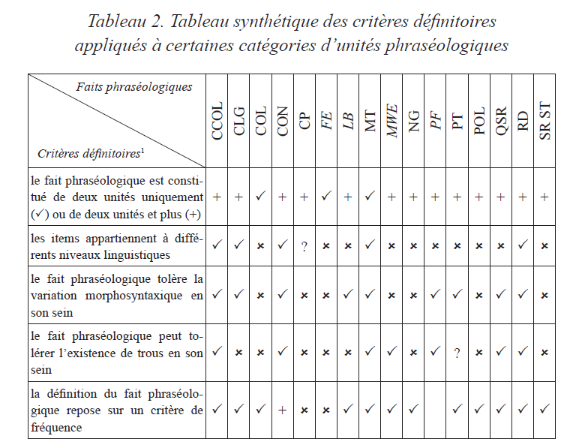
New ways to identify phraseological patterns : between statistics and AI
1.1. A variety of “phraseological units” : from fixed pattern to various variations according to the
various types of “phraseological units”
cfr Marion Bendinelli
lenght of the string
multidimentionality
morphosyntactic variations
gaps
frequency

Slide 4
New ways to identify phraseological patterns : between statistics and AI
1.1. A variety of “ phraseological units ” : from fixed pattern to multiple variations, an example
Sinclair J. (1991), Corpus, Concordance, and Collocation, Oxford: Oxford University Press, 111-112.
collocations as “the occurrence of two or more words within a short space of each other in a text” with a non totally fixed pattern :
- lexical variations inside a paradigmatic list : in some cases / in some instances
- morphological variations : it is not in his nature to / it was not in her nature to
- syntactic variation: set X on fire / set fire to X
- variation in word order : it is not in his nature to recriminate / recriminate is not in his nature

Slide 5
New ways to identify phraseological patterns : between statistics and AI
1.2. From easy to very difficult automatic detection : with or without variations
easy detection :
repeated segments (Salem, 1986) : without gaps or permutation
verbal tense sequences (Longree & Luong, 2003) : without multidimensionality
syntactic motifs (Mellet & Longrée, 2009) : without multidimensionality or permutation
more complicated... :
- non-totally fixed patterns (Fillmoreet alii 1988 ; Sinclair, 1991: 111-112 ; Gledhill & Frath 2007)
multidimensional phraseological patterns
> made up of items of several natures (forms, lemmas, grammatical categories, etc.)
allowing various variations :
- lexical or morphological variations,
- permutations, presence or absence of elements,
- spaces between pattern elements.
each of these variations = a new challenge for automated detection based on a sequential search

Slide 6
New ways to identify phraseological patterns : between statistics and AI
1.2. From easy to very difficult automatic detection : the frequency problem
repetitions are necessary to insure the memorization of the patterns (Lavigne et alii 2016; Longrée, Mellet & Lavigne, 2019)
a high frequency of a pattern does not always mean that the pattern is phraseological (e.g. syntactic patterns)
frequency varies according to the type of the repeated pattern :
- syntactico-lexical construction :
bellum gerere, “to make war”
- idioms
cfr Fillmore, Kay & O’Connor (1988) : If + clause, clause (if it rains, it rains)
- pragmatic phasemes
cfr Mel’čuk (1998) or Depecker (1999) : “ There's no smoke without fire! ”
- textual motifs (with a textual function)
cfr (Longrée & Mellet 2018) : Quibus rebus cognistis “ These things having been known”

Slide 7
New ways to identify phraseological patterns : between statistics and AI
1.2. From easy to very difficult automatic detection : the frequency problem
E.g. A Latin narrative “motif” :
a multidimensional pattern allowing variations :
[Dum (« conj. « while ») + Nom. Neutral Demonstrative + locative + Verb. Pres. 3d pers. Plur.] :
Dum haec Romae/ in Gallia geruntur, [...] :
« While these things/facts happen in Rome / Gaul… »
Haec dum apud hostes geruntur, [...]
Dum ea [Ø] geruntur, [...]
Dum ea [Ø] parantur, [...] : « While these things are prepared… »
Structuring function : a transition between two narrative simultaneous episodes in two different places
> a very low frequency in comparison with a syntactico-lexical construction as bellum gerere, “to make war”

Slide 8
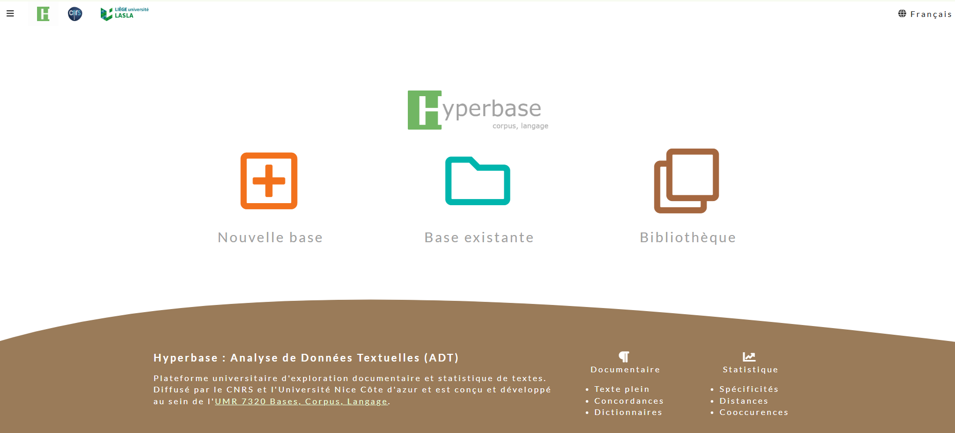
New ways to identify phraseological patterns : between statistics and AI
1.3. Hyperbase Web (L. Vanni, University Côte d’Azur),
offering various tools to identify various linguistic patterns

Slide 9
New ways to identify phraseological patterns : between statistics and AI
1.3. Hyperbase Web (L. Vanni, University Côte d’Azur): compared to other softwares
from simple concordances to CNN and transformers
various parameters :
contrastive vs non-contrastive approach :
- non-contrastive approach (based only on patterns and frequency)
- contrastive approach (based on specificity)
> “textual motifs” > characteristic of an author, a literary genre, a discourse mode...
sequential (based on text linearity ) vs (based on text reticularity)
corpus-based vs corpus-driven
with a comparison with other software (SDMC, Lexicoscope)
with an example : Caesar, De Bello Gallico, as lemmatised and annotated by the LASLA (ULiège)
Question : will AI replace the other data mining tools statistically based ?

Slide 10
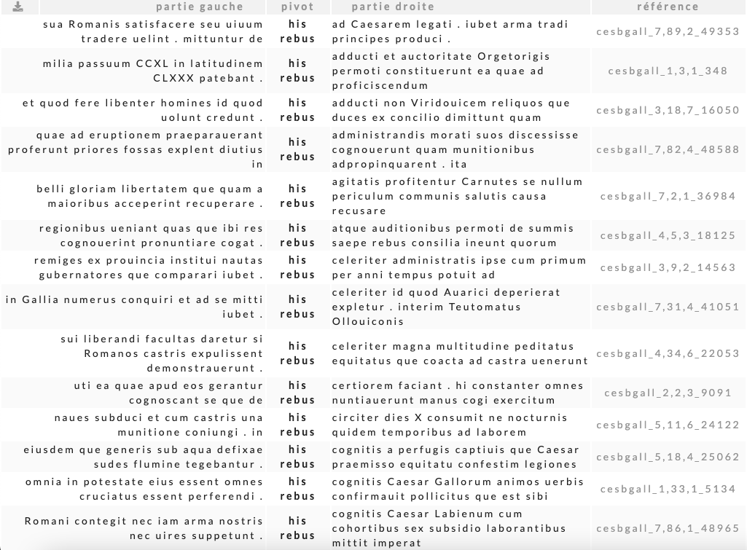
New ways to identify phraseological patterns : between statistics and AI
2. A Corpus-based Approach
2.1. Sequential search
2.1.1. Concordance based on a word form or a lemma, or a string of word forms - lemmata :
search :
his rebus
sorted on the right side
transitional textual motif :
his rebus cognitis

Slide 11
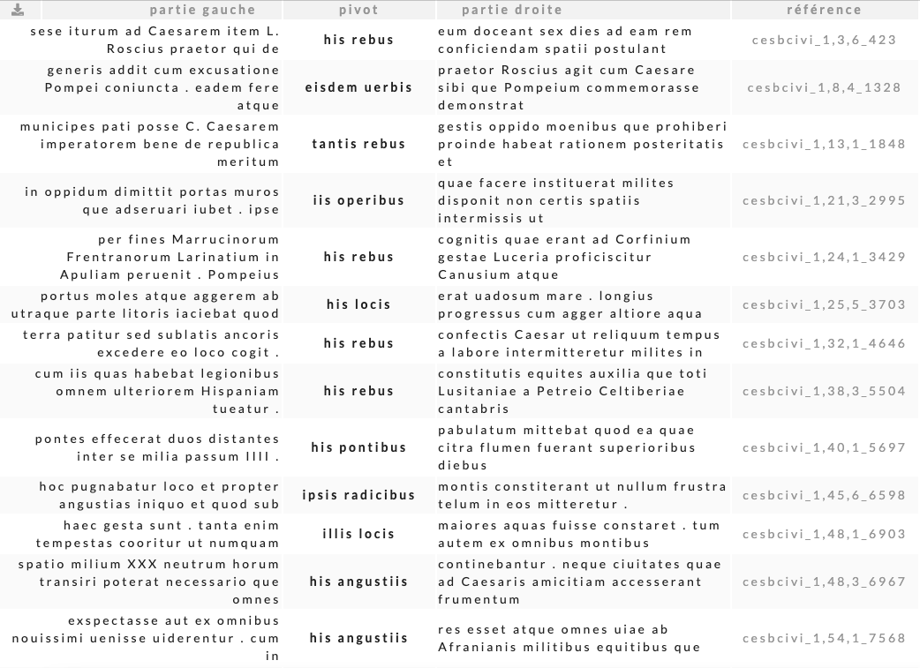
New ways to identify phraseological patterns : between statistics and AI
2. A Corpus-based Approach
2.1. Sequential search
2.1.2. Concordance based on a string of tags :
search :
"DemPro:Abl:Plur Subs:Abl:Plur"
sorted on the right side
sort : right side
variations of the textual motif :
his rebus cognitis
his rebus confectis
his rebus constitutis
tantis rebus gestis

Slide 12
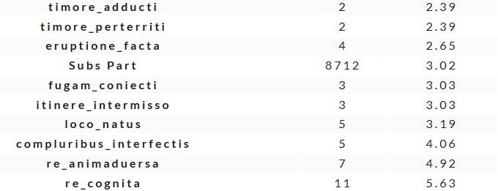
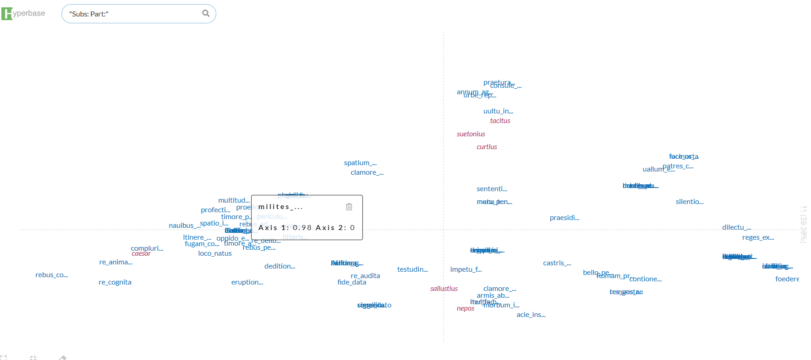
New ways to identify phraseological patterns : between statistics and AI
Caesar’s most specific instances
2.1. Sequential search
2.1.2. Distribution of the first 100 most frequent instances of
a string of tags (contrastive – frequency and specificity based)
string : “substantive participle”
Caesar

Slide 13
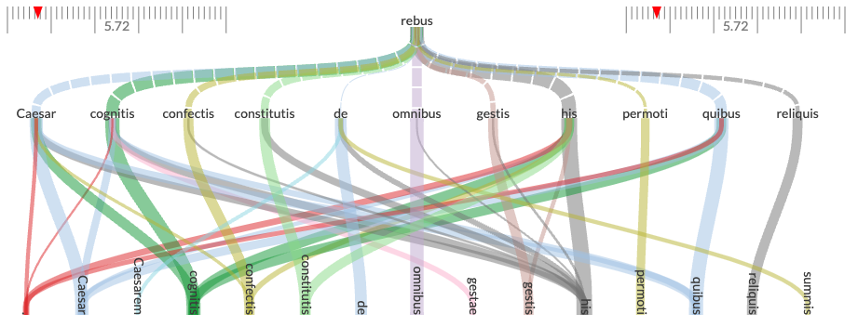
New ways to identify phraseological patterns : between statistics and AI
2.2. Non-Sequential search (contrastive or not-contrastive, specificity)
2.2.1. Hyerbase Web : specific cooccurrences
search :
word form : rebus
Z-score test for associated word forms
(collocations)
variations of the textual motif :
his rebus cognitis
his rebus confectis
his rebus constitutis
also
quibus rebus cognitis
his rebus permoti

Slide 14
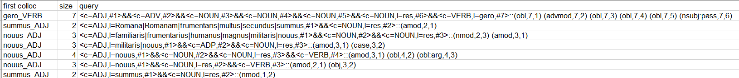
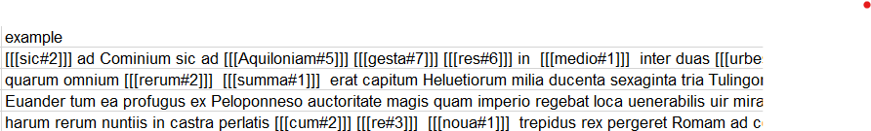
New ways to identify phraseological patterns : between statistics and AI
2.2. Non-Sequential search (contrastive, specificity) :
2.1.2. « Arbres lexico-syntaxique » from the Lexicoscope (O. Kraiff, U. Grenoble- Alpes)
based on syntactic trees
example : syntactic trees including the lemma « RES » “thing, event”
new “motifs” :
harum rerum nuntiis in castra perlatis
but no totally reliable parser...

Slide 15
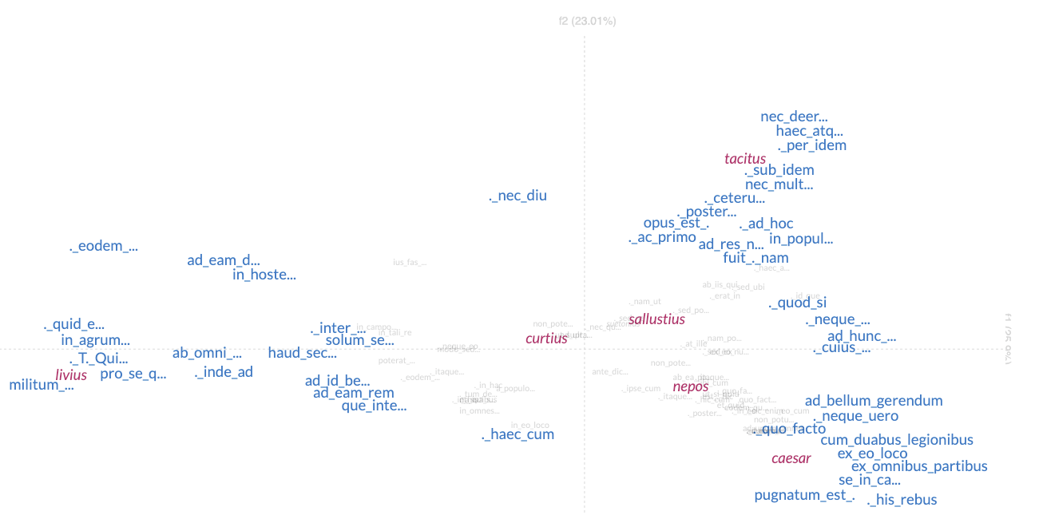
New ways to identify phraseological patterns : between statistics and AI
3. A Corpus-driven Approach
3.1. Sequential
3.1.1. Repeated-segments (with or without constraints) : contrastive – z-score - lenght 3

Slide 16
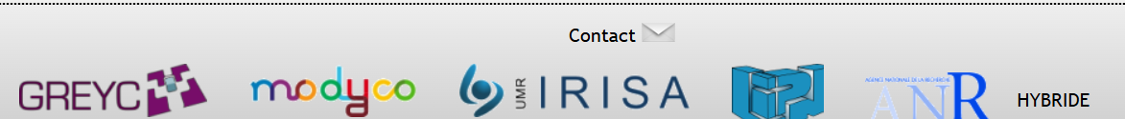
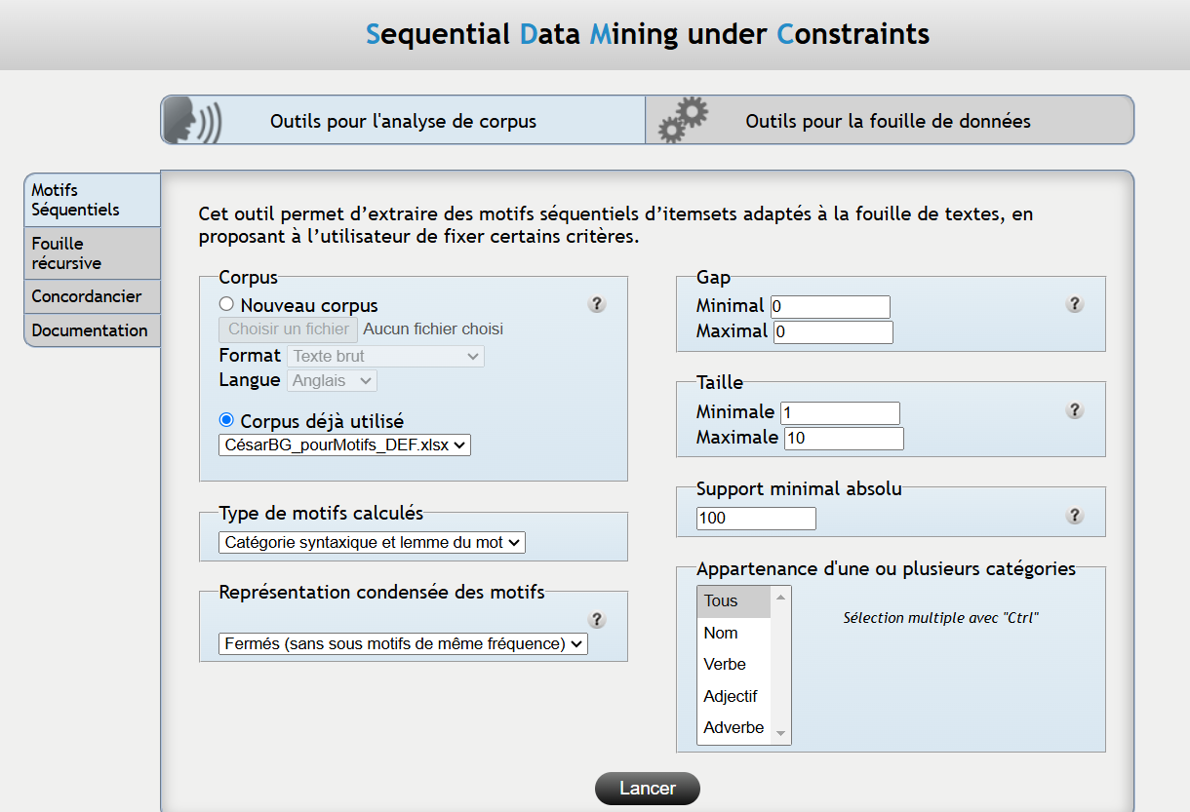
New ways to identify phraseological patterns : between statistics and AI
3.1.2. SDMC (Sequential data mining under constraint) :
constraints on
- 3 dimensions :
word form, lemma, POS
- gap (minimum – maximum to define)
- string lenght (to define)
- minimal frequency

Slide 17
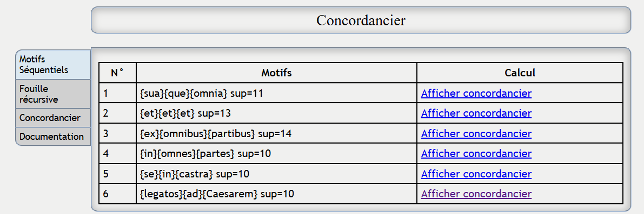
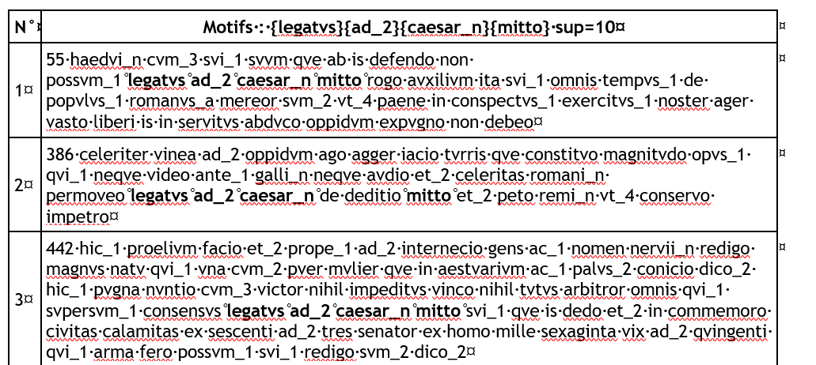
New ways to identify phraseological patterns : between statistics and AI
> frequential, non-contrastive > more phaseological

Slide 18
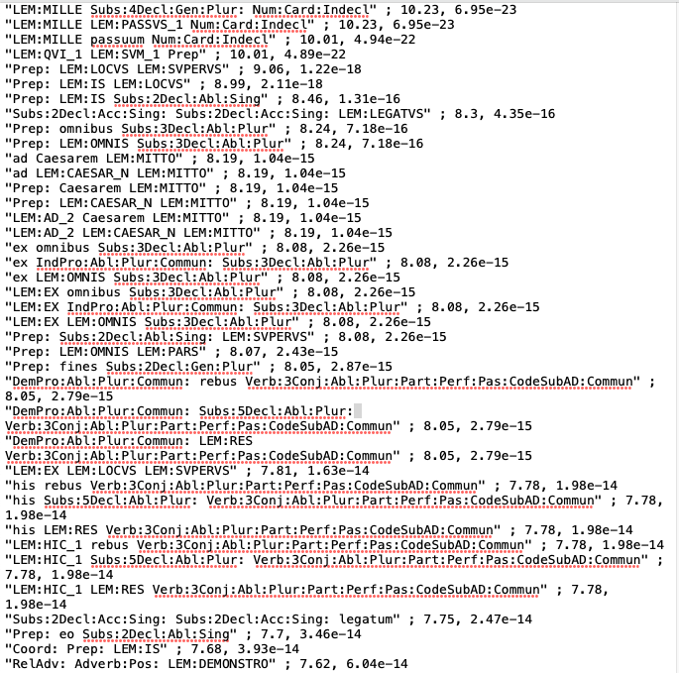
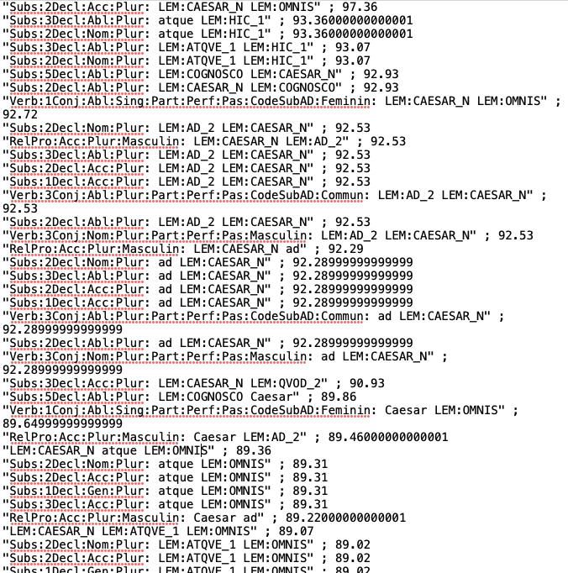
New ways to identify phraseological patterns : between statistics and AI
3.1.3. Hyperbase Web : Sequential – multidimensional repeted segments – z-score
z-score of the segment (3 elements) addition of the z-scores of 3 elements

Slide 19
New ways to identify phraseological patterns : between statistics and AI
3.1.3. Hyperbase Web : Sequential – multidimensional repeted segments – z-score
addition of the z-scores of 3 elements
to sensitive to high frequency
always Caesar in the string

Slide 20
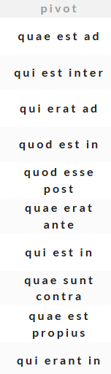
New ways to identify phraseological patterns : between statistics and AI
3.1.3. Hyperbase Web : Sequential – multidimensional repeted segments – z-score
z-score of the segment (3 elements)
with various strings correponding
to the same instances :
mille passum decem, etc.
e loco superiore
ad Caesarem mittunt
but also with various instances :
"LEM:QVI_1 LEM:SVM_1 Prep«

Slide 21

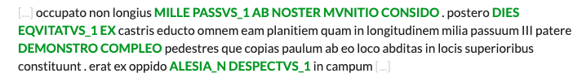
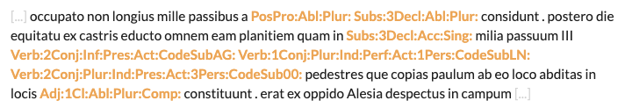
New ways to identify phraseological patterns : between statistics and AI
3.1.4. Hyperbase Web : HyperDeep – CNN
> contrastive (corpus of Latin Historians) – Convolutional Markers for Caesar recognition
word forms based
lemmata based
tags based

Slide 22
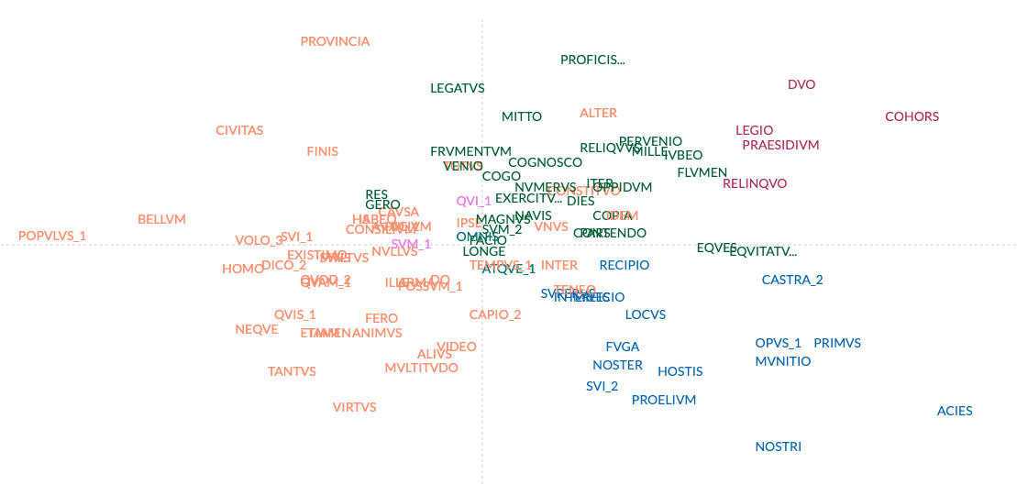
New ways to identify phraseological patterns : between statistics and AI
3.2. Corpus driven non-sequential
3.2.1. Hyperbase Web : « correlates » -
based on the lists of specific cooccurents (z-score) of each lemma
based on the 1000
most frequent
lemmata in Caesar

Slide 23
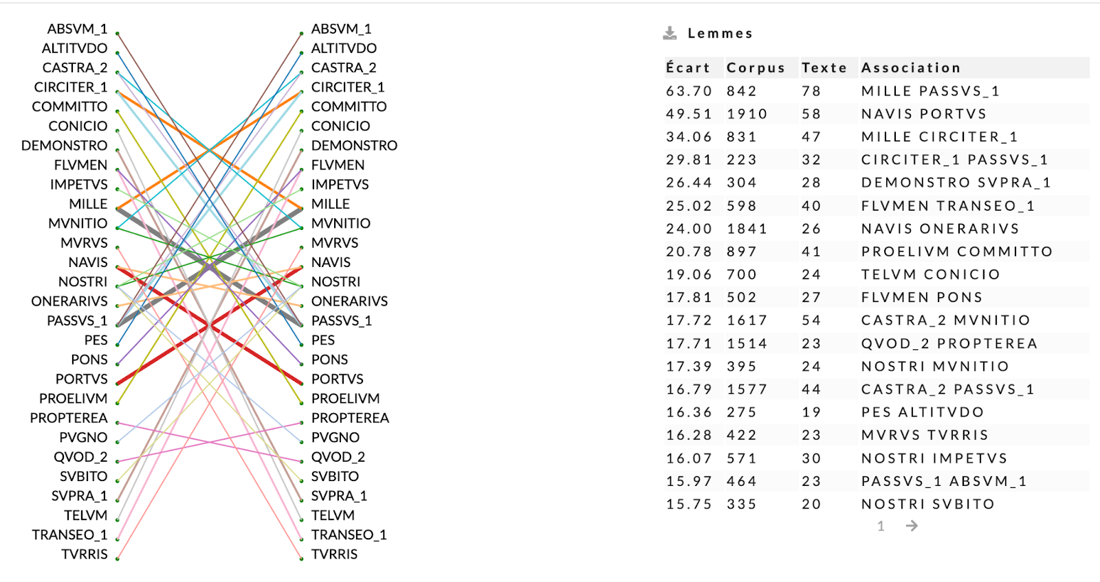
New ways to identify phraseological patterns : between statistics and AI
3.2.2. Hyperbase Web : « associations » - based on z-score association
contrastive
motifs :
quod supra demontraui
lexical :
circiter duo milia passuum

Slide 24
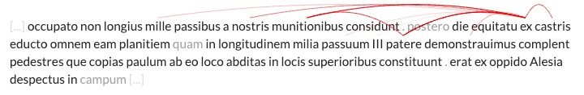
New ways to identify phraseological patterns : between statistics and AI
3.2.3. Hyperbase Web : Hyperdeep – transformer – Long distance association
contrastive
transformer markers for Caesar recognition (self attention)
lexical : munitionibus, castris
but also non longius mille passibus related with ex castris

Slide 25
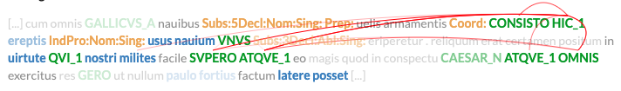
New ways to identify phraseological patterns : between statistics and AI
3.3. Hybrid : sequential and non sequential : Hyperdeep –
Multichannels Convolutional Transformer (MCT)
contrastive
conbining CNN and transformer markers for Caesar recognition
multidimensional (multichannel)
new type of « motifs » : « atque *** atque LEM:OMNIS » 5 occurrences only in Caesar...
but why CONSISTO HIC_1 and SVPERO ATQVE_1 ?

Slide 26
New ways to identify phraseological patterns : between statistics and AI
4. What’s the place of AI in order to mine phraseological patterns ?
will not replace statistical based tools
but complementary of statistical tools
detect most of the patterns detected by statistical tools
but also other types of linguistic patterns : « Deep motifs »
not always easy to interpret, especially with the self-attention
will nevertheless force us to ask new questions about the langage of the authors

