Slide 1

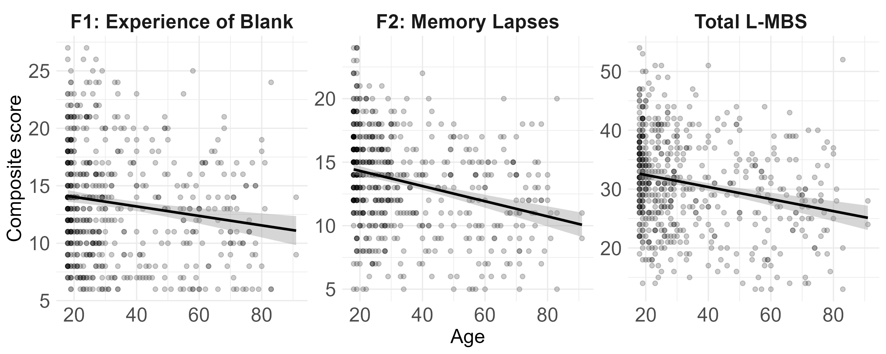
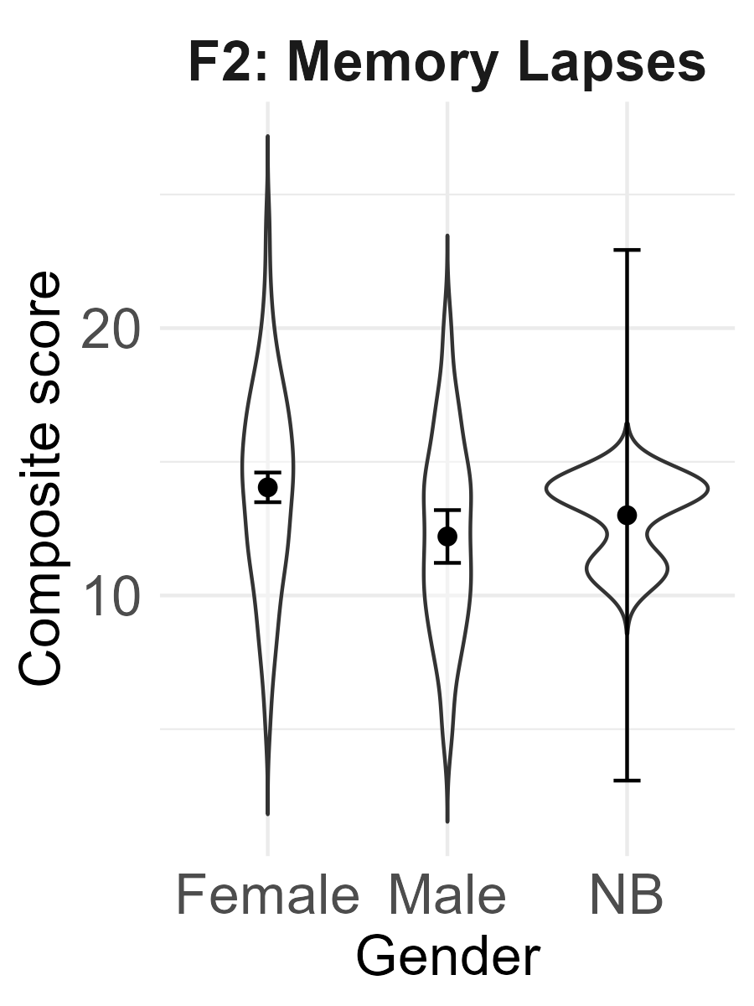
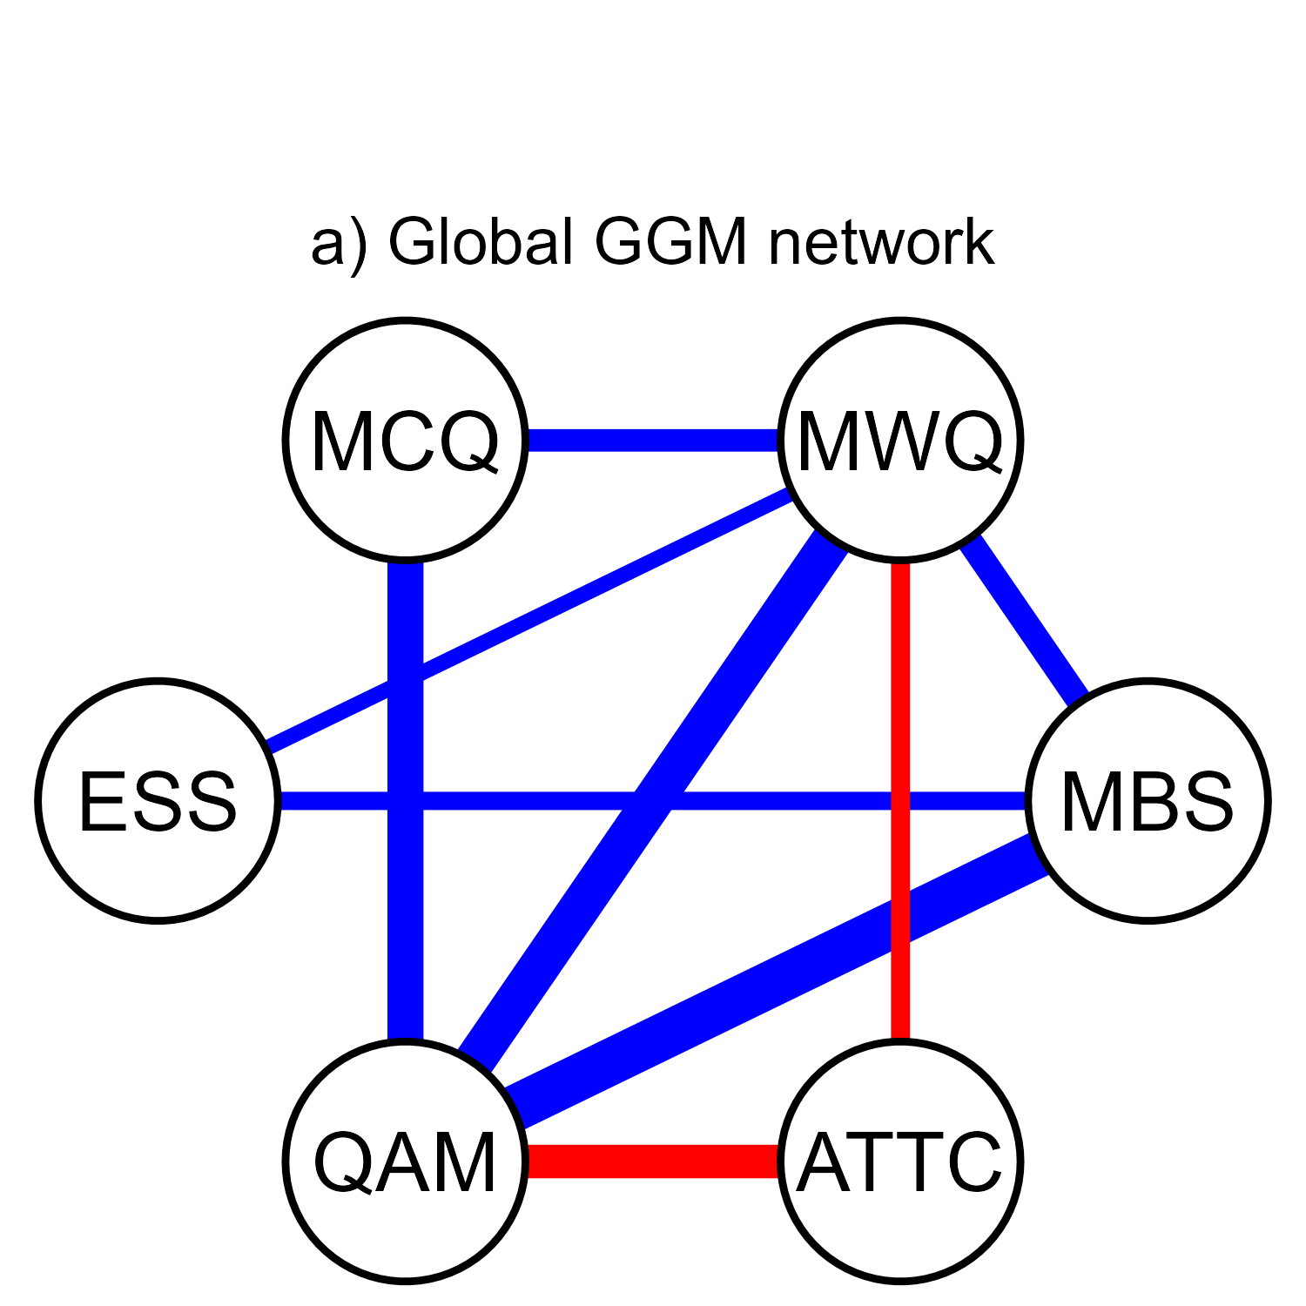
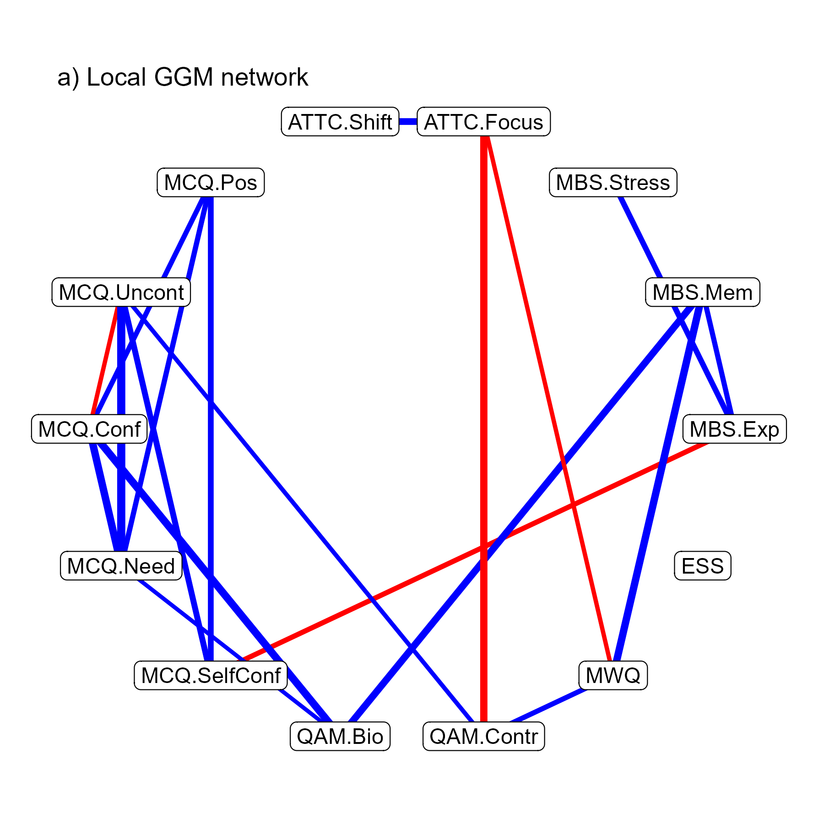
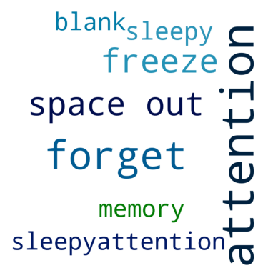
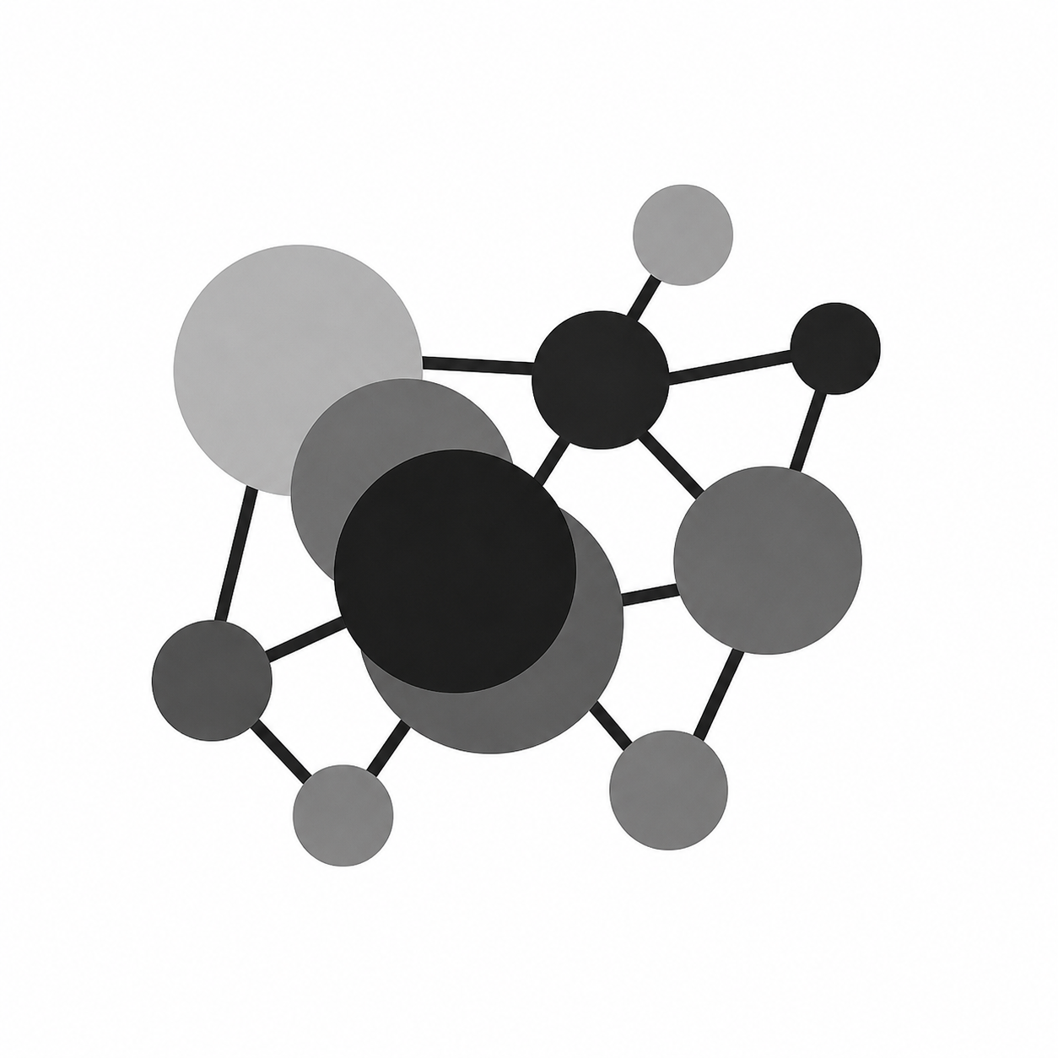
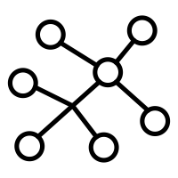
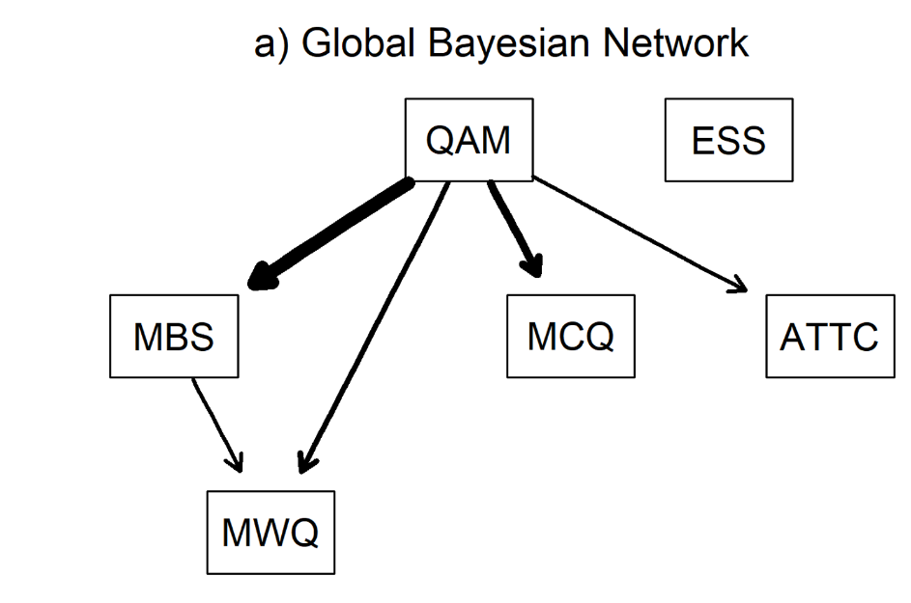
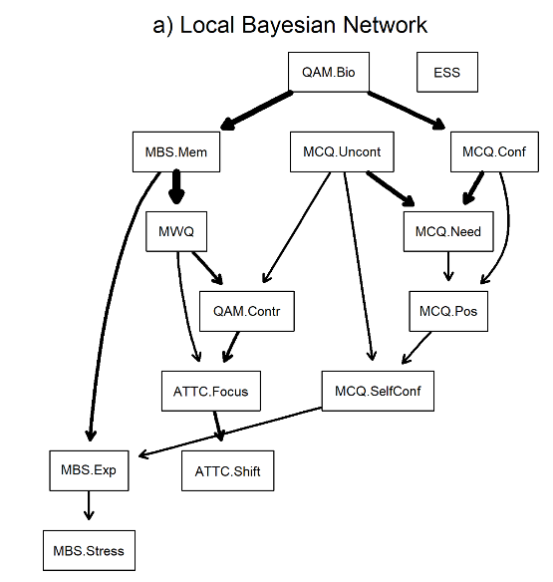
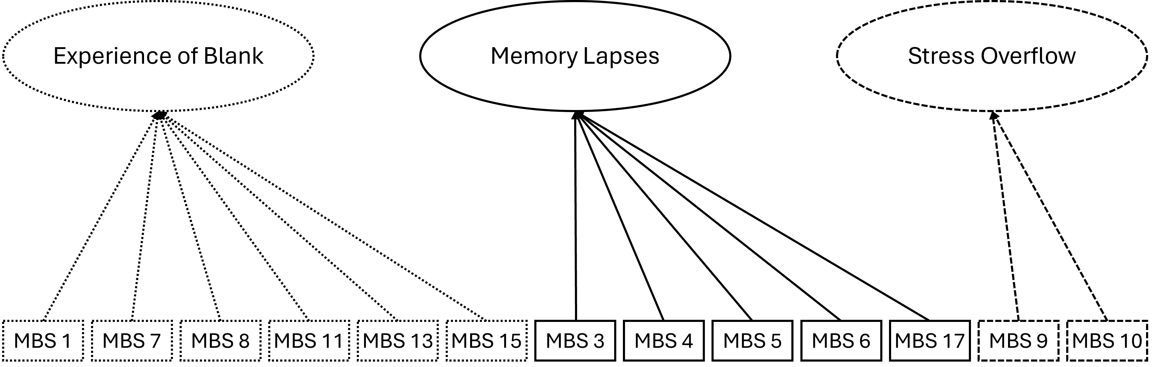




The Liege Mind-Blanking Scale (L-MBS): a tool to assess the heterogeneity of mind blanking experiences in everyday life
Paradeisios Alexandros Boulakis^{1,2}, Marion Balla², Agustina Aragón-Daud^{2,3}, Giovanni Briganti^{4,5,6,7}, David Stawarczyk^{1,8}, Athena Demertzi^{1,2}, Steve Majerus^{1,8}
¹Psychology and Neuroscience of Cognition Unit (PsyNCog), University of Liège, Belgium; ²Physiology of Cognition Lab, GIGA CRC Human Imaging, GIGA Institute, University of Liège, Belgium; ³Applied Machine Learning Lab, Institute of Neuroscience and Medicine: Brain & Behaviour (INM-7), Forschungszentrum Jülich, Germany; ⁴ Unit of computational medicine and neuropsychiatry, Faculty of Medicine, Pharmacy, and Biomedical Sciences, University of Mons, Belgium; ⁵Digital Health, Department of Clinical Sciences, Faculty of Medicine, University of Liège; ⁶Faculty of medicine, Université Libre de Bruxelles, Belgium; ⁷Department of Psychiatry, Oxford University, United Kingdom; ⁸GIGA CRC Human Imaging, GIGA Institute, University of Liège, Belgium
Paradeisios.Boulakis@uliege.be
Introduction
Results – Population covariates
Mind blanking (MB): moments when people report having no mental content to reflect upon or are unable to describe any experience at all¹
MB has primarily been quantified with experience sampling (state-level)
people introspect and report their immediate past content^{2,3}
Fundamental caveats:
Not necessarily a homogeneous experience^{1,4}
Lacks a psychological theory⁴
Experience sampling is time-consuming, and MB does not occur often⁵
We can try a trait-level exploration
develop a scale that describes how people experience MB
Hypotheses:
an expansive MB will decompose into different blank experiences
different latent factors will correlate with different cognitive domains
Trait MB decreases with age
Trait MB lower in men
Results – Network analysis
Methods
GLOBAL analysis: Composite scores of questionnaires
LOCAL analysis: Subscales of questionnaires
Gaussian Graphical Models: partial correlations between items
Bayesian Networks: conditional independence between items
N Participants: 644 (median age = 26, sd = 18, range = [18,91], N female = 473)
N Exploratory Sample: 628, to uncover latent structure
N Confirmatory Sample: 212, to validate latent structure in a novel population
L-MBS development
GLOBAL GGM network
LOCAL GGM network
Literature Review
Initial Items (n=38)
Validated Items (n=18)
EFA (n=13)
Confirmed MB structure
Authors
External
Panel
Strong loadings
Weak cross-loadings
Author agreement
Can be translated
Panel Agreement
Additional Questionnaires
Network Analysis
Mind Wandering Questionnaire (MWQ)
Memory Self-Evaluation (QAM)
Attentional Control Scale (ATTC)
Metacognition-30 (MCQ)
Epworth Sleepiness (ESS)
Overlapping phenomena
Clear Structure
GLOBAL BN network
LOCAL BN network
Results – Questionnaire structure
If item A -> MBS, change in A should change MBS
If MBS -> item A, change in MBS should change item A
If item A -> item B -> MBS, MBS is conditionally independent from item A
There are moments when I pay attention to nothing at all.
During the day, I notice that I am thinking of nothing.
When I am calm, it feels like my mind is empty.
I lose track of my thoughts and can’t remember what I was thinking.
There are moments when I am sure that I had a thought, but I am not sure what.
I catch myself halfway through an action without knowing how I started it.
My mind blanks when I am under pressure.
When something bad happens, and I need to think of solutions, my mind goes blank.
Discussion
H1: MB is a heterogeneous phenomenon. The L-MBS can track :
The experience of MB
Brief memory lapses
Blanks due to pressure for immediate response
H2: Different MB factors have different psychological correlates:
The experience of MB ~ metacognitive monitoring
Memory lapses ~ memory failures, metacognitive feeling of knowledge
Stress overflow ~ the experience of blank
We currently lack a psychological theory of MB. We can use Bayesian networks to make informed causal predictions and revise our current models.
References
1. Andrillon, T., Lutz, A., Windt, J., & Demertzi, A. (2025). Where is my mind? A neurocognitive investigation of mind blanking. Trends in Cognitive Sciences, 29(7), 600–613; 2. Andrillon, T., Burns, A., Mackay, T., Windt, J., & Tsuchiya, N. (2021). Predicting lapses of attention with sleep-like slow waves. Nature Communications, 12(1), 3657; 3. Mortaheb, S., Van Calster, L., Raimondo, F., Klados, M. A., Boulakis, P. A., Georgoula, K., Majerus, S., Van De Ville, D., & Demertzi, A. (2022). Mind blanking is a distinct mental state linked to a recurrent brain profile of globally positive connectivity during ongoing mentation. Proceedings of the National Academy of Sciences, 119(41), e2200511119; 4. Boulakis, P. A., & Demertzi, A. (2025). Relating mind-blanking to the content and dynamics of spontaneous thinking. Current Opinion in Behavioral Sciences, 61, 101481; 5. Boulakis, P. A., Aragón-Daud, A., Stawarczyk, D., & Demertzi, A. (In Prep). How often do we blank? A Bayesian meta-analysis and systematic review of mind blanking report rates during experience-sampling.

