Slide 1

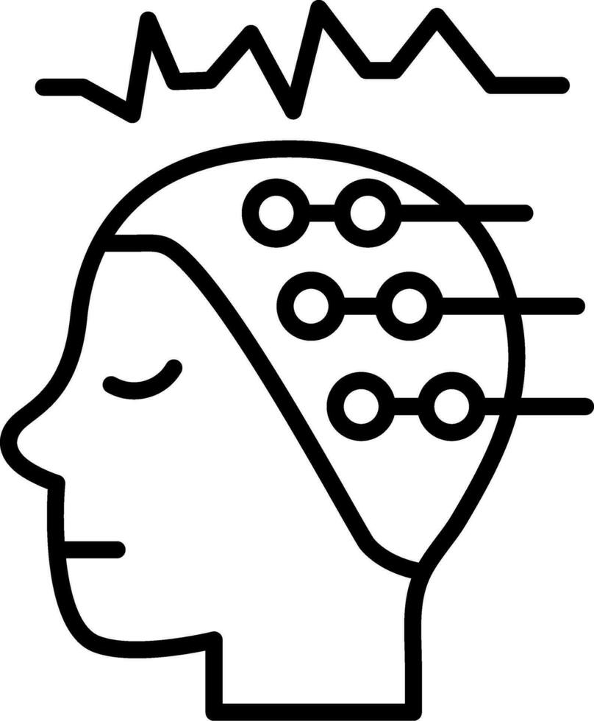

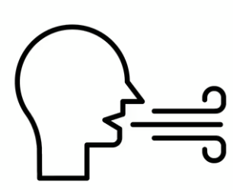

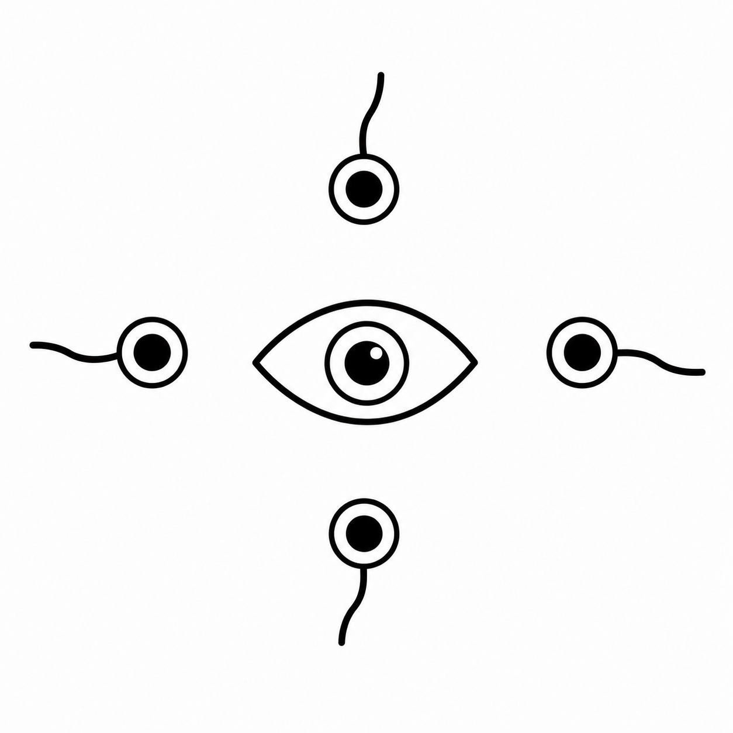
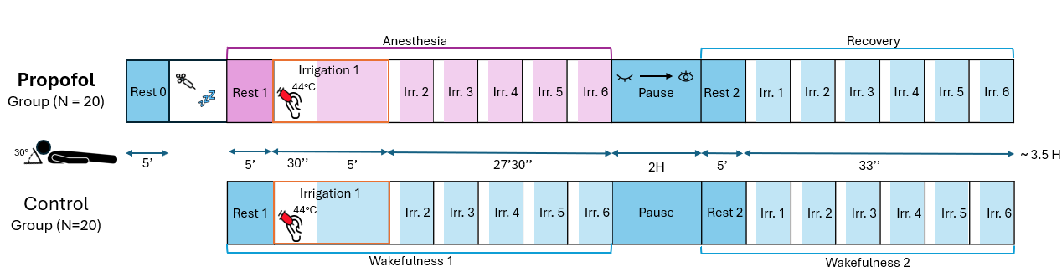
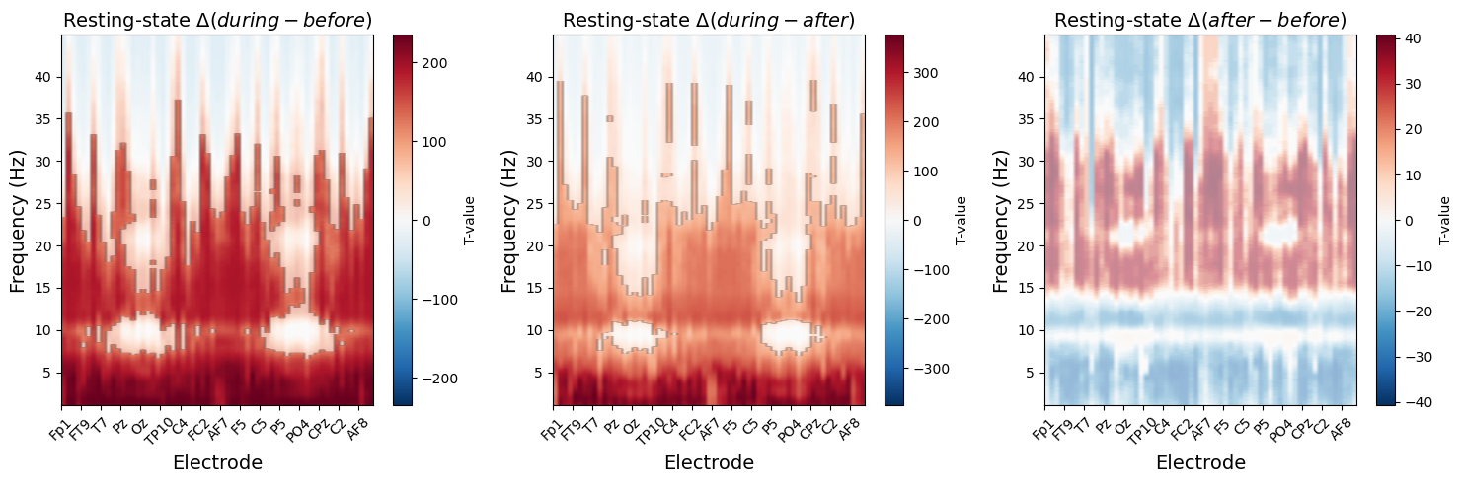
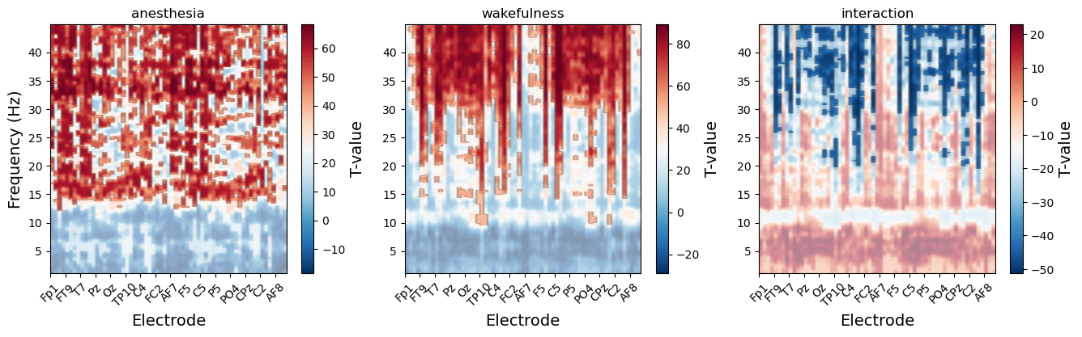
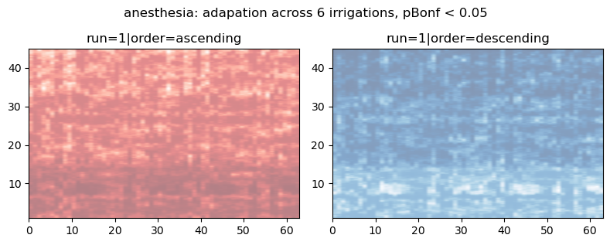
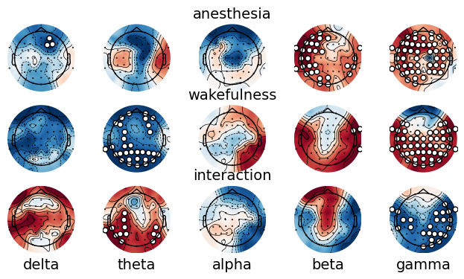
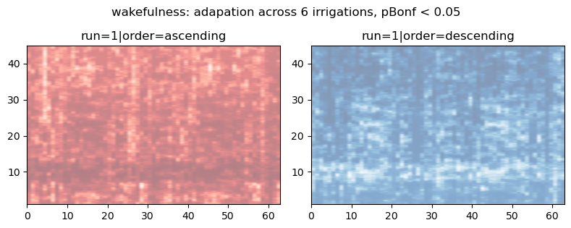
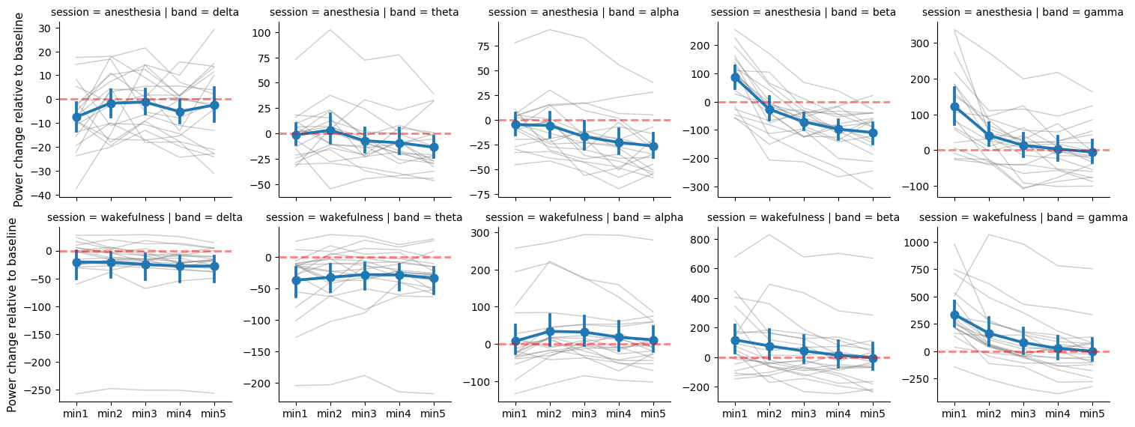
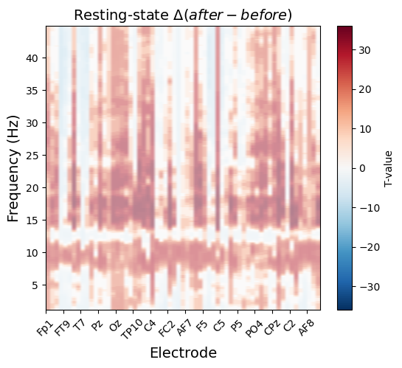
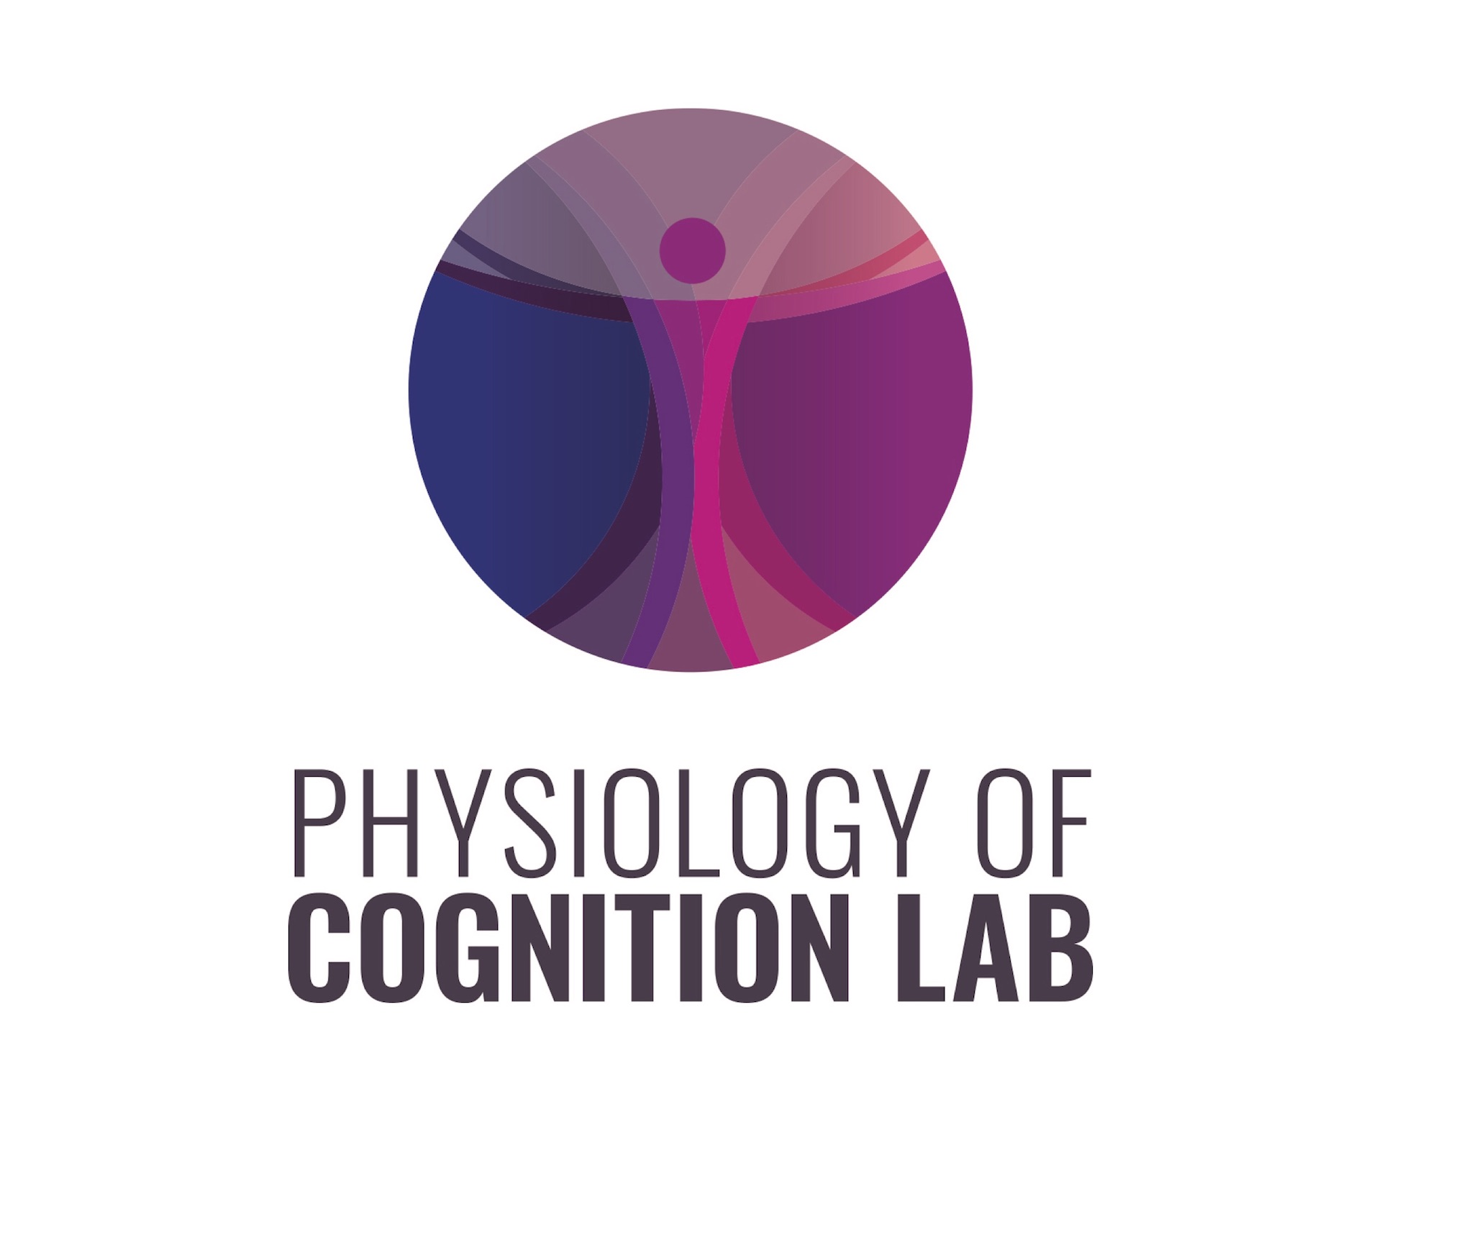




Sentience-like processes are revealed in low arousal by employing interoceptive stimulation
Paradeisios Alexandros Boulakis^{1,2}, Daphne Chylinski¹, Matthieu Koroma¹, Sepehr Mortaheb^{1,3}, Marion Bala¹, Stefania Zoi^{1,4}, Murielle Kirsch^{5,6}, Marie Detroz^{7,8}, Cecile Staquet^{5,6}, Veronique Pacolet⁸, Floris Wuyts³, Vincent Bonhomme^{5,6}, Athena Demertzi^{1,2}
¹Physiology of Cognition Lab, CRC Human Imaging, University of Liège, Liège, Belgium; ²Psychology and Neuroscience of Cognition, Department of Psychology, University of Liège, Liège, Belgium; ³Laboratory for Equilibrium Investigations and Aerospace, University of Antwerp, Antwerp, Belgium; ⁴Institut de la Vision, Sorbonne Université, Paris, France; ⁵Department of Anesthesia and Intensive Care Medicine, University Hospital of Liège, Liege, Belgium; ⁶Anesthesia and Perioperative Neuroscience Laboratory, GIGA-Consciousness, Liège University, Liège, Belgium; ⁷Sensation and Perception Research Group, GIGA Consciousness, University of Liège, Liege, Belgium.; ⁸Department of Otorhinolaryngology Head and Neck Surgery, University Hospital of Liège, Liege, Belgium
Paradeisios.Boulakis@uliege.be
Introduction
Methods
Interoceptive predictive coding¹: contrast brain predictions about the body with samples from body (glucose, heart rate)
If mismatch, adjust predictions or adapt the body
Aim: minimize mismatch
Ν Participants: 40 (20 in anesthesia, 20 in control group)
        80% power
Design: 2b (group) x 2w (session) x 6w (irrigation)
Anesthesia: Propofol
False interoceptive feedback: Caloric vestibular stimulation³
        Supine position on a bed with head titled at 30°
        Monoaurally (left ear)
        Warm water: 44°C
Brain – body monitoring
            64-channel EEG
            Electrocardiography
            Respiratory Belt
            Electrodermal activity
            Horizontal / Vertical EOG
Selfhood: multilayered construct² rooted in successful mismatch minimization
SELF
social
narrative
minimal
Question: If the basis of selfhood (minimal) is the body, can we probe the self during low arousal states?
Hypothesis: False interoceptive feedback will induce physiological adaptation in anesthesia
Results
The brain at rest
Response to first irrigation (first minute)
Is there adaptation across irrigations ?
Anesthesia
Increase in higher frequencies
Anesthesia: localized to irrigation site
Control: broadcasted to parietal and central electrodes
Cluster permutation t-test, pFDR < .05
No evidence for adaptation
Cluster permutation Page’s L-test
Discussion & References
Return to baseline after 5 minutes
Responses are not attenuated in anesthesia, but …
No evidence for neuronal response adaptation
Moving forward:
Examine baseline reference for adaptation
Examine bodily adaptations
Examine brain-body interactions
¹Seth, A. K., Suzuki, K., & Critchley, H. D. (2011). An interoceptive predictive coding model of conscious presence. Frontiers in Psychology, 2, 395; ²Blanke, O., & Metzinger, T. (2009). Full-body illusions and minimal phenomenal selfhood. Trends in Cognitive Sciences, 13(1), 7–13; ³Shepard, N. T., & Jacobson, G. P. (2016). Chapter 9—The caloric irrigation test. In J. M. Furman & T. Lempert (Eds.), Handbook of Clinical Neurology (Vol. 137, pp. 119–131). Elsevier.
Control

