Slide 1

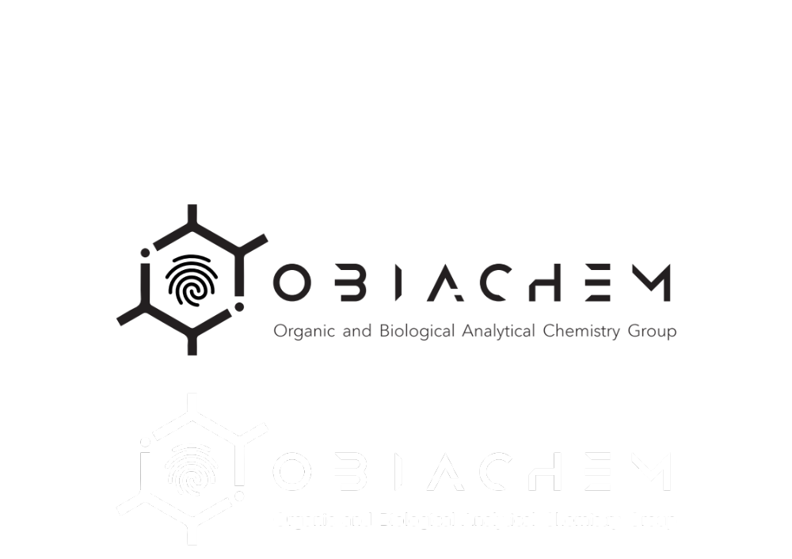


Multi-Omics Characterization of Human Stool Samples Using GC×GC-TOFMS: Effects of Diet and Storage
Organic and Biological Analytical Chemistry Group
Thibaut Dejong, Kinjal Bhatt, Jean-François Focant, Pierre-Hugues Stefanuto
Organic and Biological Analytical Chemistry Group (OBiAChem), University of Liège, Belgium
T. Dejong et al., ‘Comparative development of volatile-oriented multi-SPME and derivatisation-based GC×GC-TOFMS workflows for non-targeted faecal metabolomics’, Talanta, vol. 308, p. 129954, Oct. 2026, doi: 10.1016/j.talanta.2026.129954.

