Slide 1


Dynamical decoupling for interacting qudit systems
Colin Read
In collaboration with E. Serrano-Ensástiga and J. Martin
Institut de Physique Nucléaire, Atomique et de Spectroscopie,
CESAM, University of Liège, Belgium

Slide 2
Outline
Introduction
Decoupling of spin ensembles
From spins to qudits
(Application in QEC)
Outlook

Slide 3
Introduction

Slide 4
Introduction
« Dynamical decoupling for interacting qudit systems »
Interactions with a bath
Interactions within the system
→ Periodic refocusing

Slide 5
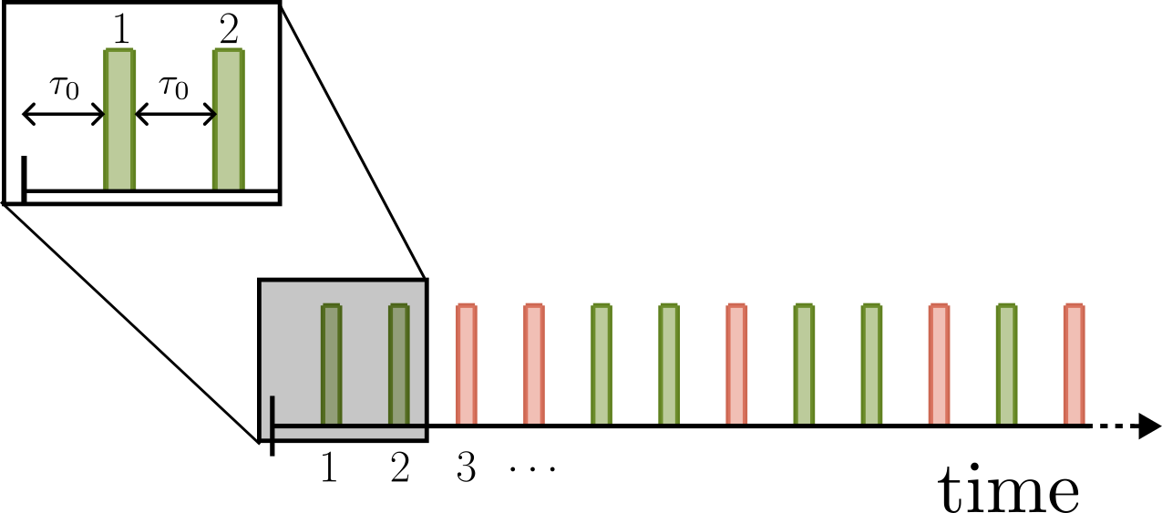

Introduction
« Dynamical decoupling for interacting qudit systems »
Unitary transformation of the Hamiltonian
pulses
$$≡$$
Sequence of unitary transfo.
First-order :
Objective :
(→ decoupling)

Slide 6
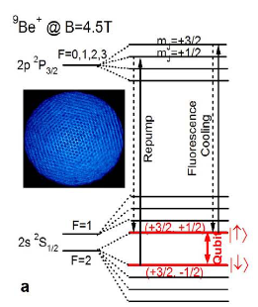
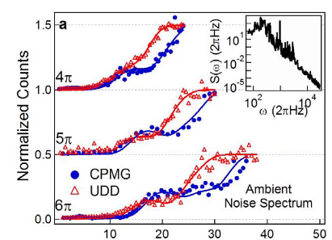
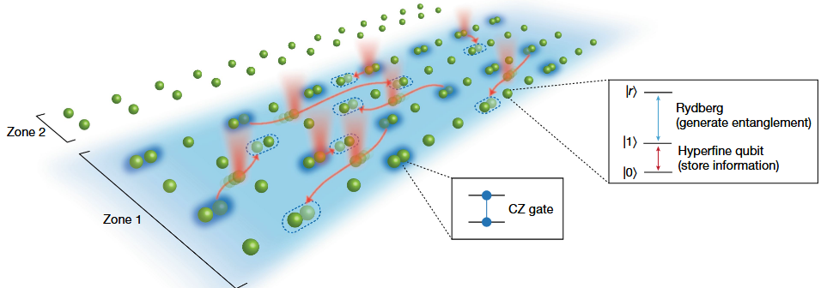
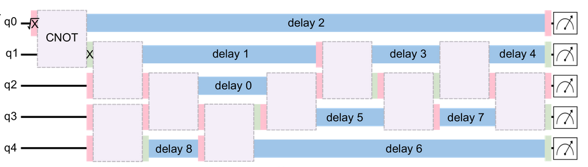
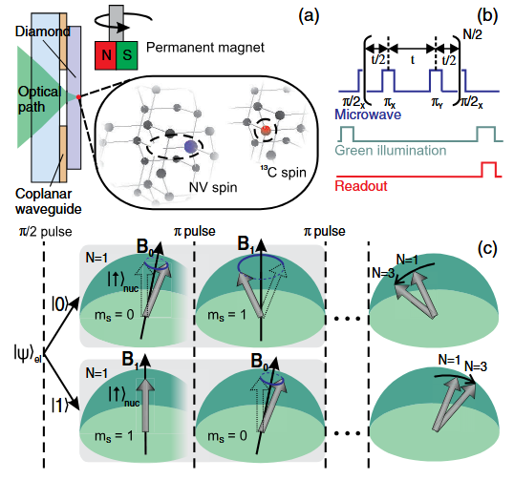
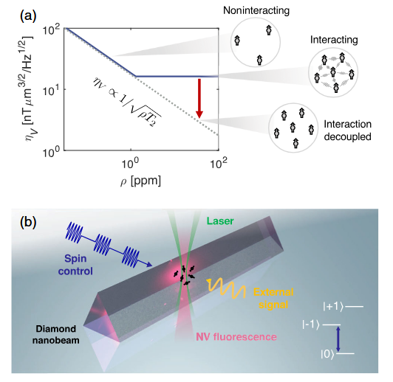
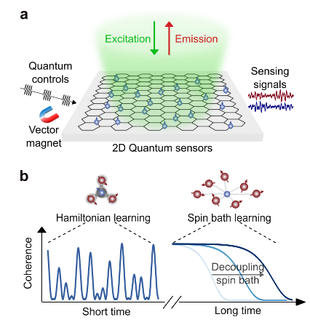
Introduction
Extend coherence time
M.J.Biercuk, et al, Nature 458, 996–1000 (2009)
Paul Coote, et al, PRX Quantum 6, 010332 (2025)
D.Bluvstein, …, M.D.Lukin, Nature 604, 451–456 (2022)
Quantum sensing of AC-field
Entangling gate
H. Zhou, ... M.D.Lukin, PRX 10, 031003 (2020)
S. Biswas, et al, arXiv:2509.08984 (2025)
S. Kolkowitz,.. M.D.Lukin, PRL 109, 137601 (2012)

Slide 7
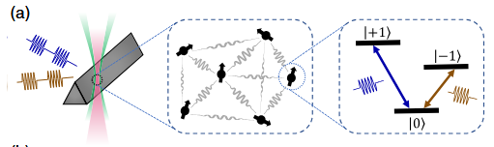
Introduction
« Dynamical decoupling for interacting qudit systems »
pulse
J.S.Waugh, et al, PRL 20, 180 (1968)
…
S.Choi, … M.D.Lukin, PRX 10, 031002 (2020)
P.Peng, …P.Cappellaro, PRA 18, 024033 (2022)
d=2 →
Spin ensembles
d=3 →
Qutrit ensembles
H. Zhou,.., M.D.Lukin, PRX 14, 031017 (2024)
S.Choi, N.Yao,M.D.Lukin, PRL 119, 183603 (2017)
Any d →
Our work :
« global SU(d) pulses »
arXiv:2604.05871
Qudit ensembles

Slide 8
Decoupling of spin ensembles
CR, E.Serrano-Ensástiga, J.Martin, Quantum 9, 1661 (2025)
Key ingredients :
#1
#2
Majorana constellation of operators
Symmetrization of operators under SU(2)

Slide 9
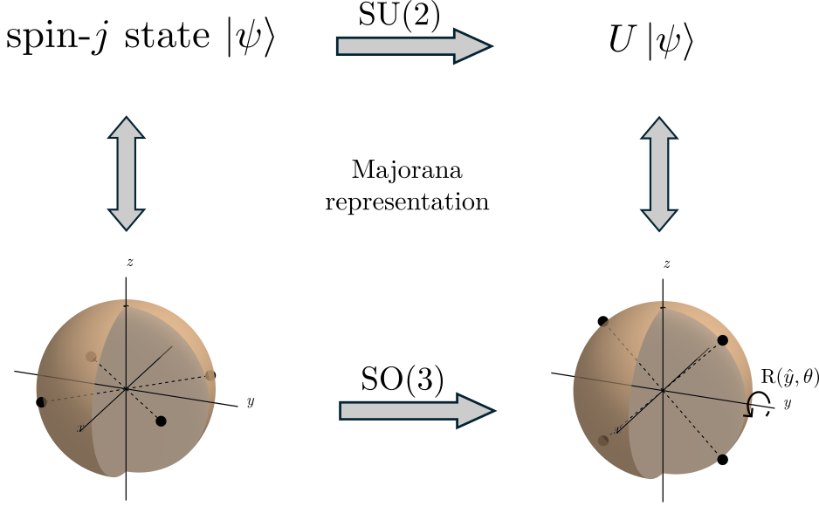
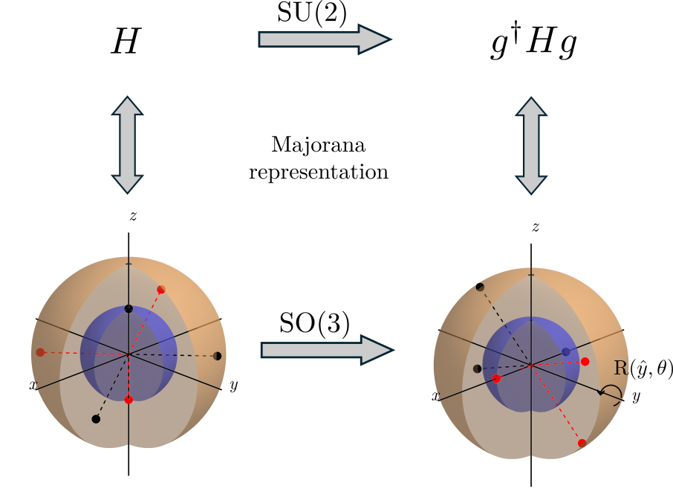
Majorana representation
for pure states
for operators
2j stars
E. Majorana, Nuovo Cim 9, 43–50 (1932)
E. Serrano-Ensástiga and D. Braun, Phys. Rev. A 101, 022332 (2020)

Slide 10
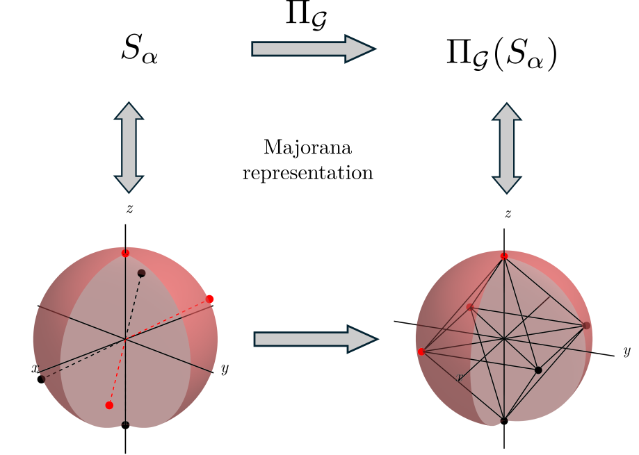
Symmetrization
Unwanted Hamiltonian
SU(2) pulse
pulse sequence
position of the stars
radii of the spheres
pulse sequence
What can change ? →
What cannot change ? →
number of stars

Slide 11
Symmetrization
is a subgroup of SO(3)
Unwanted Hamiltonian
SU(2) pulse
pulse sequence
pulse sequence
The constellation is symmetrized !
Number of stars preserved

Slide 12
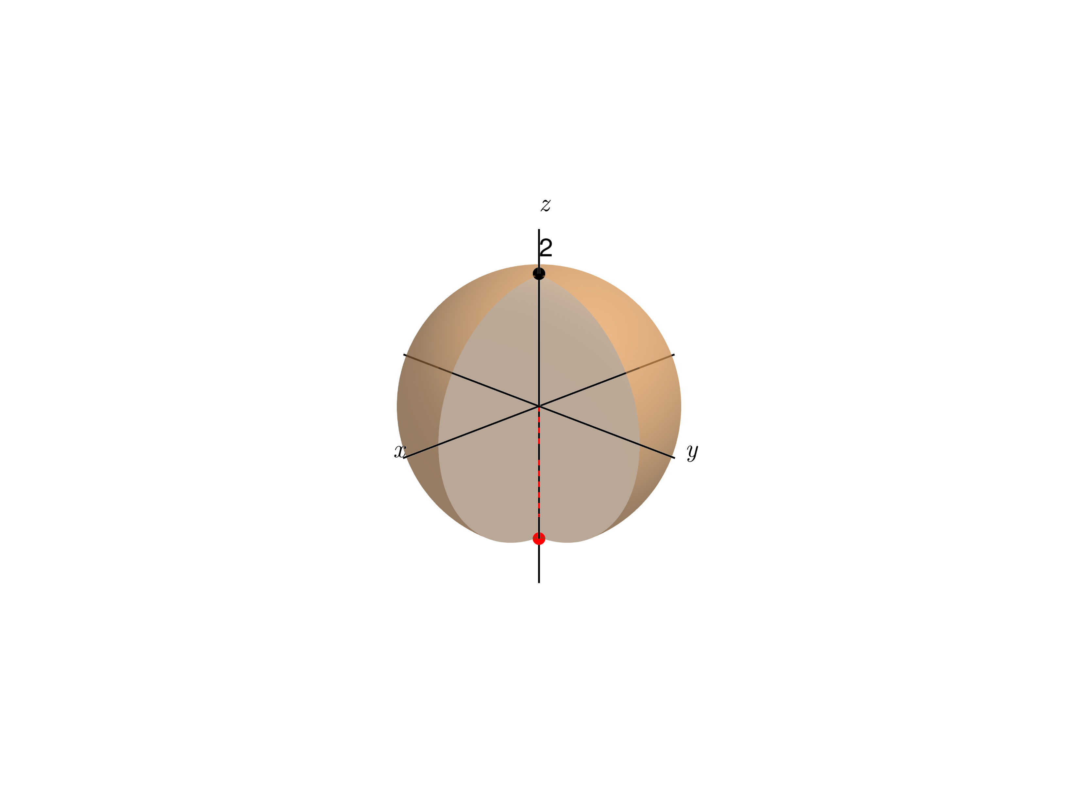
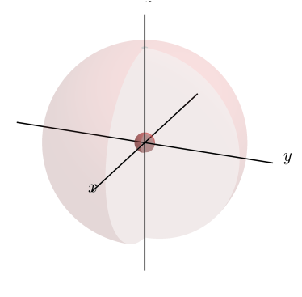
Symmetrization
is a subgroup of SO(3)
Unwanted Hamiltonian
SU(2) pulse
pulse sequence
pulse sequence
The constellation is symmetrized !
Number of stars preserved
Goal :
The constellation is annihilated !
Design a sequence that implements a symmetry « inaccessible »
Radius collapses to zero !

Slide 13
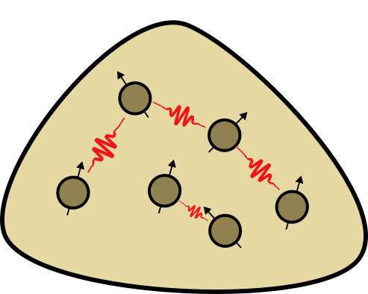
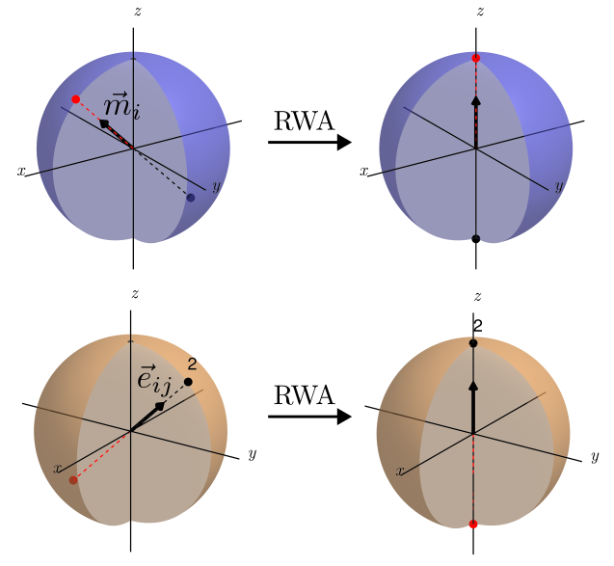
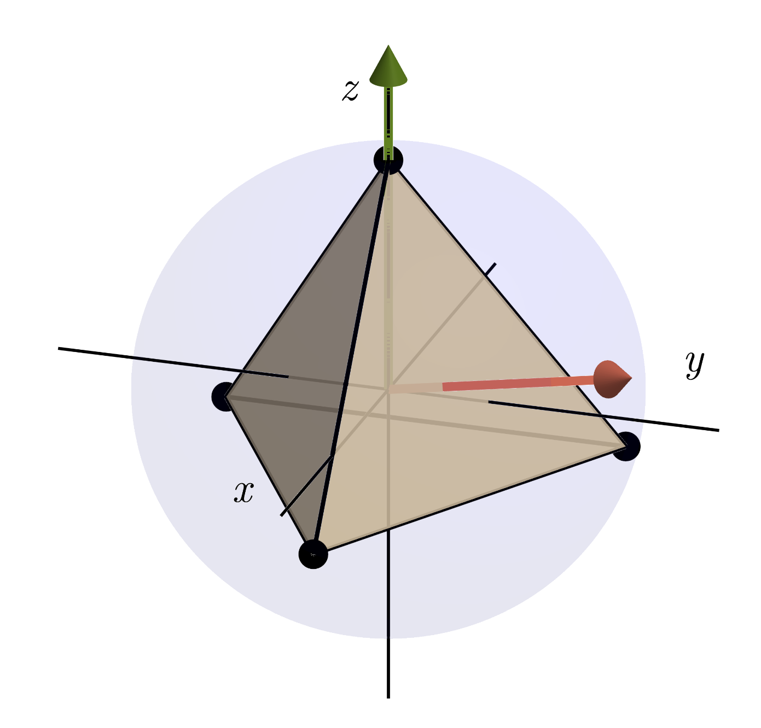
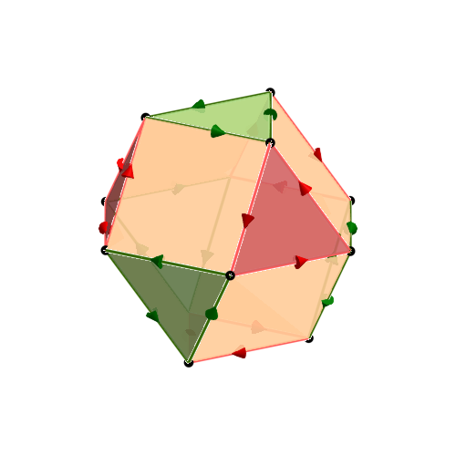

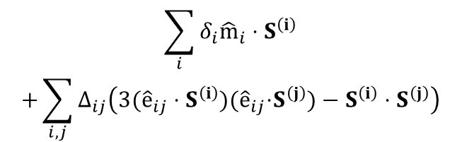



General framework
Pick an Hamiltonian to decouple
Pick an inaccessible symmetry
Draw the Cayley graph *
Take an Eulerian path
Draw the constellation
$${\hat{n}}_{1}$$
$$R\left({\hat{n}}_{1},\frac{2π}{3}\right)$$
$$R\left({\hat{n}}_{2},\frac{2π}{3}\right)$$
disorder
$$\sum_{i}{δ_{i}{\hat{m}}_{i}}⋅S^{\left(i\right)}$$
$$+\sum_{i,j}{Δ_{ij}\left(3({\hat{e}}_{ij}⋅S^{\left(i\right)}\text{)(}{\hat{e}}_{ij}\text{⋅}S^{\left(j\right)})−S^{\left(i\right)}⋅S^{\left(j\right)}\right)}$$
$${\hat{n}}_{2}$$
2 stars
dipole-dipole
Tetrahedral point group
TEDD sequence
*
L.Viola, E.Knill, PRL 90, 037901 (2003)
Béla Bollobás, « Mordern Graph Theory » (1998)
4 stars

Slide 14
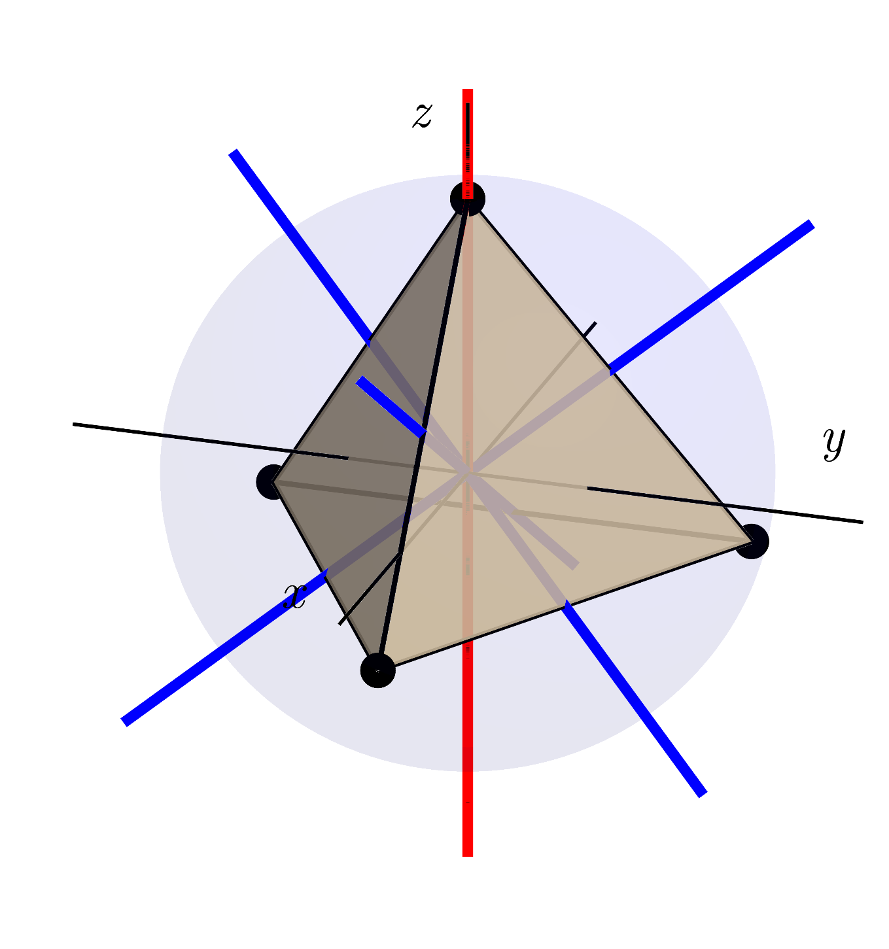
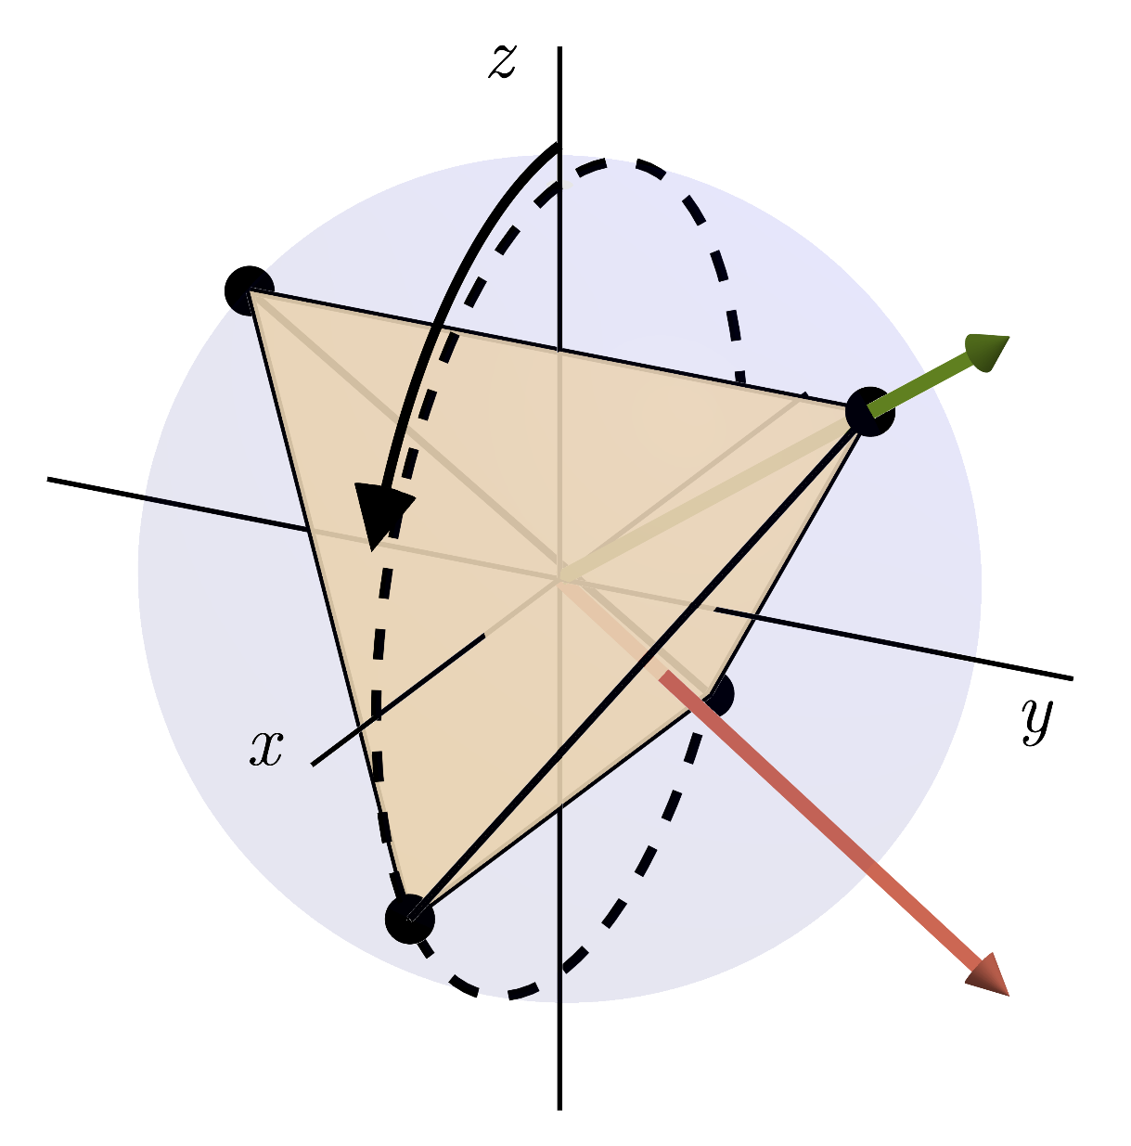
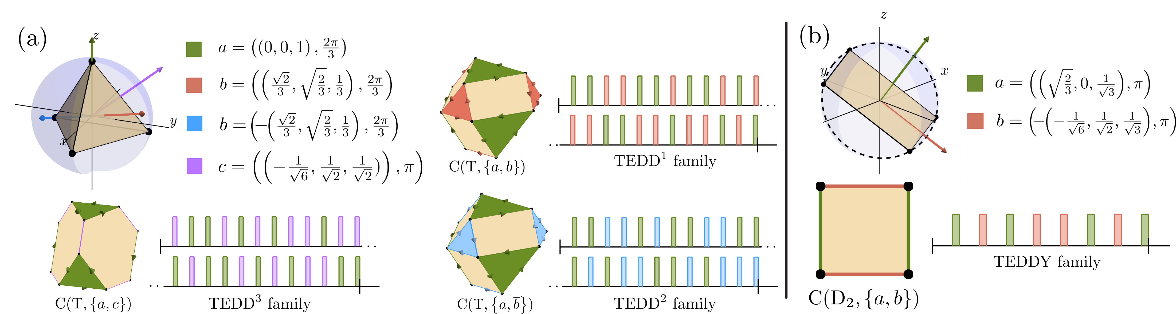
More results
Leverage Hamiltonian symmetries to design smaller sequences
CR, E.Serrano-Ensástiga, J.Martin, Quantum 9, 1661 (2025)
CR, E.Serrano-Ensástiga,
J.Martin, PRA 112, 042601 (2025)
Dynamically-corrected gate
J.Denis, CR, J.Martin, SciPost Phys. Core 9, 001 (2026)
Optimal designs for high-order decoupling
CR, ESE, JM. In progress.

Slide 15
Generalization to qudit ensembles
Key ingredients :
#1
#2
Representation theory of Lie group
Majorana constellation for SU(d) ?
Decomposition of operator space in irreps of SU(d)
Majorana constellation of operators
Symmetrization of operators under SU(d)

Slide 16
Same as before, but in a new language
,
,
Hamiltonian
Majorana constellation
Symmetrization
Symmetry inaccessible
Projection on the invariant subspace
SU(2) irrep decomposition

Slide 17


Generalization to SU(d)
decompose in
irreps of SU(d)
select the irreps of interest
pick a subgroup $𝒢<$SU(d)
pick a different group
Sym. accessible
SU(d)
Sym. inaccessible

Slide 18

Example : interacting qutrits and SU(3)
Hilbert space of one qutrit
identity
Gell-Mann
One qutrit
$$ℬ\left(ℋ_{3}\right)≅\left(1,0\right)⊗\left(0,1\right)$$
$$≅ (0, 0)⊕(1,1)$$
e.g., disorder
Space of operators acting on 1 qutrit
2-qutrit
e.g., dipolar
Young Calculus
K-qutrit
$${(1,1)}^{⊗K}≅⋯$$

Slide 19
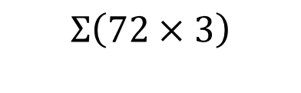
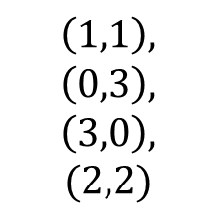

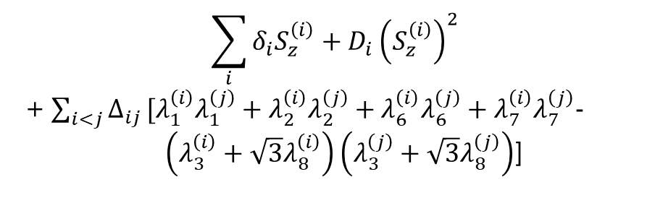
Example : interacting NV-centers
Irrep
$$(1,1)$$
72 or 144 pulses
disorder
$$\sum_{i}{δ_{i}S_{z}^{\left(i\right)}}+D_{i}{\left(S_{z}^{\left(i\right)}\right)}^{2}$$
+ $\sum_{i<j}{Δ_{ij}}[λ_{1}^{\left(i\right)}λ_{1}^{\left(j\right)}+λ_{2}^{\left(i\right)}λ_{2}^{\left(j\right)}+λ_{6}^{\left(i\right)}λ_{6}^{\left(j\right)}+λ_{7}^{\left(i\right)}λ_{7}^{\left(j\right)}− \left(λ_{3}^{\left(i\right)}+\sqrt{3}λ_{8}^{\left(i\right)}\right)\left(λ_{3}^{\left(j\right)}+\sqrt{3}λ_{8}^{\left(j\right)}\right)$]
$$Σ\left(72×3\right)$$
dipole-dipole in NV
$$\left(1,1\right),$$
$$\left(0,3\right),$$
$$\left(3,0\right),$$
$$(2,2)$$
S.Choi, N.Yao,M.D.Lukin, PRL 119, 183603 (2017)

Slide 20

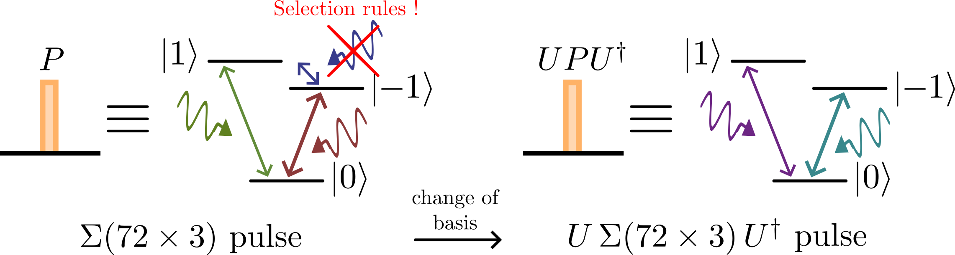

Example : interacting qutrits and SU(3)
Shorter decoupling sequences using the Hamiltonian symmetries
arXiv:2604.05871
Simplify the pulses by changing the orientation
$$Σ\left(72×3\right)$$

Slide 21
Application in Quantum Error Correction

Slide 22

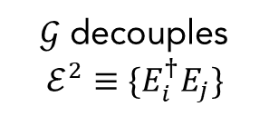
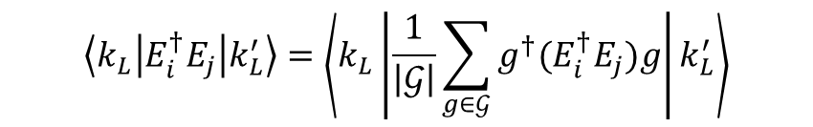




Connection to QEC
Error correction is possible iff…
In a nutshell….
$$\left\langle k_{L}\left|E_{i}^{†}E_{j}\right|k_{L}^{′}\right\rangle =δ_{kk^{′}}C_{ij}$$
« codespace »
Knill-Laflamme condition
$𝒢$ decouples $ℰ^{2}≡\{E_{i}^{†}E_{j}\}$
if
and
$$g\left|k_{L}\right\rangle =e^{iθ\left(g\right)}\left|k_{L}\right\rangle$$
$$∀g∈𝒢$$
Set of errors
$$ℰ=\{E_{j}\}_{j}$$
$$\left\langle k_{L}\left|E_{i}^{†}E_{j}\right|k_{L}^{′}\right\rangle =\left\langle k_{L}\left|\frac{1}{\left|𝒢\right|}\sum_{g∈𝒢}{g^{†}(E_{i}^{†}E_{j})g}\right|k_{L}^{′}\right\rangle$$
$$∝δ_{kk^{′}}$$
Physical system
e.g.
→ Knill-Laflamme is satisfied

Slide 23
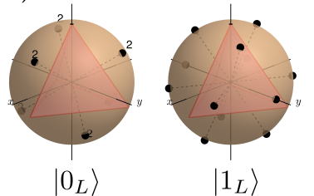
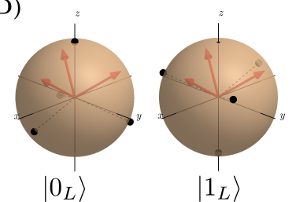






Example
Physical system :
$$⋯$$
Codespace inside
$$Sym$$
$$⋯$$
$$≅$$
spin-j=Ns
N spin-s
Noise
Symmetry
Codespace
Physical system
12 spin-1/2 or 6 spin-1 or
…
Example 1 :
Depolarization ($S_{±},S_{z})$
Example 2 :
dephasing ($S_{z})$
4 spin-1/2 or 2 spin-1 or
1 spin-2

Slide 24
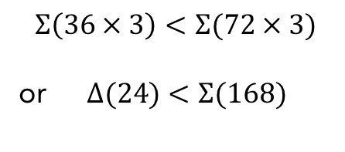
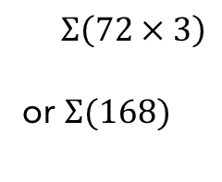

Example
Physical system :
$$⋯$$
Codespace inside
$$Sym$$
$$⋯$$
N qutrits
Noise
Symmetry
Physical system
$Σ\left(72×3\right)$
or $Σ(168)$
12 qutrits (logical qutrit)
12 qutrits
(logical qubit)
Example 1 :
Single qutrit error
$$Σ\left(36×3\right)<Σ(72×3)$$
or $Δ(24)<Σ(168)$
6 qutrits (logical qubit)
4 qutrits
(logical qubit)
Example 2 :
dephasing

Slide 25
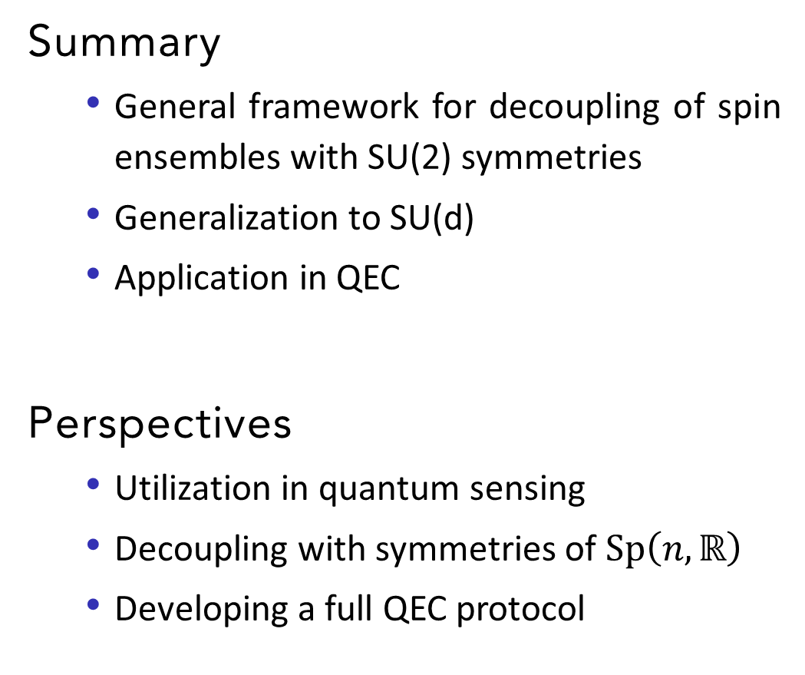

Outlook
Summary
  General framework for decoupling of spin ensembles with SU(2) symmetries
  Generalization to SU(d)
  Application in QEC
Perspectives
  Utilization in quantum sensing
  Decoupling with symmetries of $\text{Sp}\left(n,ℝ\right)$
  Developing a full QEC protocol
CR, E.Serrano-Ensástiga, J.Martin, Quantum 9, 1661 (2025)
CR, E.Serrano-Ensástiga,
J.Martin, PRA 112, 042601 (2025)
Thank you ☺
$$Σ\left(72×3\right)$$
arXiv:2604.05871

Slide 26
Back-up slides

Slide 27
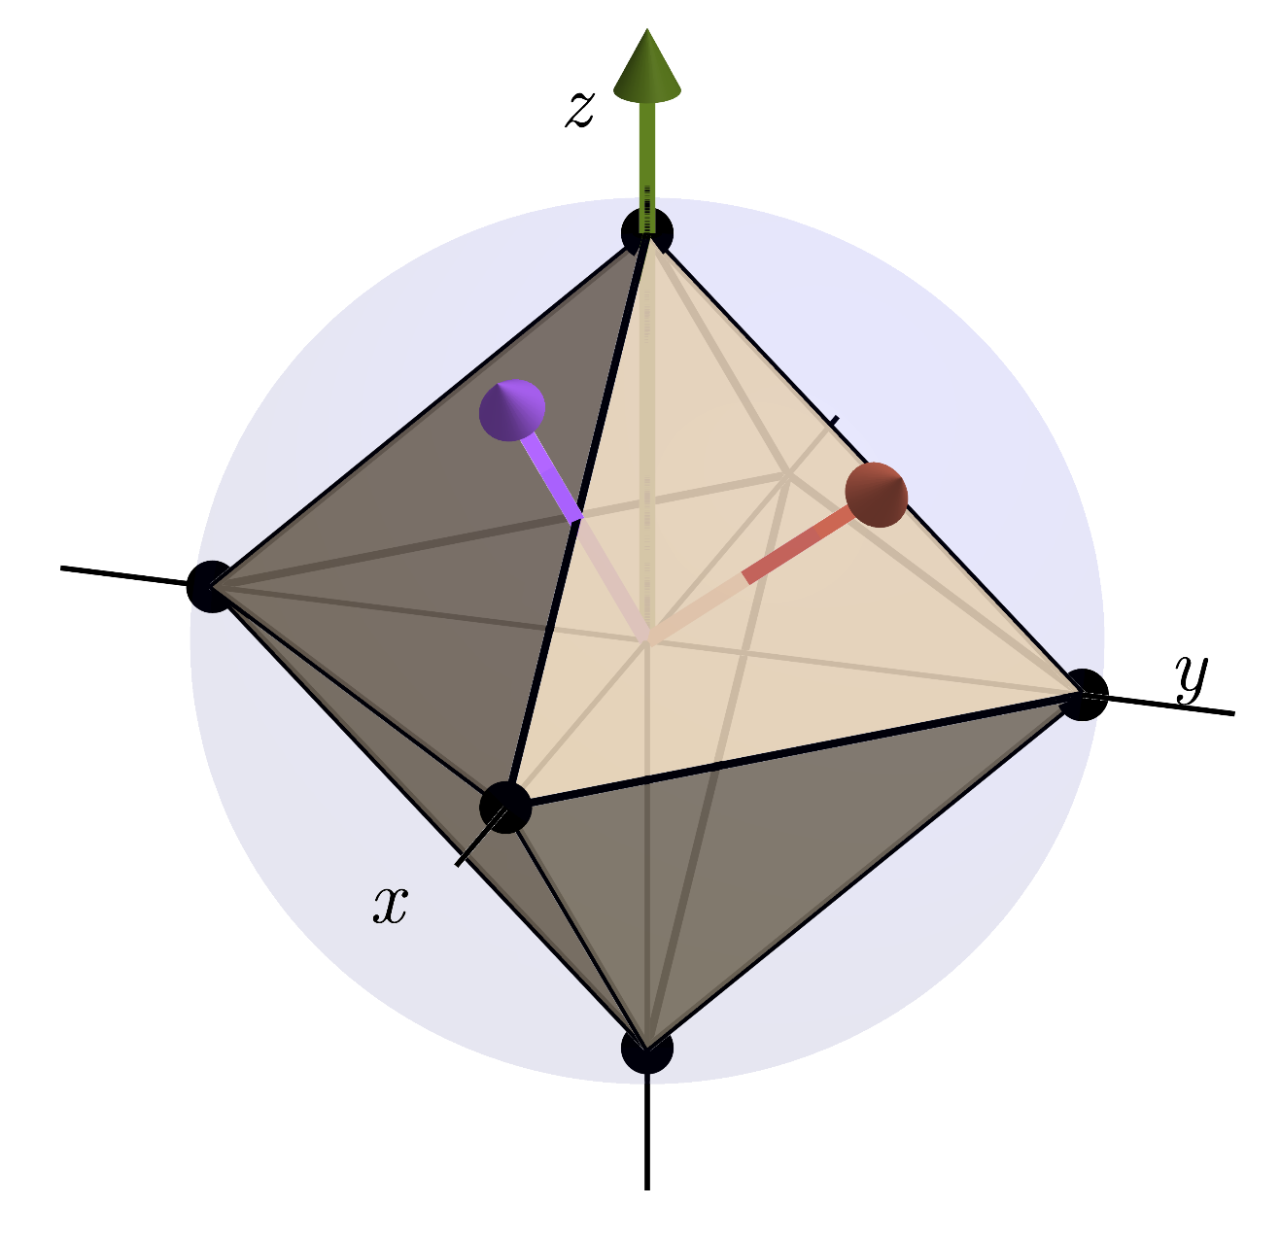
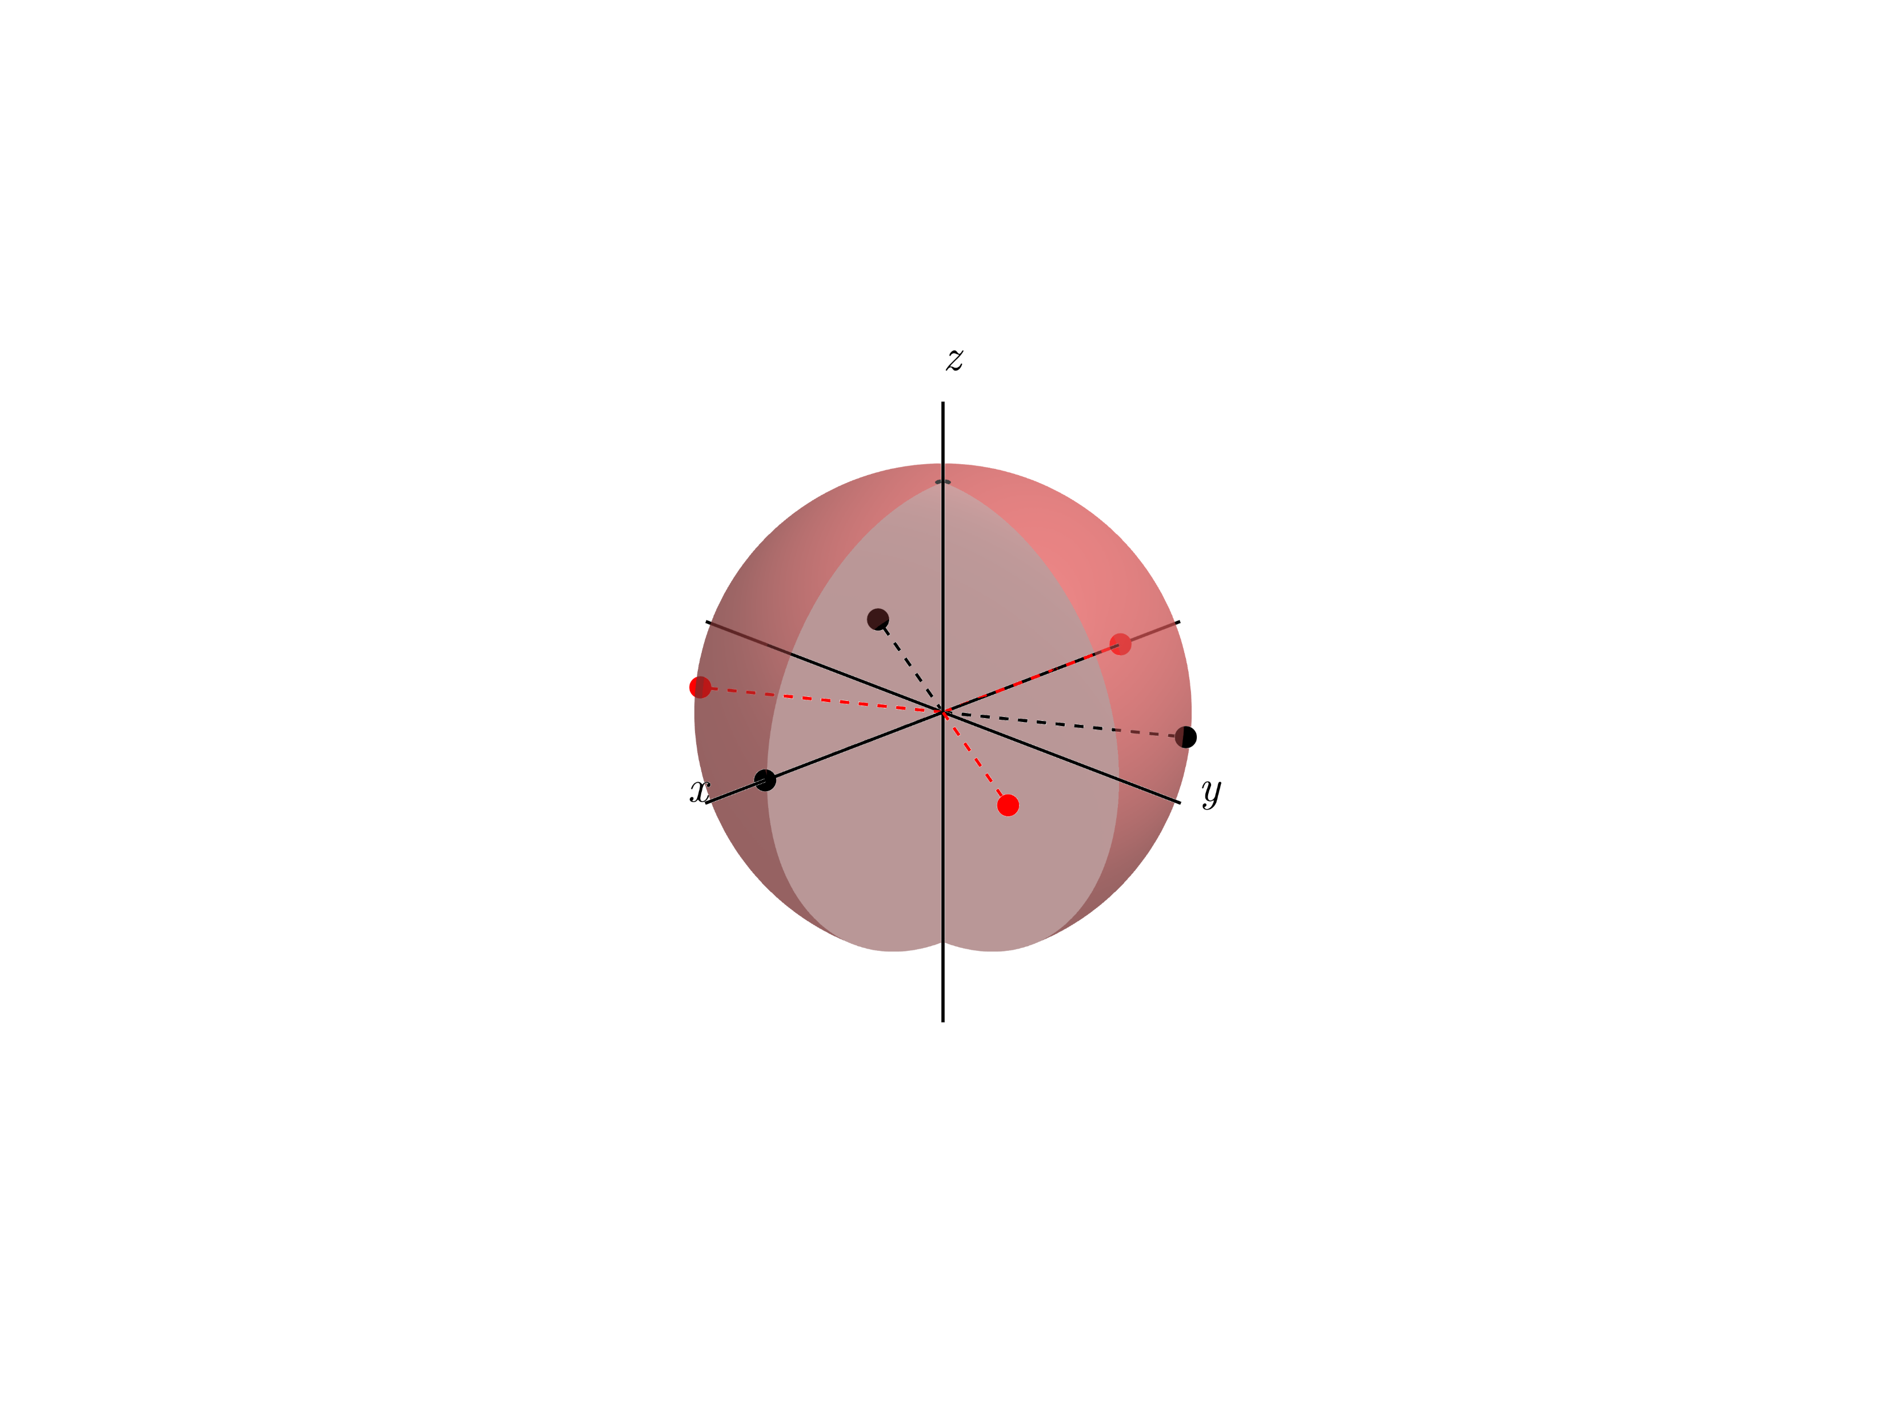
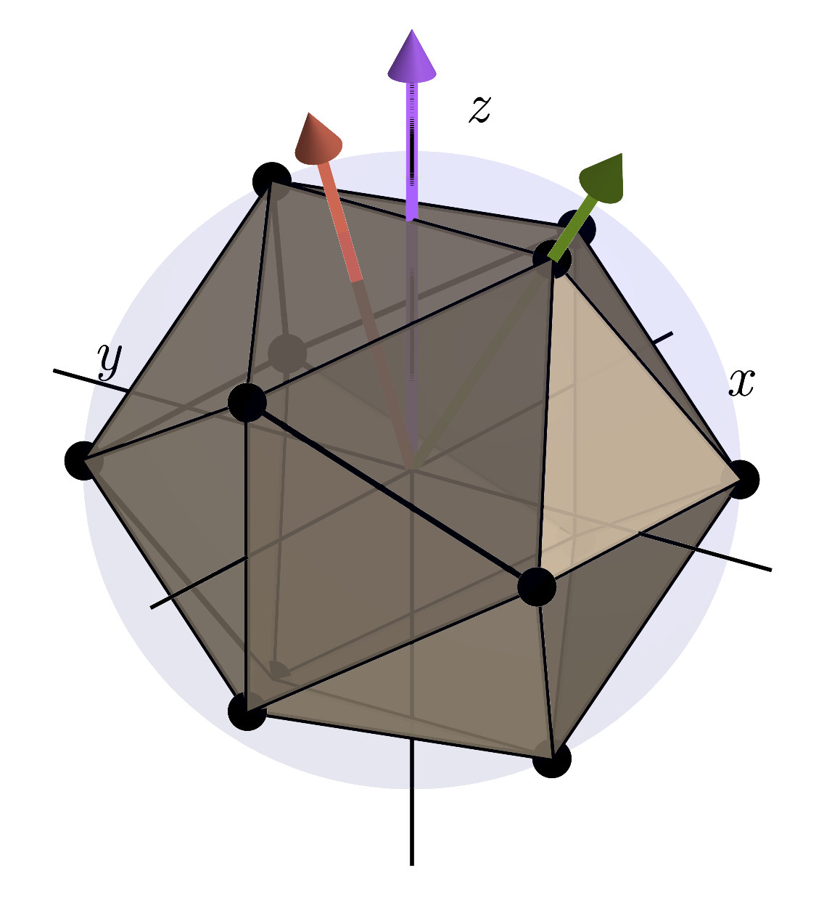
More results in SU(2)
Octahedral point group
3-body interactions
OEDD
e.g.
Cayley graph
Eulerian path
4- & 5-body interactions
IEDD
Icosahedral point group

Slide 28
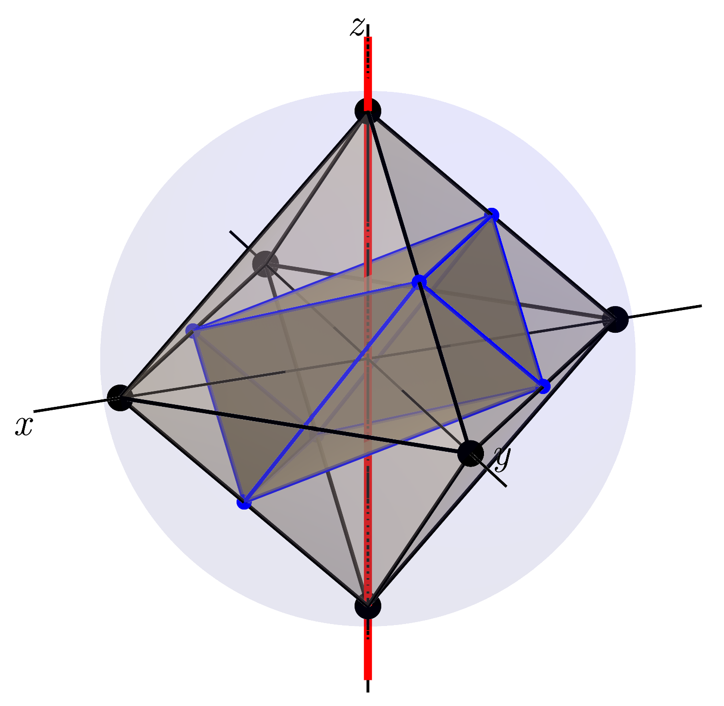
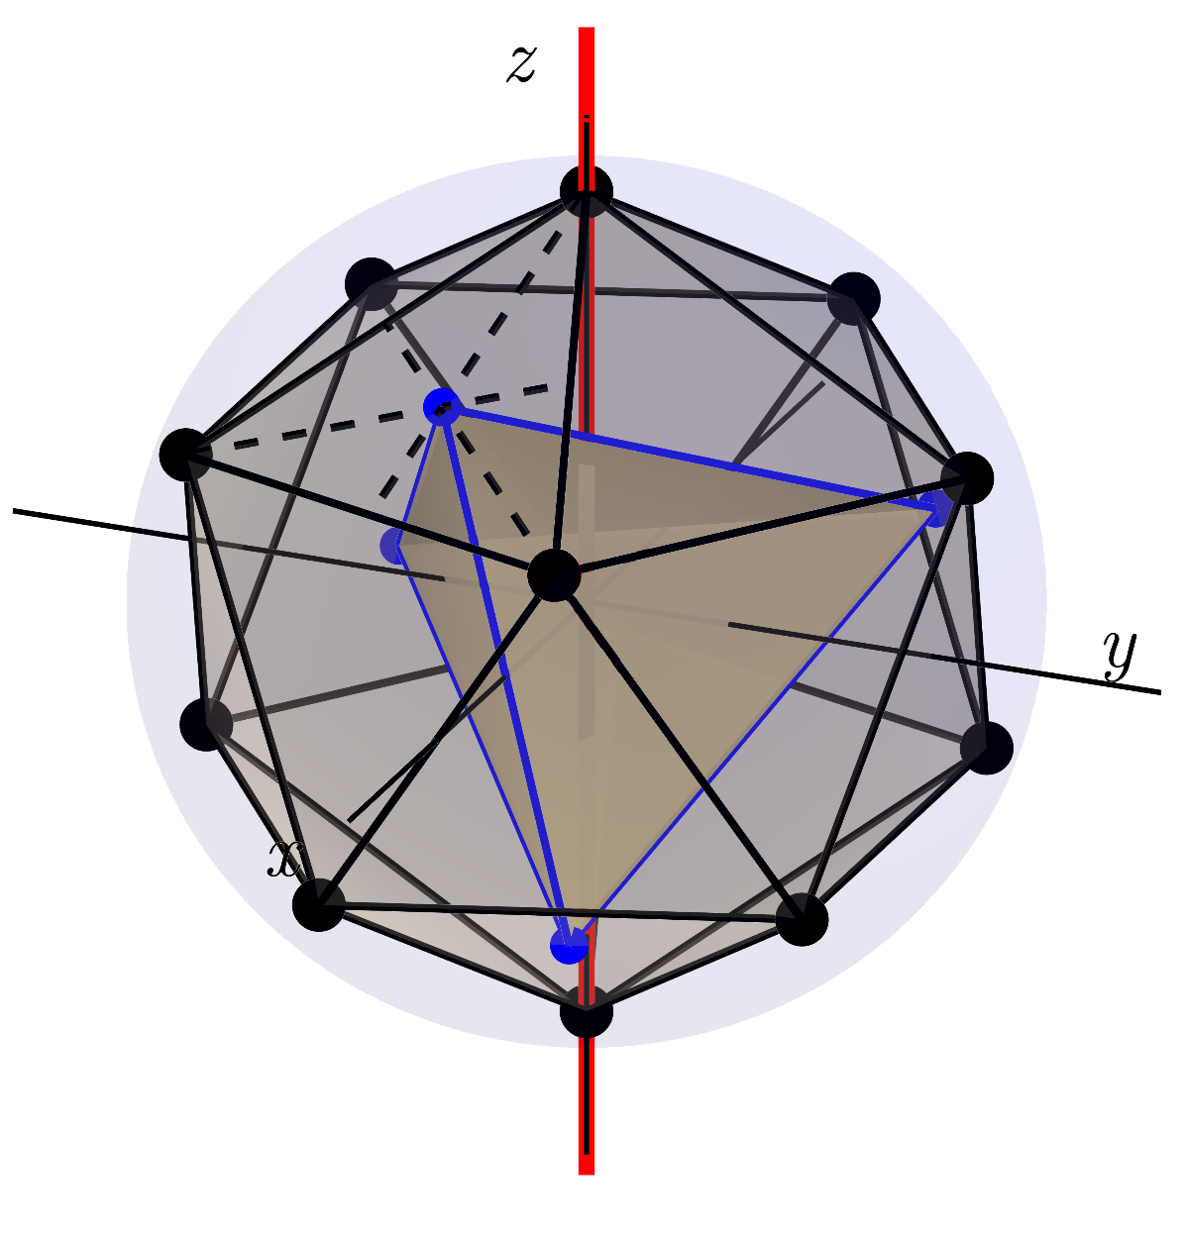
More results in SU(2)
3-body interactions
O = C₄ D₃
24 elements
6 elements
Rotating wave approximation
4- & 5-body interactions
I = C₅ T
60 elements
12 elements

Slide 29
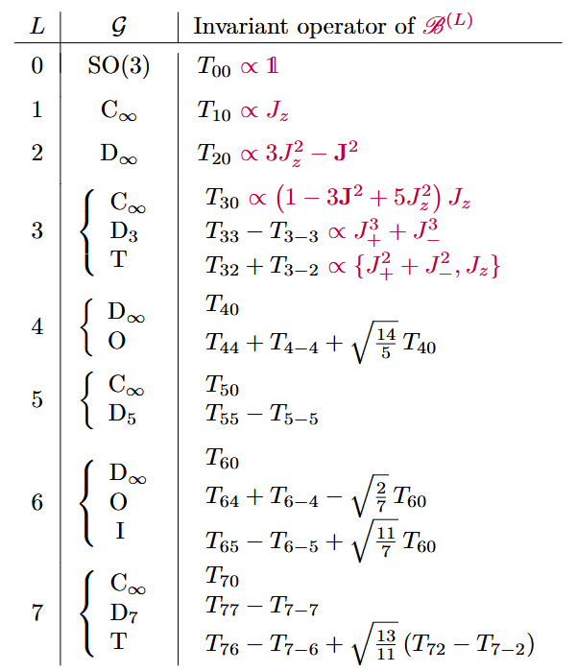
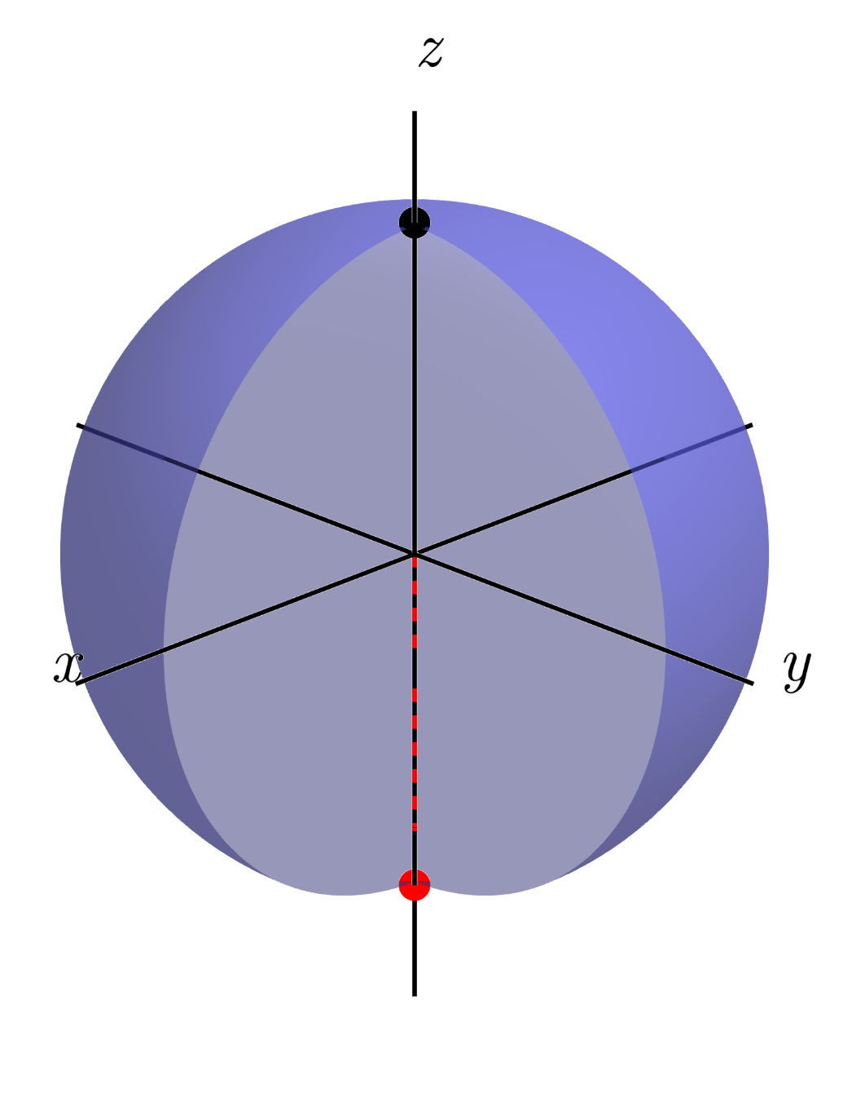
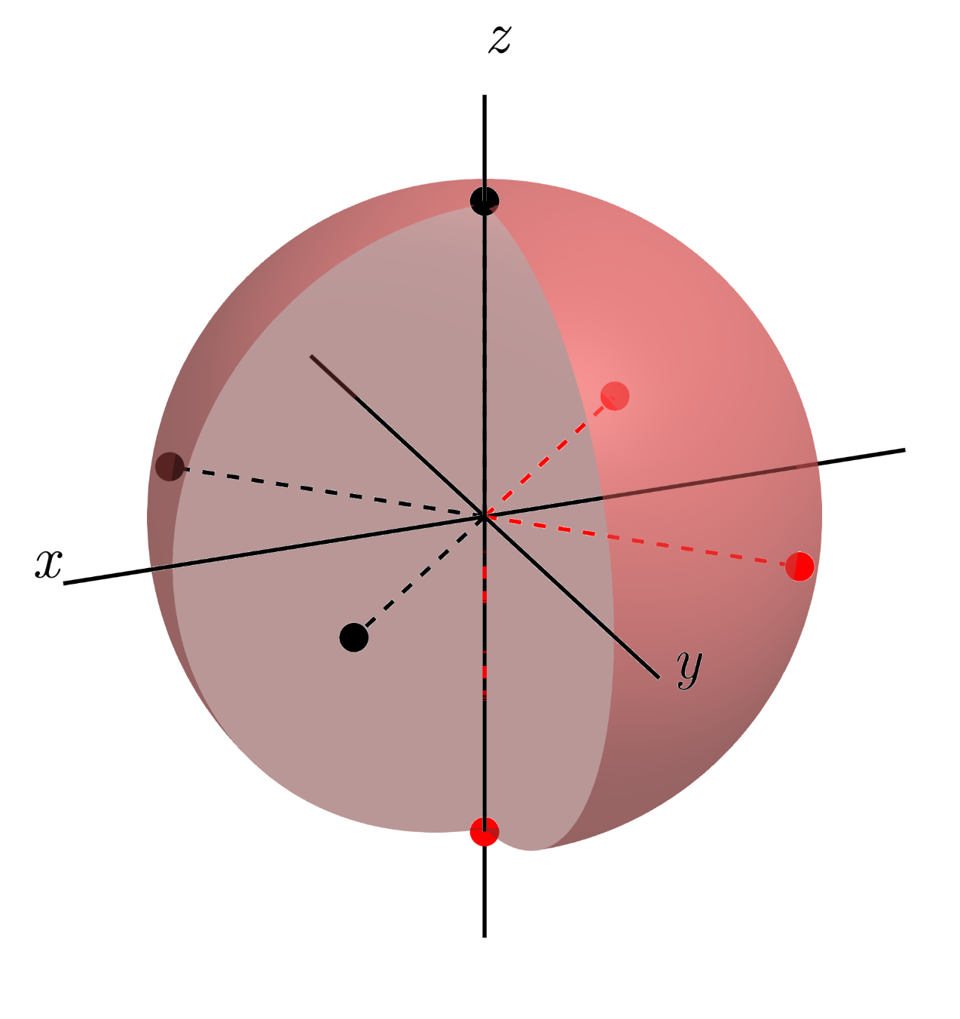
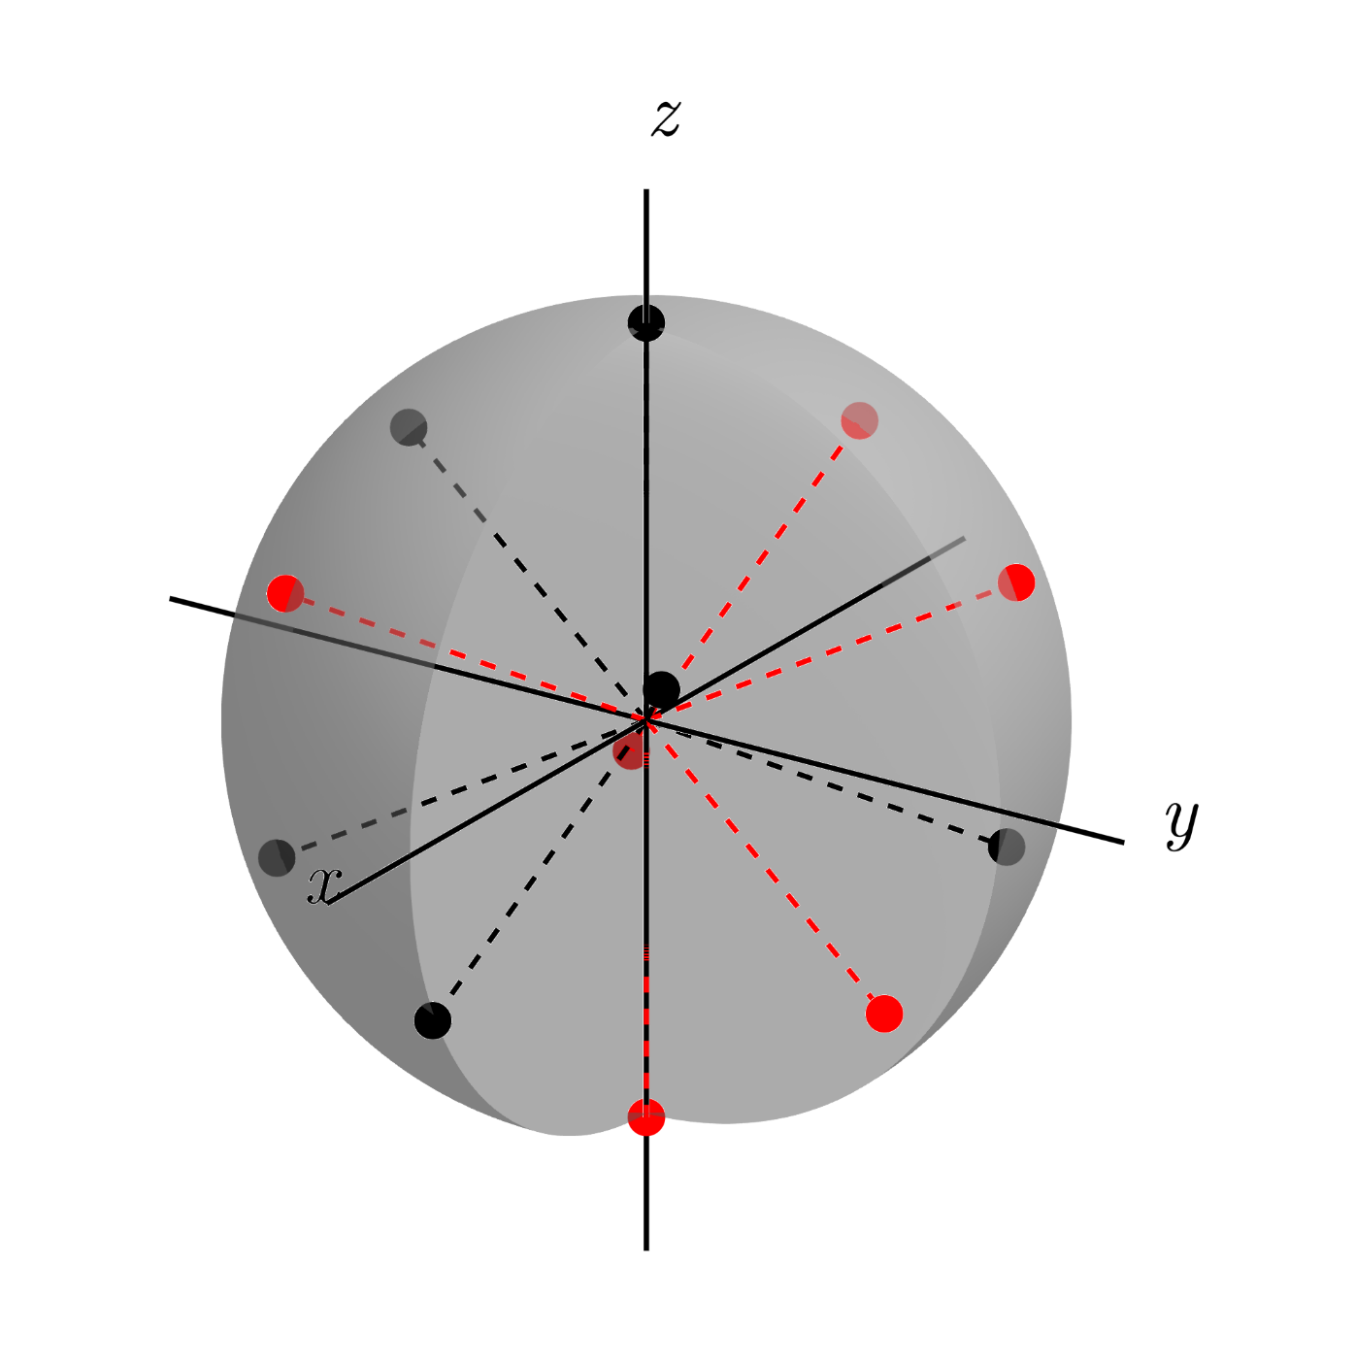
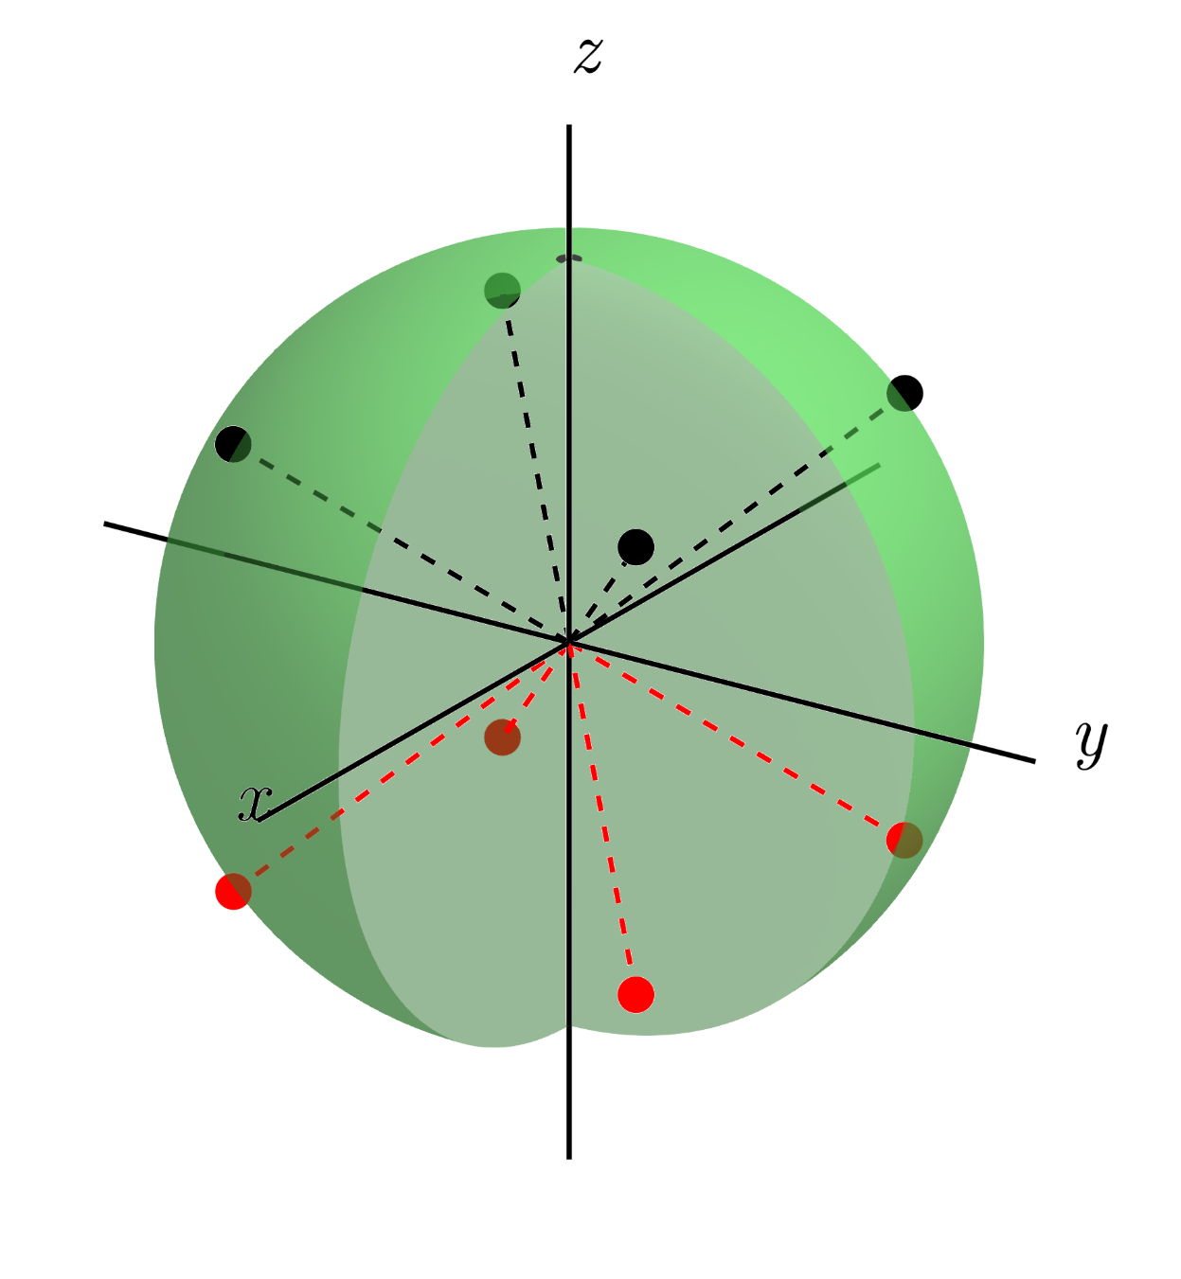
More results in SU(2)
D∞
C∞
D₃
T
O
I

Slide 30
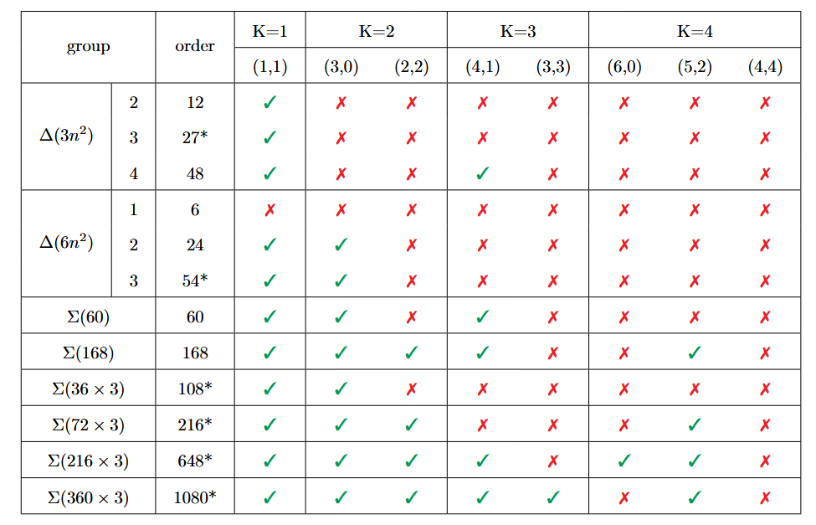
More results in SU(3)
Symmetry accessible
Single-qutrit
2-body
3-body
4-body
Symmetry inaccessible
Subgroups of SU(3)

Slide 31
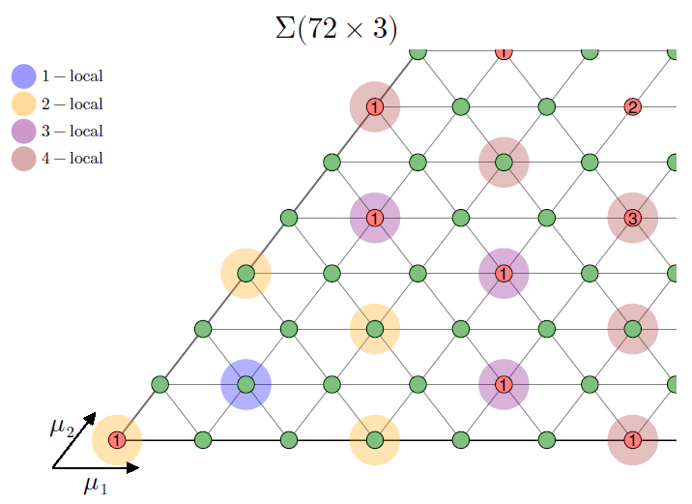
More results in SU(3)
(0,1)
(1,1)
(1,0)

Slide 32



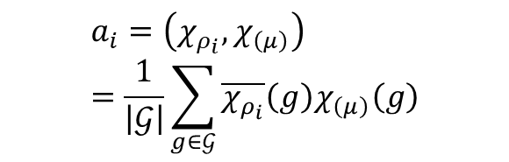
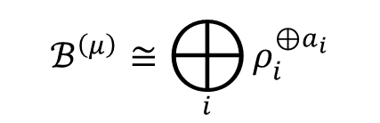
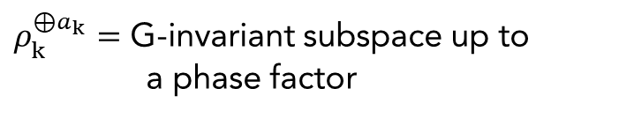
Searching for G-invariant subspace
Decoupling
Must be 0
$ρ_{1}^{⊕a_{1}}=$ G-invariant subspace
Trivial irrep
QEC
Dimension of codespace
$$a_{i}=\left(χ_{ρ_{i}},χ_{\left(μ\right)}\right) =\frac{1}{\left|𝒢\right|}\sum_{g∈𝒢}{\overline{χ_{ρ_{i}}}\left(g\right)χ_{\left(μ\right)}\left(g\right)}$$
$ρ_{k}^{⊕a_{k}}=$ G-invariant subspace up to a phase factor
Multiplicity
$$ℬ^{\left(μ\right)}≅⨁_{i}{ρ_{i}^{⊕a_{i}}}$$
One-dimensional irrep
Irrep of SU(d)
Irrep of G<SU(d)
$χ_{ρ_{i}}(g)$ → character tables
$χ_{(μ)}(g)$ → Weyl Character Formula

Slide 33
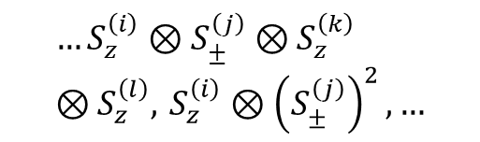








Spin QEC for two-body errors
Orientation requirement
$$ℰ={\{E}_{k}\}$$
$$ℰ^{2}={\{E}_{k}^{†}E_{q}\}$$
Symmetry
Dephasing $(S_{z})$ and dissipation $(S_{±})$
$$S_{z},S_{±},{ S}_{z}^{\left(i\right)}⊗S_{z}^{\left(j\right)},S_{±}^{\left(i\right)}⊗S_{z}^{\left(j\right)},S_{z}^{2}…$$
Tetrahedron
/
Dephasing $(S_{z})$
$$S_{z}, { S}_{z}^{\left(i\right)}⊗S_{z}^{\left(j\right)}, S_{z}^{2}$$
2-dihedral (D₂)
T = D₂ C₃
Dephasing, dissipation and two-body
$$…S_{z}^{\left(i\right)}⊗S_{±}^{\left(j\right)}⊗S_{z}^{\left(k\right)}⊗S_{z}^{\left(l\right)}, S_{z}^{\left(i\right)}⊗{\left(S_{±}^{\left(j\right)}\right)}^{2},…$$
Icosahedron
/
Dephasing, two-body (RWA)
$$…S_{z}^{\left(i\right)}⊗S_{z}^{\left(j\right)}⊗S_{z}^{\left(k\right)}⊗S_{z}^{\left(l\right)}, S_{z}^{\left(i\right)}⊗{\left(S_{z}^{\left(j\right)}\right)}^{2},…$$
Tetrahedron
I = T C₅
$$…S_{z}^{\left(i\right)}⊗S_{z}^{\left(j\right)}⊗S_{z}^{\left(k\right)}⊗S_{z}^{\left(l\right)}, S_{z}^{\left(i\right)}⊗{\left(S_{±}^{\left(j\right)}\right)}^{2},…$$
O > T
such that
I = T C₅
Dephasing, dissipation and two-body (RWA)
Octahedron

