Slide 1




Can we predict the host of a virus ?
A study case on plant viruses applying machine learning approaches on curated viral proteomics features
Nikolay Simankov
Rachid Tahzima
Hélène Soyeurt
Sébastien Massart
Notes:
Can we predict the host of a virus using machine learning?
Today I’ll try to answer this question with a study case on plant viruses applying machine learning on curated viral proteomic data.

Slide 2
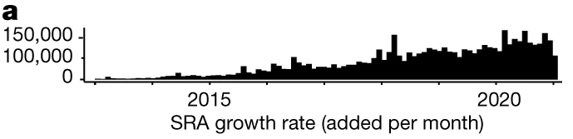
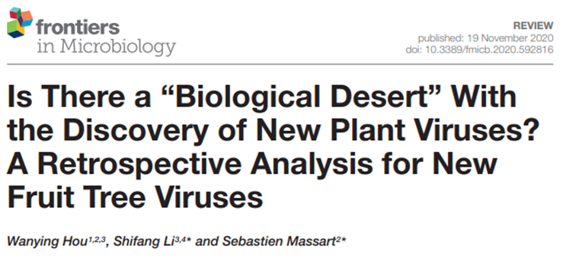
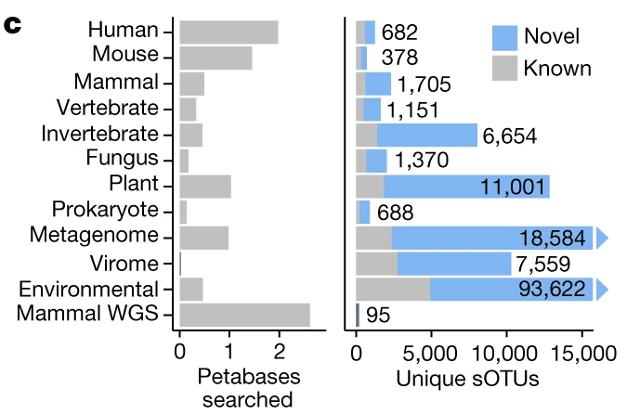
High throughput sequencing
A
Sequence Read Archive (SRA) – HTS
SERRATUS
11 000 uncharacterized sequences of plant RNA viruses
Biological characterization of new viruses is often incomplete
A) Edgar et al., 2022. Petabase-scale sequence alignment catalyses viral discovery
Notes:
High-throughput sequencing has resulted in thousands of new viral sequences, including more than eleven thousand uncharacterized plant RNA viruses.
However, for most of these viruses we lack biological information.
This creates an urgent need for approaches that can help interpret these genomic data and anticipate possible host ranges.

Slide 3
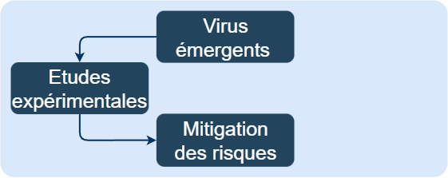
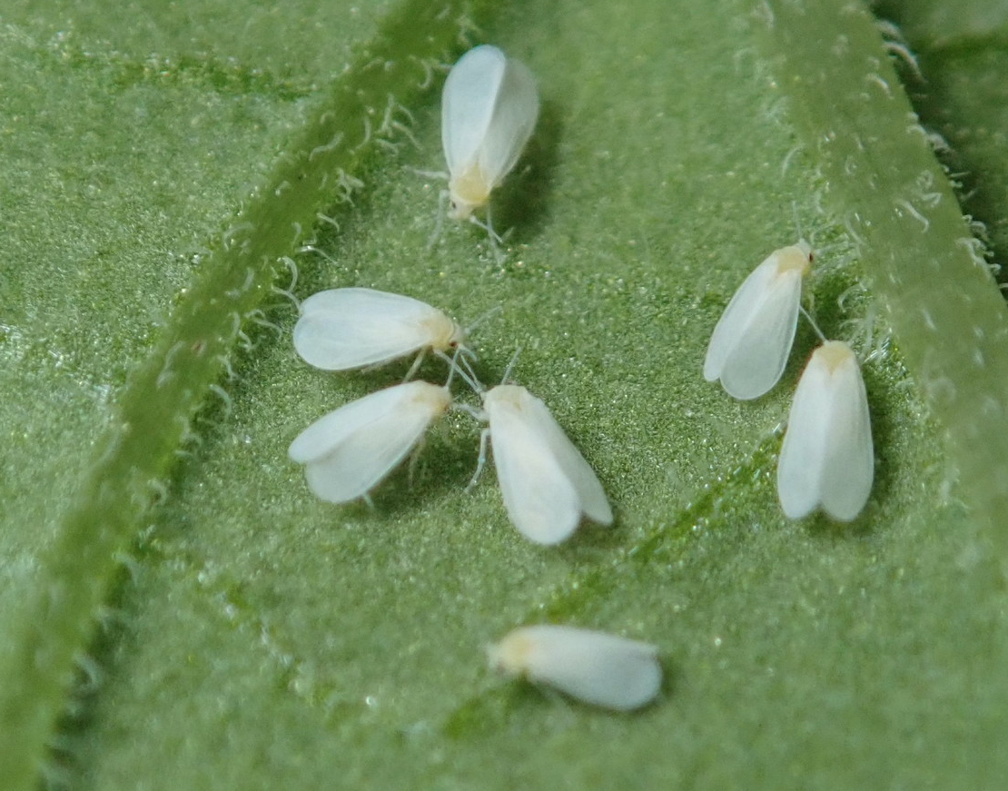

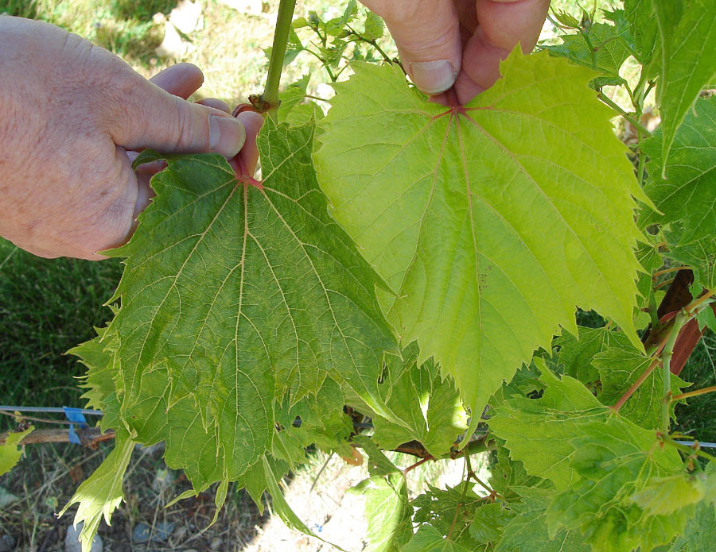
The challenges of experimental studies
Emerging viruses
Experimental studies
Risk mitigation
Testing relationships experimentally
Not exhaustive
Comparing genomic and proteomic patterns
Allows to quickly process large amount of data
Time-consuming
Expensive
Based on observations
Sometimes inconclusive
Based on complete genomes (HTS)
Uses high-performance bioinformatics tools
Enables understanding of virus-vector-host interactions
Notes:
Experimental host identification remains slow, expensive, and not exhaustive.
It often relies on observations and can be inconclusive, especially for emerging viruses.
These limitations highlight the need for complementary numerical tools to support faster risk assessment.

Slide 4
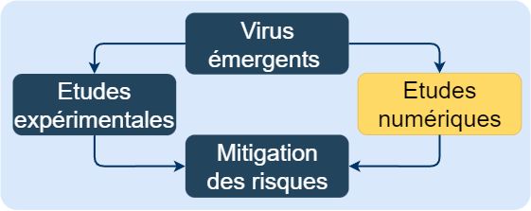




The suggested approach
Emerging viruses
Experimental studies
Numerical studies
Risk mitigation
Testing relationships experimentally
Not exhaustive
Comparing genomic and proteomic patterns
Based on complete genomes (HTS)
Uses high-performance bioinformatics tools
Time-consuming
Expensive
Based on observations
Sometimes inconclusive
Allows to quickly process large amount of data
Enables understanding of virus-vector-host interactions
Notes:
The suggested approach is to combine numerical analysis with classical experimental studies.
Using complete genomes and high-performance bioinformatics, we can explore host–virus relationships on a large scale.
This complementary strategy enables much faster hypothesis generation while experiments provide final validation.

Slide 5

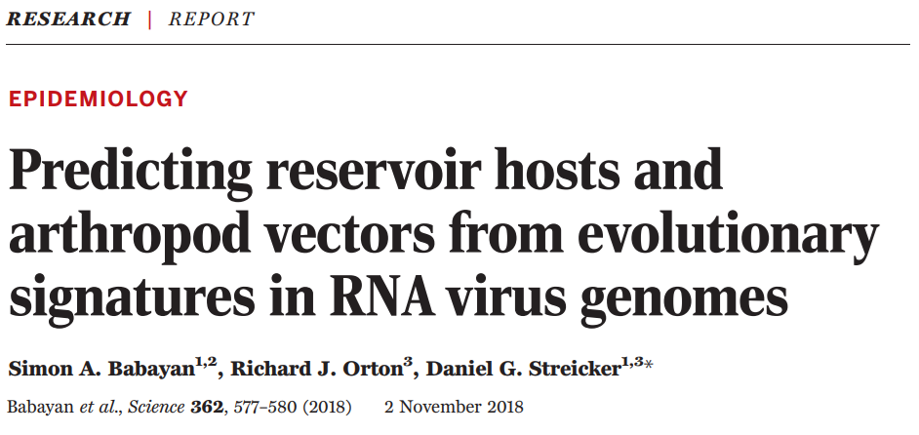


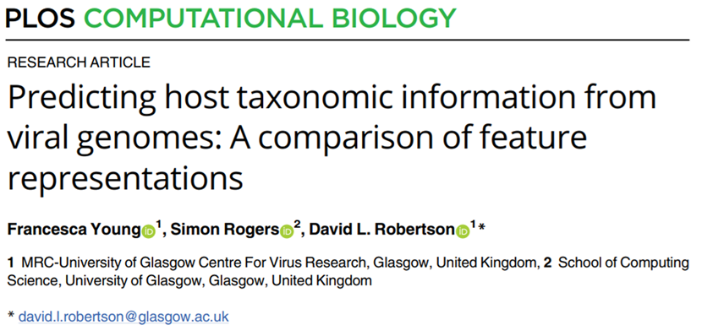
State of the art – Nothing for plants
Major trends
High or limited viral diversity
Our approach
Viral diversity limited to plant viruses (35 Families)
Genome-based
K-mers transform
Low host resolution (Kingdom, Class) or very few predictable species
Models are not available
Protein-based
Functional and biophysical characterization
High host resolution (Species and Genus Level)
Data and prediction-oriented dashboard
4
Notes:
In the current literature, most predictive methods are genome-based
, use k-mer transformations,
and provide only low host resolution often limited to kingdom or class
Finally,almost no one addresses plant viruses

Slide 6
State of the art – Nothing for plants
Major trends
High or limited viral diversity
Our approach
Viral diversity limited to plant viruses (35 Families)
Genome-based
K-mers transform
Low host resolution (Kingdom, Class) or very few predictable species
Models are not available
Protein-based
Functional and biophysical characterization
High host resolution (Species and Genus Level)
Data and prediction-oriented dashboard
4
Notes:
Our approach differs by the integration of a wide intraspecific diversity into the scope of plant viruses, a high host resolution, protein-based functional descriptors, and operational predictive models accessible through a dashboard.

Slide 7
How to predict the host of a plant virus?
Building a comprehensive virus/host relationship database
Building a consistent plant-virus protein database
Building an alignment-free, biologically relevant protein representation
Training models with a Machine Learning pipeline
Building a user-friendly dashboard
Notes:
Our workflow consists of five steps: building a comprehensive virus–host relationship database, constructing a consistent plant-virus protein database, designing biologically relevant protein representations, training machine-learning models, and finally delivering the results in an intuitive dashboard.

Slide 8
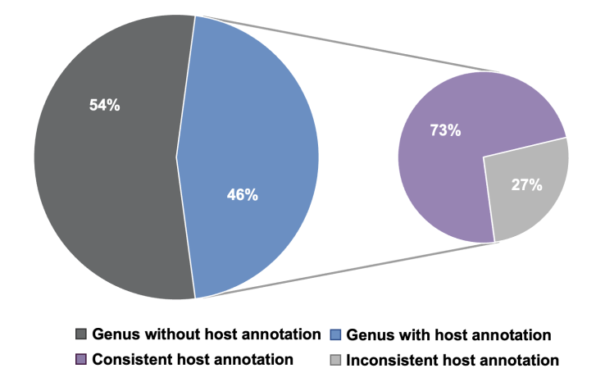
Building the largest virus/host plant relationship database
A
Host annotation consistency in the Viral RefSeq database
B
Scientific information with plant virus discovery
A) Shang, J., Peng, C., Guan, J., Cai, D., Wang, D. & Sun, Y. (2025). Computational approaches for virus host prediction: A review of methods and applications. undefined.
B) Hou W, Li S, Massart S. (2020). Is There a "Biological Desert" With the Discovery of New Plant Viruses? A Retrospective Analysis for New Fruit Tree Viruses.
Notes:
The main reason why the host resolution in the literature is low is that it is not that easy to get the whole picture.
For instance, you can see here that in RefSeq, only 46% of genera have host annotation.
And only 73% of them have a consistent host annotation.
This gap between the genome availability and host range will only grow.
As you can see on the second graph, a review of 78 publications of new viruses found on fruit trees emphasized that only 23% of them provided the host range, while 92% provided the complete genome.

Slide 9
Building the largest virus/host plant relationship database
A
Host annotation consistency in the Viral RefSeq database
Harvested relations from:
Virus-Host DB
NCBI Virus
DpvWeb
ONEKP
RefSeq
UniProt
GenBank
Serratus
CABI
Vide
EPPO
Plant-Virus DB → max 9010 relations
Automatic semantic correction, uniformization, updated taxonomy and TaxID retrieval
Corrected and completed by a consortium of 16 experts from 9 countries
B
Scientific information with plant virus discovery
A) Shang, J., Peng, C., Guan, J., Cai, D., Wang, D. & Sun, Y. (2025). Computational approaches for virus host prediction: A review of methods and applications. undefined.
B) Hou W, Li S, Massart S. (2020). Is There a "Biological Desert" With the Discovery of New Plant Viruses? A Retrospective Analysis for New Fruit Tree Viruses.
Notes:
In this context, we have tried to overcome this problem as much as possible.
First, we integrated information from 12 databases.
Then, we performed automatic semantic correction and updated all the taxonomy and taxids.
Finaly, sixteen experts from nine countries contributed to the verification and completion of the relationships.

Slide 10
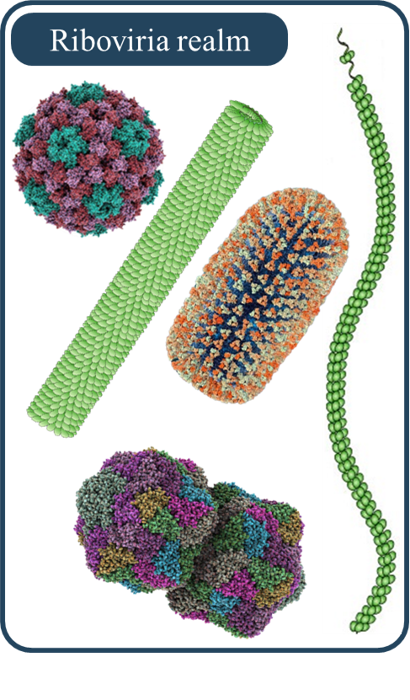
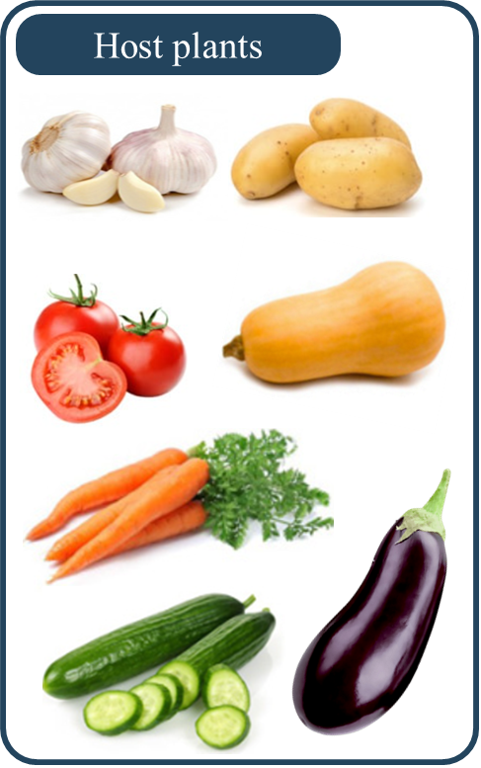
Building the largest virus/host plant relationship database
Riboviria and
Monodnaviria realms
Viridiplantae realm
3,748 Virus species infecting plants
4,157 Plant species
Notes:
The final dataset contains
3,748 virus species
4,157 plant species

Slide 11
Building the largest virus/host plant relationship database
Riboviria and
Monodnaviria realms
Viridiplantae realm
3,748 Virus species infecting plants
4,157 Plant species
22,338 Relationships
Notes:
And we ended up with the largest curated virus–host relationship database for plant virology with more than 22 000 relationships.

Slide 12
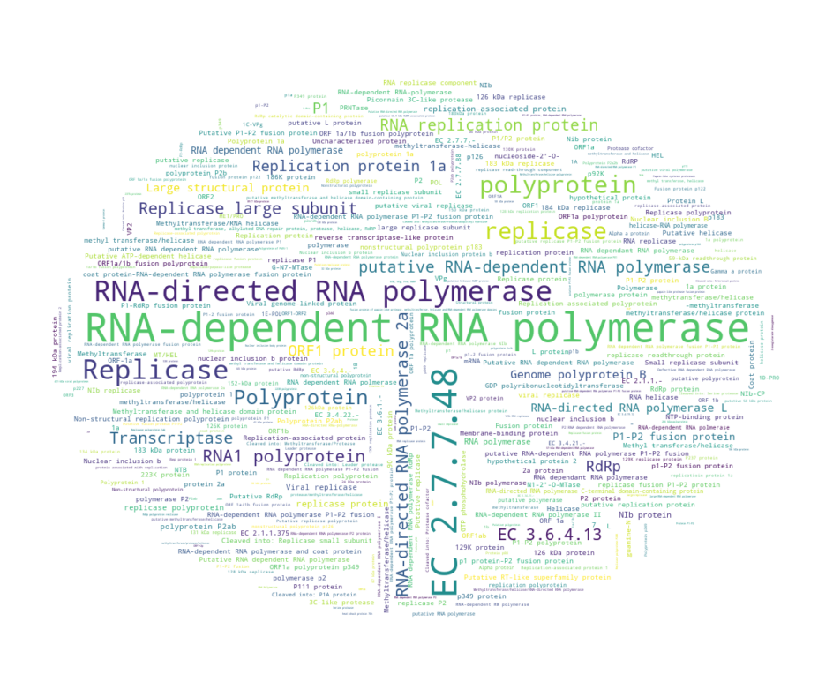

Notes:
Then we collected all available protein sequences from NCBI and Uniprot and this was a mess.

Slide 13
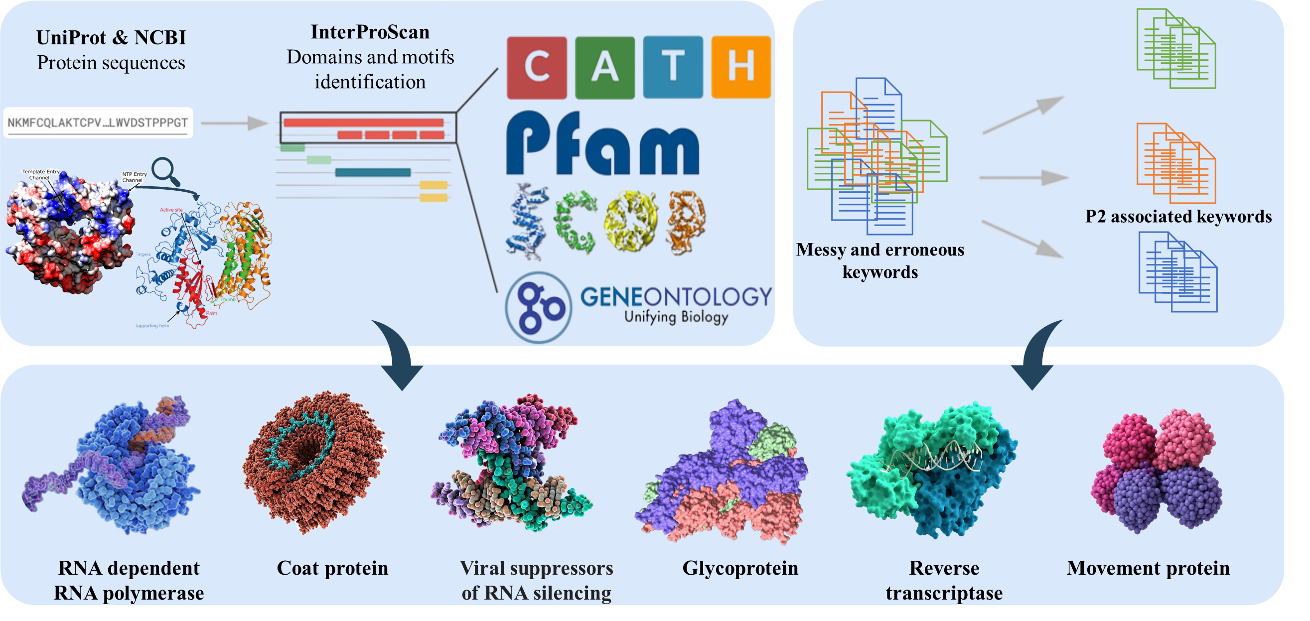
Building a consistent plant-virus protein database
From 4,107 keywords to 27 unique functional entities
From 350,000+ Entries to 110,000+ complete, curated, and annotated proteins
Notes:
We started from more than four thousand heterogeneous protein names containing miss-annotations.
Through clustering protein sequences by length and functional profiles, semi-automatically annotation supported by bibliography, we managed to group them into 27 consistent functional entities.
In the end, we obtained over one hundred thousand complete and annotated proteins.

Slide 14
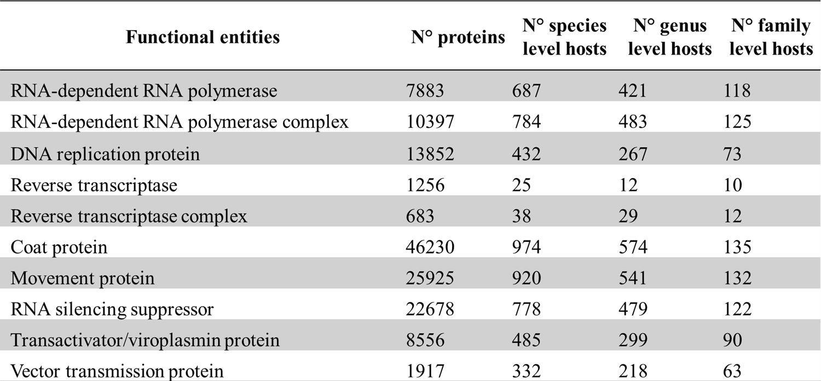
Building a consistent plant-virus protein database
Functional entities | N° Protein sequences | N° Plant species* | N° Plant genera* | N° Plant families*
* Targets meeting the minimal requirements specified later on
Notes:
These functional groups include essential viral proteins such as diverse replication protein groups, coat proteins, movement proteins, RNA silencing suppressors and so on.
For instance, we have more than 45 000 coat proteins that can be linked to the host plant species.
Among the targets that meet the minimum requirements for robust machine learning, there are nearly 1,000 plant species and more than 500 genera to be predicted.

Slide 15
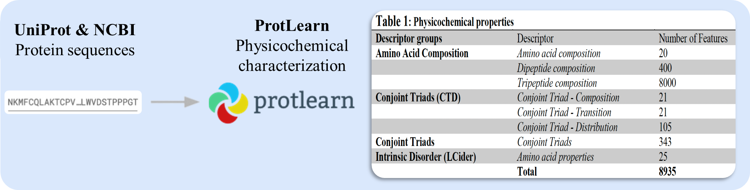
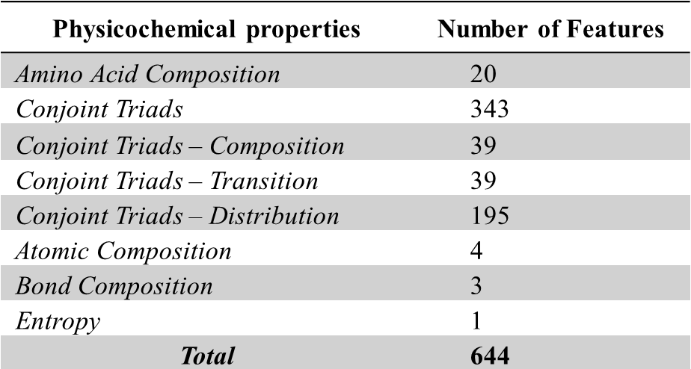
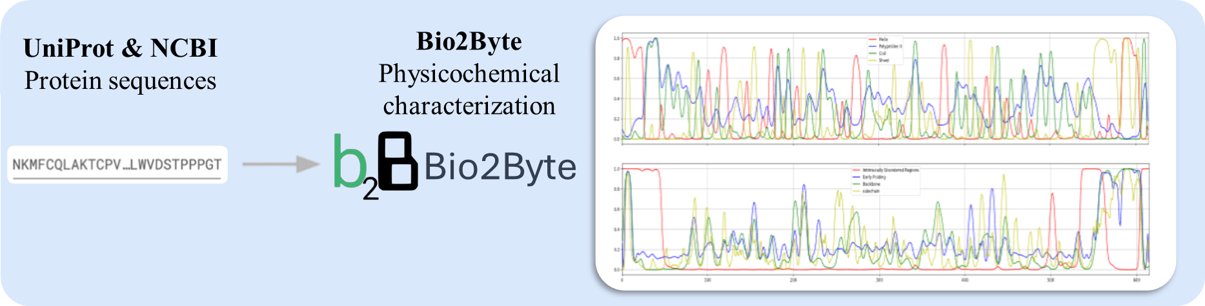
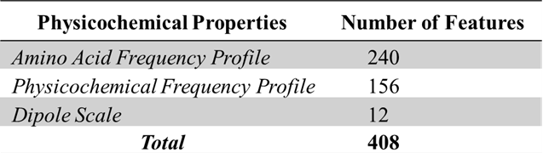
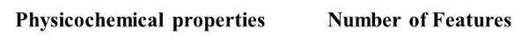

Building alignment-free protein representation
ProtLearn
Biophysical
characterisation
Pred-Omics
Physicochemical characterization
PredOmics
Biophysical
frequency profile
Notes:
To integrate proteins without alignment, we used two complementary descriptor sets.
ProtLearn provides biophysical characterizations such as amino acid composition, conjoint triads, and atomic composition.
PredOmics quantifies amino acid, and biophysical frequency profiles. Together, these descriptors capture relevant biological information and result in more than one thousand features per protein.

Slide 16
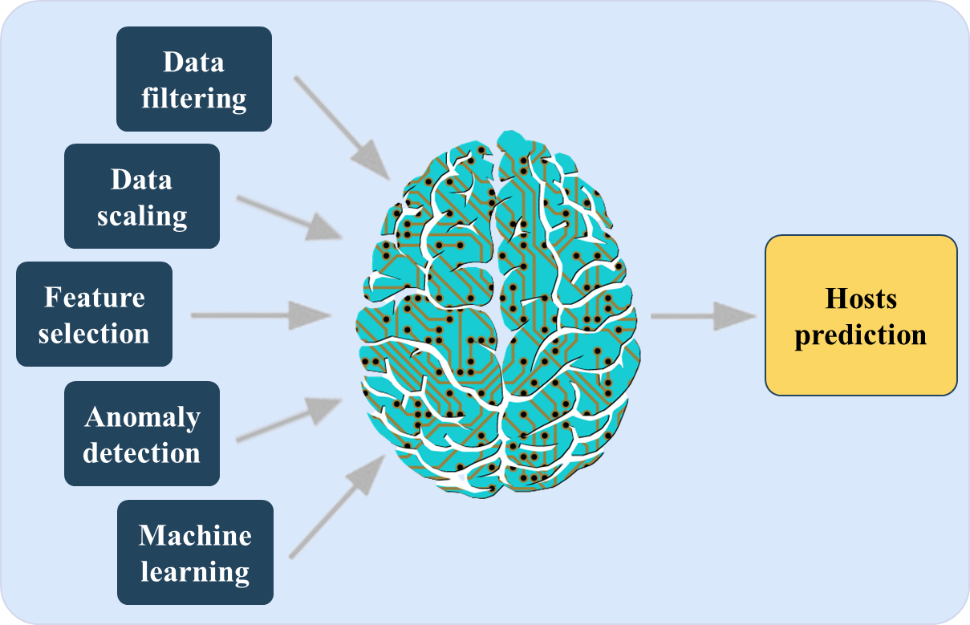
Training models with a Machine Learning pipeline: Haramo
Minimal requirement to train a model:
500 Unique protein sequences
8 Virus species known to infect the target taxon
40 Unique protein sequences from species known to infect the target taxon
Notes:
We developed a dedicated HARAMO, a Holistic AutoML-driven Robust pipeline training for Applied Multi-Omics.
To expect a robust model for a specific plant taxon, we require at least five hundred unique protein sequences and eight virus species infecting that taxon.

Slide 17
Training models with a Machine Learning pipeline: Haramo
Minimal requirement to train a model:
500 Unique protein sequences
8 Virus species known to infect the target taxon
40 Unique protein sequences from species known to infect the target taxon
Outer 4-fold CV:
Model evaluation and selection
Inner 4-fold CV:
Hyperparameter tuning
Outer train/validation sets
Outer test sets
Inner train sets
Inner validation sets
Notes:
The pipeline uses nested cross-validation: the inner loop tunes hyperparameters while the outer loop provides unbiased model evaluation. This structure ensures robustness and avoids overfitting.

Slide 18
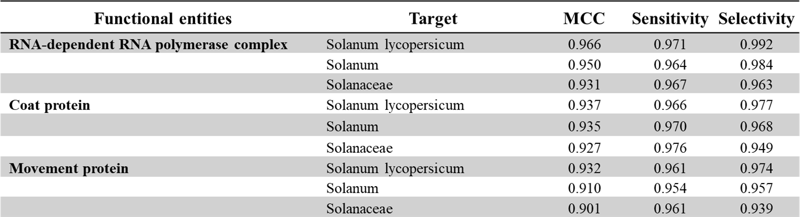
Model evaluation – Solanum lycopersicum
Mean MCC score of 0.956±0.036 across all targets and proteins → Models handle intraspecific sequence diversity very well
Sensitivity is increasing with the reduction of host resolution → Reducing class imbalance helps the model to learn
Selectivity is decreasing with the reduction of host resolution → Viruses often have species-specific traits, so aggregating hosts at higher level merges biologically distinct traits
Notes:
Overall, our models achieved a mean MCC score of about 0.96 across all targets and proteins. This shows that the models handle large intra-specific diversity very well.
If we zoom on Tomato, we can observe that sensitivity can increases when we reduce the host resolution, due to a decrease in class imbalance,
whereas selectivity decreases because viruses often have species-specific traits, so aggregating hosts at higher level merges biologically distinct traits

Slide 19
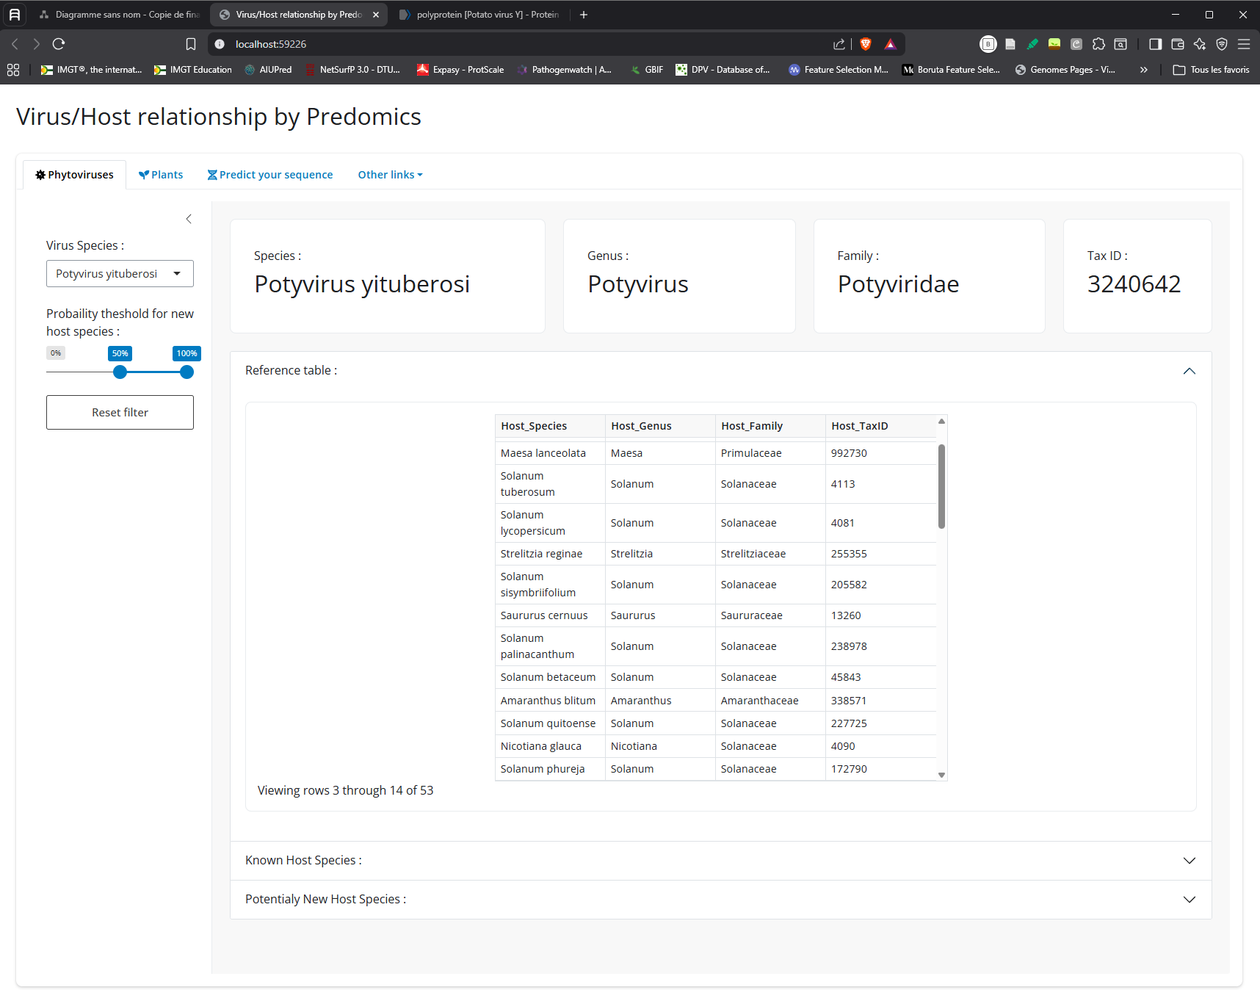
Building a user-friendly dashboard – Database exploration
Notes:
To make our work accessible, we developed a user-friendly dashboard.
Users can explore the curated virus–host relationships

Slide 20
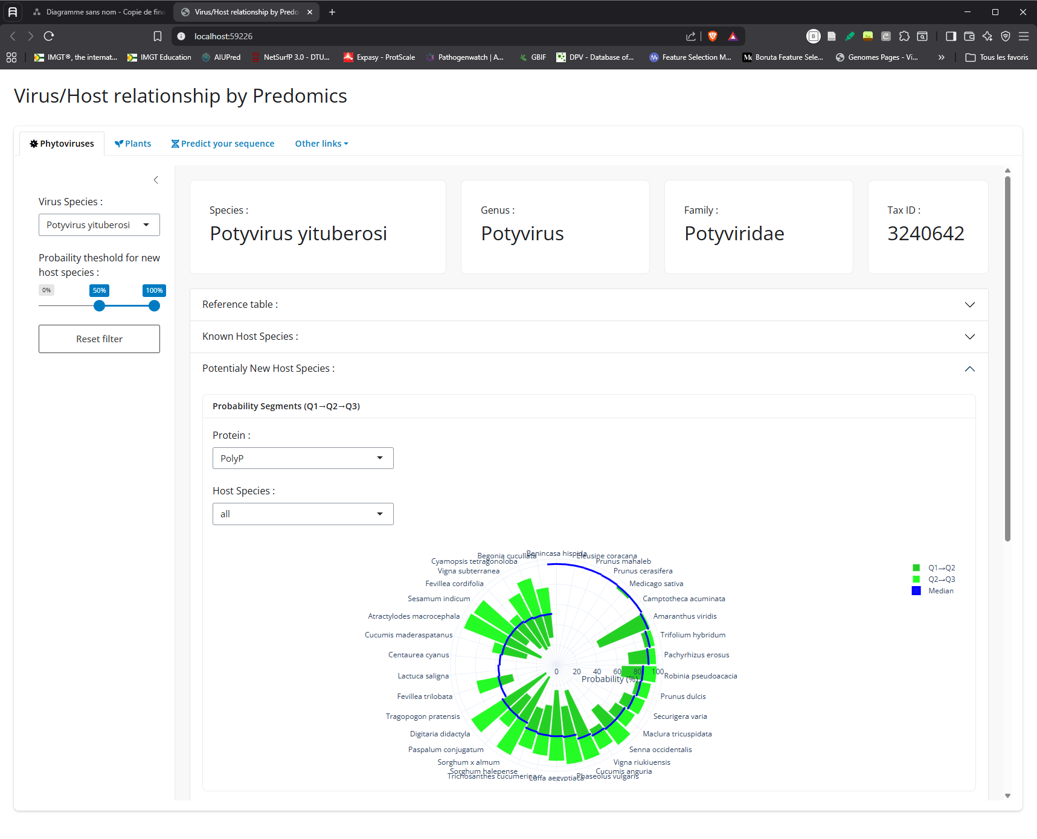
Building a user-friendly dashboard – Predicted relationships
Notes:
visualise potentially new host ranges for specific virus species.

Slide 21
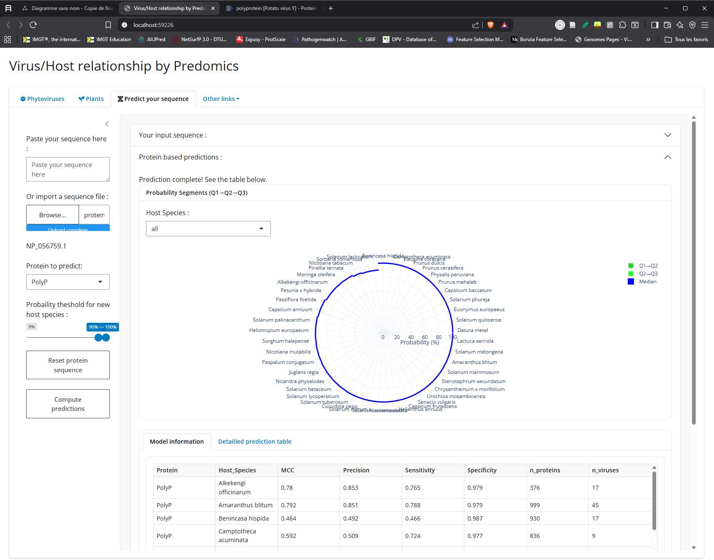
Building a user-friendly dashboard – Sequence prediction
Notes:
and even upload new protein sequences.
After computing the descriptors, our models return probabilistic predictions for the most likely host plants.

Slide 22
Take-home message
Key Insights:
A unified and expert-validated virus–host relational database now provides the most comprehensive foundation available for plant virology, integrating 22,000+ curated interactions.
The construction of a consistent and biologically meaningful plant-virus protein database of 110,000+ curated proteins enables robust comparative analyses.
A physicochemical protein characterization offers a biologically interpretable alternative to k-mer approaches.
Machine-learning pipelines developed with a rigorous nested cross-validation pipeline (Haramo) demonstrate high accuracy, sensitivity, and selectivity, even in the presence of large intraspecific viral diversity.
A user-friendly dashboard translates all these advances into an accessible tool.
Perspectives:
Model evaluation on novel virus species remains an essential next step. The generalization capacity of the models to completely new virus species still needs to be systematically assessed.
Experimental validation will be conducted by the laboratories of the consortium members to refine model performance through biological feedback.
Conclusion :
Integrating curated biological knowledge with modern machine-learning approaches provides a powerful framework for predicting plant virus hosts with unprecedented resolution.
This strategy complements experimental virology and facilitates faster risk assessment, surveillance, and biological interpretation of emerging viruses.
Notes:
To summarise the take home message of this presentation would be that:
we built the most comprehensive and curated virus–host database for plants viruses with more than 22 000 relationships

Slide 23
Take-home message
Key Insights:
A unified and expert-validated virus–host relational database now provides the most comprehensive foundation available for plant virology, integrating 22,000+ curated interactions.
The construction of a consistent and biologically meaningful plant-virus protein database of 110,000+ curated proteins enables robust comparative analyses.
A physicochemical protein characterization offers a biologically interpretable alternative to k-mer approaches.
Machine-learning pipelines developed with a rigorous nested cross-validation pipeline (Haramo) demonstrate high accuracy, sensitivity, and selectivity, even in the presence of large intraspecific viral diversity.
A user-friendly dashboard translates all these advances into an accessible tool.
Perspectives:
Model evaluation on novel virus species remains an essential next step. The generalization capacity of the models to completely new virus species still needs to be systematically assessed.
Experimental validation will be conducted by the laboratories of the consortium members to refine model performance through biological feedback.
Conclusion :
Integrating curated biological knowledge with modern machine-learning approaches provides a powerful framework for predicting plant virus hosts with unprecedented resolution.
This strategy complements experimental virology and facilitates faster risk assessment, surveillance, and biological interpretation of emerging viruses.
Notes:
We assembled a biologically grounded protein repertoire with more than 100 000 curated and well annotated proteins that enables robust comparative analyses

Slide 24
Take-home message
Key Insights:
A unified and expert-validated virus–host relational database now provides the most comprehensive foundation available for plant virology, integrating 22,000+ curated interactions.
The construction of a consistent and biologically meaningful plant-virus protein database of 110,000+ curated proteins enables robust comparative analyses.
A biophysical protein characterization offers a biologically interpretable alternative to k-mer approaches.
Machine-learning pipelines developed with a rigorous nested cross-validation pipeline (Haramo) demonstrate high accuracy, sensitivity, and selectivity, even in the presence of large intraspecific viral diversity.
A user-friendly dashboard translates all these advances into an accessible tool.
Perspectives:
Model evaluation on novel virus species remains an essential next step. The generalization capacity of the models to completely new virus species still needs to be systematically assessed.
Experimental validation will be conducted by the laboratories of the consortium members to refine model performance through biological feedback.
Conclusion :
Integrating curated biological knowledge with modern machine-learning approaches provides a powerful framework for predicting plant virus hosts with unprecedented resolution.
This strategy complements experimental virology and facilitates faster risk assessment, surveillance, and biological interpretation of emerging viruses.
Notes:
We applied alignment-free biophysical descriptors for protein characterization that offers a biologically interpretable without generating hundreds of thousands of non-informative features

Slide 25
Take-home message
Key Insights:
A unified and expert-validated virus–host relational database now provides the most comprehensive foundation available for plant virology, integrating 22,000+ curated interactions.
The construction of a consistent and biologically meaningful plant-virus protein database of 110,000+ curated proteins enables robust comparative analyses.
A biophysical protein characterization offers a biologically interpretable alternative to k-mer approaches.
Machine-learning pipelines developed with a rigorous nested cross-validation pipeline (Haramo) demonstrate high accuracy, sensitivity, and selectivity, even in the presence of large intraspecific viral diversity.
A user-friendly dashboard translates all these advances into an accessible tool.
Perspectives:
Model evaluation on novel virus species remains an essential next step. The generalization capacity of the models to completely new virus species still needs to be systematically assessed.
Experimental validation will be conducted by the laboratories of the consortium members to refine model performance through biological feedback.
Conclusion :
Integrating curated biological knowledge with modern machine-learning approaches provides a powerful framework for predicting plant virus hosts with unprecedented resolution.
This strategy complements experimental virology and facilitates faster risk assessment, surveillance, and biological interpretation of emerging viruses.
Notes:
The resulting machine-learning models show high accuracy, sensitivity, and selectivity even in the presence of large intraspecific viral diversity.

Slide 26
Take-home message
Key Insights:
A unified and expert-validated virus–host relational database now provides the most comprehensive foundation available for plant virology, integrating 22,000+ curated interactions.
The construction of a consistent and biologically meaningful plant-virus protein database of 110,000+ curated proteins enables robust comparative analyses.
A biophysical protein characterization offers a biologically interpretable alternative to k-mer approaches.
Machine-learning pipelines developed with a rigorous nested cross-validation pipeline (Haramo) demonstrate high accuracy, sensitivity, and selectivity, even in the presence of large intraspecific viral diversity.
A user-friendly dashboard translates all these advances into an accessible tool.
Perspectives:
Model evaluation on novel virus species remains an essential next step. The generalization capacity of the models to completely new virus species still needs to be systematically assessed.
Experimental validation will be conducted by the laboratories of the consortium members to refine model performance through biological feedback.
Conclusion :
Integrating curated biological knowledge with modern machine-learning approaches provides a powerful framework for predicting plant virus hosts with unprecedented resolution.
This strategy complements experimental virology and facilitates faster risk assessment, surveillance, and biological interpretation of emerging viruses.
Notes:
The dashboard makes the system practical and useful for our collaborators from the consortium.

Slide 27
Take-home message
Key Insights:
A unified and expert-validated virus–host relational database now provides the most comprehensive foundation available for plant virology, integrating 22,000+ curated interactions.
The construction of a consistent and biologically meaningful plant-virus protein database of 110,000+ curated proteins enables robust comparative analyses.
A biophysical protein characterization offers a biologically interpretable alternative to k-mer approaches.
Machine-learning pipelines developed with a rigorous nested cross-validation pipeline (Haramo) demonstrate high accuracy, sensitivity, and selectivity, even in the presence of large intraspecific viral diversity.
A user-friendly dashboard translates all these advances into an accessible tool.
Perspectives:
Model evaluation on novel virus species remains an essential next step. The generalization capacity of the models to completely new virus species still needs to be systematically assessed.
Experimental validation will be conducted by the laboratories of the consortium members to refine model performance through biological feedback.
Conclusion :
Integrating curated biological knowledge with modern machine-learning approaches provides a powerful framework for predicting plant virus hosts with unprecedented resolution.
This strategy complements experimental virology and facilitates faster risk assessment, surveillance, and biological interpretation of emerging viruses.
Notes:
Concerning the Perspectives
In the near future we will evaluate performance on truly novel virus species to evaluate the generalization capacity.

Slide 28
Take-home message
Key Insights:
A unified and expert-validated virus–host relational database now provides the most comprehensive foundation available for plant virology, integrating 22,000+ curated interactions.
The construction of a consistent and biologically meaningful plant-virus protein database of 110,000+ curated proteins enables robust comparative analyses.
A biophysical protein characterization offers a biologically interpretable alternative to k-mer approaches.
Machine-learning pipelines developed with a rigorous nested cross-validation pipeline (Haramo) demonstrate high accuracy, sensitivity, and selectivity, even in the presence of large intraspecific viral diversity.
A user-friendly dashboard translates all these advances into an accessible tool.
Perspectives:
Model evaluation on novel virus species remains an essential next step. The generalization capacity of the models to completely new virus species still needs to be systematically assessed.
Experimental validation will be conducted by the laboratories of the consortium members to refine model performance through biological feedback.
Conclusion :
Integrating curated biological knowledge with modern machine-learning approaches provides a powerful framework for predicting plant virus hosts with unprecedented resolution.
This strategy complements experimental virology and facilitates faster risk assessment, surveillance, and biological interpretation of emerging viruses.
Notes:
and experimental validation by the laboratories of the consortium members will be conducted to refine the models and make new discoveries.

Slide 29
Take-home message
Key Insights:
A unified and expert-validated virus–host relational database now provides the most comprehensive foundation available for plant virology, integrating 22,000+ curated interactions.
The construction of a consistent and biologically meaningful plant-virus protein database of 110,000+ curated proteins enables robust comparative analyses.
A biophysical protein characterization offers a biologically interpretable alternative to k-mer approaches.
Machine-learning pipelines developed with a rigorous nested cross-validation pipeline (Haramo) demonstrate high accuracy, sensitivity, and selectivity, even in the presence of large intraspecific viral diversity.
A user-friendly dashboard translates all these advances into an accessible tool.
Perspectives:
Model evaluation on novel virus species remains an essential next step. The generalization capacity of the models to completely new virus species still needs to be systematically assessed.
Experimental validation will be conducted by the laboratories of the consortium members to refine model performance through biological feedback.
Conclusion :
Integrating curated biological knowledge with modern machine-learning approaches provides a powerful framework for predicting plant virus hosts with unprecedented resolution.
This strategy complements experimental virology and facilitates faster risk assessment, surveillance, and biological interpretation of emerging viruses.
Notes:
To conclude, I’ll answer that integrating curated biological knowledge with modern machine-learning approaches provides a powerful framework for predicting plant virus hosts with unprecedented resolution.

Slide 30
Take-home message
Key Insights:
A unified and expert-validated virus–host relational database now provides the most comprehensive foundation available for plant virology, integrating 22,000+ curated interactions.
The construction of a consistent and biologically meaningful plant-virus protein database of 110,000+ curated proteins enables robust comparative analyses.
A biophysical protein characterization offers a biologically interpretable alternative to k-mer approaches.
Machine-learning pipelines developed with a rigorous nested cross-validation pipeline (Haramo) demonstrate high accuracy, sensitivity, and selectivity, even in the presence of large intraspecific viral diversity.
A user-friendly dashboard translates all these advances into an accessible tool.
Perspectives:
Model evaluation on novel virus species remains an essential next step. The generalization capacity of the models to completely new virus species still needs to be systematically assessed.
Experimental validation will be conducted by the laboratories of the consortium members to refine model performance through biological feedback.
Conclusion :
Integrating curated biological knowledge with modern machine-learning approaches provides a powerful framework for predicting plant virus hosts with unprecedented resolution.
This strategy complements experimental virology and facilitates faster risk assessment, surveillance, and biological interpretation of emerging viruses.
Notes:
This strategy could complement experimental virology and facilitate faster risk assessment, surveillance, and biological interpretation of emerging viruses.

Slide 31




Acknowledgement
Our team
Plant virology consortium
Rachid Tahzima
Laboratory of Plant Pathology
Gembloux Agro-BioTech
University of Liège (ULiège)
5030 Gembloux, Belgium
Hélène Soyeurt
Statistics, Computer Science and Modeling applied to bioengineering Gembloux Agro-BioTech
University of Liège (ULiège)
5030 Gembloux, Belgium
Kadriye Çağlayan TR
Adrian Fox UK
Kris De Jonghe BE
Serkan Önder TR
Philippe Roumagnac FR
Denis Filloux FR
Jean-Michel Lett FR
Pierre Hellin BE
Denis Kutnjak SLO
François Maclot FR
Marleen Botermans NL
Eva Varallyay HU
Cecile Desbiez FR
Dijana Škorić HR
Thierry Candresse FR
Işıl Tulum TR
Merike Sõmera EST
Sebastien Massart BE
Sébastien Massart
Laboratory of Plant Pathology
Gembloux Agro-BioTech
University of Liège (ULiège)
5030 Gembloux, Belgium
This study is supported by the Walloon Region as part of a FRIA grant No. FC 52719. The present research benefited from computational resources made available on the NIC5 cluster of the University of Liège, installed in the framework of the "Consortium des Équipements de Calcul Intensif" (CÉCI), funded by the "Fonds de la Recherche Scientifique de Belgique" (F.R.S.-FNRS) under Grant No. 2.5020.11 and by the Walloon Region.
Notes:
I would like to thank the plant virology consortium, my supervisors, and the supporting institutions. Thank you for your attention, and I will be pleased to take questions.

