Slide 1



Attention and the representation of serial order in verbal working memory
Robin Remouchamps¹, Johanna Hein², Evie Vergauwe², Steve Majerus¹
¹University of Liège, Belgium
²University of Geneva, Switzerland

Slide 2
Introduction
Working memory (WM):
A capacity-constrained process that allows the temporary storage and manipulation of information.

Slide 3

Introduction
+32 485 52 46 74

Slide 4

Introduction
Calling…
+32 485 52 64 74

Slide 5


Introduction
Order error
+32 485 52 64 74
Instead of
+32 485 52 46 74

Slide 6

Introduction
Item error
+32 485 53 46 74
Instead of
+32 485 52 46 74

Slide 7
Introduction
Serial order
working memory
Item
Order
Evidence for item/order distinction
Phonological similarity effect: item memory order memory (ex: BRDK) (Crowder, 1979)
Semantic dementia: item memory with preserved order memory (Majerus et al., 2007)
Neuroimaging evidence: order memory → right IPS regions and item memory → right + left IPS regions (Majerus et al., 2006 )

Slide 8
Introduction
Attentional control
Higher cost
Memory for order
Memory for item
Guitard et al. (2021)

Slide 9
Introduction
Cross item-order task
Encoding phase
Retrieval phase
MEMORIZE THE ORDER
ORDER
LIST
MEMORIZE THE ORDER
ORDER
LIST
ITEM
TEST
Or
Or
Or
MEMORIZE THE ITEM
ITEM
LIST
MEMORIZE THE ITEM
ITEM
LIST
ORDER TEST
List 1
List 2
List 1 or list 2
Guitard et al. (2021)

Slide 10
Introduction
Literature:
- Tradeoff between list in the study of Guitard et al., 2021
- Study of Camos et al., 2017 didn’t observe a differential effect of attentional availability on item vs. order recall.

Slide 11
Hypothesis
Does serial order WM require more attentional control than item WM?
If serial order WM requires more attentional control than item WM, it should be more disrupted by a secondary task that increases attentional control.

Slide 12
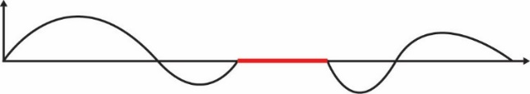

Method: Experiment 1a
In the same order as in the list (from top to bottom)?
1000 ms
Order
Encoding
4000ms
SOLEIL
MAISON
arbre
maison
soleil
or
table
Item
or
SAISON
SOLEIL
Attentional control secondary task during encoding
In the list?
Low attentional control
Hz
Time
High attentional control
+
Detect stabilizations

Slide 13
Method: Experiment 1b
Maintenance
(only 1b)
In the same order as in the list (from top to bottom)?
1000 ms
Order
Encoding
4000ms
SOLEIL
MAISON
arbre
maison
soleil
or
table
Item
or
4000ms
SAISON
SOLEIL
Attentional control secondary task during maintenance
In the list?
Low attentional control
Hz
Time
High attentional control
Detect stabilizations
+

Slide 14
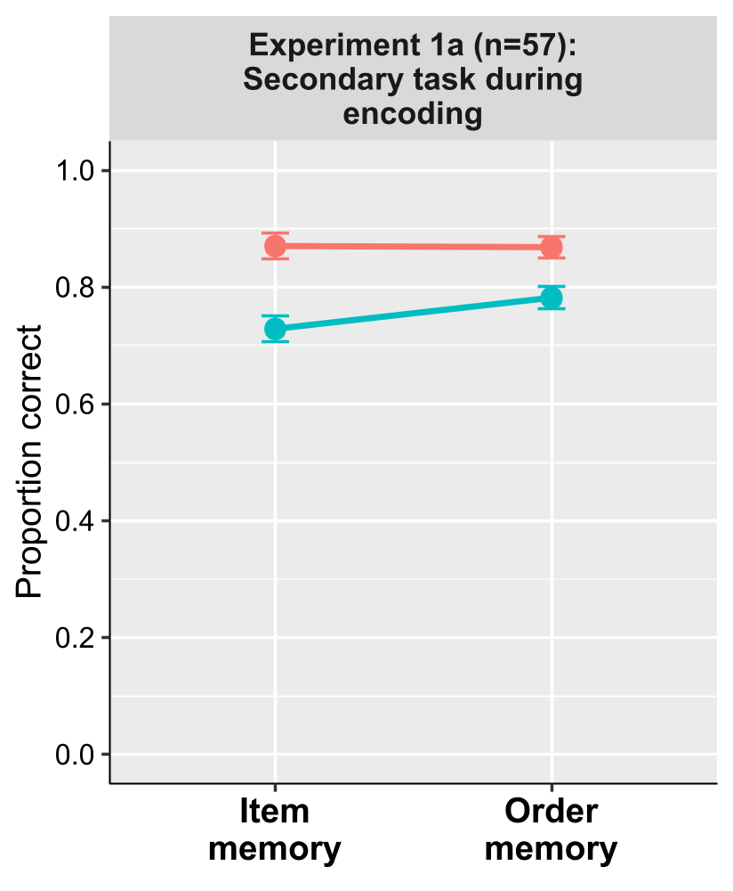
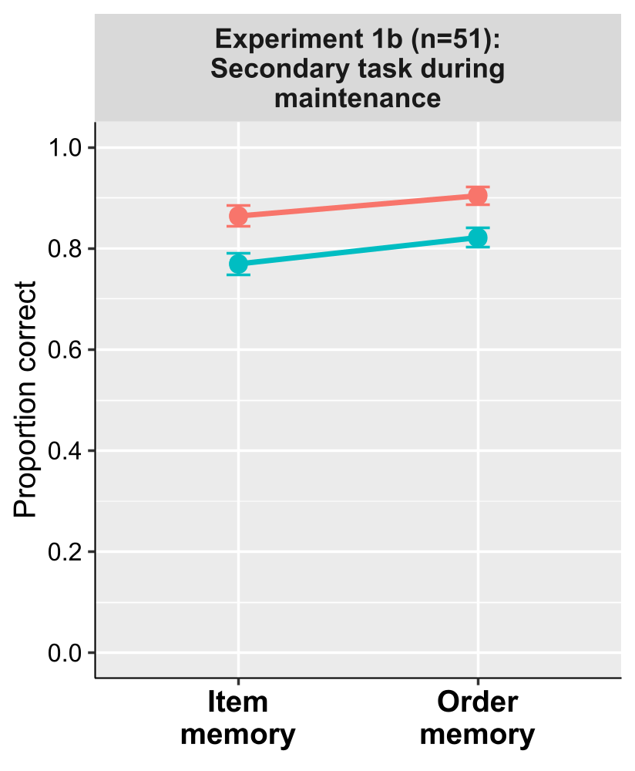
Results: Experiments 1a and 1b
Attentional control*memory type
No conclusive support for interaction
Attentional control*memory type
BF01 = 1.025
Attentional control*memory type
BF01 = 1.766
Note: The Bayes factor was calculated by comparing the best model with the model of interest.

Slide 15
Discussion: Experiments 1a and 1b
Contrary to the results of Guitard et al. (2021), no interaction between attentional control and memory type
- Item and order memory are equally impacted by attentional control

Slide 16
Method: Experiment 2a
Encoding
4000ms
arbre
maison
soleil
table
?
Recall all words in order
Attentional control secondary task during encoding
Low attentional control
Hz
Time
High attentional control
+
Detect stabilizations

Slide 17
Method: Experiment 2b
Maintenance
(only 2b)
Encoding
4000ms
arbre
maison
soleil
table
?
4000ms
Recall all words in order
Attentional control secondary task during maintenance
Low attentional control
Hz
Time
High attentional control
+
Detect stabilizations

Slide 18
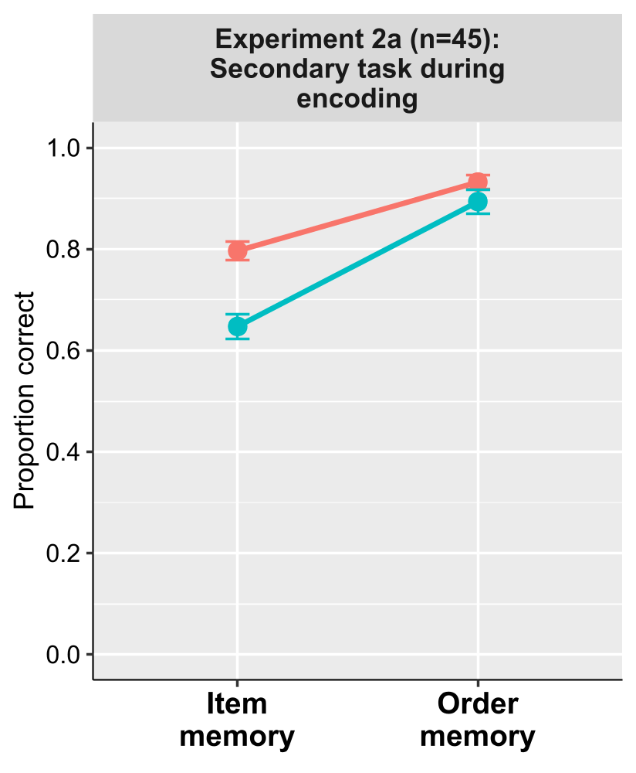
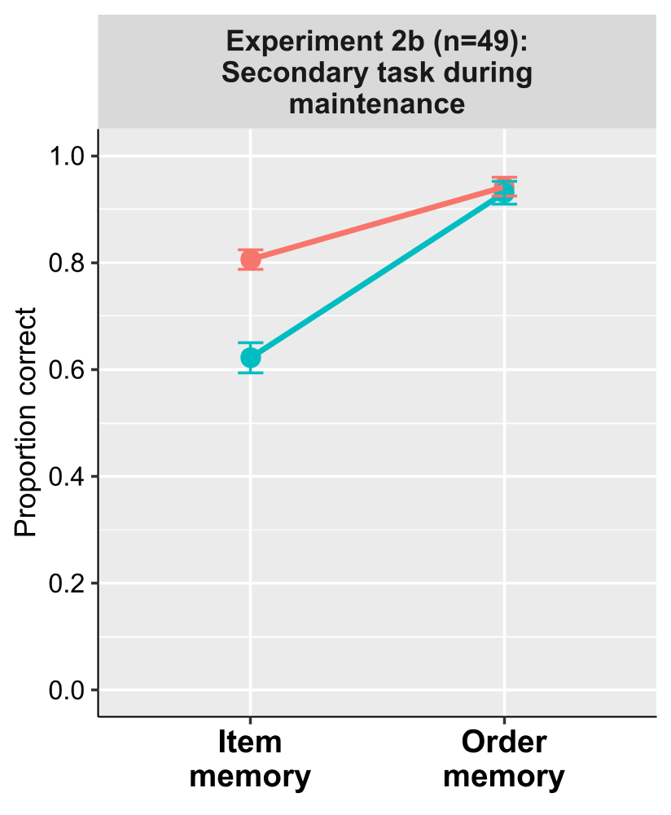
Results: Experiments 2a and 2b
Attentional control*memory type
Very strong support for interaction
but with item memory being more
sensitive to attentional control
Attentional control*memory type
BF10 = 87.785
Attentional control*memory type
BF10 > 100
Note: The Bayes factor was calculated by comparing the best model with the model of interest.

Slide 19
Discussion: Experiments 2a and 2b
Strong interaction between attentional control and memory type
Item memory being more impacted by attentional control but very little order error (ceiling effect) compared to item error
Removable interaction

Slide 20
Method: Experiments 1c
In the same order as in the list (from top to bottom)?
1000 ms
Order
Encoding
5000ms
REPAS
MAGIE
lunette
magie
repas
or
papier
espace
Item
or
REPAS
SOLEIL
Attentional control secondary task during encoding
In the list?
Low attentional control
Hz
Time
High attentional control
+
Detect stabilizations

Slide 21
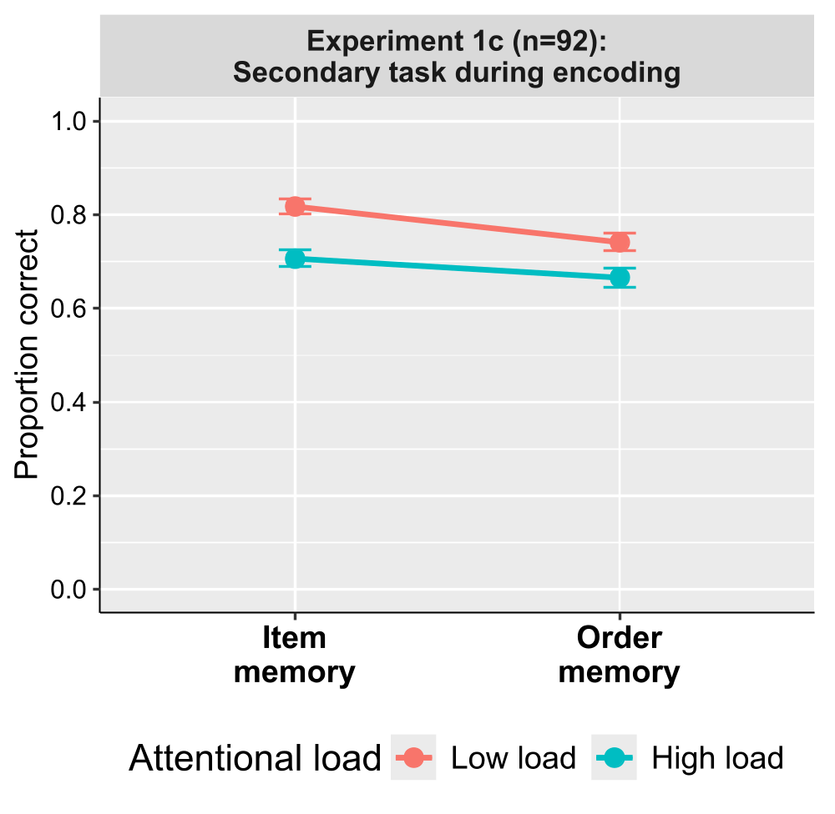
Results: Experiments 1c
Attentional control*memory type
Moderate support for interaction
but with item memory being more
sensitive to attentional control
Attentional control*memory type
BF10 = 6.655
Note: The Bayes factor was calculated by comparing the best model with the model of interest.

Slide 22
Discussion: Experiments 1c
Moderate interaction between attentional control and memory type
Item memory more impacted by attentional control, even if order memory has globally more error

Slide 23
General discussion
Why didn’t we observe the same effect as Guitard et al. (2021)?
The strategic aspect of the task of Guitard's study
No direct manipulation of the attentional control in Guitard's study
Item condition seems easier than the order condition (item recognition vs. order reconstruction)

Slide 24
Conclusion
Across 5 experiments, we never found evidence for a larger effect of attentional control on order.
If anything, there was a higher attentional cost for item WM
Future perspectives for serial order representation:
- Attentional cost theories show limited potential
- Temporal and spatial codes as more promising alternatives

Slide 25
Thank you for your attention !

Slide 26
References
Crowder, R. G. (1979). Similarity and Order in Memory1. In G. H. Bower (Éd.), Psychology of Learning and Motivation (Vol. 13, p. 319‑353). Academic Press. https://doi.org/10.1016/S0079-7421(08)60086-9
Guitard, D., Saint-Aubin, J., & Cowan, N. (2021). Asymmetrical interference between item and order information in short-term memory. Journal of Experimental Psychology: Learning, Memory, and Cognition, 47(2), 243.
Hulme, C., Roodenrys, S., Schweickert, R., Brown, G. D. A., Martin, S., & Stuart, G. (1997). Word-frequency effects on short-term memory tasks : Evidence for a redintegration process in immediate serial recall. Journal of Experimental Psychology: Learning, Memory, and Cognition, 23(5), 1217‑1232. https://doi.org/10.1037/0278-7393.23.5.1217
Hulme, C., Stuart, G., Brown, G. D. A., & Morin, C. (2003). High- and low-frequency words are recalled equally well in alternating lists : Evidence for associative effects in serial recall. Journal of Memory and Language, 49(4), 500‑518. https://doi.org/10.1016/S0749-596X(03)00096-2
Majerus, S., Norris, D., & Patterson, K. (2007). What does a patient with semantic dementia remember in verbal short-term memory? Order and sound but not words. Cognitive Neuropsychology, 24(2), 131‑151. https://doi.org/10.1080/02643290600989376

