Slide 1
Disclosures
Disclosures
No relevant disclosure to display.
No use of AI for this slideshow.
The author is not an historian…!

Slide 2
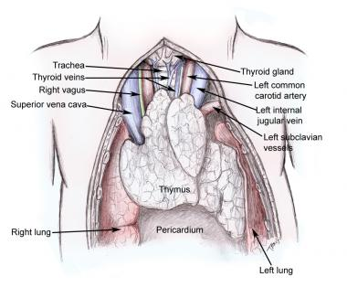




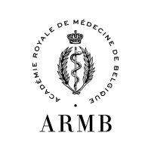

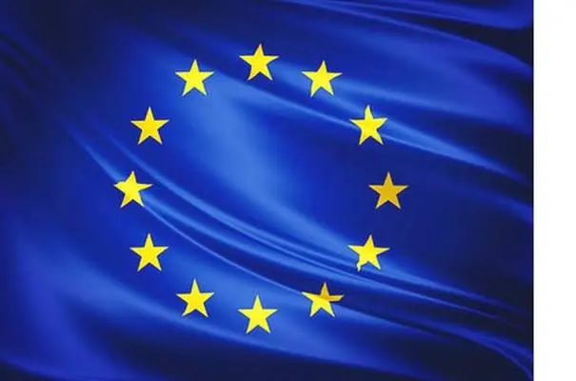
History of the thymus:
From a vestigial organ to the unique orchestrator of central self-tolerance to neuroendocrine principles
Clark T. Sawin Memorial History of Endocrinology Lecture
Prof. Vincent GEENEN, MD, PhD
Member of the Royal Academy of Medicine of Belgium (ARMB)
Research director emeritus of the Belgian Fund of Scientific Research
Professor emeritus at the University of Liège, Belgium
Past Head of Clinics in Endocrinology at the University Hospital of Liège, Belgium
Scientia optimum
GIGA-I³ Center of Immunoendocrinology
Notes:
Bonsoir à toutes et tous. Je souhaite d’abord vous dire que je suis extrêmement heureux de ma trouver ce soir devant vous et je tiens à remercier de tout cœur les Amis de l’ULiège pour cette invitation qui m’honore. J’ai présenté diverses conférences au sein de mon institution chérie, sur le langage de la communication cellulaire, les cellules souches, le transhumanisme, les géants de la science en Outremeuse, la Fondation Léon Fredericq, la créativité dans les arts et la science, etc. Mais c’est bien la toute première fois que je vais avoir l’immense plaisir de vous entretenir de l’organe qui est l’objet de ma passion de médecin-chercheur depuis 35 ans, ce thymus dont on me disait qu’il était un simple vestige de l’évolution alors que j’étais étudiant en Médecine au début des années 80 et qui depuis s’est révélé essentiel tant pour notre santé que pour la survie des vertébrés. C’est donc bien une passion que je vais partager avec vous et mon premier souhait sera d’essayer de vous transmettre une large part de mon enthousiasme et de l’émerveillement qui colore ma vie depuis maintenant quelques années. Je vous prie dès lors aussi de vouloir bien m’excuser si une grande partie de cette conférence sera consacrée aux travaux que mon équipe de recherche et moi-même avons menés depuis 1985…

Slide 3

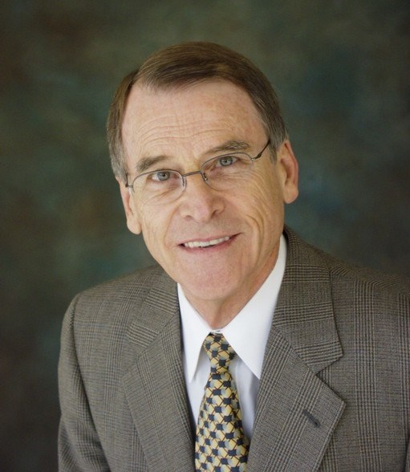
My tribute to Delbert A. Fisher
1928 – 2026
World-renowned pediatric endocrinologist for thyroid diseases in children (screening for congenital hypothyroidism).
Past Editor-in-Chief of JCEM and Metabolism & Pediatric Research.
Past President of the Endocrine Society (1983-1984).
Member of the US National Academy of Medicine (1988).
> 500 scientific papers and book chapters including the paper The use of thyroglobulin to induce antigenicity to small molecules (Journal of Laboratory and Clinical Medicine 1972). Coincidentallly, the very first paper I read and used to develop a specific radioimmunoassay of the nonapeptide Oxytocin (Acta Endocrinologica 1985).
Very poignantly, I received the Delbert A. Fisher Award on the very day of his passing, March 4th of this year.

Slide 4
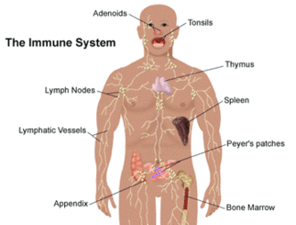
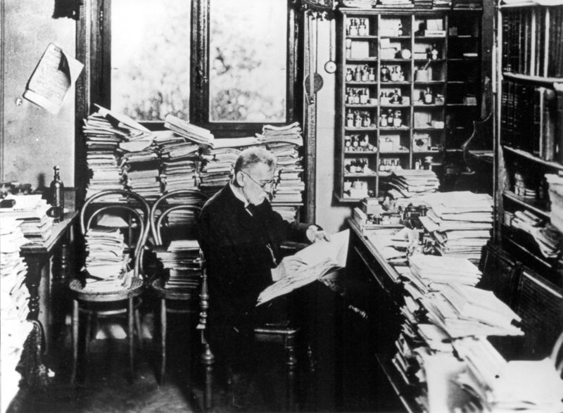
The immune system belongs to the body
Science (1985)
Paul Ehrlich (1854-1915)
First Textbook of Immunology (1899)
Nobel Prize 1908
A prediction by logical thinking
« Horror autotoxicus »
Two arms composed our system of immune defenses
Innate immunity
Adaptive immunity
Cellular immunity: T lymphocytes (thymus) – ±10¹⁸ TCR recombinations
Humoral immunity: B lymphocytes (bone marrow) – ±10¹³ BCR (Ig) recombinations

Slide 5
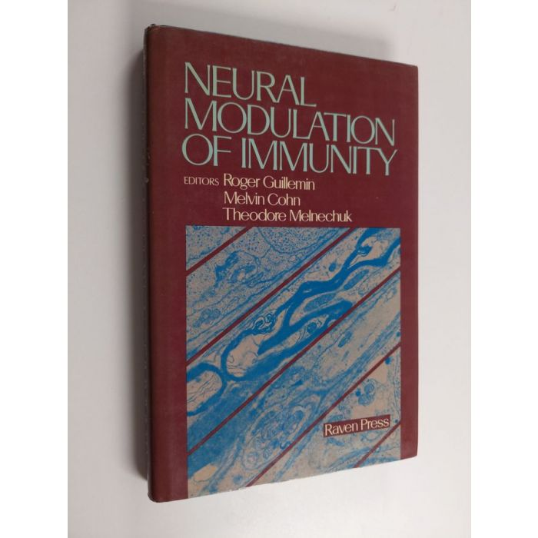
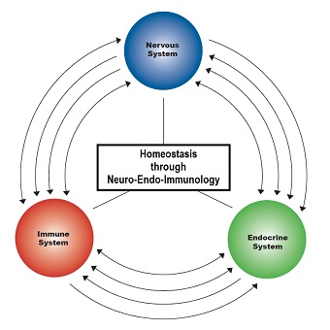
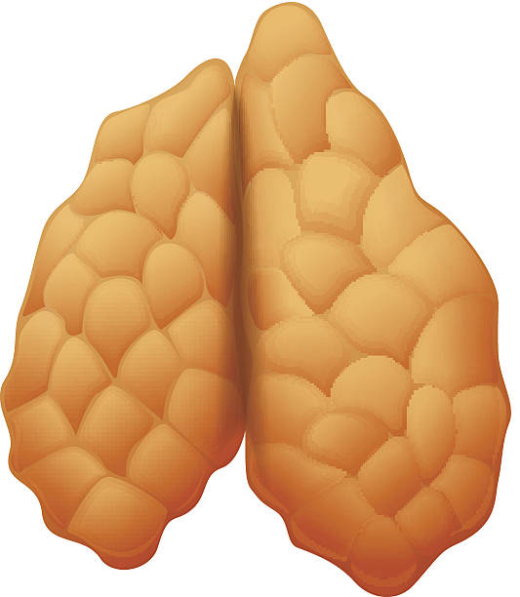
Reciprocal interactions between the three systems of cell-to-cell communication
Thymus
International Symposium under the auspices of the Foundation
Princess Lilian (Brussels, 1983)
Initial intuition
The thymus is a central intersection of
the three systems

Slide 6
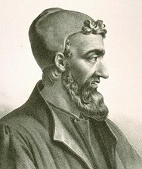
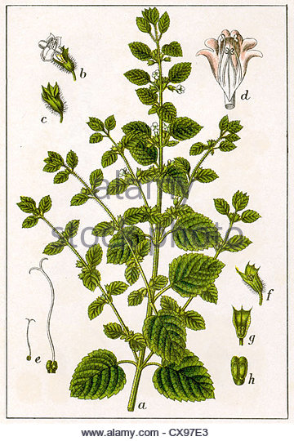
The moving place of the thymus in History
Discovery of the organ
Claude Galen(us) – 2nd father of Western medicine (129 – 210 AD)
Born in Pergamon (Asia Minor) but operated mainly in Antique Rome.
Reported the resemblance of the thymus with the leaf of Thymus cunila.
Galen viewed the thymus as a cushion for protection of truncal vessels.
He had already noticed that thymus volume diminishes with age.

Slide 7
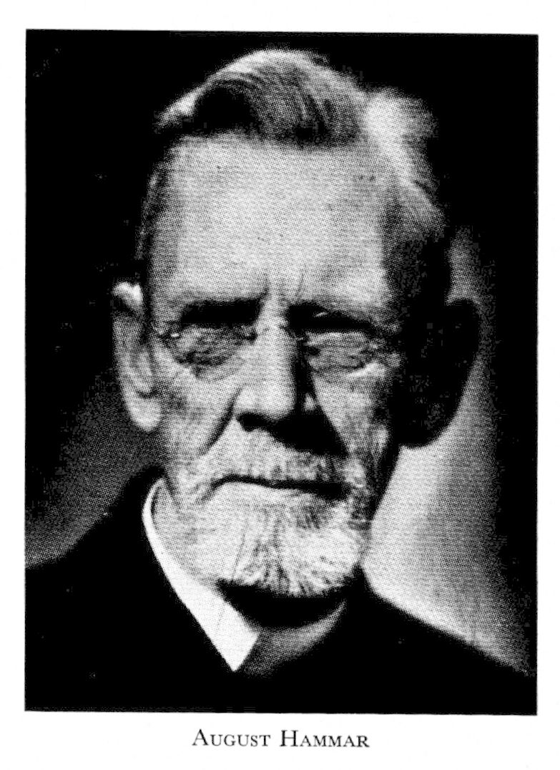
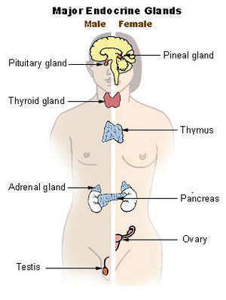
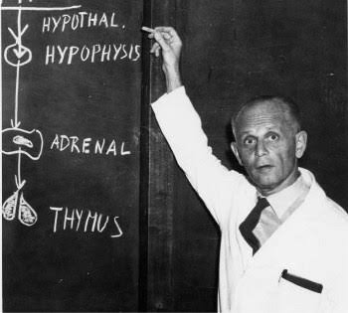
The moving place of the thymus in History
J August Hammar (Sweden) Endocrinology (1921)
Major observations:
To talk about involution of the thymus after puberty is not correct.
Thymus hyperplasia in Graves’ and Addison’s diseases, acromegaly, myasthenia gravis and after orchidectomy.
Thymus involution in pregnancy, undernourishment and several infectious diseases.
All these observations are still correct today!
The thymus was then considered as an endocrine gland.
Hans Selye (Austria – Canada)
Stress (or alarm reaction) stimulates the hypothalamic-pituitary-adrenal (HPA) axis and induces thymus involution together with adrenal hypertrophy (1946).

Slide 8
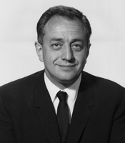
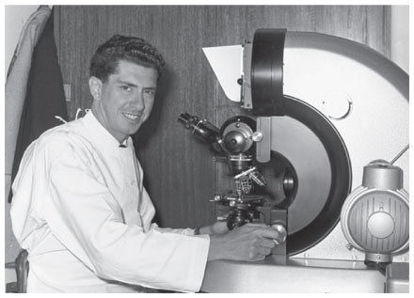
The moving place of the thymus in History
Scientific breakthroughs
Robert A. Good
USA
1922-2003
Jacques FAP Miller
France – Australia
1931 -
In 1962, using thymectomy, they independently demonstrated the importance of the thymus in immune development and function: generation of thymo-dependent (T) cells, production of antibodies, graft rejection and resistance to infections.
Good performed pioneering studies of primary immune deficiencies. The Good syndrome associates thymoma, severe immunodeficiency and some autoimmune manifestations.
In 1968, Good led the team that performed the first successful bone marrow transplantation.
Miller advanced the hypothesis of thymic-specific ‘hormones’, which was not confirmed beyond any doubt.
Never again the thymus will be considered an endocrine gland!

Slide 9
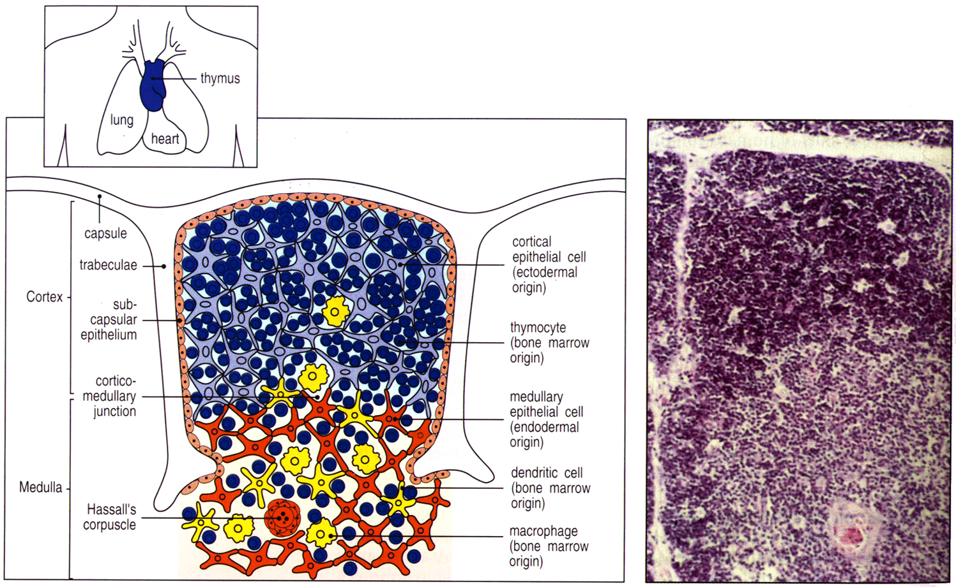
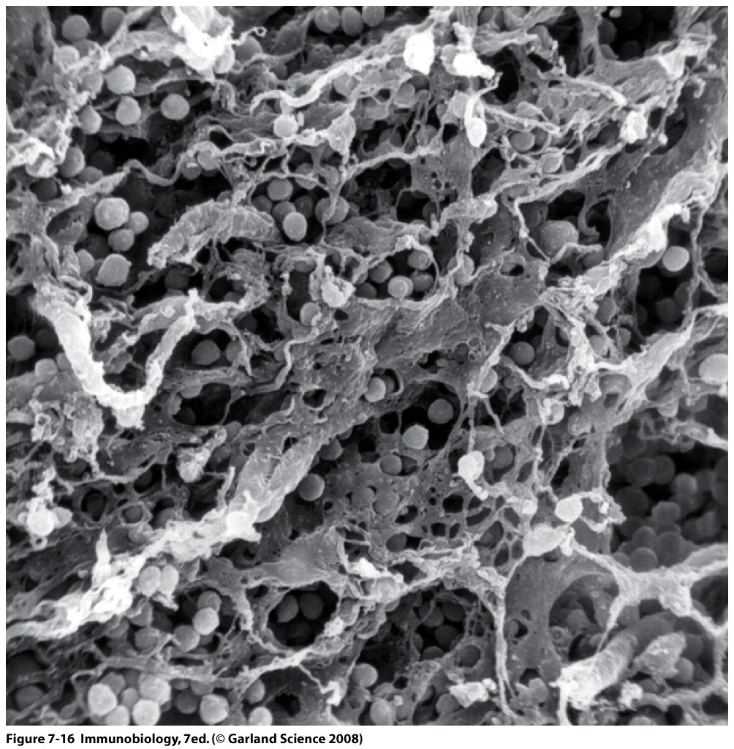
Thymic microenvironment
Development and structure
Stromal cells
Cortical epithelial cells (cTECs)
Medullary epithelial cells (mTECs)
Both derive from the 3rd pharyngeal pouch endoderm
Induction +++ by the mesenchyme derived from the cephalic neural crest (DiGeorge syndrome)
Migratory cells
Dendritic cells (DCs)
Macrophages (Mφ)
Developing T cells (thymocytes) from fetal liver then bone marrow
Scanning electron micrograph
Extensive network of TECs with small pre-T cells
FOXN1/foxn1^{-/-} « nude » mouse
from bone marrow

Slide 10
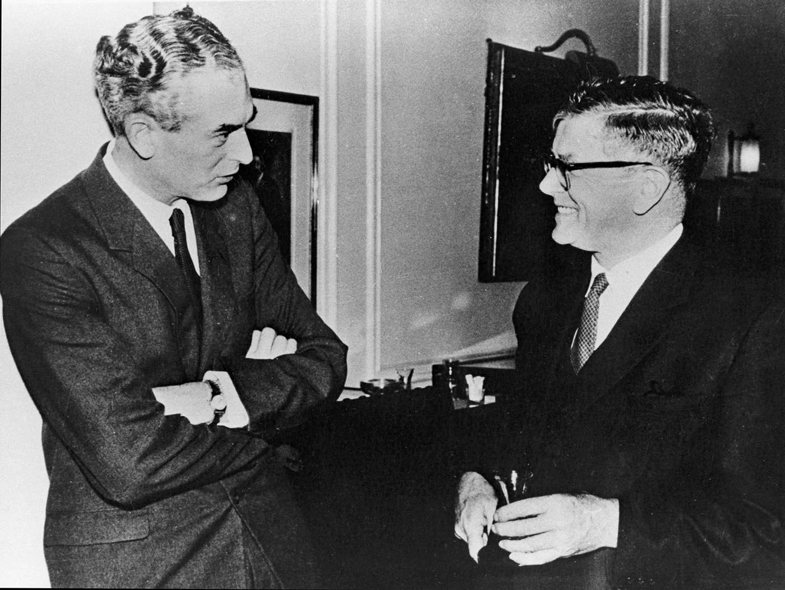
Peter Medawar (UK) and Frank Macfarlane Burnet (Australia)
(Nobel Prize 1960 in physiology or medicine for their discovery of acquired immune tolerance)
An ‘argument of authority’
“ We shall come to regard the presence of lymphocytes in the vestigial thymus as an evolutionary accident of no very great significance.”
Sir Peter MEDAWAR (1963)
In marked contrast, an immortal prophecy
“ If, as I think, the thymus is the place where occur proliferation and differentiation of lymphocytes with precise immunological functions, we have to consider another function – the elimination of lymphocytes with reactivity to self, the ‘forbidden clones’.
I predict that a failure of this process will be responsible for the initiation of autoimmune diseases.”
Sir Frank Macfarlane BURNET, University of London (1962)

Slide 11
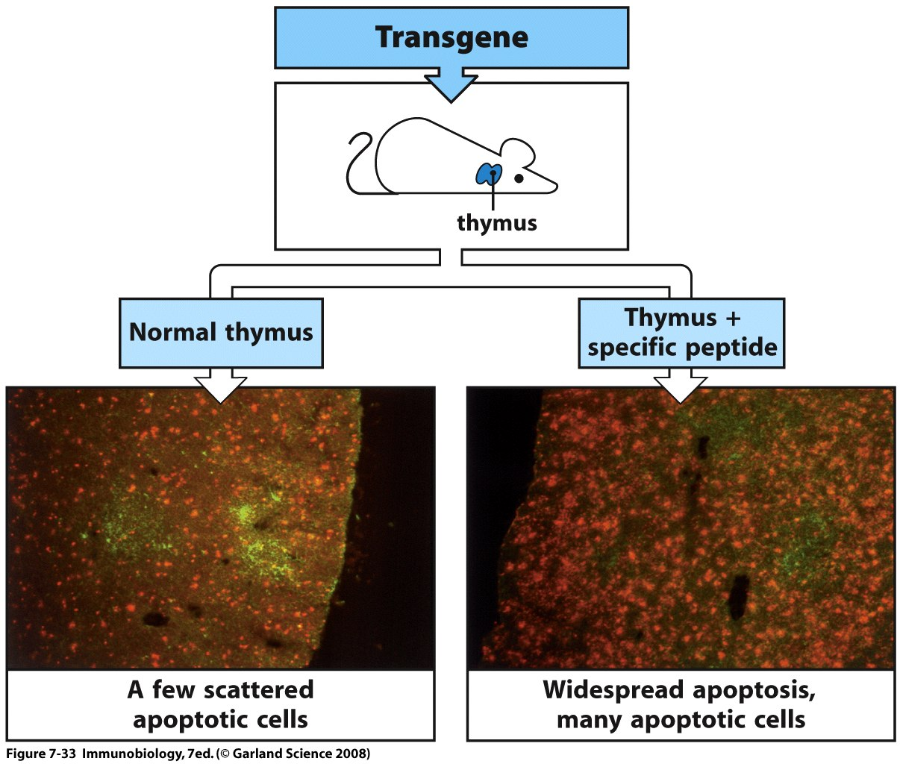
Central self-tolerance in the thymus
Negative selection of self-reactive (forbidden) T-cell clones
Full demonstration by four seminal works
Ohki H, Martin C, Corbel C, Coltey M & Le Douarin NM Science (1987)
Kappler JW, Roehm N & Marrack P Cell (1987)
MacDonald HR, Schneider R, Lees RK, Acha-Orbea H, Zinkernagel R & Hengartner H Nature (1988)
Kisielow P, Bluethmann H, Staerz UD, Steinmetz M & von Boehmer H Nature (1988)

Slide 12
The thymus is a cemetery for early T cells
Cortical TEC
Thymic Nurse Cell
(TNC)
Subcapsular T blasts
Multiplication +++
CORTEX
Small cortical T cells
Macrophage
100 hematopoietic T progenitors (from fetal liver then bone marrow)
Macrophage
MEDULLA
Medullary TEC
Medullary T cells
Dendritic cell
TEC
MHC
?
Self-antigen
Emigration of self-tolerant and competent naïve CD4/CD8 T + tTreg cells (only 2-5%)
TCR
T
Negative selection of self-reactive T cells during fetal life (recessive tolerance)
Generation of self-specific tTreg cells after birth (dominant tolerance)

Slide 13
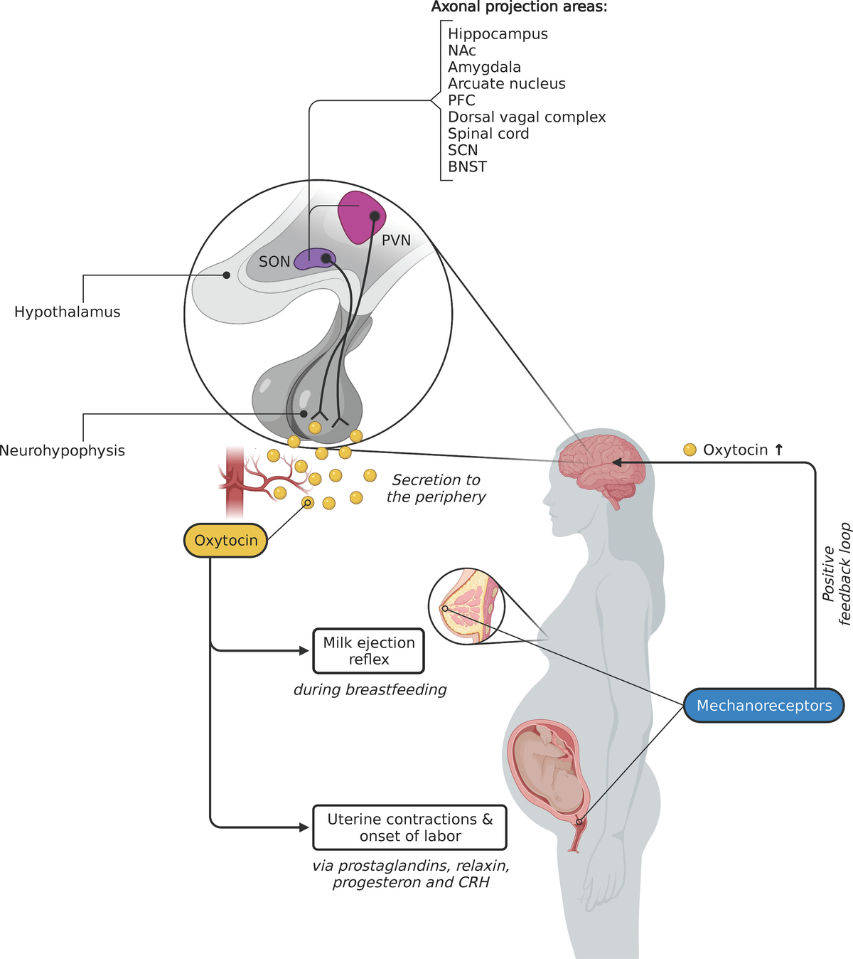
Oxytocin (OT), the ‘love’ neurohormone
OT is also a neuropeptide implicated in
several higher cognitive functions
Maternal behavior
Social bonding & affiliation
Anxiolytic & stress reduction
Social cognition, trust & empathy
Memory & learning
Reward system
First peptide hormone identified in 1952 by Vincent du Vigneaud (Nobel Prize 1955)

Slide 14
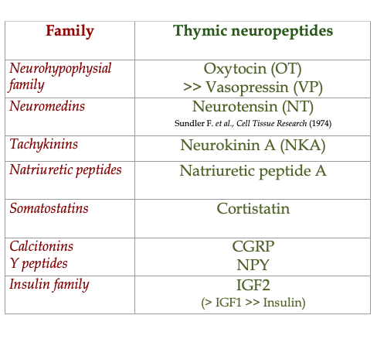
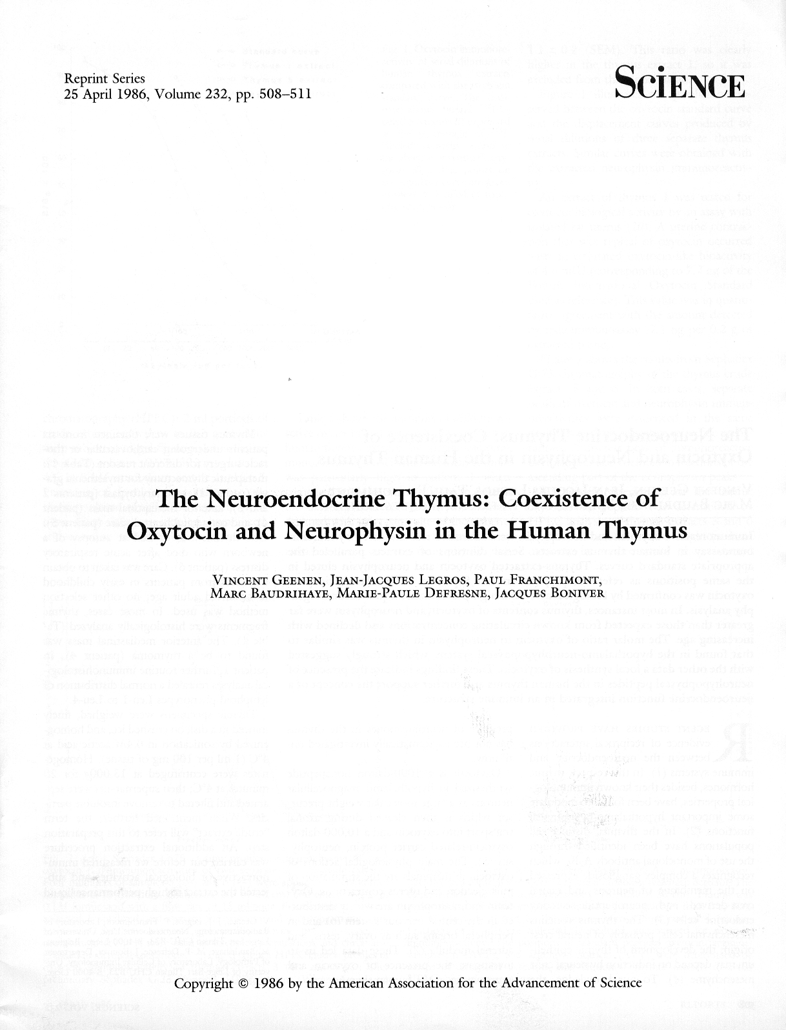
The repertoire of neuropeptides synthesized in the thymus
Ott I & Scott JC
The galactagogue action of the thymus and corpus luteum
Proc Soc Exp Biol Med (1910)
A principle of biological parsimony in the organization of this repertoire:
One dominant member per family
Ericsson AE, Geenen V et al., Molecular Endocrinology (1990)
Martens H, Goxe B & Geenen V, Immunology Today (1996)
Geenen V, Journal of Neuroendocrinology (1998)

Slide 15
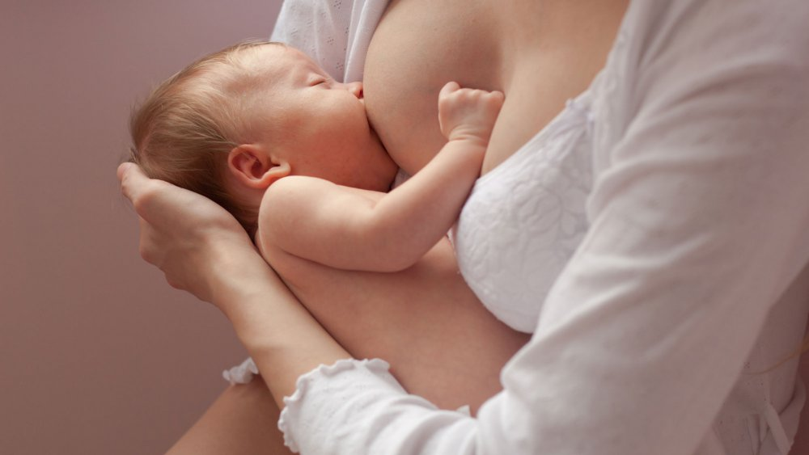
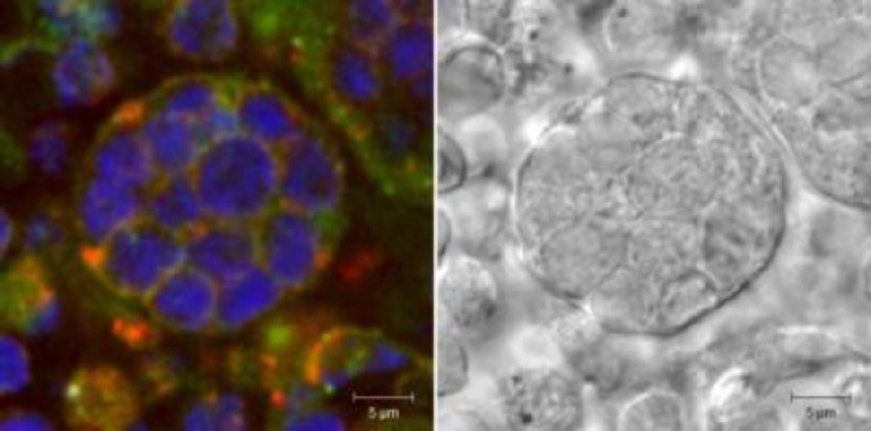
Metaphorical analogy of OT nursing functions
OT⁺ Thymic nurse cell (cTEC)
→ CD8+ T cell development
Geenen V et al., Neuroendocrinology (1988)

Slide 16
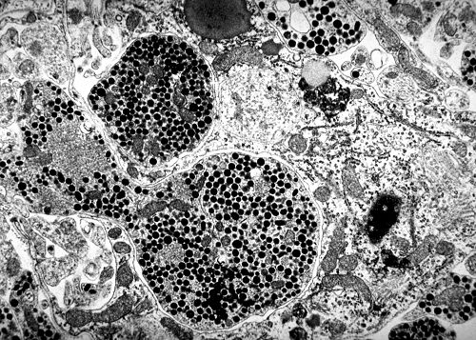
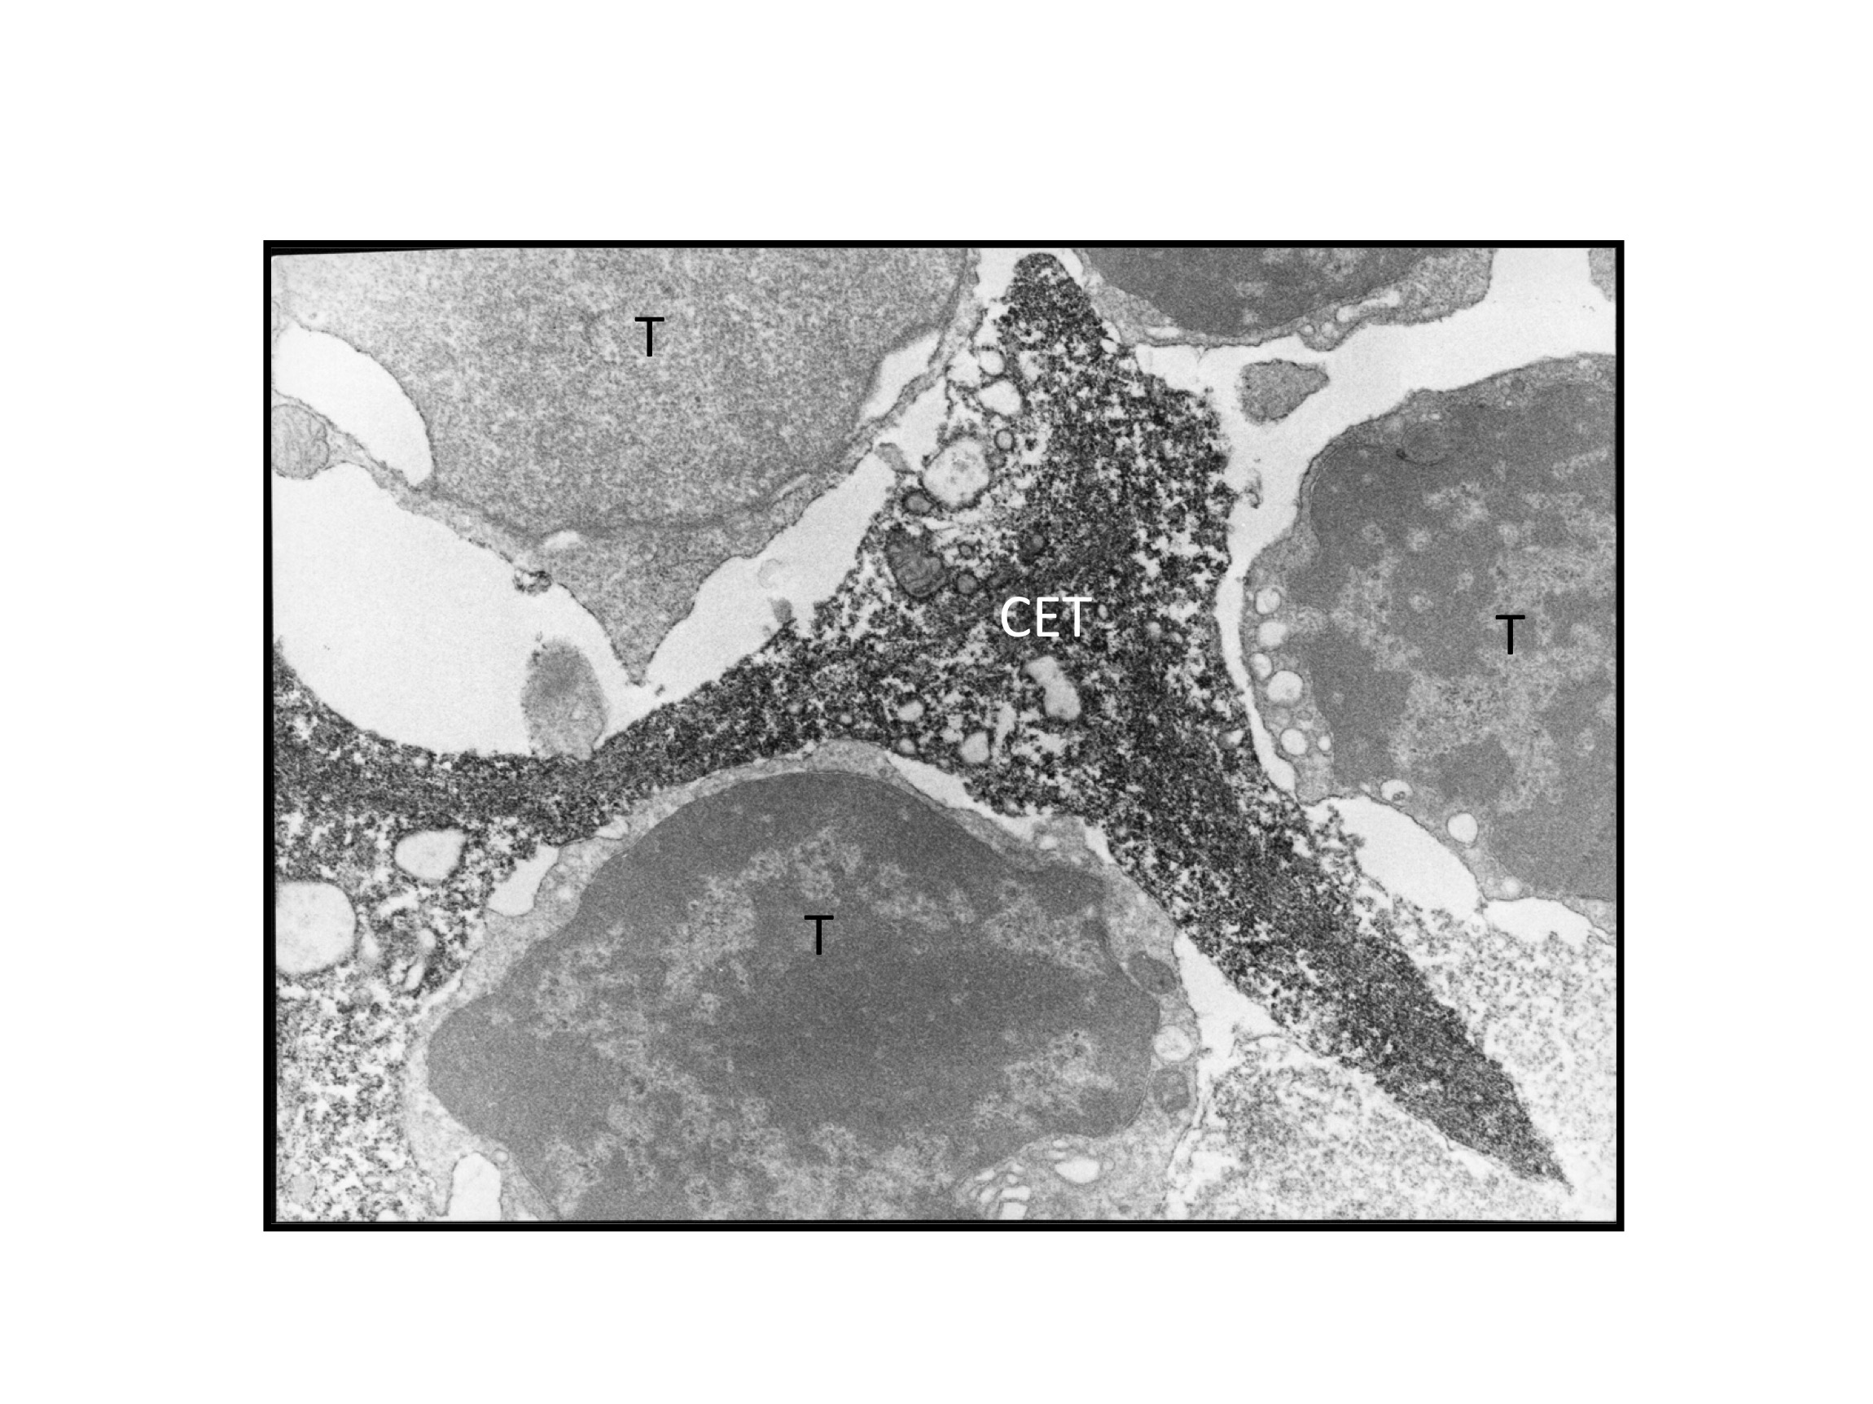
A major conceptual obstacle…
TEC
Neurohypophysis
OT was the very first basis for the model of neurosecretion
Ernst & Berta Scharrer (1920-1930)
Geoffrey Harris (1940-1950)
Vincent du Vigneaud (1952)
OT⁺ Thymic epithelial cell (TEC)
No secretory granules
No OT secretion by TECs in culture
“The essential is invisible for the eye”
(The Little Prince, Saint-Exupéry)
→ Cryptocrine signaling (John W. Funder, 1990)

Slide 17
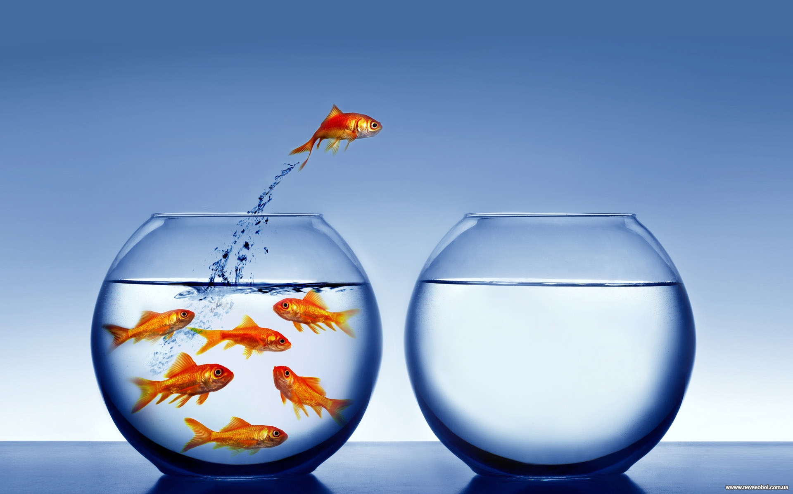
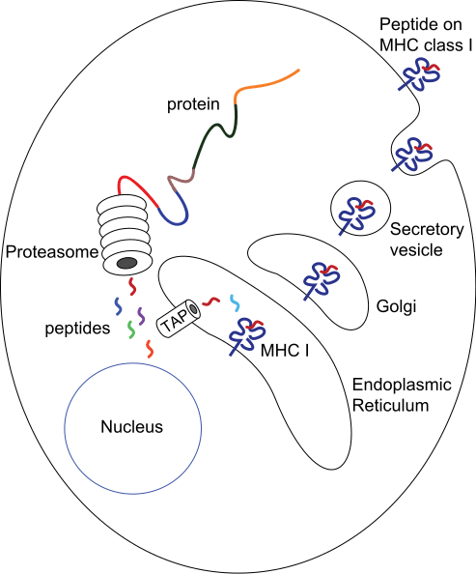
Outside the endocrine ‘fishbowl’ perspective
and immersing into the immunological thinking
Antigen presentation by MHC-I
Was this the case for thymic neuropeptides?

Slide 18
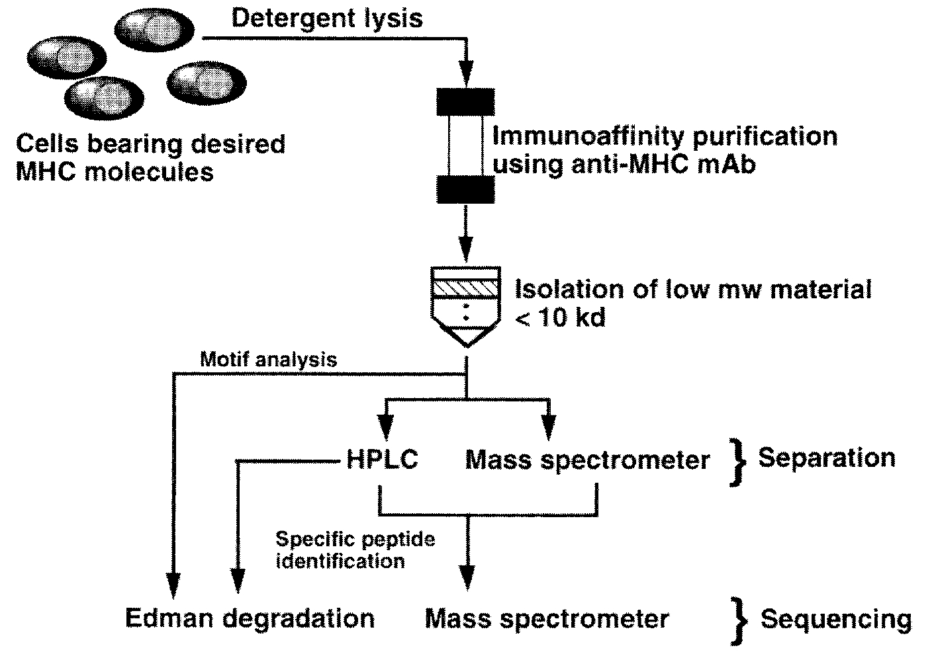
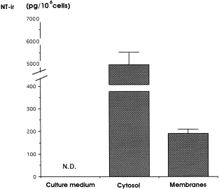
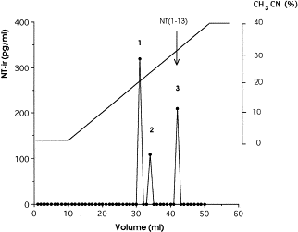
MHC-I presentation of neurotensin by human TECs
Neurotensin (NT) = Glu - Leu - Tyr - Glu - Asn - Lys - Pro- Arg -Arg - Pro - Tyr - Ile -Leu
= ELYENKPRRPYIL
Reference protocol by HG Rammensee et al., Nature (1991)
Human TEC membranes
Anti-MHC-I
Elution with diethylamine at basic pH
Vanneste Y et al., Journal of Neuroimmunology (1997)

Slide 19
A paradigm shift for thymic OT
From a neurohormone to the self-antigen of the neurohypophysial family
TEC
Thymic epithelial cell (TEC)
Presentation of OT by TECs to pre-T cells
(via a hybrid protein MHC I-Neurophysin)

Slide 20
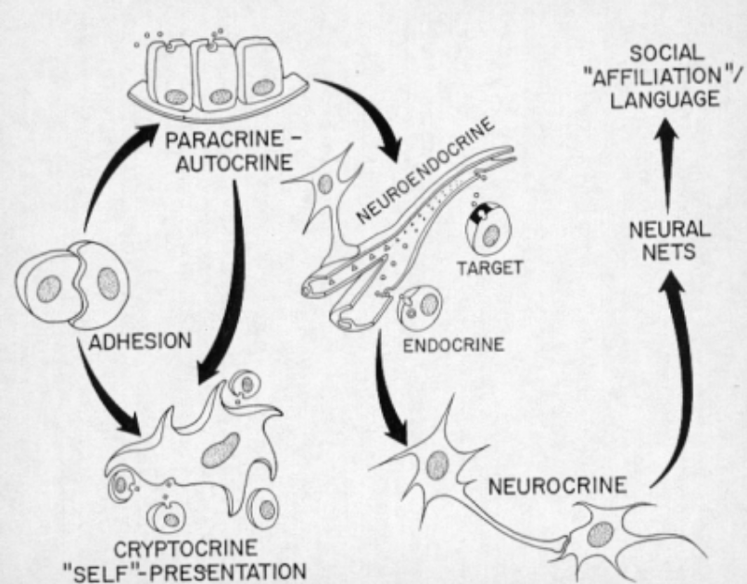
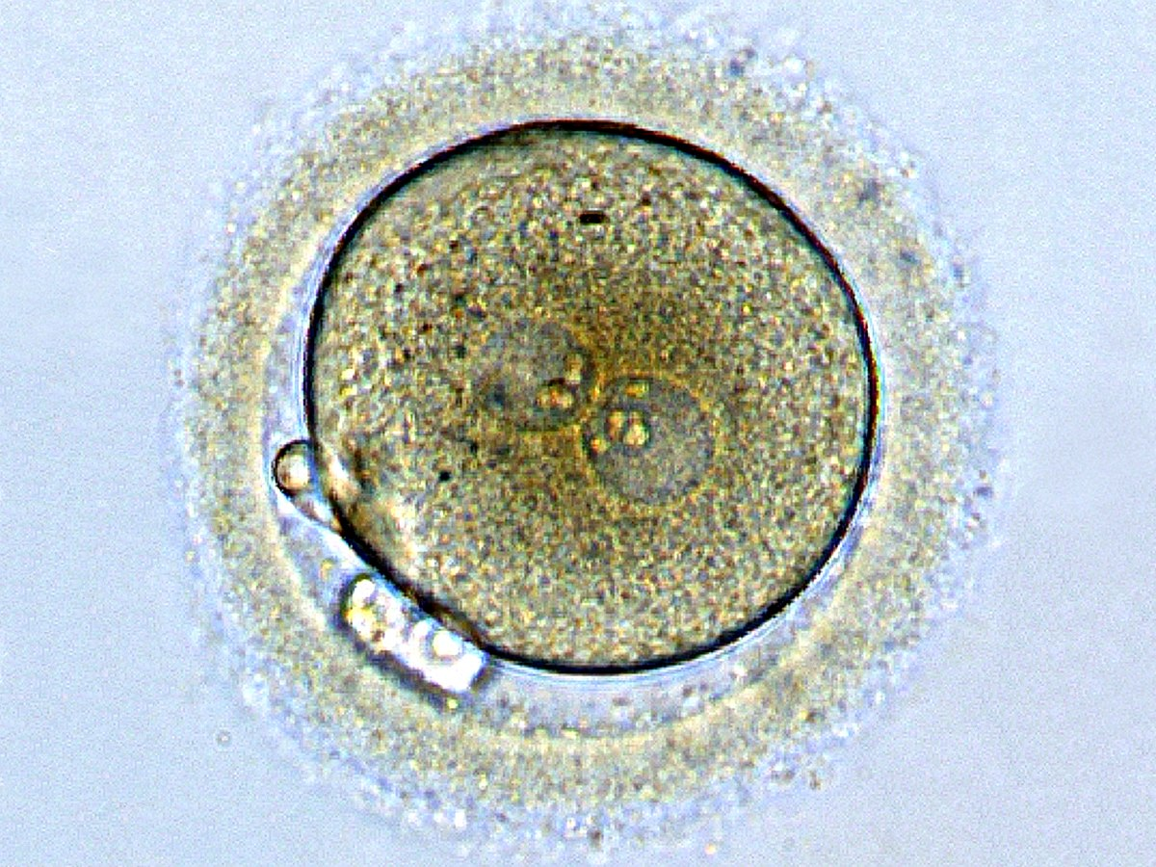
“Ontogeny recapitulates phylogeny”
Ernst HAECKEL (1834-1919)
The place of cryptocrine signaling / self-presentation in evolution and development of cellular communication (Evo-Devo conceptual approach)
Embryo
Fusion of pronuclei

Slide 21
The science of neuroendocrine self
Dominant member of a neuroendocrine family expressed in the thymus epithelium.
Conserved sequences during evolution of the family.
OT transcription in the thymus precedes brain expression.
No secretion but PRESENTATION by TECs in association with MHC.
Importance for species conservation
OT ☞ Reproduction while VP ☞ Water homeostasis and vascular tone
Tolerance to OT > VP
Importance for ontogeny
IGF-2 ☞ Fetal growth factor while Insulin ☞ Glucose metabolism
Tolerance to IGF-2 > Insulin
Geenen V et al., Journal of Molecular Medicine (1995)
Martens H, Goxe B & Geenen V, Immunology Today (1996)
Geenen V, Journal of Neuroendocrinology (1998)

Slide 22

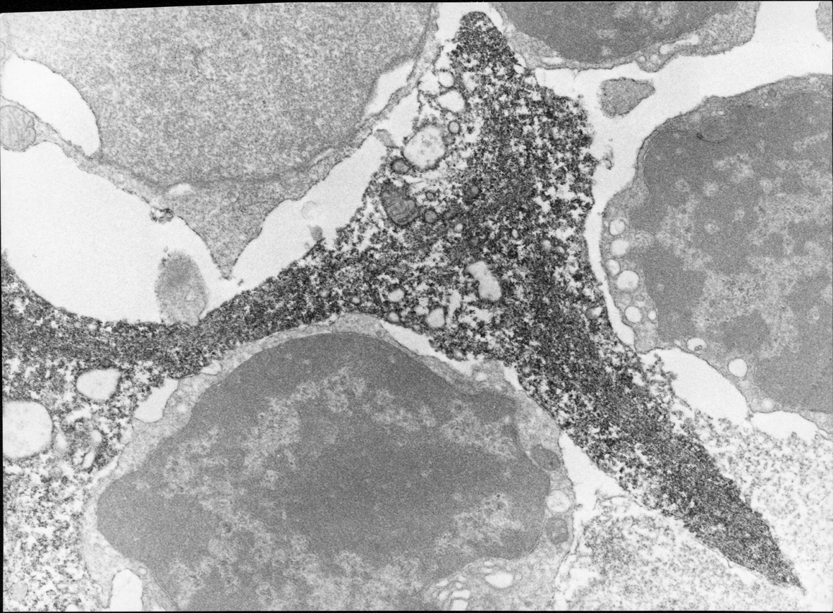
The dual role of thymic Pro-Oxyphysin
Thymic epithelial cell
(TEC) – FOXN1⁺
IP₃
OTR
+
Ligand OT
No secretion but contact
Kd = 10⁻¹⁰ - 10⁻¹¹ M
Low specificity
Tyr-FAK
Pro-Oxyphysin
(OT precursor)
MHC
Self-Ag OT
TCR
FOXP3⁺ tTreg
Focal adhesions/Immune synapses between OT⁺ TEC and thymocytes
-
+

Slide 23
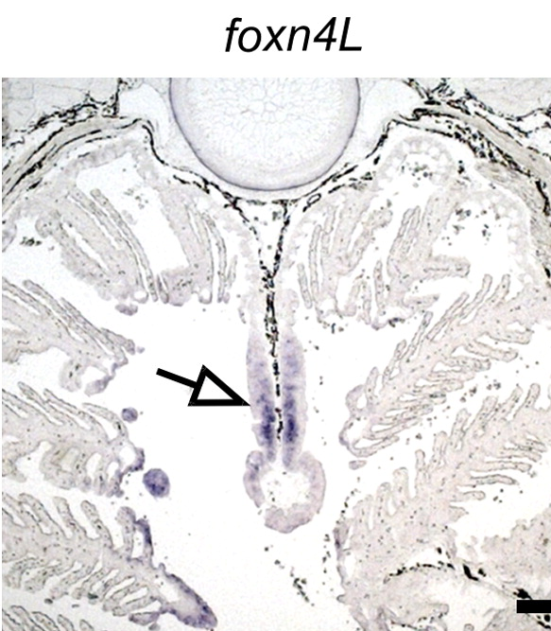
The fascinating beauty of evolution
Jawless vertebrates
(lampreys)
Invertebrates
Protochordates
Jawed vertebrates
(sharks, rays)
VCBP
VLR
Adaptive immunity
Ancestral forms of anticipative immunity
RAG1 & RAG2
450 Millions years
TCR diversity
10¹⁸ combinations
Major risk of autotoxicity!
BCR (Ig) diversity
Thymoïds (Foxn4)
Bajoghli B et al., Nature 2011
1st unique thymus (Foxn1)
Horror autoxicus
Innate immunity (Pattern recognition receptors including TLRs)
Neuroendocrine system
Geenen V, The Thymus and The Science of Self. Seminars in Immunopathology (2021)

Slide 24
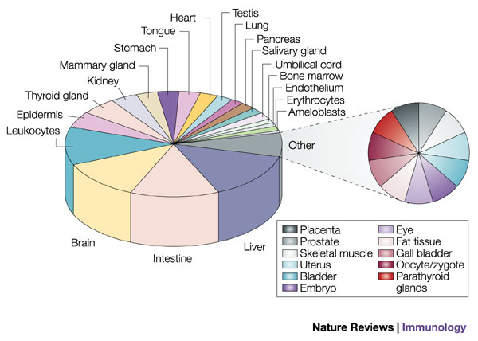
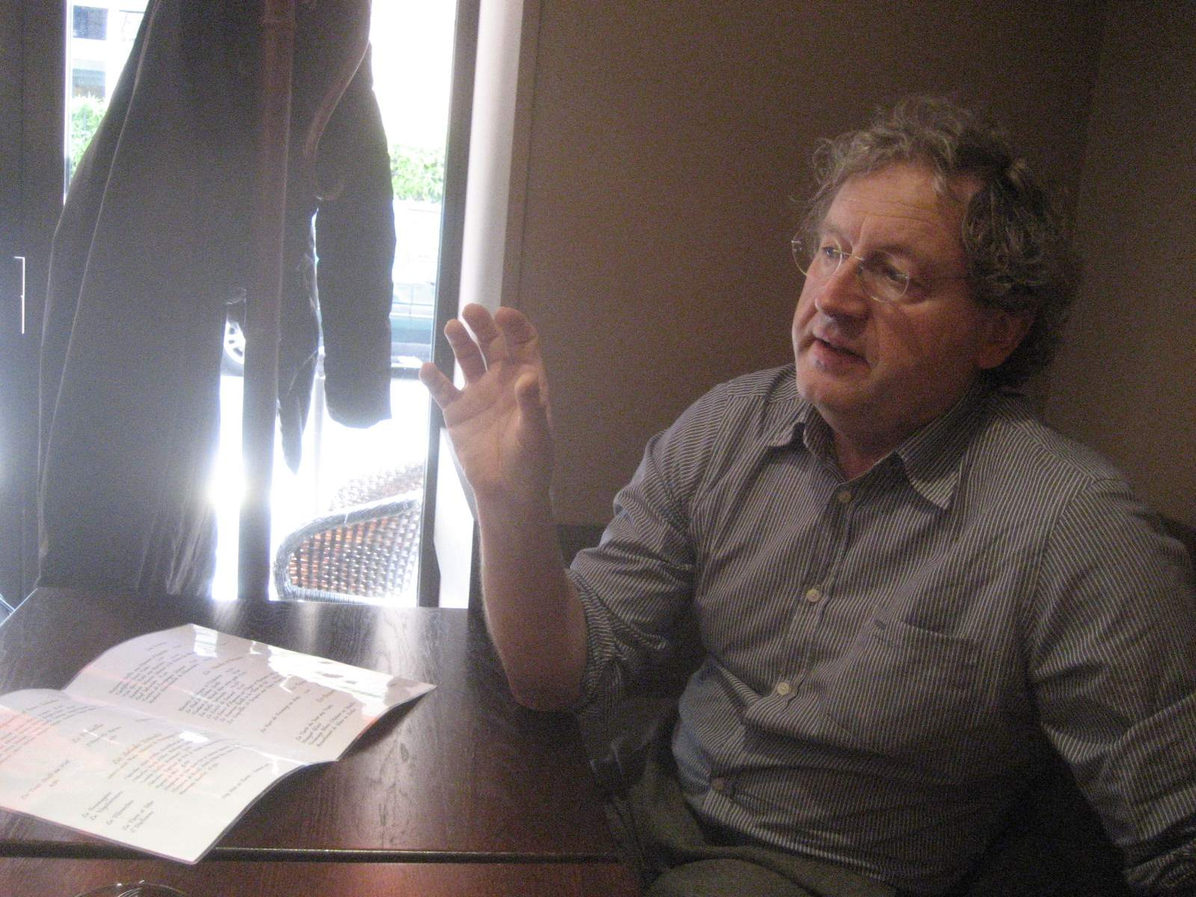
Promiscuous expression of many tissue-specific antigens (TSAs) in mTECs
Bruno KYEWSKI †
(DKFZ Heidelberg, 1950-2018)
Princess Lilian Chair at ULiège 2014-2015
Kyewski B & Derbinski J, Nature Reviews Immunology (2004)
Kyewski B & Klein L, Annual Reviews in Immunology (2006)

Slide 25

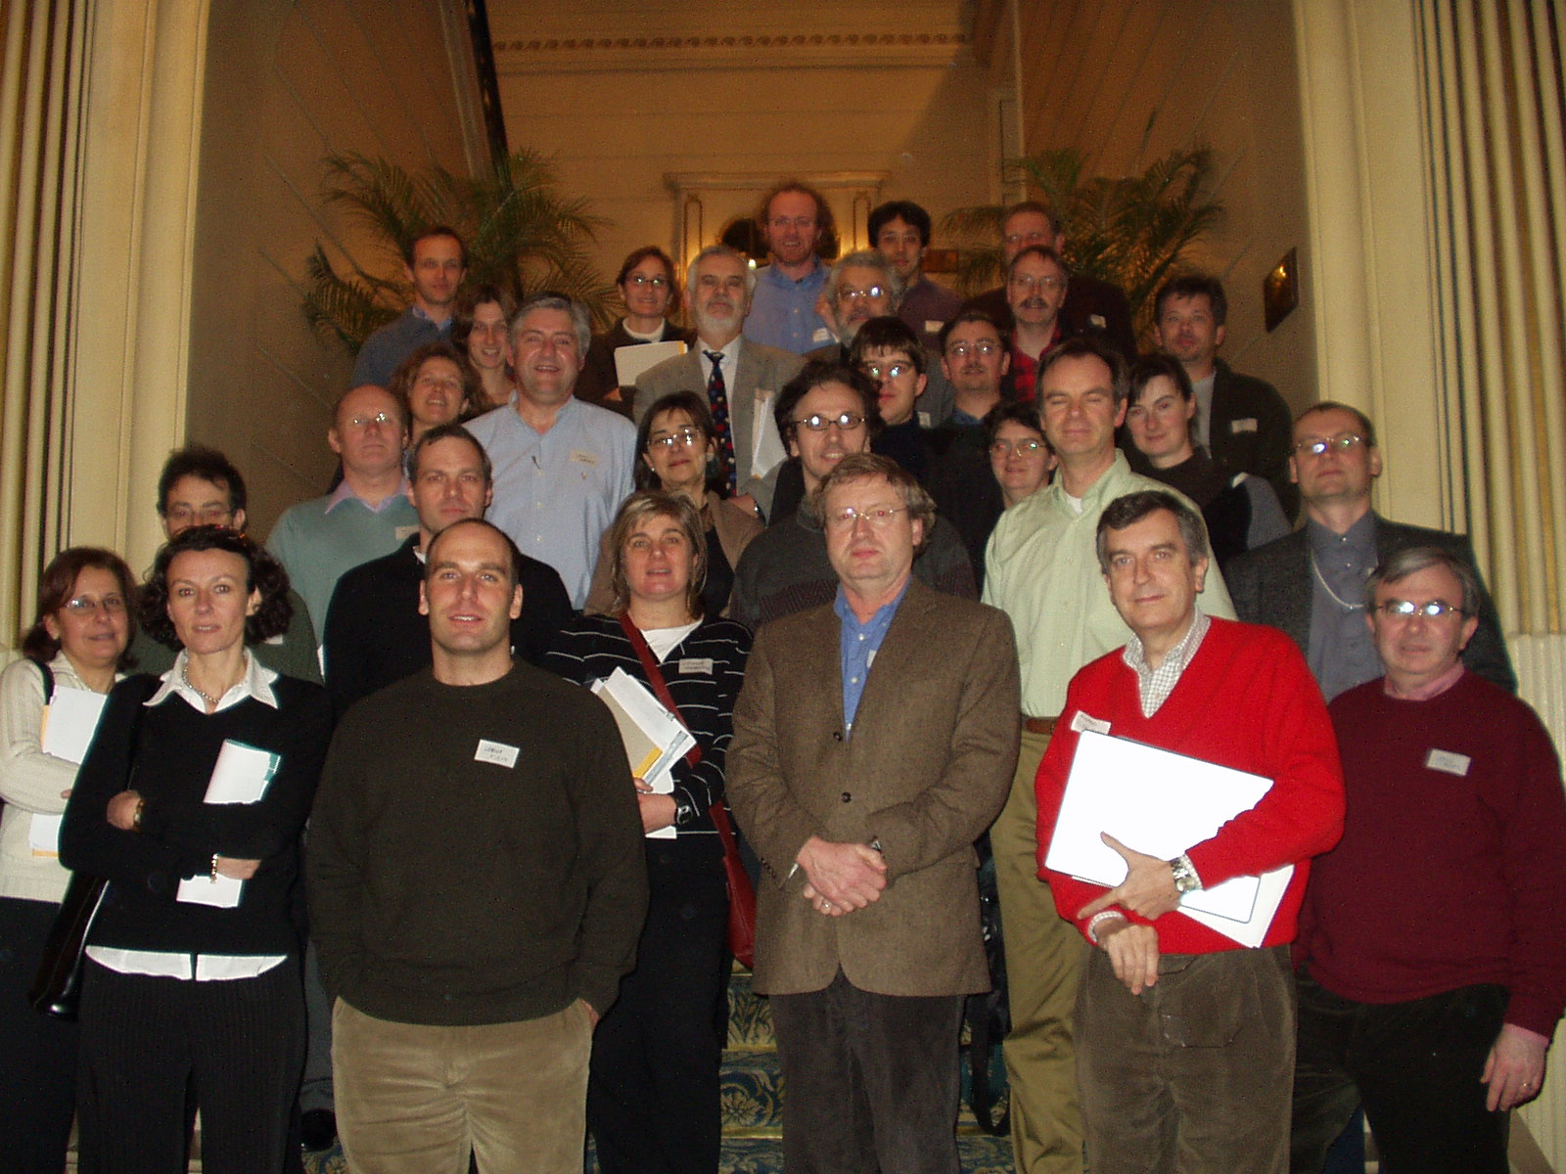
EU Integrated Project EURO-THYMAIDE (2004-2009)
Central objective of the Euro-Thymaide project:
Understanding the mechanisms underlying the development of autoimmune diseases,
by exploring the major biological functions of the thymus
Euro-Thymaide Consortium
20 European academic partners expert in thymology and 5 biotech companies
Coordination by the University of Liège

Slide 26
Genesis of autoimmunity:
A defect in the thymus programming of self-tolerance?

Slide 27

Expression of insulin-related genes in the thymus of diabetes-prone BB rats
Igf2 transcription is deficient in the thymus of 11/15 diabetes-prone BB rats
in correlation with incidence of diabetes (± 70%) in this rat strain
M
1
2
3
4
5
6
7
8
9
10
11
12
13
14
15
H2O
M
1000 bp
Actin
500 bp
600 bp
378 bp
Igf2
C
H2O
300 bp
213 bp
Igf1
150 bp
C
H2O
322 bp
Ins2
300 bp
Kecha-Kamoun O et al., Diabetes/Metabolism Research & Reviews (2001)

Slide 28
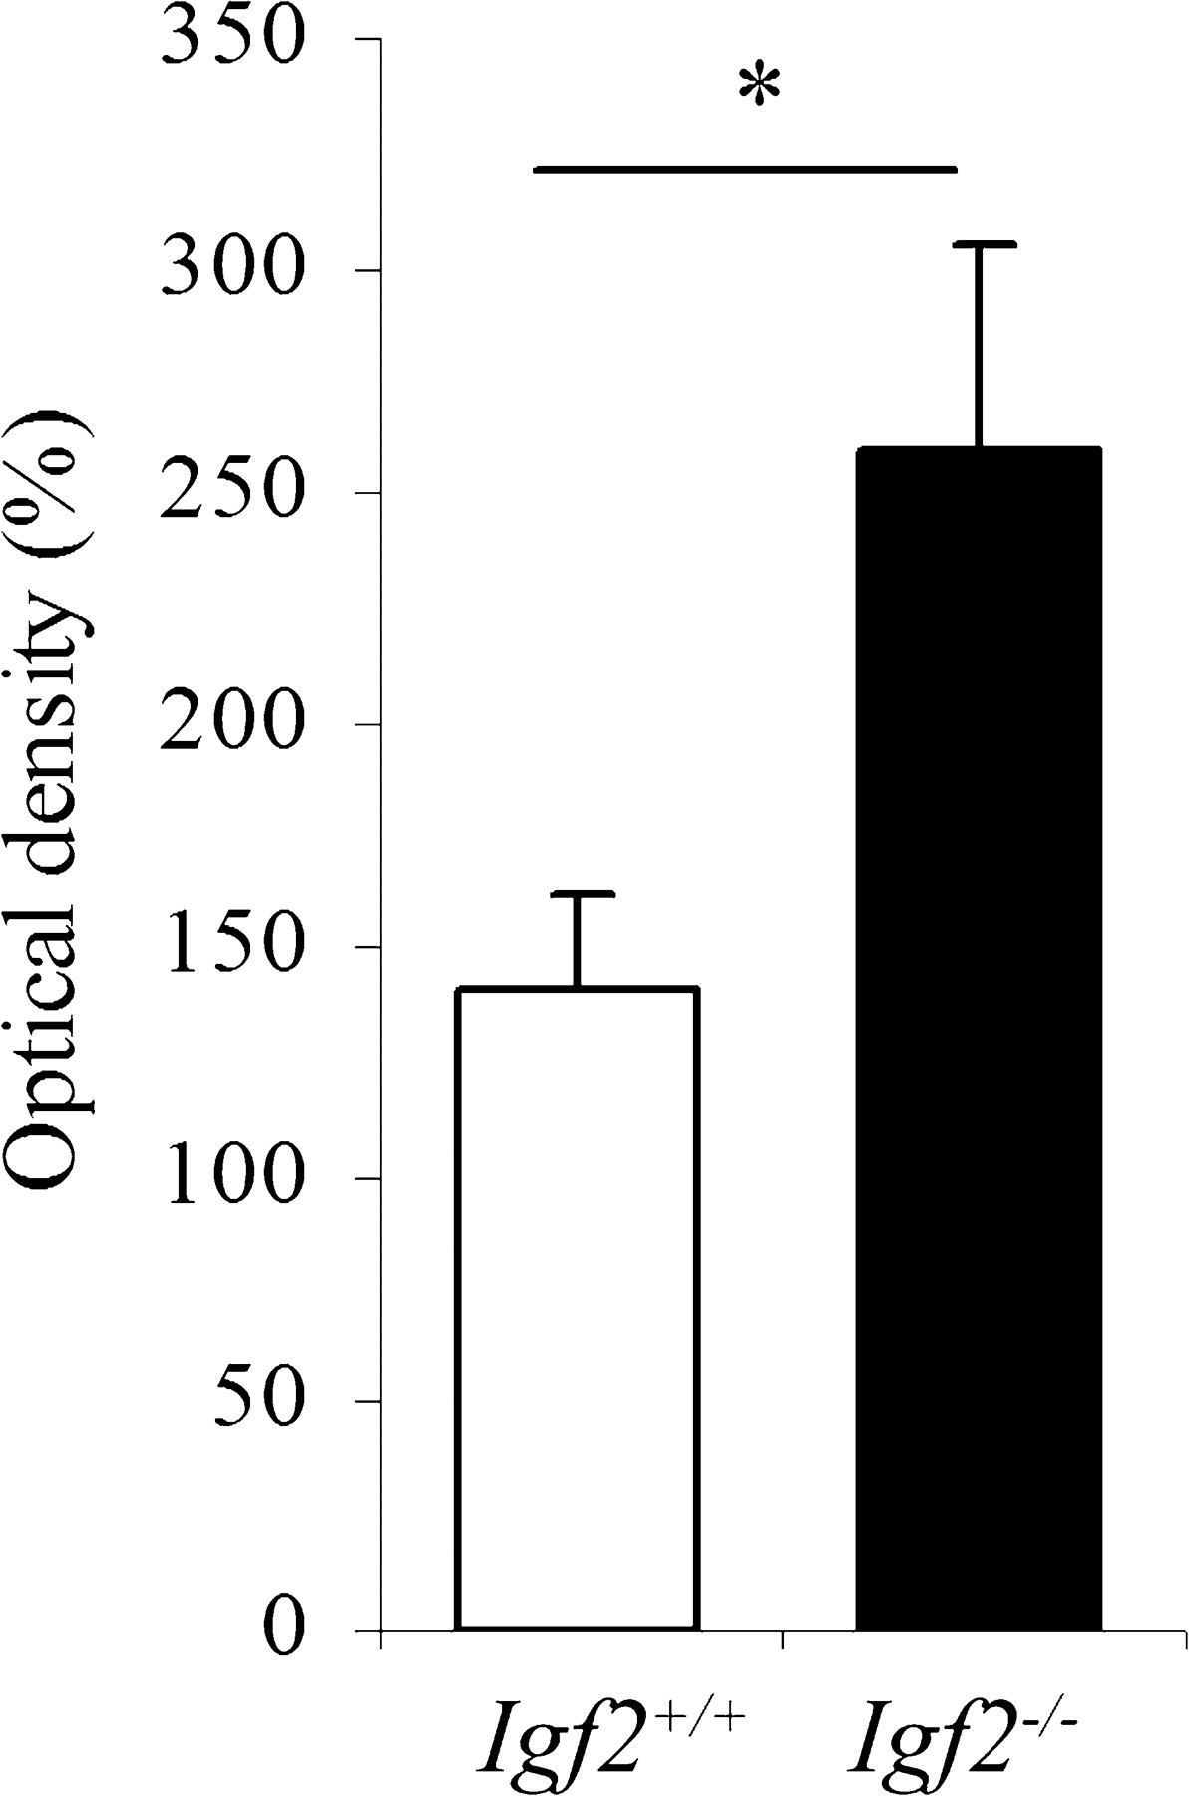

Igf2 deletion decreases tolerance to Insulin:
Cross-tolerance between IGF2 and Insulin
p <0.01
Hansenne I et al., Journal of Immunology (2006)

Slide 29
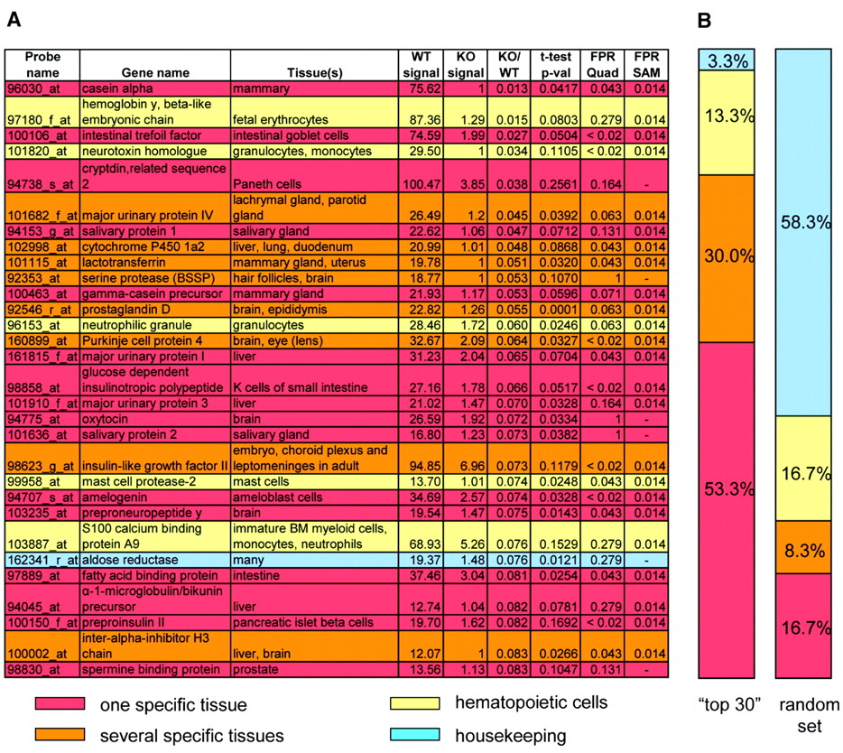
Autoimmune polyglandular syndrome type 1 (APS-1/APECED)
Rare autoimmune disease linked to the gene AIRE (AutoImmuneREgulator)
Maximal expression of AIRE in mTECs
Anderson MS et al., Science (2002) – UC San Francisco Diabetes Center

Slide 30
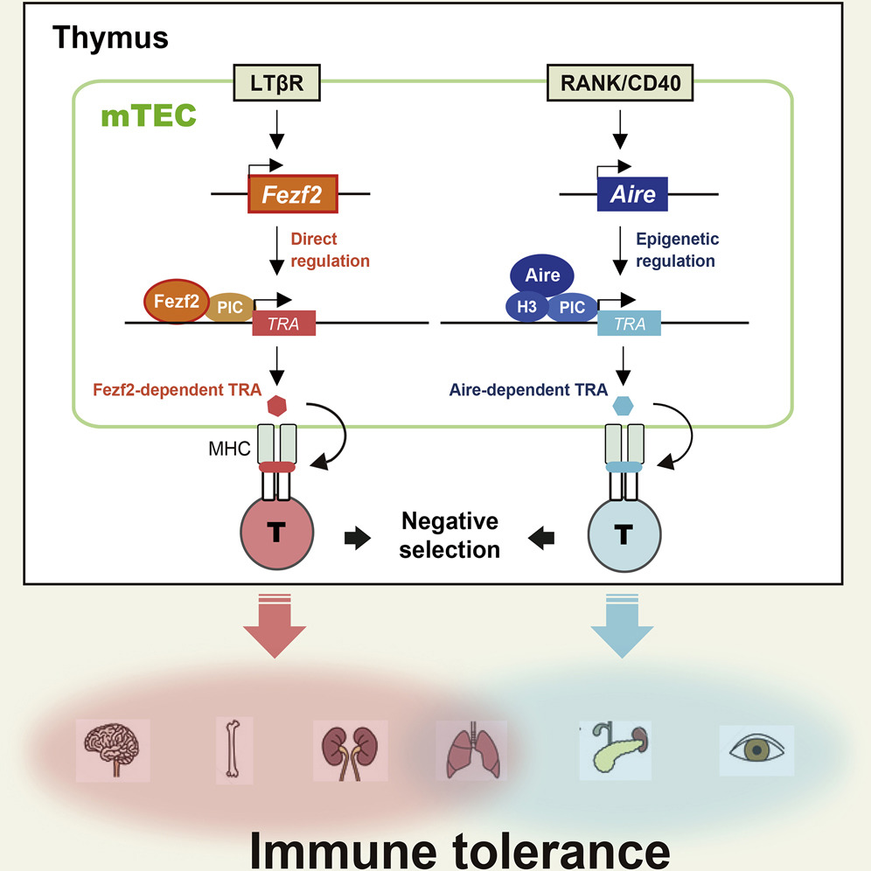
Fezf2 also controls self-antigen expression in the thymus
Central self-tolerance relies on at least 2 complementary pathways, Aire and Fezf2
Takaba T. et al., Cell (2015)

Slide 31
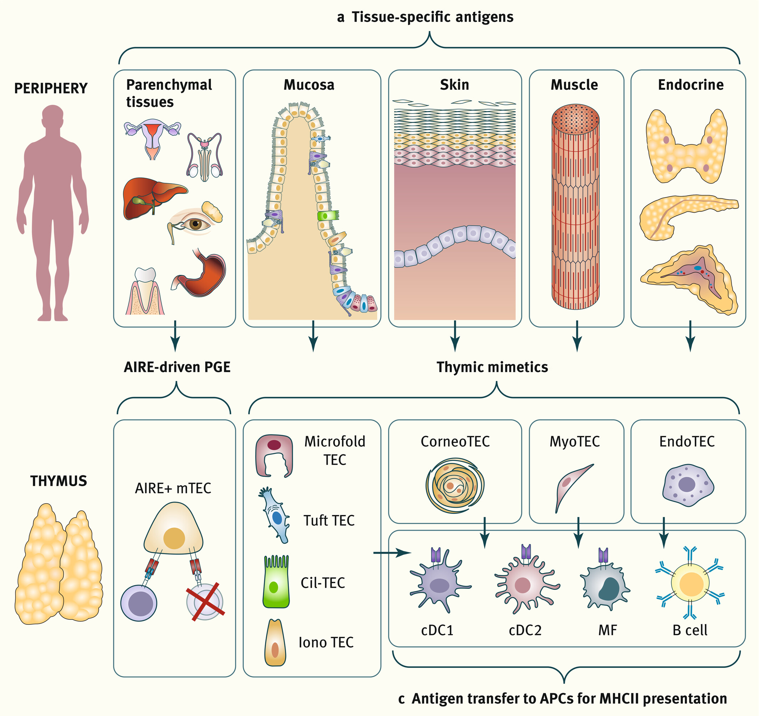
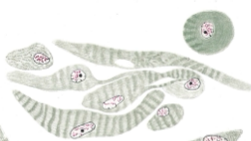
AIRE, Fezf2 and Thymic mimetic cells
Myoid cells
Mayer S (1888)
Dustin A (1914)
Amylin
Ghrelin
Adropin
Intrathymic paracrine actions
Michelson DA et al., Cell (2022)
Michelson DA & Mathis D, Annual Reviews Cell Developmental Biology (2024)
Abramson J, Immunological Reviews (2026) – Author of this figure (Wiley)
Fezf2 regulates not only TSA expression but also the development of specialized mimetic TEC subsets that resemble peripheral tissues. Germino J et al., bioRxiv (2026)
Notes:
Expanding frameworks of central tolerance in the thymus. (a) Medullary thymic epithelial cells (mTECs) express the vast majority of tissue‐specific antigens (TSAs) through two major mechanisms. First, AIRE‐driven promiscuous gene expression (PGE) enables mTECs to express ~90% of protein‐coding genes (lower panel) that are normally found in most parenchymal tissues (upper panel). Second, self‐representation is further expanded through diversification of the mTEC lineage into TEC mimetics, which emulate key cell types that make up complex peripheral tissues, including mucosal barriers (e.g., tuft‐, microfold‐, entero‐, iono‐, and cilia‐TECs), skin (corneo‐TECs), muscle (myo‐TECs), and neuroendocrine tissues (endo‐TECs); (b) The thymus also exhibits constitutive inflammatory signaling, termed “thymflammation” (lower panel), which promotes tolerance to inflammation‐associated self‐antigens (ISAs), which are barely detectable at baseline but dramatically surge following diverse inflammatory triggers such as infection or tissue damage (upper panel); (c) In addition to mTECs, central tolerance is orchestrated by a multicellular antigen‐presenting network including thymic DCs, B cells and macrophages, which cooperate to broaden antigen presentation, including antigens derived from cell types with limited antigen‐presenting capacity, such as mimetic TECs.
IF THIS IMAGE HAS BEEN PROVIDED BY OR IS OWNED BY A THIRD PARTY, AS INDICATED IN THE CAPTION LINE, THEN FURTHER PERMISSION MAY BE NEEDED BEFORE ANY FURTHER USE. PLEASE CONTACT WILEY'S PERMISSIONS DEPARTMENT ON PERMISSIONS@WILEY.COM OR USE THE RIGHTSLINK SERVICE BY CLICKING ON THE 'REQUEST PERMISSIONS' LINK ACCOMPANYING THIS ARTICLE. WILEY OR AUTHOR OWNED IMAGES MAY BE USED FOR NON-COMMERCIAL PURPOSES, SUBJECT TO PROPER CITATION OF THE ARTICLE, AUTHOR, AND PUBLISHER.

Slide 32
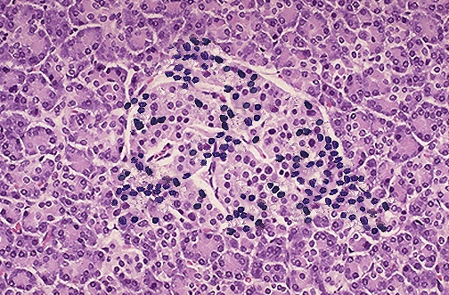
A thymus dysfunction drives autoimmunity
Tolerogenic function of the thymus
Transcription by TECs and mTECs of neuroendocrine self-antigens and TSAs under the control of Aire and Fezf2
Presentation of neuroendocrine self-antigens and TSAs
Elimination of self-reactive T cells (‘forbidden’ T cells) during fetal life
Generation of self-specific regulatory T (tTreg) cells after birth
Thymus
Thymus dysfunction
Decrease in the expression/presentation of thymic self-antigens (Aire and Fezf2 mutations, NOD mouse, BB rat, Down syndrome, viral infection of the thymus…)
Enrichment of the peripheral T-cell repertoire in ‘forbidden’ self-reactive T cells (Teff)
Decrease in the generation of self-specific tTreg
Autoimmunity is programmed during fetal life
This engram is necessary but not sufficient to develop an autoimmune disease
Teff
tTreg
Environmental factors are implicated
Viruses, anti-cancer checkpoint blockade, sexual hormones, nutrition, vitamin D deficiency, intestinal microbiote, endocrine disruptors, stress…
Target cells

Slide 33
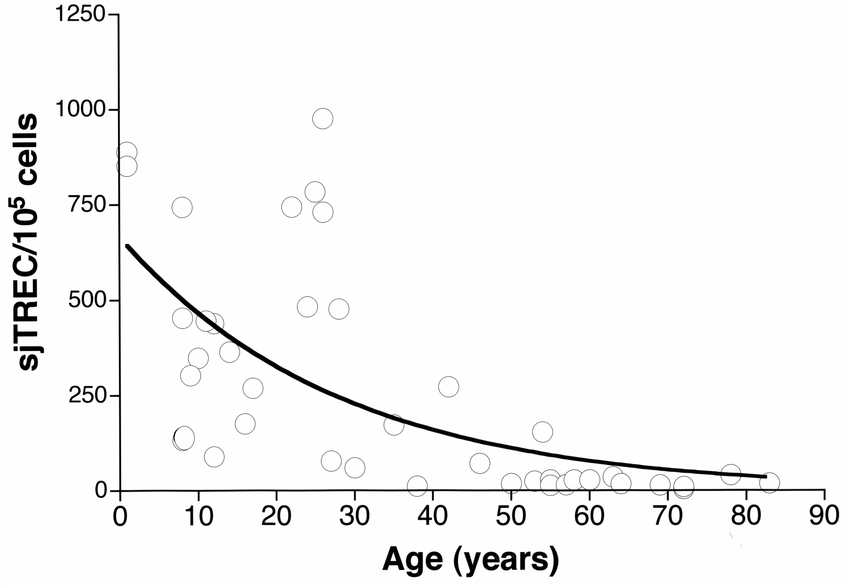
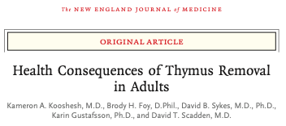
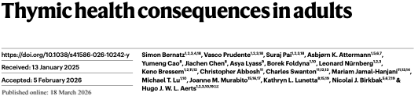
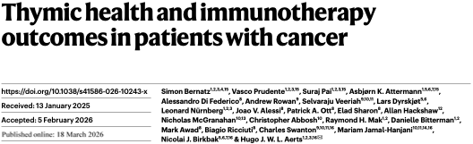
The fundamental role of the thymus in adult life
NEJM August 2023
3 August 2023
Thymectomy increases all-cause mortality, risk of cancer and incidence of autoimmune diseases.
Nature 18 March 2026
Geenen V et al., Journal of Endocrinology (2003)
The thymus is functional until an advanced
age after puberty
Higher thymic health is associated with lower mortality, reduced lung cancer incidence and lower cardiovascular mortality
There is now a need to understand the mechanisms of thymus premature senescence with the purpose of promoting healthy ageing and longevity.
Thymic health is a determinant of anti-cancer
immunotherapy efficacy.

Slide 34
« Immunology is the science of self and non-self. »
Frank Macfarlane Burnet
There is no discrimination between self and non-self in the thymus, only education to self.
Outside the thymus, in normal conditions (i.e. not in autoimmune diseases), there is only activation by non-self antigens.
Finally, a question of etymology and semantics?
Auto (αυτο in Greek)
Spontaneity of action like in the « first motor» (Aristotle)
Self/soi (Se[i] in Latin)
Notion of a reflective character toward the person
In English language
Self-antigen = Auto-antigen
In French language
Antigène du soi (Self-antigen) ≠ Auto-antigène
Homology is not identity!
Oxytocin ≠ Vasopressin
IGF-2 ≠Insulin
An immunogenic auto-antigen (VP, Insulin) is not equivalent to a tolerogenic self-antigen (OT, IGF-2)
Geenen V, The Thymus and The Science of Self. Seminars in Immunopathology (2021)
Swiatczak B & Tauber A, Philosophy of Immunology. In: Stanford Encyclopedia of Philosophy (2026, in press)
Notes:
« Remarquons au passage la déviation introduite par l’usage alternatif des particules auto et self en anglais. Auto et self, respectivement dérivées du grec et du latin, correspondent initialement à des sens différents que l’usage a fini par confondre (…). Auto exprime la spontanéité de l’action, celle du premier moteur chez Aristote (ou comme dans notre moderne automobile), on est donc loin du caractère réfléchi introduit par self (…). L’horror autotoxicus, barbare accouplement d’une racine latine et d’une racine grecque, véhiculait donc un contresens auquel les générations ont emboîté le pas. »

Slide 35
To conclude this long and fascinating history
The unsuspected role of the thymus from fetal life until advanced age
The thymic organ is the architect of our biological identity and orchestrates immune self-tolerance to neuroendocrine and peripheral tissues.
The basic mechanism of central self-tolerance is the active transcription and presentation of neuroendocrine self-antigens and TSAs by TECs, in particular medullary TECs.
A failure of thymus self-tolerance is the primary causal event in autoimmunity. Environment acts as the revealer of a pre-existing script written during fetal and early life.
In the near future, innovative therapies will appear against autoimmune diseases, which are the heavy tribute paid mainly by mankind for the diversity of its adaptive immunity.
And, last but not least, thymus integrity determines lifelong immune fitness.

Slide 36



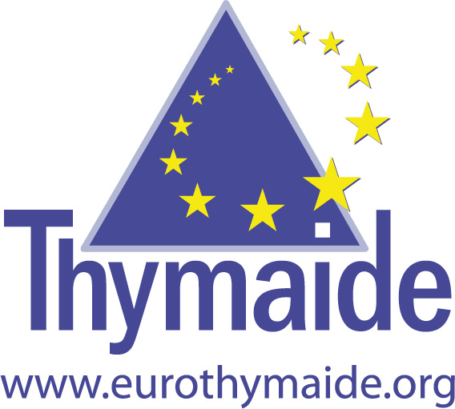



Acknowledgments
S C I E N T I A O P T I M U M
GIGA Research Institute
Center of Immunology
Henri Martens, PhD
Fabienne Brilot, PhD – Professor Neuroimmunology at USydney
Isabelle Hansenne, PhD – Assurance qualité Trasis
Gwennaëlle Bodart, PhD – Data manager CHU
Denis Franchimont, MD, PhD – Professor at ULB
Virginie Gridelet, PhD – Embryologie animale Fac. Médecine
Barbara Polese, PhD – RISE Gestion interne de la recherche Fac. Médecine
Charlotte Trussart, PhD
Béatrice Goxe, PhD
Gabriel Morrhaye, PhD
Khalil Farhat, PhD
Imane Achour, PhD
Ouafae Kecha-Kamoun, PhD
Hélène Michaux, PhD - Dendrogenix
Aymen Halouani, PhD
Hamid Kermani, PhD
Yves Vanneste, PhD
Olivier Dardenne, PhD
Eric Vandersmissen, BSc
Chantal Renard, Assistant
Marie-Thérèse Hazée-Hagelstein, Assistant
Abdellah Benhida, Assistant
Sophie Perrier d’Hauterive, MD, PhD – Professor of Embryology at ULiège
Vincent Geenen, MD, PhD
University of Lille 2 – CHRU Lille (France)
Laboratory of Virology
Hela Jaïdane , PhD – University of Tunis
Delphine Caloone, PhD
Pierre-Emmanuel Lobert, PhD
Didier Hober, MD, PhD
Johns Hopkins Medical Center (Baltimore, USA)
Roberto Salvatori, MD, PhD
Waleo 3 - Tolediab
Notes:
I would like to thank our partners and sponsors in the completion of these studies and I thank you all for your kind attention.

Slide 37





« …by standing on the shoulders of giants »
Isaac Newton (Letter to Robert Hooke, 1675)
Paul FRANCHIMONT †
(1934-1994)
Radioimmunology
Gonadotrophins and inhibin
Pierre LEFEBVRE
Type 1 and Type 2 diabetes
Jean-Michel FOIDART
Implantation of embryo
Maternal tolerance to the fetal allograft
George P. CHROUSOS
Doctor Honoris Causa ULiège (2003)
And thank you all very much for your kind attention!
Please excuse my faults in English pronunciation and syntax.
MERCI !

