Slide 1
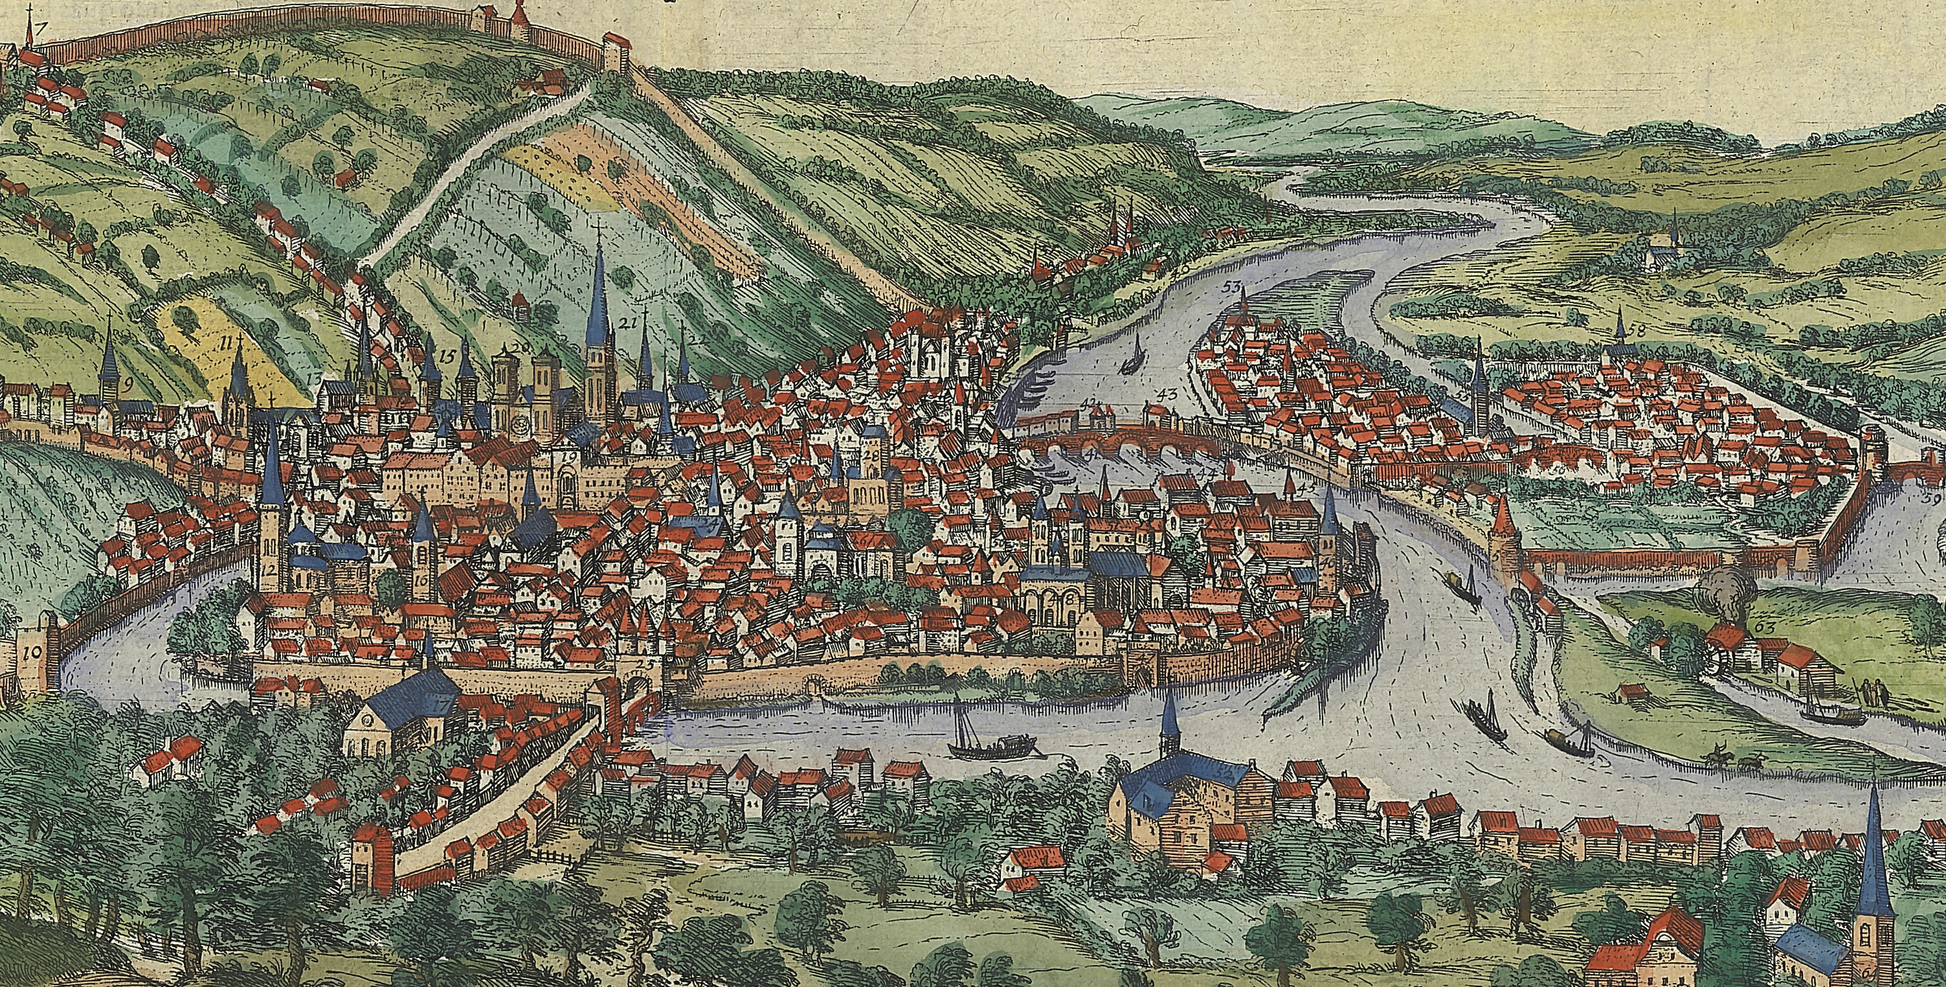

Disseminating the Law in the Prince-Bishopric of Liège during the Early Modern Period
Dr Renaud ADAM

Slide 2
The Prince-Bishopric of Liège in 1560
Liège

Slide 3

Making the Law, consent of the Estates
Estate of Clergy
Prince-Bishop
Estate of Nobility
Sens of the Country
Privy Council
Third Estate

Slide 4
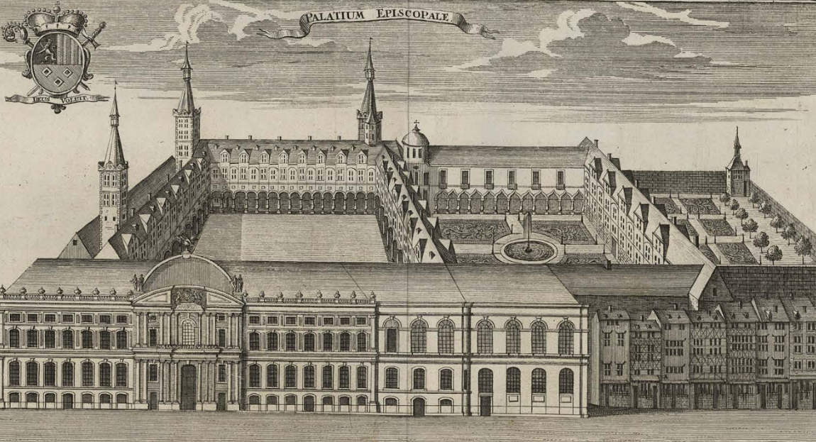
Making the Law, general policing
Prince-Bishop
Privy Council
Chancellor

Slide 5
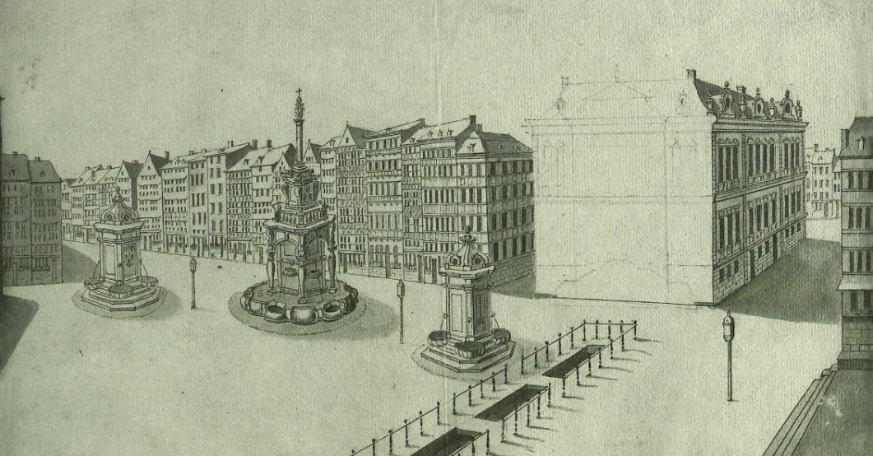
Making the Law, public proclamation
Legal Record
Local Aldermen
Prince-Bishop
Ordinance
Publication in Every City
Proclamation
At the Perron

Slide 6
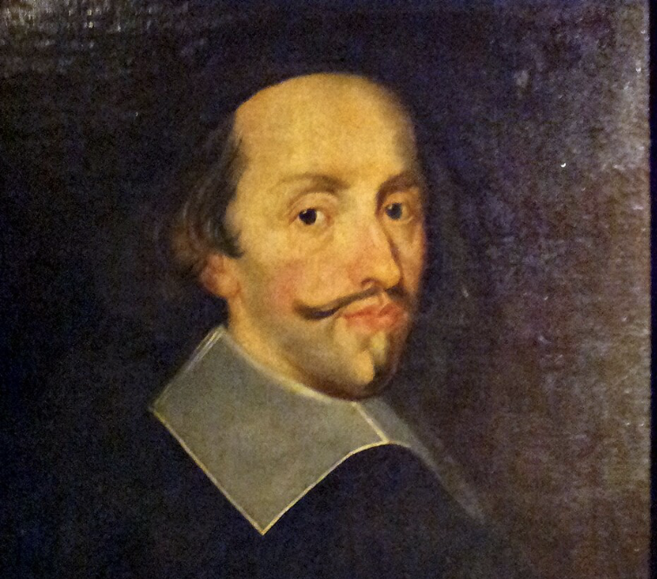
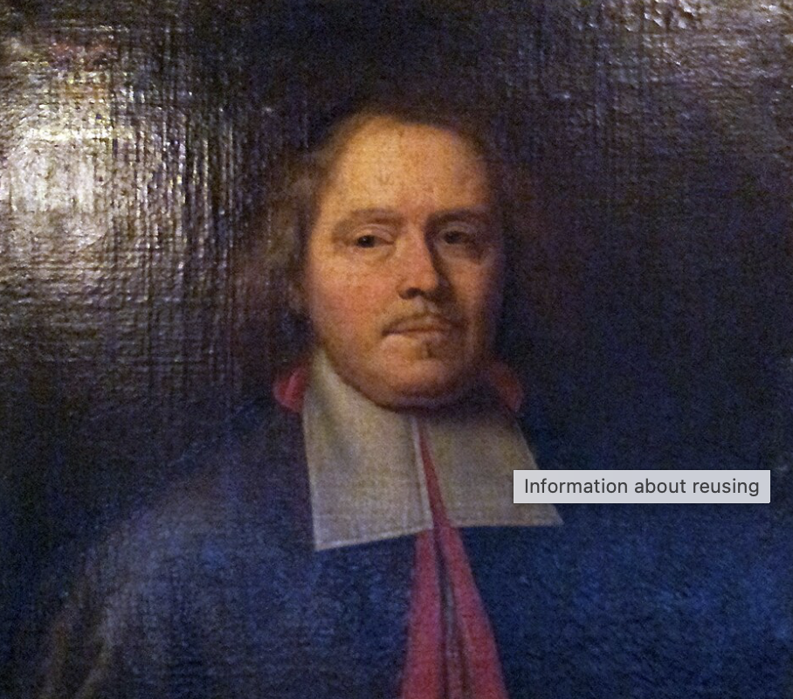
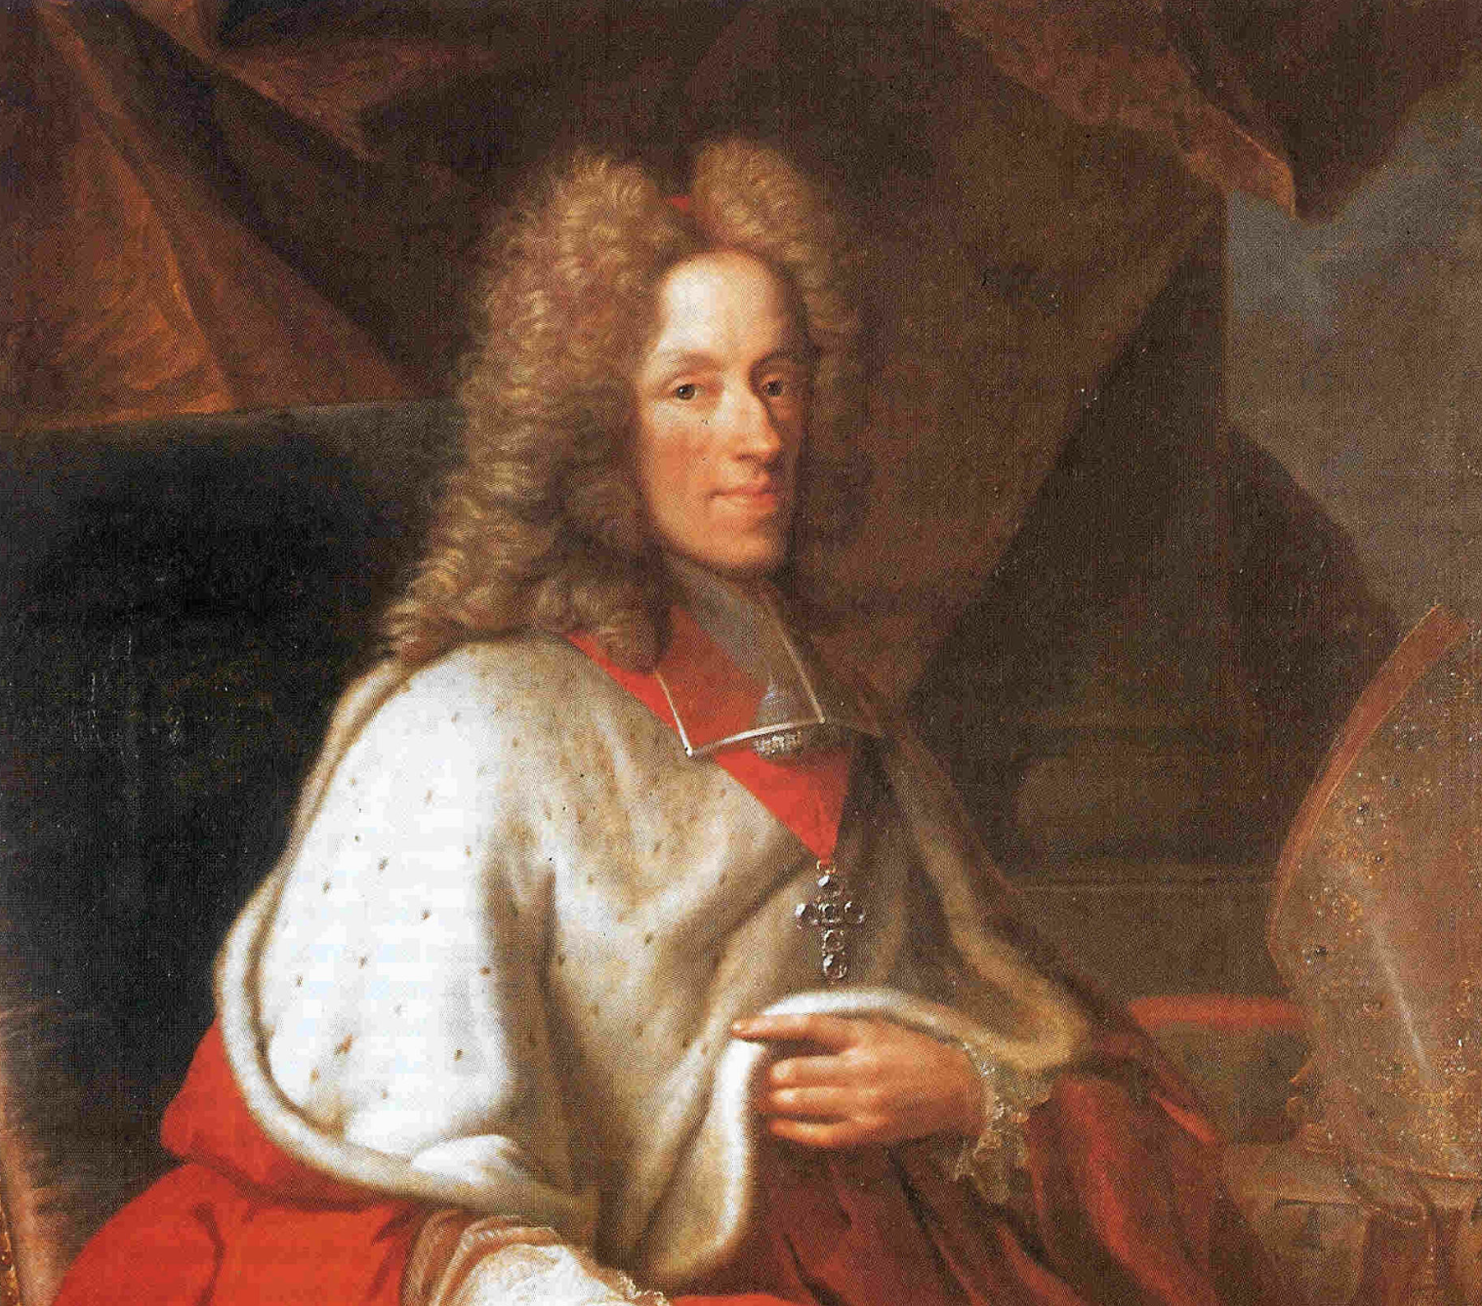
Printing the Law, Guillaume-Henri Streel (1654-1710)
Maximilian Henry of Bavaria
35 edicts
Jean-Louis d’Elderen
28 edicts
Joseph Clemens of Bavaria
21 edicts

Slide 7
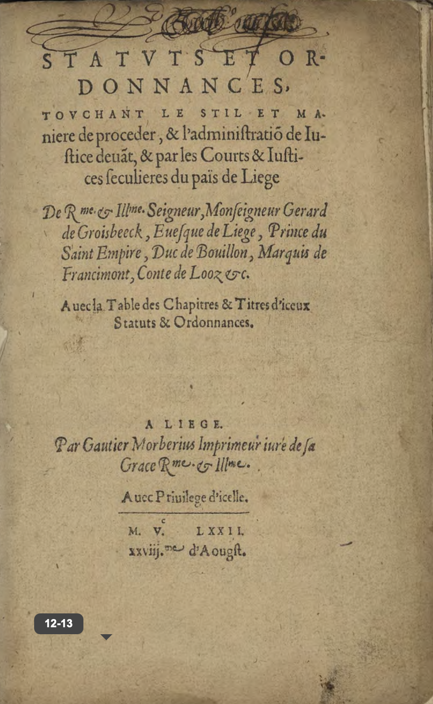
Printing the Law, time necessary
Promulgation: 3 July 1572
Registration and Public Reading: 4 July 1572
Privilege granted: 6 August 1572
Impression: 28 August 1572

Slide 8
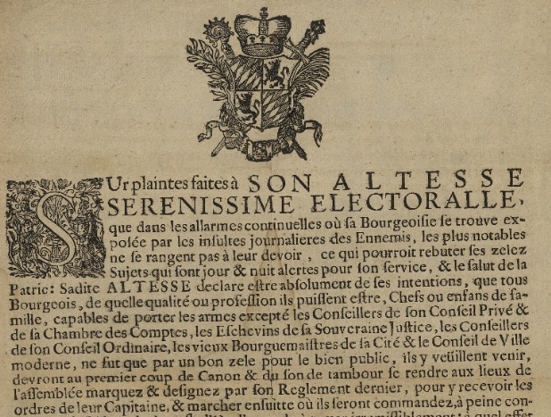
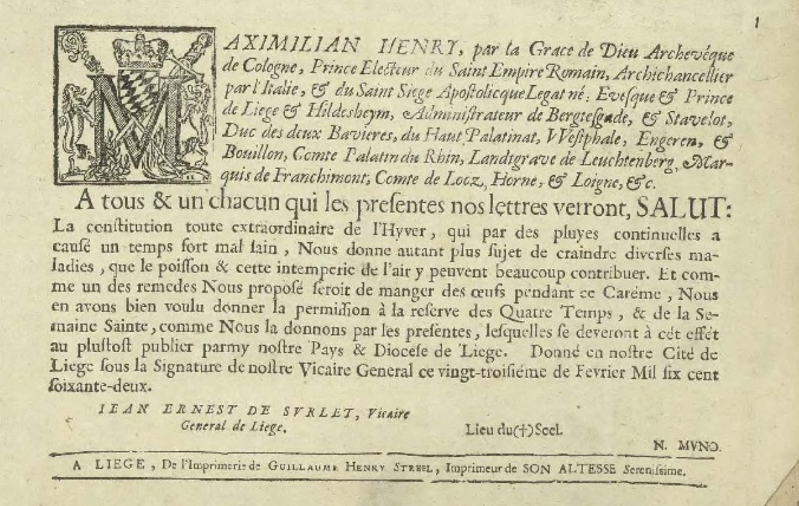
Printing the Law, layout of placards
Titulature in Italics
Decorated Initial
Name of the Prince-Bishop
Coat of Arms
Vicar General
Official Printer
Seal
Legal text in Romans
Secretary

Slide 9
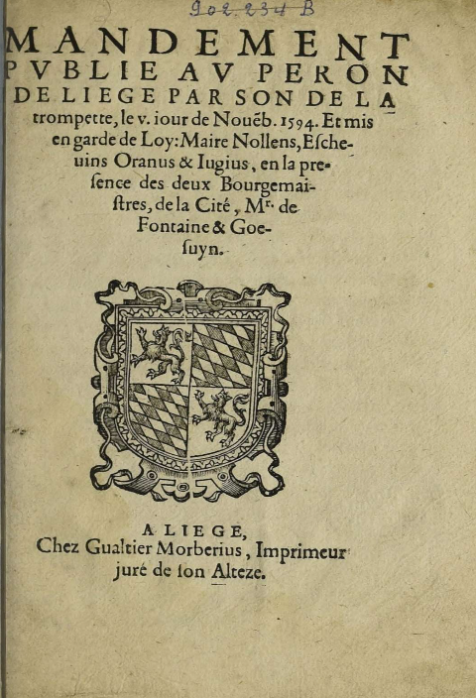
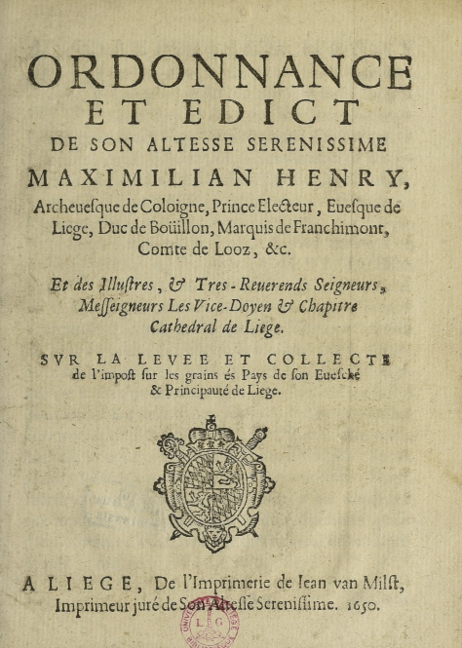
Printing the Law, layout of pamphlets
Title in Capitals
Cry of the Perron
Subject
Coat of Arms
Official Printer

Slide 10
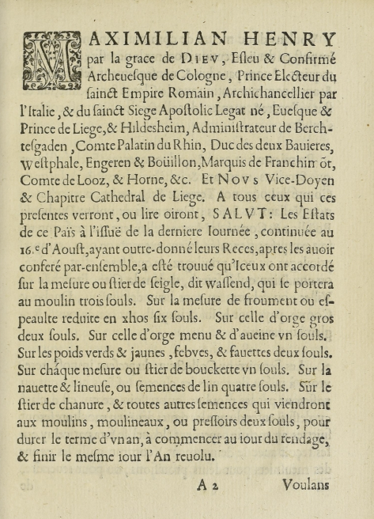
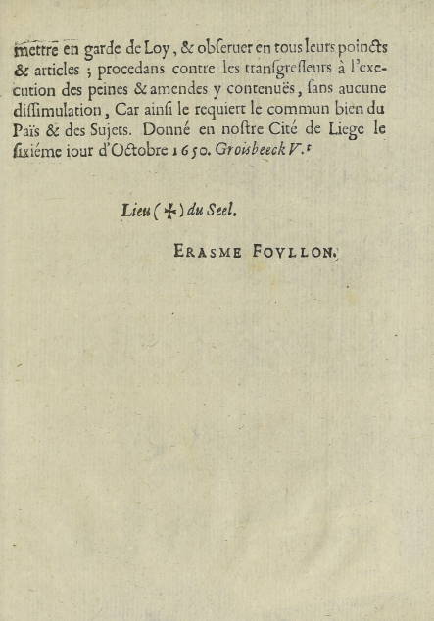
Printing the Law, layout of pamphlets
Name of the
Prince-Bishop
Decorated
Initial
Seal
Name of the
Chancellor

Slide 11
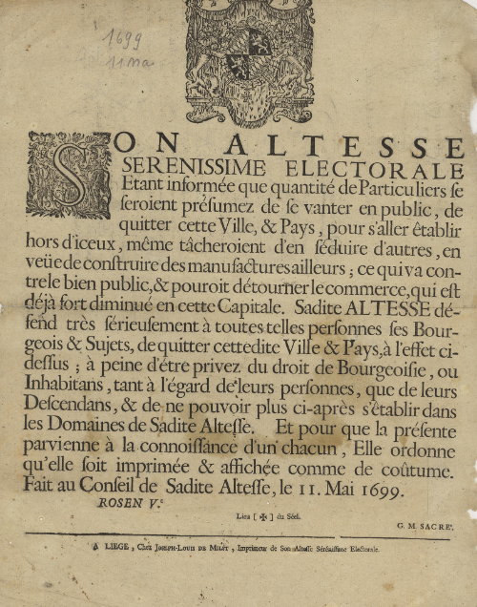
Disseminating the Law, formula
Order for the printing and posting of the placard in the customary places:
Elle ordonne qu’elle soit imprimée & affichée comme de coûtume

Slide 12
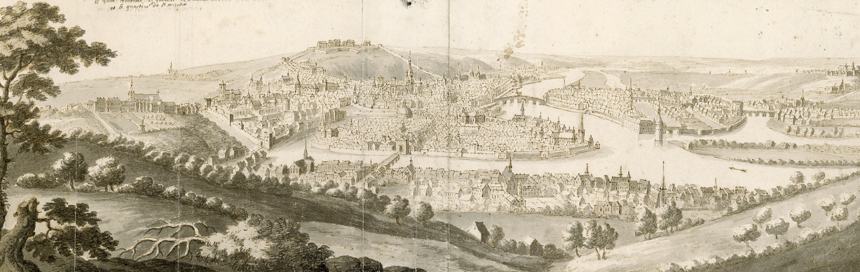
Disseminating the Law, circulation among officers
Rural communities
Prince-Bishop
Grand Baillif
Burgomasters

Slide 13
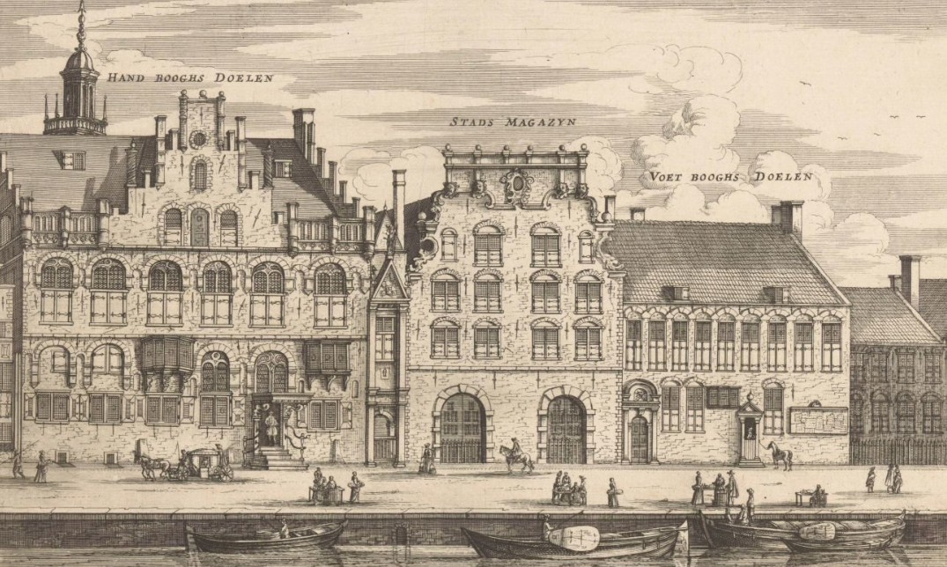
Disseminating the Law, affixing
Courts & juridictions
Crossroads
Public square
Churches…

