Slide 1
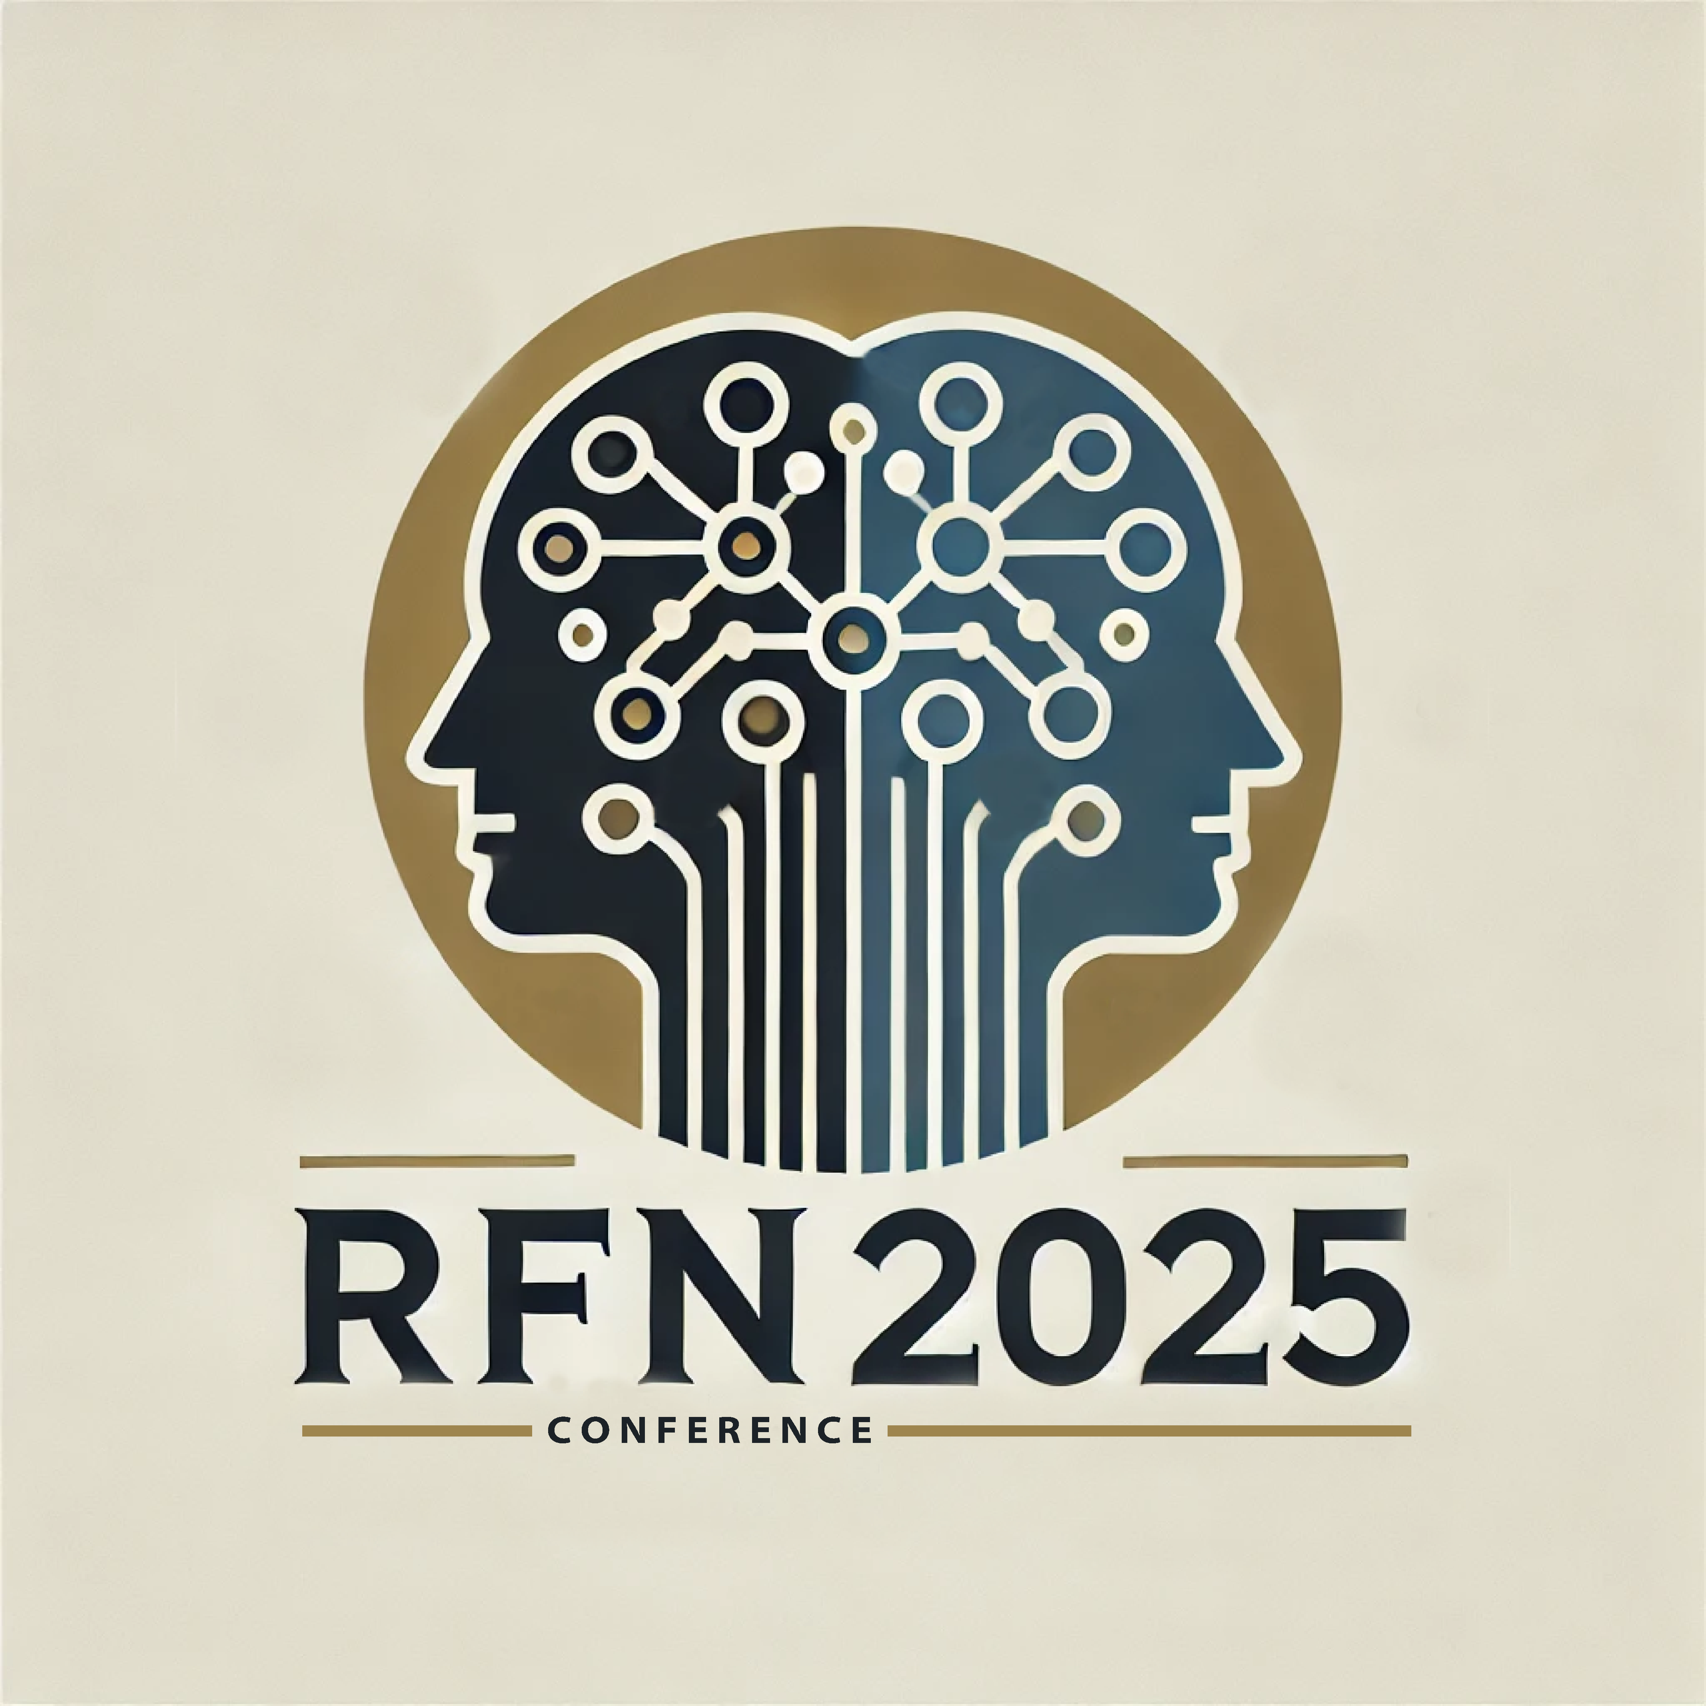



Motives for transmitting and remembering
A functional analysis of intergenerational memory transmission in the family
David Baudet
15/04/2025
Principal Investigators: Christine Bastin, Aline Cordonnier, Olivier Luminet

Slide 2
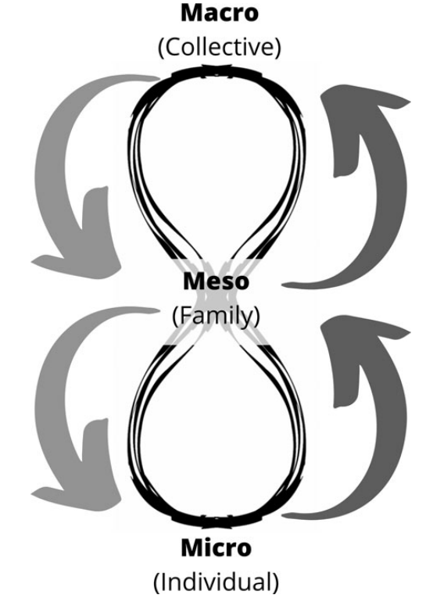
Family
Oral, direct transmission of memory from an older to a younger generation
Frequent and natural (Fivush & Merrill, 2016)
  Occurs approximately every 5 minutes during family dinnertime (Bohanek et al., 2009)
Serves key functions: shaping worldviews, validating emotions, and fostering belonging both as an individual and as a group (Fivush et al., 2010)
Cordonnier et al., (2022)

Slide 3

Autobiographical memory
Memories that are “specific, personal, long-lasting, and of significance to the self” (Nelson, 1993)
  reflective processing,
  significance and personal relevance (Conway, 2005; Fivush, 2008; Fivush et al., 2011; Habermas and Bluck, 2000)
Serves different functions (Harris et al., 2014)
  Reflective functions (“self positive”)
  Social functions (conversation, bonding)
  Ruminative (“self negative”)
  Generative (teach, leave a positive impact)
Notes:
Autobiographical memory (AM) involves more than the mere recollection of past events; it also encompasses the evaluation of these events, including their significance and personal relevance (Conway, 2005; Fivush, 2008; Fivush et al., 2011; Habermas and Bluck,2000)
Reflective > self-continuity (TALE), directing behavior (TALE), identity (RFS), problem solving (RFS)
Social > social-bonding (TALE), conversation (RFS)
Ruminative > boredom reduction (RFS), bitterness revival (RFS)
Generative > intimacy maintenance (RFS), teach/inform (RFS), death prep (RFS)

Slide 4
‘Children are born in a storied world’ (Fivush & Merril, 2016)
Stories told by primary caregivers form the foundation of children’s AM development (Fivush and Salmon, 2023; Merrill and Fivush, 2016; Nelson and Fivush, 2004)
  Maternal training in elaborative reminiscing leads to more coherent life narratives and fewer emotional problems in adolescents (Mitchell & Reese, 2022)
Roots of collective remembering (Reese & Fivush, 2008)

Slide 5

Collective memory
Sustains collective identity (Hirst & Manier, 2008)
“Communicative memory” (Assmann & Czaplicka, 1995)
  collective memories based on everyday communications
World War II (Cordonnier et al., 2021; Pohn-Lauggas, 2021; Stone et al., 2014)
The Holocaust (Auerhahn & Laub, 1998; Wiseman et al., 2006)
Wars in the former Yugoslavia (Svob et al., 2016)

Slide 6
Our study
Functions of intergenerational memory from both generations' perspectives

Slide 7


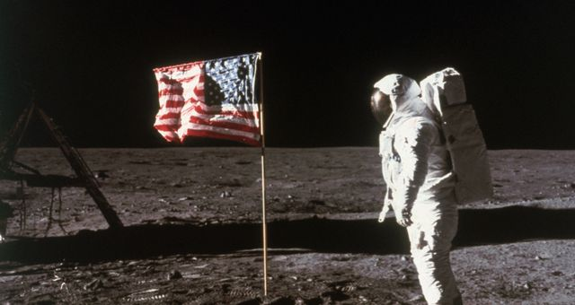









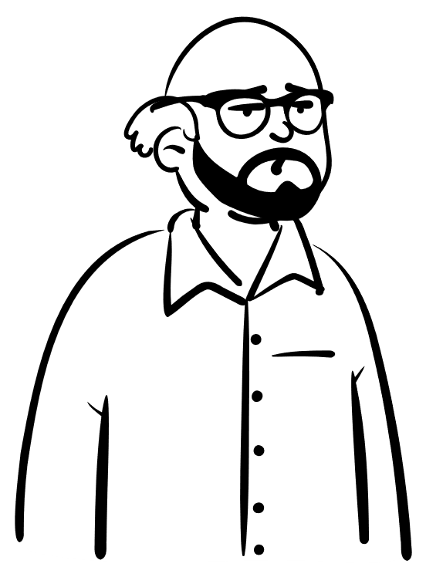




Why ?
©Getty - Bettmann
vs.
CAPITALISM
Notes:
Motivations of parents and grandparents to transmit important personal and public memories to younger generations and the motivations of the younger generation to remember memories from the older generations

Slide 8
Method

Slide 9
Participants
Two sets of data :
  64 duos parent-child
  49 duos grandparent-grandchild
Generation | Age min | Age max | Age mean (SD) | Women
Parents | 37 | 69 | 50.9 (6.0) | 51 (79.7%)
Children | 17 | 27 | 20.5 (2.5) | 55 (85.9%)
Generation | Age min | Age max | Age mean (SD) | Women
Grandparents | 60 | 94 | 74.4 (5.9) | 35 (71.4%)
Grandchildren | 16 | 29 | 20.1 (2.5) | 37 (75.5%)
Grandparents: MoCA (Nasreddine & Patel, 2016) ≥ 23 (Carson et al., 2018)

Slide 10

Listing memories
When my parents met
King Baudouin’s death
Children
09/11
Parents’ wedding
Carnival parade in leek costume
Mom’s divorce
« What important memories did your parents tell you about? »
At least 2 public and 2 personal
That she lived before turning 30 years old
Transmitted directly
« Episodic » (not repeated, short)

Slide 11
Memory selection
When my parents met
King Baudouin’s death
Children
09/11
Parents’ wedding
Carnival parade in leek costume
Mom’s divorce
Centrality of Event Scale (Berntsen & Rubin, 2006)

Slide 12


Memory narrative and functions
My parents met in the Carré…
Reminiscence Functions Scale (Webster, 1993)
« Why do you remember this memory? »
For each memory

Slide 13
Same thing for the parent/grandparent…

Slide 14
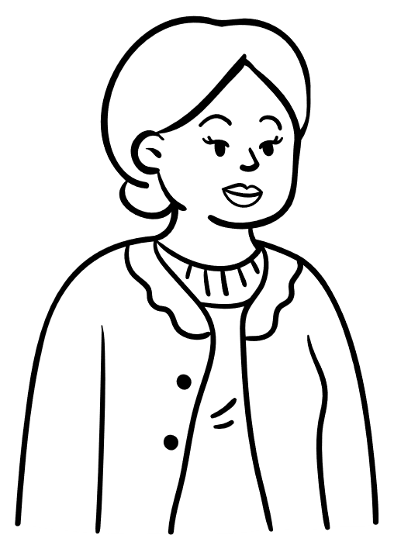
Listing memories
Assassination of JFK
Meeting my husband
Parent/grandparent
Earthquakes in 1983
Birth of my first child
Driving licence exam
« What important memories did you share with your child/grandchild? »
At least 2 public and 2 personal
That you lived before turning 30 years old
Transmitted directly
« Episodic » (not repeated, short)

Slide 15
Listing memories
Assassination of JFK
Meeting my husband
Parent/grandparent
Earthquakes in 1983
Birth of my first child
Driving licence exam
Centrality of Event Scale (Berntsen & Rubin, 2006)

Slide 16
Memory narrative and functions
When I learned about JFK…
Reminiscence Functions Scale (Webster, 1993)
« Why did you share this memory with your child? »
For each memory

Slide 17
Variables
Type of memory
  Personal
  Public
Generation
  Parent vs. child
  Grandparend vs. grandchild
Functions
  Ruminative
  Reflective
  Generative
  Social

Slide 18
Results

Slide 19
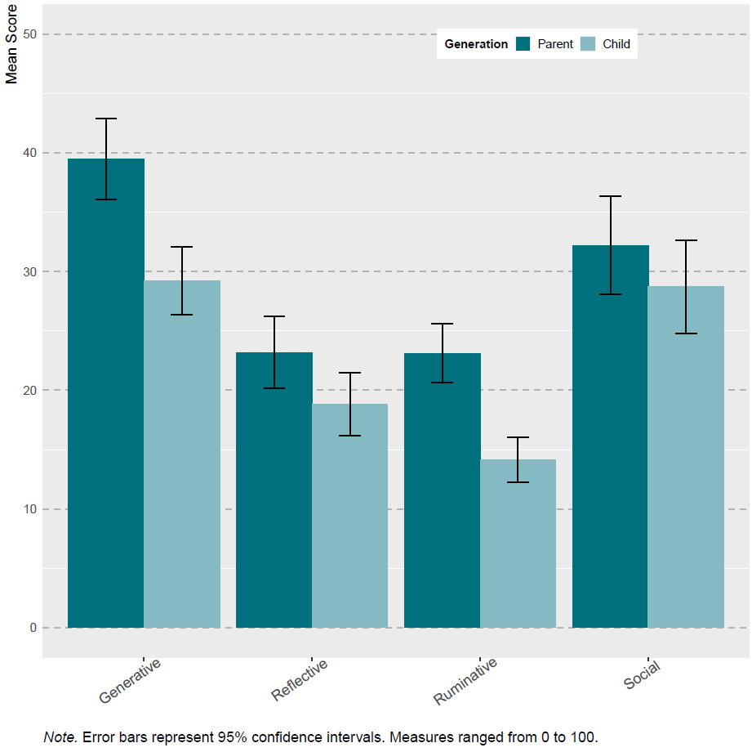
Parent-Child
**
p < .001 ***
p < .01 **
p < .05 *
Generation
  Generative: parents > children
  Reflective: parents > children
  Ruminative: parents > children
*
**
Notes:
Triple interaction non-significative

Slide 20
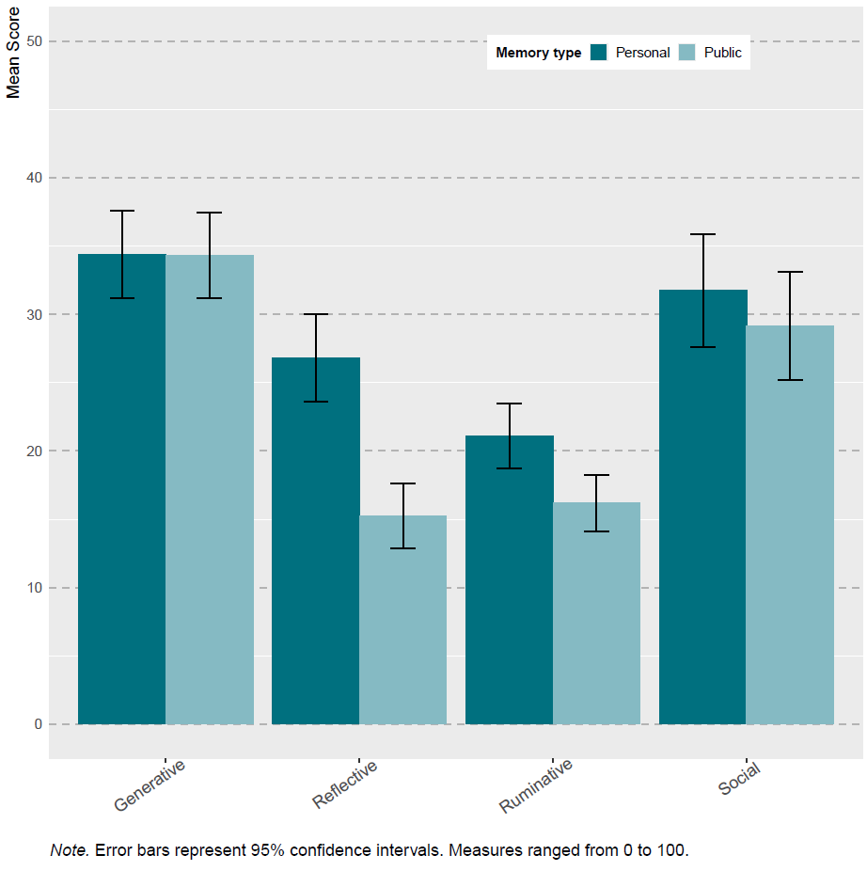
Parent-Child
p < .001 ***
p < .01 **
p < .05 *
Generation
  Generative: parents > children
  Reflective: parents > children
  Ruminative: parents > children
Memory type
  Reflective: personal > public
  Ruminative: personal > public
***
*
Notes:
Triple interaction non-significative

Slide 21
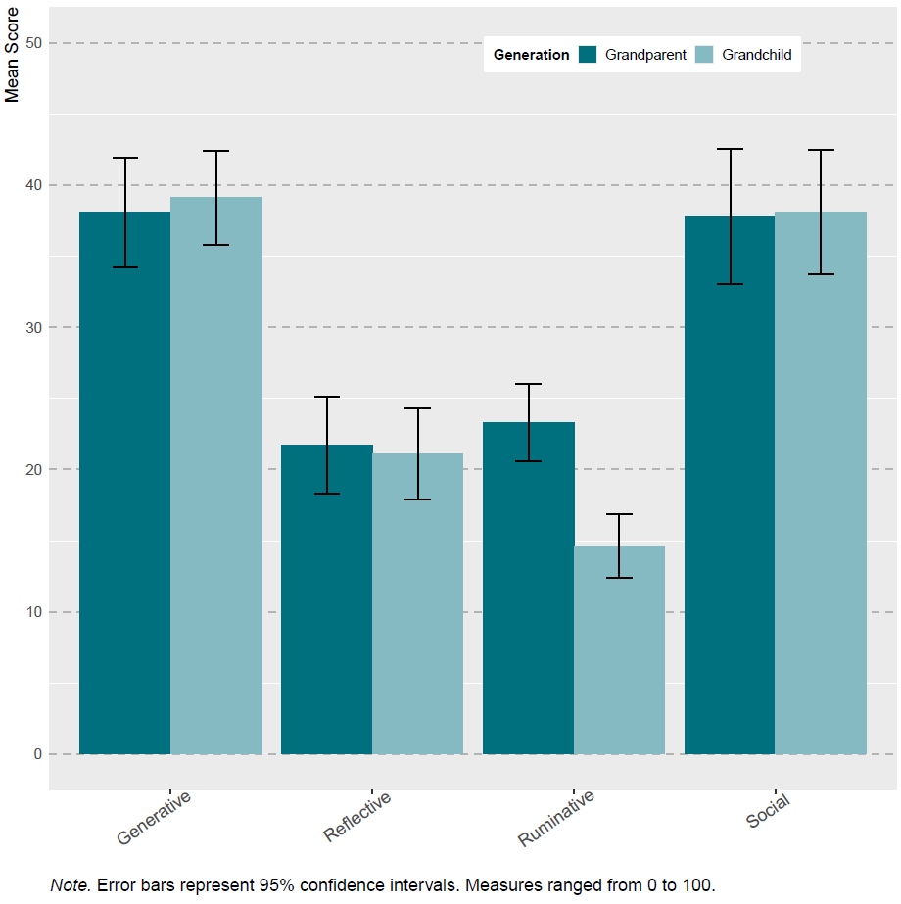
Grandparent-Grandchild
p < .001 ***
p < .01 **
p < .05 *
Generation
  Ruminative: grandparents > grandchildren
***
Notes:
Triple interaction non-significative

Slide 22
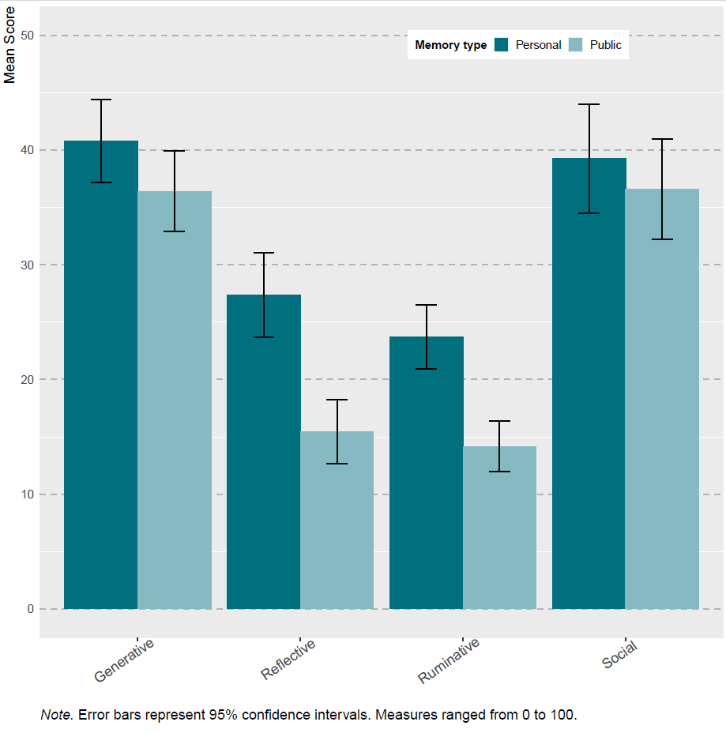
Grandparent-Grandchild
p < .001 ***
p < .01 **
p < .05 *
Generation
  Ruminative: grandparents > grandchildren
Memory type
  Reflective: personal > public
  Ruminative: personal > public
***
***
Notes:
Triple interaction non-significative

Slide 23
Results - summary
Both personal and public memories help transmit values and initiate conversations
vs.
CAPITALISM
Personal memories provide more self-related information than public memories
Notes:
Motivations of parents and grandparents to transmit important personal and public memories to younger generations and the motivations of the younger generation to remember memories from the older generations

Slide 24
Spark conversation/bond
Values
Spark conversation/bond
Values (leave positive impact)
Share self-related information
vs.
Create discussion/bond
Pass down important values
Share origins (reflective function)
Discuss adverse events
Create conversation/bond
Notes:
Motivations of parents and grandparents to transmit important personal and public memories to younger generations and the motivations of the younger generation to remember memories from the older generations

Slide 25
Motivations for telling a story are not always the same as the ones for remembering it (Harris et al., 2024)
Intergenerational memory sharing helps preserve generational links
For older generations, memories are ways to teach values, teach about where they are from, about life
Younger generations : learn values, especially from grandparents?
  Grandparents’ stories play a role in identity development (Green, 2019)
More memory transmission linked to higher levels of well-being among adolescents and young adults, including improved self-esteem and emotional regulation (Chen et al., 2021; Duke et al., 2008; Fivush et al., 2010; Fivush et al., 2011; Merrill et al., 2017)
Leave something behind
  Generativity linked to life-satisfaction (McAdams et al., 1993)

Slide 26
Thank you for your attention
david.baudet@uliege.be

Slide 27
Main hypotheses
Parent-Child
  Generative: parents > children
  Reflective: children > parents
  Personal > public
Grandparent-Grandchild
  Ruminative & social : grandparents > grandchildren
  Reflective & generative: grandchildren > grandparents
  Personal > public

Slide 28
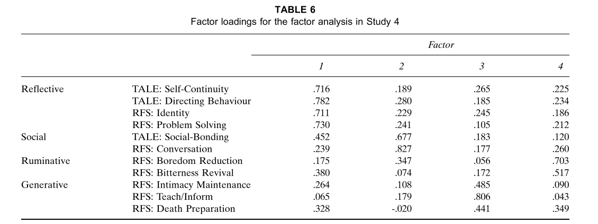
Harris, C. B., Rasmussen, A. S., & Berntsen, D. (2014). The functions of autobiographical memory: An integrative approach. Memory, 22(5), 559-581. https://doi.org/10.1080/09658211.2013.806555

Slide 29
Adapted CES
Je pense que cet événement est devenu une partie intégrante de mon identité personnelle et/ou familiale.
Cet événement est devenu un point de référence pour la façon dont je me comprends moi-même et/ou ma famille.
Cet événement est devenu un point de référence pour la façon dont je comprends le monde.
Je pense que cet événement est central dans mon histoire personnelle et/ou familiale.
Cet événement a un impact sur la manière dont je perçois d'autres événements.
Cet événement a changé de manière permanente ma vie et/ou celle de ma famille.
Je pense souvent aux effets que cet événement a et aura sur ma propre vie.
Cet événement a été un tournant dans l'histoire de ma vie et/ou celle de ma famille.

Slide 30
G2G3_predic2 <- lmer(G3 ~ G2C+Func.class+ G2C:Func.class + (1|ID), data= df_predic)
Within duo analysis
  Parent’s scores predict children’s scores?
  When parents score higher on social and generative functions, their children tend to score lower on these functions?
 | Parent - Child
 | Estimate | p-value
Reflective | 0.04 | 0.5489
Social | -0.24 | <.0001
Ruminative | 0.13 | 0.0868
Generative | -0.15 | 0.0393
Notes:
Analyse de fréquences des différentes fonctions des enfants en fonction des fonctions du parent

Slide 31
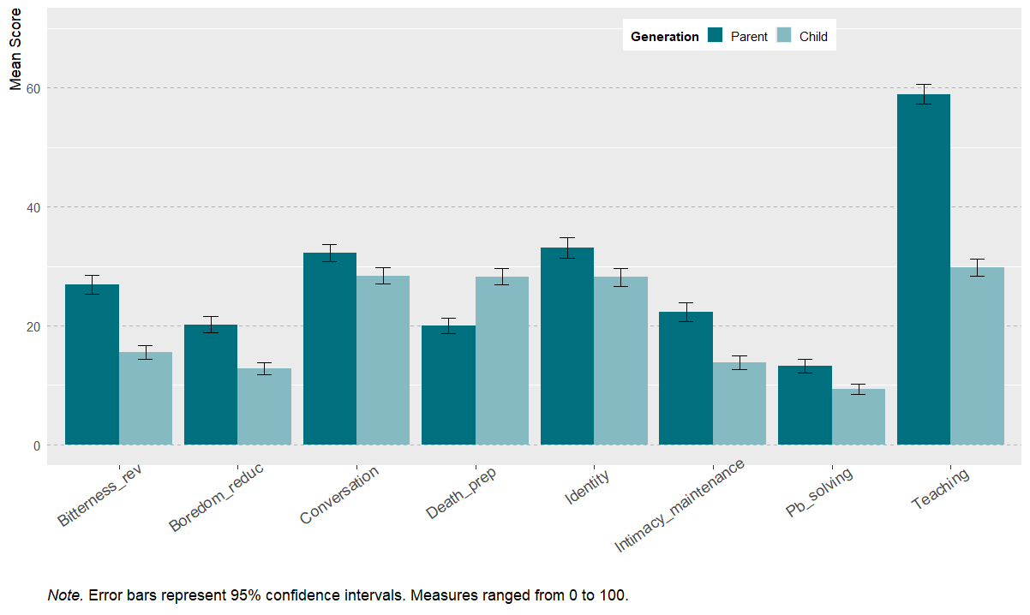

Slide 32
