Slide 1


Motives for transmitting and remembering
A functional analysis of intergenerational memory transmission in the family
David Baudet
12/06/2025
Principal Investigators: Christine Bastin, Aline Cordonnier, Olivier Luminet

Slide 2
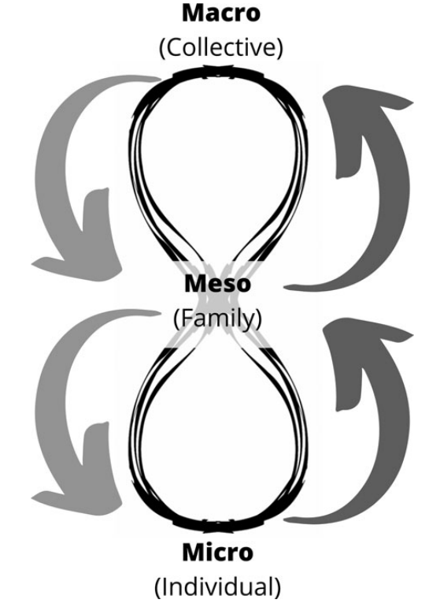
Family
Oral, direct transmission of memory from an older to a younger generation
Frequent and natural (Fivush & Merrill, 2016)
  Occurs approximately every 5 minutes during family dinnertime (Bohanek et al., 2009)
  Perceived as relatively frequent by all generations (Baudet et al., 2025)
Serves key functions: shaping worldviews, validating emotions, and fostering belonging both as an individual and as a group (Fivush et al., 2010)
Cordonnier et al., (2022)

Slide 3
‘Children are born in a storied world’ (Fivush & Merril, 2016)
Stories told by primary caregivers form the foundation of children’s AM development (Fivush and Salmon, 2023; Merrill and Fivush, 2016; Nelson and Fivush, 2004)
Serves different functions (Harris et al., 2014)
  Reflective functions (“self positive”)
  Social functions (conversation, bonding)
  Ruminative (“self negative”)
  Generative (teach, leave a positive impact)
Roots of collective remembering (Reese & Fivush, 2008)
Notes:
Research shows that children with more elaborative mothers tend to develop stronger autobiographical skills, demonstrating how discussions about past events scaffold important abilities related to identity construction, and understanding the world and the self
Reflective > self-continuity (TALE), directing behavior (TALE), identity (RFS), problem solving (RFS)
Social > social-bonding (TALE), conversation (RFS)
Ruminative > boredom reduction (RFS), bitterness revival (RFS)
Generative > intimacy maintenance (RFS), teach/inform (RFS), death prep (RFS)

Slide 4
Our study
Functions of intergenerational memory from both generations' perspectives

Slide 5
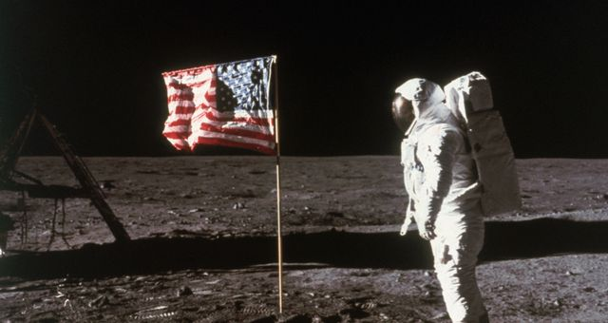
Why ? Functions ?
©Getty - Bettmann
vs.
CAPITALISM
Notes:
Motivations of parents and grandparents to transmit important personal and public memories to younger generations and the motivations of the younger generation to remember memories from the older generations

Slide 6
Method

Slide 7
Participants
Two sets of data :
  64 duos parent-child
  49 duos grandparent-grandchild
Generation | Age min | Age max | Age mean (SD) | Women
Parents | 37 | 69 | 50.9 (6.0) | 51 (79.7%)
Children | 17 | 27 | 20.5 (2.5) | 55 (85.9%)
Generation | Age min | Age max | Age mean (SD) | Women
Grandparents | 60 | 94 | 74.4 (5.9) | 35 (71.4%)
Grandchildren | 16 | 29 | 20.1 (2.5) | 37 (75.5%)
Grandparents: MoCA (Nasreddine & Patel, 2016) ≥ 23 (Carson et al., 2018)

Slide 8
Listing memories
Parents’ wedding
Death of Diana
Children
09/11
Mom’s divorce
« What are the most important memories did your parents tell you about? »
At least 2 public and 2 personal
That she lived before turning 30 years old
Transmitted directly
« Episodic » (not repeated, short)

Slide 9
Memory narrative and functions
My parents met at the Pub…
Reminiscence Functions Scale (Webster, 1993)
« Why do you remember this memory? »
For each memory

Slide 10
Same thing for the parent/grandparent…

Slide 11
Listing memories
Assassination of JFK
Meeting my husband
Parent/grandparent
Apollo 11
Birth of my first child
« What important memories did you share with your child/grandchild? »
At least 2 public and 2 personal
That you lived before turning 30 years old
Transmitted directly
« Episodic » (not repeated, short)

Slide 12
Memory narrative and functions
When we were watching Apollo 11 …
Reminiscence Functions Scale (Webster, 1993)
« Why did you share this memory with your child? »
For each memory

Slide 13
Variables
Type of memory
  Personal
  Public
Generation
  Parent vs. child
  Grandparend vs. grandchild
Functions
  Ruminative
  Reflective
  Generative
  Social
glmm(Function.score ∼Function.type + Generation + Event.type + Function.type:Generation + Function.type:Event.type+ (Function||ID) + (1|Function))

Slide 14
Results

Slide 15
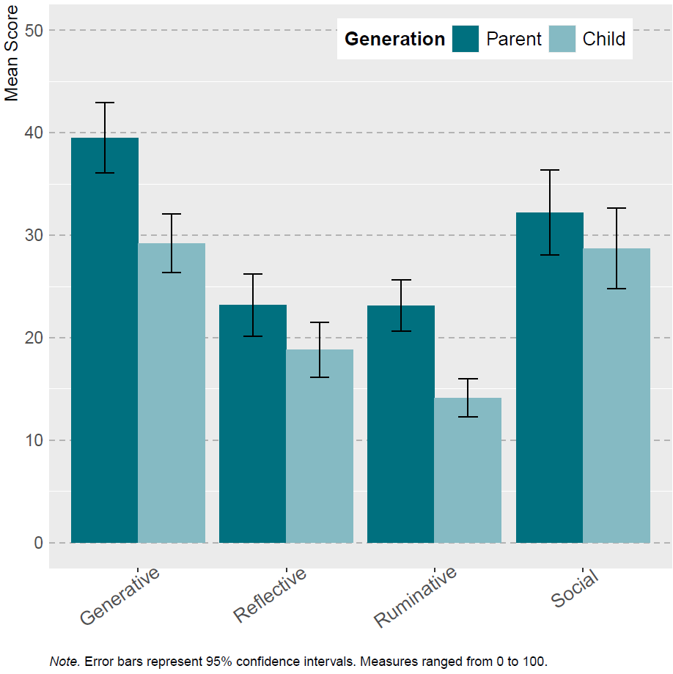
Parent-Child
**
p < .001 ***
p < .01 **
p < .05 *
Generation
  Generative: parents > children
  Reflective: parents > children
  Ruminative: parents > children
*
**
Notes:
Triple interaction non-significative

Slide 16
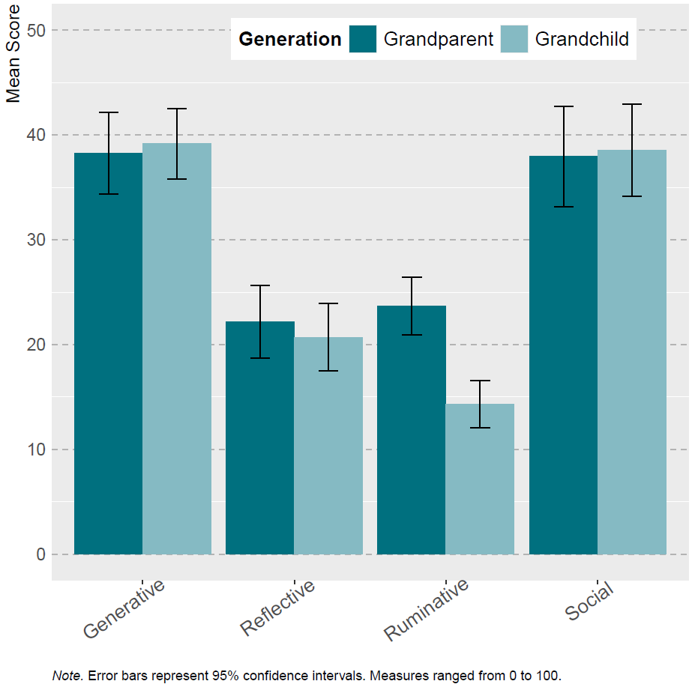
Grandparent-Grandchild
p < .001 ***
p < .01 **
p < .05 *
Generation
  Ruminative: grandparents > grandchildren
***
Notes:
Triple interaction non-significative

Slide 17
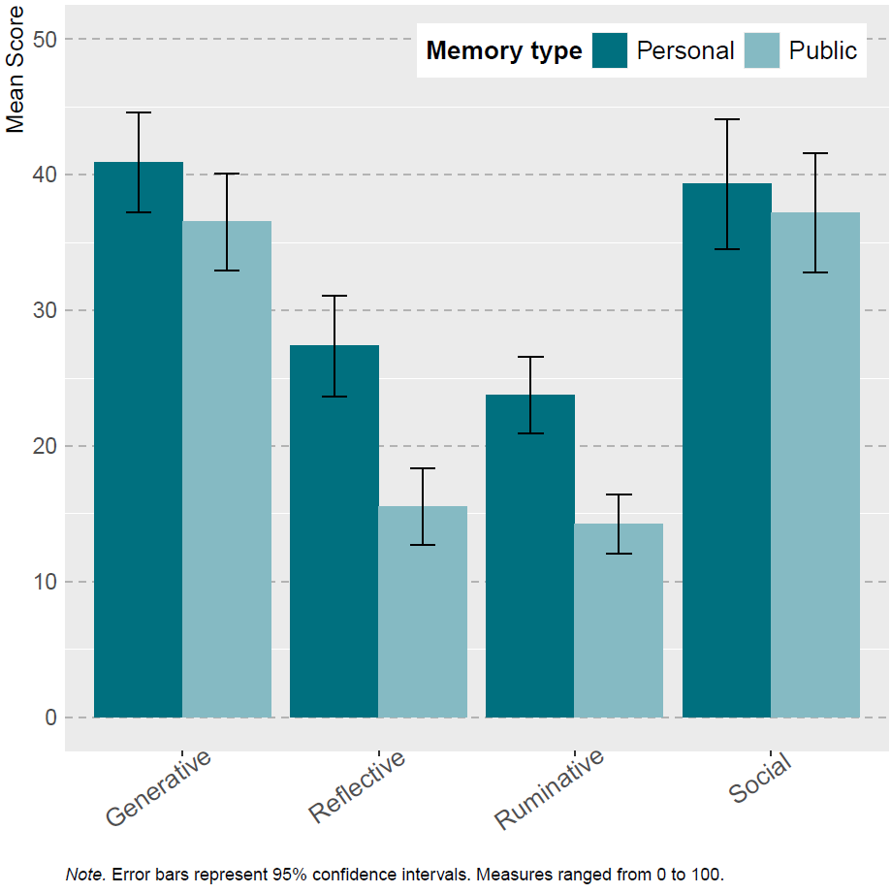
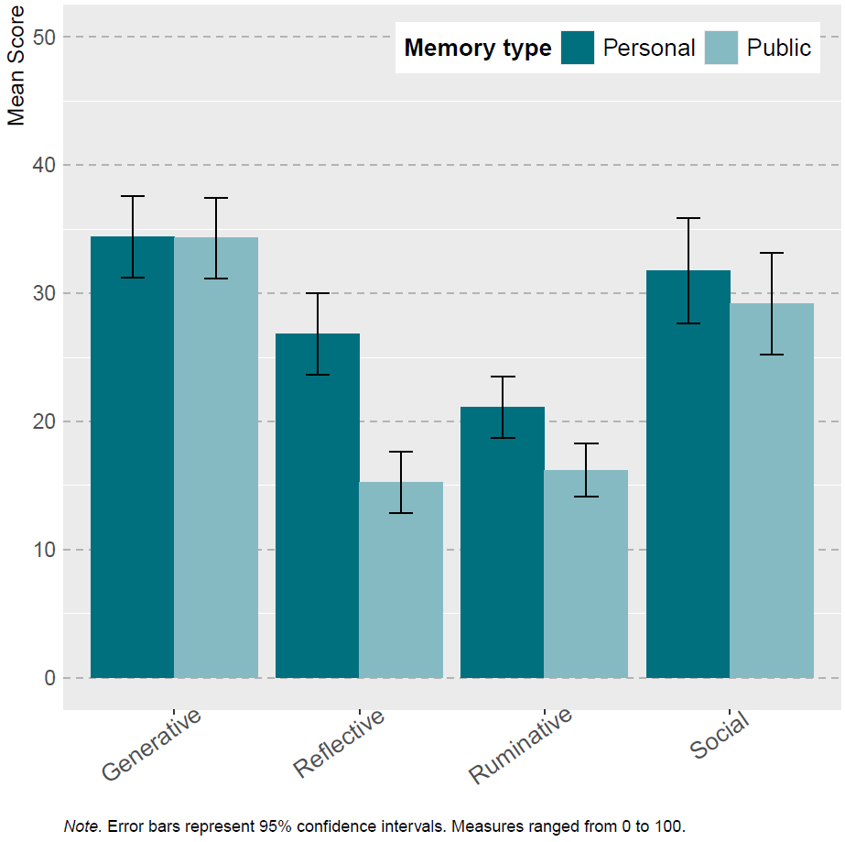
Personal vs. public
p < .001 ***
p < .01 **
p < .05 *
Grandparent-grandchild
Parent-child
***
***
***
*
Notes:
Triple interaction non-significative

Slide 18
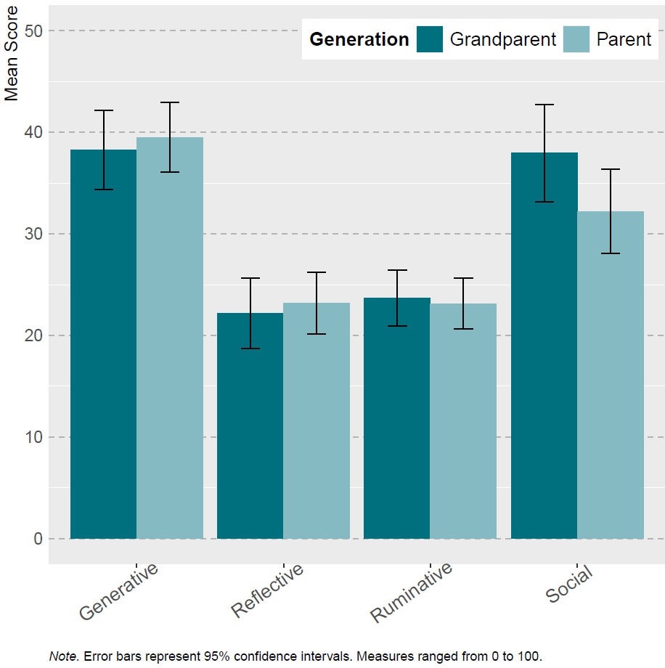
Parent vs. grandparent
p < .001 ***
p < .01 **
p < .05 *
Why transmitters share their stories ?
  No difference
Notes:
Triple interaction non-significative

Slide 19
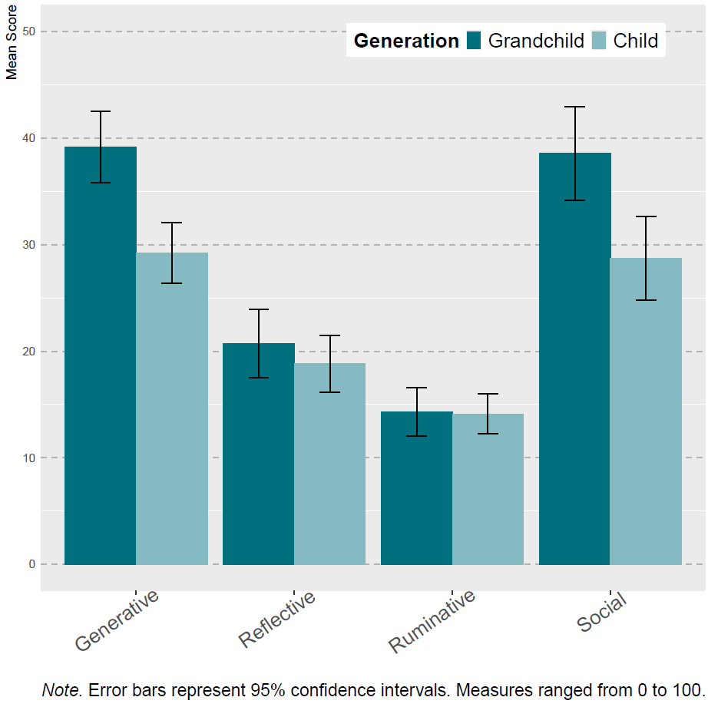
Child vs. grandchild
*
p < .001 ***
p < .01 **
p < .05 *
Why the younger generation remember these stories ?
  Generative function :
  Stories from grandparents > stories from grandchildren
Notes:
Triple interaction non-significative

Slide 20
Results - summary
Both personal and public memories help transmit values and initiate conversations
vs.
CAPITALISM
Personal memories provide more self-related information than public memories
Notes:
Motivations of parents and grandparents to transmit important personal and public memories to younger generations and the motivations of the younger generation to remember memories from the older generations

Slide 21
Spark conversation/bond
Values (leave positive impact)
Personal background
Share adverse self-related information (ruminative)
Spark conversation/bond
Values
Personal background
vs.
Create discussion/bond
Pass down important values
Share origins (reflective function)
Discuss adverse events
Create conversation/bond
Notes:
Motivations of parents and grandparents to transmit important personal and public memories to younger generations and the motivations of the younger generation to remember memories from the older generations

Slide 22
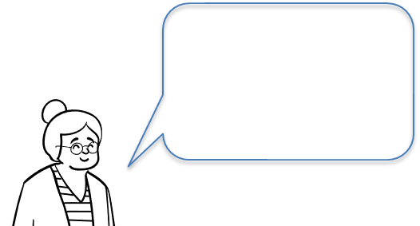
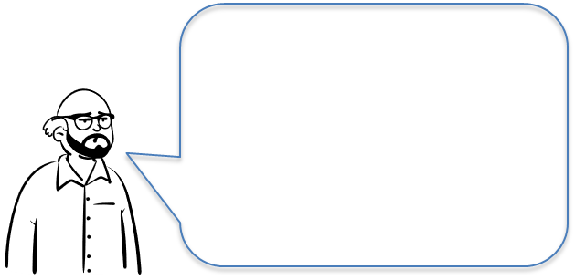
=
CAPITALISM
>
values
Notes:
Motivations of parents and grandparents to transmit important personal and public memories to younger generations and the motivations of the younger generation to remember memories from the older generations

Slide 23
Motivations for telling a story are not always the same as the ones for remembering it (Harris et al., 2024)
Intergenerational memory sharing helps preserve generational links
For older generations, memories are ways to teach values, teach about where they are from, about life
Younger generations : learn values, especially from grandparents?
  Grandparents’ stories play a role in identity development (Green, 2019)
More memory transmission linked to higher levels of well-being among adolescents and young adults, including improved self-esteem and emotional regulation (Chen et al., 2021; Duke et al., 2008; Fivush et al., 2010; Fivush et al., 2011; Merrill et al., 2017)
Leave something behind
  Generativity linked to life-satisfaction (McAdams et al., 1993)

Slide 24
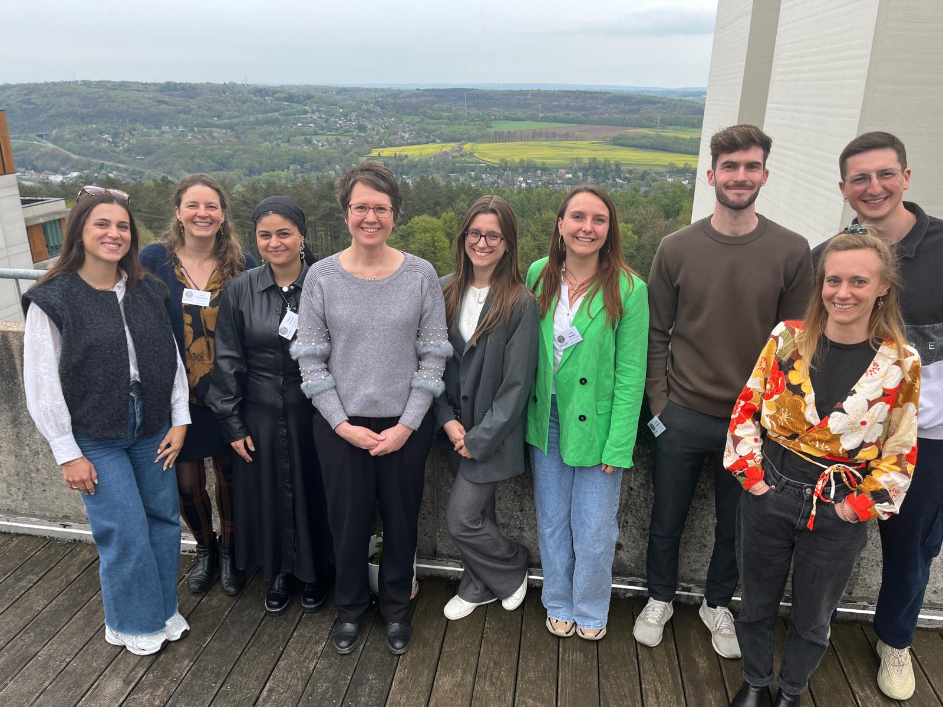
Thank you for your attention
david.baudet@uliege.be

Slide 25

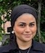





12/06 14:30 - 15:50 Moore Abbey Suite
14/06 15:20 - 16:40 Belling Suite
“What is familiarity? The complex nature of an apparently simple form of memory”
Christine Bastin
“Intergenerational memory transmission of historical events”
Aline Cordonnier
ORAL PRESENTATION
13/06 10:20 - 11:20 Lockewood Suite
13/06 10:20 - 11:20 Boardroom 1
“Personal and Collective Memories and Future Thoughts: An analysis of episodic and semantic content across two studies”
Nawël Cheriet
“Novelty Enhances Memory: Besides Providing Novel Spatial Environments, Virtual Reality also Constitutes a Novel Distinctive Experience”
Anaïs Servais
13/06 19:00 - 21:00 Thompson/Ainsworth Suite
“The similarity of memories in parent-child dyads: A relation with reminiscing style”
Dr. Nawël Cheriet
“Preserved structural gists in healthy ageing but impaired short-term memory visuospatial details”
Jérémy Gardette
POSTERS
“Improving Memory in Older Adults with Mild Memory Difficulties: Enhancing Encoding Through Music and Metacognition”
Elisa Balthasart
“Method of Loci and Semantic Link: Evaluating the Memory Benefit in Healthy Aging”
Laure Debroux
“The role of visual imagery and semantic memory in short-term memory conjunctive binding : a study in aphantasia”
Emma Delhaye

Slide 26
G1G3:
  Same: ~21% (41/196)
G2G3:
  Same: ~18% (45/256)

Slide 27
Main hypotheses
Parent-Child
  Generative: parents > children
  Reflective: children > parents
  Personal > public
Grandparent-Grandchild
  Ruminative & social : grandparents > grandchildren
  Reflective & generative: grandchildren > grandparents
  Personal > public

Slide 28
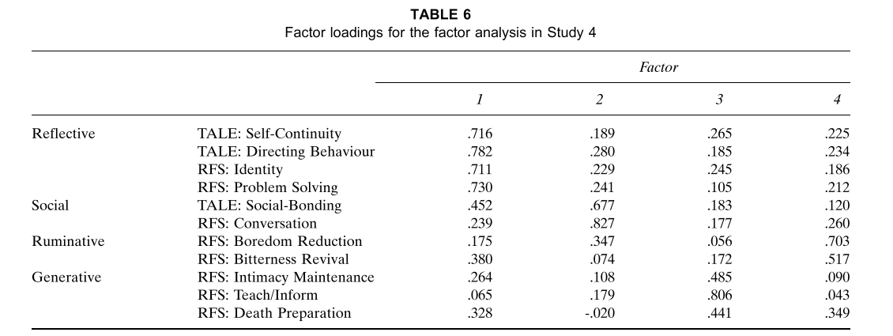
Harris, C. B., Rasmussen, A. S., & Berntsen, D. (2014). The functions of autobiographical memory: An integrative approach. Memory, 22(5), 559-581. https://doi.org/10.1080/09658211.2013.806555

Slide 29
Adapted CES
Je pense que cet événement est devenu une partie intégrante de mon identité personnelle et/ou familiale.
Cet événement est devenu un point de référence pour la façon dont je me comprends moi-même et/ou ma famille.
Cet événement est devenu un point de référence pour la façon dont je comprends le monde.
Je pense que cet événement est central dans mon histoire personnelle et/ou familiale.
Cet événement a un impact sur la manière dont je perçois d'autres événements.
Cet événement a changé de manière permanente ma vie et/ou celle de ma famille.
Je pense souvent aux effets que cet événement a et aura sur ma propre vie.
Cet événement a été un tournant dans l'histoire de ma vie et/ou celle de ma famille.

Slide 30
G2G3_predic2 <- lmer(G3 ~ G2C+Func.class+ G2C:Func.class + (1|ID), data= df_predic)
Within duo analysis
  Parent’s scores predict children’s scores?
  When parents score higher on social and generative functions, their children tend to score lower on these functions?
 | Parent - Child
 | Estimate | p-value
Reflective | 0.04 | 0.5489
Social | -0.24 | <.0001
Ruminative | 0.13 | 0.0868
Generative | -0.15 | 0.0393
Notes:
Analyse de fréquences des différentes fonctions des enfants en fonction des fonctions du parent

Slide 31
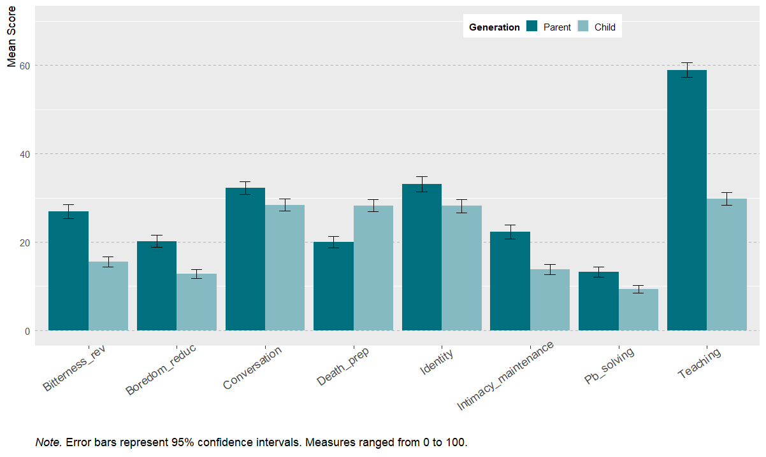

Slide 32
