Slide 1

Complications associated with misreduction of supracondylar fracture of humerus in children
Dr Schrouff Isabelle
Orthopaedica Belgica 2026
Notes:
I am Isabelle Schrouff and I come from the University Hospital of Liège.
i'm going to talk to you about the problems and complications that can arise from improper fracture reduction of the distal Humerus.

Slide 2

Epidemiology-supracondylar fracture of the humerus
60% of the elbow
17% of the fracture of children
Prevalence :7 years old
2 types: -in extension (95%)
-in flexion(5%)
Notes:
Supracondylar fractures of the elbow account for 60% of elbow fractures
It accounts for 17% of fractures in children
They are most common in 7-year-old children and can be of two types: extension in 95% of cases and flexion in 5% of cases.

Slide 3
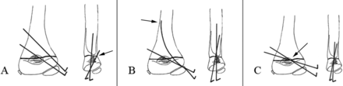

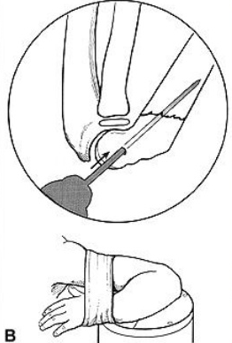
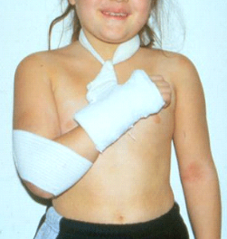
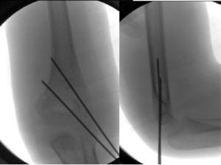
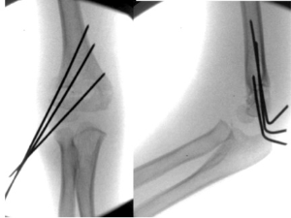
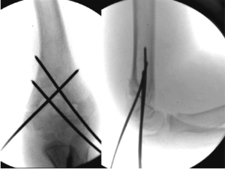
Reduction and/or fixation
Notes:
Here you can see the Blunt technique, which is an orthopedic reduction, and the different methods of fracture fixation.
You must secure it with at least 2 pins: One laterally and one medially or two laterally. Or more pins

Slide 4
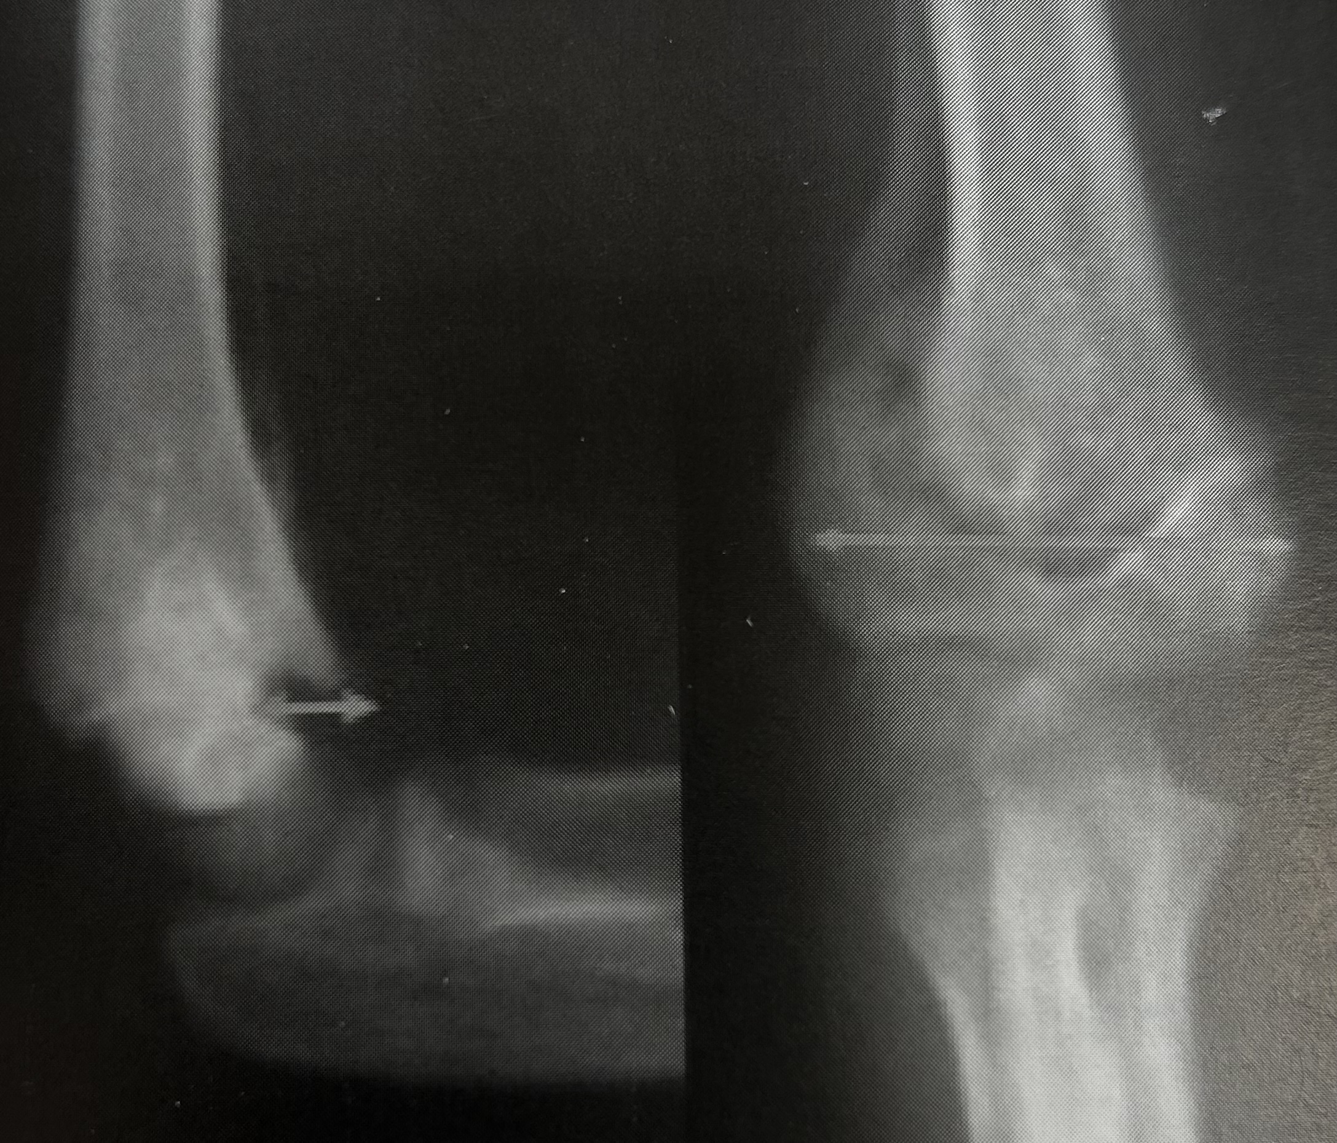
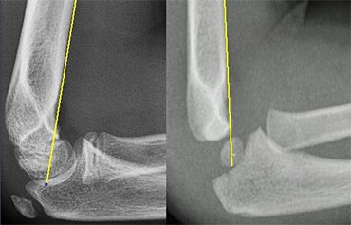
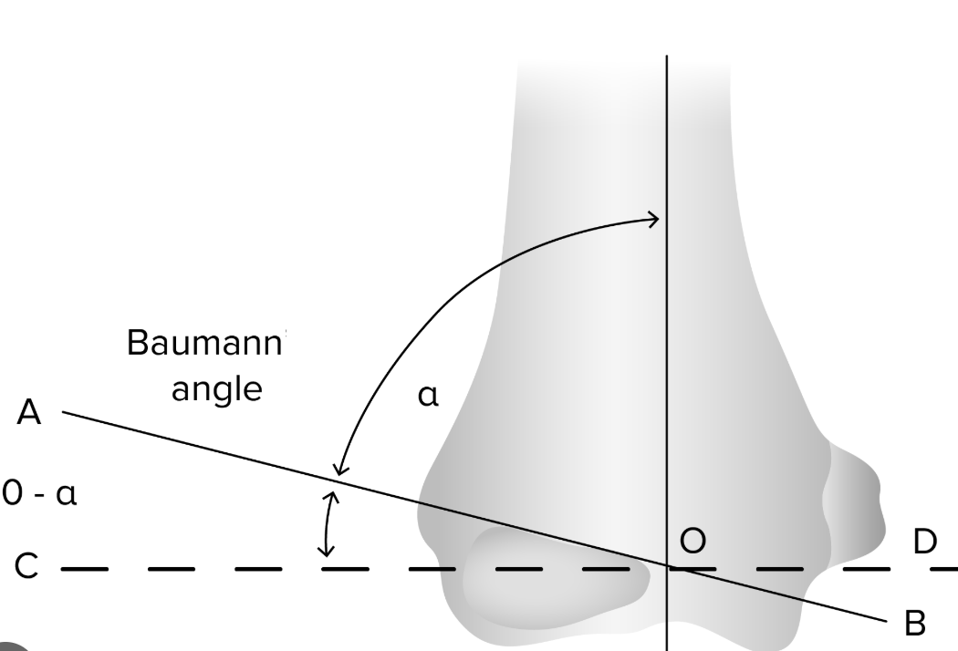
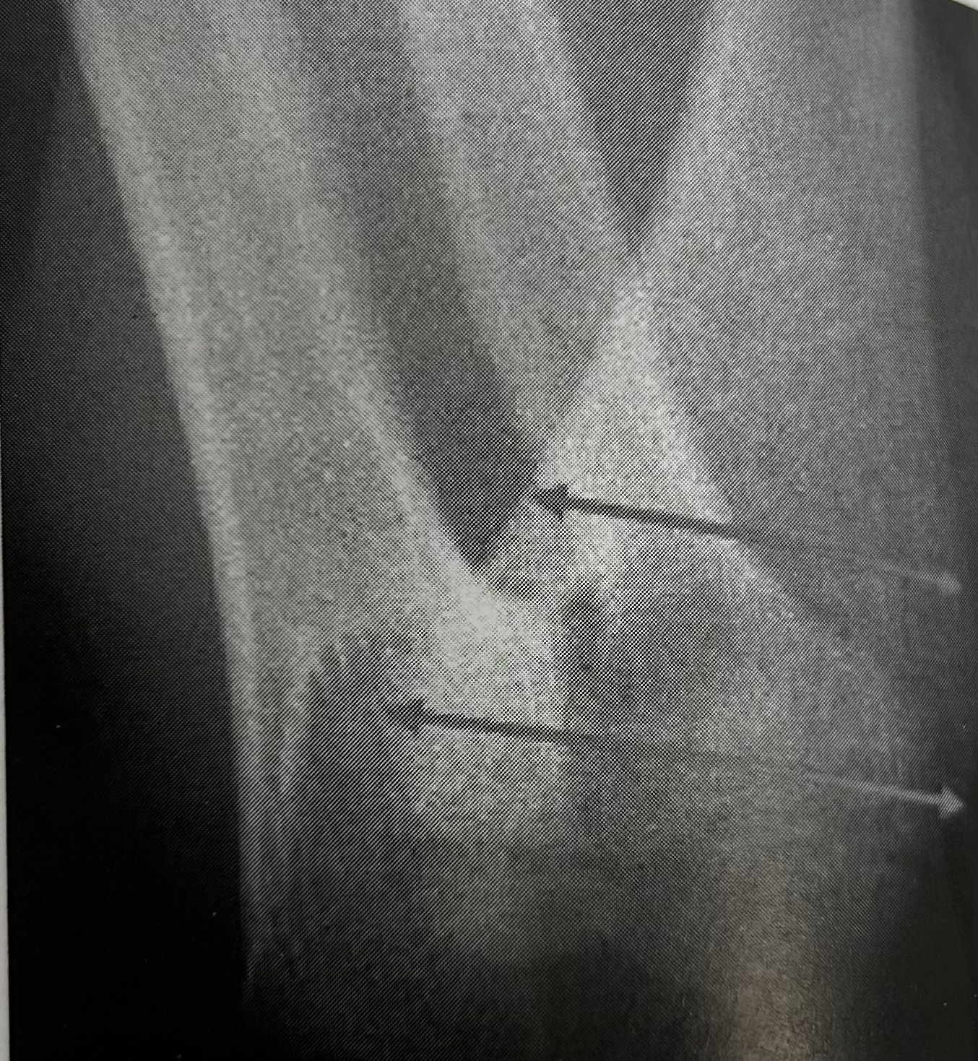
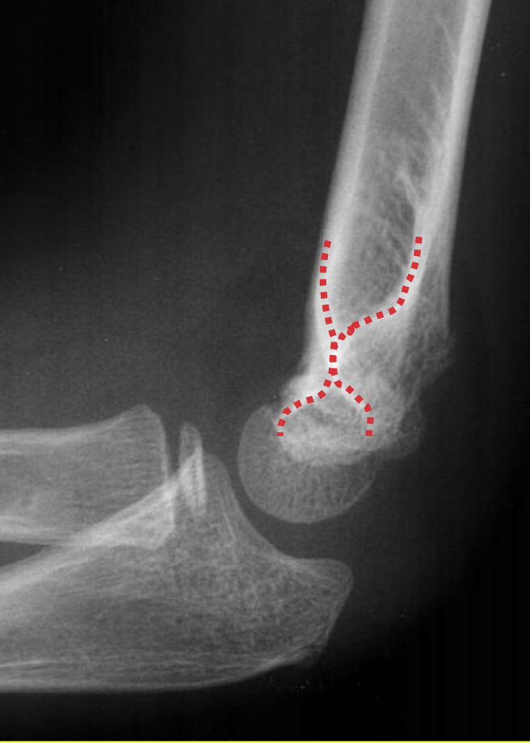
Criteria for reduction
Rogers ‘s line
Hourglass
restoring the columns
Bauman’s angle
malrotation quotient
Notes:
Here are the criteria you need to ensure you get a good reduction on your fracture
Rogers' line is the line that passes through the anterior cortex of the humerus and must pass through the capitelum.
You must find the hourglass symbol
You need to restore the medial and lateral columns.
It measures the inclination of the physis (growth plate) of the lateral condyle relative to the axis of the humerus. A normal value is generally between 70° and 80°.
The malrotation quotient is equal to the width of the metaphyseal beak on the lateral view divided by the width of the humeral epiphysis measured on an anteroposterior view.
If the malrotation quotient is less than 0.1, it is not associated with an axis disorde

Slide 5
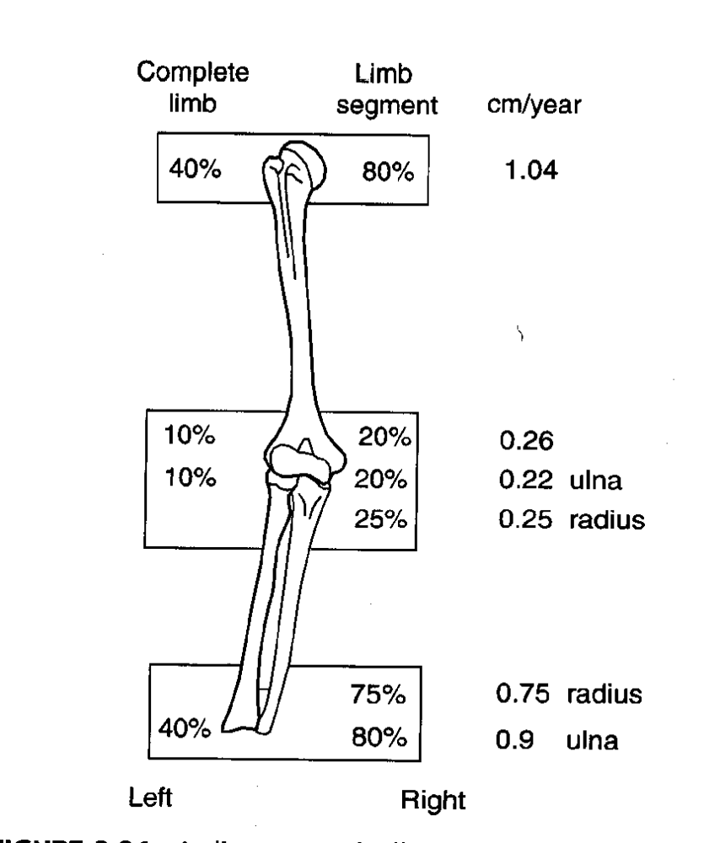
Remodeling
Far from the elbow, close to the knee
At 6 years old, the residual growth of the humerus is 10 cm, of which 2 cm is for the distal physis.
Notes:
Growth occurs primarily in the proximal humerus and not in the distal humerus.
At age 6, the humerus grows by 10 cm, of which only 2 cm is for the distal physis.
The remodeling potential of the distal humerus is very low.

Slide 6
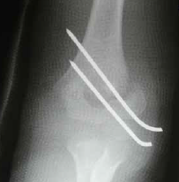
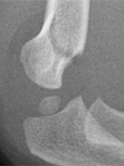
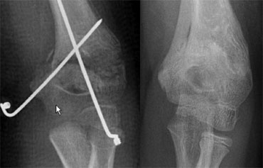
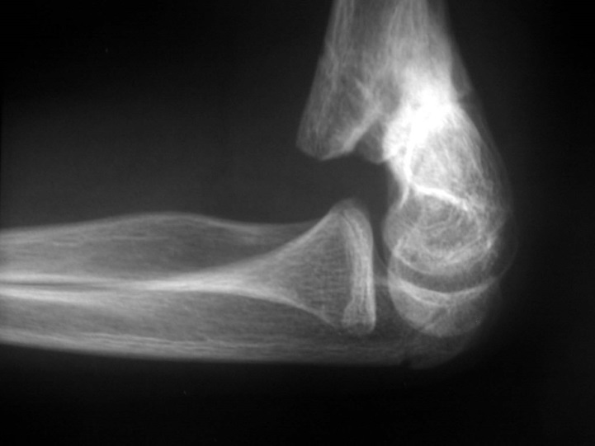
Remodeling vicious callus
In the sagittal plane, less than 20°
In the coronal plane, no correction
In rotation, no correction
In translation, good correction
Notes:
Very little angulation in the sagittal plane can be expected to remodel. Lack of of extension or flexion depending of deformity

Slide 7
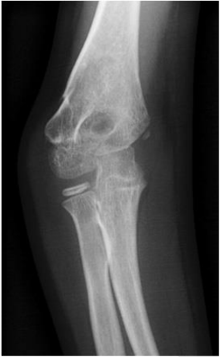
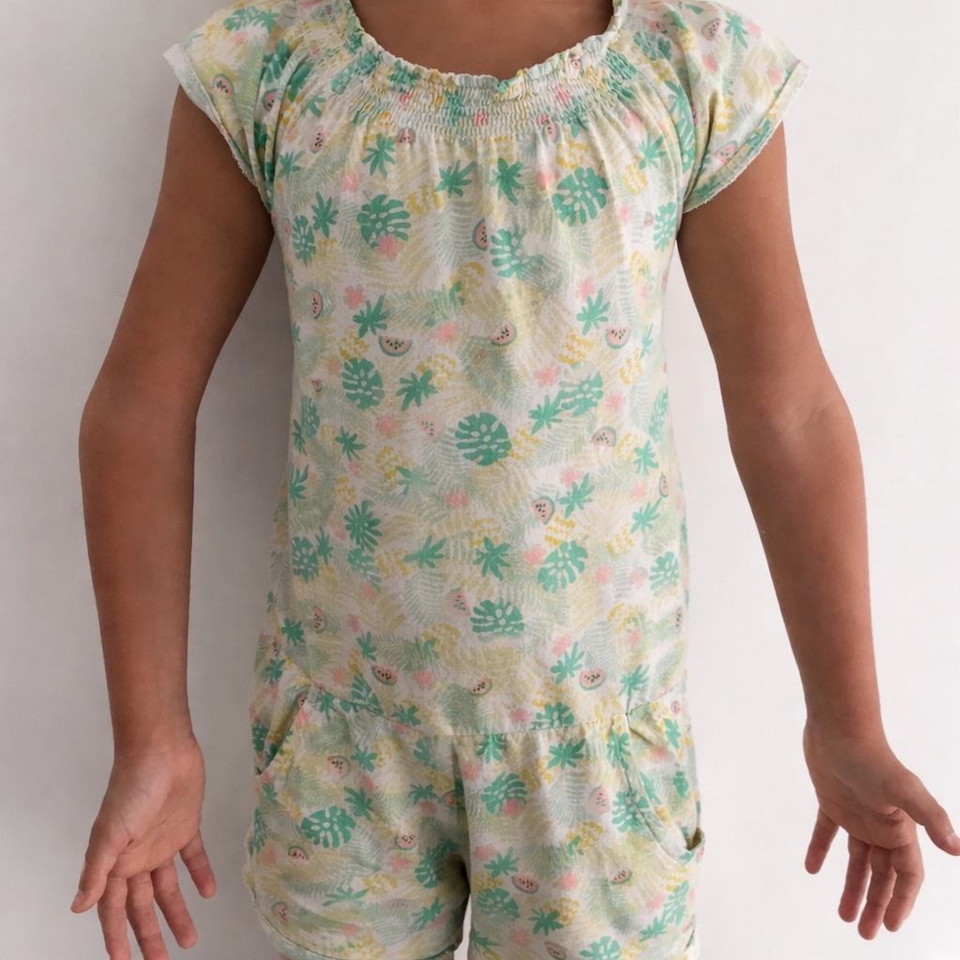
vicious rotating callus
  deviation of the forearm in extension , cubitus varus (3-58%)
Notes:
The deformation is often poorly tolerated aesthetically but gives a fairly good functional result; flexion and extension can limit but not significantly

Slide 8
long-term complications
iterative fracture
Chronic pain
late posterolateral rotational instability
progressive subluxation of the ulnar nerve (transfer, neurolysis?)
posterior shoulder instability

Slide 9
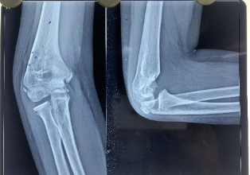
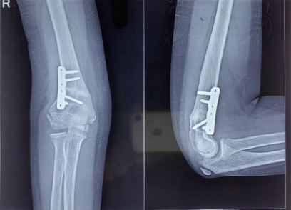
Cubitus Varus
Good function, deformities intolerable
Correction:-deformation >15-30° (tolerance?)
-high rate of complications (25%):nonunion, nerve palsies, loss of motion …
-lateral, medial, posterior approch.
-fixation: pins or plate-screw
Notes:
In cubitus varus deformities, the aesthetic deformity is significant, but the function of the elbow is good.

Slide 10
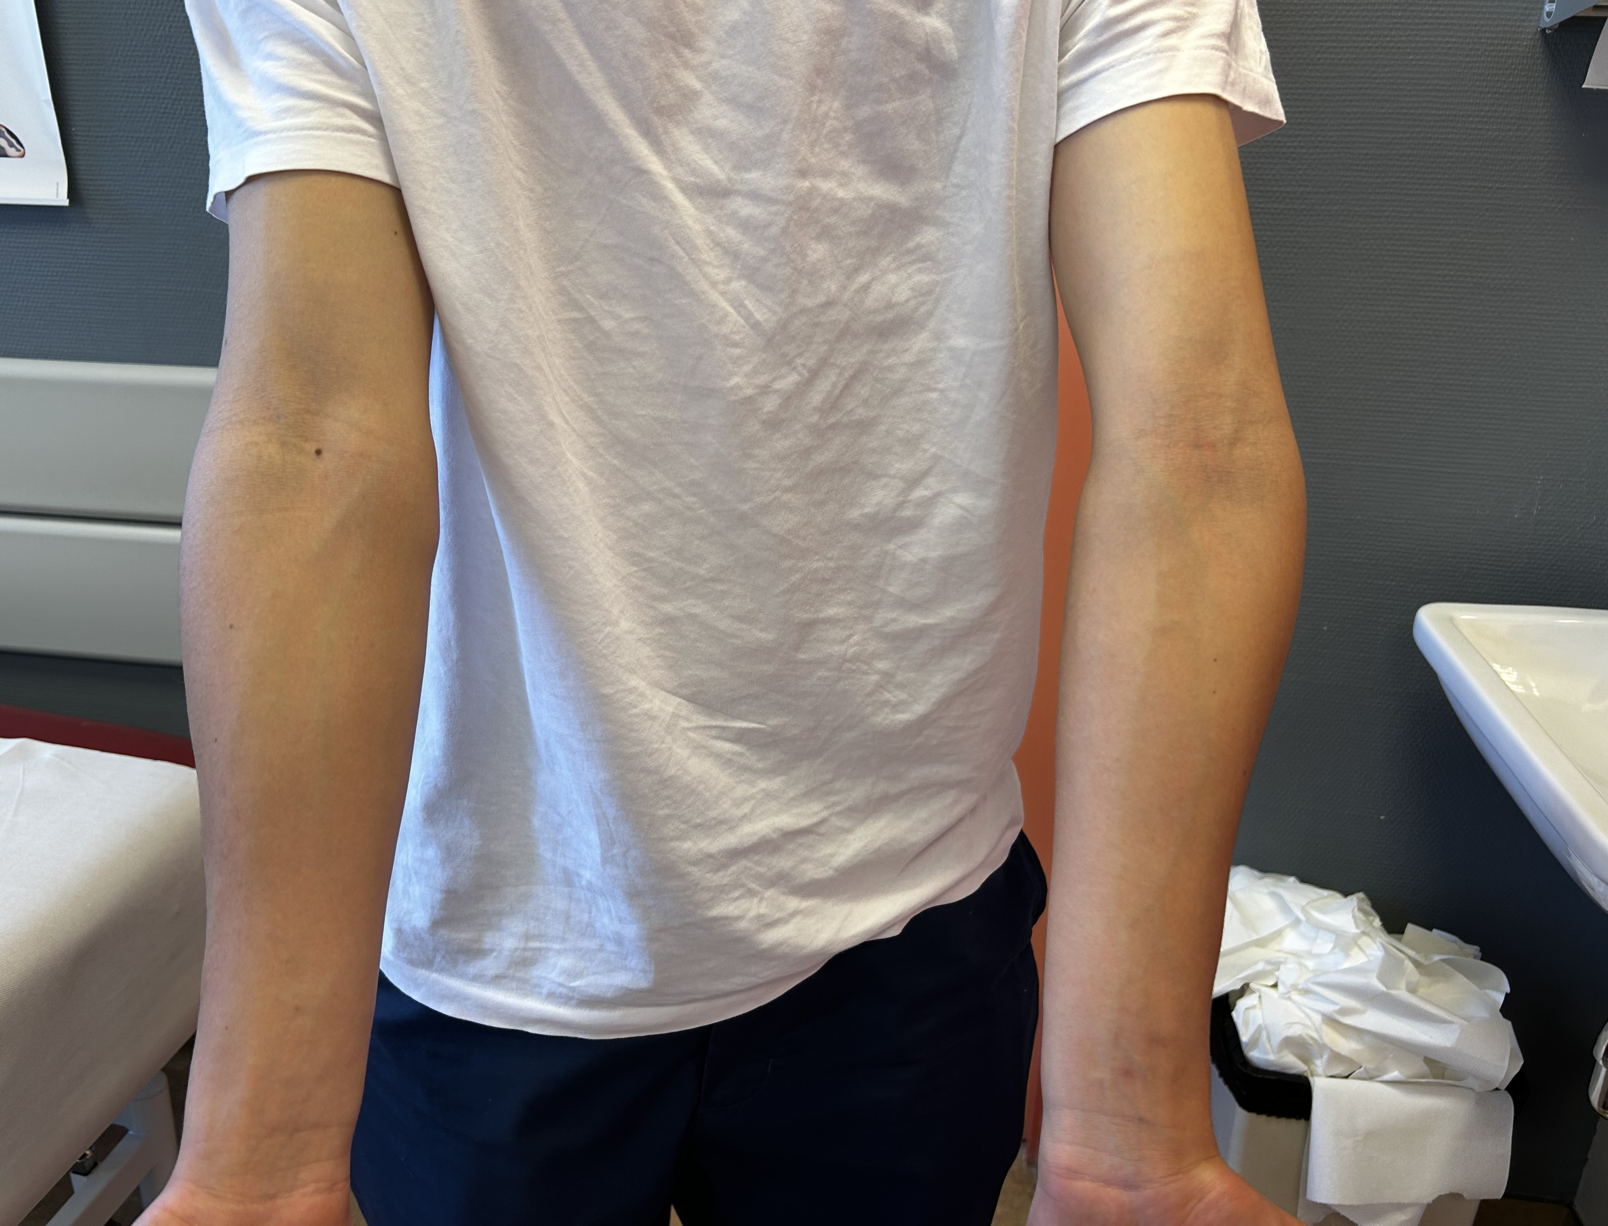
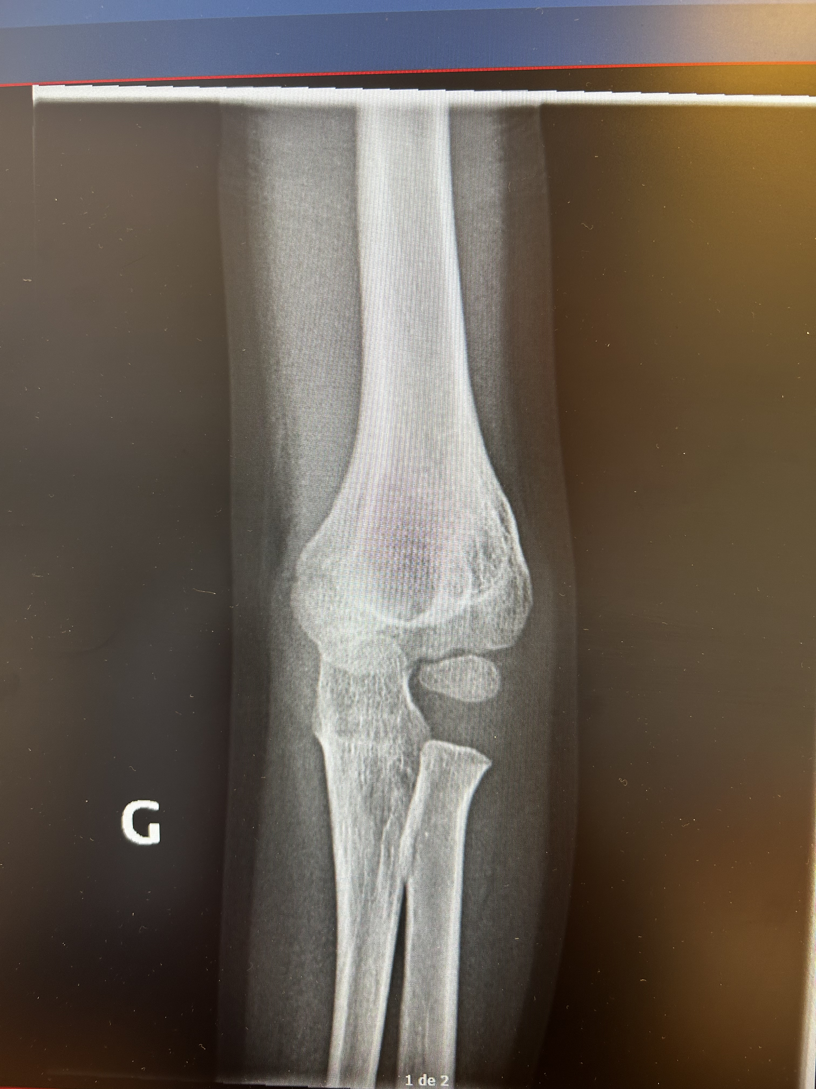
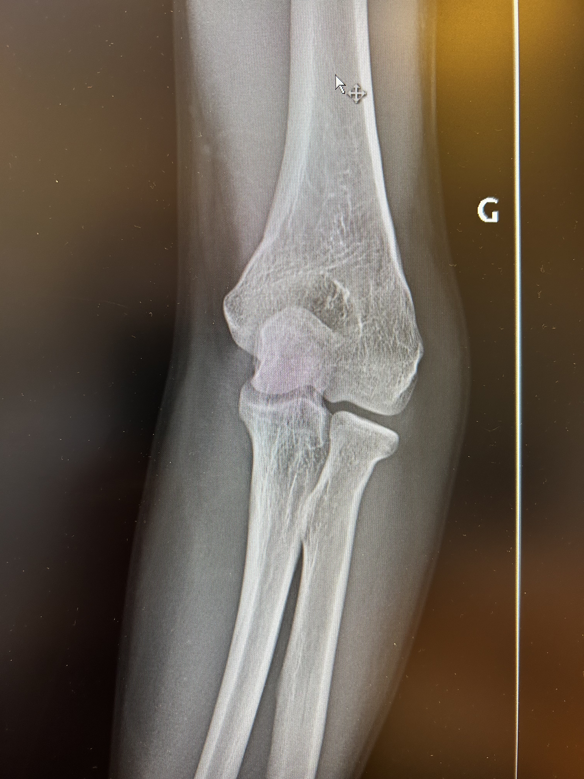
Notes:
Here you can see the example of a young, high-level basketball player
Elbow function is good with only a 5-degree flexion deficit
He is somewhat bothered by the aesthetic appearance of his elbow
His coach is requesting a correction because he believes his shot is less accurate due to the deformation.
Despite his coach's wishes and after discussion, the child prefers not to have his elbow corrected due to the post-operative risks

Slide 11
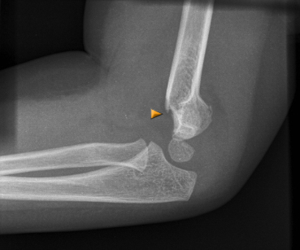
vicious callus in extension
Flexion deficit due to abutment
Notes:
Flexion or extension deficits are much less well tolerated, especially in elite athletes, where even a small deformity can have significant impacts.

Slide 12
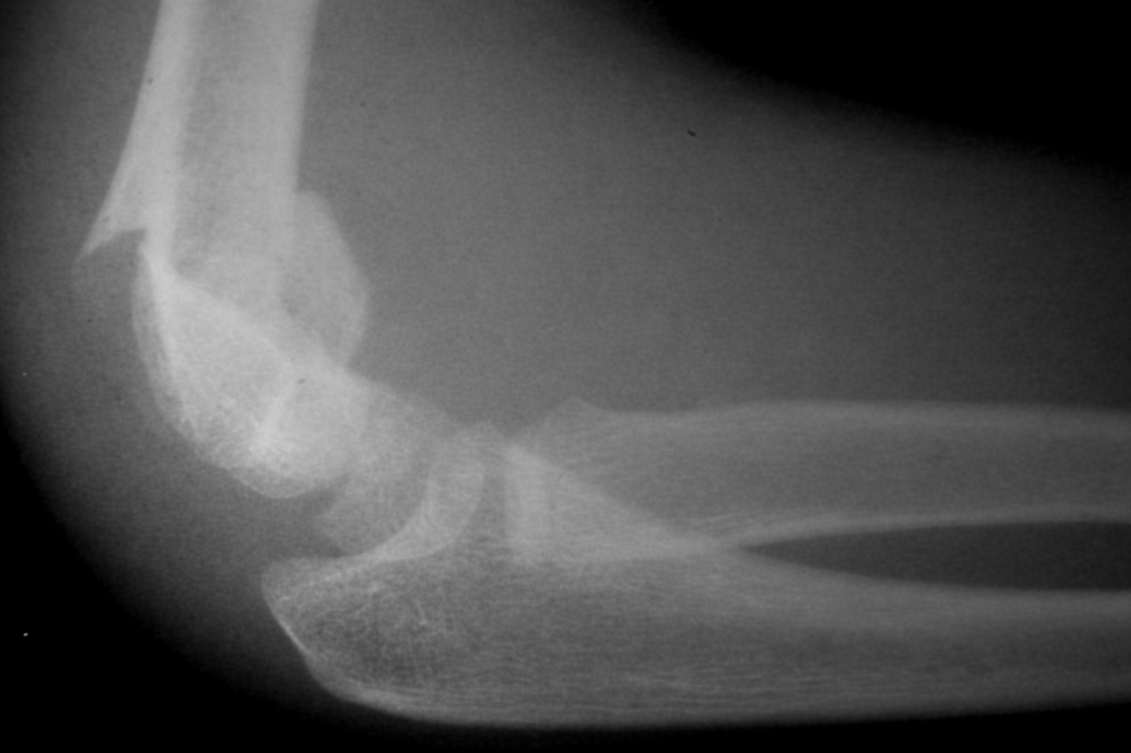
vicious callus in flexion

Slide 13
Vicious callus in extension-flexion
Due to bad reduction or loss of reduction
need to operate again quickly, within 15 days maximum
Little correction with remodeling
Loss of flexion and greater extension

Slide 14
When?
Immediately or the next day.
Before the 15th day and in percutanous before the 7th day.
If not rapidely, it’s better to wait the complete consolidation.

Slide 15
How?
It’s better to change methode ( open if closed, surgically if conservatory..)
For late revisions, a low humeral osteotomy must be performed. (no places for orthesis or epiphysiodesis).

Slide 16
Late revision
Ostetomy has to be near the initial fracture
no lateral or medial hinge osteotomy
pay attention to the anteversion of the palette
to assess the rotational defect
accurately assess the deformation in the frontal plane

Slide 17
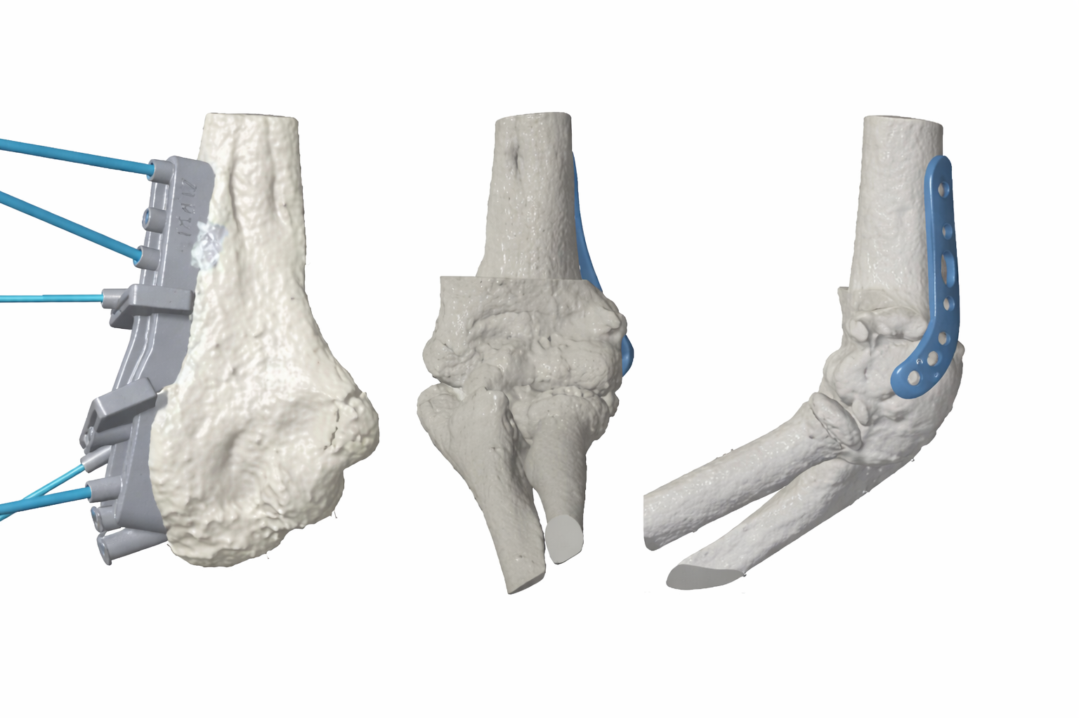
3D planning with cutting guide
Notes:
Increasingly, there are developments with three-dimensional cutting guides.
These guides are very useful for correctly correcting the palette, but their size makes them difficult to use epecially in the children

Slide 18
Thank you
Questions?

