Slide 1
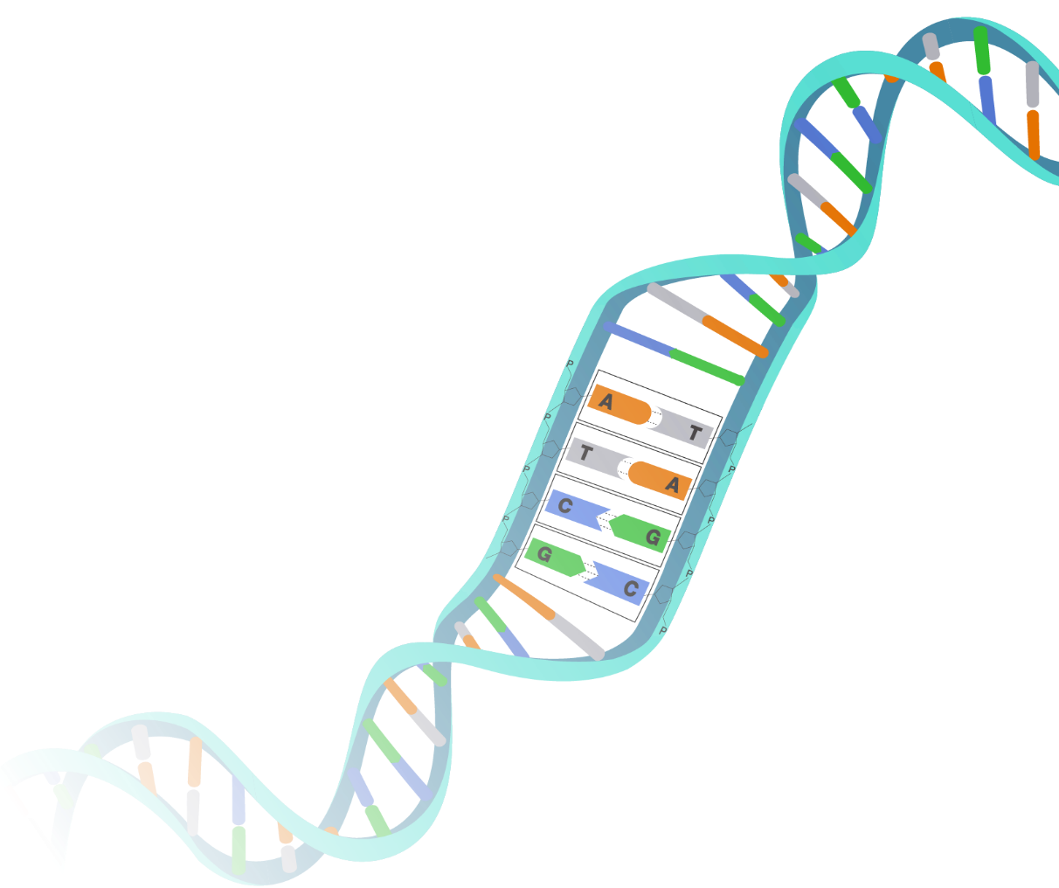




14th International Conference on Bioinformatics and Computational Biology
March 27, 2026 @ Kitakyushu, Japan
Improving GAN-Generated Splice Site Sequences Through Conditional Frequency Guidance
Espoir Kabanga, Wesley De Neve, Arnout Van Messem

Slide 2
Overview
What is a splice site and why does it matter?
Frequency blending framework
Dataset and GAN architecture
Results
Conclusions
2/16
2

Slide 3
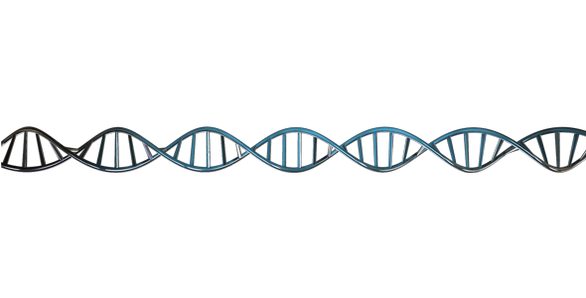
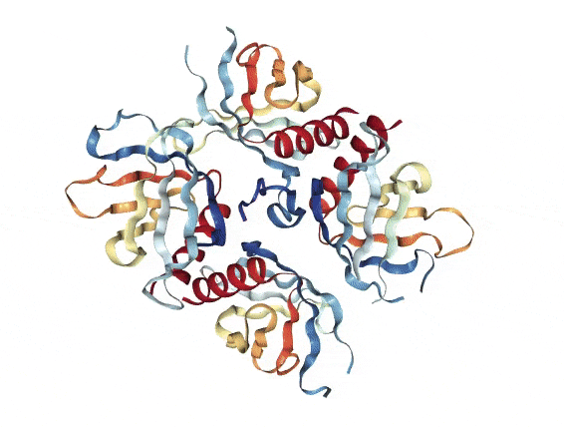
What is a splice site and why does it matter?
Donor splice site
Acceptor splice site
UTR
Exon
Intron
Exon
Intron
Exon
Intron
Exon
UTR
GT
AG
GT
AG
GT
AG
3/16
3
Notes:
Each cell of the human body contains 23 chromosome pairs. Each chromosome pair has a number of genes that regulate the creation of proteins (bottom drawing). Those proteins all have different kinds of functionality in the body.
After transcription (copying of DNA to messenger RNA), each gene can be split up in a couple of parts
- A leading and a trailing untranslated region
- Exons (coding regions), that make for the coding of proteins
- Introns (non-coding regions), that regulate the selection of exons
Very simplified version: between transcription and translation, all exons get combined together, and the final protein is formed based on that sequence.

Slide 4
What is a splice site and why does it matter?
Exon
Intron
Exon
Intron
Exon
Intron
Exon
GT
AG
GT
AG
GT
AG
Why does predicting splice sites matter?
  Improves understanding of gene regulation
  Improves genetic annotation
  Facilitates research on diseases
4/16
4
Notes:
Gene regulation — One gene can produce dozens of different proteins depending on how it is spliced
Genome annotation — Helps identify where genes start and end in newly sequenced organisms
Disease research — Faulty splicing causes conditions like muscular dystrophy, sickle-cell anemia, and certain cancers

Slide 5
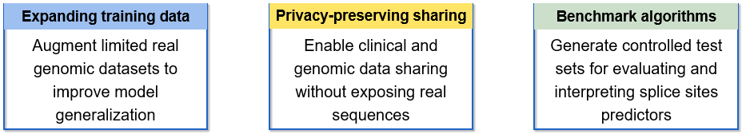
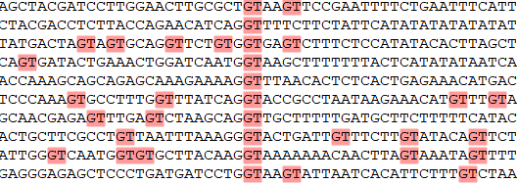
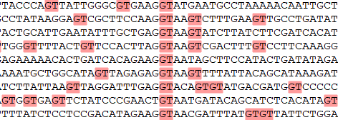
What is a splice site and why does it matter?
Why synthetic splice site sequences?
Real sequences
Synthetic sequences
Versus
Synthetic sequences can look realistic but may not be functional…
5/16
5
Notes:
Synthetic sequences serve four practical purposes: they expand limited real datasets to build better-trained models, enable safe data sharing without exposing sensitive patient information, provide controlled test sets for fairly evaluating prediction algorithms, and allow consistent comparisons across different species and models.
Synthetically generated sequences can look realistic overall but consistently miss the precise nucleotide patterns at specific positions that define a functional splice site.

Slide 6
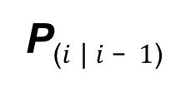
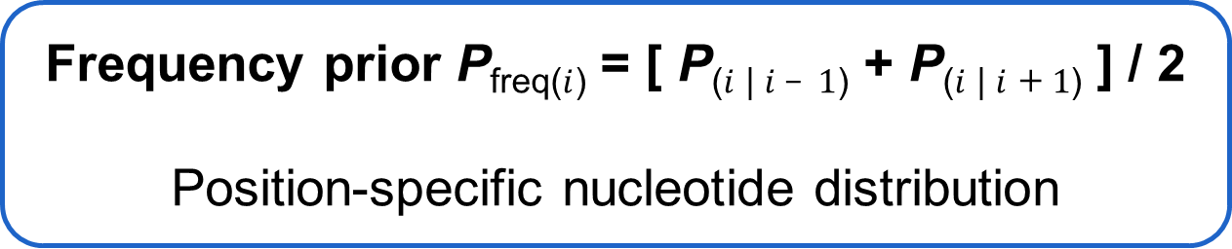



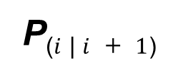
Frequency blending framework
The probability of a nucleotide at position $i$ is estimated from its immediate neighbors
$$i − 1$$
$$i$$
$$i + 1$$
A
Left neighbor
?
T
Right neighbor
P₍$i$ | $i – 1$₎
P₍$i$ | $i + 1$₎
Frequency prior P_{freq(}$i$₎ = [ P₍$i$ | $i – 1$₎ + P₍$i$ | $i$ $+ 1$₎ ] / 2
Position-specific nucleotide distribution
6/16
Notes:
DNA sequences are made up of four nucleotides A, C, G, and T, arranged in a specific order. In real splice sites, this order is not random: certain nucleotides tend to appear next to specific others. Conditional frequency analysis captures this pattern.
The figure focuses on one position in the sequence, marked with a question mark. Instead of guessing what nucleotide belongs there independently, we look at its two immediate neighbors, the nucleotide just to its left (i−1) and the one just to its right (i+1). From a large collection of real sequences, we can measure how often each nucleotide appears at position i when the left neighbor is, say, A, and separately when the right neighbor is T. These two measurements are called conditional probabilities, written as P(i | i−1) and P(i | i+1), where the vertical bar simply means "given that we know." So P(i | i−1) reads as "the probability of nucleotide at position i, given the nucleotide at the previous position."
Each of these two conditional probabilities produces a distribution over the four possible nucleotides, for example, it might tell us that given a A to the left, position i is 60% likely to be A, 20% C, 15% G, and 5% T. The two distributions are then averaged, divided by 2, to combine both neighboring influences equally. The result is what we call a frequency prior p_freq(i), a single probability distribution that reflects the biological tendencies observed in real data from both sides of the target position.
This prior essentially encodes the question: "given what we see on either side, what nucleotide is most likely here?" The result is a position-specific distribution that respects the local sequence context, rather than treating each position as if it were independent of its surroundings. This is important because splice sites are defined not just by individual nucleotides, but by the patterns they form together.

Slide 7
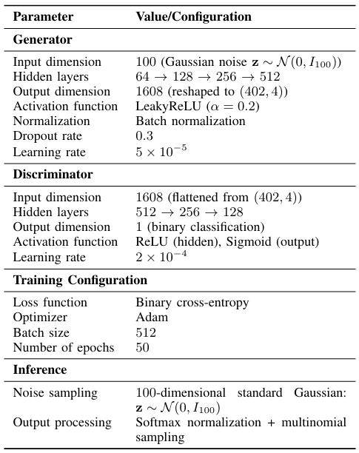
Dataset and GAN architecture
Dataset (DRANetSplicer*)
GAN architecture details
Arabidopsis thaliana
Total #sequences: ~64,000
GAN training set: 50,000
Splice types: Donor & Acceptor
Homo sapiens
Total #sequences: ~120,000
GAN training set: 100,000
Splice types: Donor & Acceptor
Sequence length: 402 bp (centered on splice boundary)
* Liu, X. et al. (2024). DRANetSplicer: A Splice Site Prediction Model Based on Deep Residual Attention Networks. Genes.
7/16
Notes:
Details on the dataset used and our GAN architecture

Slide 8
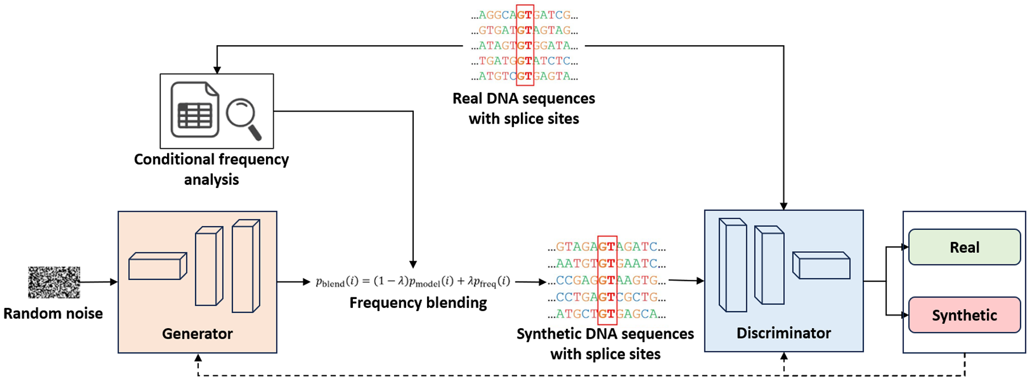


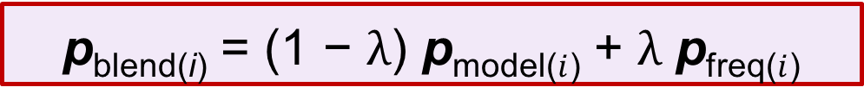
Dataset and GAN architecture
p_{blend(i)} = (1 − $λ$) p_{model(}$i$₎ + $λ$ p_{freq(}$i$₎
$$λ$$
0.0
0.25
0.5
0.75
1.0
No-Blend
Model dominating
Perfectly balanced
Frequency prior dominating
8/16
Notes:
The figure illustrates how the frequency-blended GAN framework generates synthetic splice site sequences. The process begins on the left, where random noise is fed into the Generator, a neural network that learns to produce DNA sequences from scratch. On its own, the Generator would output sequences that look plausible but miss important biological patterns. This is where conditional frequency analysis plays a role: by examining real DNA sequences, it extracts position-specific nucleotide patterns and passes them to the blending step.
Before blending can happen, the Generator's raw outputs, called logits, are first converted into proper probabilities using a mathematical operation called softmax normalization. Softmax takes a set of arbitrary numerical values and transforms them into a probability distribution, meaning all four nucleotide probabilities at each position sum to exactly 1. This normalized output is what we call p_model(i), the Generator's predicted probability distribution at position i.
Frequency blending then combines p_model(i) with p_freq(i), the frequency prior obtained from real sequences, using the formula p_blend(i) = (1 − λ) · p_model(i) + λ · p_freq(i). Here, i refers to a specific position along the sequence, p_blend(i) is the final blended probability distribution at that position, and λ is a mixing parameter between 0 and 1 that controls the balance between the two sources. When λ is close to 0, the blended output relies almost entirely on the Generator. When λ is close to 1, it relies more heavily on the patterns observed in real sequences. A value of λ = 0.5 gives equal weight to both. Once the blended distribution is computed at every position, a nucleotide is sampled from it independently, producing the final synthetic sequence.
These synthetic sequences are then passed to the Discriminator, another neural network whose job is to tell real and synthetic sequences apart. Both real sequences from biological databases and the newly generated synthetic ones are evaluated side by side. The Discriminator's feedback is sent back to the Generator through the dashed loop at the bottom, pushing it to continuously improve. Over many training rounds, this competition between the Generator and the Discriminator results in synthetic sequences that are increasingly difficult to distinguish from real ones.

Slide 9
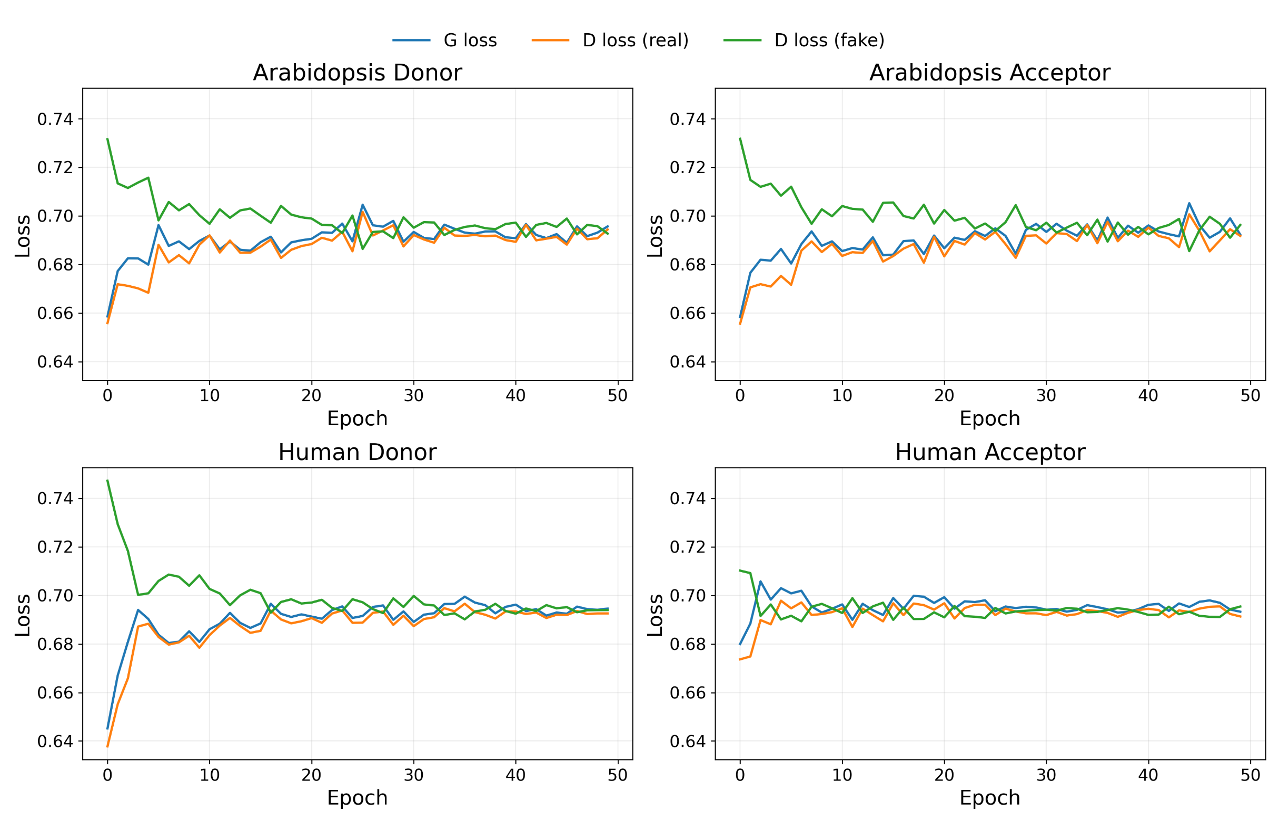
Dataset and GAN architecture
9/16
Notes:
On this slide, we can see how the Generator and Discriminator losses evolve over 50 training epochs across all four datasets. At the start of training, the three curves begin at different values, reflecting the initial imbalance between the two networks. As training progresses, all three losses converge and stabilize around 0.69, which is the expected equilibrium value for a GAN trained with binary cross-entropy loss. This convergence indicates that neither network is consistently winning the competition, a sign of stable adversarial training. The pattern is consistent across both species and both splice site types, confirming that the training behavior is reliable and not specific to one dataset.

Slide 10
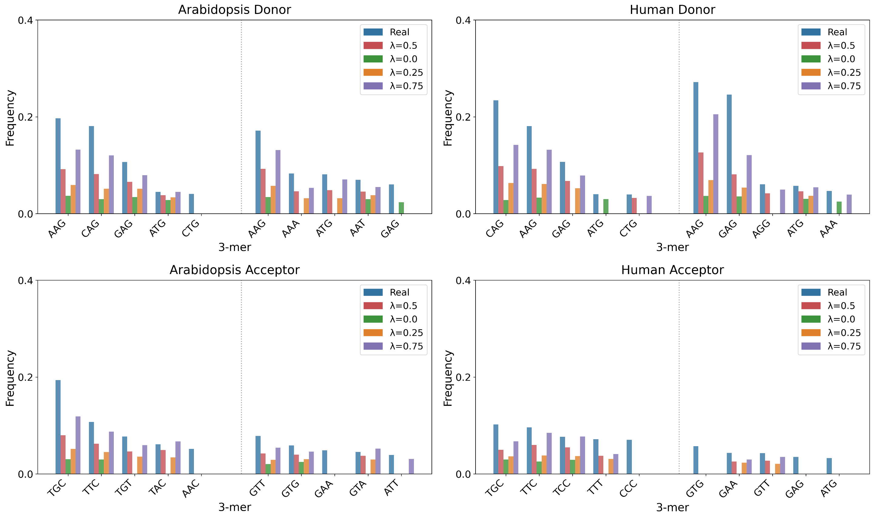
Results: Direct biological evaluation
Frequency blending progressively incorporates biological positional information,
higher $λ$ provides stronger enforcement of empirical motifs
10/16
Notes:
Each bar chart compares the frequency of the ten most common 3-mers, immediately flanking the splice junction. The five patterns on the left of each chart are the top upstream patterns, and the five on the right are the top downstream patterns. The blue bars represent real sequences and serve as the reference.
As the blending weight increases, synthetic sequences progressively recover the nucleotide patterns observed in real sequences, with higher λ values producing colored bars that more closely match the blue reference. This improvement is consistent across both species and both donor and acceptor splice site types. Notably, some patterns are entirely absent in synthetic sequences yet clearly present in real data, as highlighted by the red circles, illustrating how synthetic sequences can completely miss biologically critical local sequence patterns.

Slide 11
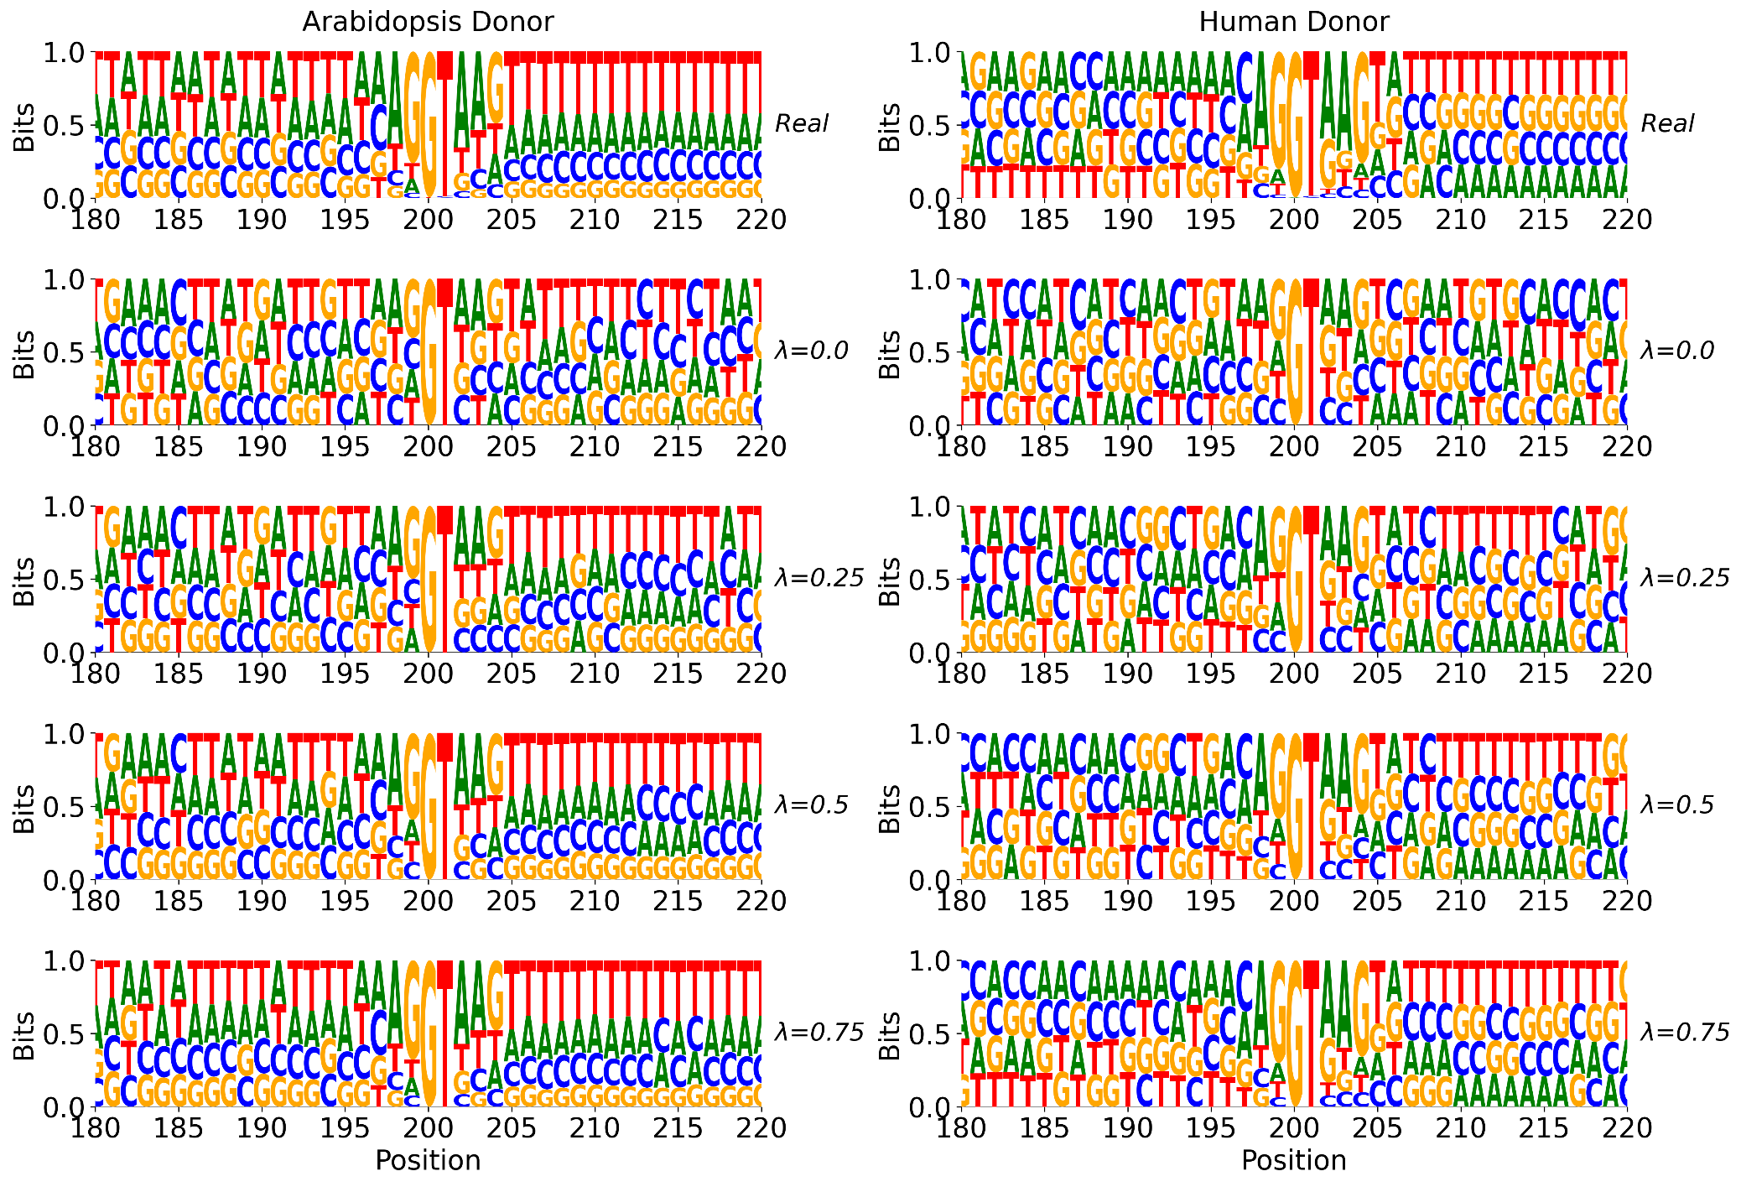
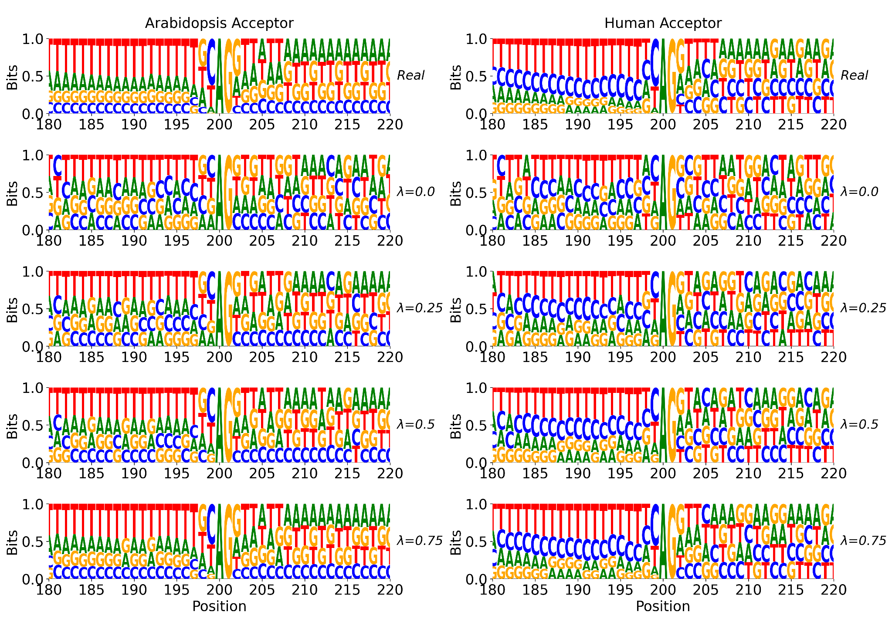
Results: Direct biological evaluation
Frequency blending progressively incorporates biological positional information,
higher $λ$ provides stronger enforcement of empirical motifs
11/16
Notes:
Sequence logos are a standard way to visualize how conserved each position is in a set of DNA sequences. The taller the letter at a given position, the more consistently that nucleotide appears across all sequences in that group. Each column in this figure shows one dataset, and each row corresponds to a different blending weight, with the top row always showing real sequences as the reference.
In the real sequences, strong and consistent nucleotide patterns are visible around the splice junction, particularly in the highlighted regions. At λ = 0.0, these patterns are largely absent or weakened, confirming that unguided generation fails to reproduce biologically meaningful conservation. As the blending weight increases toward λ = 0.75, the logos progressively resemble the real reference, with taller and more consistent letters emerging at the critical positions. This visual recovery of conservation patterns is consistent across both species and both splice site types.

Slide 12
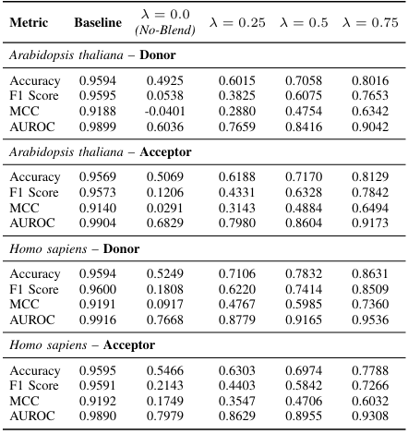
Results: Indirect evaluation
Model architecture: SpliceRover*
Scenario 1: Train-Real / Test-Synthetic (baseline : Train-Real / Test-Real)
Species/Type | Train | Valid | Test
Arabidopsis donor | 100,000 | 14,056 | 120,000
Arabidopsis acceptor | 100,000 | 15,156 | 120,000
Homo sapiens | 200,000 | 39,254 | 120,000
Homo sapiens | 200,000 | 36,748 | 120,000
Synthetic sequence quality improves consistently with higher blending weights, though a gap in predictive performance with the baseline confirms that real sequences remain richer in discriminative biological features
12/16
*Zuallaert, J. et al. (2018). SpliceRover: interpretable convolutional neural networks for improved splice site prediction, Bioinformatics.
Notes:
This table reports how well a splice site predictor, trained exclusively on real sequences, performs when tested on synthetic sequences generated at different blending weights. A high score means the synthetic sequences carry enough biological signal to be recognized by a model that has never seen them before.
At λ = 0.0, performance is near random across all four datasets, with accuracy around 0.49 to 0.52 and near-zero F1 and MCC scores, indicating that unblended synthetic sequences bear little resemblance to real ones. As the blending weight increases, all metrics improve consistently and substantially. At λ = 0.5, accuracy reaches above 0.69 and AUROC above 0.84 across all datasets. At λ = 0.75, results approach the baseline in several cases, with Homo sapiens donors reaching an accuracy of 0.86 and an AUROC of 0.95. Despite this progress, a gap with the baseline remains across all conditions, confirming that synthetic sequences still do not fully replicate the discriminative features present in real genomic data.

Slide 13
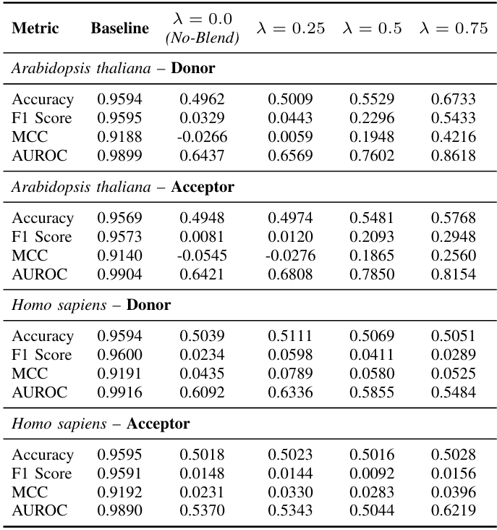
Results: Indirect evaluation
Model architecture: SpliceRover*
Scenario 2: Train-Synthetic / Test-Real (baseline : Train-Real / Test-Real)
Species/Type | Train | Valid | Test (EnsembleSplice**)
Arabidopsis donor | 120,000 | 5,160 | 16,000
Arabidopsis acceptor | 120,000 | 5,504 | 16,000
Homo sapiens | 120,000 | 39,254 | 16,000
Homo sapiens | 120,000 | 36,748 | 16,000
Synthetic sequences alone cannot substitute for real data as training material, particularly for the more complex human genome where the domain gap remains severe regardless of blending weight
* Zuallaert, J. et al. (2018). SpliceRover: interpretable convolutional neural networks for improved splice site prediction, Bioinformatics.
** Akpokiro, V. et al. (2022). EnsembleSplice: ensemble deep learning model for splice site prediction. BMC Bioinformatics.
13/16
Notes:
This table reports how well a splice site predictor, trained exclusively on synthetic sequences, performs when tested on real sequences. This scenario directly measures how much biological knowledge transfers from synthetic to real data.
For Arabidopsis thaliana, blending brings modest but visible improvements. Donor sites show gradual gains with increasing λ, reaching an AUROC of 0.86 at λ = 0.75, while acceptor sites improve more slowly and remain further from the baseline. For Homo sapiens, the results tell a different story: performance stays near random across all blending weights for both donors and acceptors, with accuracy hovering around 0.50 and MCC values close to zero regardless of λ. This indicates that synthetic sequences, even heavily blended, fail to transfer meaningful biological information for the more complex human genome.
The contrast between the two species points to a fundamental limitation: local nucleotide patterns captured by frequency blending are sufficient to partially represent the simpler Arabidopsis splice sites, but fall short of capturing the long-range dependencies and structural complexity that characterize human splice sites.

Slide 14
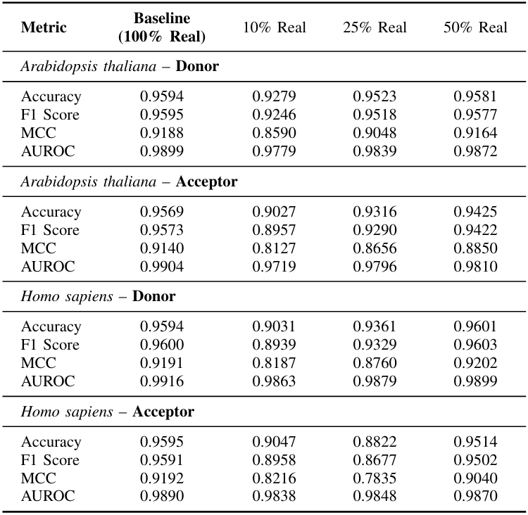
Results: Indirect evaluation
Model architecture: SpliceRover*
Scenario 3: Data augmentation (baseline : Train-Real / Test-Real)
Real fraction | Positive (real+synthetic) | Negatives | Total
10% | 5k / 10k real + 45k / 90k synthetic | 50k / 100k | 100,000 / 200,000
25% | 12.5k / 25k real + 37.5k / 75k synthetic | 50k / 100k | 100,000 / 200,000
50% | 25k / 50k real + 25k / 50k synthetic | 50k / 100k | 100,000 / 200,000
50% real + 50% synthetic achieves near-baseline predictive performance, effectively halving real data requirements
* Zuallaert, J. et al. (2018). SpliceRover: interpretable convolutional neural networks for improved splice site prediction, Bioinformatics.
14/16

Slide 15

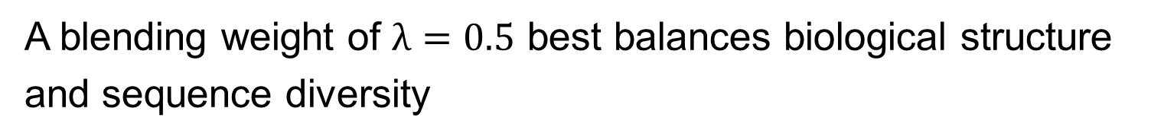
Conclusions
Frequency blending progressively recovers position-specific nucleotide patterns that unguided generation systematically misses
✔
Thank You
✔
A blending weight of $λ=0.5$ best balances biological structure and sequence diversity
Key Paper Contributions
Post-training blending mechanism
✔
Species-specific limits: Arabidopsis thaliana shows strong transfer; Homo sapiens domain shift remains challenging
Two-species validation
Persistent limitations in Homo sapiens suggest that local patterns alone cannot capture the full complexity of mammalian splice sites
$λ$ ablation study
✔
Data augmentation analysis
✔
50% real + 50% synthetic sequences achieves state-of-the-art predictive performance while halving real sequence requirements
15/16

Slide 16



Espoir Kabanga
Research and Teaching Assistant
Center for Biosystems and Biotech Data science
Ghent University Global Campus
E espoir.kabanga@ghent.ac.kr
T +82 32 626 43 06 espoirkabanga.github.io
Ghent University (Global Campus)
@ugent / @ugentkorea
@ugent / @ghentuniv.kor.official
Ghent University

