Slide 1

Introduction to
Design
Spring 2026 – Guest Lecture: Introduction to Sustainable Design

Slide 2
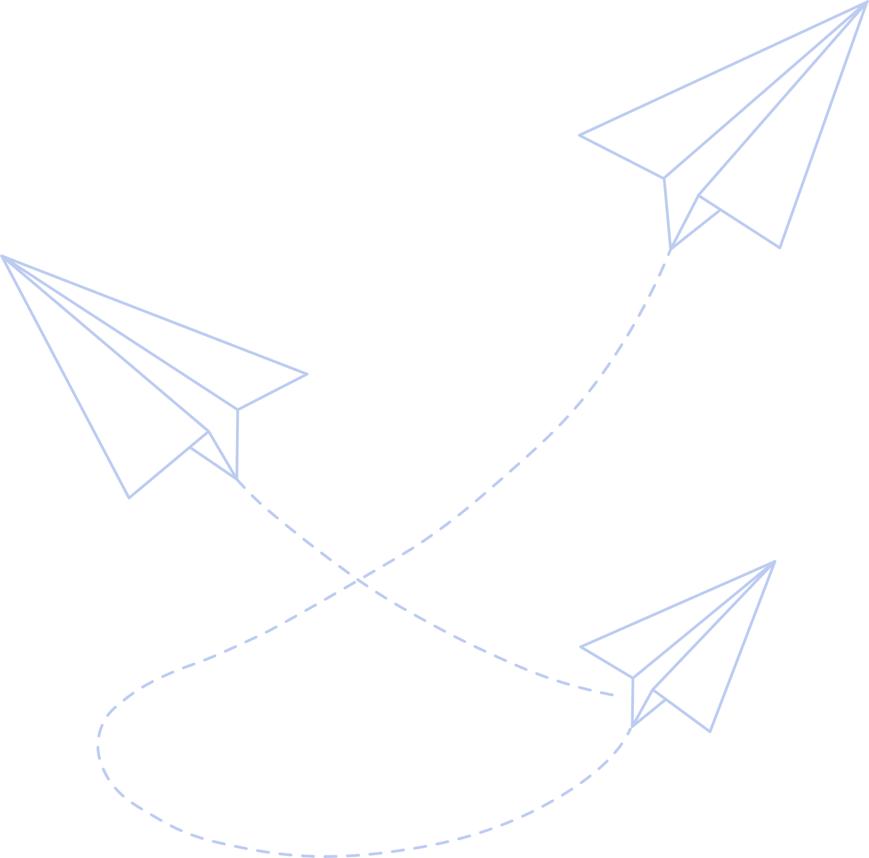
What we’ll cover today
01
02
03
04
Introduction
Sustainability
Why think about sustainability?
What do you mean?
10R Framework
Moreover
A recipe you get to try
For those who’d like to dig deeper

Slide 3





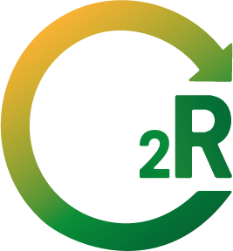

Hello!
I am Audrey
Guest Lecturer – amertens@mit.edu

Slide 4
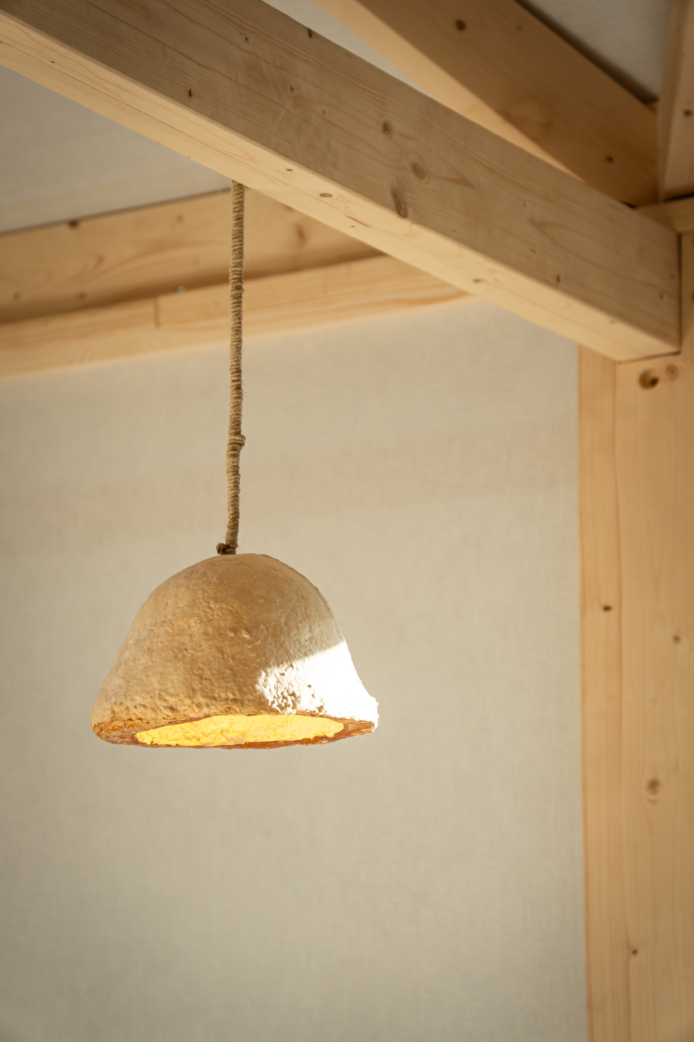
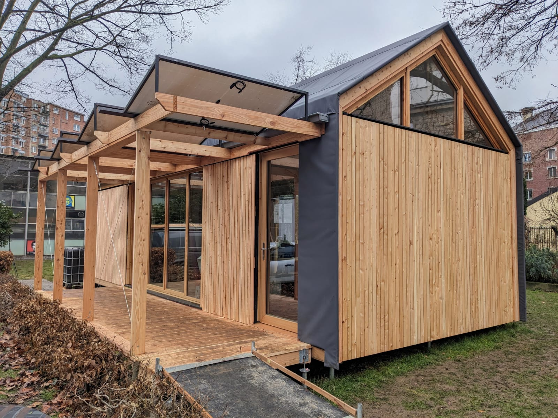
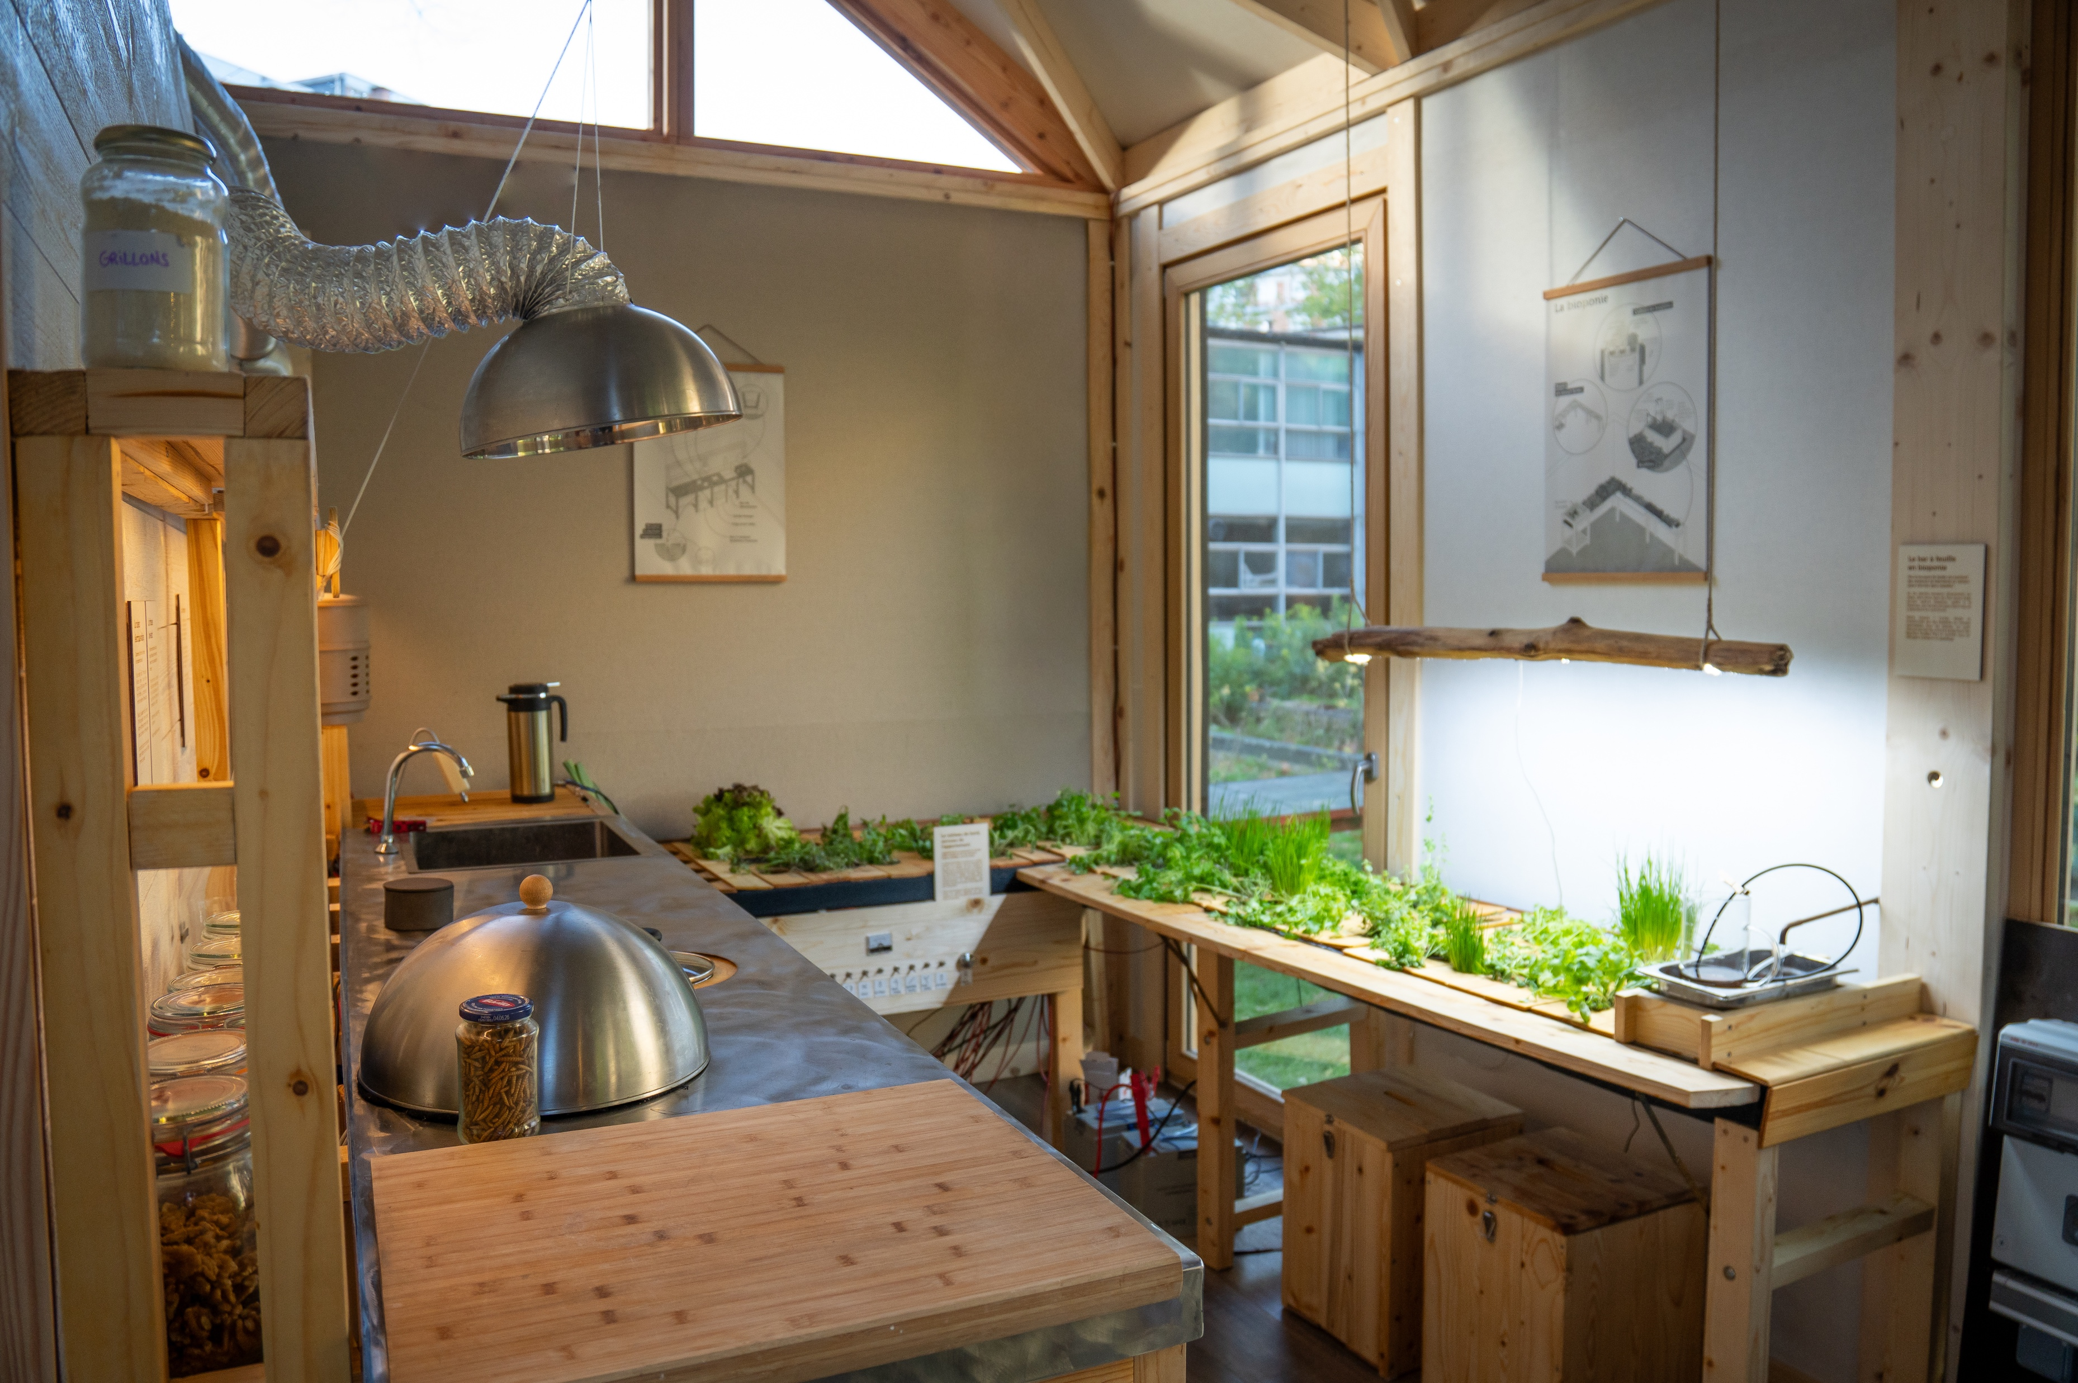
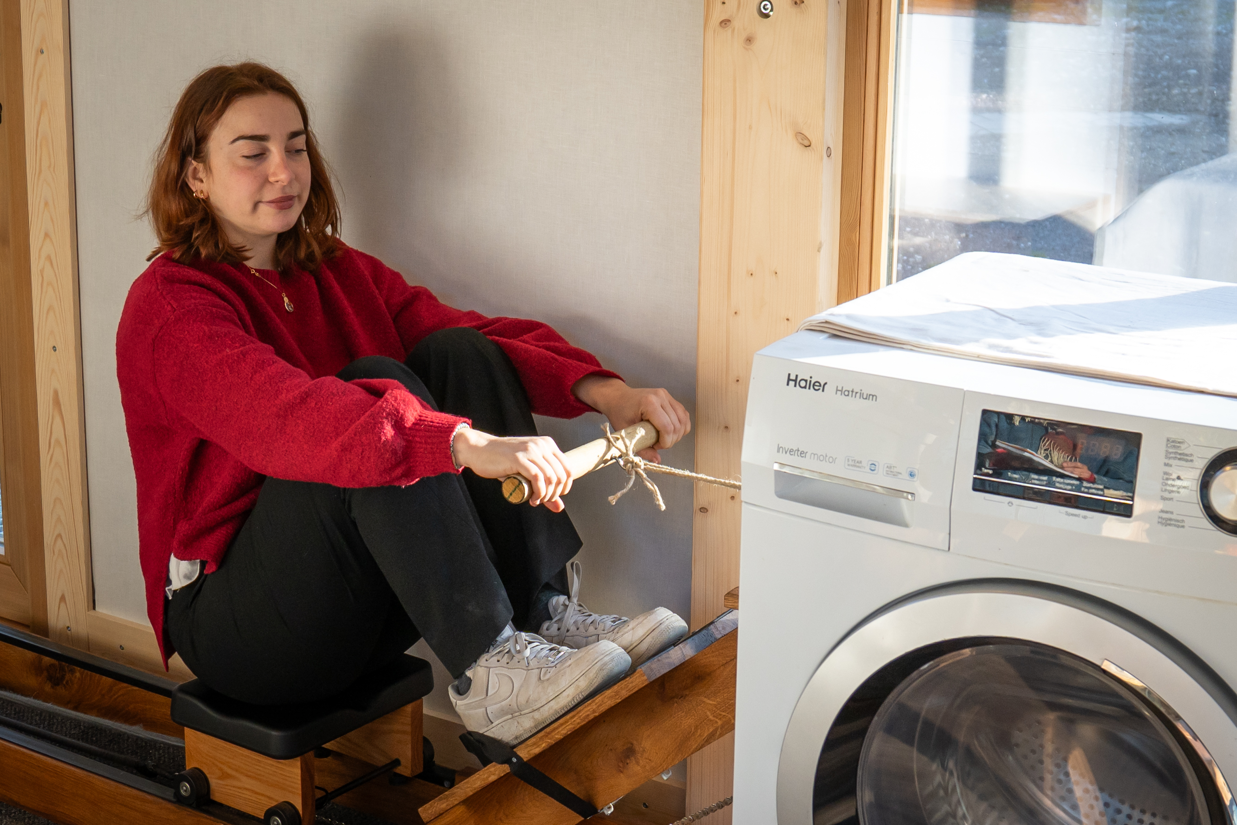
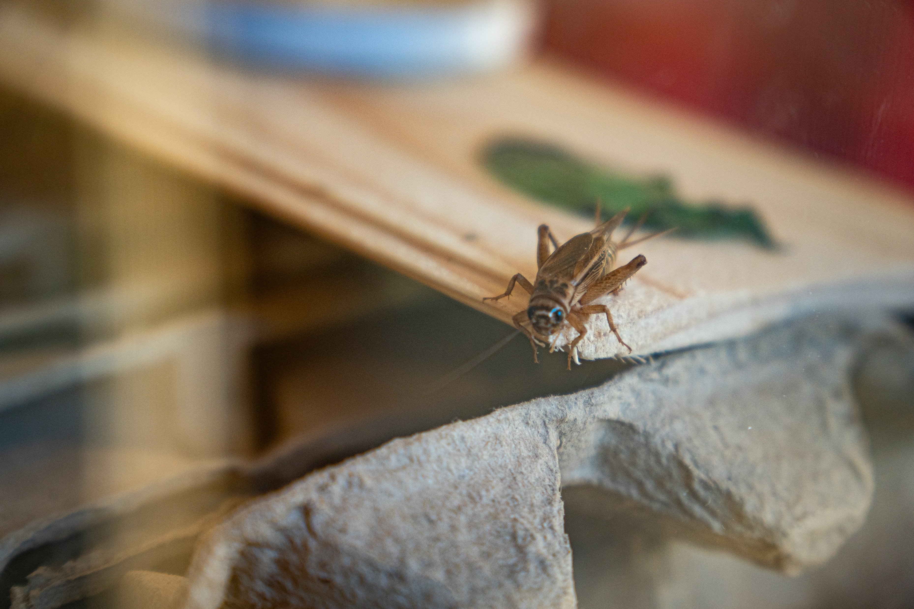
Low-Tech =
Useful
+
Inclusive
+
Sustainable
Photo Credits: Virginie Havelange
Photo Credits: Hellow.coop
Photo Credits: Virginie Havelange
Photo Credits: Virginie Havelange
Photo Credits: Virginie Havelange
Notes:
Photo Credits: Virginie Havelange & Hellow.coop

Slide 5
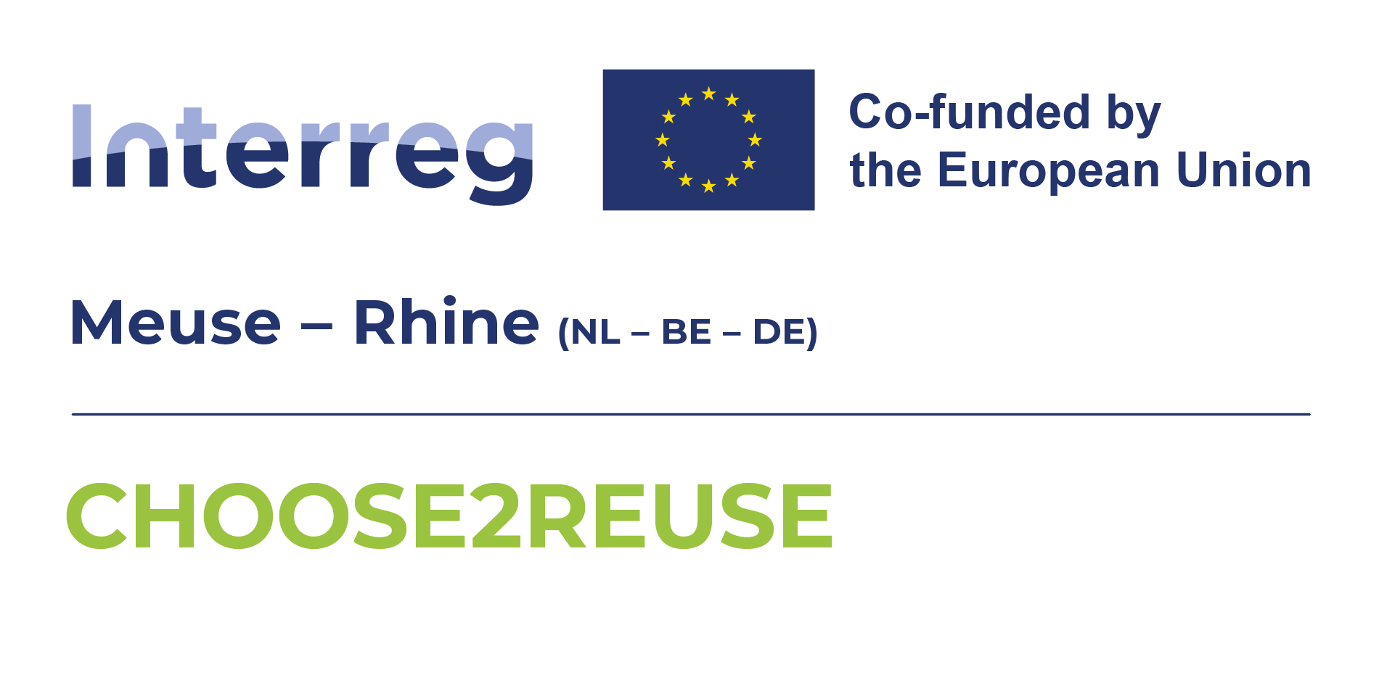
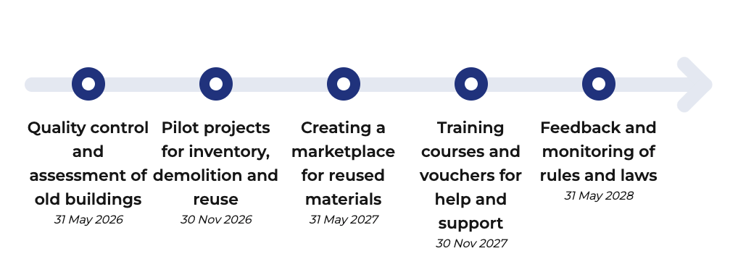

Slide 6

01
Introduction
Why think about sustainability?

Slide 7
Design is already shaping crises.
Notes:
Whether you design a chair, a phone, or a building: you’re shaping how resources are used over time.
You’re not just designing products.
You’re designing how long things last, how they fail, and whether they deserve to exist in the first place.
So when I say ‘design shapes crises’, I don’t mean indirectly.
I mean that thousands of small design decisions, made by people like you, scale up into global consequences.

Slide 8
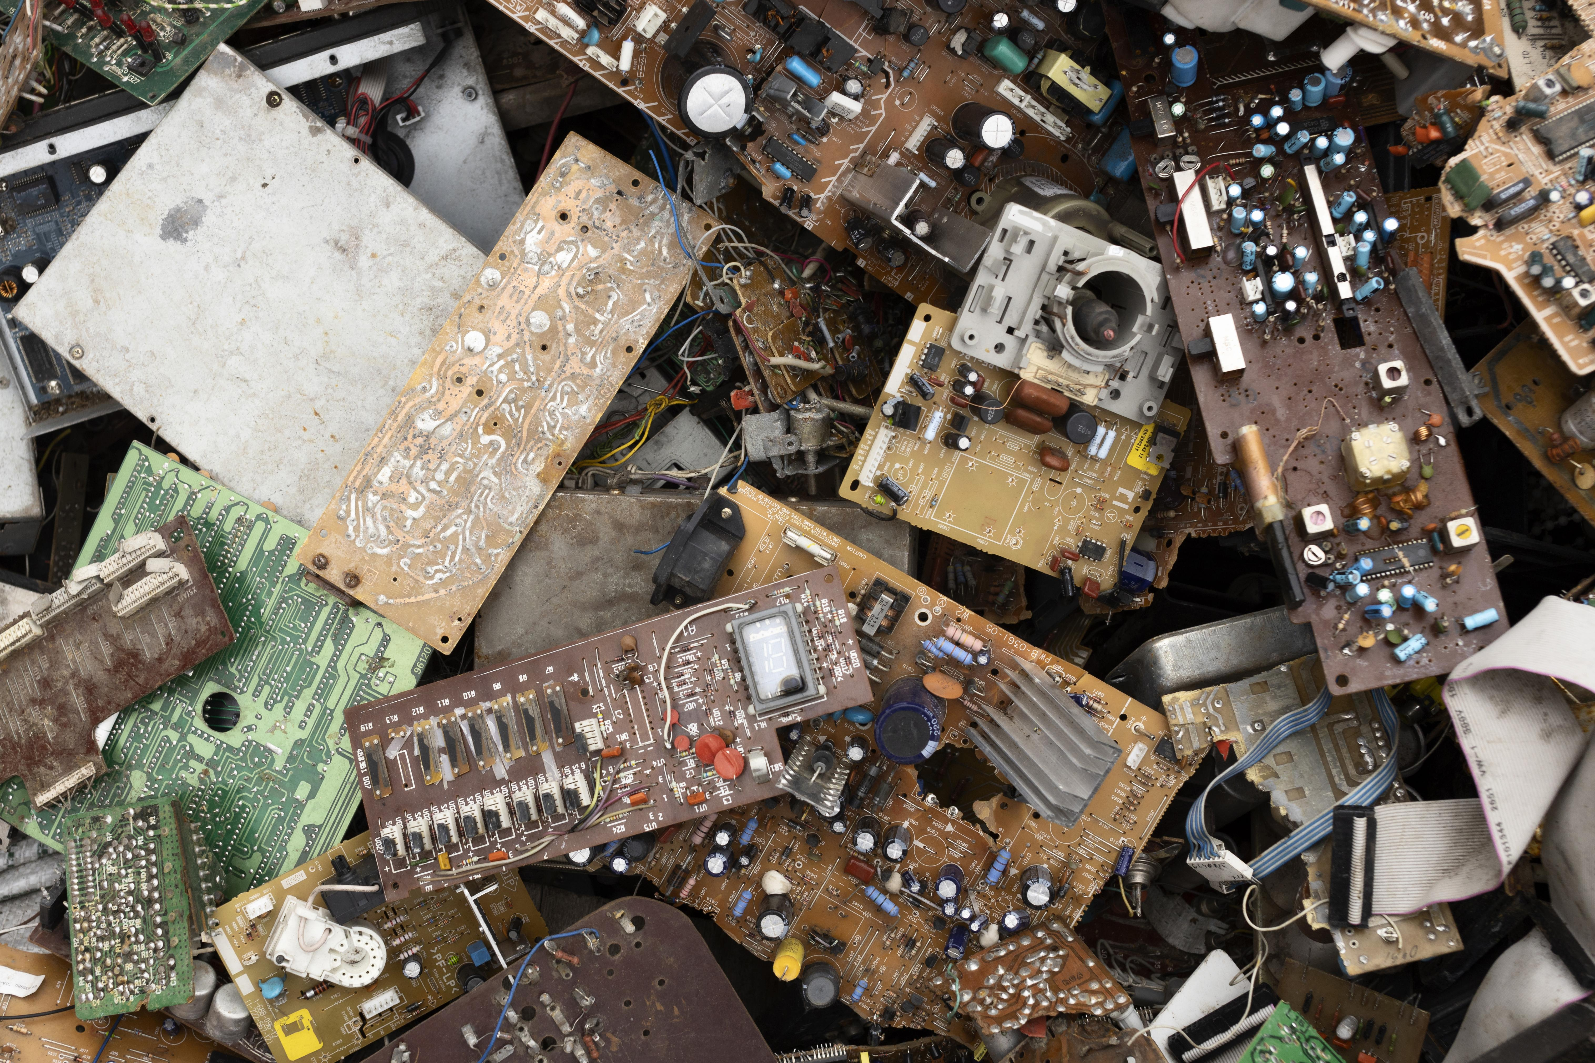
70%
Design is already shaping crises.
According to Global E-waste Monitor, 62 million tonnes of e-waste generated globally in 2022.
Only ~22% properly collected and recycled.
Notes:
Smartphones are designed in ways that directly contribute to the global e-waste crisis. Design decisions that caused it: glued batteries proprietary screws, non-modular components, software obsolescence…

Slide 9
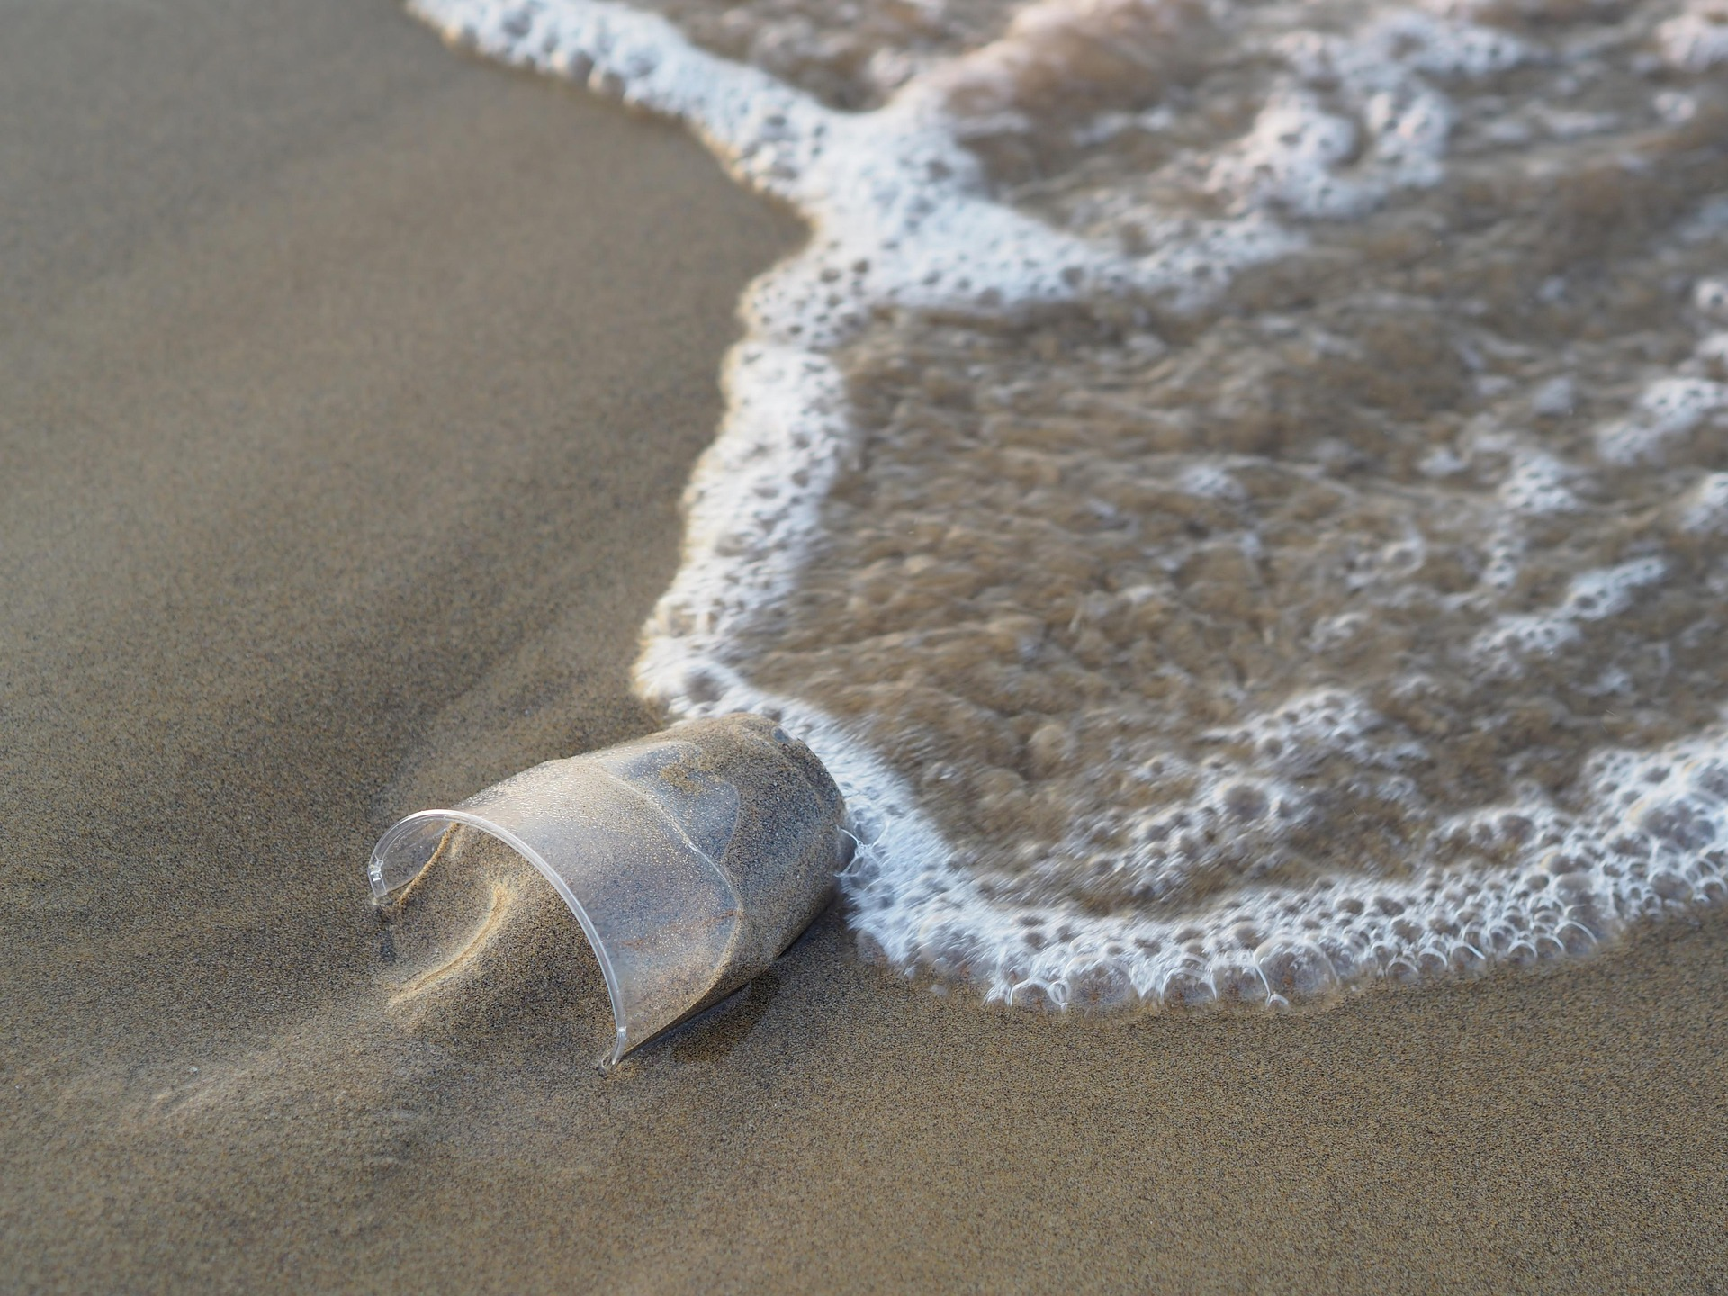
70%
Design is already shaping crises.
Single-use product design created a planetary-scale pollution problem.
Notes:
We didn’t accidentally create plastic waste.
We designed a system where throwing away is the default.

Slide 10
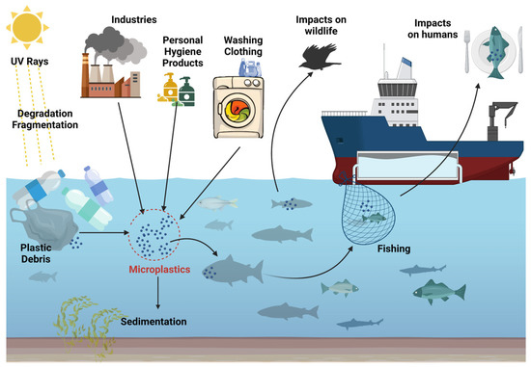
70%
Ziani, K., Ioniță-Mîndrican, C., Mititelu, M., Neacșu, S. M., Negrei, C., Moroșan, E., Drăgănescu, D., & Preda, O. (2023). Microplastics: a real global threat for environment and food Safety: A State of the art review. Nutrients, 15(3), 617. https://doi.org/10.3390/nu15030617
Notes:
We didn’t accidentally create plastic waste.
We designed a system where throwing away is the default.
Microplastics are not only the result of disposable products, they are also generated through the normal use and degradation of materials embedded in everyday systems like textiles, tires, and coatings.

Slide 11
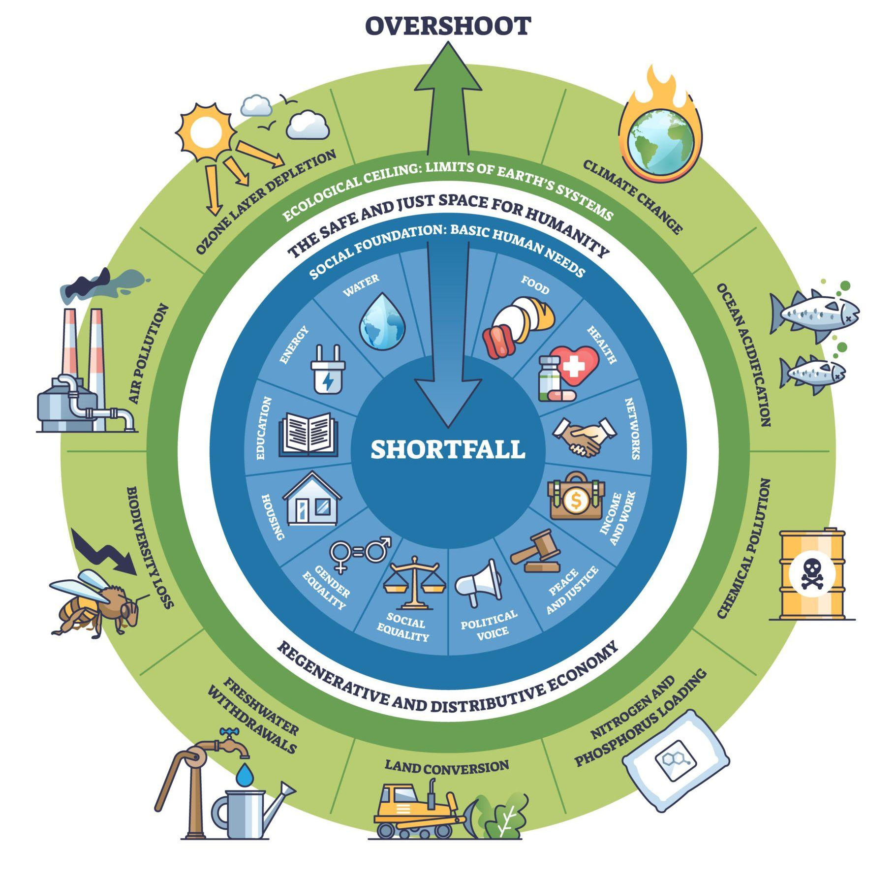
The Donut Theory
70%
Notes:
Donut theory
This model is called Doughnut Economics, developed by Kate Raworth.
It shows that sustainability is not just about reducing impact: it’s about staying within a space that is both environmentally safe and socially just.
Inner ring → Social foundation (housing, health, energy, equity…)
Outer ring → Ecological ceiling (climate change, biodiversity loss, pollution…)
The donut → the safe and just space for humanity
(image: istock)

Slide 12
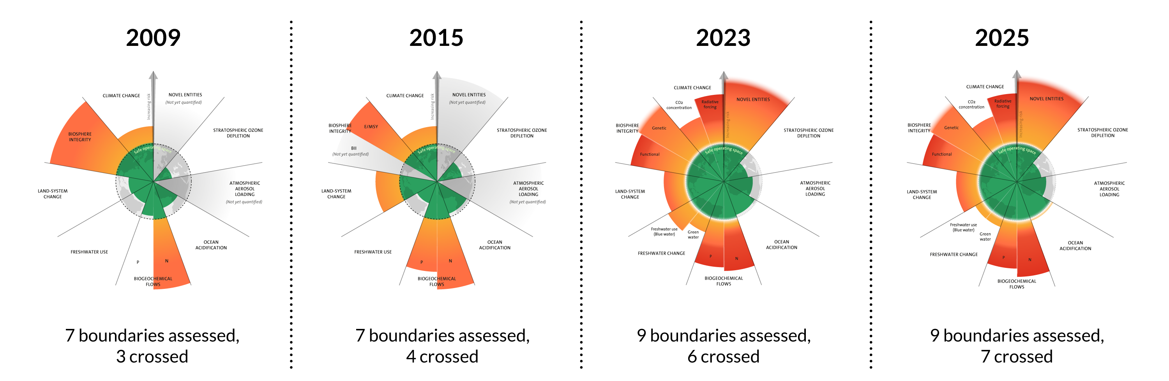
70%
The evolution of the planetary boundaries framework. Licenced under CC BY-NC-ND 3.0 (Credit: Azote for Stockholm Resilience Centre, Stockholm University. Based on Sakschewski and Caesar et al. 2025, Richardson et al. 2023, Steffen et al. 2015, and Rockström et al. 2009).
Notes:
Donut theory
The problem is: today, we’ve already crossed several planetary boundaries.
In 2025, 7 out of 9 planetary boundaries were exceeded.
So as designers, the question is no longer ‘can we optimize this product?’—
it’s ‘are we designing in a way that brings us back within that safe space?

Slide 13
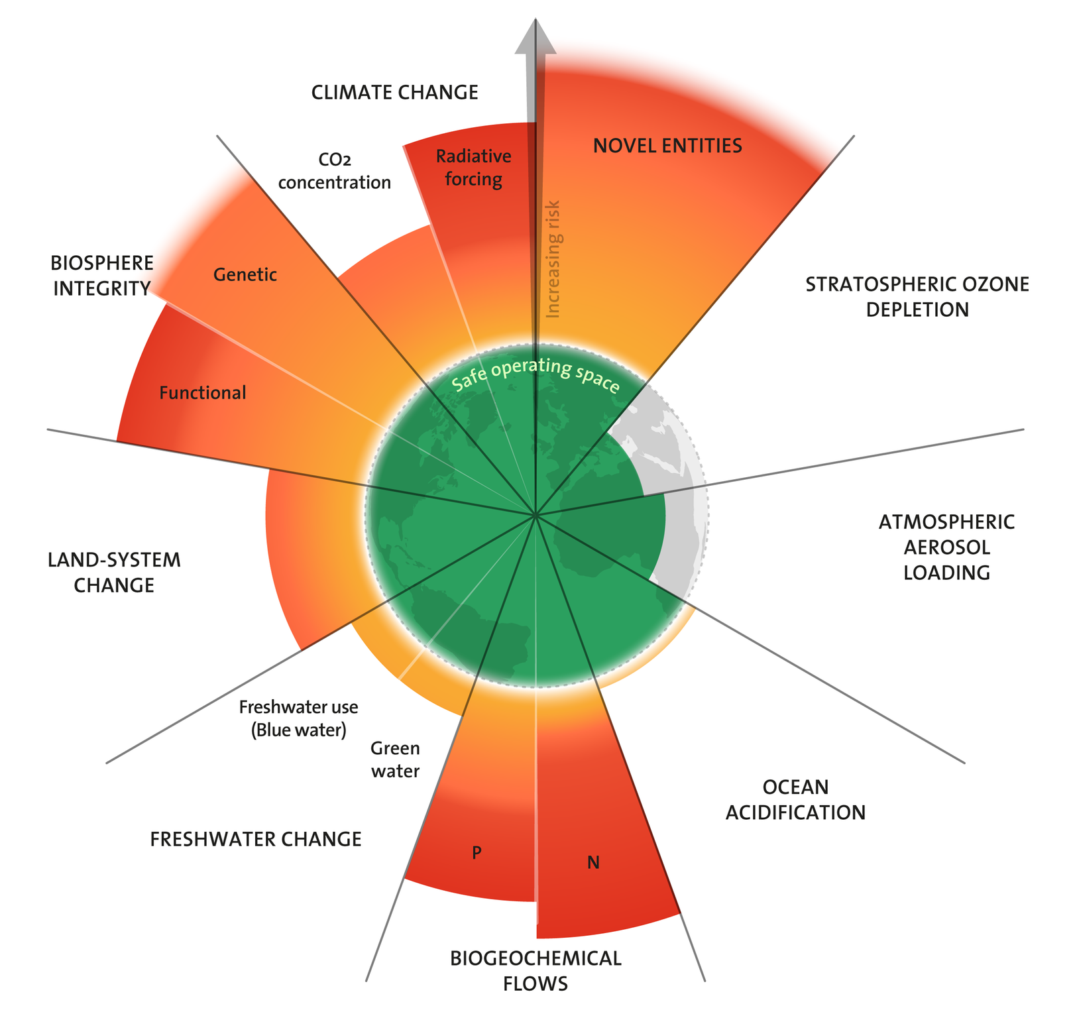
The 2025 update to the Planetary boundaries. Licensed under CC BY-NC-ND 3.0. Credit: "Azote for Stockholm Resilience Centre, based on analysis in Sakschewski and Caesar et al. 2025".

Slide 14

02
Sustainability
What do you mean?

Slide 15
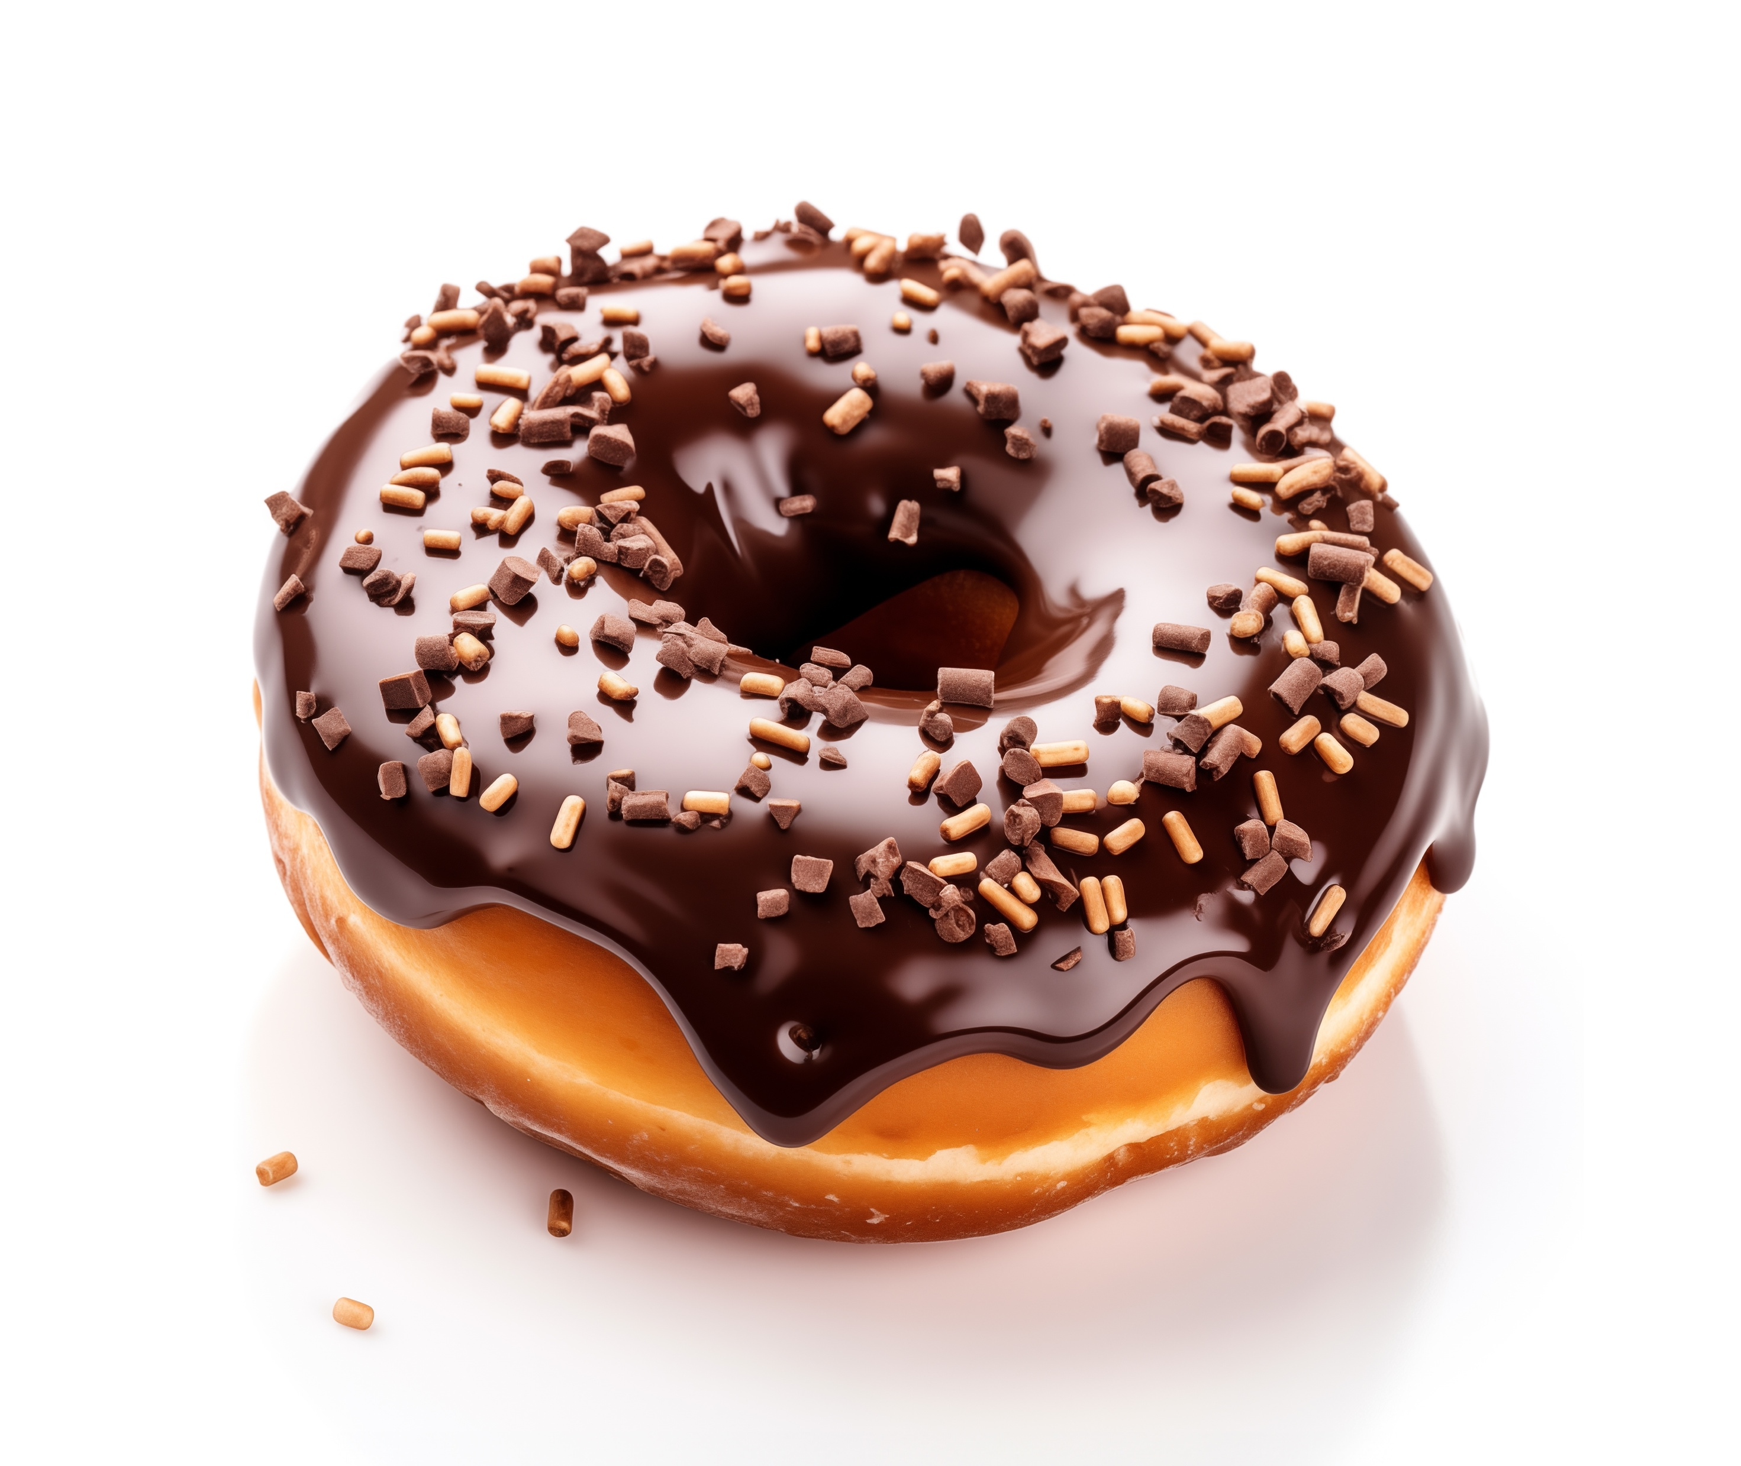
The goal is to meet human needs within planetary limits.
Image by Gugacurado from Pixabay
Notes:
A product is only sustainable if people can use, maintain, and live with it, without exhausting the systems that support it.
= meeting needs without overshooting planetary limits.
Image by https://pixabay.com/users/gugacurado-9127389/?utm_source=link-attribution&utm_medium=referral&utm_campaign=image&utm_content=8365292
gugacurado from Pixabay

Slide 16
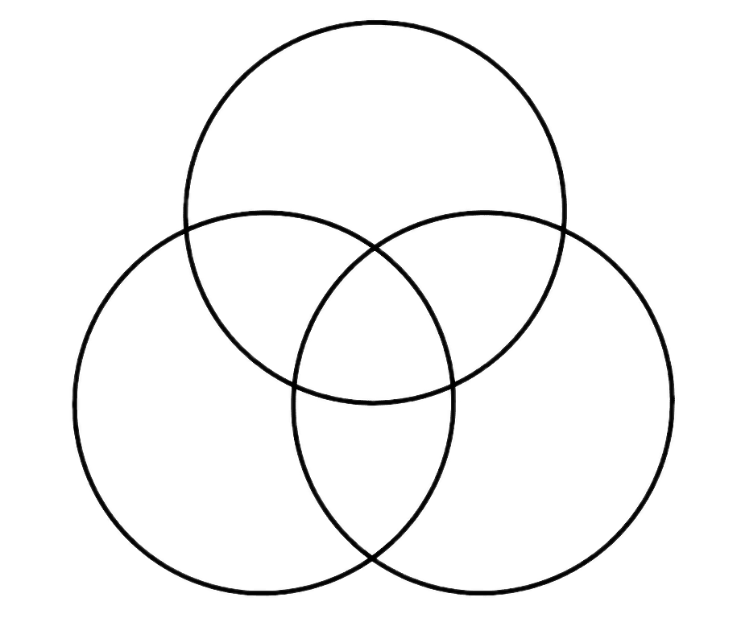
Environmental
Social
Economic
Notes:
Venn Diagram

Slide 17
Sustainability is NOT JUST…
energy efficiency
materials
technology-driven

Slide 18
Sustainability is…
contextual
systemic
relational
long-term

Slide 19
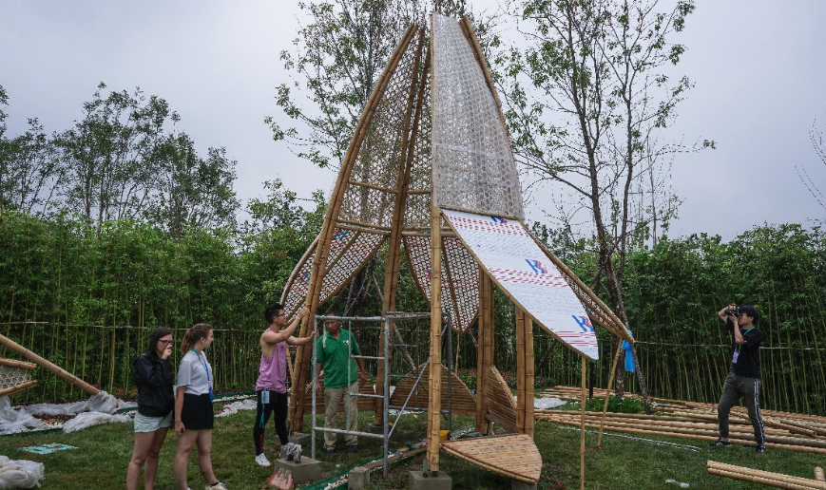
Notes:
Bamboo: Environmental impact of transport
Source: Collection personnelle de photos

Slide 20
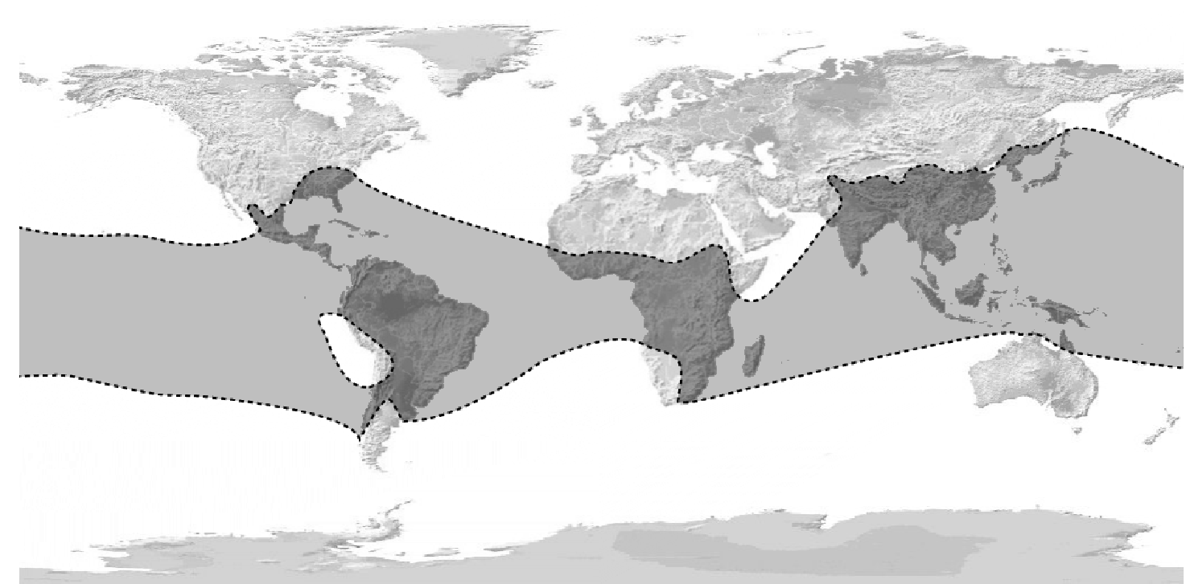
Source: Broto, Eduard, McBride Emily, et Barros Lídia. Le bambou : architecture et design : manuel pratique et 59 projets. Barcelone: Links, 2014. Print.
Notes:
Bamboo: Environmental impact of transport
Source: Collection personnelle de photos

Slide 21
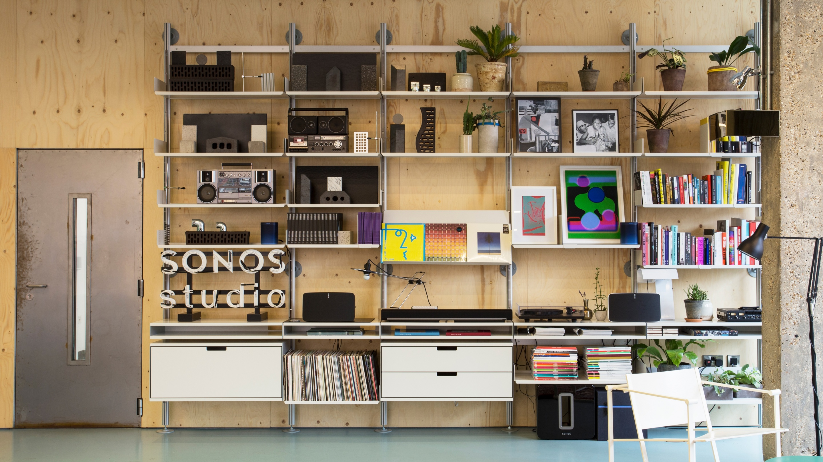
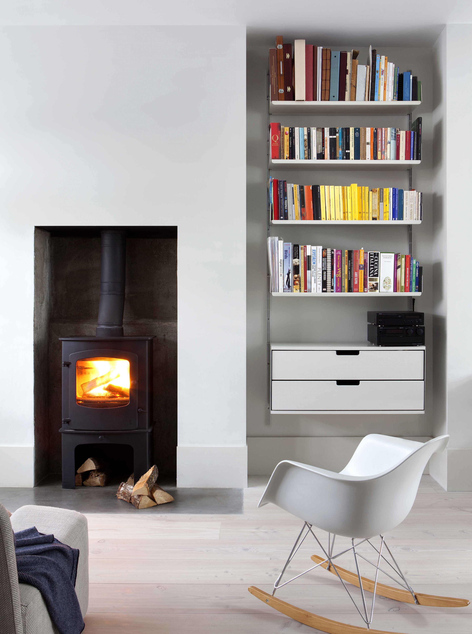
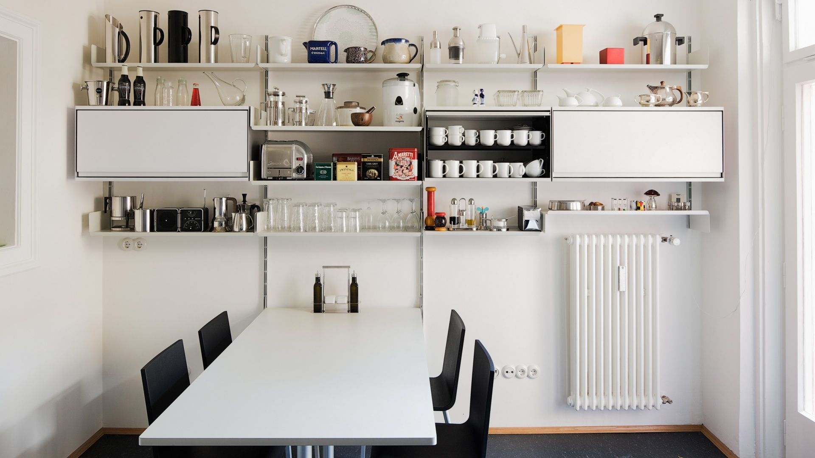
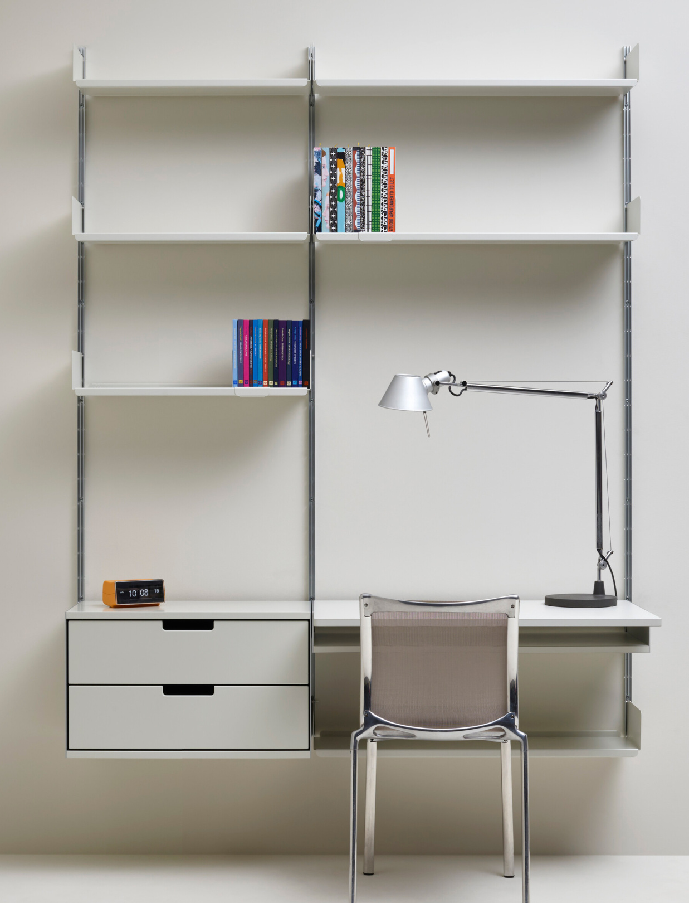
Source & Image Credits : Vitsoe 606 Universal Shelving System
Notes:
Designed to evolve with you
Modular system adapts over decades instead of being replaced
Users reconfigure instead of buying new furniture High durability + timeless design Sustainability comes from adaptability over time
Source: Vitsoe 606 Universal Shelving System

Slide 22
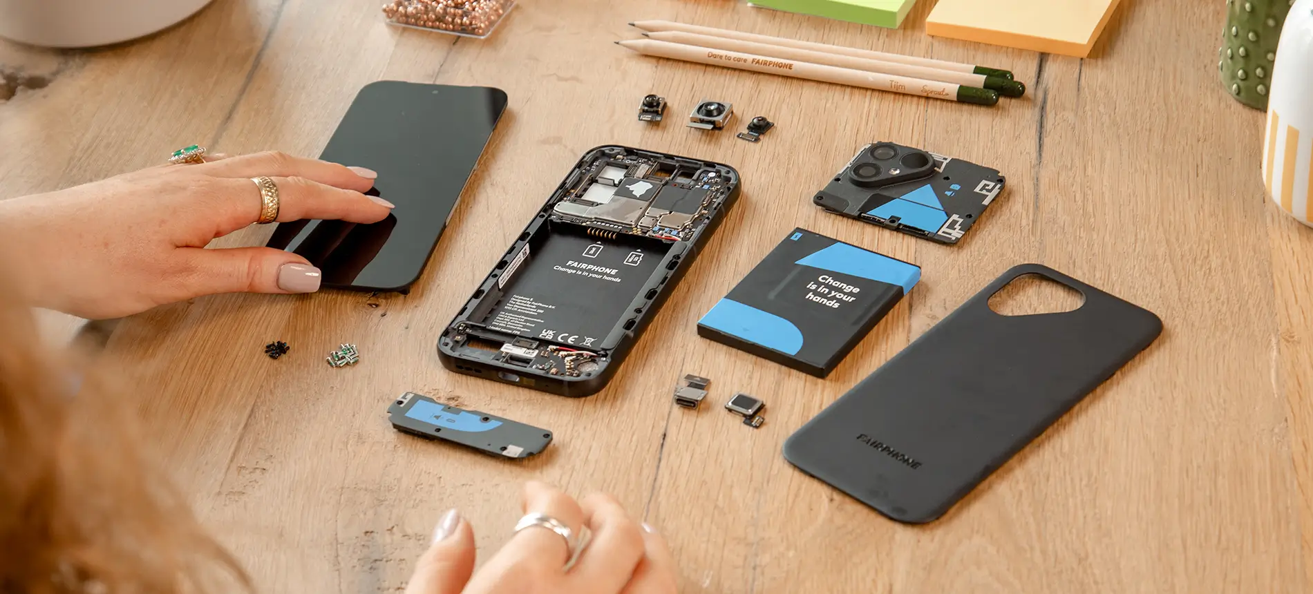
Fairphone: A Smartphone Designed to Be Repaired & Updated
Source & Image Credits: Fairphone
Notes:
Good example of transparency & repairability: Fairphone

Slide 23
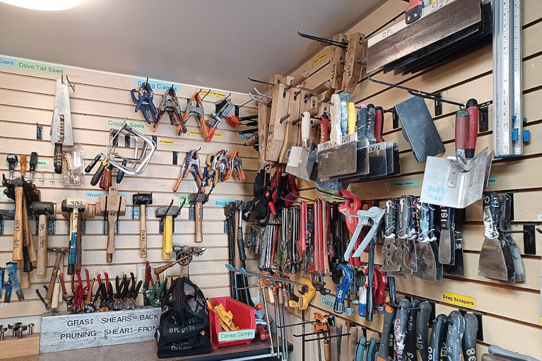
Resilience. (2023, August 8). It’s time for tool libraries to go global. Resilience. https://www.resilience.org/stories/2023-08-07/its-time-for-tool-libraries-to-go-global/
Notes:
Example: Tool libraries
Access over ownership
Shared tools reduce the need to produce and own rarely-used products
A drill used 10 min/year → no need for everyone to own one
Sustainability comes from shared use + trust + organization
The “design” is the service + community, not the object

Slide 24
The Basics
Material
  What is it made of?
  Extraction impact?
Manufacturing
  Energy? complexity? waste?
Use phase
  Energy consumption?
  Maintenance?
End of life
  Repairable? recyclable? modular?
Consider the product’s Grey energy =
the energy required to produce materials and construct it
Also consider its Operational energy =
energy used during the use phase

Slide 25
In many projects, sustainability goals can sort of contradict each other → tension
For example:
energy efficiency vs. material use
affordability vs. durability
environmental performance vs. user comfort.
Core idea:
Instead of assuming sustainability goals are always aligned, recognize that design decisions often involve trade-offs.
Notes:
Example:
Designing a passive house (explain) with very thick insulation and triple glazing
Trade-off:
Very low heating energy over time vs. High material use (insulation, glass, frames)
You reduce operational impact, but increase embodied impact upfront
Example:
Cheap electric kettle vs durable stainless-steel one
Trade-off:
Cheap → accessible to more users
Breaks quickly → replaced often
Insight:
Low cost can lock users into cycles of replacement

Slide 26
Sustainability goals don’t always align
Design = choosing between competing priorities
Notes:
Example:
Designing a passive house with very thick insulation and triple glazing
Trade-off:
Very low heating energy over time vs. High material use (insulation, glass, frames)
You reduce operational impact, but increase embodied impact upfront
Example:
Cheap electric kettle vs durable stainless-steel one
Trade-off:
Cheap → accessible to more users
Breaks quickly → replaced often
Insight:
Low cost can lock users into cycles of replacement

Slide 27
Mini exercise (2–3 min).
A company asks for ergonomic office chairs to reduce back pain.
What’s the most sustainable option?
Notes:
Design criteria.
Let them answer. If they tackle material: Interesting, But the biggest impact decisions often happen before that.
Could it last 30 years instead of 5?
Can it be repaired instead of replaced?
Challenge:
Do we need to design new chairs at all? Do you design a better chair, or reduce the need to sit? If the solution is ‘sit less’, then designing a better chair might actually reinforce the problem.

Slide 28

03
10 R Framework
A recipe you get to try

Slide 29
Level | Strategy | Meaning in design
R0 | Refuse | Avoid the product or component entirely
R1 | Rethink | Intensify use (shared products, multifunctionality)
R2 | Reduce | Use fewer materials or energy
R3 | Reuse | Use product again without major modification
R4 | Repair | Fix defects to extend life
R5 | Refurbish | Restore or update product
R6 | Remanufacture | Rebuild using components
R7 | Repurpose | Use components for a different function
R8 | Recycle | Process materials into new raw material
R9 | Recover | Energy recovery from waste
Cramer, J., and Stahel, W. (later formalized by PBL Netherlands Environmental Assessment Agency.)
Notes:
Recycling is NOT the goal. It’s the last resort.

Slide 30
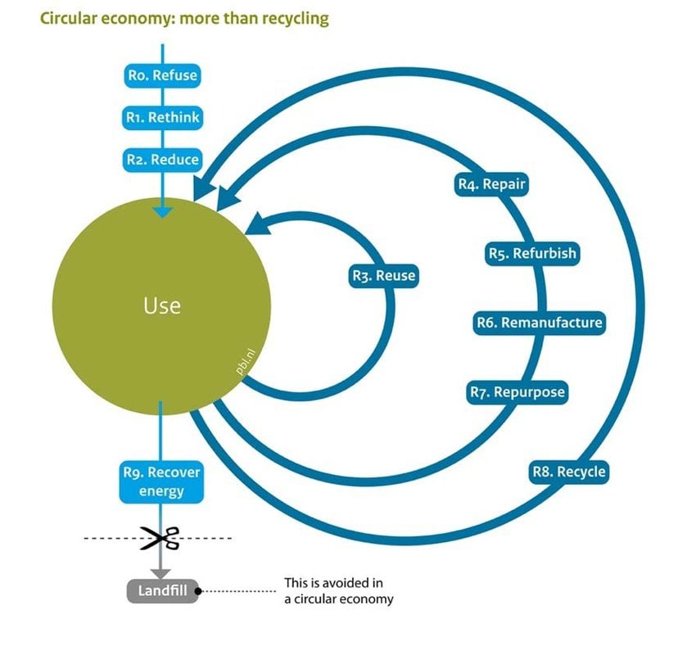
Potting, J., Hekkert, M., Delahaye, R., Ganzevles, J., Hoekstra, R., & Lijzen, J. (2018). Circular economy: What we want to know and can measure: Framework and baseline assessment for monitoring the progress of the circular economy in the Netherlands. PBL Netherlands Environmental Assessment Agency, p.11.
Notes:
Recycling is NOT the goal. It’s the last resort.

Slide 31
Think about:
        Materials’ impact (extraction, transport, transformation of primary materials necessary)
    Users
    Resource consumption (water, electricity, gas…)
    Products’ emissions (CO2, GES, …)
    Maintenance
    Repair
    Adaptation/Modularity (prolonge the life)
    End of Life
Notes:
Instead of: performance, cost, aesthetics
Add: lifespan, repairability, user behavior, failure scenarios
Materials’ impact * comparaisons between cases for convergence. Think about, impact your design. No in-depth calculation/analysis.

Slide 32
04
Moreover
For those who’d like to dig deeper

Slide 33
LCA: Life Cycle Assessment raw materials → manufacturing → transport→ use → end-of-life
Stage | Description
Raw material extraction | mining, harvesting resources
Manufacturing | production of materials and components
Transport | logistics and distribution
Use phase | operation and maintenance
End of life | recycling, reuse, landfill or incineration
Notes:
LCA quantifies environmental impacts from cradle to grave, meaning from raw material extraction to disposal or recycling.

Slide 34
Design for X (DfX):
Design for disassembly
Design for repair
Design for durability

Slide 35
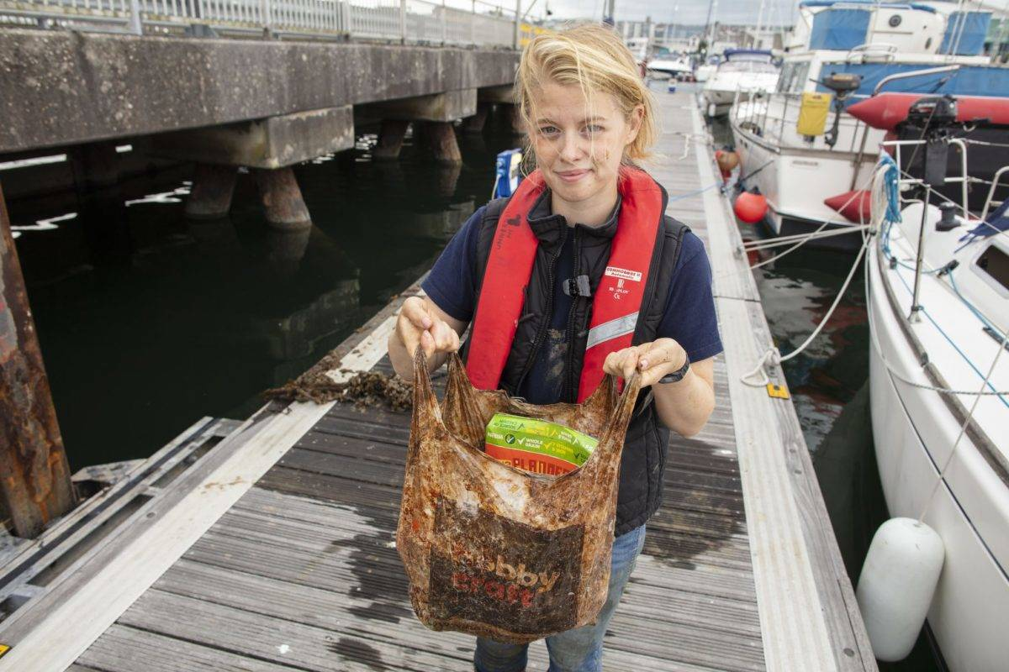
« After 3 Years in the Ocean, These Supposedly Biodegradable Bags Are Still Intact »
Napper, I. E., & Thompson, R. C. (2019). Environmental Deterioration of Biodegradable, Oxo-biodegradable, Compostable, and Conventional Plastic Carrier Bags. Environmental Science & Technology. https://www.kqed.org/science/1941258/after-3-years-in-the-ocean-these-supposedly-biodegradable-bags-are-still-intact?
Notes:
“100% recyclable packaging”
Reality:
Not accepted in most recycling systems
Multi-layer plastics impossible to separate
Claims of "Biodegradable” or “compostable” plastics which requires industrial conditions and do not degrade in nature or landfill
A study published by researchers from the University of Plymouth tested these bags in real conditions (soil, air, sea):
After 3 years in the environment, the bags were still present
Some could still carry groceries without breaking
Instead of degrading, they fragmented into microplastics

Slide 36
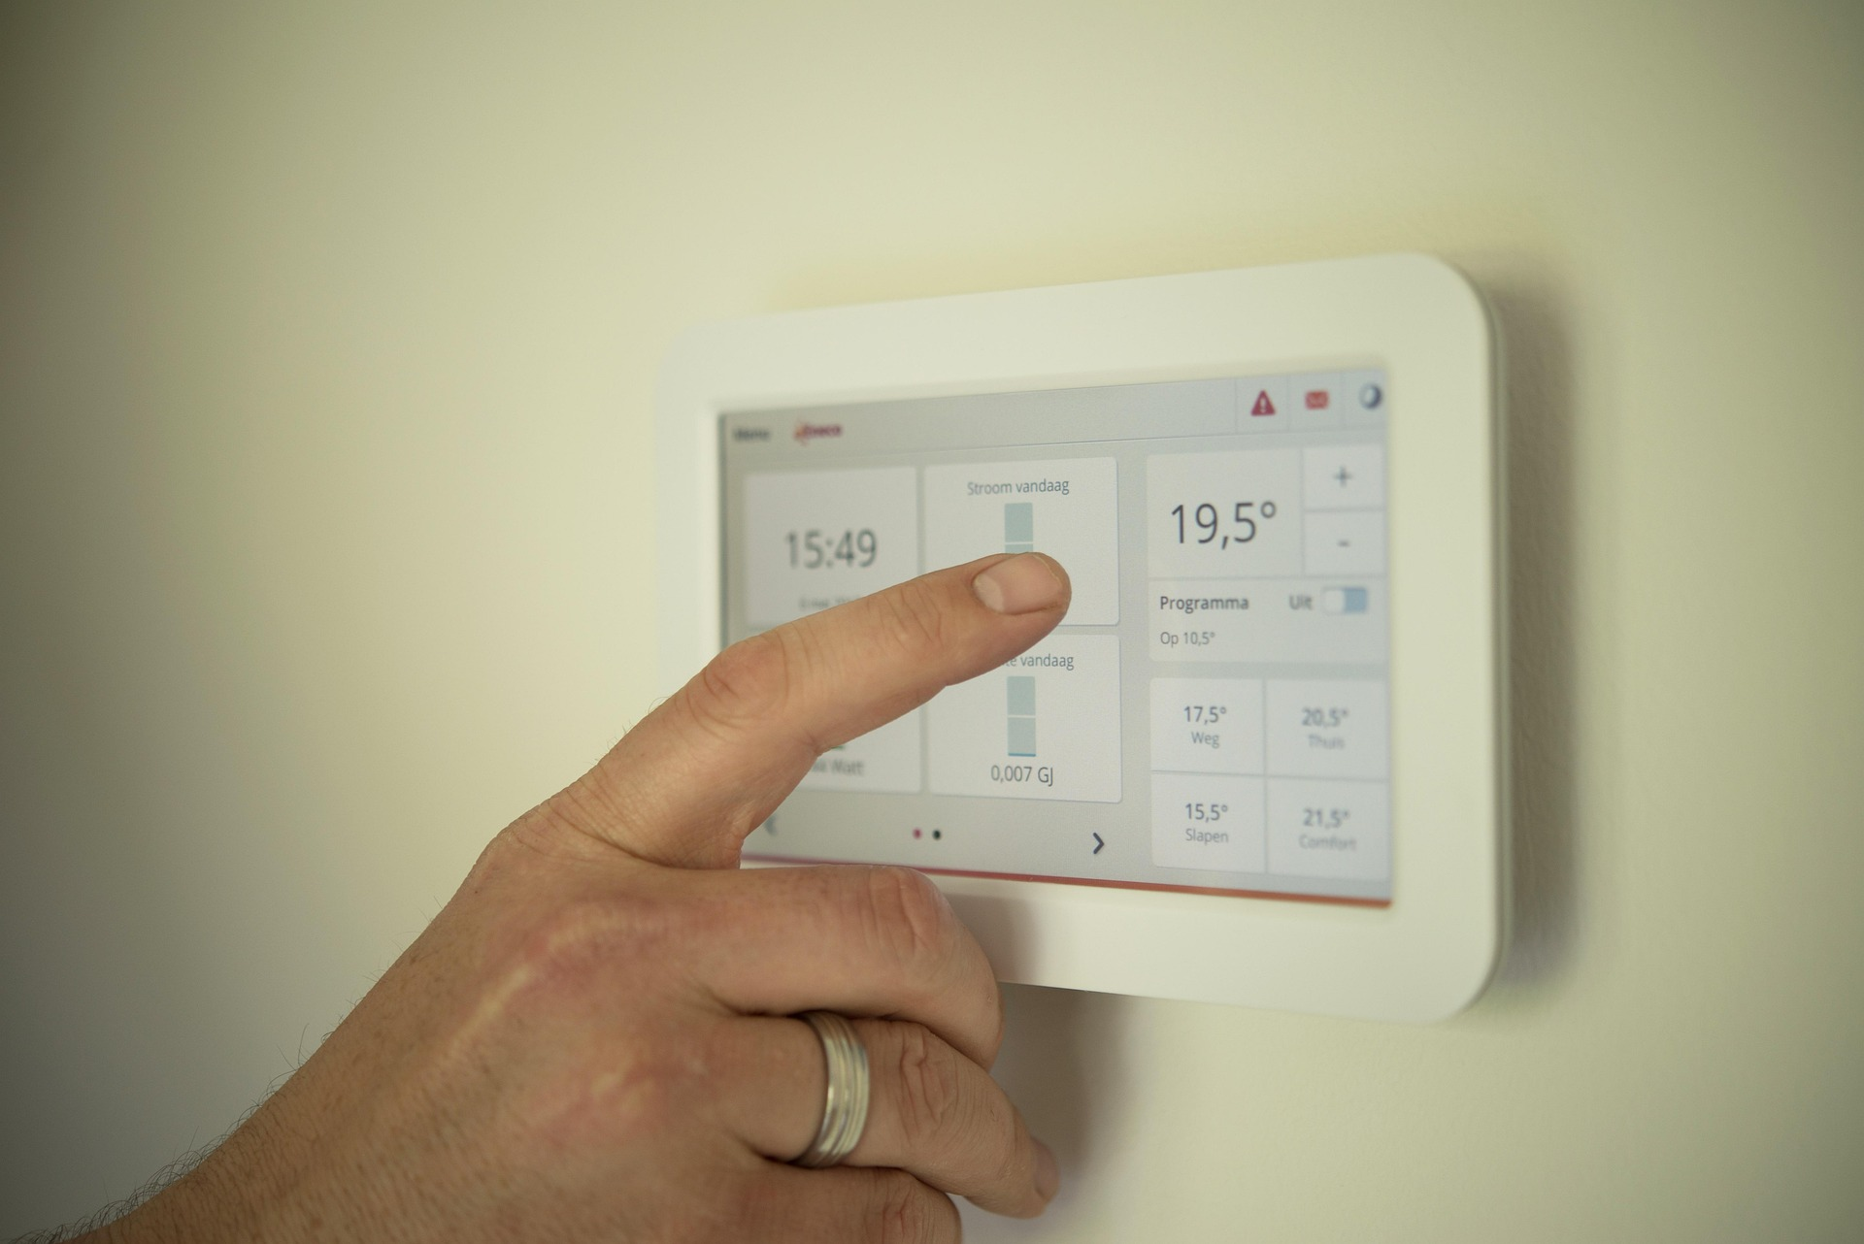
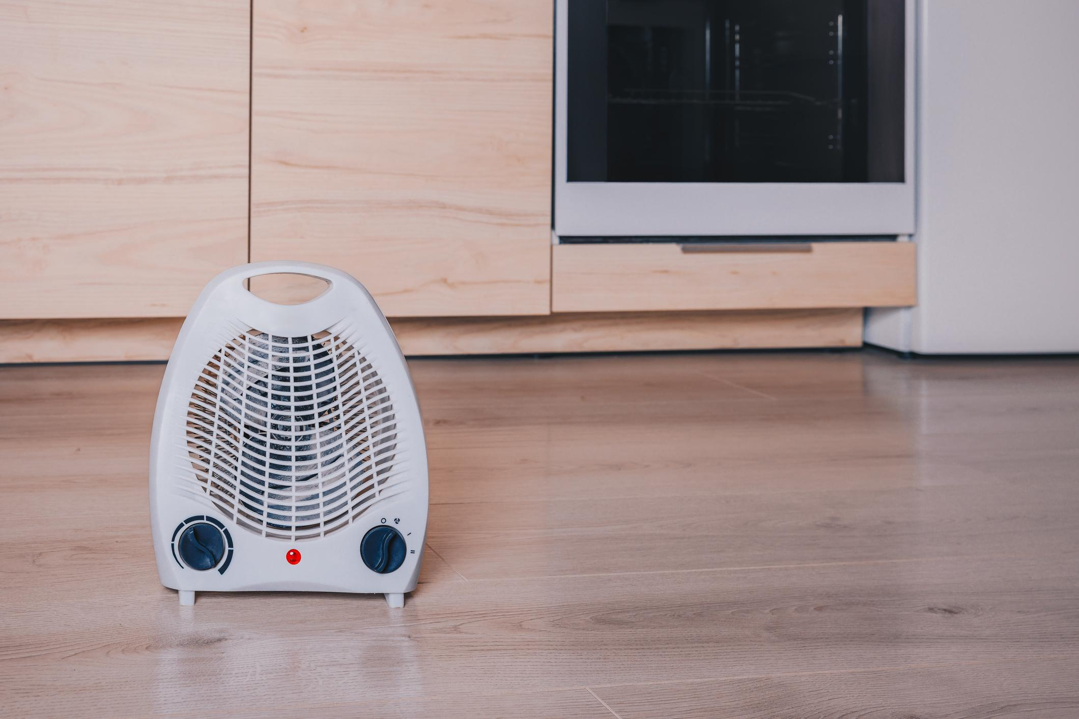
Notes:
An engineer designs a highly efficient, smart heating system:
optimized energy performance
automated controls
complex interface
requires correct setup and maintenance
Sustainable… on paper
In reality:
Users don’t understand the system, override it, open windows because it’s too hot, and buy cheap electric heaters for comfort
The system was perfectly designed, but not for the people using it.
(images: pixabay)

Slide 37
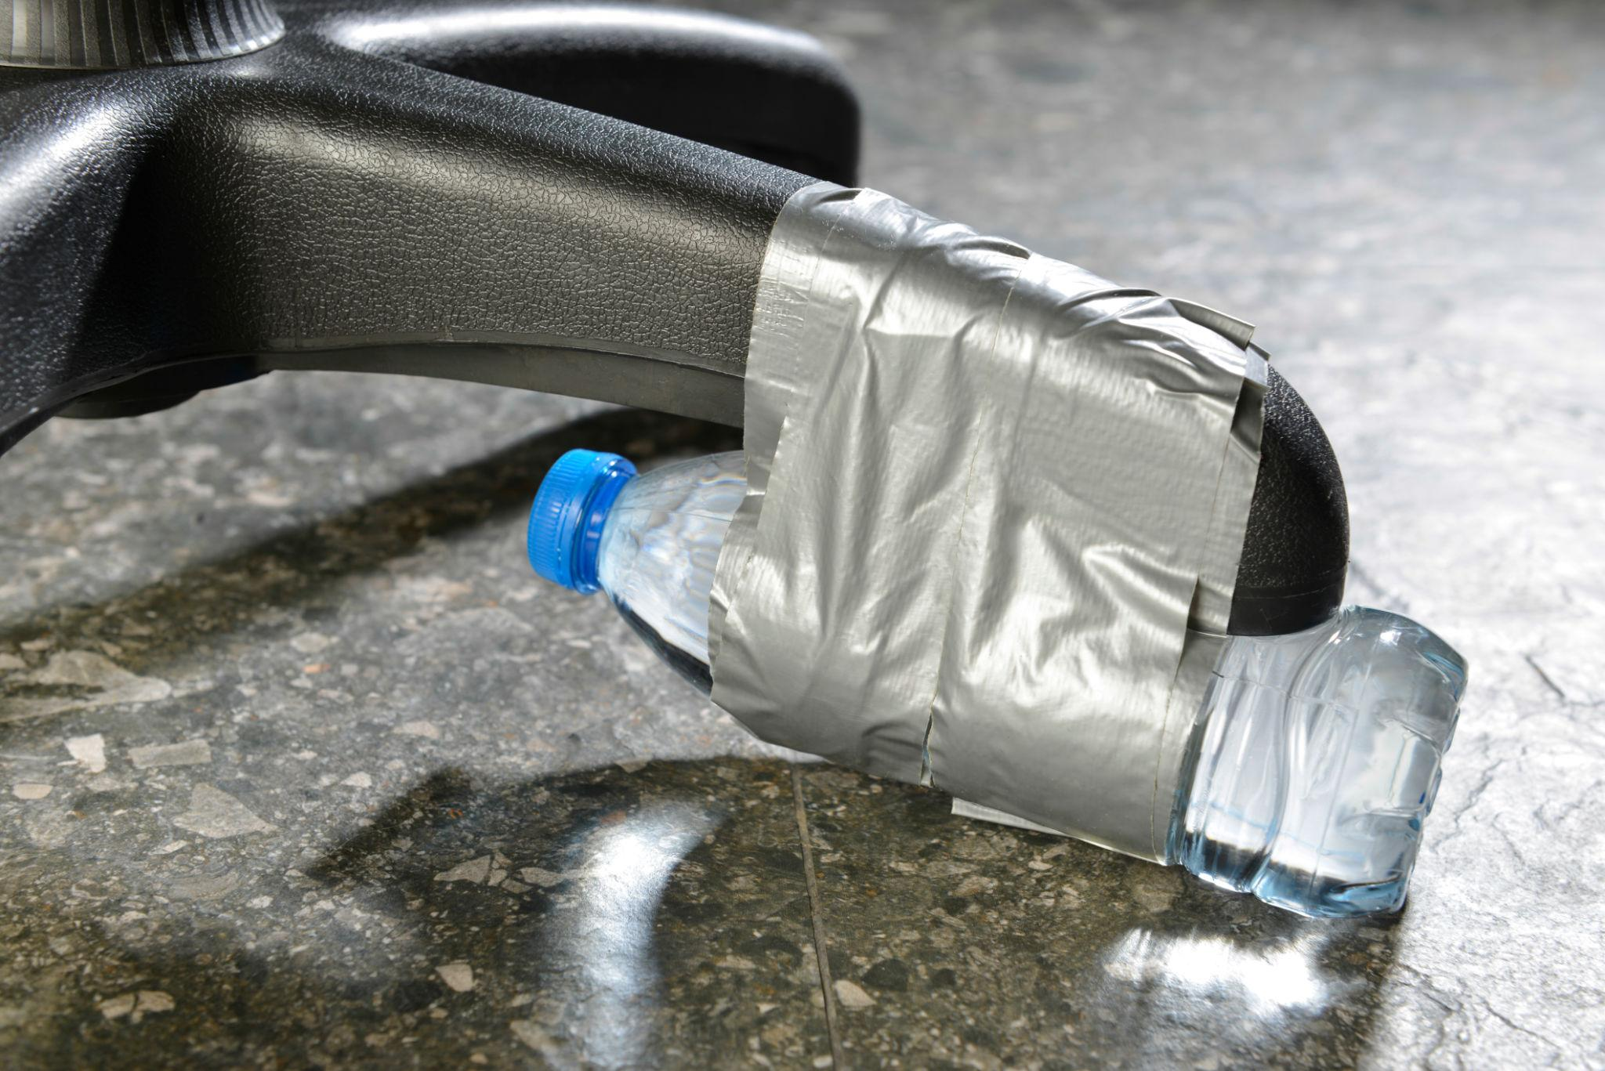
Not designed for repair → users improvise
Notes:
Ugly fixes but longer life
We often think sustainability comes from designing perfect, optimized objects.
But in reality, people adapt, misuse, repair, and improvise.
And sometimes, those imperfect adaptations are more sustainable than the original design.
Image: iStock

Slide 38
Design decisions have long-term consequences.
Users are part of the system.

