Slide 1
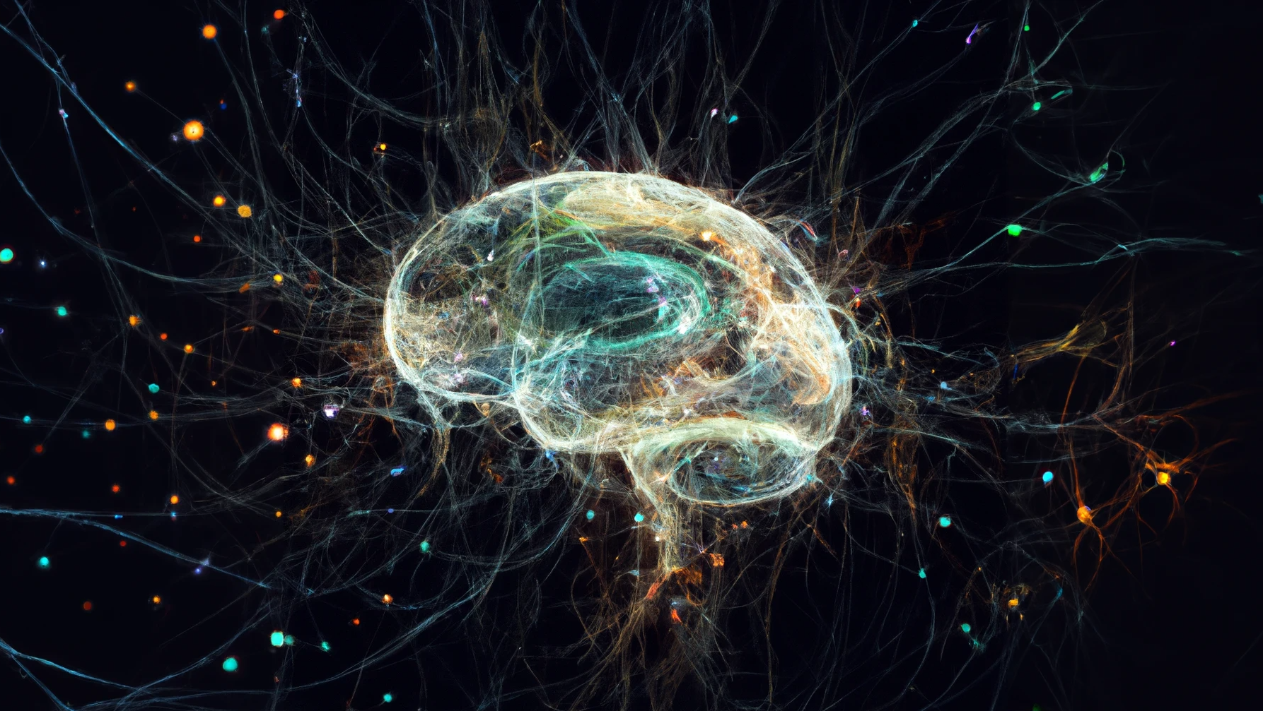


Neuromodulation supports robust rhythmic pattern transitions in degenerate central pattern generators with fixed connectivity
Robust switching between periodic orbits on a fixed network, despite parametric redundancy
Arthur Fyon, Alessio Franci, Pierre Sacré & Guillaume Drion
July 9th 2026

Slide 2
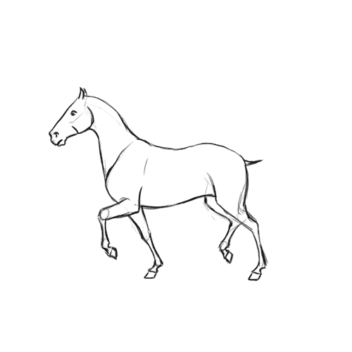
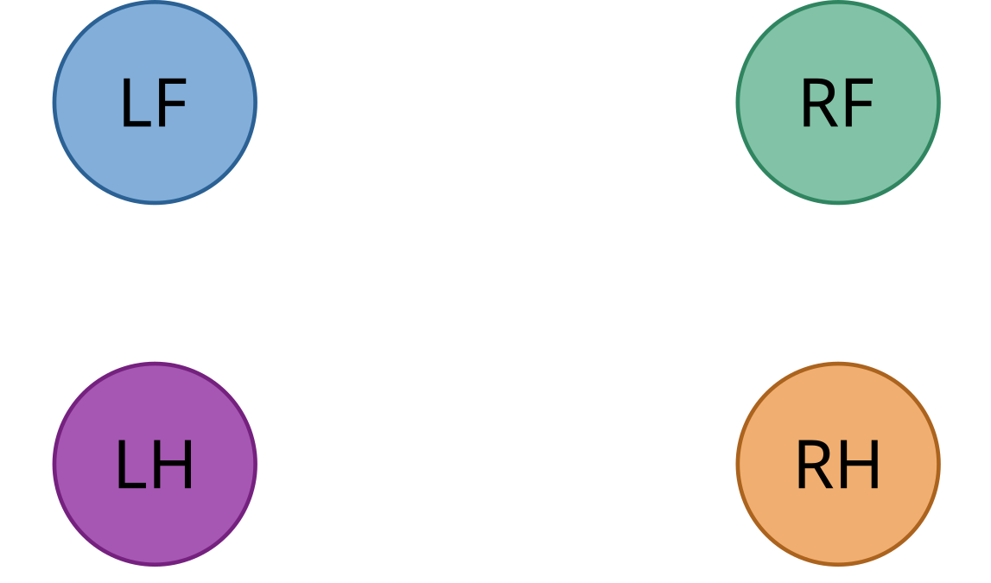
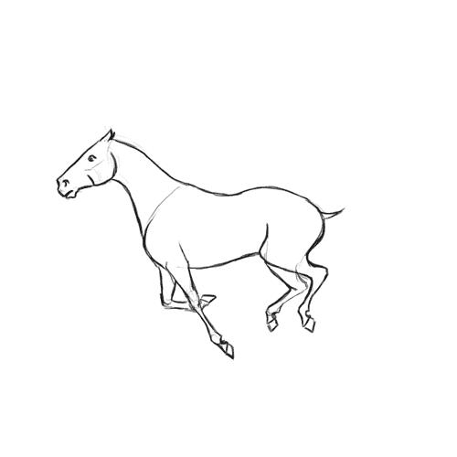
Gait switching in animals relies on a fixed network
?
Trot:
A fixed network of coupled spiking dynamical systems that must switch between distinct stable periodic orbits, on demand.
Gallop:
1

Slide 3
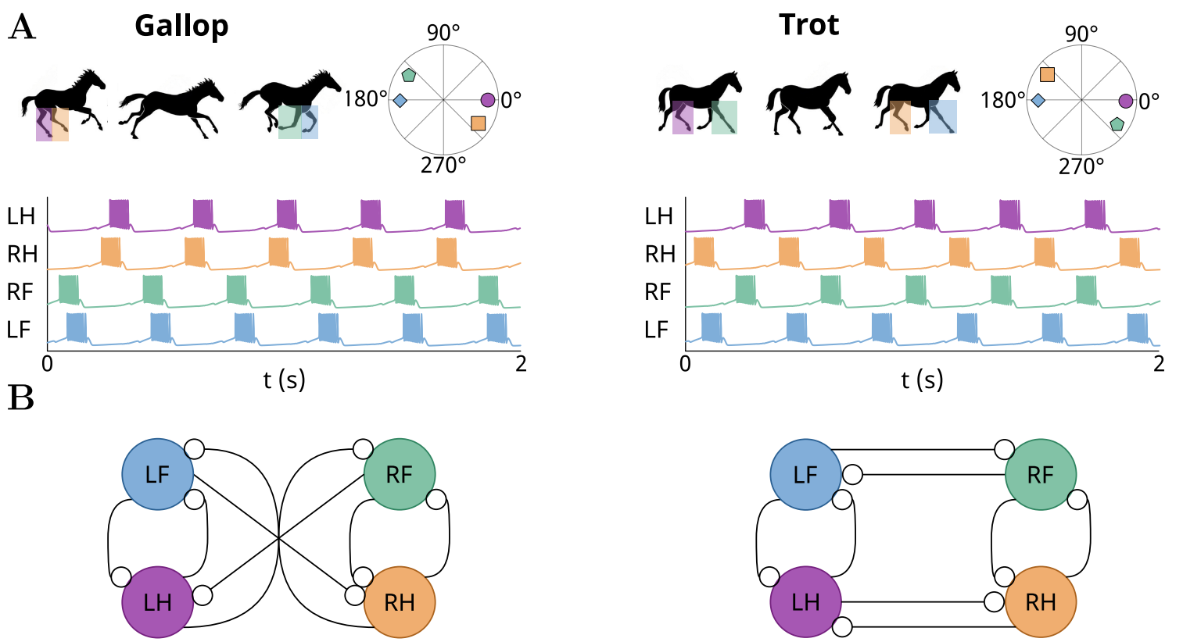
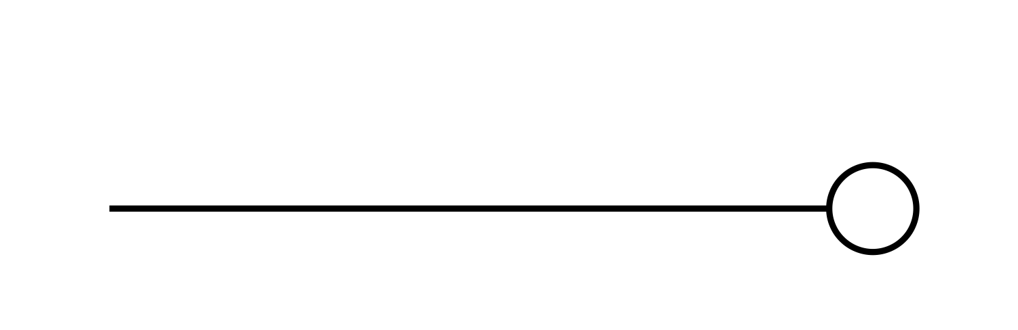



Classical solutions rely on rewiring the connectome
cccc
cc
cccc
Inhibition
Rewiring
Fast
Multistable
Node modulation
Slow
Monostable
Edge modulation
cc
Synaptic plasticity
One topology per
rhythmic orbit
Model abstraction hides switching mechanism
2

Slide 4
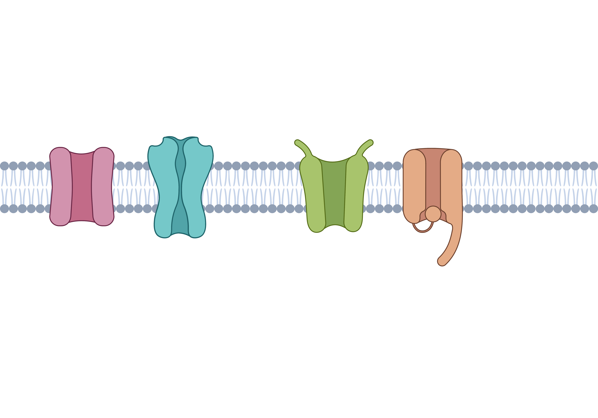
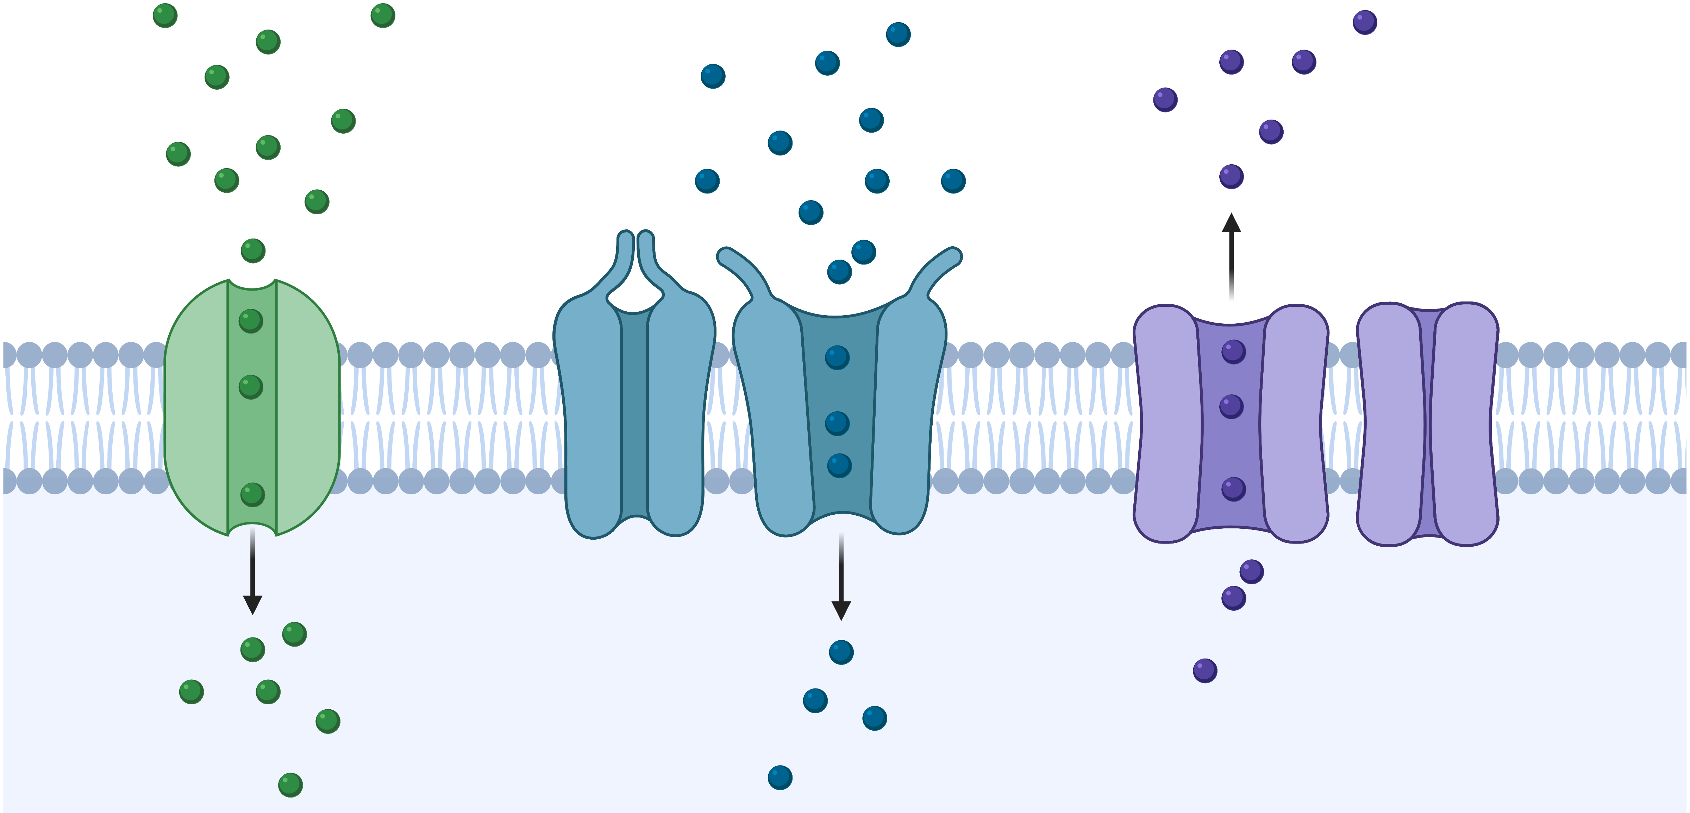
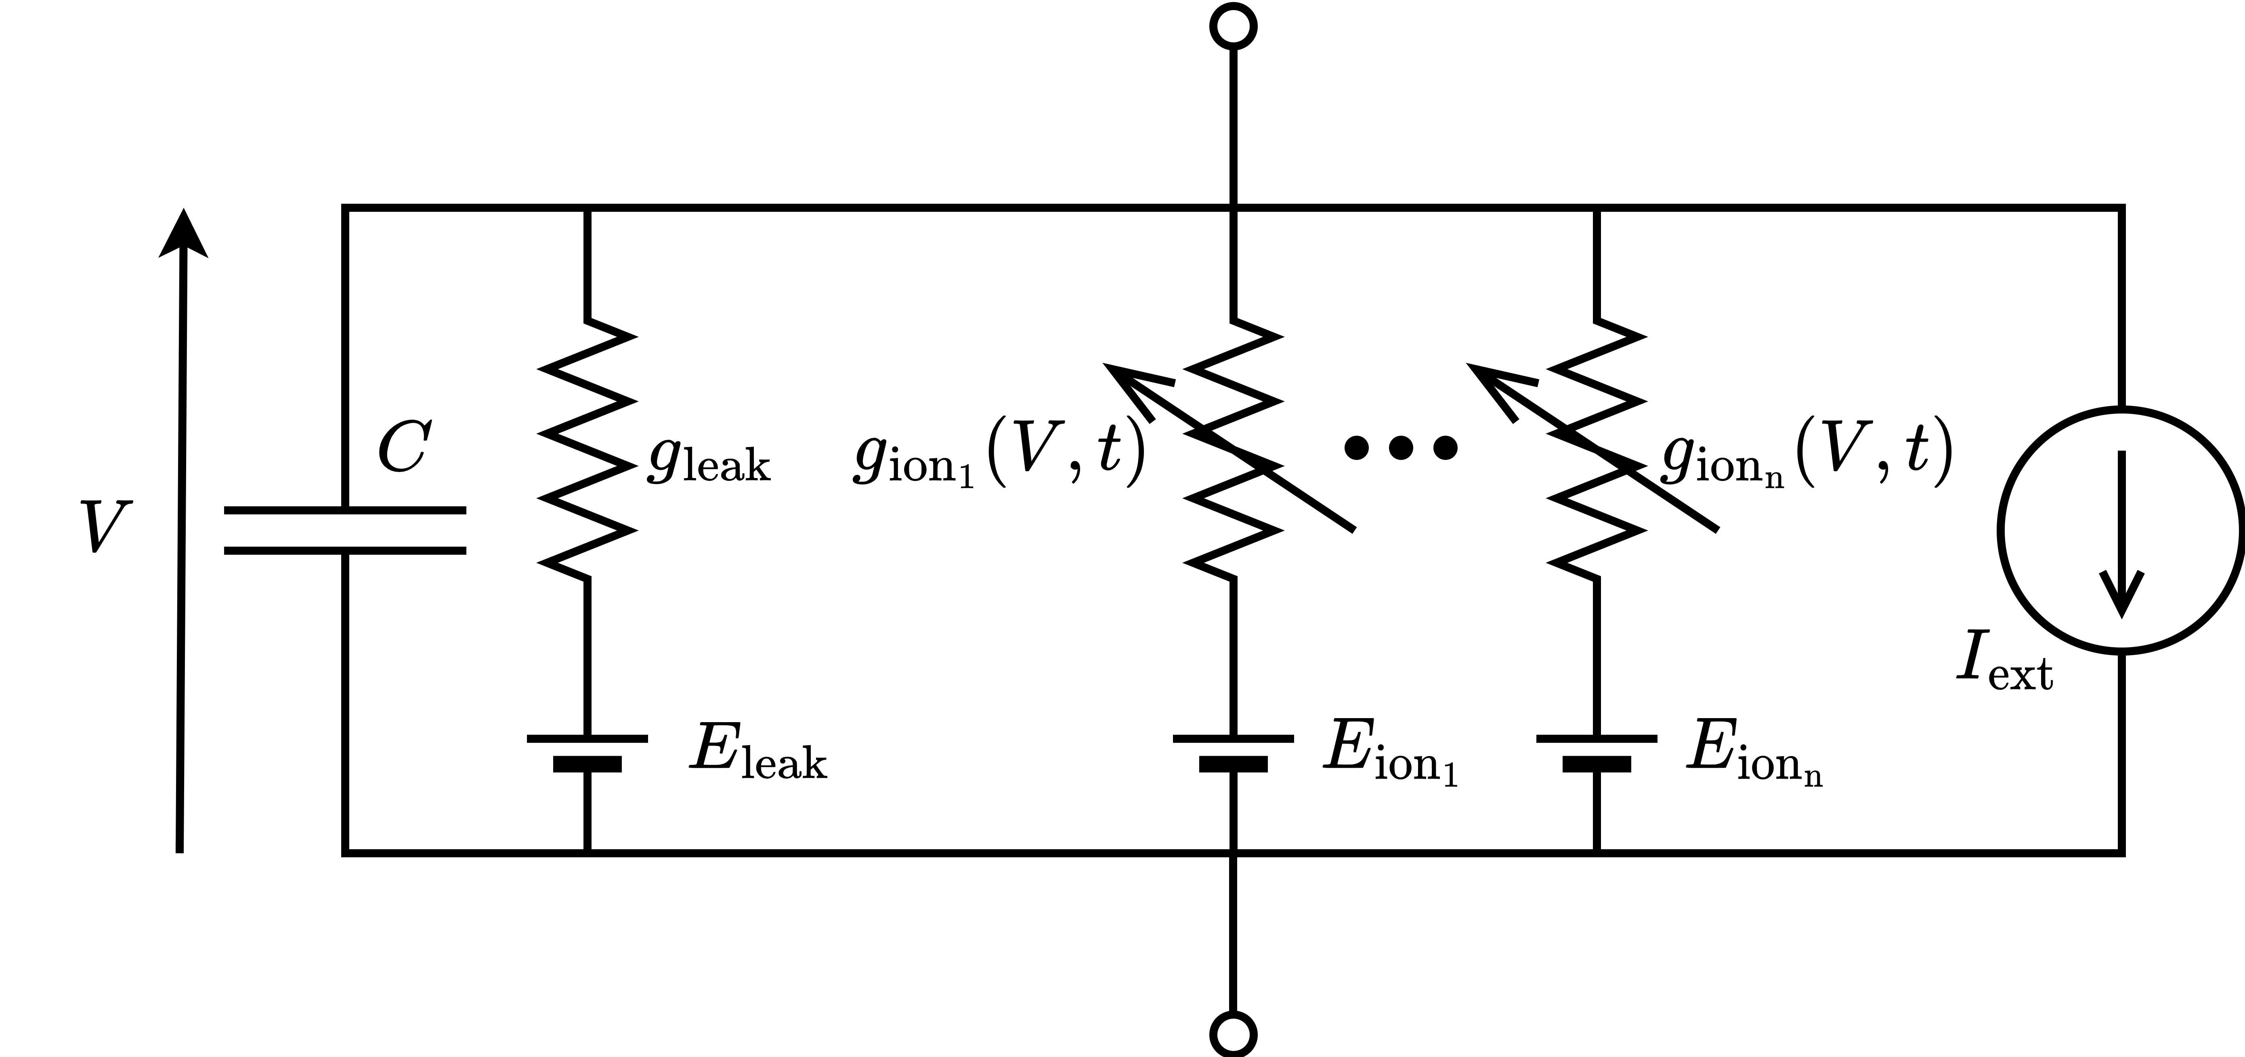
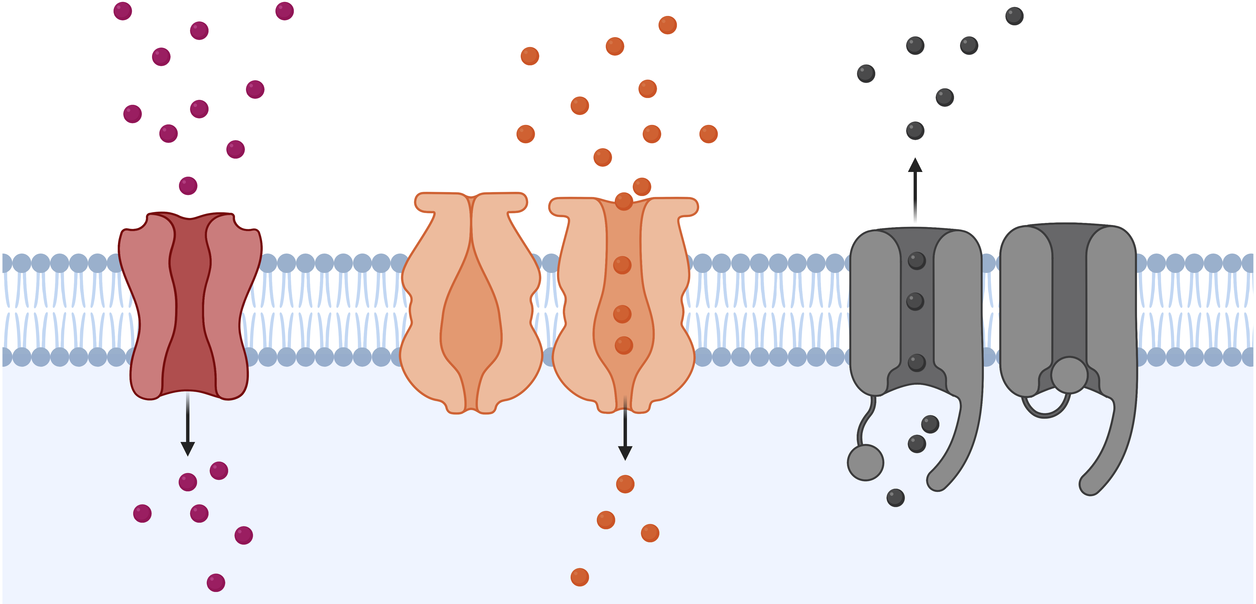
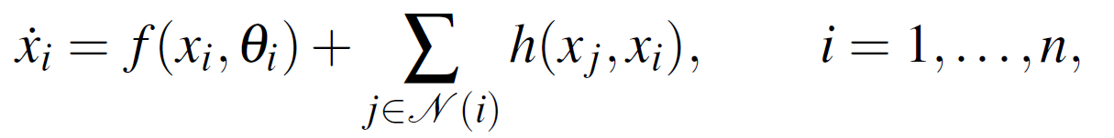
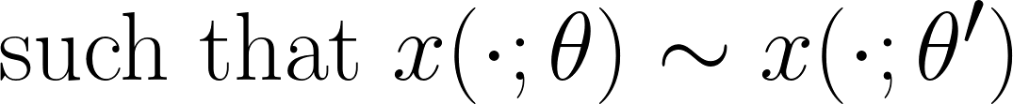
Dynamics arise from conductance-based models
Neuronal degeneracy:
Gait-switching control strategy:
robust to neuronal degeneracy
tuning of only a subset of model parameters.
3
Notes:
Equivalent to redundancy in control terms but different in biology

Slide 5
Research questions
Which network topologies admit the existence of target gaits (gallop and trot)?
How to reach and switch between them robustly under neuronal degeneracy?
?
?
?
u
4

Slide 6
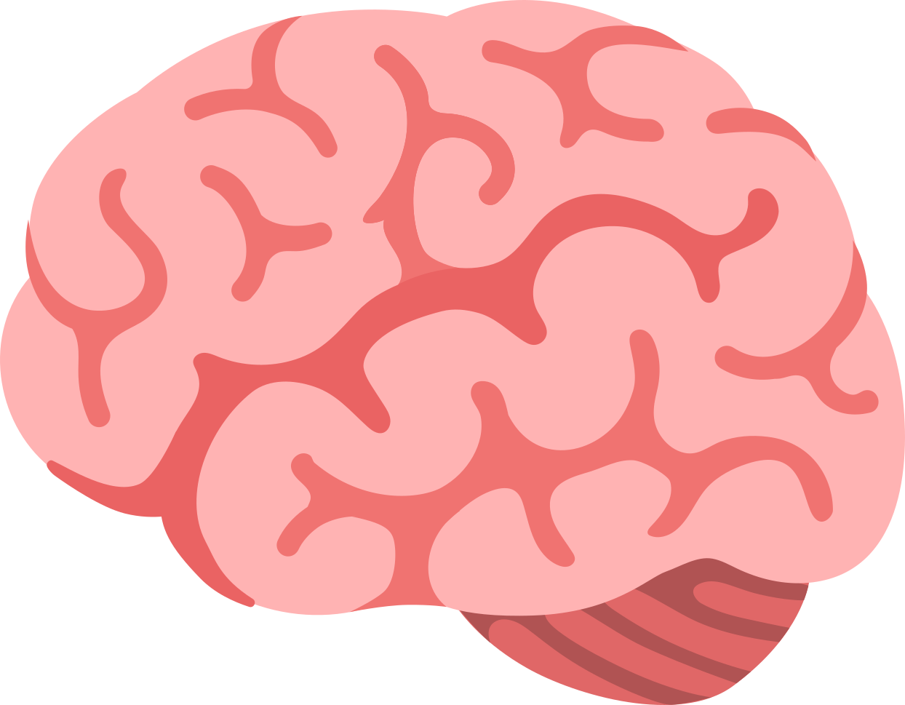
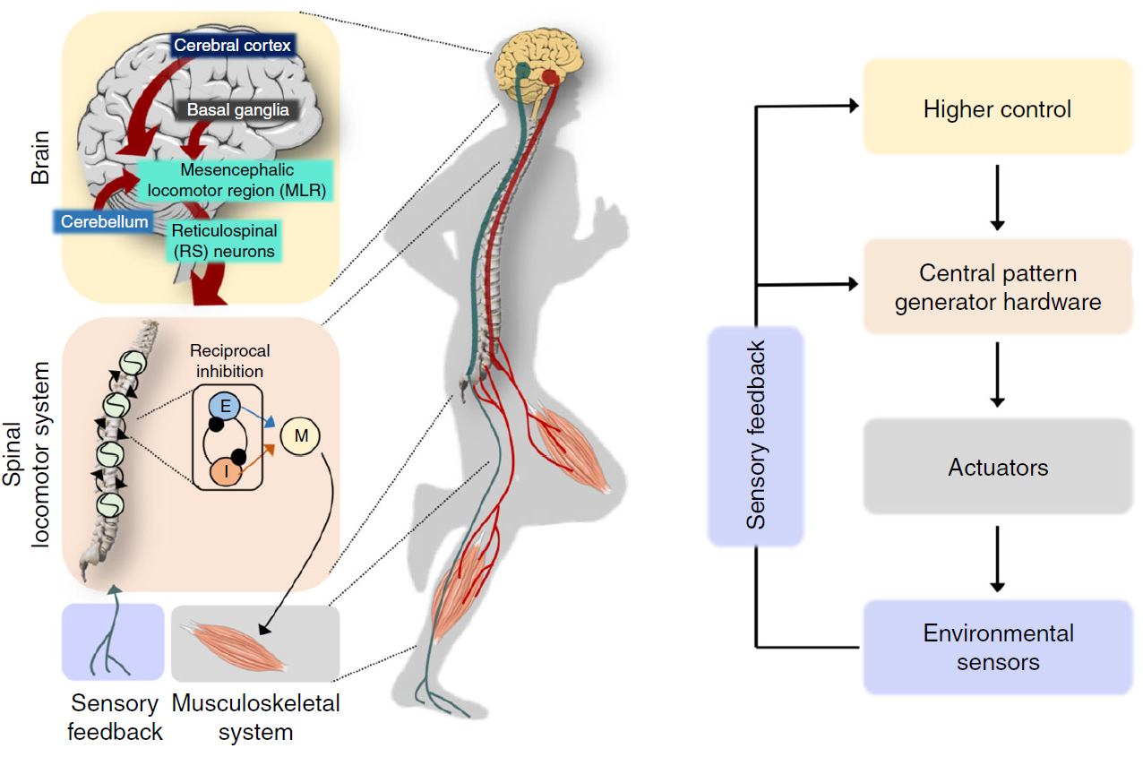
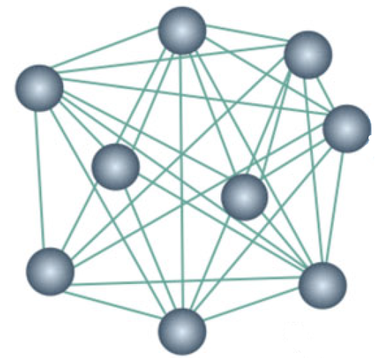
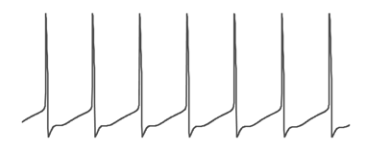
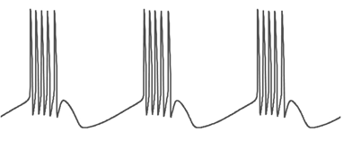
Neuromodulation as the proposed architecture
Neuromodulatory input
Neuromodulated network
OFF
ON
Dutta et al., 2019
Motor neurons
5

Slide 7
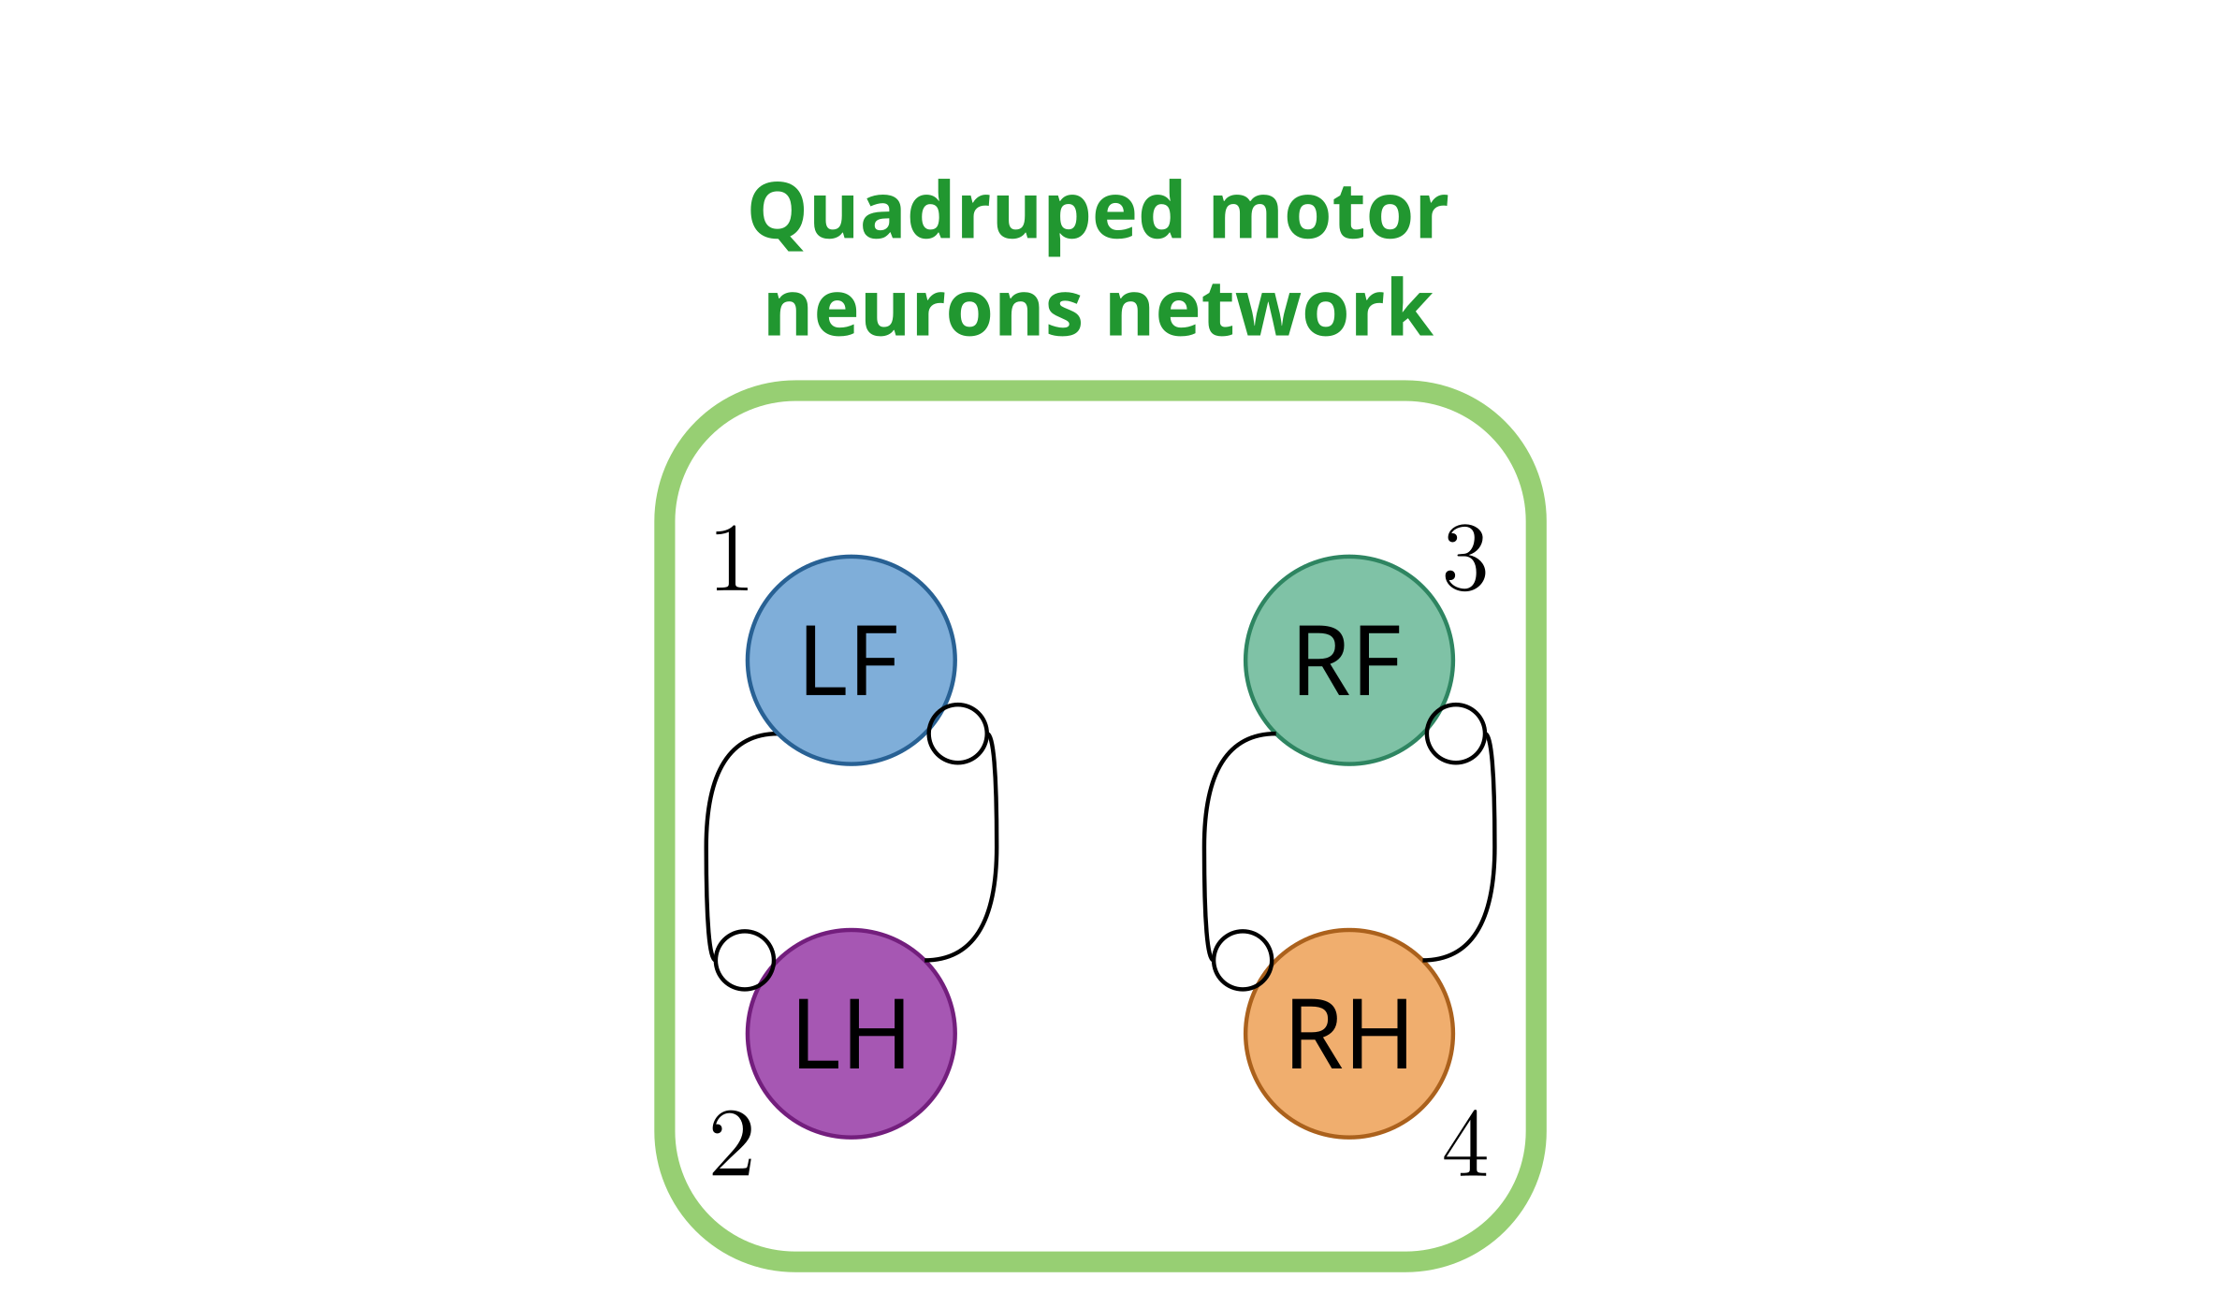
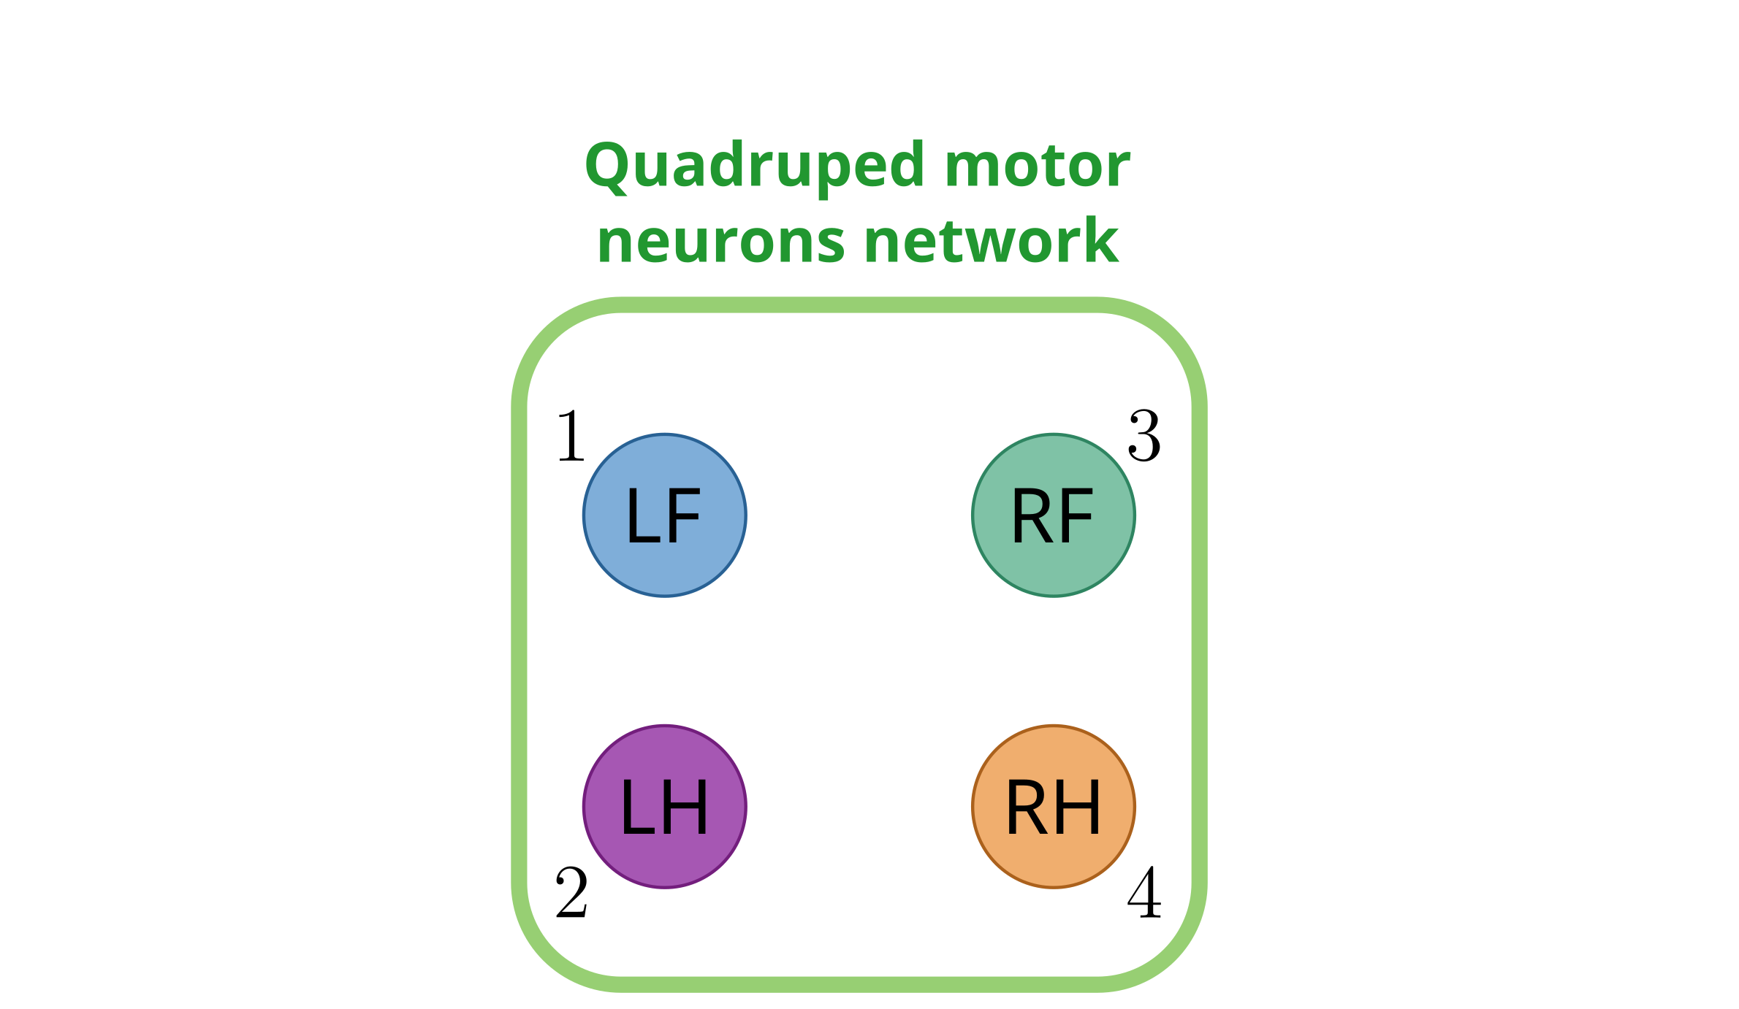
Q1: Which network topology?
?
6
Notes:
Known primitives are half center oscillators.

Slide 8
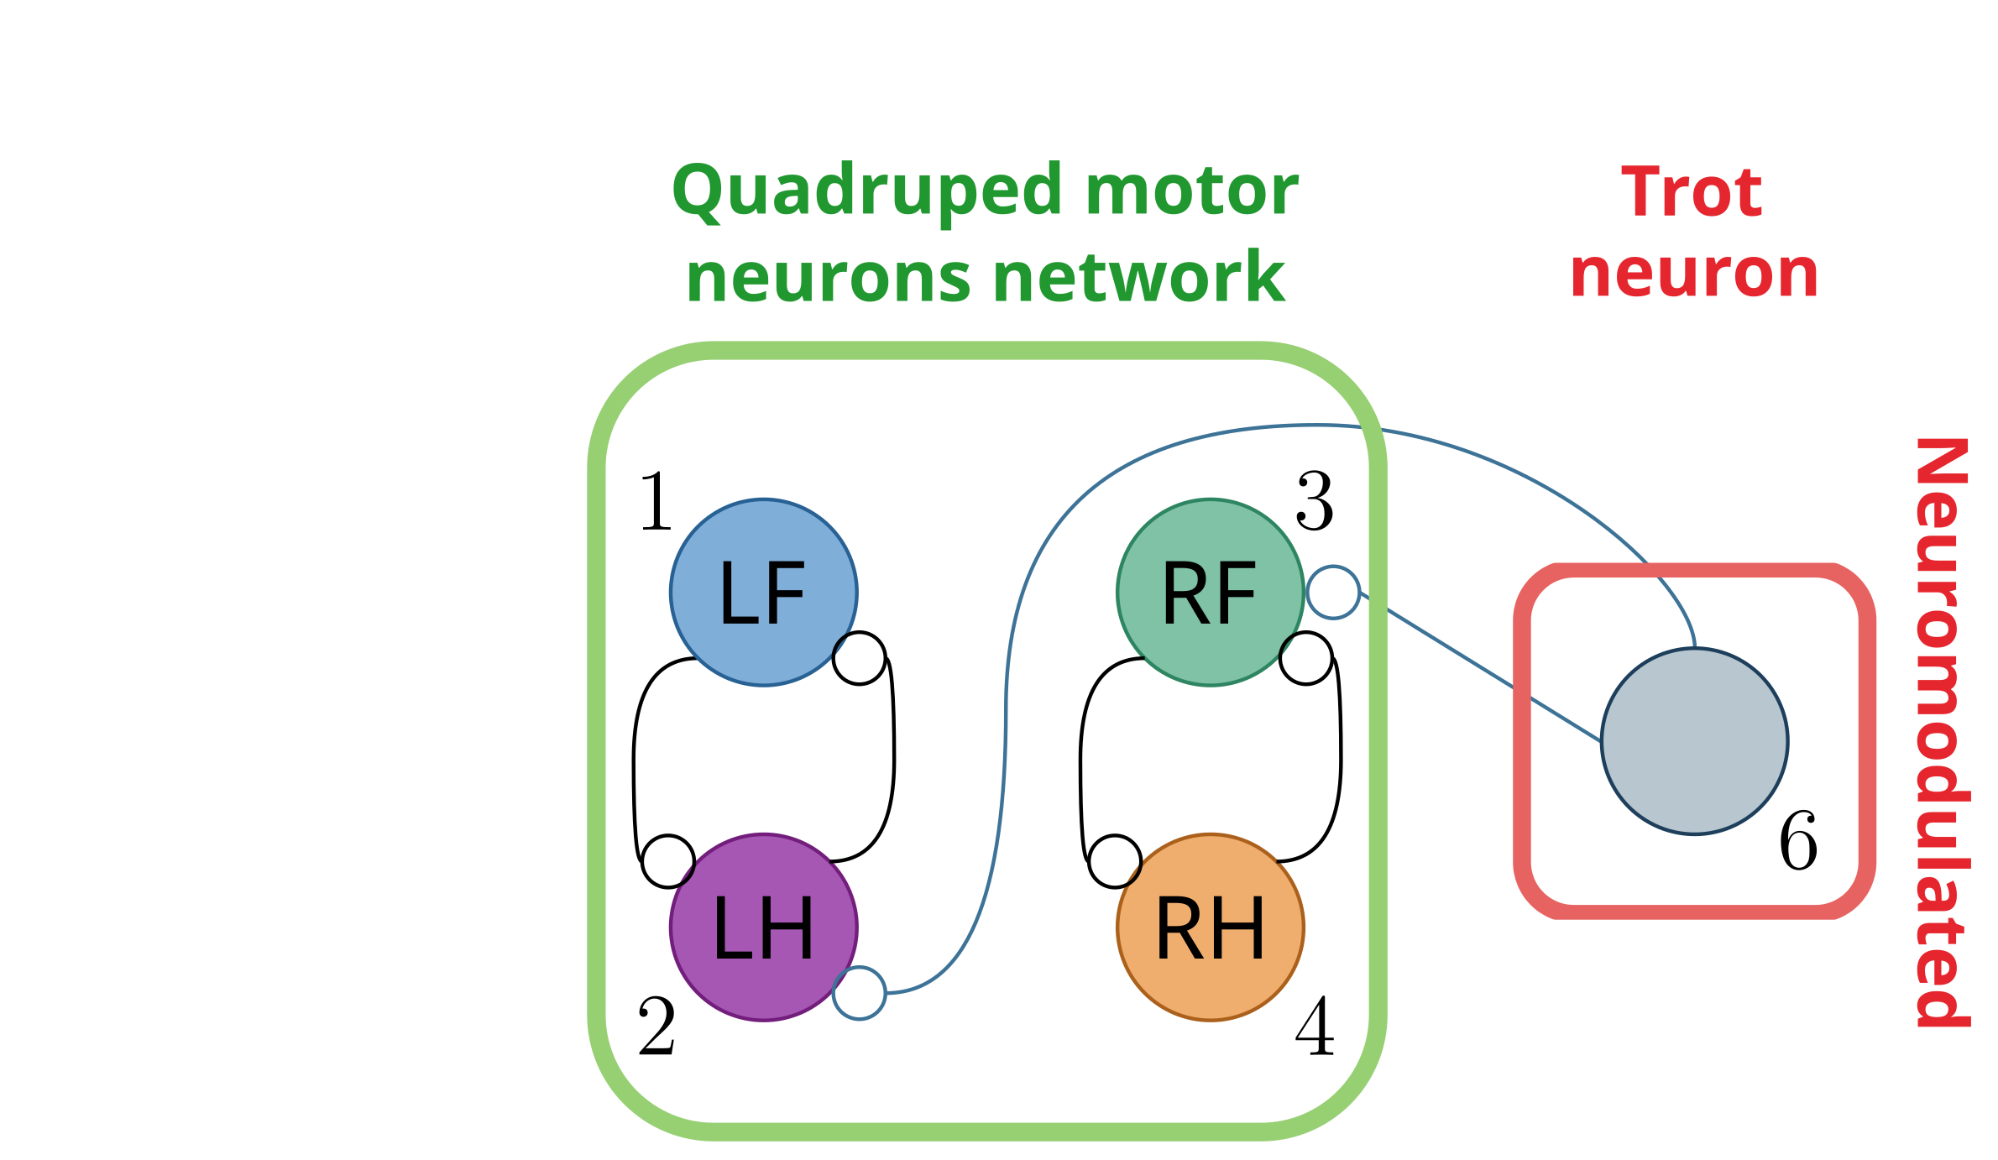
The smallest network admits one neuromodulated neuron per gait
?
7

Slide 9
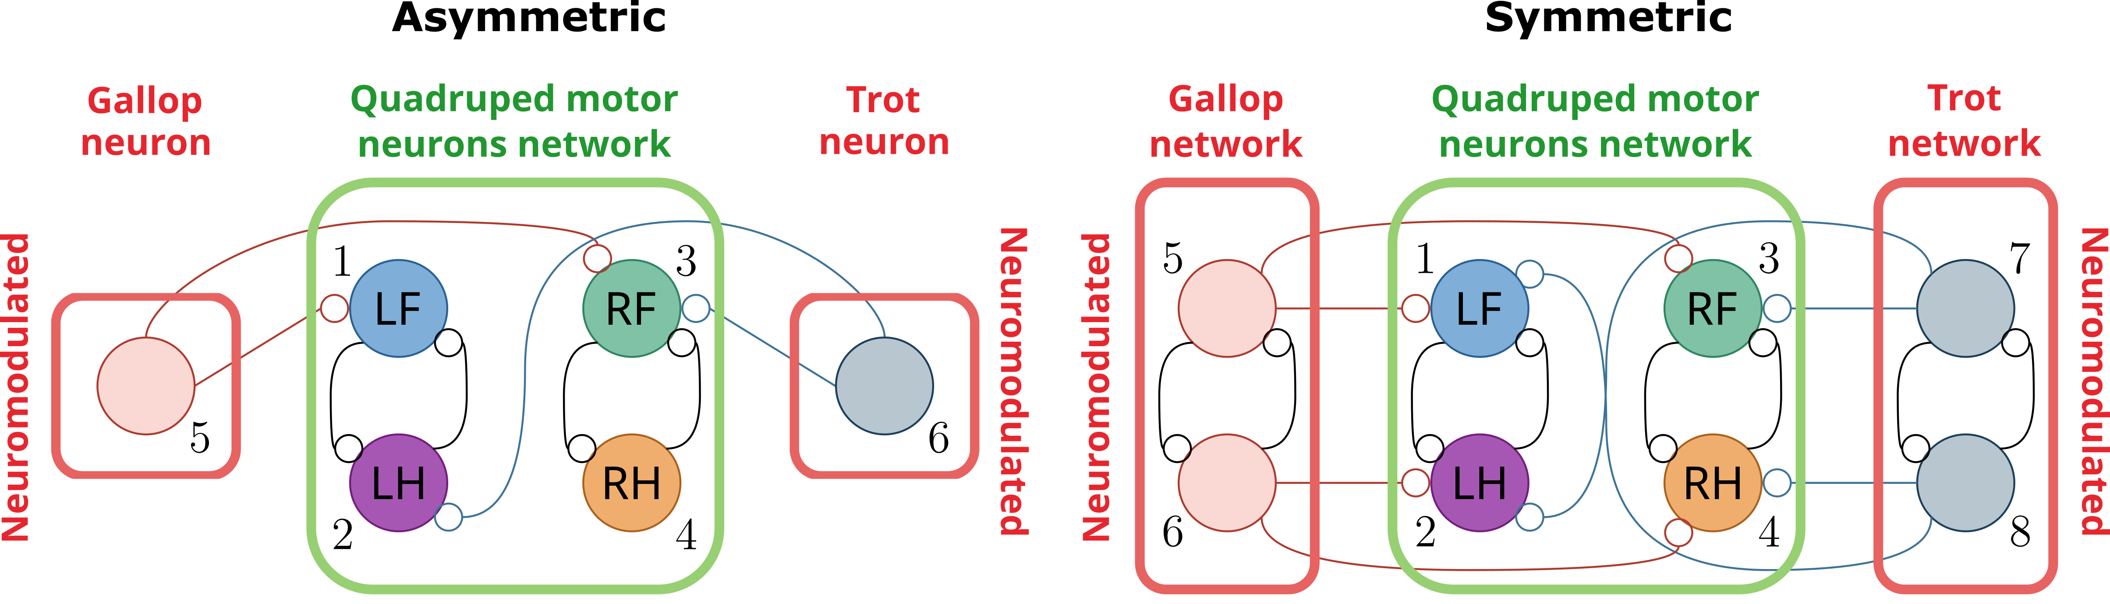
The smallest network admits one neuromodulated neuron per gait
?
7

Slide 10
Equivariant bifurcation theory predicts no stable orbit under asymmetric projections
?
No periodic orbits
for trot and gallop
8

Slide 11
Equivariant bifurcation theory predicts 2 stable orbits under symmetric projections
?
No periodic orbits
for trot and gallop
2 periodic orbits:
trot and gallop
9

Slide 12
Q2: Which switching mechanism?
?
u
10

Slide 13
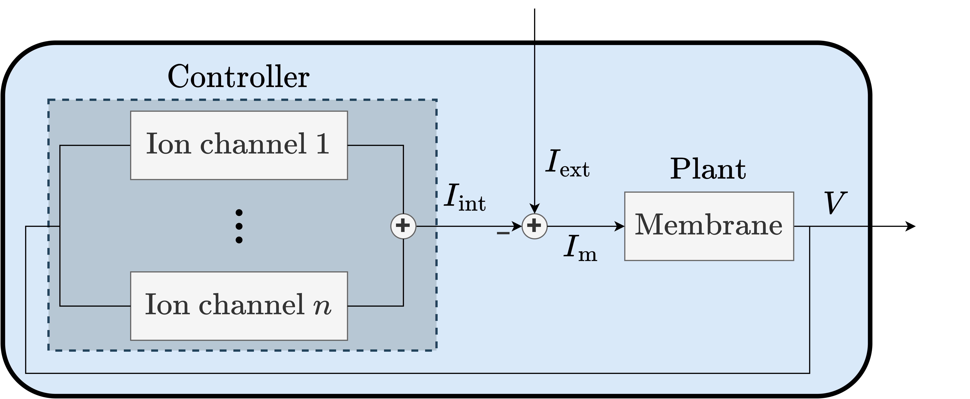

Neurons as feedback models
?
u
11

Slide 14
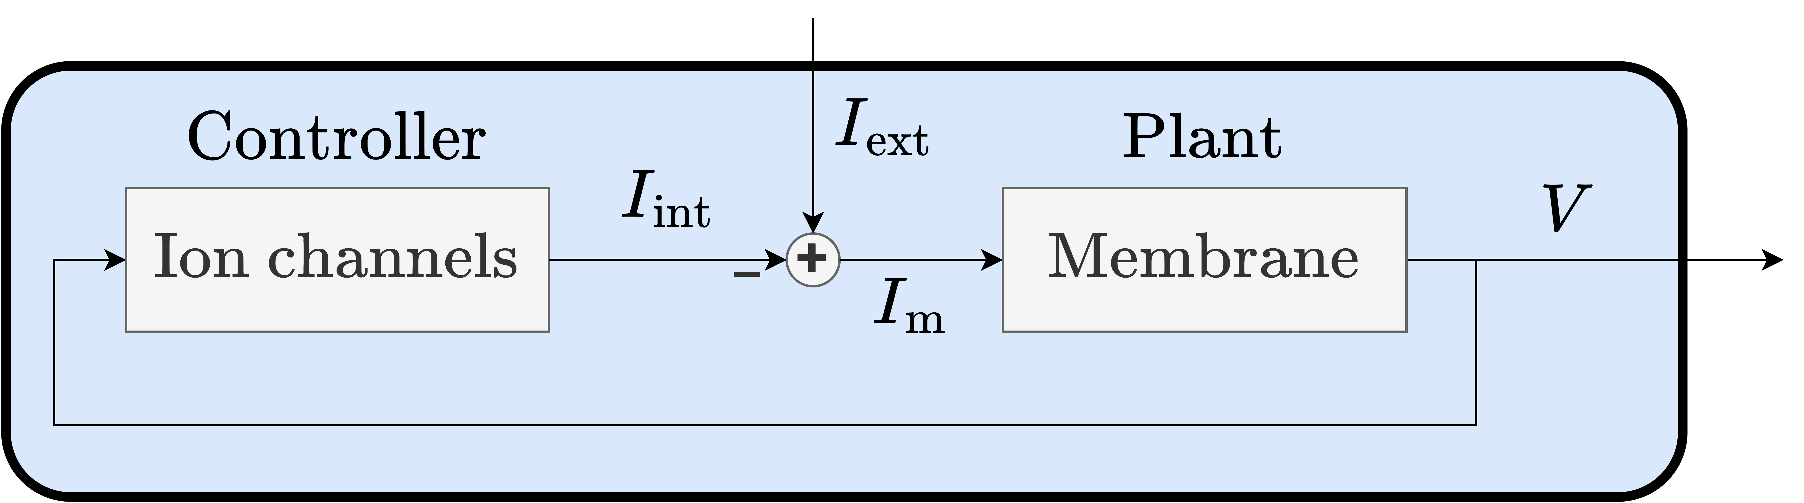
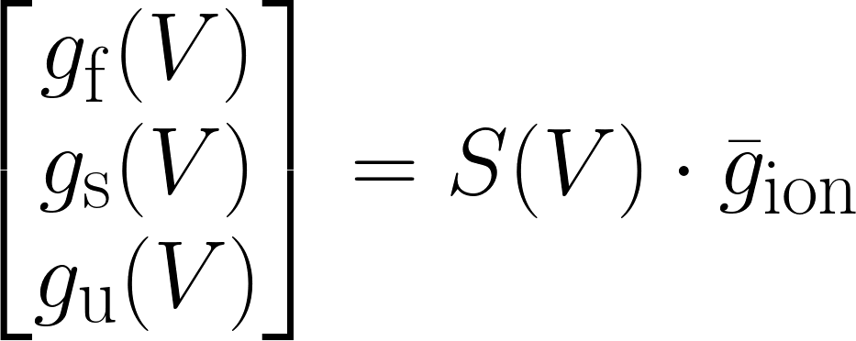
The control action of ion channels can be aggregated in 3 feedback gains
?
u
These can be aggregated into 3 neuronal feedback gains = 3 voltage dependent conductances: Dynamic Input Conductances (DICs)
Fast
Slow
Ultraslow
Drion et al., 2015
12

Slide 15
Neuromodulation is adaptive control
?
u
Fyon et al., 2023
13

Slide 16
Neuromodulation as adaptive control is robust to neuronal degeneracy
?
u
14

Slide 17
Simulating gait switching in an asymmetric network
15

Slide 18
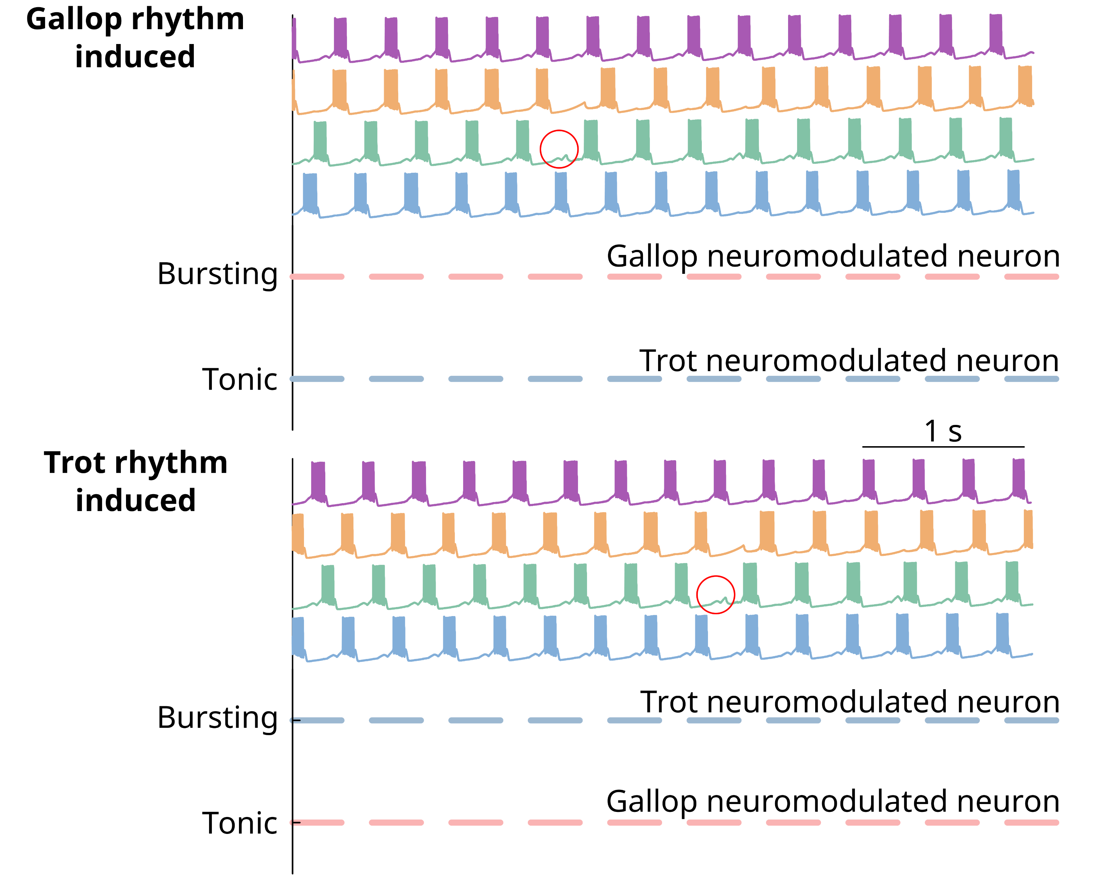

Simulations confirm asymmetric failure
16

Slide 19
Simulations confirm asymmetric failure
16

Slide 20
Simulations show symmetric robustness
17

Slide 21
Simulations show symmetric robustness
17

Slide 22

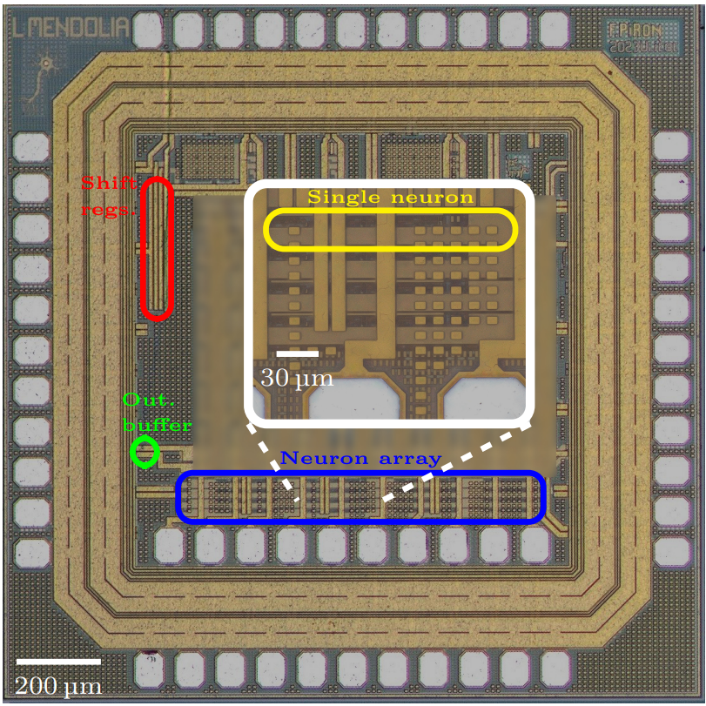
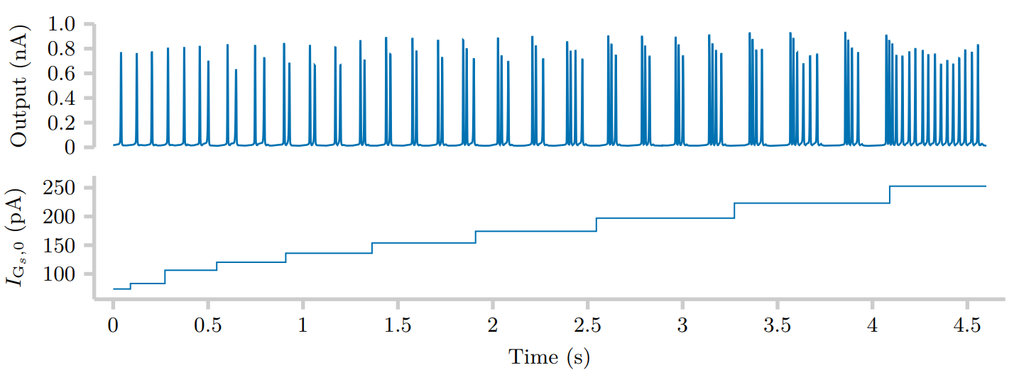
Conclusion and take home messages
One fixed connectome, no plasticity: symmetry sets which gaits exist, neuromodulation sets how to switch.
Robustness from feedback, not tuning : gaits hold across 200 networks at fivefold variability.
Next step, silicon: target gains become bias currents, degeneracy becomes device mismatch. Ongoing work with Loris Mendolia.
Mendolia et al., 2025
18

