Slide 1











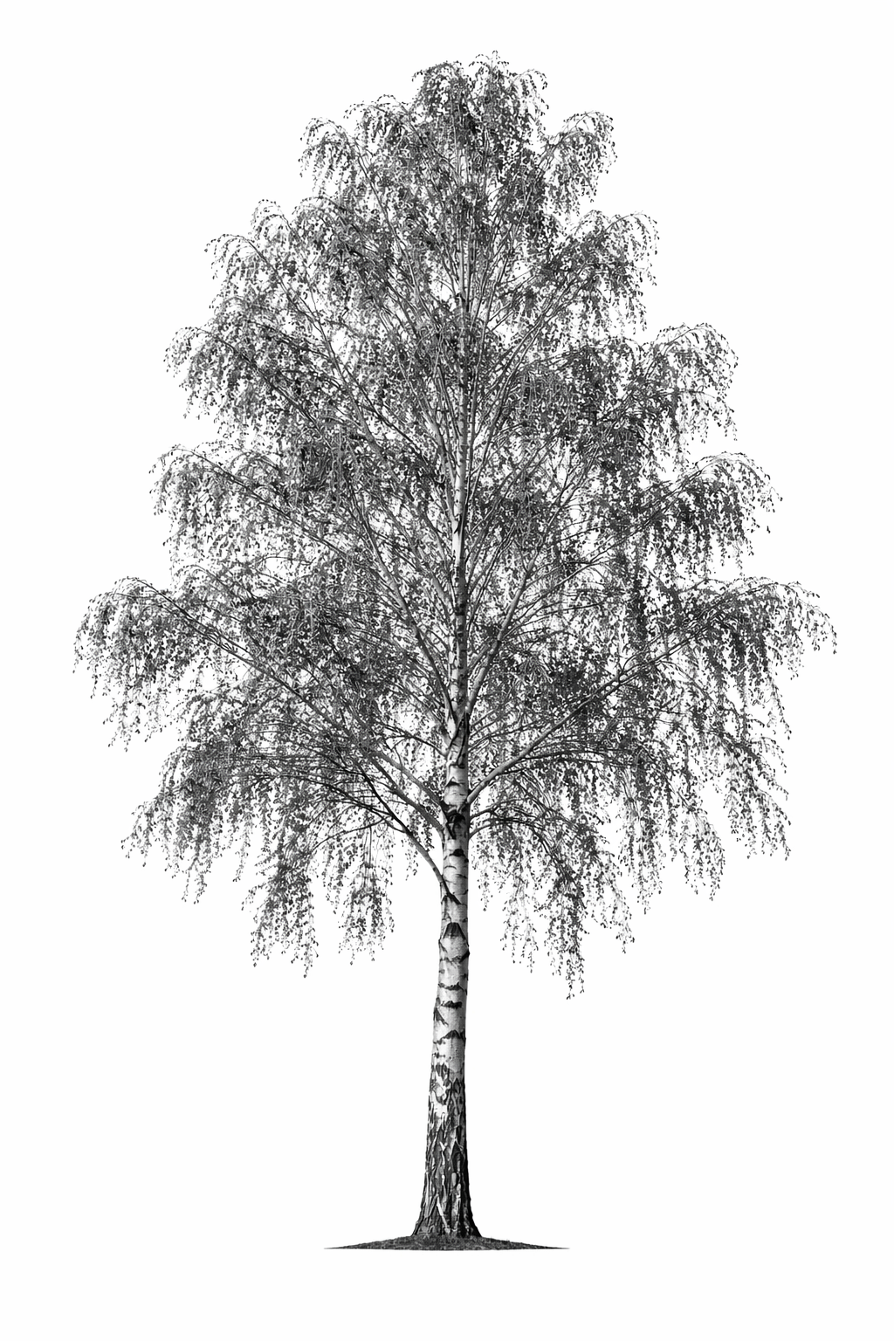
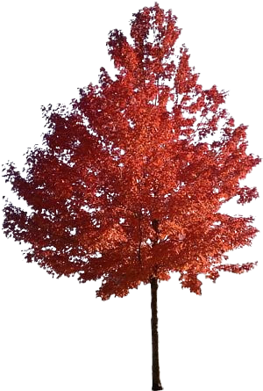
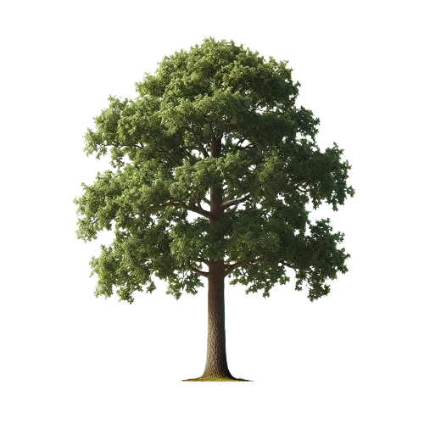
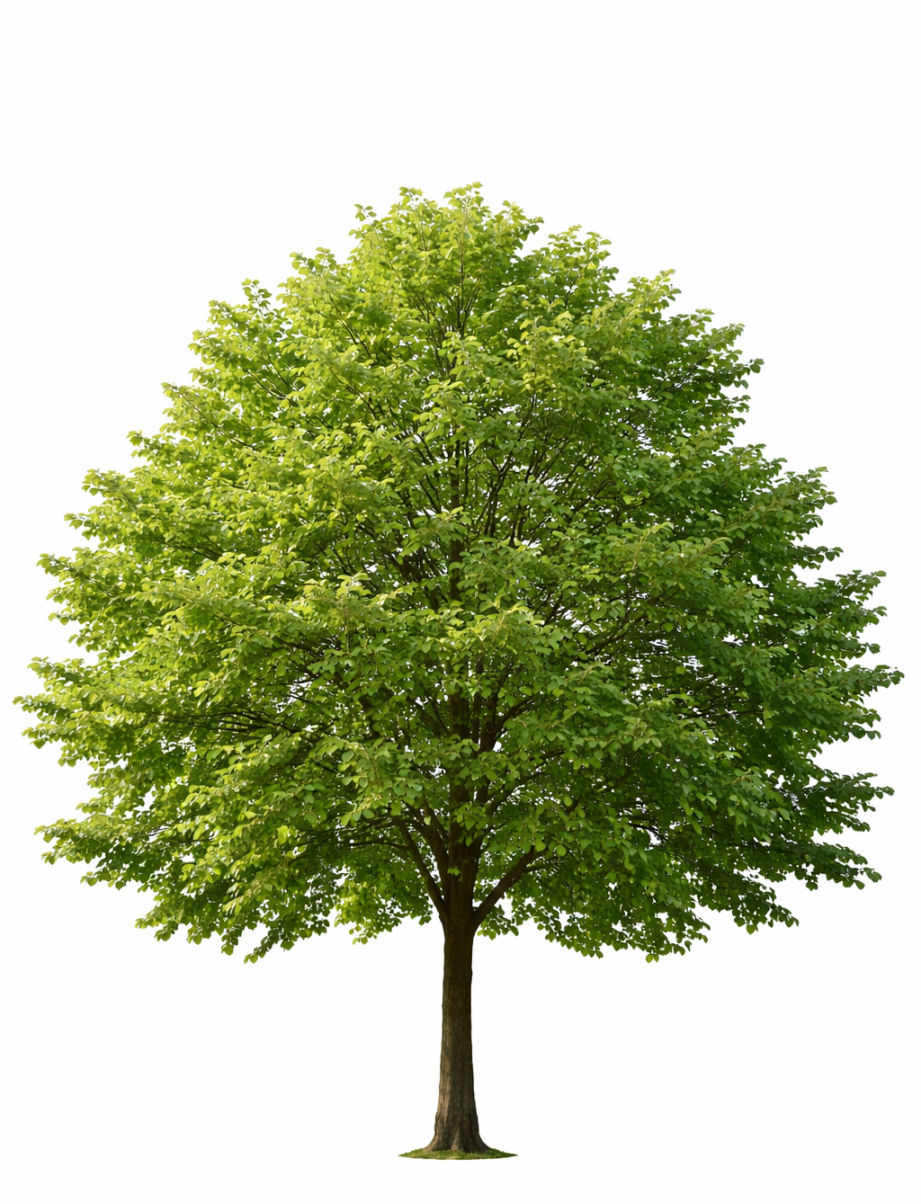
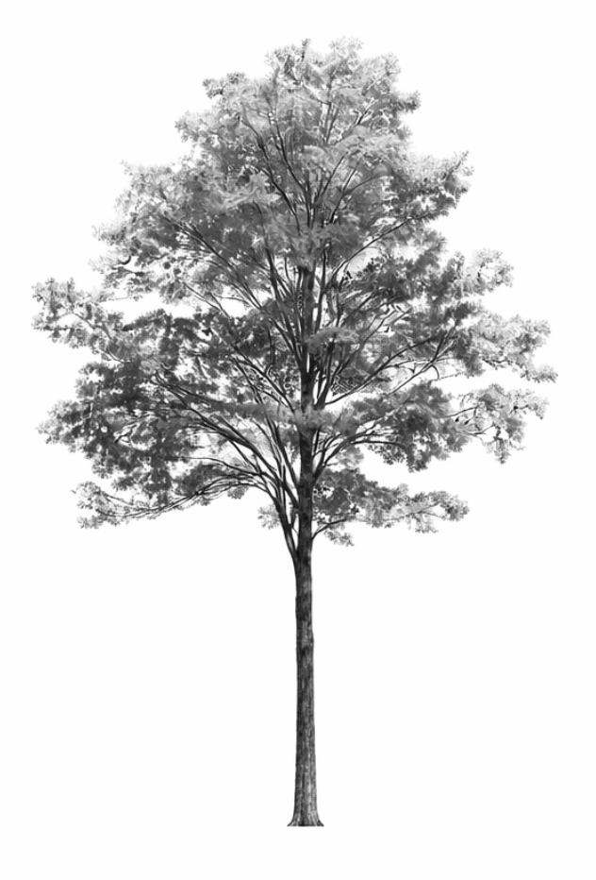
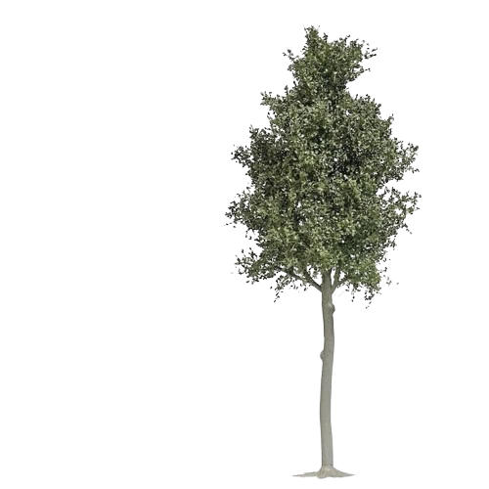
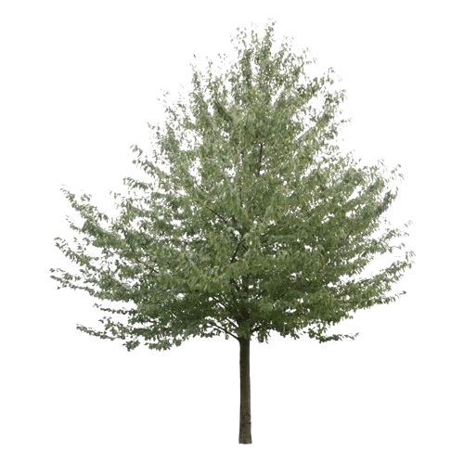
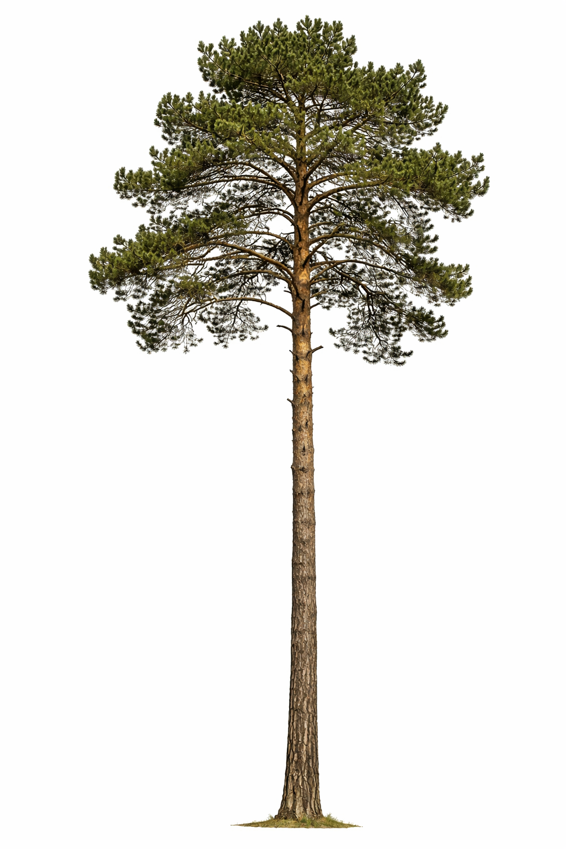
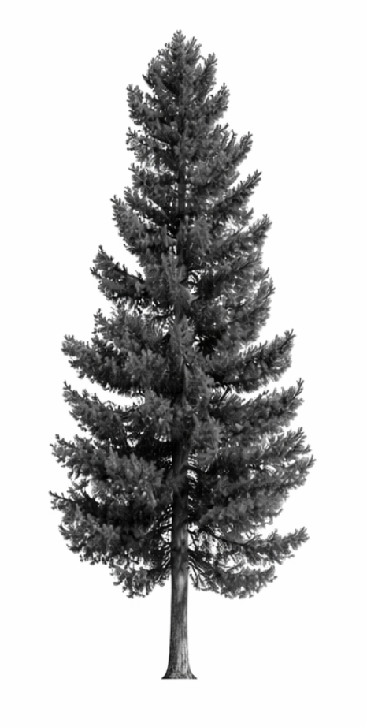
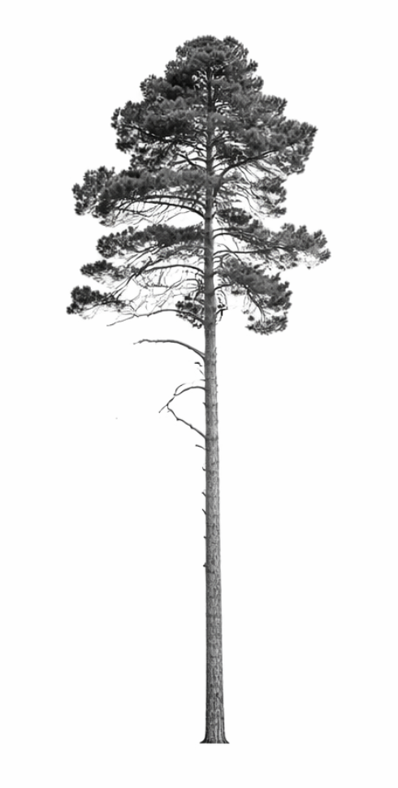
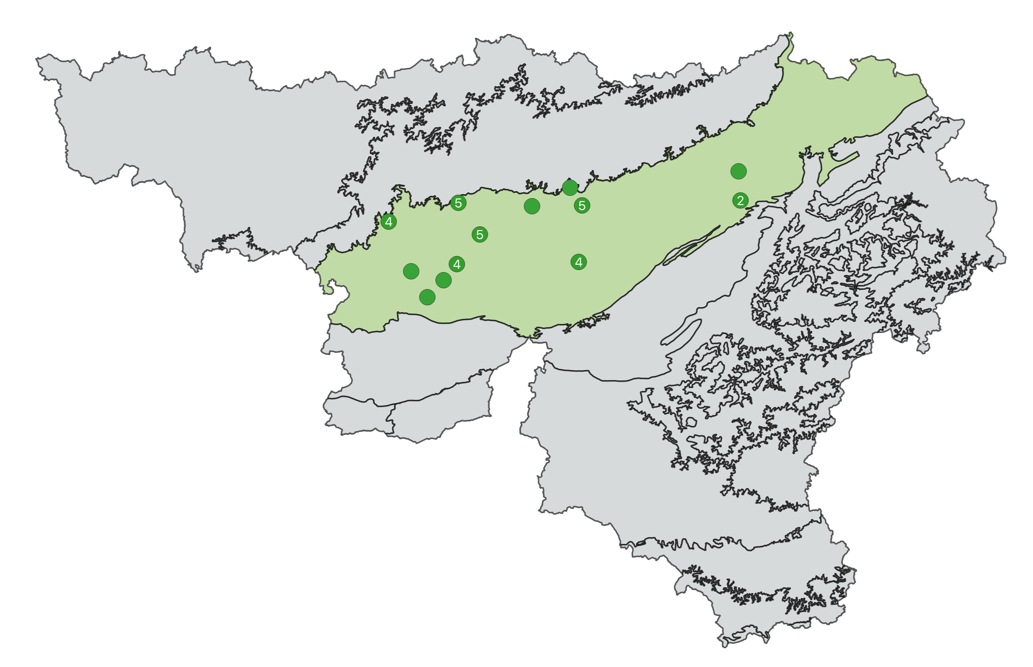

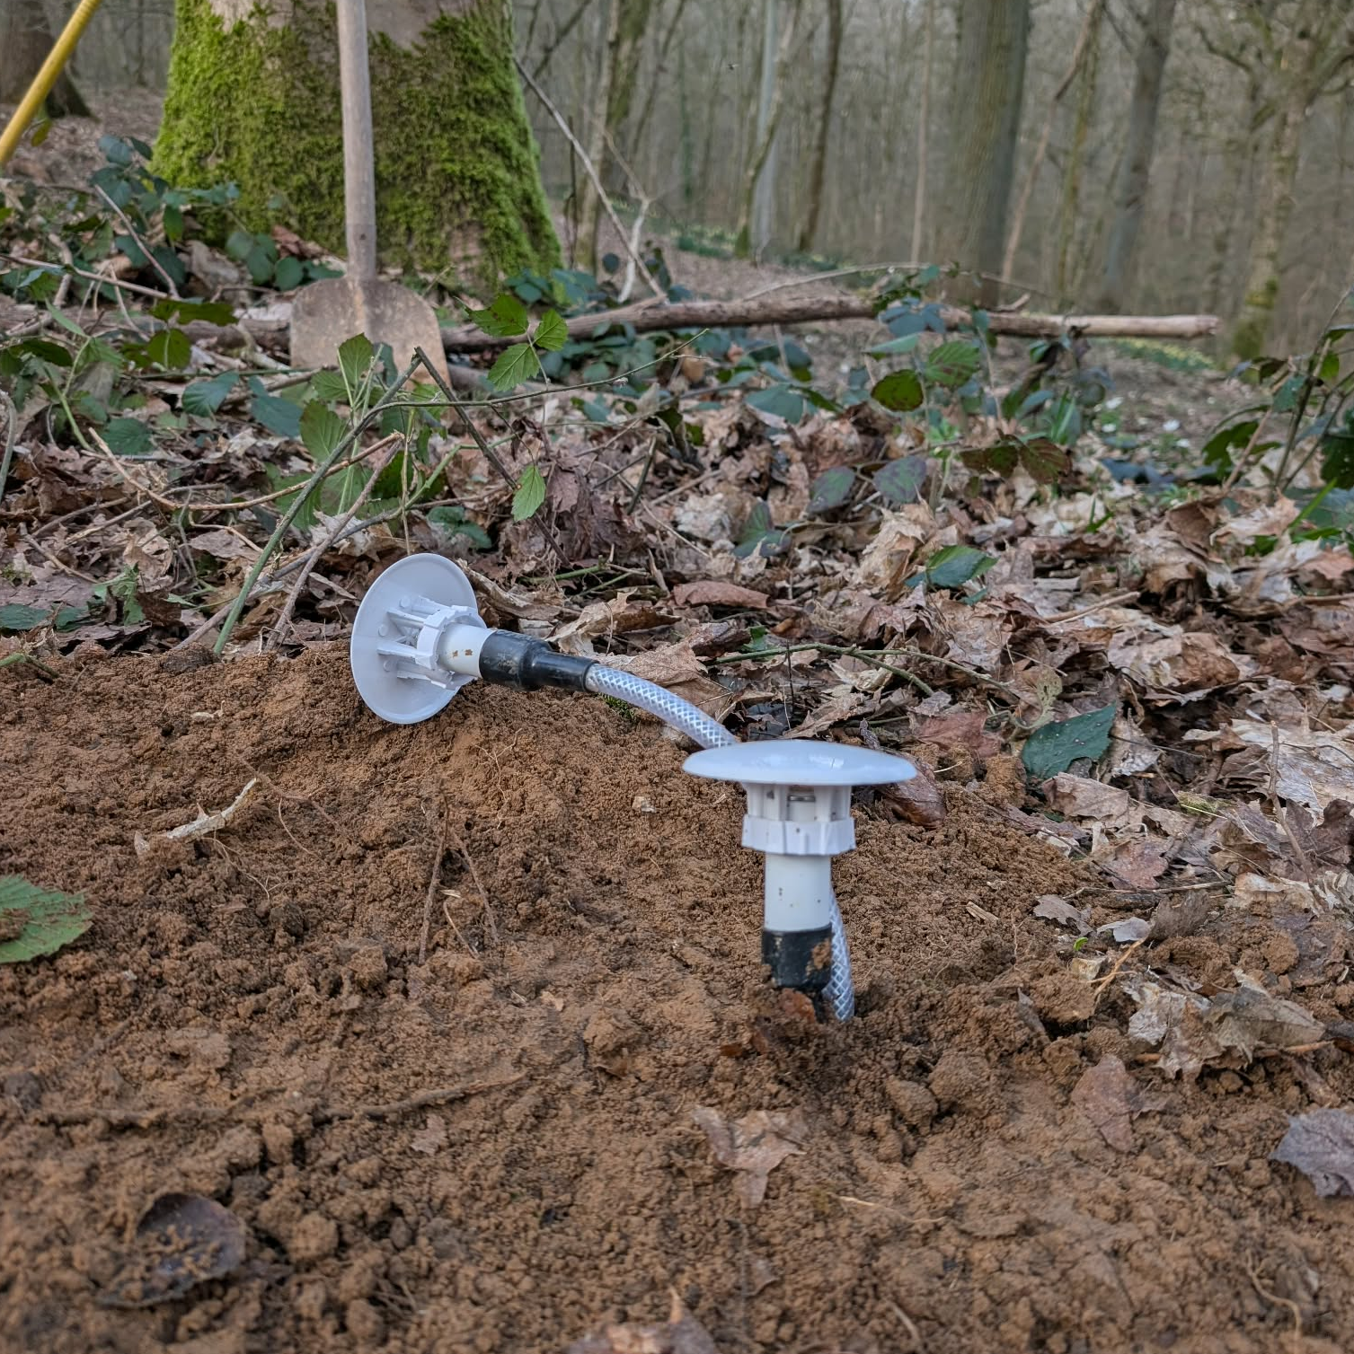

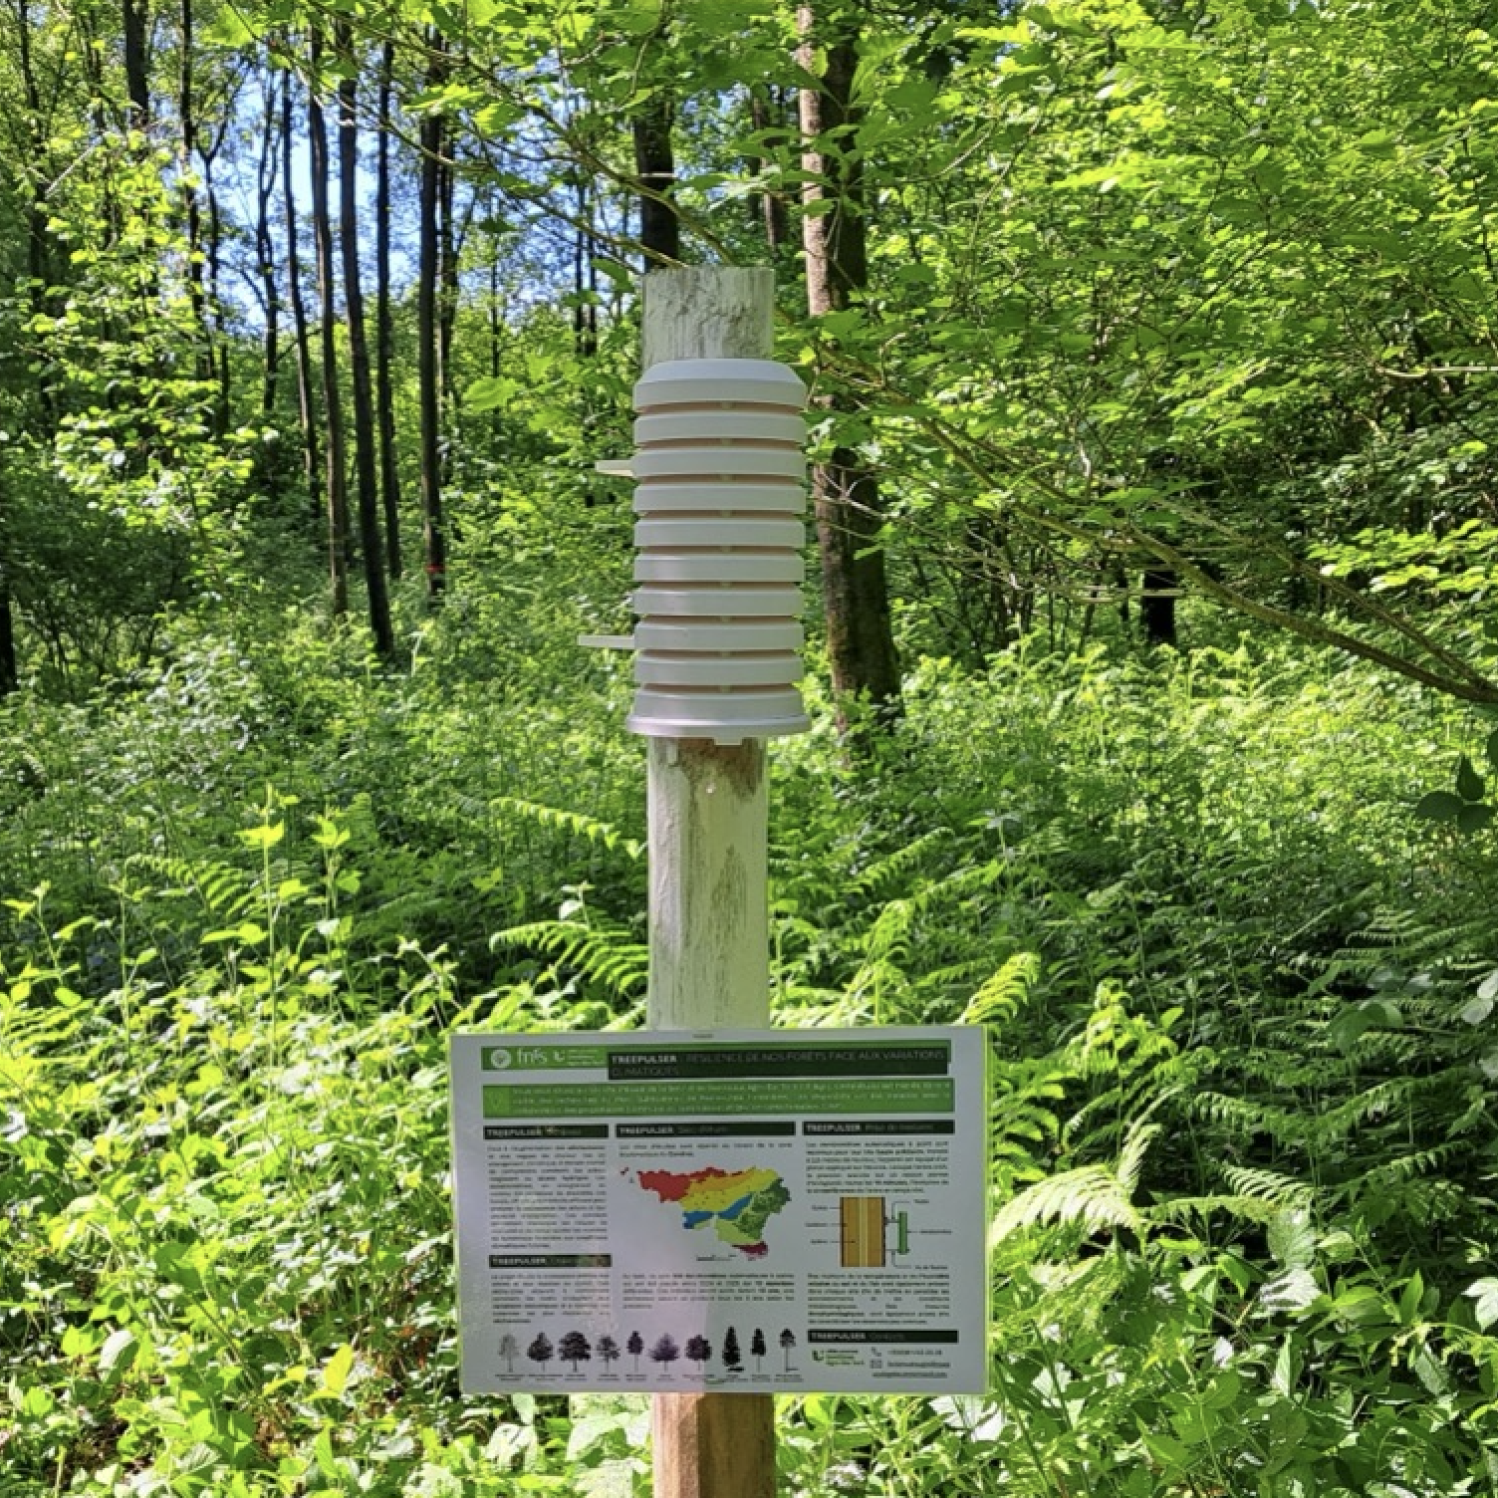
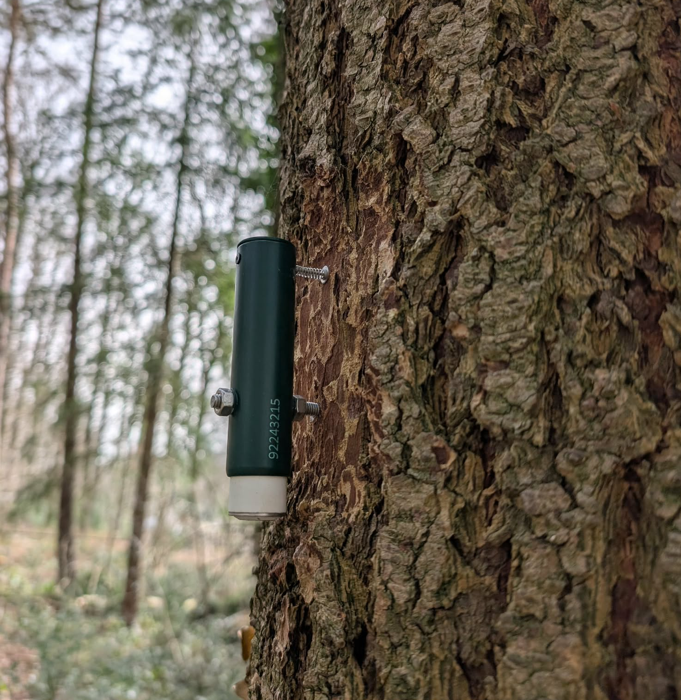


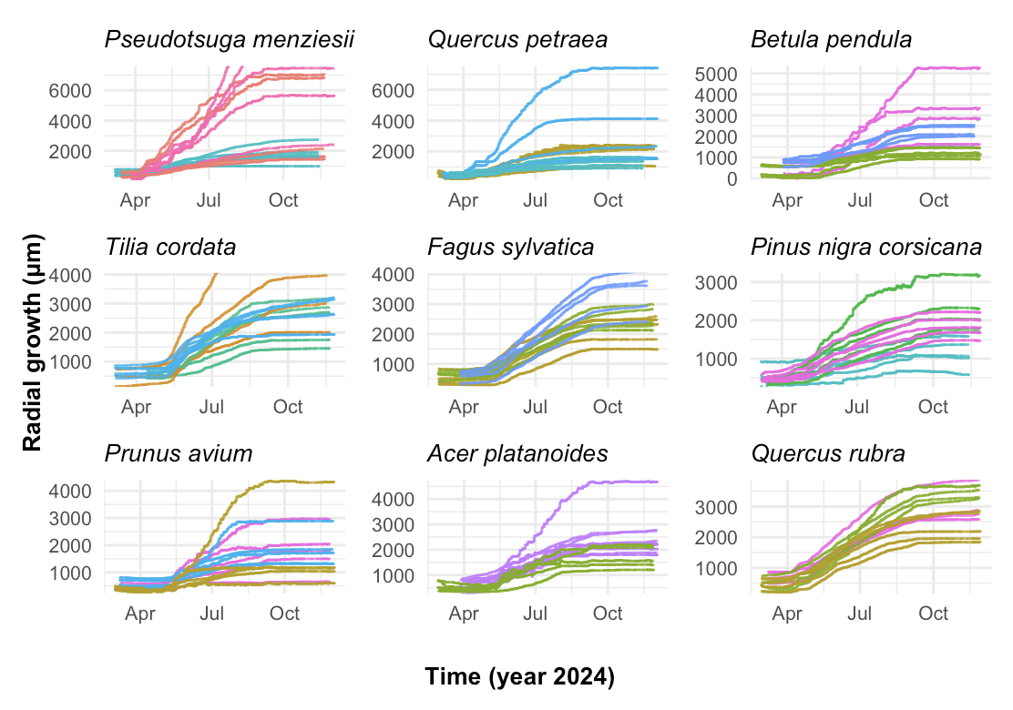
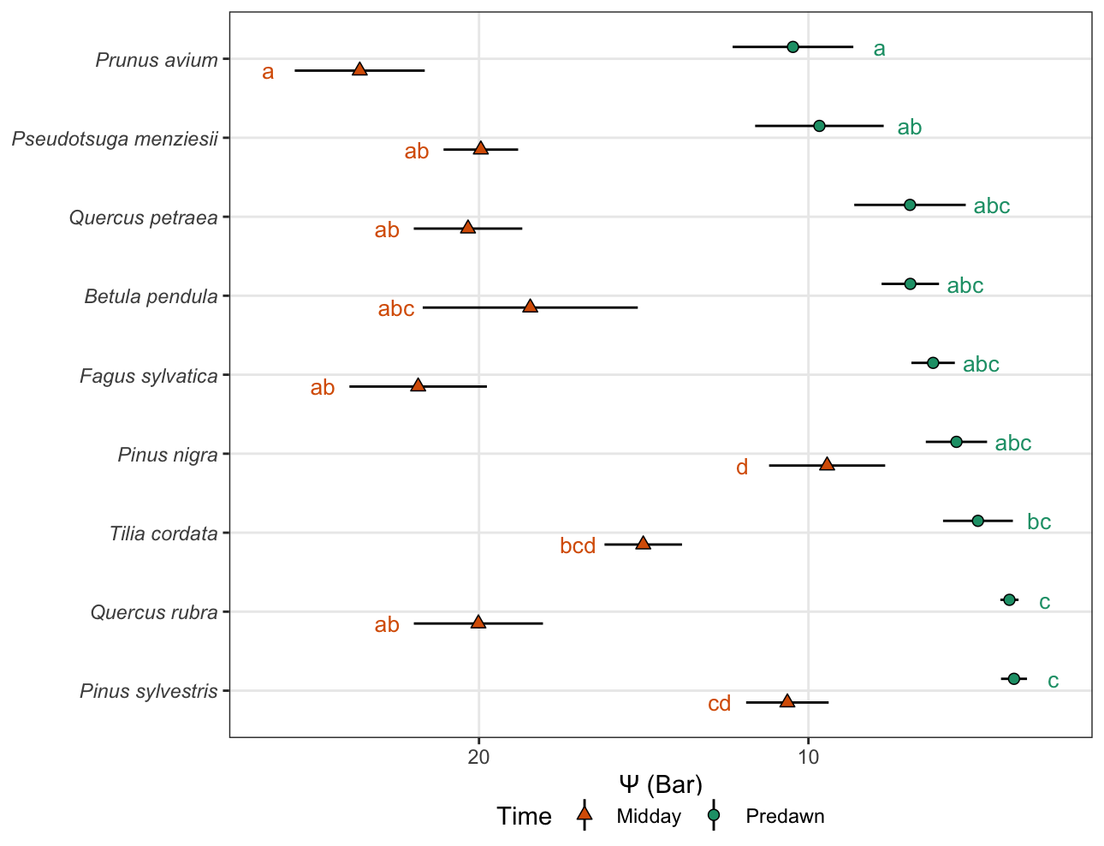




TREEPULSER: UNDERSTANDING SPECIES DIFFERENCES IN GROWTH AND DROUGHT RESPONSES TO SUPPORT RESILIENT FORESTS
HAUZEUR Harold, LIGOT Gauthier, GOREL Anaïs, DE MIL Tom
INTRODUCTION
CURRENT ISSUES
FOREST SERVICES
CURRENT ISSUES
CURRENT NEEDS
ENVIRONMENTAL
CLIMATE
CHANGE
OUTDATED
PRACTICES
FILLING KNOWLEDGE GAPS ON :
STRESS
MECHANISMS
SPECIES-SPECIFIC WATER USE STRATEGIES
ECONOMIC
PHYSIOLOGICAL TRAITS
SOCIAL
SPECIES ECOLOGY
FOREST
DECLINE
ADAPTIVE MANAGEMENT STRATEGIES FOR INCREASED FOREST RESILIENCE
FOREST DECLINE
NETWORK & METHODS
Silver birch Betula pendula | Red oak Quercus rubra | Sessile oak Quercus petraea | Small-leaved lime Tilia cordata | Norway maple Acer platanoides | European beech Fagus sylvatica | Sweet cherry Prunus avium | Corsican pine Pinus nigra var. corsicana | Douglas fir Pseudotsuga menziesii | Scots pine Pinus sylvestris
2 soil sensors
ENVIRONMENTAL MONITORING
Climatic factors ; Edaphic factors ;
Neighborhood effects
Air datalogger
5-10 dendrometers
PHYSIOLOGICAL & ANATOMIC TRAITS MONITORING
Drought resistance & hydraulic traits ;
Resource alocation traits
TREE RESPONSES
Growth ; Drought stress
PRELIMINARY RESULTS
GROWTH
DROUGHT STRESS
Species-specific & site-specific growth rates
Species-specific drought responses
NEXT STEPS
NEXT STEPS
Assessing the relative influence
of each environmental variable
Assessing species-specific traits related
to water management
Harold Hauzeur
harold.hauzeur@uliege.be
+32471687626
Notes:
Footer & header same colour ( & different colour from the rest of contents

