Slide 1
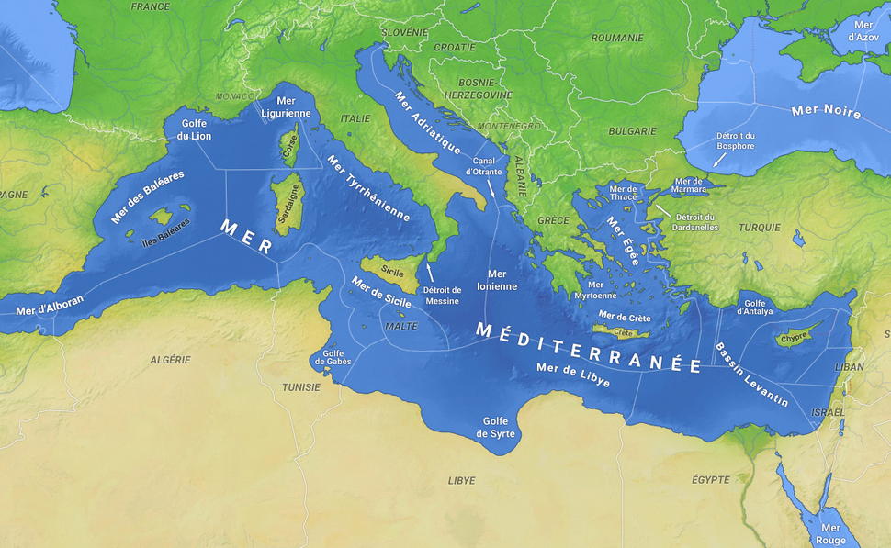
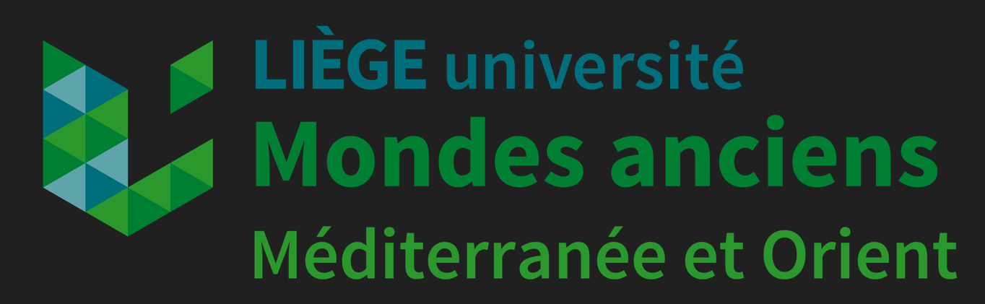
Les 75 minutes du language – Séance 6
Language en évolution, language en création
Bruno Rochette (ULiège)
Bilinguisme antique, bilinguisme moderne : quelle différence ?

Slide 2
L’exemple de l’Egypte ptolémaïque
Peremans, Willy (1983). Le bilinguisme dans les relations gréco-égyptiennes sous les Lagides. In Edmond Van't Dack, P. van Dessel & Wilfried van Gucht (Eds.), Egypt and the Hellenistic world. Proceedings of the International Colloquium, Leuven, 24-26 May 1982 (pp. 253-280). Kathol. Univ..
Peremans, Willy (1982). Sur le bilinguisme dans l'Égypte des Lagides, II. In Studia Paulo Naster oblata, II: Orientalia antiqua (pp. 143-154). Peeters.
Peremans, Willy (1964). Ueber die Zweisprachigkeit im Ptolemäischen Aegypten. In Horst Braunert (Ed.), Studien zur Papyrologie und antiken Wirtschaftsgeschichte F. Oertel zum 80. Geburtstag gewidmet (pp. 49-60). Habelt.

Slide 3
J. Fishman
1972
The Sociology of Language. An Interdisciplinary Approach to Language in Society, Cambridge (Mass.)
1972
Language Maintenance and Language Shift as a Field of Inquiry: Revisited, dans J. Fishman (éd.), Language in Sociocultural Change, Stanford
1978
Sociolinguistics : a Brief Introduction, Cambridge (Mass.), Advances in the Study of Societal Multilingualism, The Hague

Slide 4
Ch. A. Ferguson
Ch. A. Ferguson, Diglossia, dans Word, 15 (1959), 325-340 [repris dans D. Hymes (éd.), Language in Culture and Society. A Reader in Linguistics and Anthropology, New York, 1964, 429-439]

Slide 5
diglossia and bilingualism
diglossia without bilingualism
bilingualism without diglossia
neither diglossia nor bilingualism

Slide 6
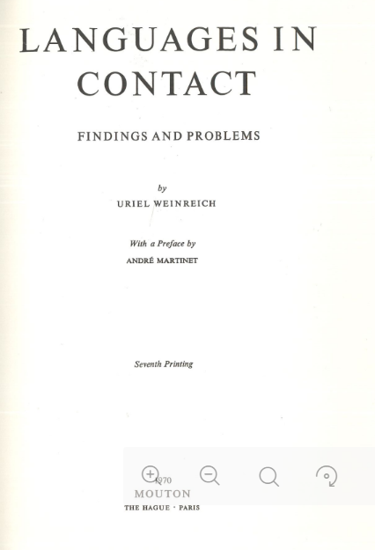
Uriel Weinreich, Languages in Contact : Findings and Problems, New York, 1953

Slide 7
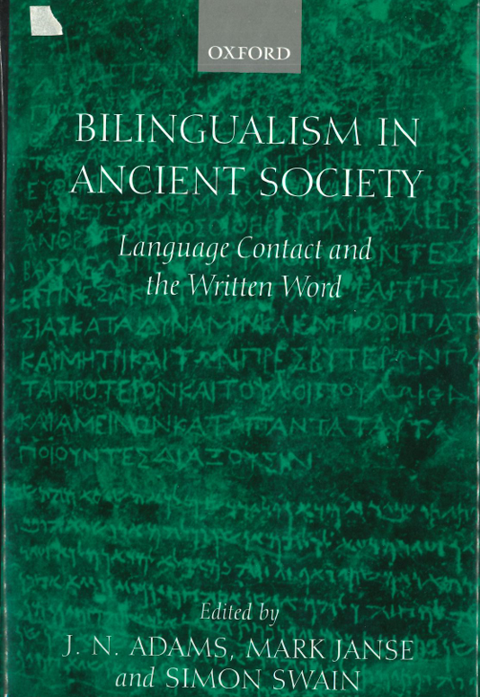
Bilingualism in ancient society: language contact and the written text / ed. by James N. Adams, Mark Janse and Simon C. R. Swain, Ed. by James N. Adams, Mark Janse and Simon C. R. Swain (), Oxford ; New York: Oxford University Pr., 2002. X-483 p.

Slide 8
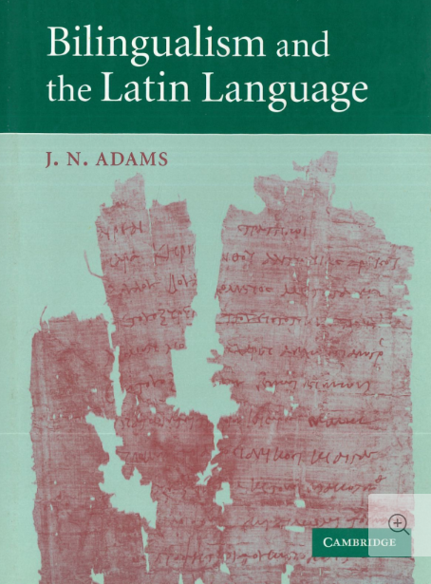
Jim N. Adams, Bilingualism and the Latin Language, Cambridge, 2003

Slide 9
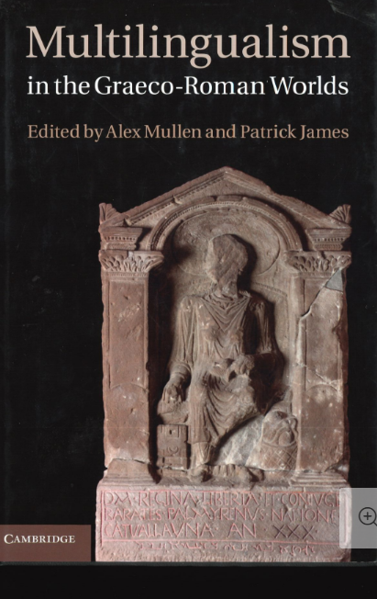
Alex Mullen and Patrick James (eds), Multilingualism in the Graeco-Roman Worlds, Cambridge, 2012.

Slide 10
C. Myers Scotton, Code-switching and Borrowing: Interpersonal and Macrolevel Meaning, dans R. Jacobson (éd.), Code-switching as a Worldwide Phenomenon, New York, 1990
Social Motivations for Code-switching, Oxford, 1993
M. Heller, Code-switching. Anthropological and Sociolinguistic Perspectives, Berlin, 1988 et Code-switching and the Politics of Language, dans L. Milroy – P. Maysken (éd.), On Speaker, Two Languages. Cross-disciplinary perspectives on code-switching, Cambridge, 1995
Code- Switching

Slide 11
Monolingual texts in a different linguistic context | Bi-/trilingual texts | Mixed-language texts | Transliterated text
Texts written in language A but showing interference/code-switching/borrowing from language B | The content is largely common to both languages A and B - idiomatic texts (version rendered idiomatically rather than word-for-word) - non idiomatic texts (verbum pro verbo translation) - complementary texts (the versions contain different information) - non complementary texts (version semantically the same) | A part in the language A and a part in the language B. Written in genetically mixed language or codes that are so mixed that is impossible to identify the dominant language. | Alphabet switching. Texts composed in language A, but the script is that of language B. Can involve texts displaying bilingual phenomena or bi-version bilingual texts.

Slide 12
Code-switching dans la correspondance de Cicéron
O. Wenskus, Triggering und Einschaltung griechischer Formen in lateinischer Prosa, dans IF, 100 (1995), 172-192
Emblematischer Codewechsel und Verwandtes in der lateinischen Prosa. Zwischen Nähesprache und Distanzsprache, Innsbruck, 1998
G.E. Dunkel, Remarks on code-switching in Cicero’s letters to Atticus, dans MH, 57 (2000), 122-129
S. Swain, Bilingualism in Cicero ? The Evidence of Code-switching, dans J.N. Adams – M. Janse – S. Swain, Bilingualism in Ancient Society. Language Contact and the Written Word, Oxford, 2002, 128-167
J.N. Adams, op. cit., 297-416 ;
M. Dubuisson, Le grec de la correspondance de Cicéron : questions préliminaires sur un cas de bilinguisme, dans La linguistique, 41 (2005), 69-86.

Slide 13
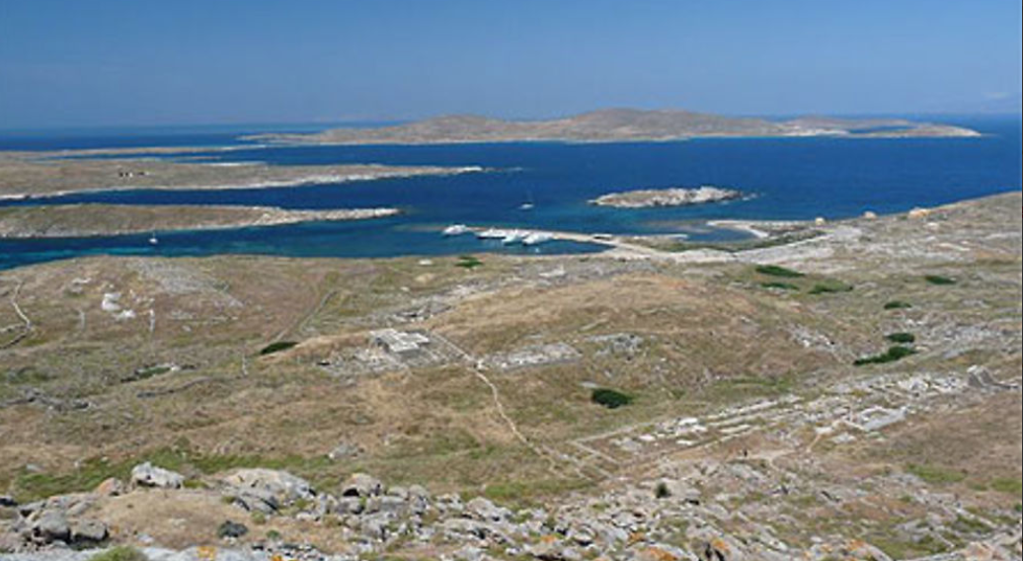
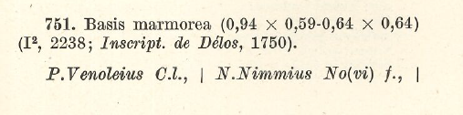
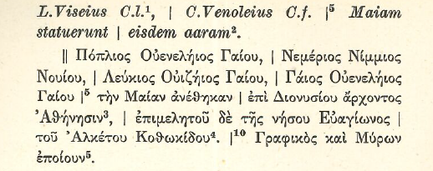
Les collegia de Délos
ILLRP 751

Slide 14
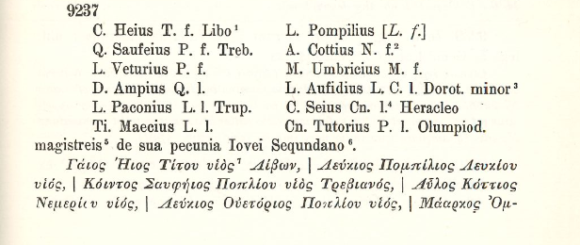
Délos ILS 9237

Slide 15
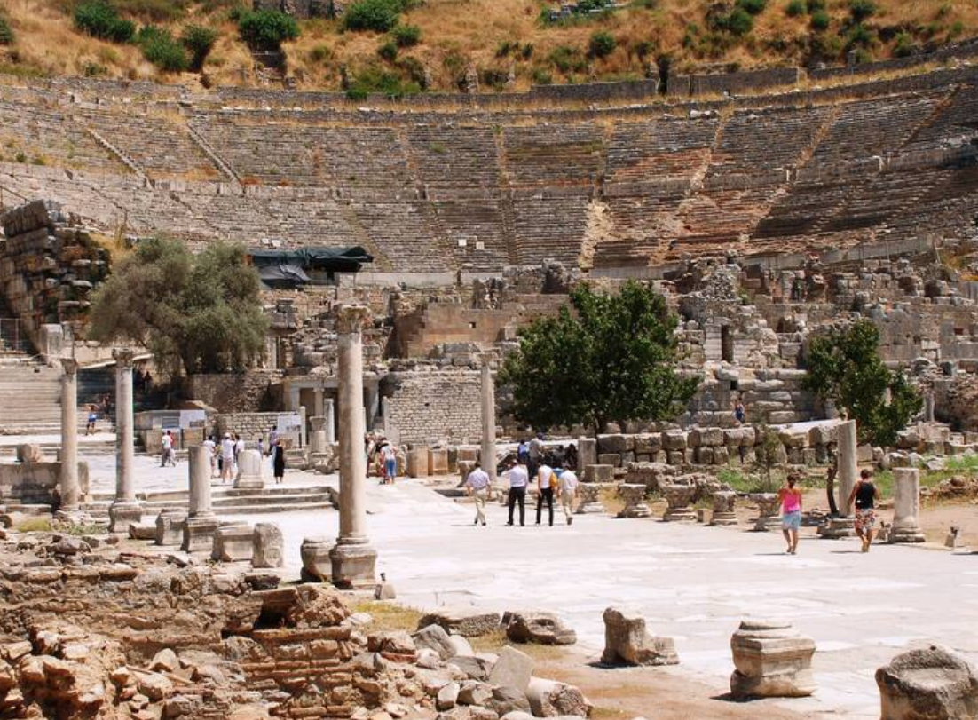

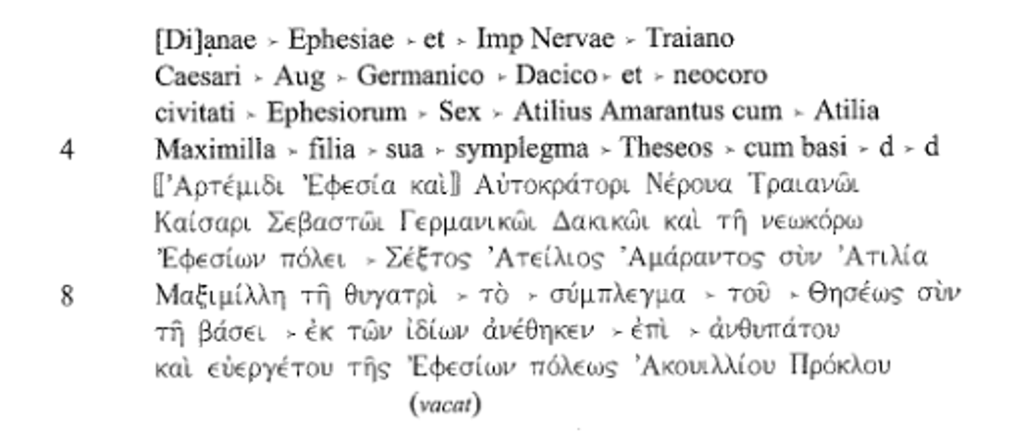
Ephèse
Base d’une statue de Thésée
R. A. Kearsley, Greeks and Romans in Imperial Asia: Mixed Language Inscriptions and Linguistic Evidence for Cultural Interaction until the End of AD III, Bonn, 159 :
2001 159

Slide 16
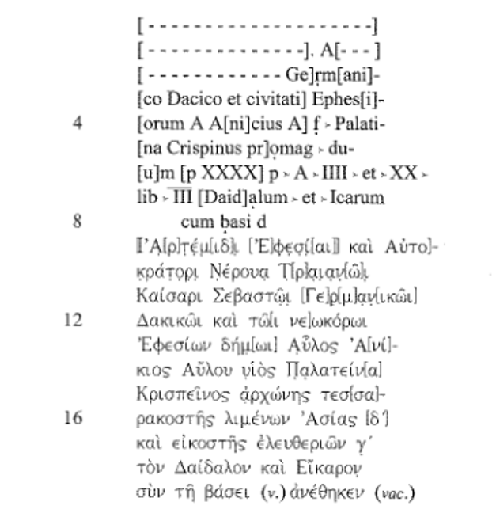
Kearsley 158 : base d’une statue de Dédale et Icare offerte par Aulus Anicius Crispinus

Slide 17
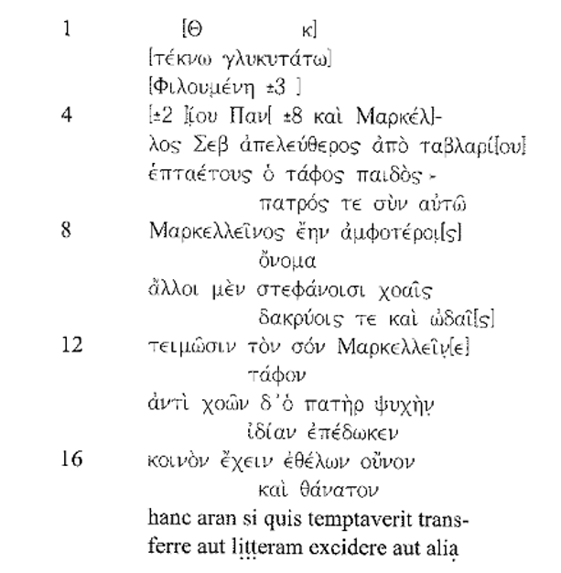
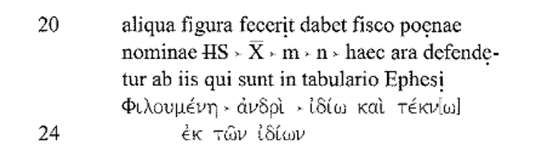
Kearsley 75 : Epitaphe de Marcellus et de son fils

