Slide 1



Clinical investigation and biophysical analysis of muscle channelopathies
Vincent Seutin
Neurophysiology
GIGA Neuroscience
François Wang
Clinical Neurophysiology
CHU Liège
GIGA SEMINAR SERIES
From bench
to bedside

Slide 2
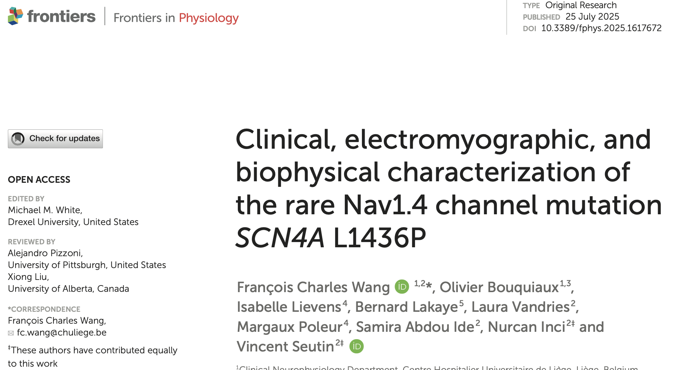
Notes:
In fact, we would like to tell you the story behind this 2025 paper, which is quite important to me because it permitted me to bridge my 35 years in clinical neurophysiology with its experimental part in cellular neurophysiology.

Slide 3
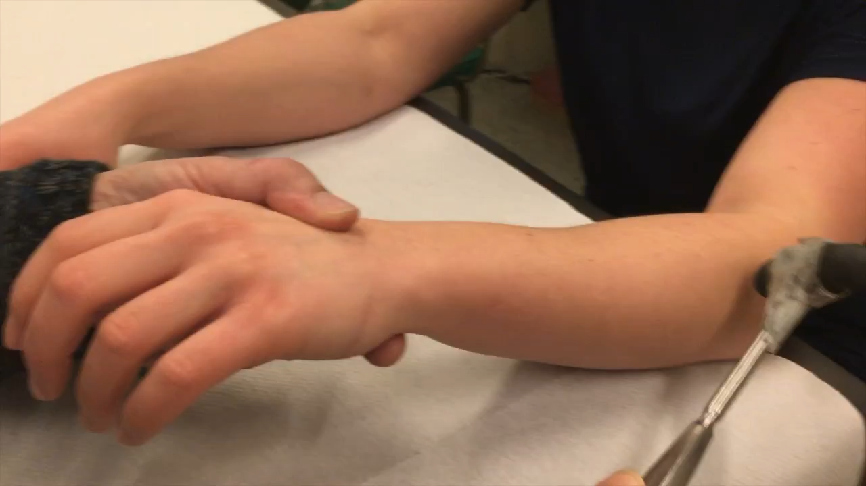
Notes:
At the beginning of this story, there was a clinical semiological sign that made it possible to detect a myotonic syndrome. As you can see, in a patient with a myotonic syndrome, there is a delay in muscle relaxation after muscle percussion.

Slide 4
Nine probands with the likely pathogenic variant L1436P of the SCN4A gene
Between 2005 and 2023 in the Liège region
Muscle stiffness and delayed muscle relaxation
Exacerbated by cold
Muscle pain
Clinical myotonia
Episodes of muscle weakness
Worsening of symptoms with exercise
« Warm-up » phenomenon
9/9
7/9
5/9
9/9
3/9
5/9
1/9
Notes:
Between 2005 and 2023, nine apparently unrelated families were identified in the Liège region as carriers of the likely pathogenic variant L1436P of the SCN4A gene. The clinical characteristics of the nine probands were :
as you have just seen in the video.
« Warm-up » phenomenon which corresponds to an improvement of symptoms with exercise

Slide 5
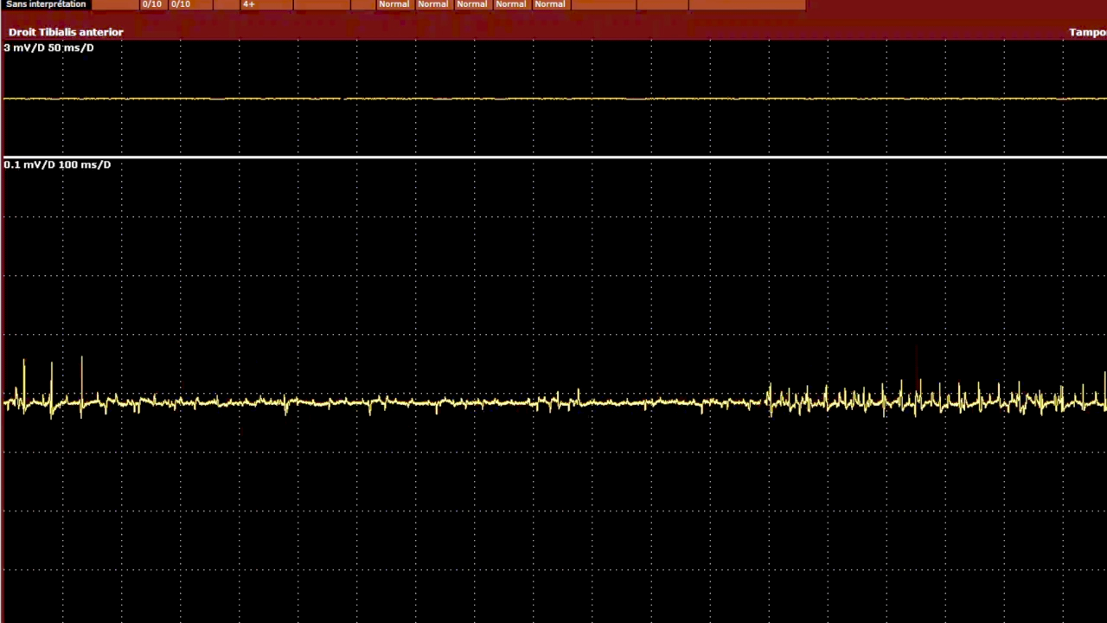
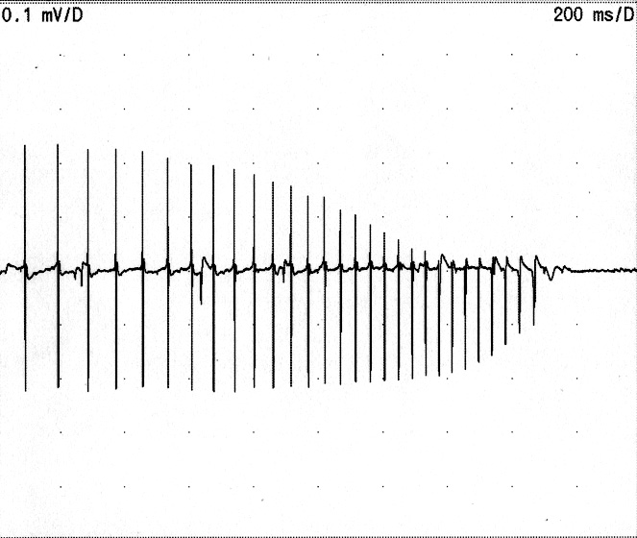
Clinical electromyography (EMG)
Myotonic discharges in EMG
Muscle fiber action potentials
Discharging repetitively
Spontaneously or triggered by
needle movement
Amplitude and frequence
Wax and Wane
SCN4A gene variant c.3917G>A: p.Gly1306Glu (G1306E)
Notes:
Clinical electromyography (EMG) involves inserting a needle electrode into the muscle. In healthy subject, at rest, there is no activity. This is electric silence. In myotonic syndromes, repetitive discharges are recorded at rest as in this video. Electrical myotonia (myotonic discharge) corresponds to muscle fiber action potentials discharging repetitively… The main characteristic of these discharges is that inside the discharge, the amplitude and the frequence change

Slide 6
Myotonic discharges in EMG
Myotonic dystrophy:
Steinert disease
Proximal Myotonic Myopathy (PROMM)
Muscular channelopathy:
Nav1.4 (SCN4A gene)
CIC-1 (CLCN1 gene)
- Thomsen disease (AD)
- Becker disease (AR)
Notes:
In practice, demonstrating a myotonic discharge is a very important finding, because the diagnostic possibilities are limited: either it is a myotonic dystrophy (Steinert or PROMM), or it is a muscular channelopathy of the sodium or chloride channels).

Slide 7
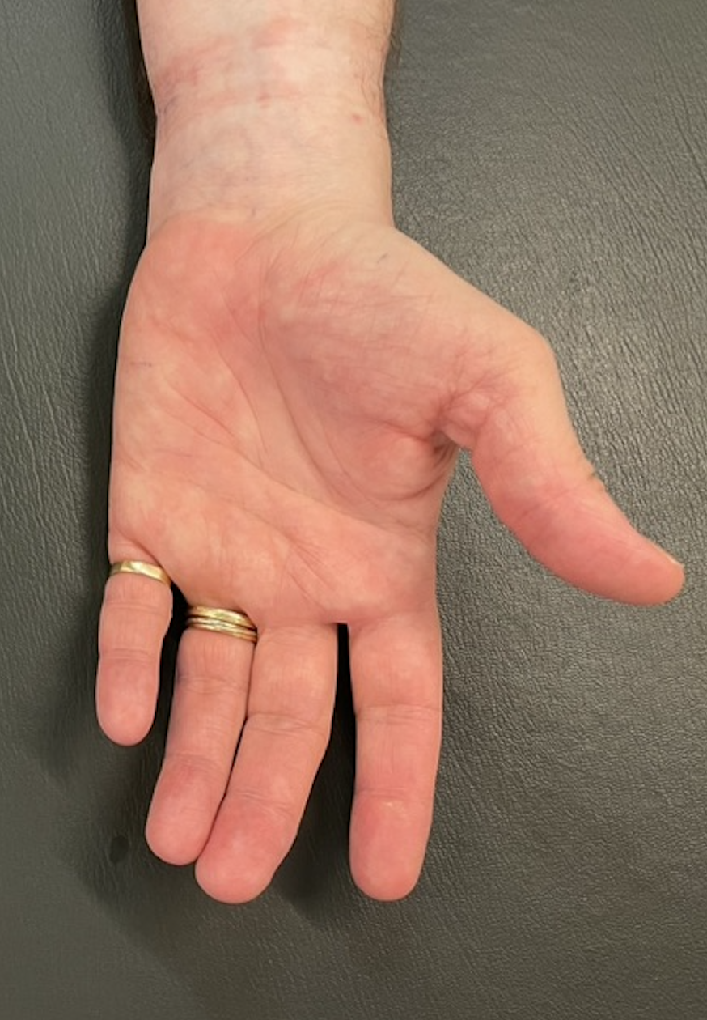
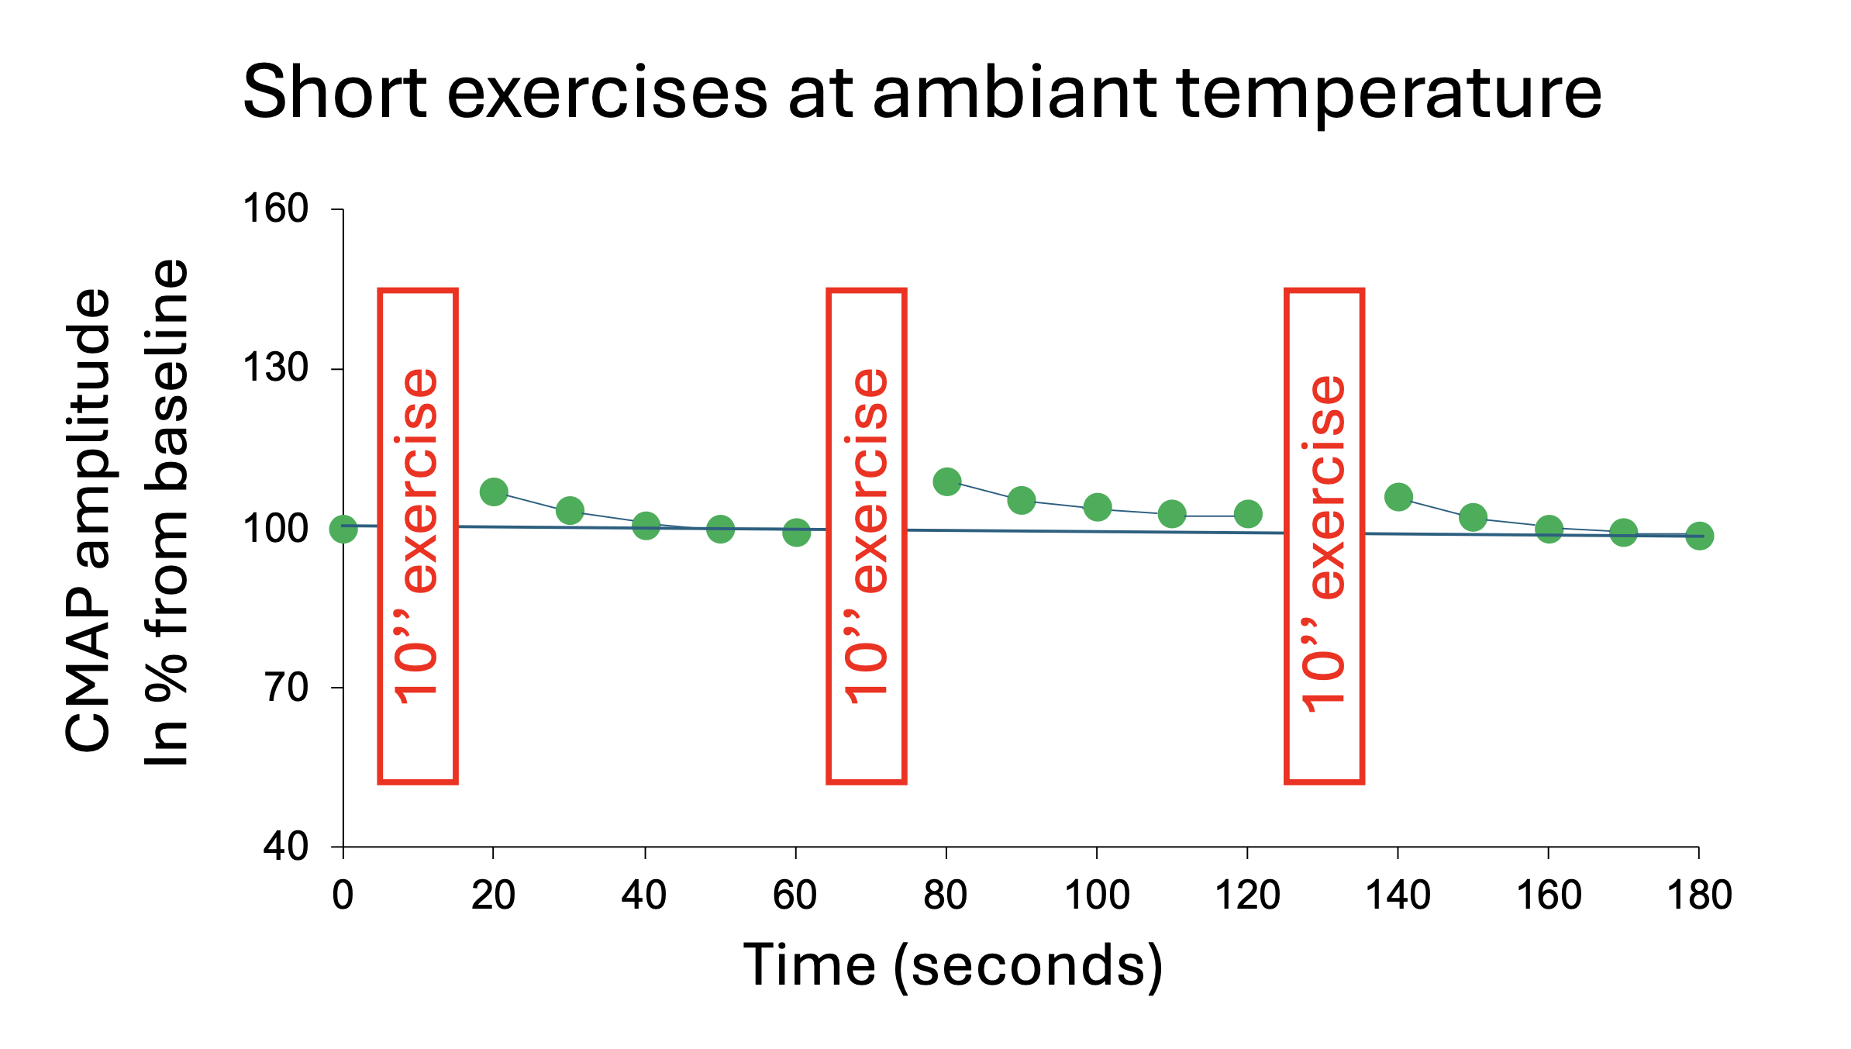
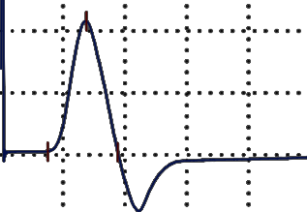
Short and long exercise tests
E0
+
Anode
CMAP
-
Cathode
E1
Amplitude
E2
Notes:
Thanks to short and long exercise tests, performed at room temperature or after muscle cooling, it is possible to characterize myotonic syndromes related to a muscle channelopathy.
Stimulation of the ulnar nerve at the wrist elicits a motor response in the hypothenar muscles, recorded by surface electrodes. This response is the compound muscle action potential, or CMAP, characterized in particular by its amplitude.
During a short exercise test, the CMAP amplitude is first measured under basal conditions and serves as the 100% reference value. A voluntary muscle contraction against resistance (finger abduction) is then performed for 10 seconds. The CMAP amplitude is measured immediately after exercise and then every 10 seconds for one minute. The 10-second exercise is repeated twice, with similar CMAP amplitude measurements obtained each time.

Slide 8
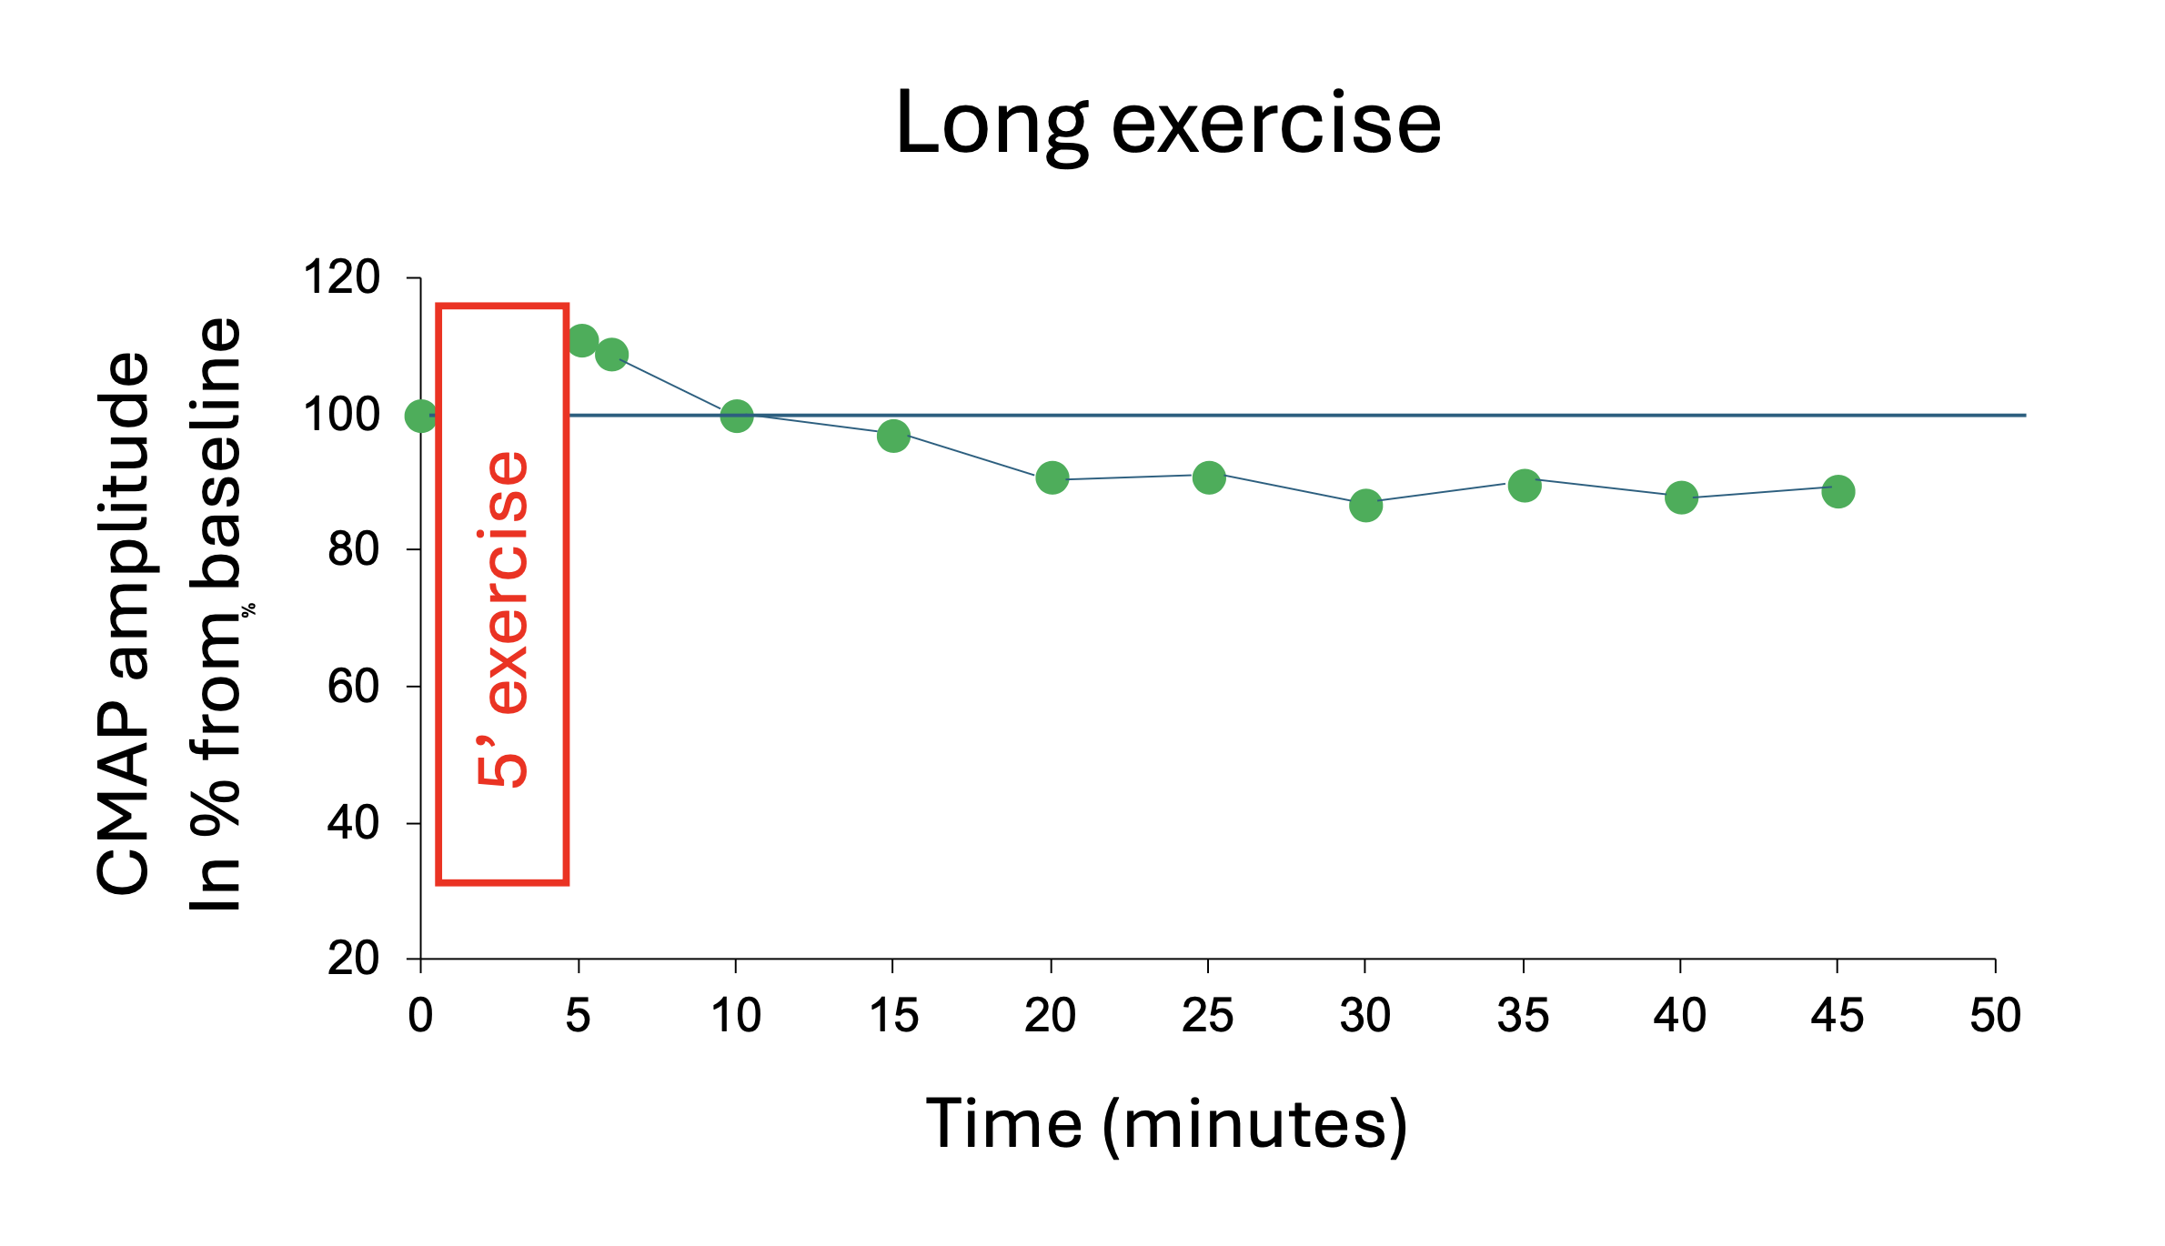
Short and long exercise tests
E0
+
Anode
CMAP
-
Cathode
E1
Amplitude
E2
Notes:
During a long exercise test, the CMAP amplitude is also measured under basal conditions. And then, a voluntary muscle contraction against resistance (finger abduction) is then performed for 5 minutes (25 seconds of exercise followed by 5 seconds of rest, repeated 10 times.). The CMAP amplitude is measured immediately after exercise and then every 5 minutes till 45 minutes after exercise.

Slide 9
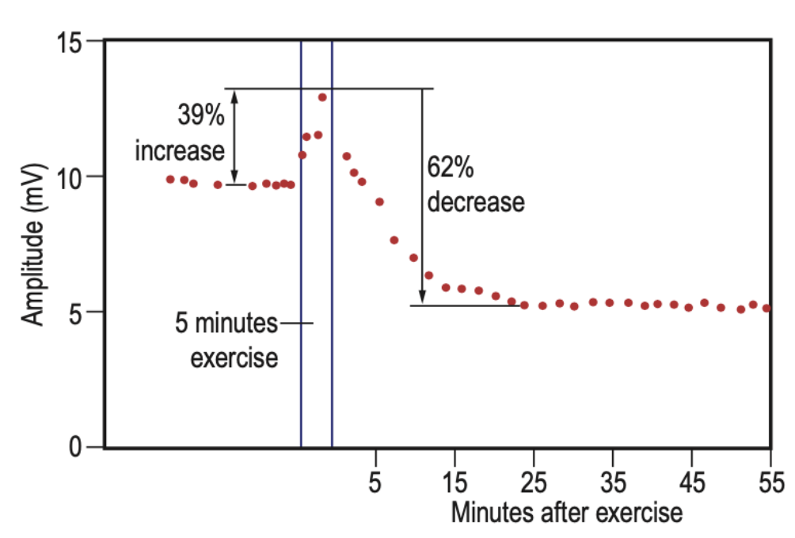
Short and long exercise tests
E0
+
Anode
CMAP
-
Cathode
E1
Amplitude
E2
Notes:
Decrement of more than 40% between CMAP amplitude immediately after exercise and later is abnormal

Slide 10
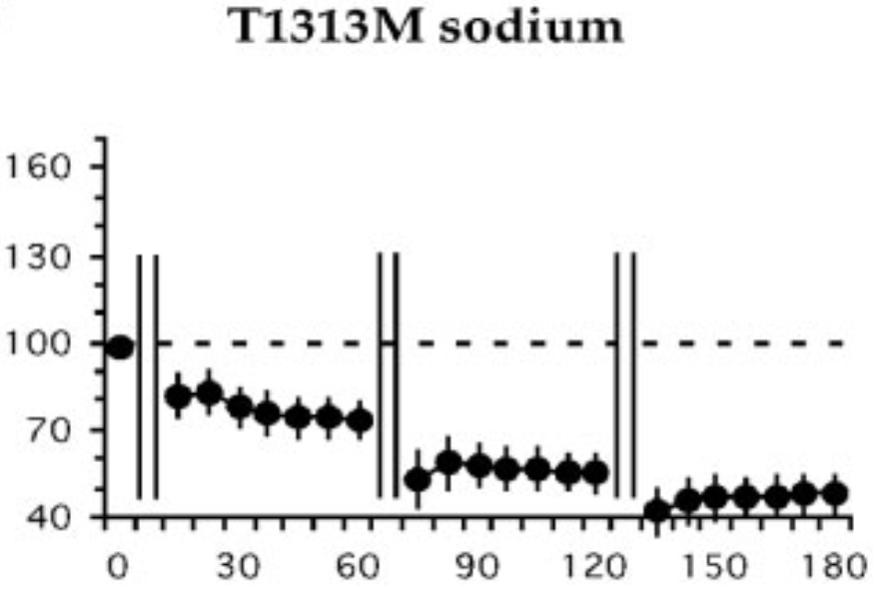
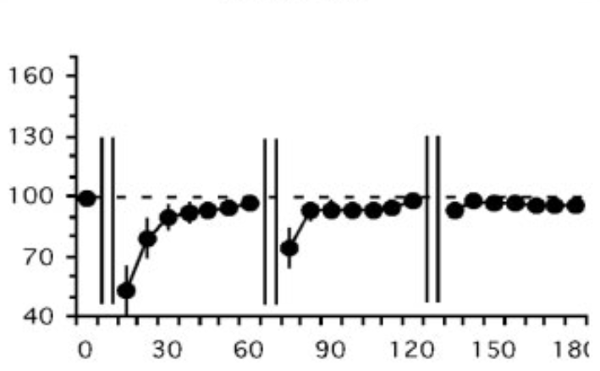
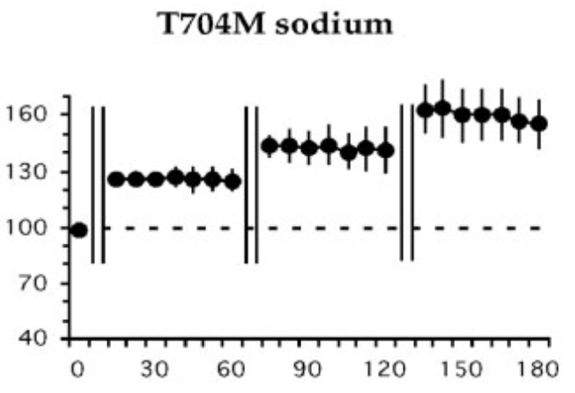
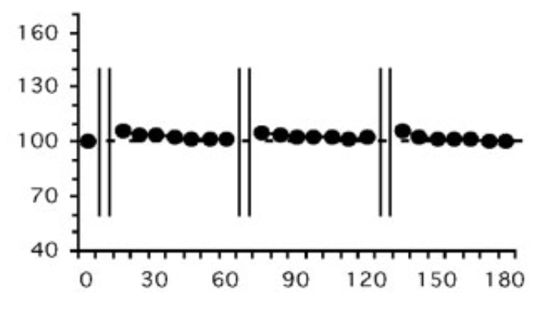
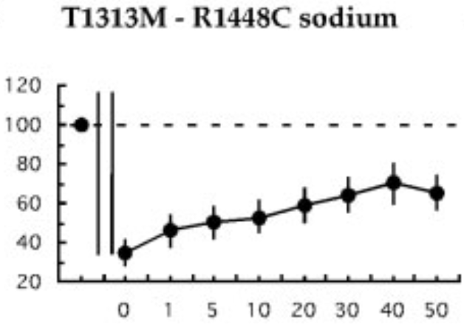
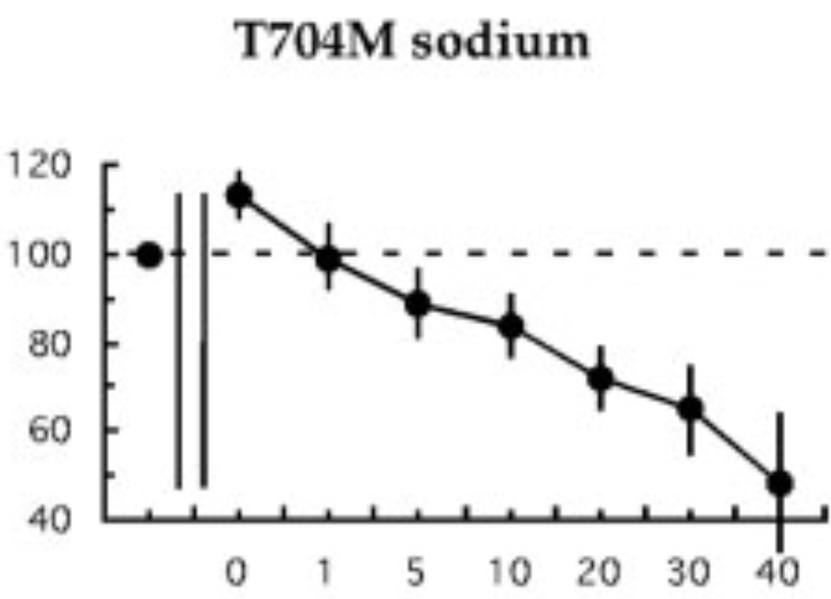
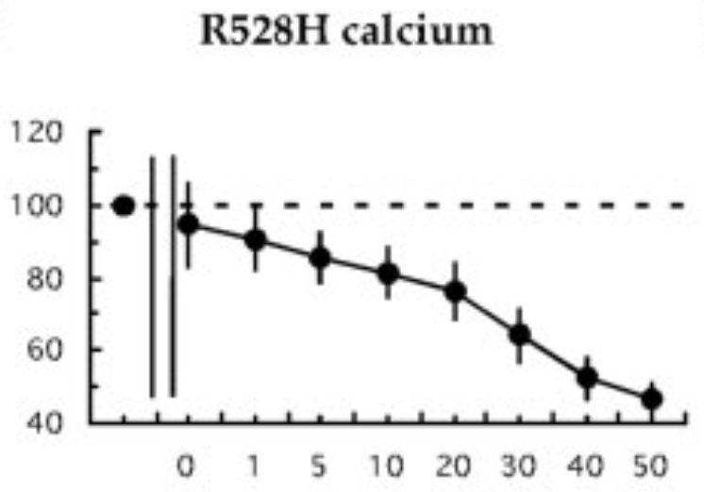
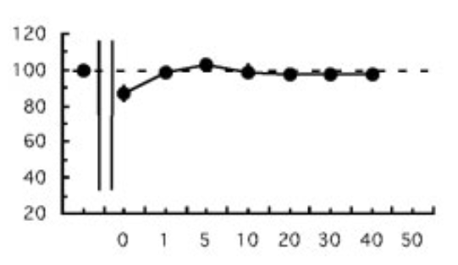
Short and long exercise tests
Five pathologic patterns (Fournier et al., 2004)
Pattern I
Pattern II
Pattern III
Pattern IV
Pattern V
no myotonia
Short exercises
Short exercises
Short exercises
Short exercises
Short exercises
Long exercise
Long exercise
Long exercise
Long exercise
Long exercise
Paramyotonia
congenita
SCN4A gene
Myotonia
congenita
CLCN1 gene
Hyperkalemic
periodic paralysis
SCN4A gene
Hypokalemic
periodic paralysis
CACNA1S gene
SCN4A gene
CLCN1 gene
Notes:
In pattern III, exercise tests are normal at room temperature. However, after muscle cooling, in some patients the pattern becomes type I (sodium channel) or type II (chloride channel).

Slide 11
Nine probands with the likely pathogenic variant L1436P of the SCN4A gene
E0
+
Anode
CMAP = Compound Muscle Action Potential
-
Cathode
E1
Amplitude
E2
7/7
Notes:
Seven of our nine probands were tested. The short exercise test at room temperature was normal in all seven.

Slide 12
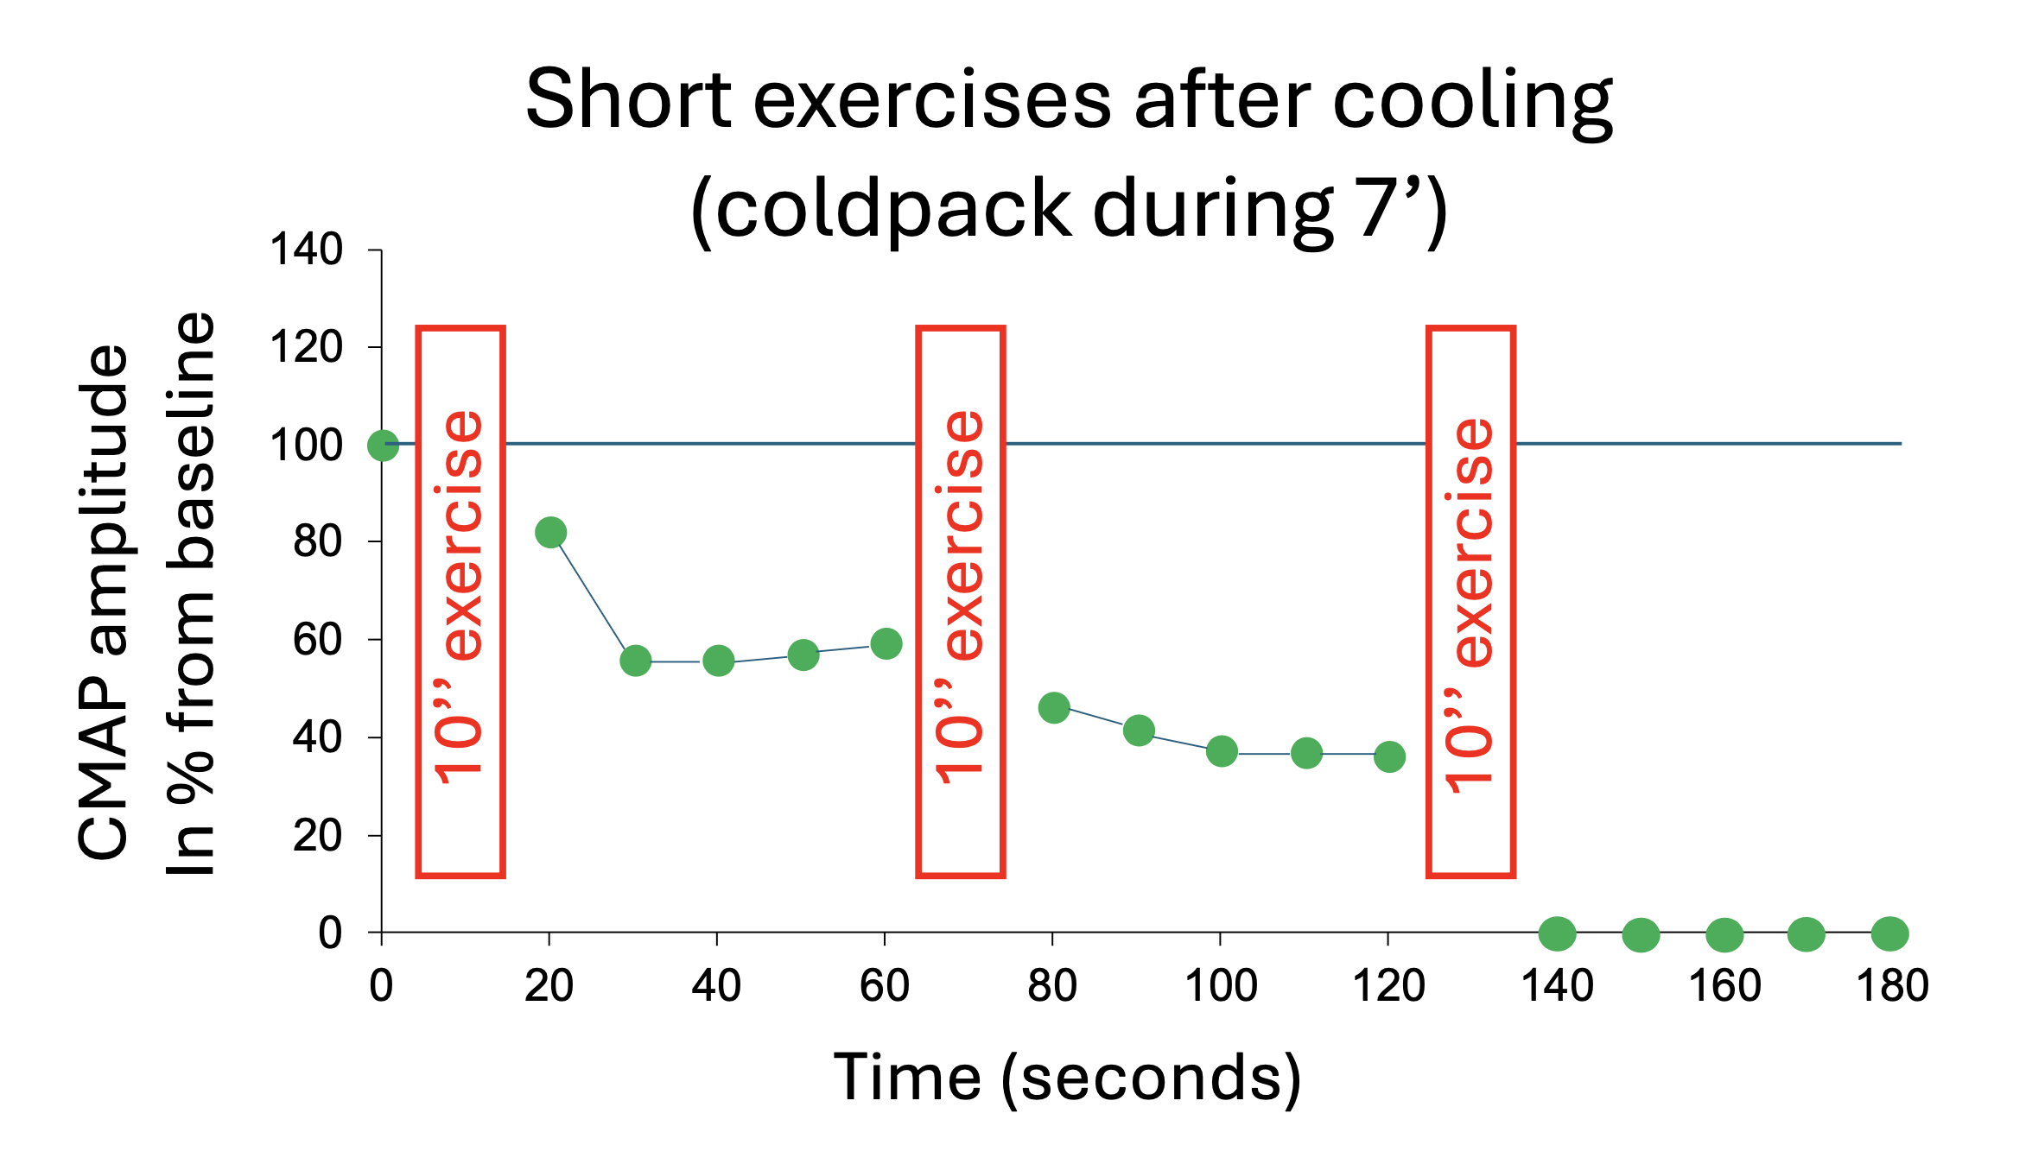
Nine probands with the likely pathogenic variant L1436P of the SCN4A gene
E0
+
Anode
CMAP = Compound Muscle Action Potential
-
Cathode
E1
Amplitude
E2
5/7
Notes:
In contrast, after 7 minutes of muscle cooling, the short exercise test was suggestive of paramyotonia in five probands.

Slide 13
Nine probants with the likely pathogenic variant L1436P of the SCN4A gene
E0
+
Anode
CMAP = Compound Muscle Action Potential
-
Cathode
E1
Amplitude
E2
7/7
Notes:
The long exercise test remained normal in all seven probands.

Slide 14
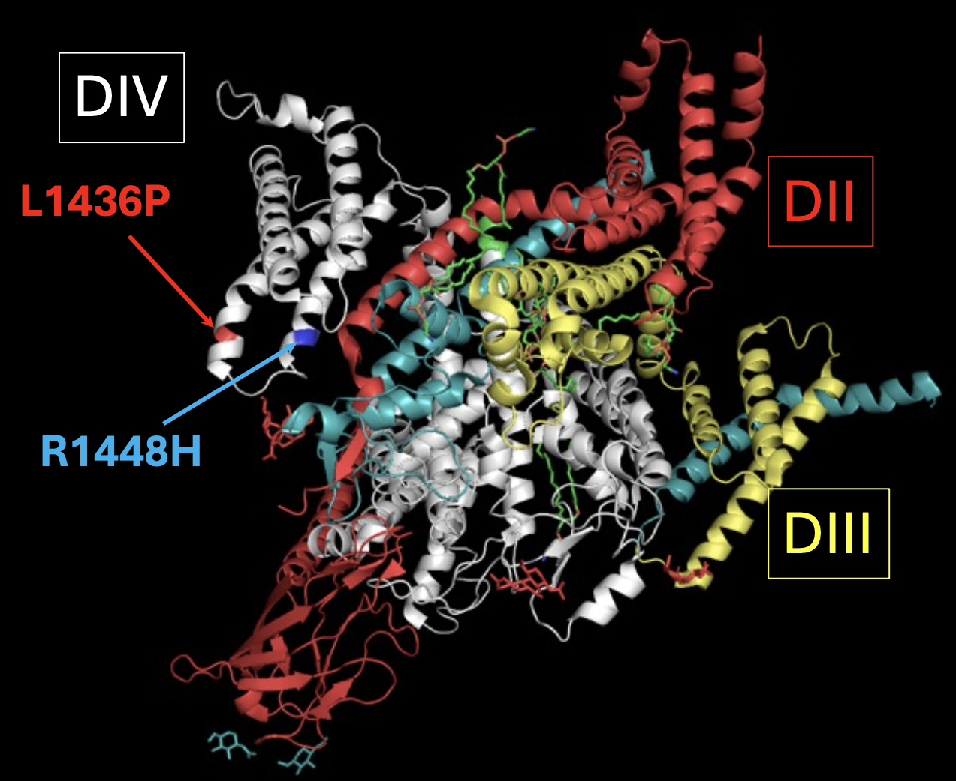
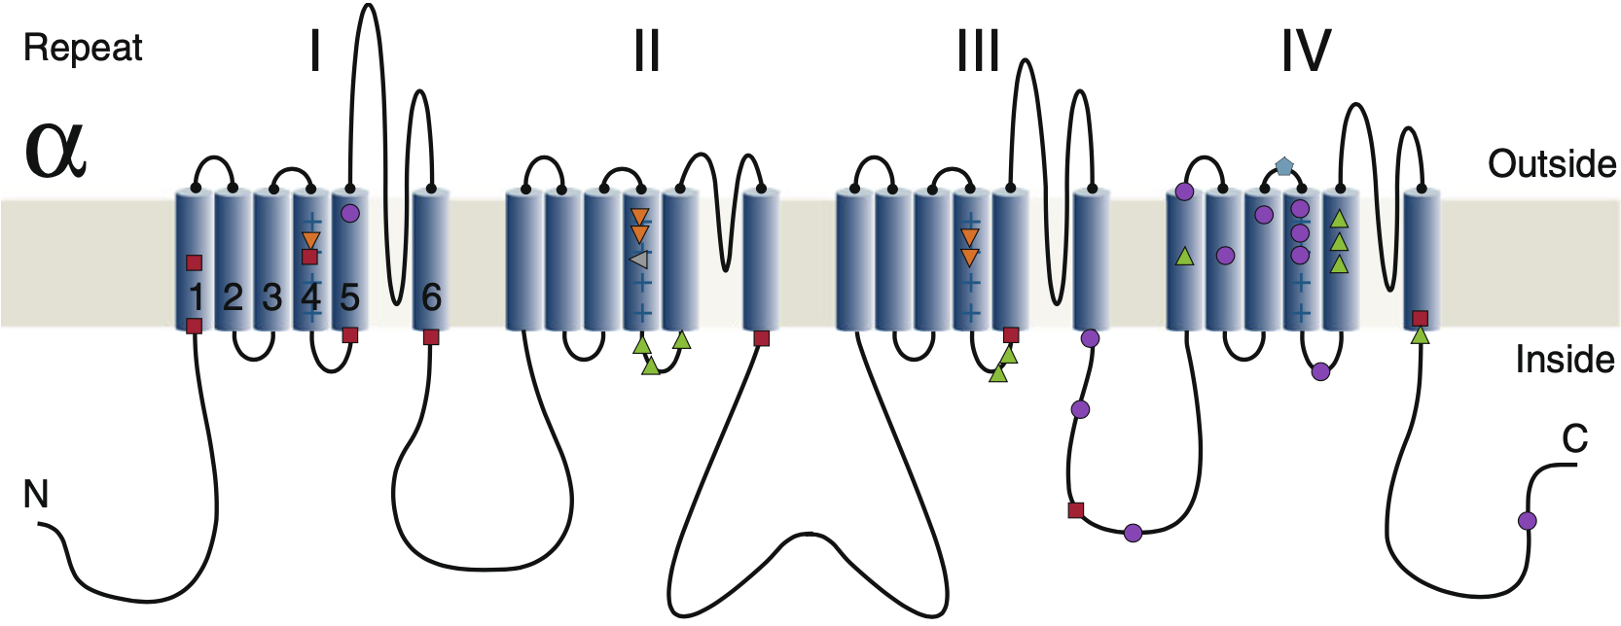
Location of the L1436P and R1448H variants
L1436P
R1448H
2D representation of α-Subunit of Nav1.4.
(Jurkat-Rott et al, 2010)
3D representation of human Nav1.4-β1 complex
based on cryo-EM structure
(Research Collaboratory for Structural Bioinformatics Protein Data Bank)
Notes:
From a genetic standpoint, we know exactly where the L1436P variant is located in both two and three dimensions.

Slide 15

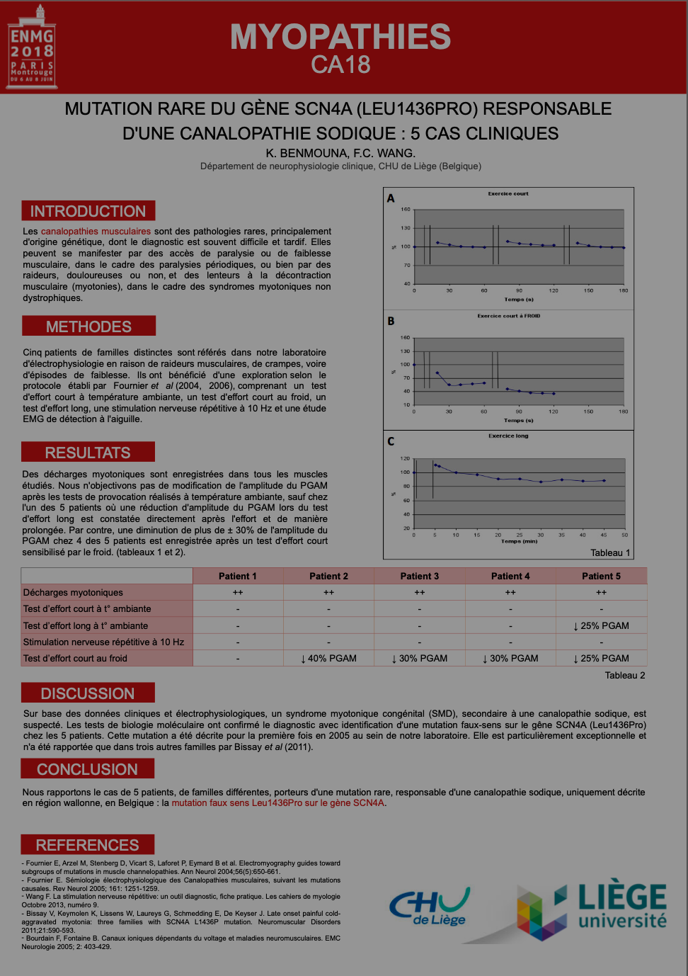


Brainstorming with Vincent
Notes:
At this precise point in the story, Vincent and I had a long brainstorming session.
Vincent explained to me that it would be possible to study the pathophysiology of my variant. HEK cells would need to be transfected with a plasmid in order to induce expression of the mutated sodium channel at the cell membrane, followed by patch-clamp recordings.

Slide 16
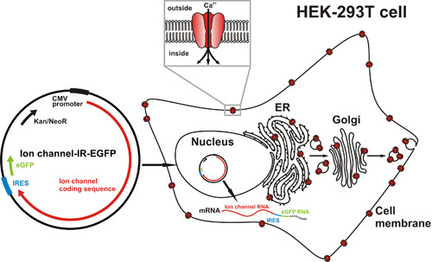
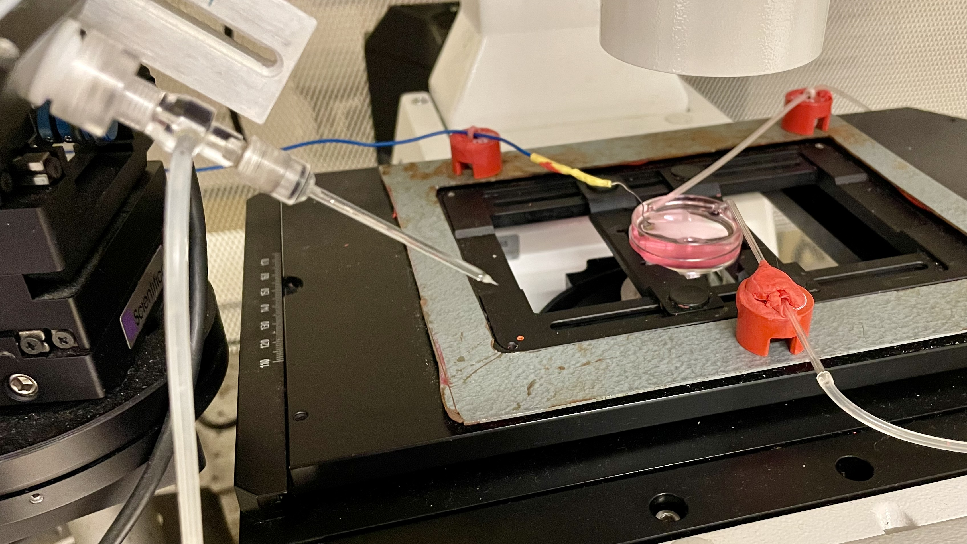
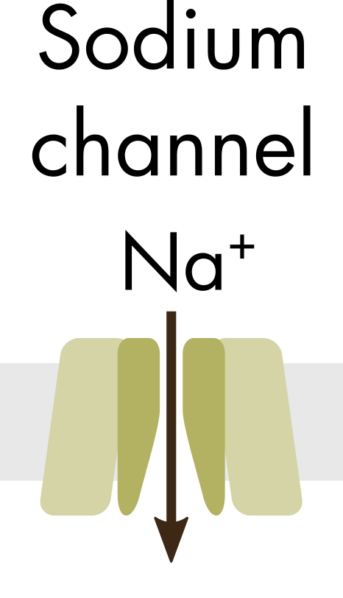
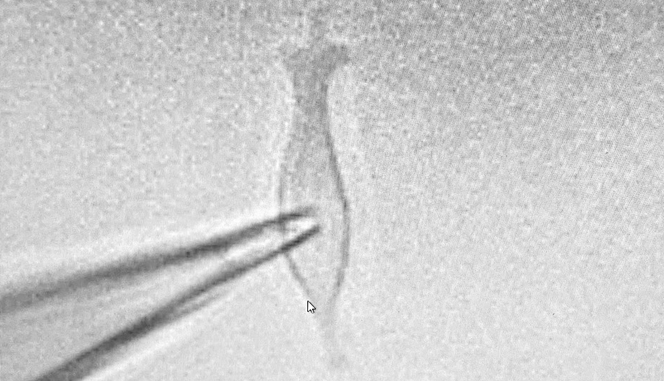
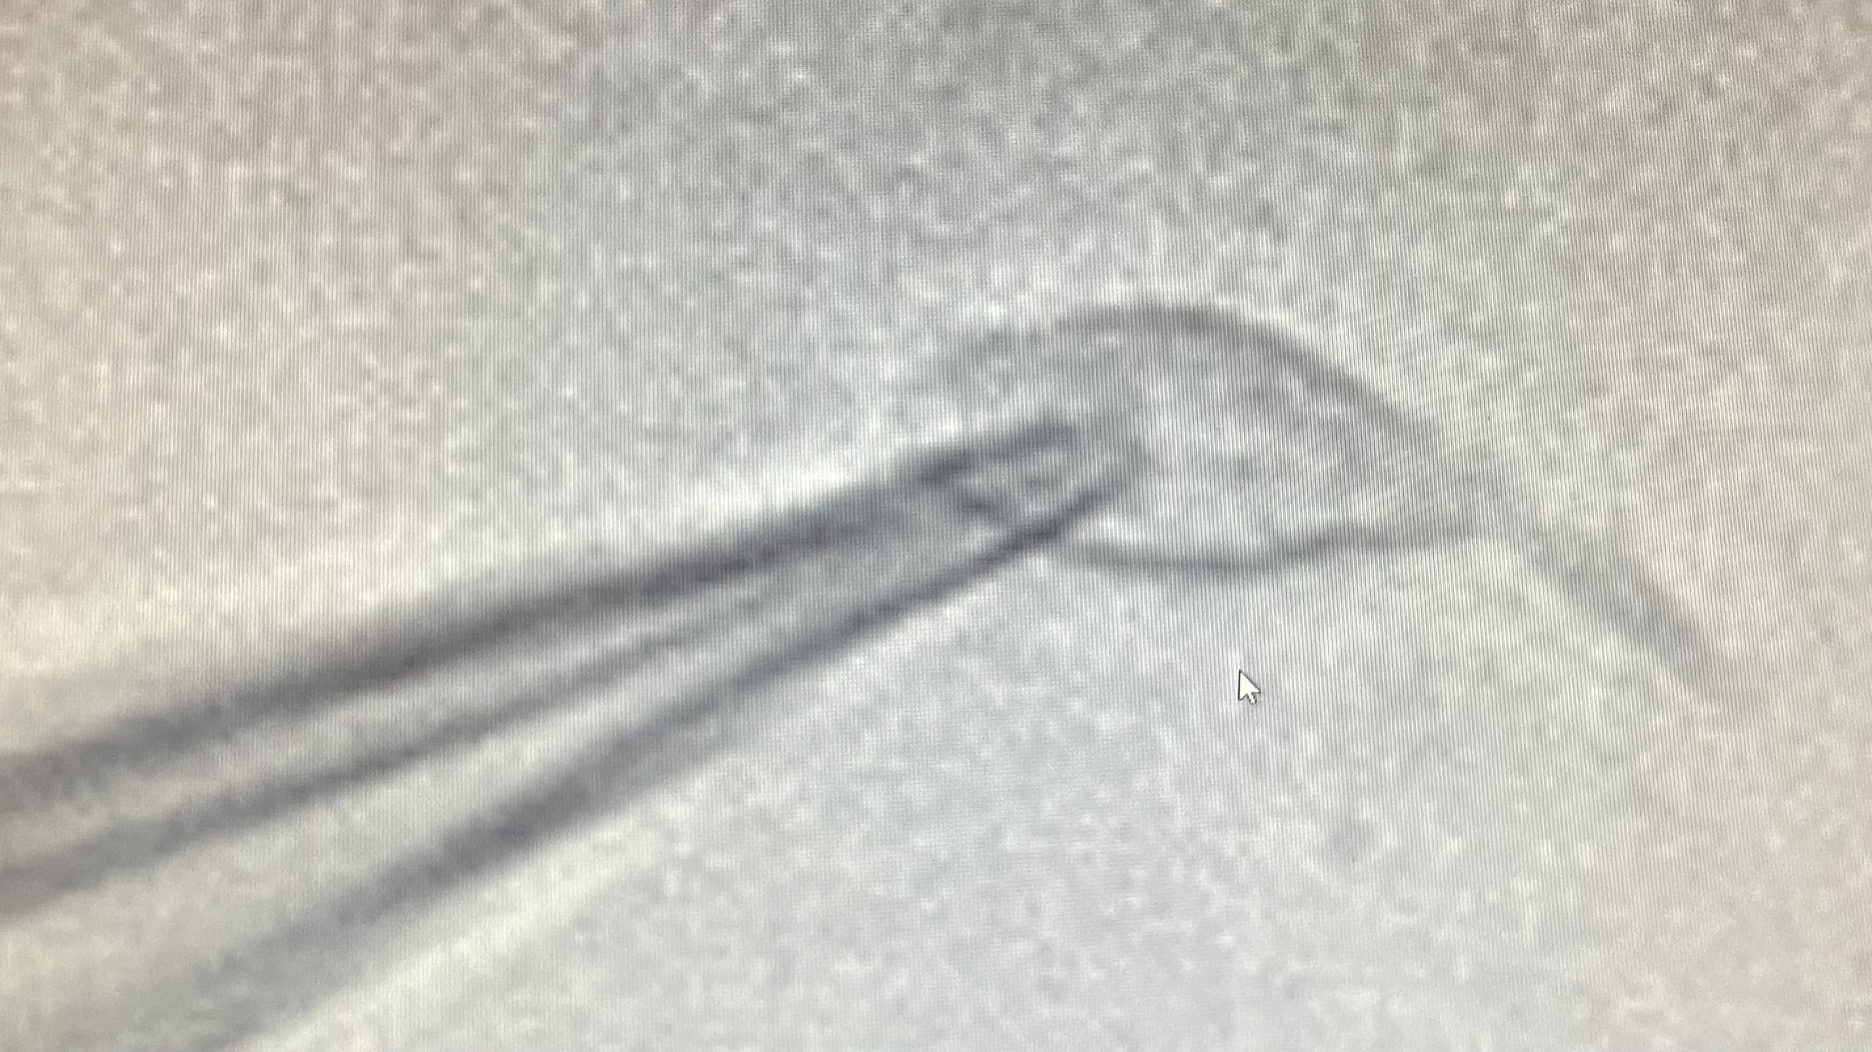
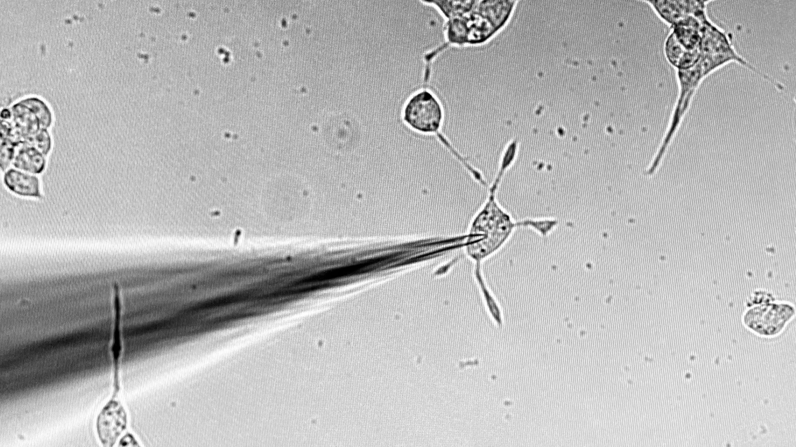
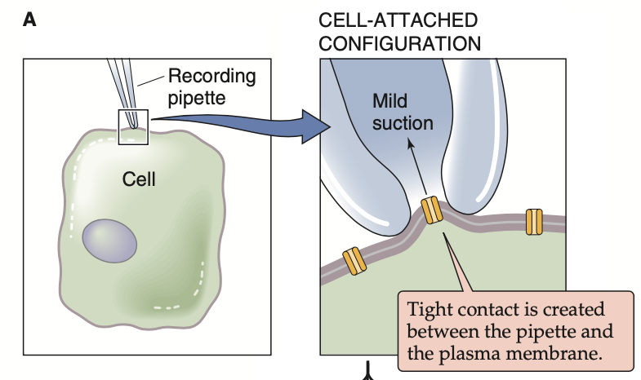
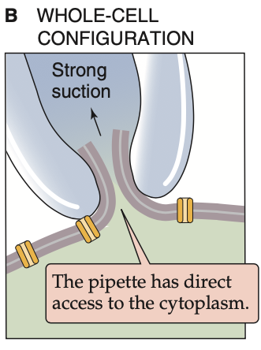
Bath electrode
(reference)
pipette
with
the active electrode inside
WT
L1436P
R1448H
Notes:
Here you can see the plasmid transfection of HEK cells. By doing so, it’s possible to introduce circular plasmid DNA in order to express a gene of interest, a wild-type or mutated ion channel as LP or RH a well known variant linked to paramyotonia.
Here you can see the set-up. Transfected HEK cell are in the dish under an optic microscope. A glass micropipette is brought into close proximity to a HEK cell membrane until a very high-resistance electrical seal is achieved, known as a gigaseal. A brief suction applied by mouth locally ruptures the membrane under the micropipette and establishes electrical access to the interior of the cell. The active electrode, located inside the micropipette, allows control of the membrane potential, while the reference electrode is placed in the extracellular solution

Slide 17
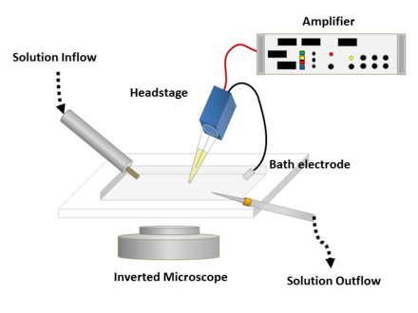
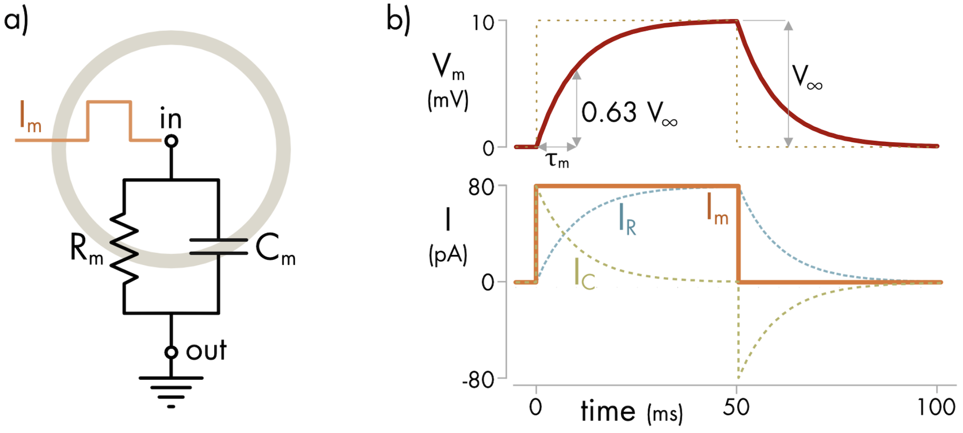
I_{m} = I_{R} + I_{C}
_{n}
I_{R} = g.(V_{m}-E_{R})
I_{C}= C.dV_{m} /dt
n
if dV_{m} /dt = 0 ; I_{C} = 0
If V_{m} is held constant, only resistive current flows:
this is the voltage clamp.
Notes:
When a current is injected into the cell, it is divided into a resistive component that obeys Ohm’s law (V = RI) and a capacitive component that exists only when the membrane potential changes. Only the resistive current is of interest, as it corresponds to the current flowing through ion channels. To eliminate the capacitive current, an electronic feedback system maintains the membrane potential constant at the desired value; this is known as voltage clamp.

Slide 18
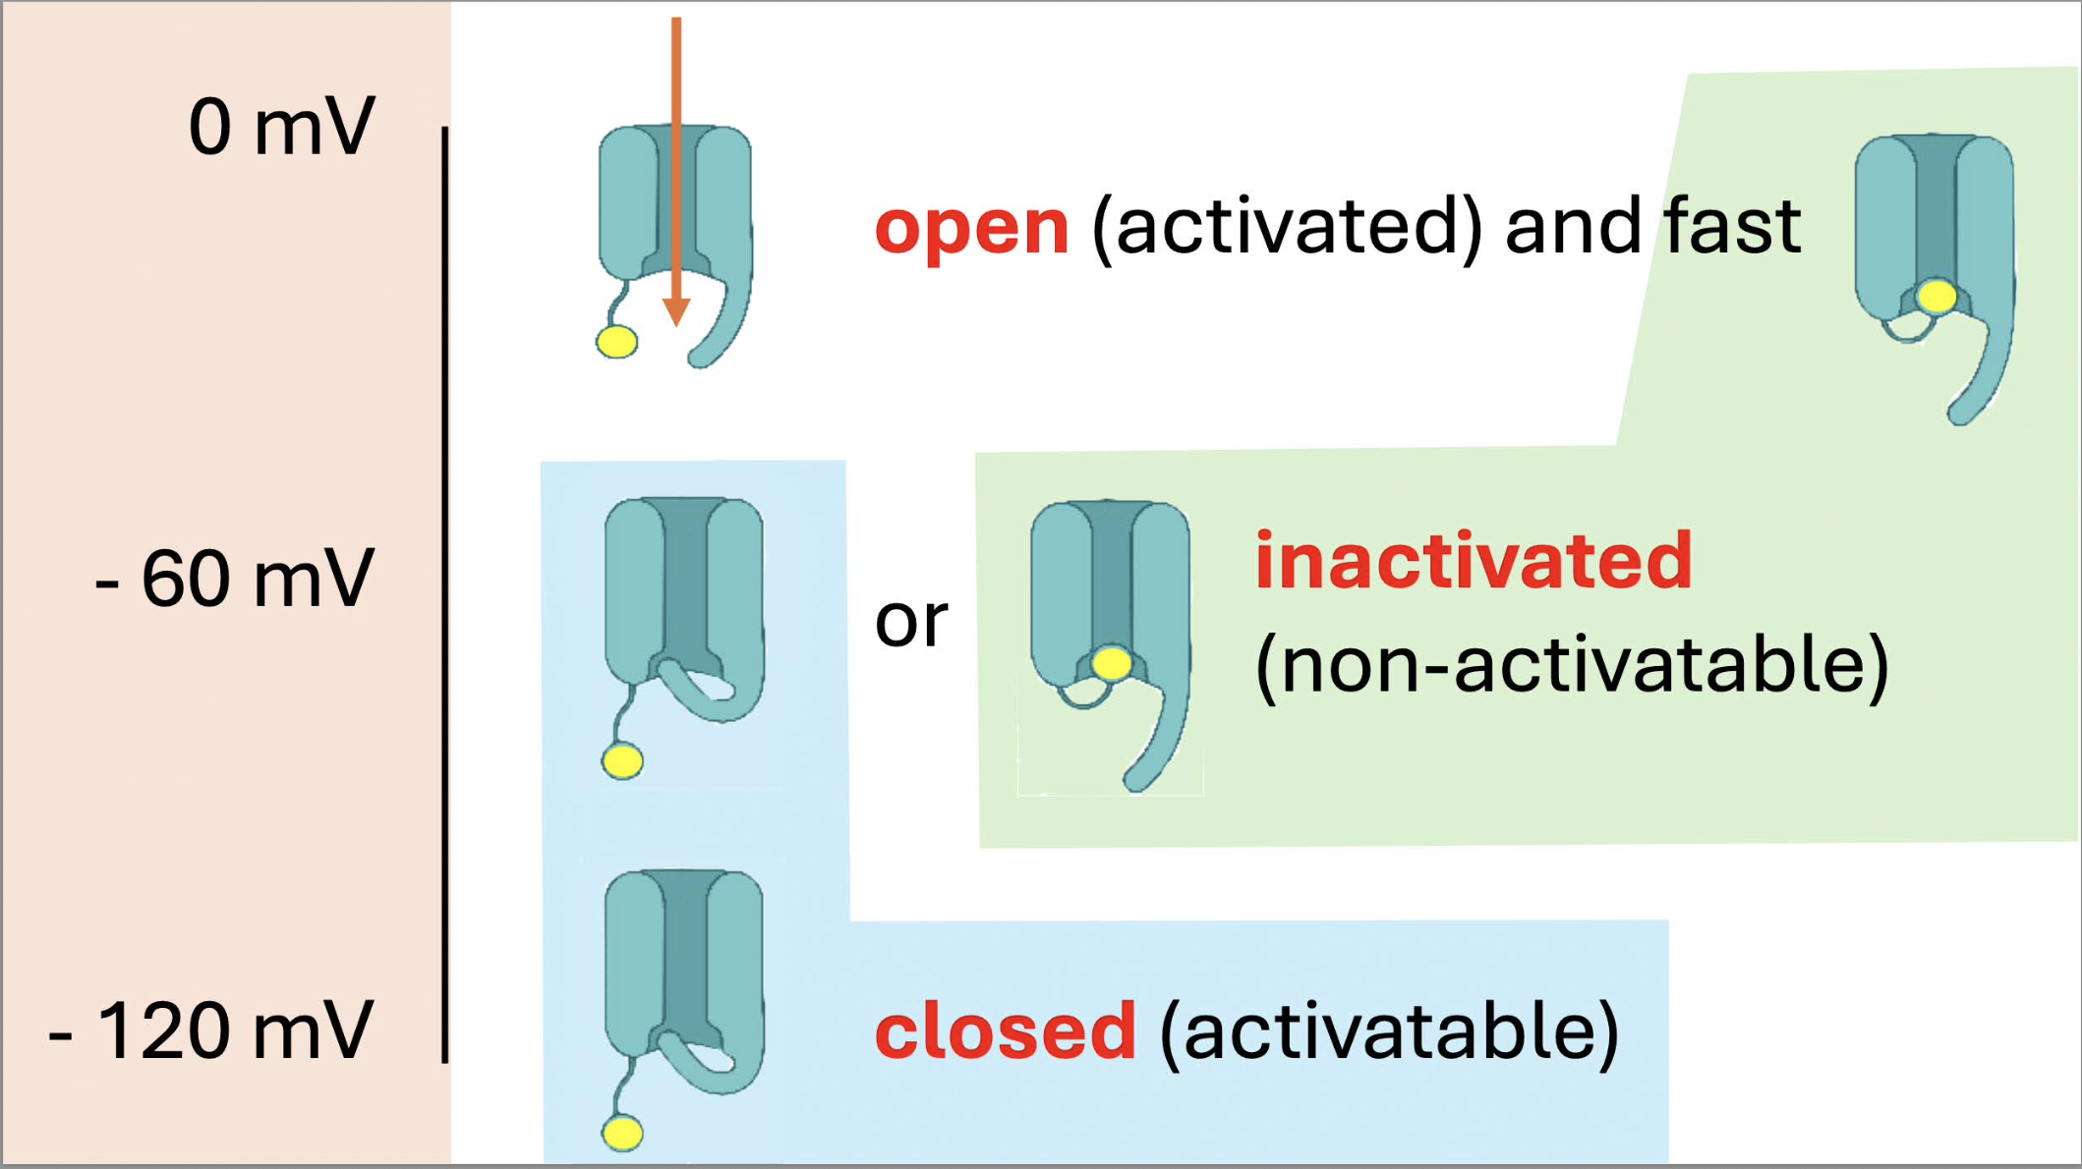
Notes:
Nav1.4

Slide 19
0
pA
- 1000
- 2000
190
195
200
205
210
ms
mV
60
0
- 60
-120
0
100
200
300
400
ms
Notes:
In a first protocol called Fast Activation, the membrane potential is initially shifted from −60 mV to −120 mV. At this potential, all voltage-dependent channels are closed. The membrane potential is then progressively brought to less negative values. At −50 mV, as you can see here in red, voltage-gated sodium channels begin to activate, and their activation increases further as the membrane potential is shifted to increasingly less negative values.

Slide 20
0
pA
- 1000
At – 60 mV =>
half inactivation
- 2000
475
485
495
505
515
ms
mV
60
0
- 60
-120
0
200
400
600
800
ms
Notes:
In a second protocol, called steady state inactivation, after closing the channels at −120 mV, two voltage steps are applied. The first step is identical to that used in the rapid activation protocol, but immediately afterward the membrane potential is brought to 0 mV. When the first step is at −120 or −110 mV, the channels are closed but become activated during the step to 0 mV. As the first step approaches −50 mV and beyond, an increasing proportion of sodium channels becomes inactivated, and therefore, during the step to 0 mV, fewer sodium channels are available to open. In this example, at −60 mV, half of the sodium channels are inactivated. It is now time for me to hand over to Vincent. Thank you for your attention.

Slide 21
0
pA
- 1000
- 2000
140
160
180
200
220
ms
mV
60
0
- 60
-120
140
160
180
200
220
ms
Notes:
V

Slide 22
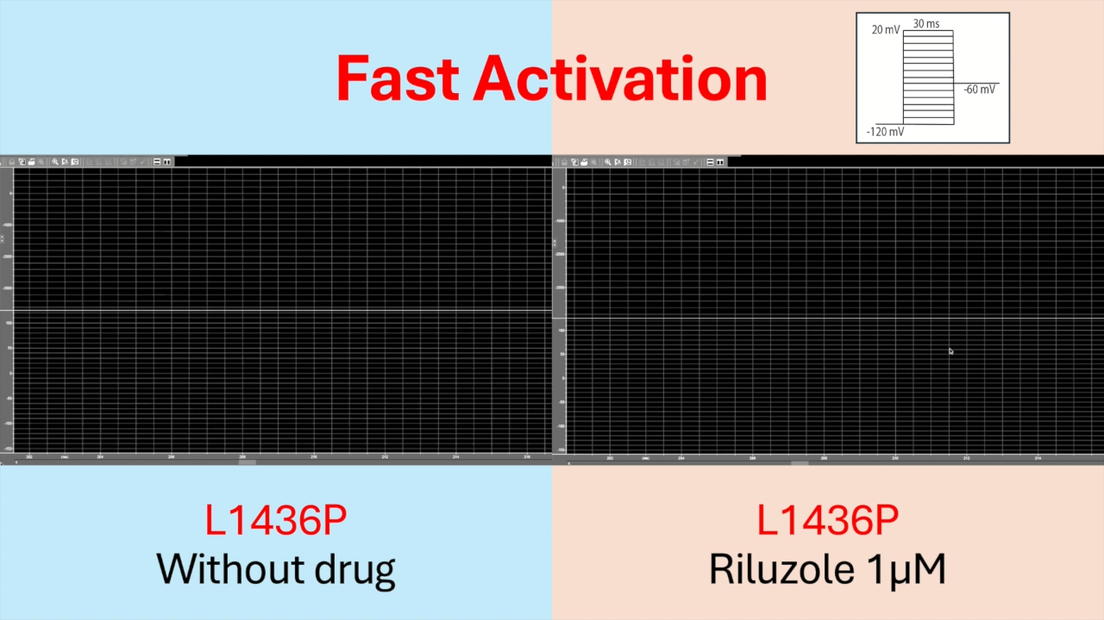

Slide 23
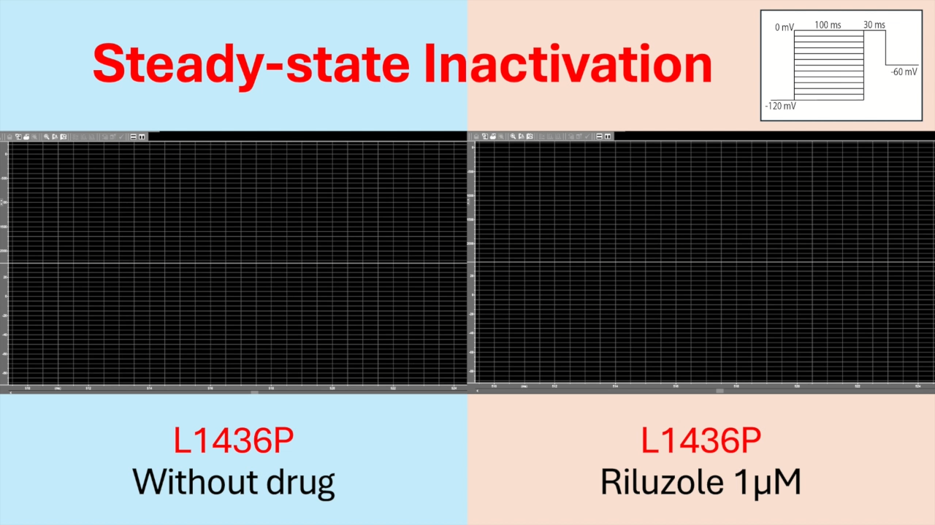

Slide 24
