Slide 1
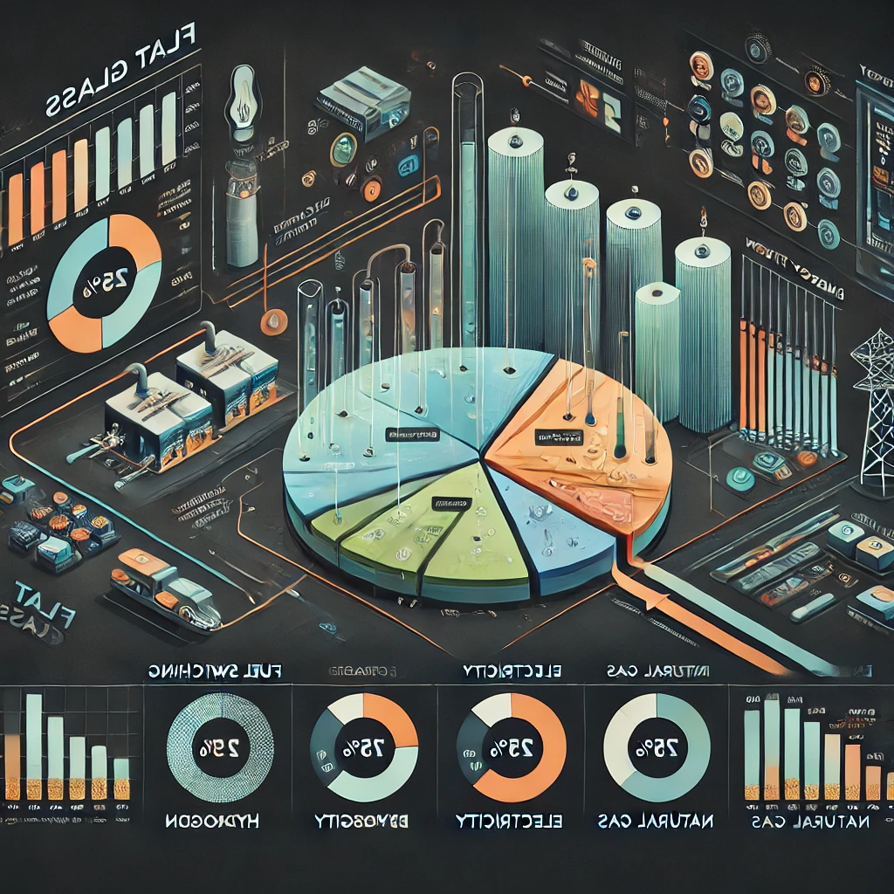
Comparative Assessment of
Fuel-Switching Options for the
Energy Transition in the Cement Industry
Muhammad Salmanª, Daniel Flórez-Orrego^{b},François Maréchal^{b}, Grégoire Léonardª
ªChemical Engineering, University of Liège, Belgium.
^{b}IPESE group, Federal Polytechnic School of Lausanne, Sion, Switzerland.

Slide 2
Contents
Salman et al.
Introduction
Methodology
Key results
Conclusion
Next steps

Slide 3
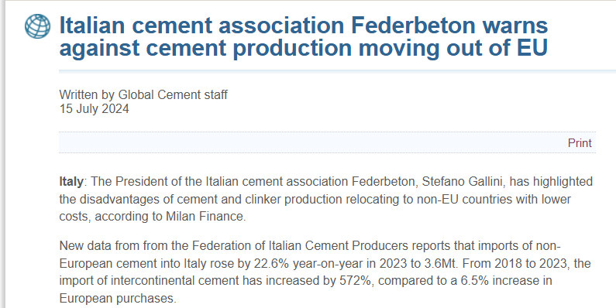
Salman et al.
https://www.globalcement.com/news/item/17601-italian-cement-association-federbeton-warns-against-cement-production-moving-out-of-eu

Slide 4
Introduction
Salman et al.
Why Cement?
  A hard-to-abate sector, central to infrastructure and development
  Responsible for ~7–8% of global CO₂ emissions
  Emissions arise from both:
    Calcination (process emissions from limestone decomposition)
    Fossil fuel combustion (heat for kilns)
What Are the Key Challenges?
  Highly energy- and carbon-intensive process
  EU ETS price increases can impact competitiveness
  Risk of industrial relocation (carbon leakage & deindustrialisation)
What Do We Need to Do?
  Conduct a systematic evaluation of all decarbonisation levers
  Identify cost-effective and low-risk pathways

Slide 5
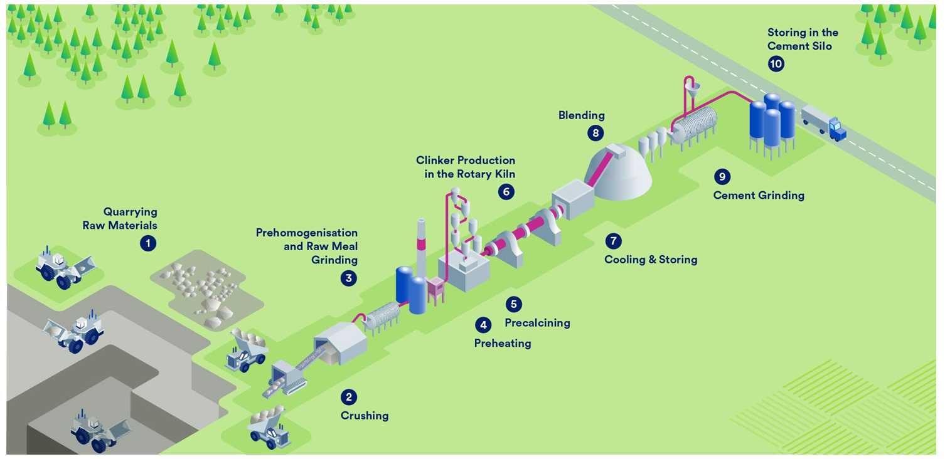
Salman et al.
Cement Production Process
https://www.catf.us/resource/role-carbon-capture-storage-decarbonising-europes-cement-sector/

Slide 6
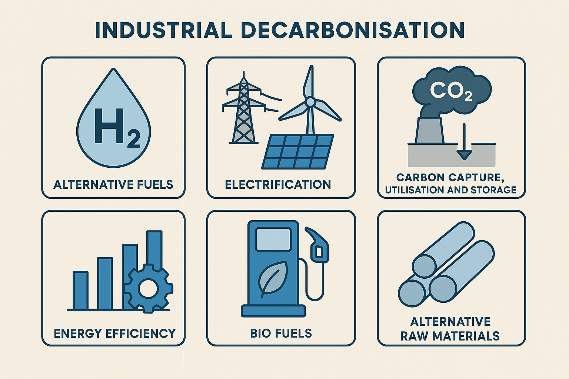
Salman et al.

Slide 7
Decarbonization of the Cement Industry:
A Comprehensive Techno-Economic Assessment of Low-Emission Pathways
Salman et al.
Techno-economic comparison of decarbonisation options
Ranking of options based on future energy scenarios
Mapping of options based on multiple variables

Slide 8
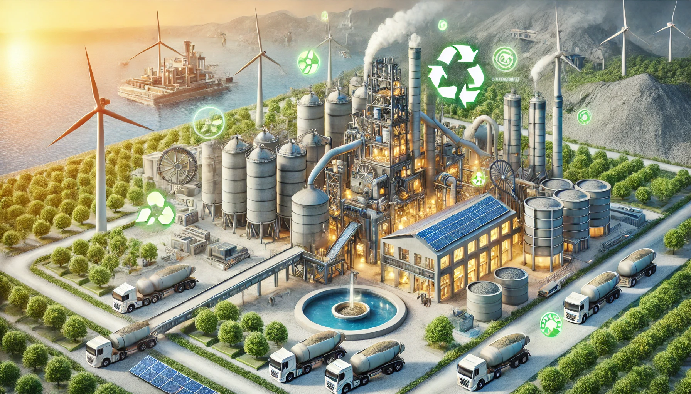
Methodology
Decarbonization of the Cement Industry

Slide 9
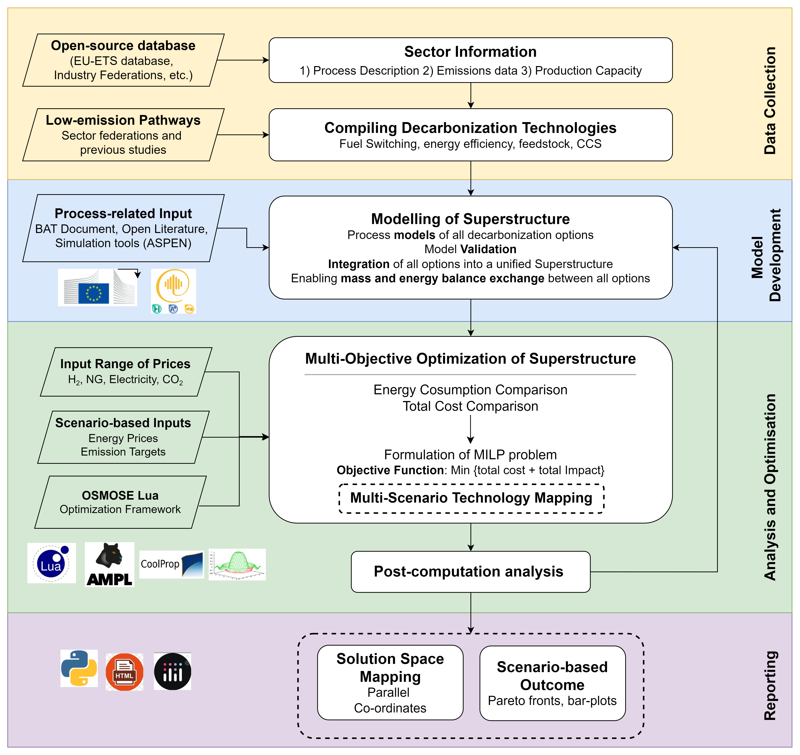
Salman et al.
Methodology for superstructure optimization

Slide 10
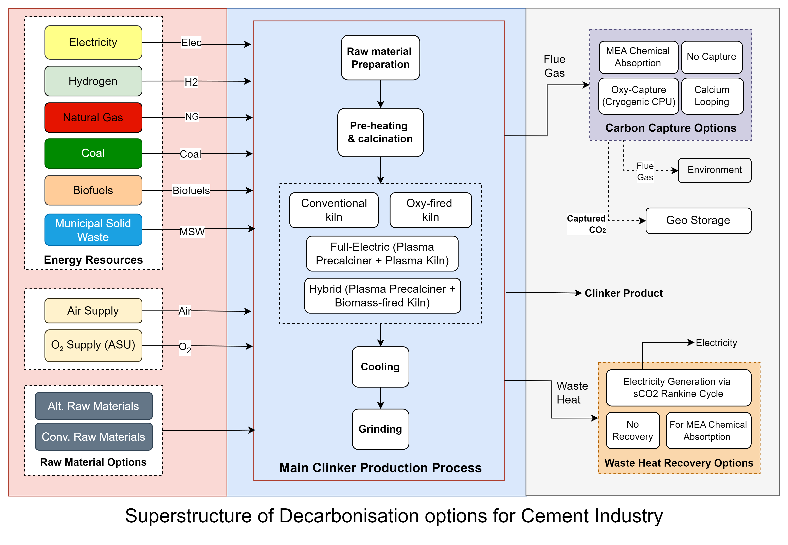
Cement Superstructure
Typical European cement plant with 5000 tonnes of clinker production per day
Salman et al.
Superstructure of Decarbonisation
options for Cement Industry

Slide 11
Kiln Options
Conventional Kiln
Oxy-combustion kiln
Plasma kiln
Hybrid-Plasma Kiln
Salman et al.

Slide 12
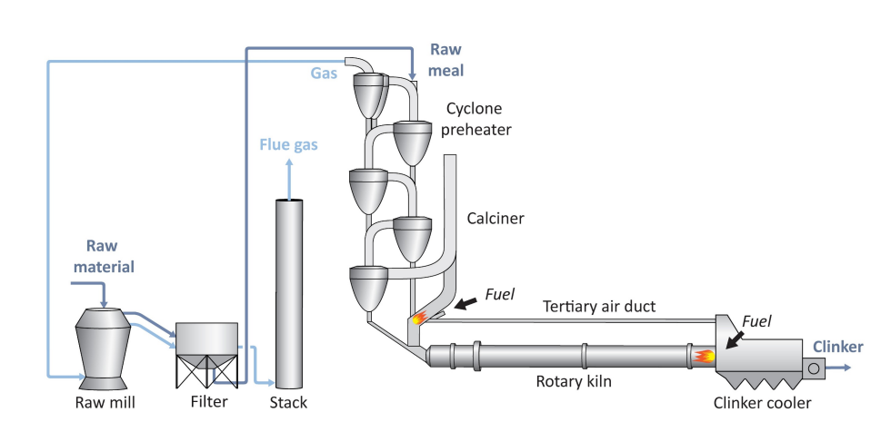
Conventional Kiln – Fuel/Air
Salman et al.
Voldsund, M. et al. (2019). Comparison of technologies for CO₂ capture from cement production—Part 1: Technical evaluation. Energies, 12(3), 559

Slide 13
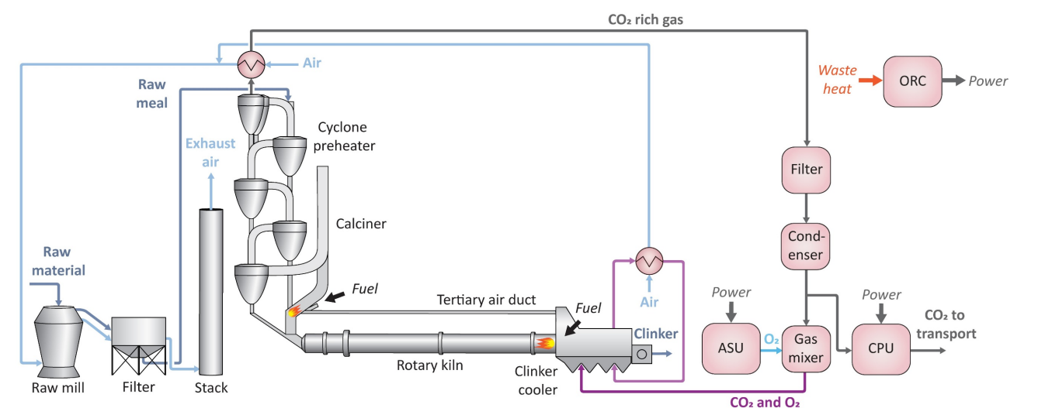
Oxycombustion kiln with CPU
Salman et al.
Voldsund, M. et al. (2019). Comparison of technologies for CO₂ capture from cement production—Part 1: Technical evaluation. Energies, 12(3), 559

Slide 14
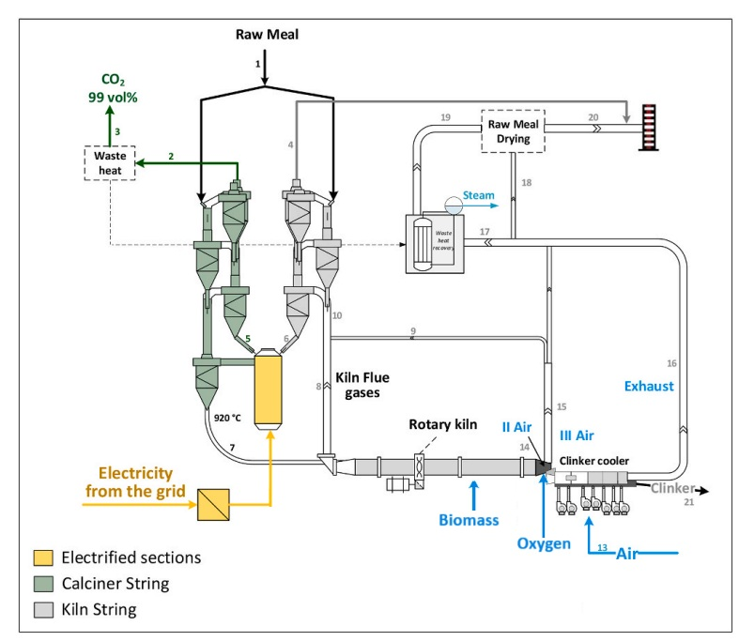
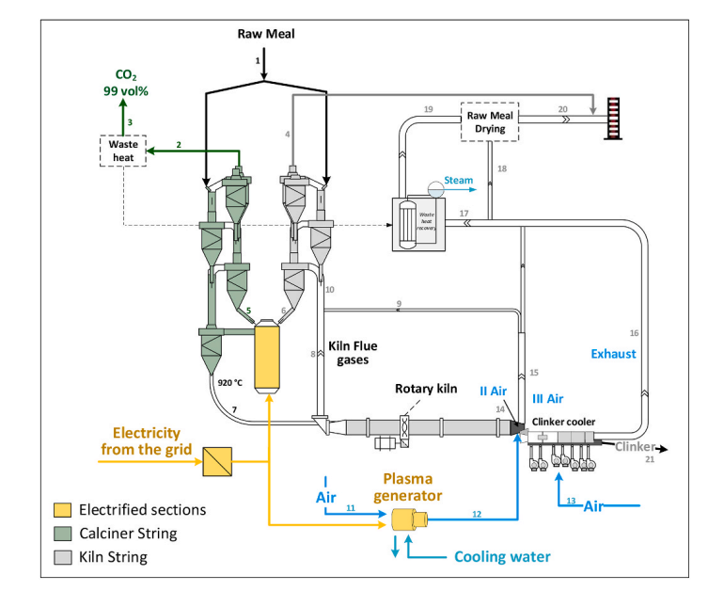
Electrification
Salman et al.
Partial Electrification (Hybrid)
Complete Electrification
Quevedo Parra, S., & Romano, M. C. (2025). Decarbonization of cement production by electrification. Journal of Cleaner Production

Slide 15
Carbon Capture Options
MEA-based Chemical Absorption Process
Oxy-combustion with CO₂ compression and purification unit (CPU)
Calcium Looping
Salman et al.

Slide 16
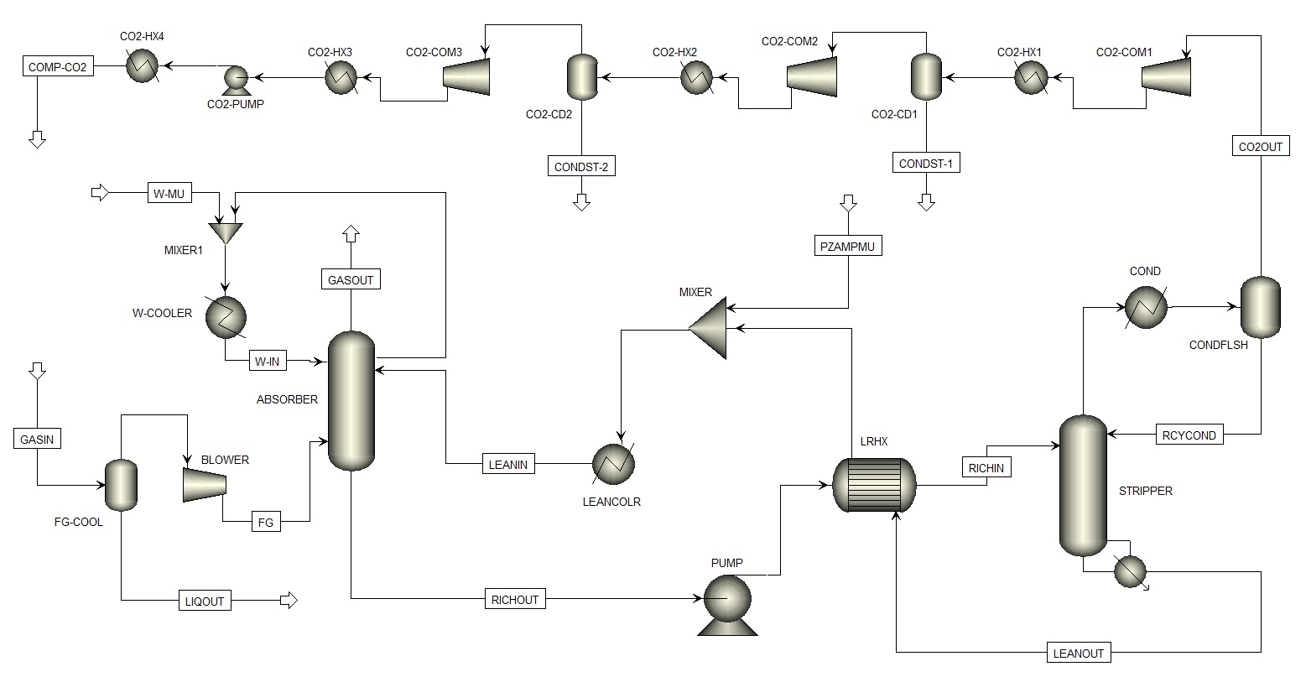
MEA Chemical Absorption Process
Salman et al.
MEA
Salman, M. et al. (2024). Techno-economic analysis of AMP/PZ solvent for CO₂ capture in a biomass CHP plant: Towards net negative emissions. Frontiers in Energy Research, 12.

Slide 17
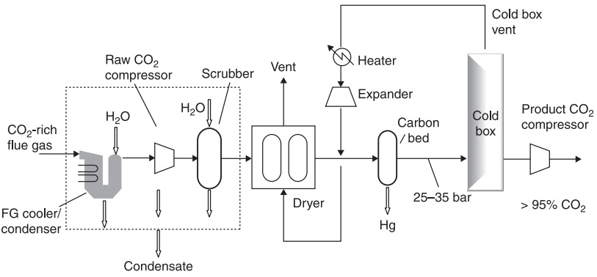
CO₂ compression and Purification Unit - CPU
Salman et al.
Shah, M.M., 2011. 11 - Carbon dioxide (CO2) compression and purification technology for oxy-fuel combustion, in: Zheng, L. (Ed.), Oxy-Fuel Combustion for Power Generation and Carbon Dioxide (CO2) Capture. Woodhead Publishing, pp. 228–255.

Slide 18
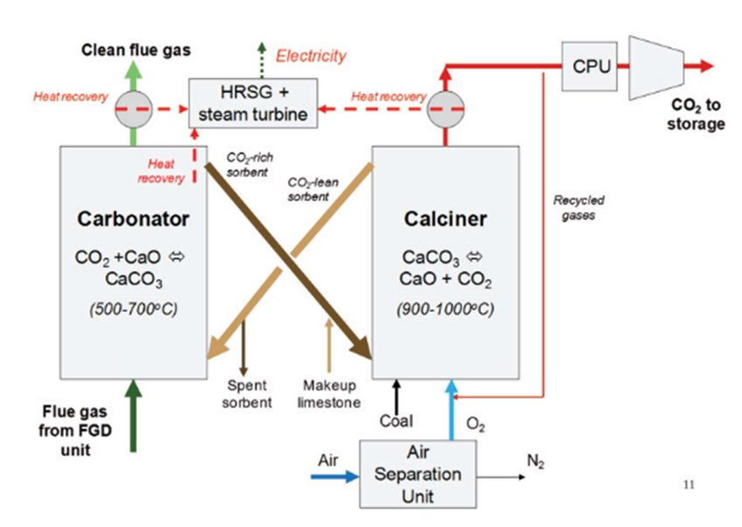
CaL Process
Salman et al.

Slide 19
Waste Heat Recovery
Supercritical CO₂ Rankine Cycle
Heat recovered for Carbon Capture
Salman et al.

Slide 20
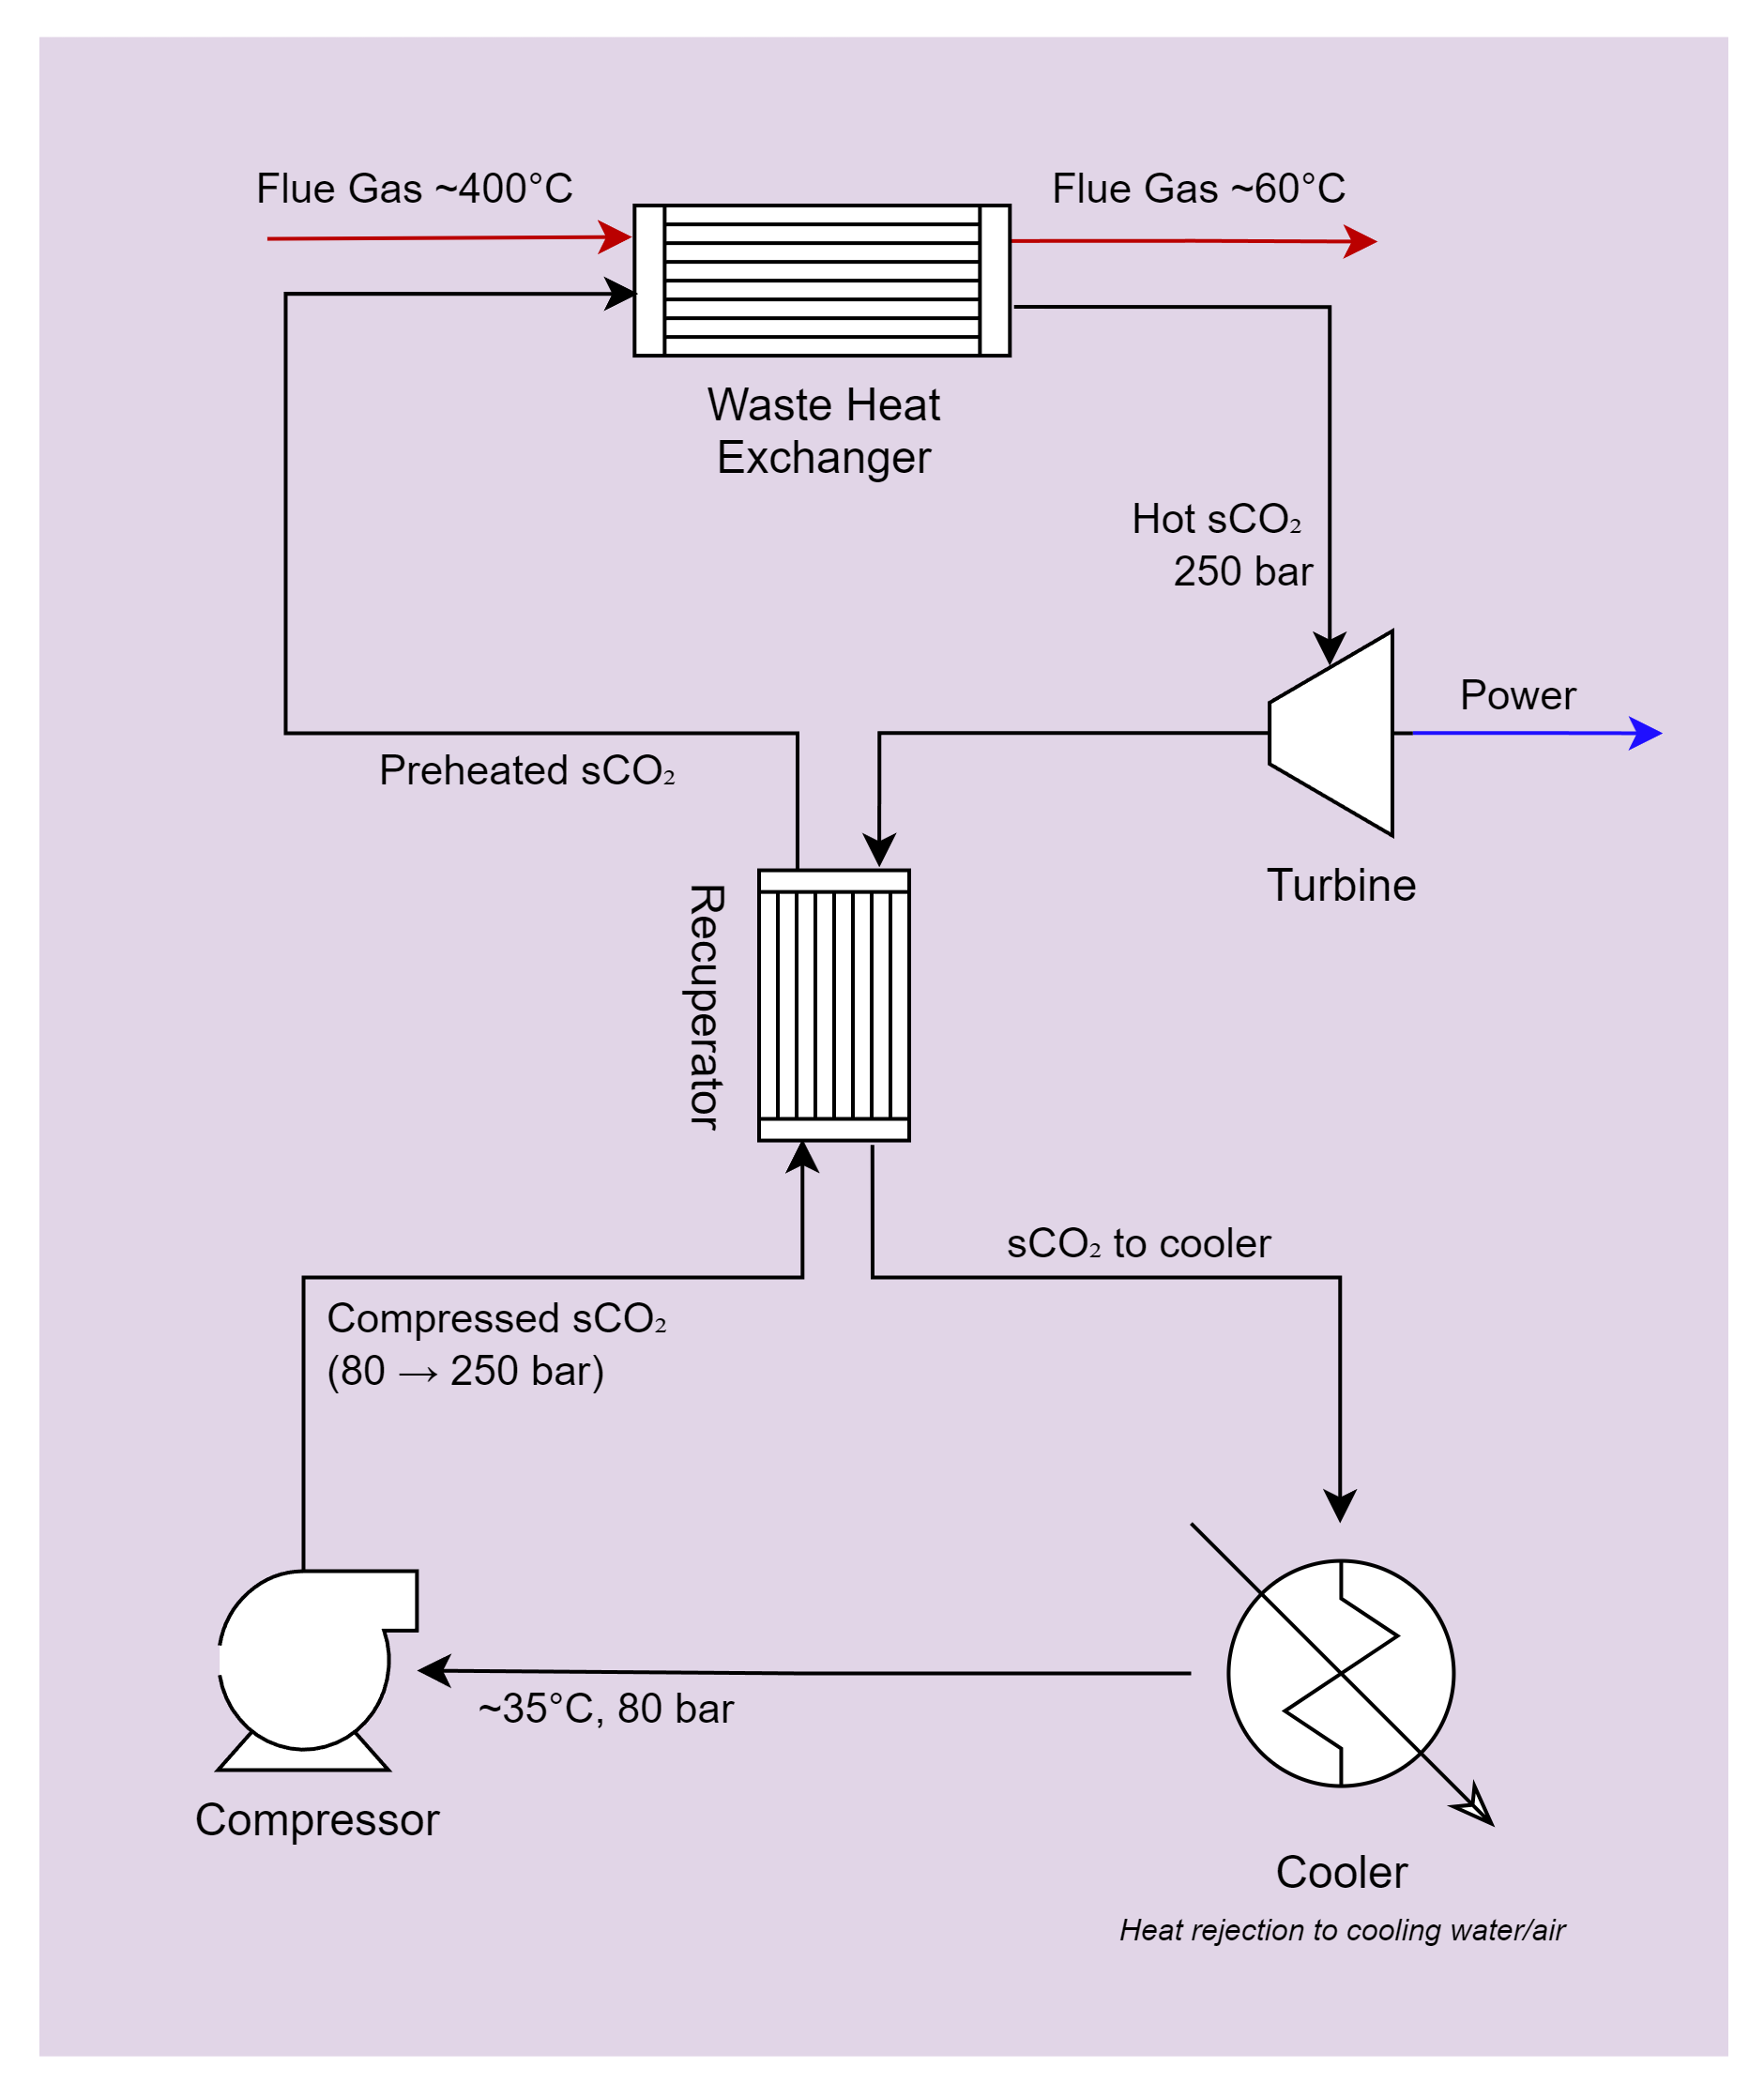
Supercritical CO₂
Rankine Cycle
Salman et al.

Slide 21
Blueprint
Salman et al.
Equation-oriented Lua script models
Includes detailed mass and energy profile of a process/unit.
Costing details (CAPEX and OPEX)
Emissions data (Scope 1 and 2)
It consists of several elements:
  Units: elementary black box ‘node’ of the system.
  Streams
  Parameters: used in the streams and units to define size, cost, T, P etc.,)
It can be associated with a predefine simulation model (e.g. Aspen model)

Slide 22
OSMOSE tool by IPESE group of EPFL
A framework for process and energy systems optimisation
Simultaneous optimisation of thermodynamic, environmental, and economic elements.
A decision support tool
Coupled with databases, simulation tools, optimisation methods, solvers and post-analysis methods.
Incorporate a database of Blueprints (equation-oriented LUA) models
Utilise AMPL language to solve MILP problems
Salman et al.
Blueprint Models
OSMOSE
Optimization results

Slide 23
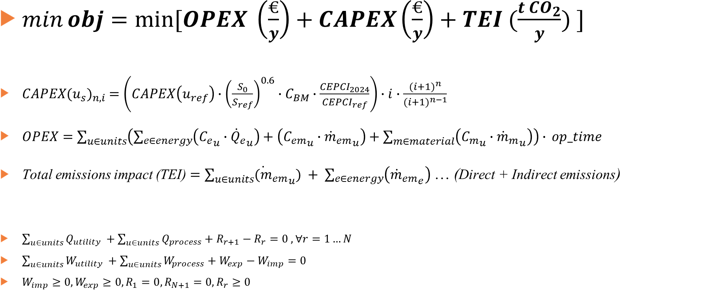
Objective Function
Salman et al.
$\min{obj}=\min{[OPEX \left(\frac{€}{y}\right)+CAPEX\left(\frac{€}{y}\right)+TEI (\frac{{t CO}_{2}}{y}) ]}$
$CAPEX{(u_{s})}_{n,i} =\left(CAPEX\left(u_{ref}\right)∙{\left(\frac{S_{0}}{S_{ref}}\right)}^{0.6}∙C_{BM}∙\frac{{CEPCI}_{2024}}{{CEPCI}_{ref}}\right)∙i∙\frac{{(i+1)}^{n}}{{(i+1)}^{n−1}}$
$OPEX=\sum_{u∈units}{\left(\sum_{e∈energy}{\left({C_{e}}_{u}∙{{\dot{Q}}_{e}}_{u}\right)}+\left({C_{em}}_{u}∙{{\dot{m}}_{em}}_{u}\right)+\sum_{m∈material}{\left({C_{m}}_{u}∙{{\dot{m}}_{m}}_{u}\right)}\right)∙} op_time$
Total emissions impact (TEI) $=\sum_{u∈units}{{{\dot{(m}}_{em}}_{u}) + \sum_{e∈energy}{\left({{\dot{m}}_{em}}_{e}\right)}}$ … (Direct + Indirect emissions)
$\sum_{u∈units}{Q_{utility }+\sum_{u∈units}{Q_{process}+R_{r+1}−R_{r}=0 , ∀r=1…N}}$
$\sum_{u∈units}{W_{utility }+\sum_{u∈units}{W_{process}+W_{exp}−W_{imp}=0 }}$
$W_{imp}≥0, W_{exp}≥0, R_{1}=0, R_{N+1}=0,R_{r}≥0$
Energy balance and
feasibility constraints

Slide 24

Configurations
Fuel switching
Coal-fired kiln (base case)
NG-fired kiln
Biogas-fired kiln
H₂/NG co-firing (50% share)
Biomass Co-firing (50% share)
Municipal solid waste Co-firing (50% share)
Electrification
Partial Electrification: Plasma pre-calciner + Biomass oxy-fired kiln + CPU
Full Electrification:
  (Plasma pre-calciner + Plasma kiln + CPU)
Salman et al.
Capture Options
MEA Chemical Absorption
Oxy-firing with cryogenic capture
Calcium Looping
Storage Options
Injection in depleted fields
Waste heat recovery
For Carbon Capture, Power generation or District heating
Notes:
MSW: C(47.1%), H(5.1%), O(30.9%), N(1.6%). S(0.8%), Cl(0.7%) – dry ash-free basis
BM: Ultimate analysis (mass basis): 47%C, 6%H, 45%O, 0%N, 0%S

Slide 25
No. | Configuration | Abbreviation
1 | Coal fired kiln | Coal
2 | Coal-fired kiln with MEA carbon capture | Coal_CC
3 | Coal-oxy-fired kiln with cryogenic capture | Coal_oxy_CC
4 | Coal-fired kiln with CaL capture | Coal_CaL
5 | Natural Gas fired kiln | NG
6 | Natural Gas-fired kiln with MEA carbon capture | NG_CC
7 | Natural Gas-oxy-fired kiln with cryogenic capture | NG_oxy_CC
8 | Natural Gas-fired kiln with CaL capture | NG_CaL
9 | Biomethane fired kiln | BioCH4
10 | Biomethane-fired kiln with MEA carbon capture | BioCH4_CC
11 | Biomethane-oxy-fired kiln with cryogenic capture | BioCH4_oxy_CC
12 | Biomethane-fired kiln with CaL capture | BioCH4_CaL
13 | Biomass co-firing kiln | BM
14 | Biomass-fired kiln with MEA carbon capture | BM_CC
15 | Biomass-oxy-fired kiln with cryogenic capture | BM_oxy_CC
16 | Biomass-fired kiln with CaL capture | BM_CaL
17 | Municipal waste co-firing kiln | MSW
18 | Municipal waste co-firing kiln with MEA carbon capture | MSW_CC
19 | Municipal waste oxy-co-firing kiln with cryogenic capture | MSW_oxy_CC
20 | Municipal waste co-firing kiln with CaL capture | MSW_CaL
21 | Hydrogen co-firing kiln | H2
22 | Hydrogen kiln with MEA carbon capture | H2_CC
23 | Hydrogen-oxy kiln with cryogenic capture | H2_oxy_CC
24 | Hydrogen kiln with CaL capture | H2_CaL
25 | Plasma Pre-calciner + Plasma kiln with cryogenic capture | Plasma
26 | Plasma Pre-calciner + Biomass-oxy kiln with cryogenic capture (hybrid kiln) | Hybrid

Slide 26
Techno-Economic Analysis
Decarbonization of the Cement Industry

Slide 27
Model Validation – Base-case
Base-case: Air-fired dry kiln (4-stage cyclone preheater pre-calciner) (No CCS)
Waste Heat = From preheater exhaust (300 – 400 °C) + clinker cooling (200 – 300 °C)
Salman et al.
Value | Blueprint Model | Industry (Confidential)
Clinker Capacity (tpd) | 5000 tpd | -
Fuel | Coal | -
Solids mass raw material | 1.9 t/t | In range
Fuel consumption | 0.12 t/t_{clinker} | In range
Fuel consumption | 3.48 GJ/t_{clinker} | In range
Emissions (Combustion + Process) | 0.8 t_{CO2}/t_{clinker} | In range
Electricity Consumption | 0.40 GJ/t_{clinker} | In range
Electricity Produced with ORC | 6 MW | In range
Air preheating | 1000 °C | Correct
Raw material preheating | 900 °C | Correct
Exhaust gases after PH and PC | 250 °C | In range
Fuel Consumption Co-firing biomass (50%) | 3.98 GJ/t_{clinker} | In range

Slide 28
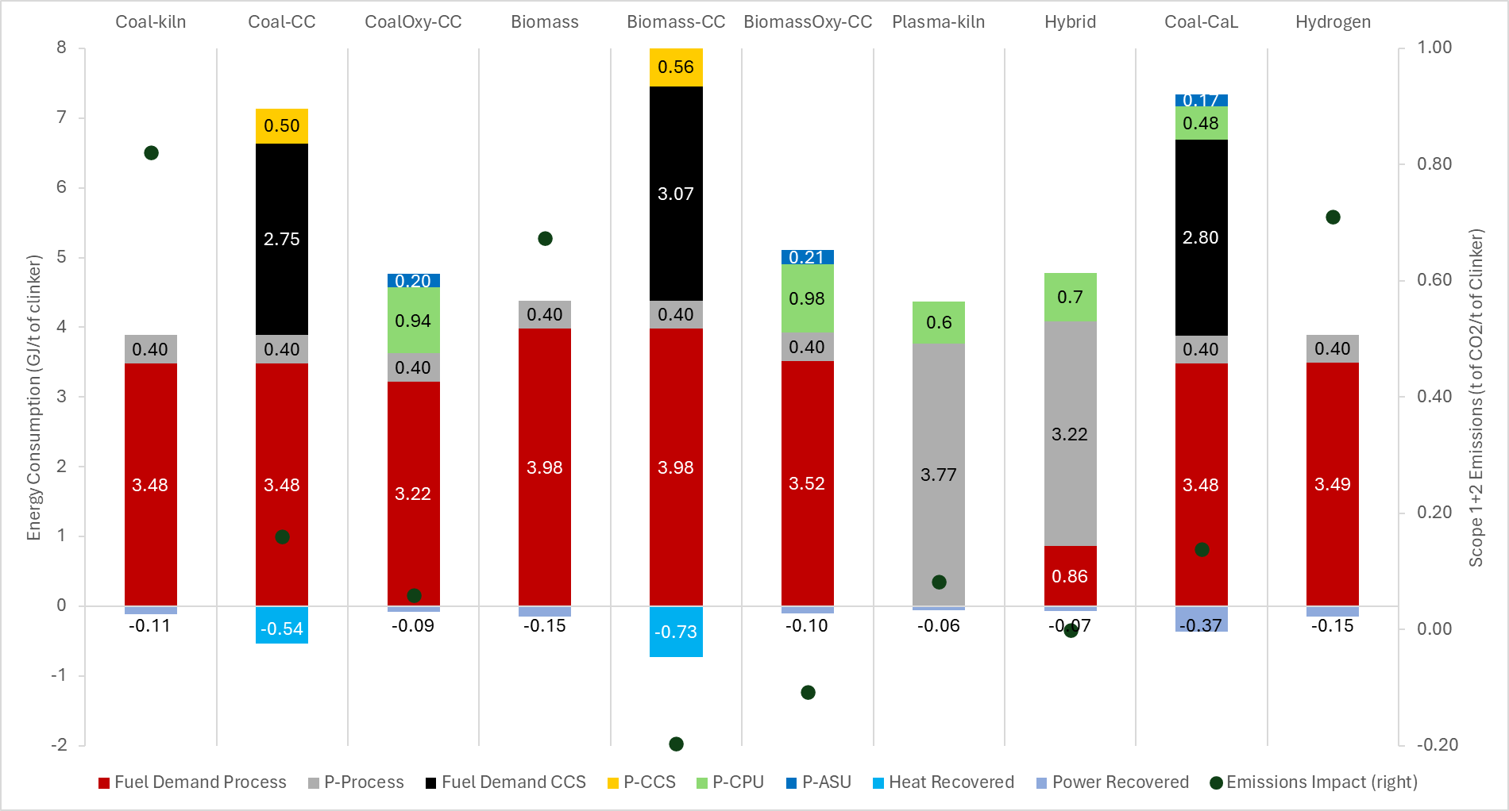
Oxyfuel-Cryo
Capture
BiomassOxy
Hybrid
Hydrogen
Base
Case
Biomass
Co-firing
kiln
Electrification
(Plasma)
Calcium
Looping
Amine-based
Capture
Biomass-CC
Energy Consumption Analysis (GJ/t of clinker)

Slide 29
Energy Consumption Analysis (GJ/t of clinker)

Slide 30
CAPEX Assumptions
Salman et al.
Modeled Plant Capacity = 5000 tpd of clinker
Lifetime = 40 years
Discount rate for combustion-based kiln = 6%
Discount rate for plasma-based kiln = 8%
Abbreviations:
  NG: Natural Gas
  BioCH₄ = Bio-methane
  BM: Biomass/coal co-firing
  MSW: Municipal Solid Waste co-firing
  H₂: Hydrogen
  CCUnit: Chemical absorption-based carbon capture
  Cryocap: cryogenic CO₂ purification unit (CPU)

Slide 31
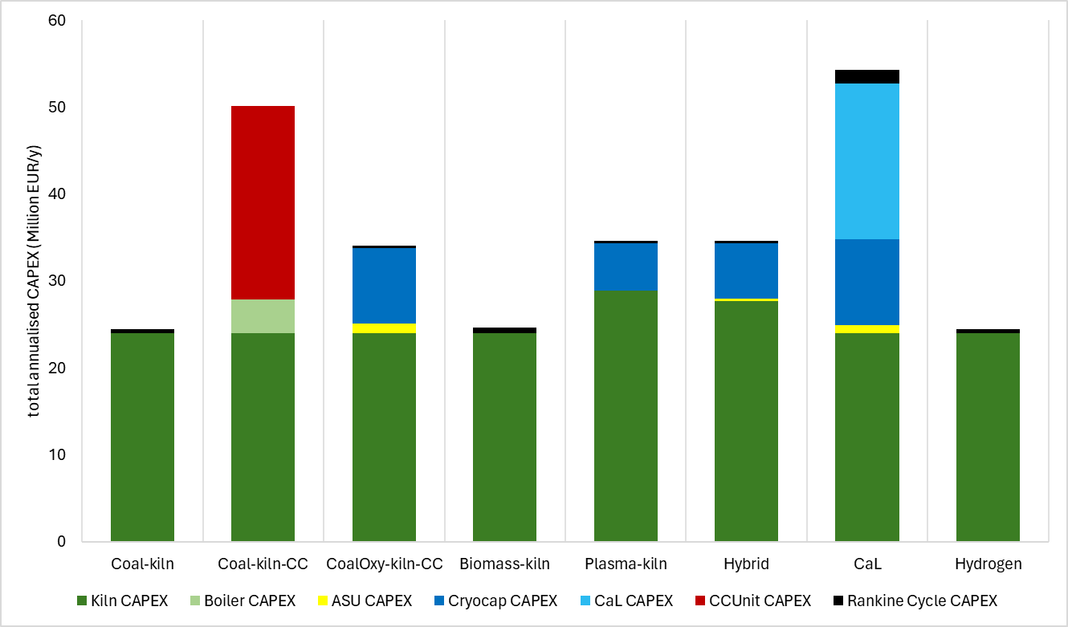
Salman et al.
Annual CAPEX for each configuration (Million €/year)

Slide 32
Scenarios – inspired from (Vito + IEA + ENTSO)
Price | 2025 | 2040 | 2050
Electricity (€/MWh) | 100 | 65 | 30
Biomethane (€/MWh) | 70 | 45 | 45
Natural Gas (€/MWh) | 35 | 35 | 35
Coal (€/MWh) | 13 | 12 | 12
Biomass (€/MWh) | 16.9 | 18 | 18
MSW (€/MWh) | 5 | 5 | 5
Hydrogen (€/MWh) | 120 | 85 | 55
CO₂ (€/tCO₂) | 80 | 140 | 200
CO₂ T&S (€/tCO₂) | 60 | 40 | 20
Electricity Impact (tCO₂/MWh) | 0.14 | 0.06 | 0.057
Hydrogen Impact (tCO₂/MWh) | 0.357 | 0.28 | 0.18
Salman et al.

Slide 33
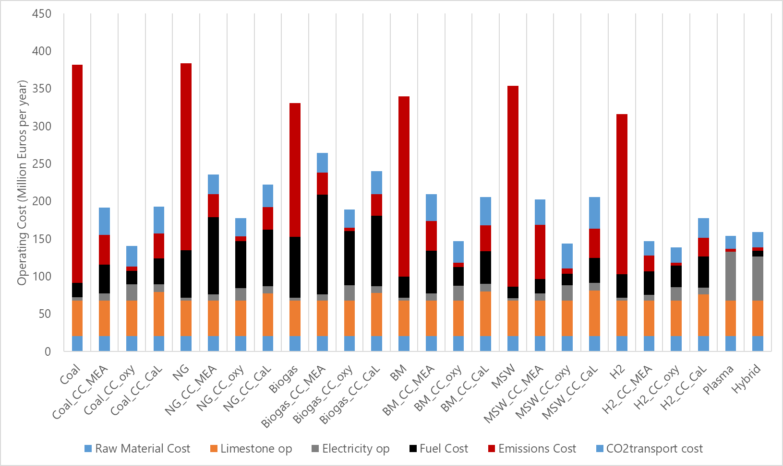
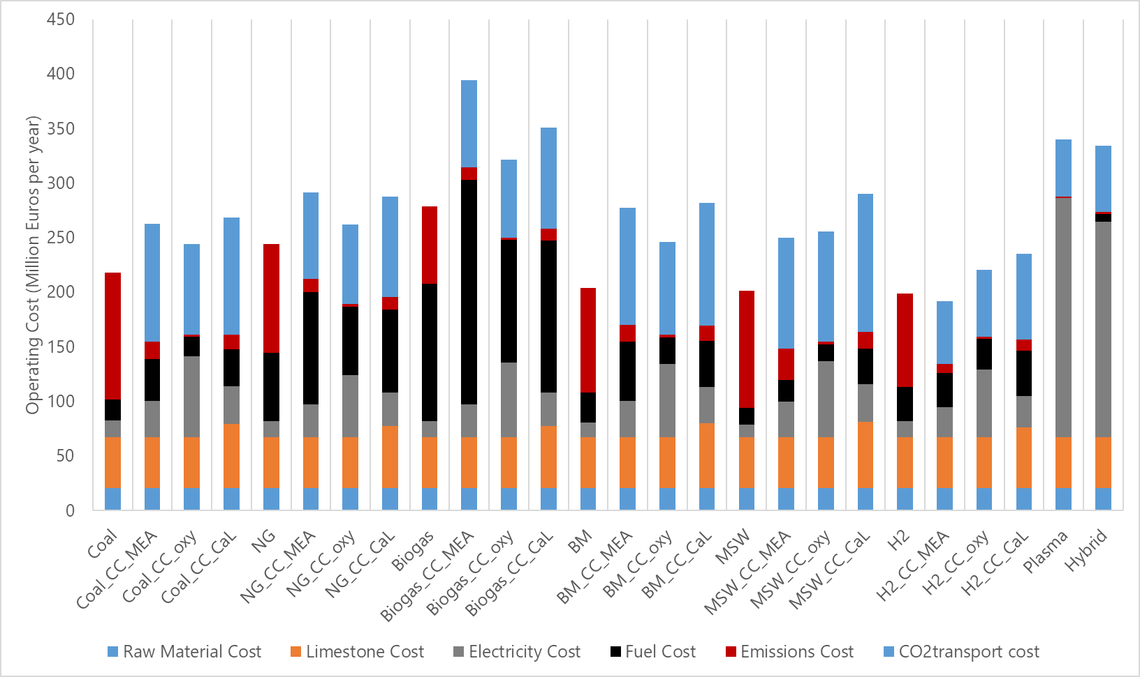
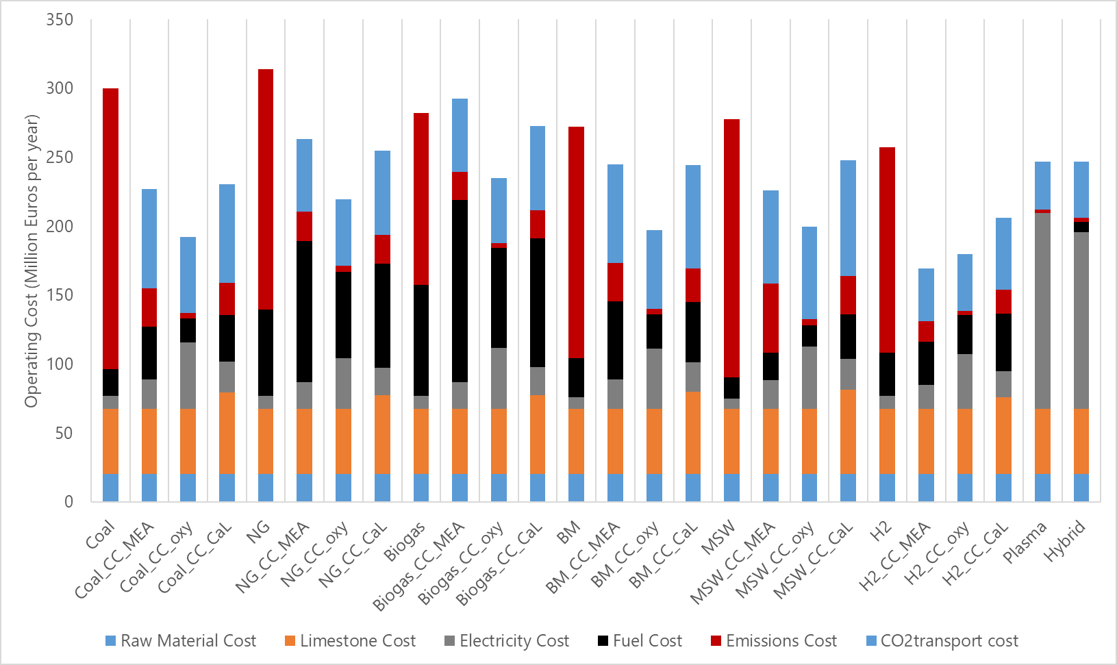
Operating Cost (M€/year)
Scenario 2025
Scenario 2050
Scenario 2040
Salman et al.

Slide 34
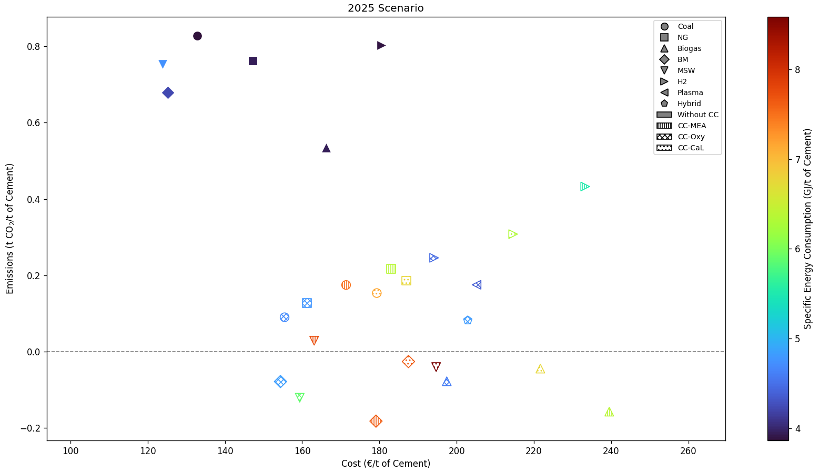
Total Annual Cost Comparison
Total Annual
Cost Comparison

Slide 35
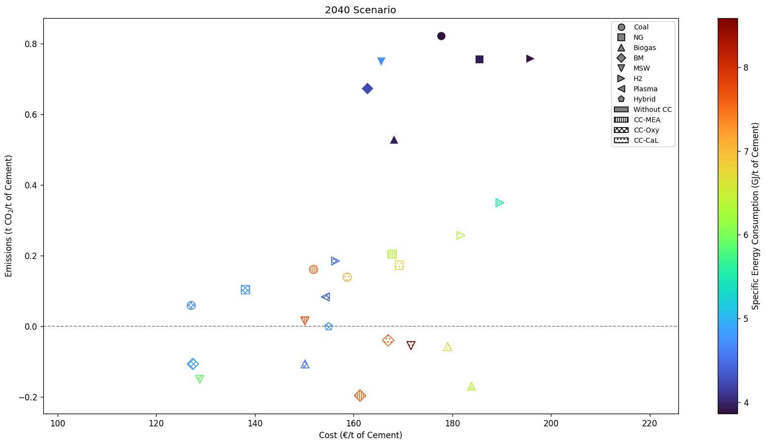
Total Annual Cost Comparison
Salman et al.

Slide 36
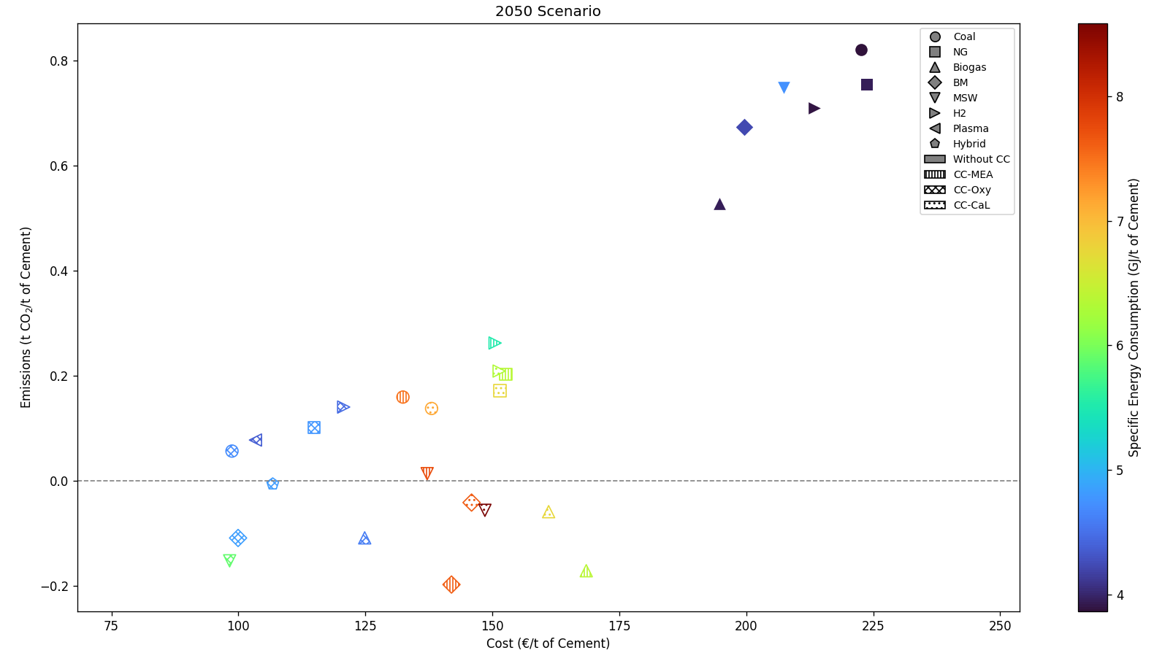
Total Annual Cost Comparison
Salman et al.

Slide 37
Conclusion
Decarbonization of the Cement Industry

Slide 38
Conclusions
Waste Heat Recovery (for power generation or CCS) has limited potential.
CCS increases CAPEX, but:
  Cryogenic capture adds only +27% annual CAPEX over the base case.
  Amine-based capture adds around +50% annual CAPEX.
OPEX is mainly driven by ETS price and fuel/electricity cost across all configurations.
In the 2025 scenario:
  Co-firing with biomass or MSW is the most cost-effective.
  CCS options offer deep emission cuts but remain costly.
  Electrification and biomethane + CCS are the most expensive pathways.
By 2040–2050, CCS becomes cost-competitive, with cryogenic capture emerging as the cheapest solution.
Alternative fuels (MSW, Biomass) already provide clear benefits, and increasing their substitution rate offers additional emissions reductions in future scenarios.
Without a higher ETS price, CCS remains cost-intensive. However, cryogenic capture provides a low-cost per ton clinker option and becomes economically viable with only a modest ETS increase.
CaL remains the most expensive CC option.
Salman et al.

Slide 39
Multi-Scenario
Technology Mapping
Future Task

Slide 40

Salman et al.
How to free yourself as an academic from “predicting” prices and not trigger people???

Slide 41
Multi-scenario analysis
Salman et al.
Independent Variables
Electricity: 10 – 200 €/MWh
Hydrogen: 10 – 200 €/MWh
Natural Gas: 10 – 100 €/MWh
Biomass: 10 – 100 €/MWh
Biogas 10 – 100 €/MWh
Coal: 10 – 100 €/MWh
MSW: 10 – 100 €/MWh
CO2 emissions: 75 – 250 €/tCO₂
CO2 T&S: 20 – 100 €/tCO₂
Approx. 1,000,000+ Simulations

Slide 42
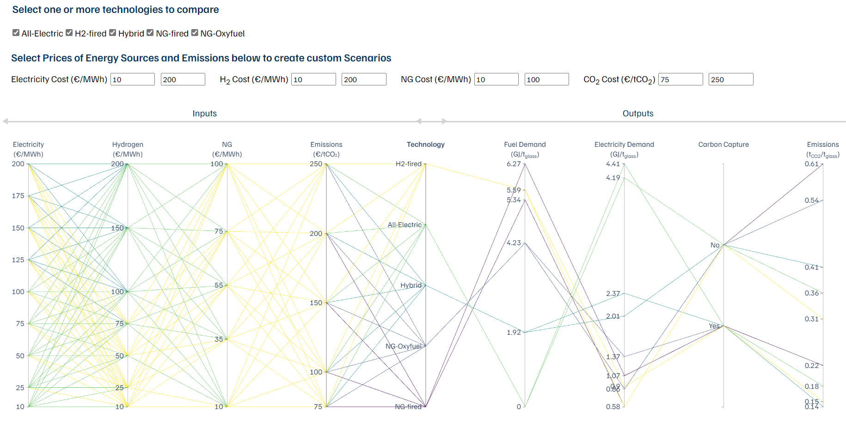
Technology Mapping via Parallel Coordinates

Slide 43
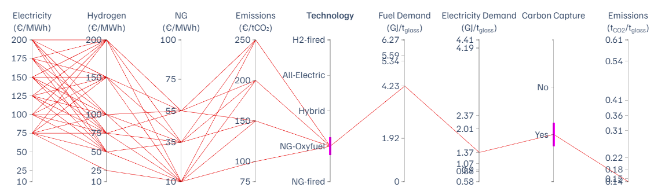
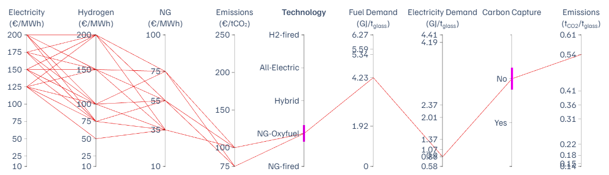
NGOxy fired furnace
Salman et al.

Slide 44
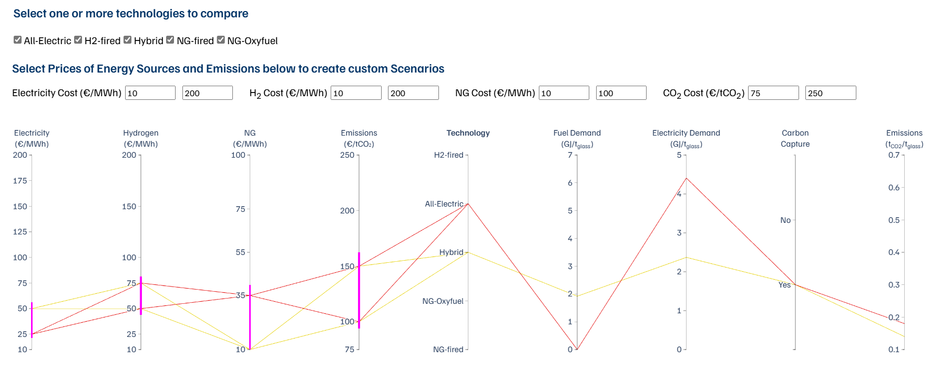
Mapping of an energy scenario

Slide 45
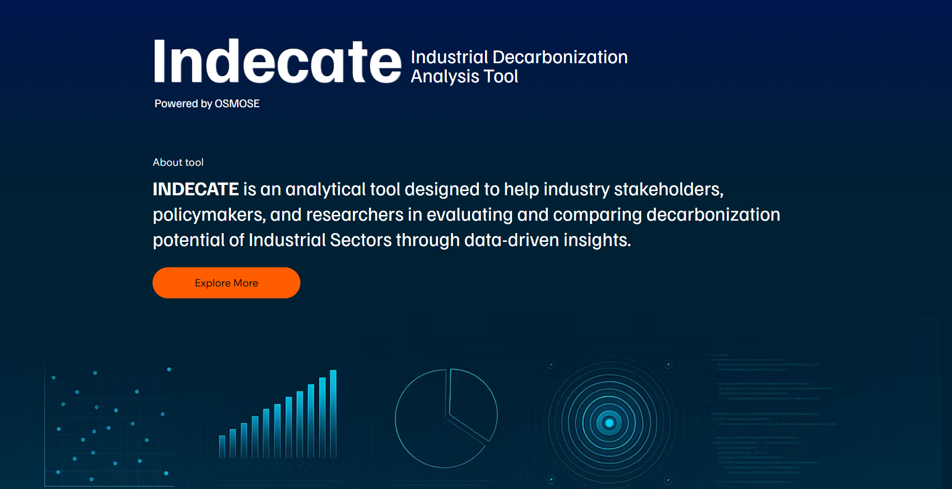
Indecate.com

Slide 46
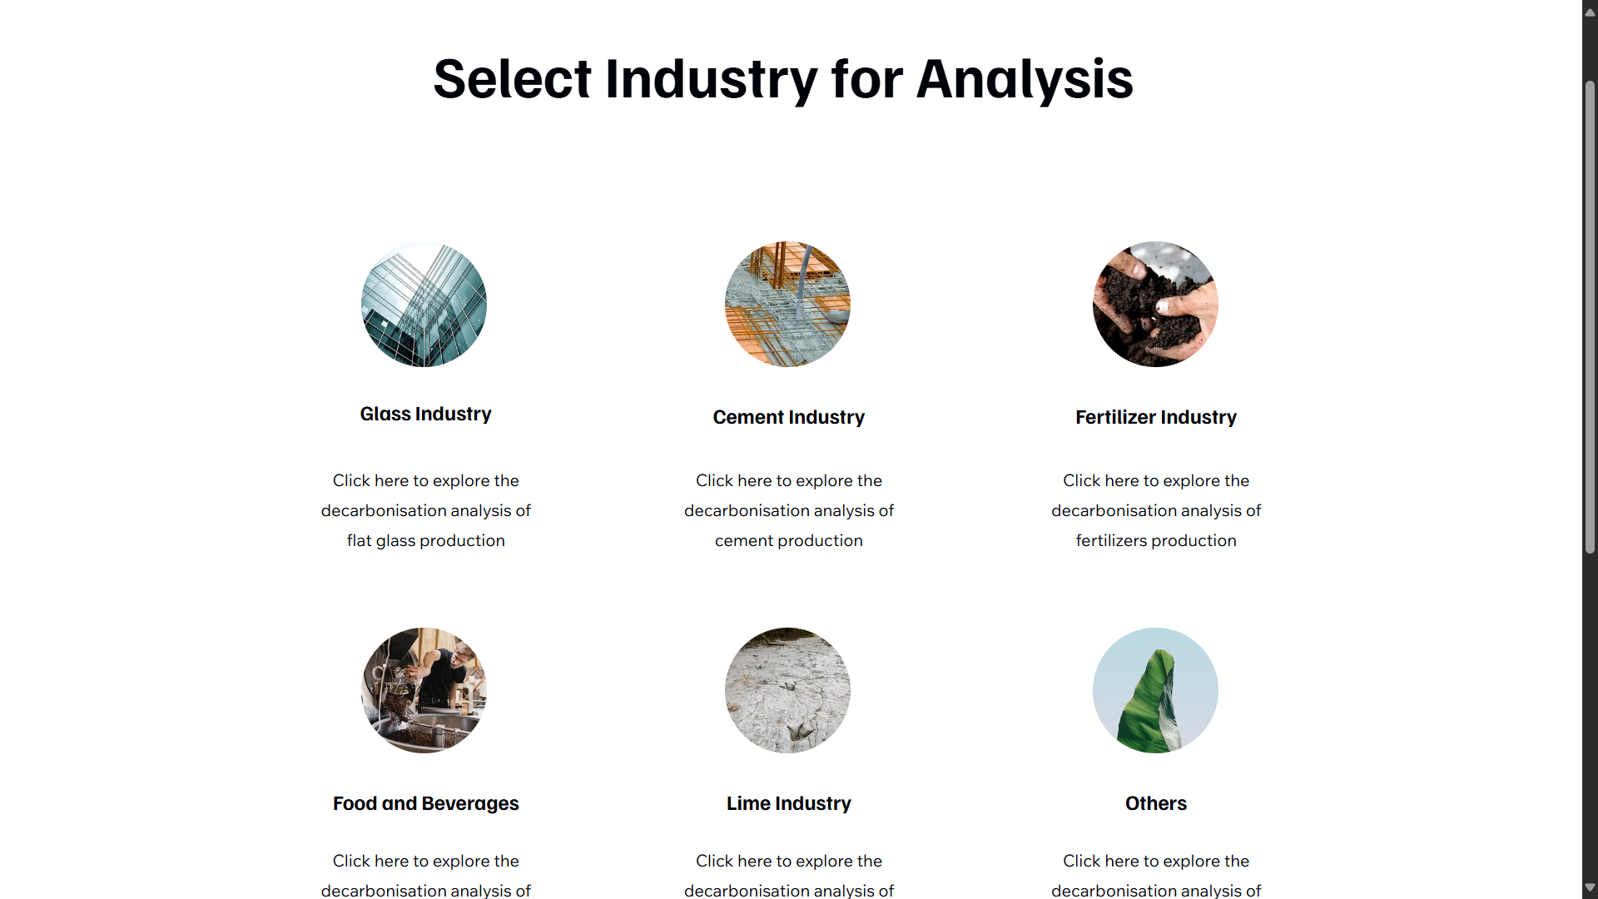

Slide 47

Thanks for your attention!
Muhammad Salman
Daniel Flórez-Orrego
François Maréchal
Grégoire Léonard
Contact:
Email: m.salman@uliege.be
Tel: +32-465671822

