Slide 1
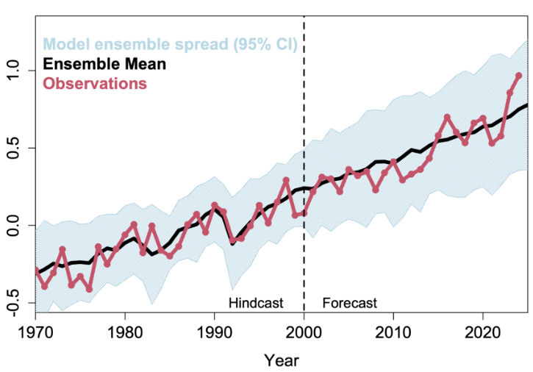
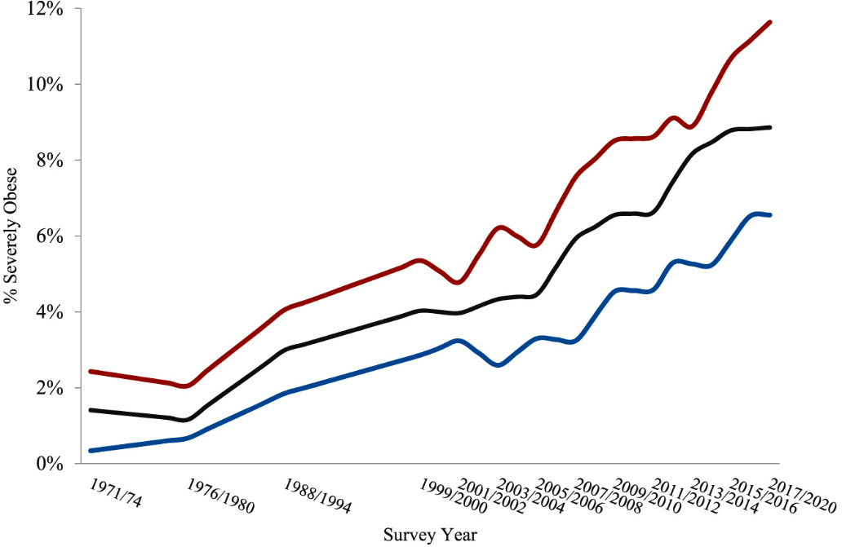
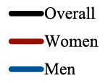
+1.0
+0.5
Temperature increase (°C)
0.0
-0.5
Year
12
10
8
Severe obesity (%)
6
4
2
0
1971/
1974
1976/1980
1988/1994
1999/
2000
2005/
2006
2011/
2012
2017/
2020

Slide 2
Global warming
Endocrine disorders
Obesity epidemic

Slide 3
Modern society
Industry
Agriculture
Transport
Heating
Climate changes
Global warming
Pollution
↓ Thermogenesis
↓ Physical Activity
Adiposopathies
↓ Brown adipocytes
Obesity epidemic

Slide 4
Obesity epidemic
Food process
Transportation
↑ UPF production
↑ energy cost
↓ walking/cycling
↑ Energy waste
↑ GHG emission
Global warming
Air pollution

