Slide 1

A plural Belgian police system? Analysis of integration mechanisms related to information and staff exchanges
Yanis Tambour
PhD Student (ULiège)
Yanis.tambour@uliege.be

Slide 2

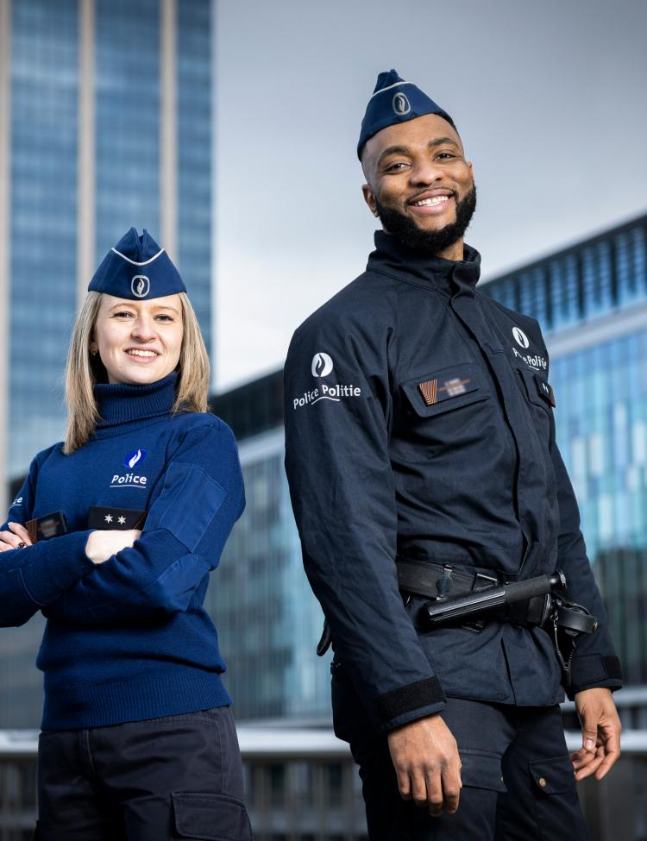
Introduction
1) Context of the study
  Master’s thesis in criminology
  PhD thesis in political sciences
2) The Belgian police: some key points
  History of the Belgian police system (1830-1998)
  The Octopus agreements (1998-)
    Two levels: the local police and the federal police
    The « integrated » nature of the administration
3) Research question
  Focus: Integration mechanisms related to information and staff flows
  Question: “How can the Belgian police model be characterised in terms of coordination and centralisation dynamics?”
  Two main goals in this research: empirical and theoretical

Slide 3

Empirical results
Centralised
H1
The local police under federal control
Uncoordinated
Coordinated
Decentralised

Slide 4
Empirical results
Centralised
Uncoordinated
Coordinated
R1
The autonomous local police and the non-binding federal police
Decentralised

Slide 5
Empirical results
Centralised
Uncoordinated
Coordinated
H2
Coordination not fully achieved
R1
The autonomous local police and the non-binding federal police
Decentralised

Slide 6
Empirical results
Centralised
Uncoordinated
Coordinated
R2
Coordination not fully achieved
R1
The autonomous local police and the non-binding federal police
Decentralised

Slide 7
Empirical results
Centralised
Uncoordinated
Coordinated
R2
Coordination not fully achieved
H3
Marked differences between PZ
R1
The autonomous local police and the non-binding federal police
Decentralised

Slide 8
Empirical results
Centralised
Uncoordinated
Coordinated
R2
Coordination not fully achieved
R3
Marked differences between PZ
R1
The autonomous local police and the non-binding federal police
Decentralised

Slide 9
Empirical results
Centralised
Uncoordinated
Coordinated
R2
Coordination not fully achieved
R3
Marked differences between PZ
R1
The autonomous local police and the non-binding federal police
= Belgian police model
Decentralised

Slide 10
Thank you for listening

