Slide 1
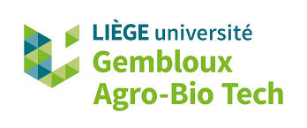


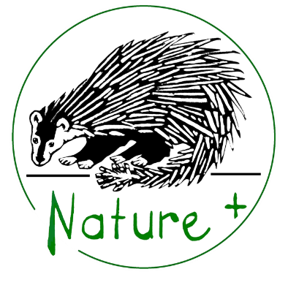
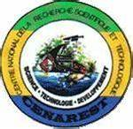
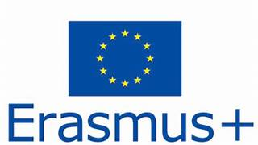
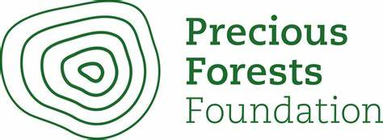
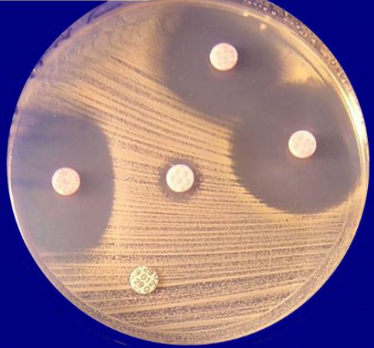
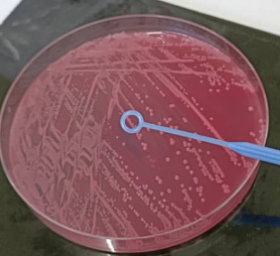
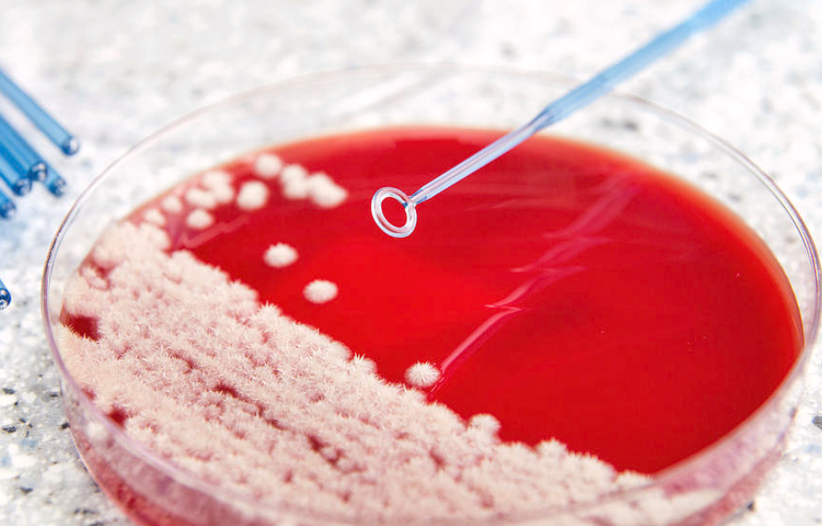
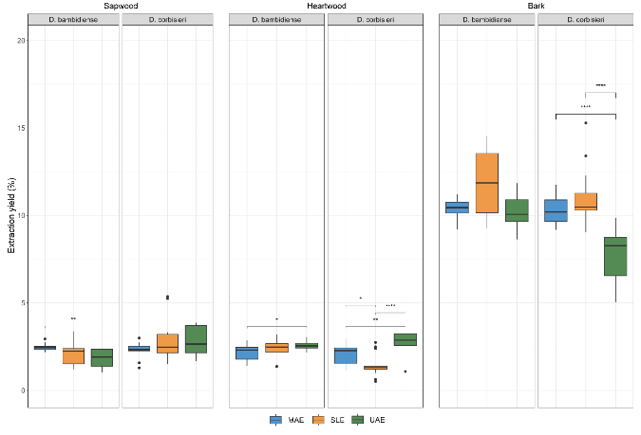
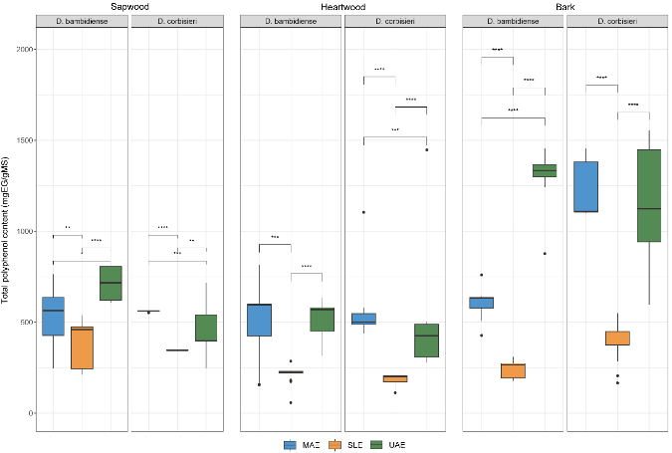
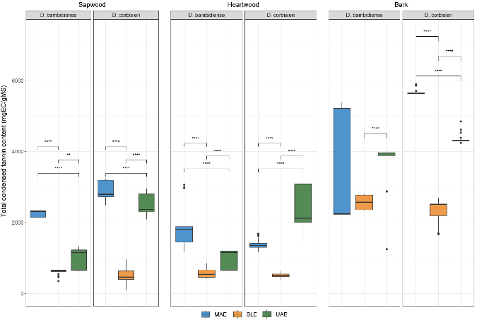
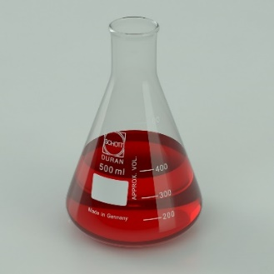
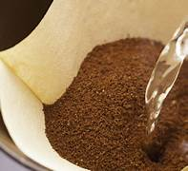
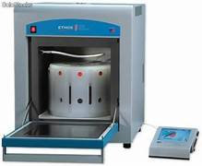
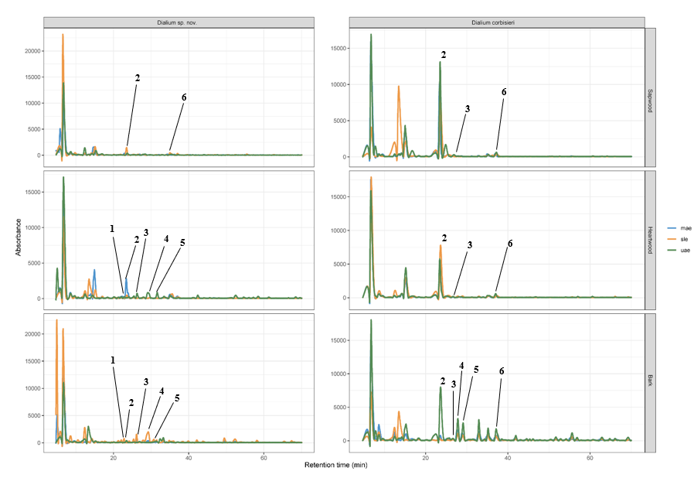
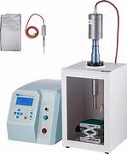
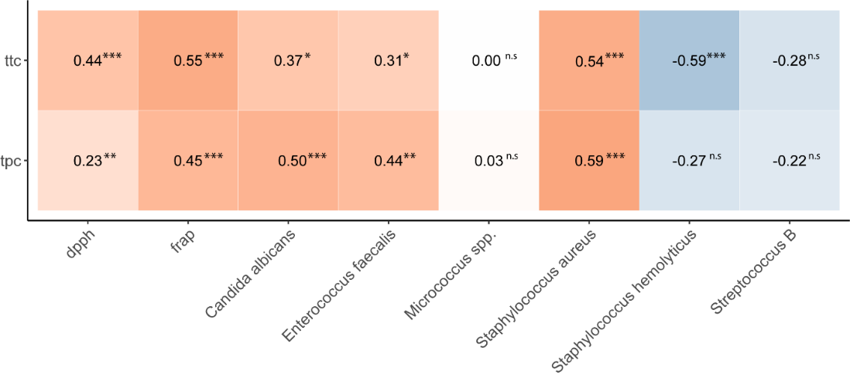
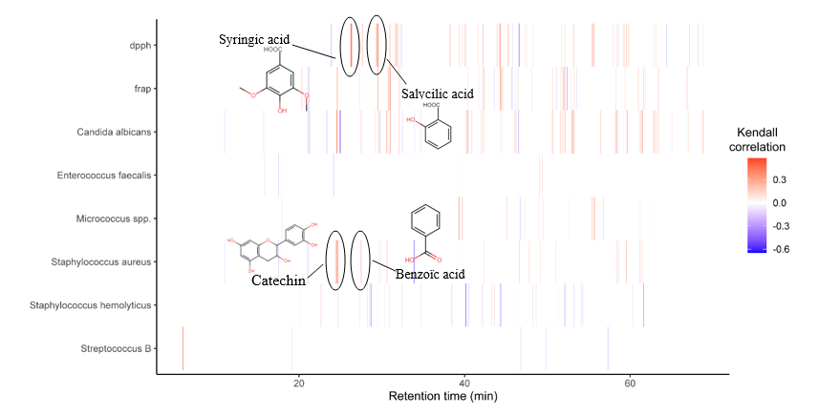
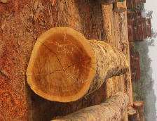
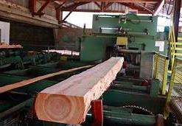
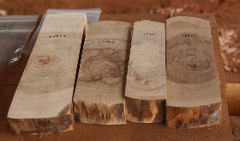
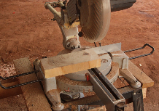
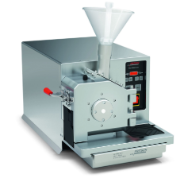
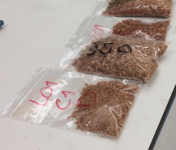
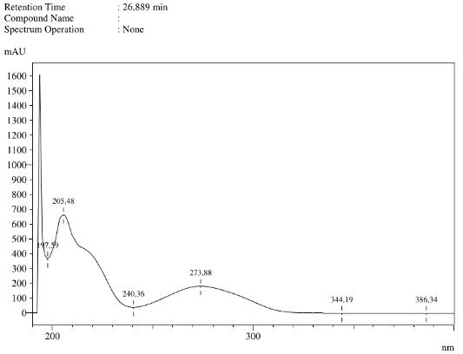
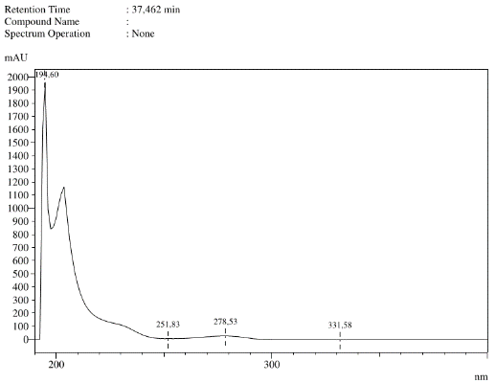
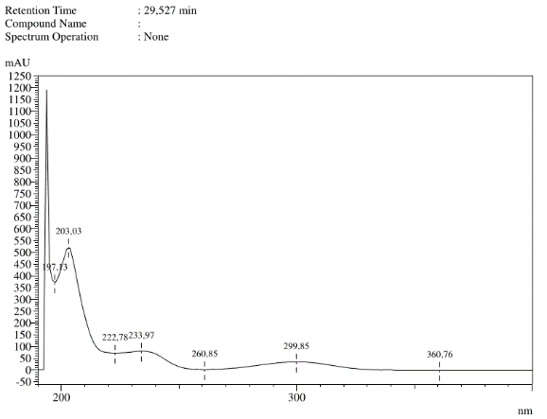
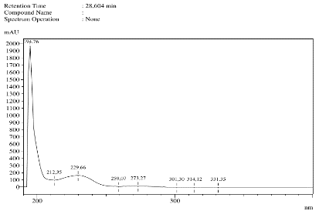
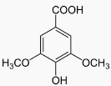

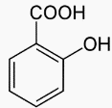

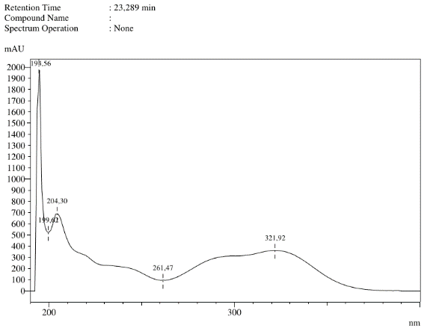

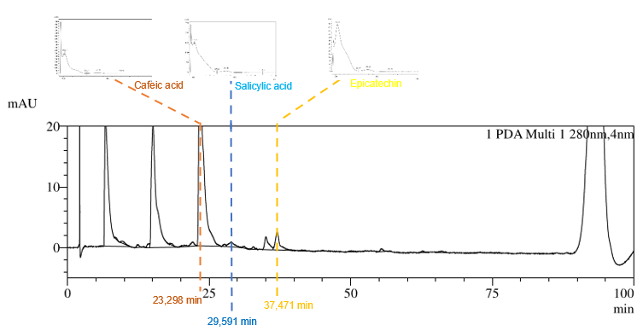
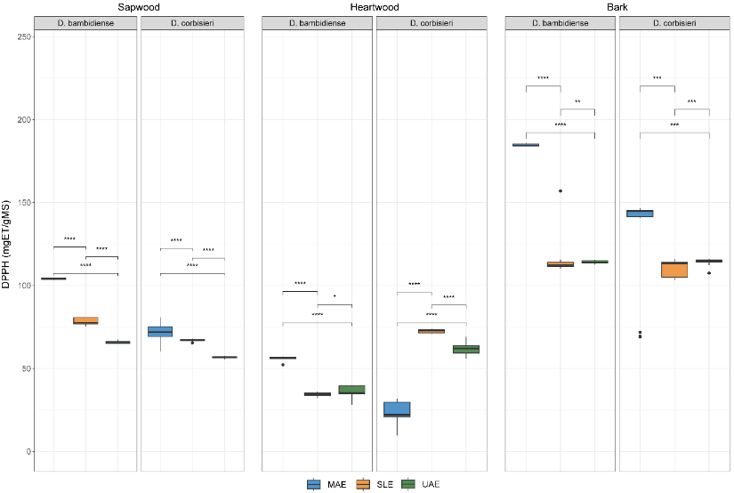
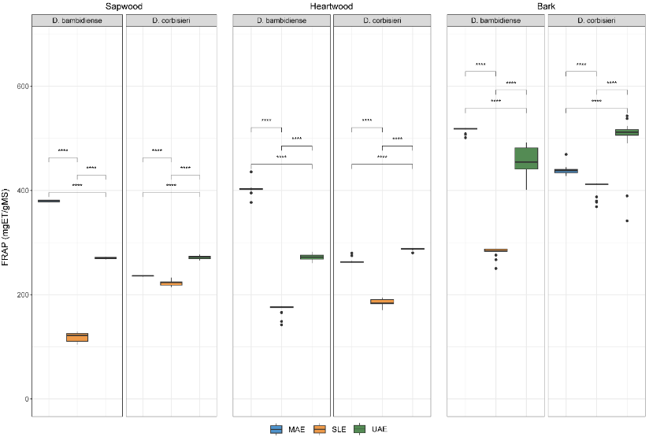
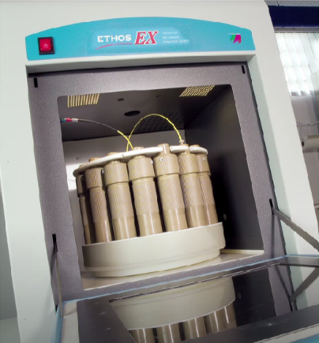
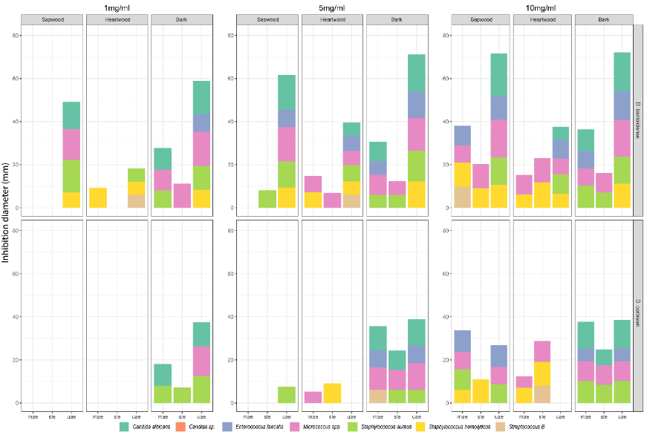
ATIBT Forum 2024 - Anvers
Impact of eco-extractives methods on the extraction of polyphenols and antioxidant and antimicrobial activities from Dialium waste wood and barks
Gaël Bibang Bengono^{1,2,3}, Robin Doucet¹, Alain Souza³, Jean-Fabrice Yala³, Jean-Louis Doucet¹, Aurore Richel²
¹Forest Is Life, TERRA Teaching and Research Centre, Gembloux Agro-Bio Tech, University of Liege, B-5030 Gembloux, Belgium
²Laboratory of Biomass and Green Technologies, Université de Liège - Gembloux Agro-Bio Tech, Passage des Déportés 2, B-5030 Gembloux, Belgium
³Electrophysiology-Pharmacology Laboratory, Agrobiology Research Unit, Masuku University of Science and Technology, Franceville B-901, Gabon
Email: gael.bibangbengono@doct.uliege.be
Abstract
Antimicrobial activities
Results
Although several wood compartments showed no inhibition on some of the microbial strains irrespective of the extraction method, e.g. Dialium corbiersi sapwood and heartwood at 1mg/ml (Figure 7), the largest inhibition diameters were obtained from Dialium bambidiense sapwood extracts at 10mg/ml by ultrasound on Candida albicans and Micrococcus spp. 18.17±1.34 mm and 17.23±0.881 mm.
Species of the genus Dialium, in the subfamily Dialoideae, are known to have high medicinal and nutritional value. This study examines the potential health benefits of waste products obtained by eco-extraction methods from the wood and bark of Dialium species from the Congo Basin. The focus is on the identification and quantification of polyphenols and the assessment of their antioxidant and antimicrobial effects. The results showed significant levels of catechin, epicatechin and salicylic acid using high-performance liquid chromatography (HPLC UV-Vis) analytical techniques. The antioxidant potential of the extracts obtained is assessed by tests targeting their ability to scavenge free radicals (DPPH) and reduce ferric oxide (FRAP), thereby inhibiting oxidative damage. This information provides an insight into the potential health benefits of eco-extracted waste. A correlative study looked at which polyphenols were likely to have certain antioxidant and antimicrobial activities.
Ultimately, Dialium corbisieri and Dialium bambidense by-products from wood processing industries in the Congo Basin countries can be considered as interesting materials for the extraction and recovery of natural polyphenols, particularly thanks to the high salicylic acid content present in the wood.
Enterococcus faecalis
Staphylococcus aureus
Staphylococcus hemolytic
Streptococcus B
Micrococcus spp.
Escherichia coli
Enterobacter cloacae
Klebsiella pneumoniae
Salmonella enterica
Pseudomonas aeruginosa
Candida albicans
Candida sp.
Extraction yields, total polyphenols content and total condensed tannin
a
b
c
A total of 12 strains were available for antimicrobial testing: five Gram + strains, five Gram - strains and two yeasts.
The germs used were frequently isolated from the various pathologies found in medical environments.
Methodology
Figure 2: variation according to extraction methods of extraction yields (%), total phenol content (mgEG/gMS) and total condensed tannin (mgEC/gMS)
Correlative study
Extractions
Extractions were carried out using a water-ethanol solution (30-70). The solid-liquid ratio was 3:60 for all extractions.
The results obtained for dry matter content, total phenolic compounds and condensed tannins show that all these contents are significantly higher for the ultrasound-assisted and microwave-assisted extraction methods. This implies a significant impact of the eco-extraction methods used in the present work for the determination of dry matter, phenolic compound and condensed tannin contents.
Considering all the essays, regardless of the different factors (species, plant tissue, and extraction method), TTC seems to correlate better with antioxidant activity (Figure 8) than TPC.
The TPC seems to be better correlated with microorganism activities with a good correlation with Candida albicans, Enterococcus faecalis, and Staphylococcus aureus (0.50, 0.44, and 0.59 respectively).
Examination of Figure 10 shows that there isn’t much correlation between the absorbance intensity of the chromatograms before 20 min retention time, i.e., with the first large peaks observed in all chromatograms. After this threshold, different patterns can be observed for each of the assays. Indeed, the retention times to which the absorbance intensity and the DPPH are correlated are globally different from those of the FRAP. This observation is also valid for anti-microorganism activities.
By comparing the absorption intensities with the HPLC-UV chromatograms, it was possible to correlate the biological activities of four identified compounds (catechin (RT=23.735); syringic acid (RT=26.891); benzoic acid (RT=28.604); salicylic acid (RT=29.527)): Catechin and benzoic acid could contribute positively to the inhibition of Staphylococcus aureus while salicylic acid and syringic acid could contribute positively to free radical scavenging antioxidant activities. However, salicylic acid could also contribute positively to antioxidant activities linked to iron (Fe2+) reduction.
Solid-liquid Extraction
65°C, 30 min, 160 RPM
HPLC-UV analysis
Microwave-assisted extraction
65°C, 15 min, 800 W
Materials
Ultrasonic assisted extraction
65°C, 9 min, 59.1 W/cm ²
Plant material
All the plant material was ground to a fine particle size of 0.5 mm using a Frich.
Obtaining fine particles
Omvong logs obtained Cut into 5x15 cm pieces Pieces of 5x15 cm Fine particles available for extraction Extracts available for extraction
from CEB Precious Wood Sawing with a tungsten blade and pulverization
into fine 0.5mm particles using a Fritch GmbH
universal knife mill.
Total phenolic content (TPC), total tannin condensed (TTC) and HPLC UV-Vis analysis
The total phenol content was quantified by the Folin-Ciocalteu method according to (McDonald and al., 2001). For this purpose, a calibration curve of gallic acid (for TPC) and catechin (for TTC) was established in g/L; in ethanol: water (75:25, v/v).
Figure 3: Average HPLC UV-Vis chromatogram for each extraction method and phenolic compounds identified in the different plant tissues for each species.
UV-Vis HPLC analysis identified six specific polyphenols out of the twenty-nine standards tested. Quantification of three of these showed that the highest levels of catechin, epicatechin and salicylic acid were respectively obtained from ultrasound-assisted extraction of Dialium bambidense bark, 875 (±41.6) mg/g DM, microwave-assisted extraction from Dialium corbisieri bark 11.93 (±2.72) mg/g DM, microwave-assisted extraction from Dialium bambidense sapwood 25.528 (±1.92) mg/g DM. While catechin and epicatechin levels were relatively higher in the bark, salicylic acid levels were more concentrated in the sapwood of the two species studied.
Syringic acid
Epicatechin
Salicylic acid
Benzoic acid
Figure 6: Identification of compounds influencing biological activities
Chemicals and reagents
All the plant material was ground to a fine particle size of 0.5 The reagents used for the extractions, the determination of total polyphenol and tannin content, and for the studies of antioxidant activity and antimicrobial effects are as follows: 96% (v/v) ethanol used to prepare the 70% solutions and Na2 CO3, purchased from . The 96% (v/v) ethanol used to prepare the 70% solutions and the Na2 CO3, Gallic acid, 2,2-diphenyl-1-picrylhydrazyl (DPPH), Ferric Reducting Antioxidant Power (FRAP), skin powder and pyrogallol purchased from Sigma-Aldrich (Chemie GmbH, Steinheim, Germany) and Folin-Ciocalteu reagent, Buffer solution, sodium acetate trihydrate, hydrochloric acid, TPTZ (2,4,6-tripyridyl-s-triazine).
Benzoic acid
Cafeic acid
a
Antioxidant activity
a
b
b
Figure 4: results of the measurement of antioxidant activities by the DPPH (a) and FRAP (b) methods
Conclusion and perspectives
Extraction
(SLE) chamber equipped
with a rotary table
(SLE) (MAE) Milestone Ethos EX microwave extraction system with
of 0 to 80 DB. Variable impact power up to 2400 w. Voltage 230 V/ max 1A
(UAE) For ultrasound-assisted extraction we used the Sonifer SFX250 Power supply, 20 kHz converter,
1.27 cm (0.5 in) threaded horn, power cord, manual, set of keys.
All plant tissues were significantly different in pairs (p<0.001). The highest median DPPH value was observed in D. sp. nov. bark extracts obtained by MAE (185 ± 0.8 mgET/gMS) while the highest median FRAP value was measured in D. sp. nov. bark extract obtained by MAE (519 ± 1 mgET/gMS).
The screening of compounds present in the wood and bark identified six phenolic compounds in Dialium. A comparison of the extraction methods shows that the use of microwaves and ultrasound not only provides a better extraction rate but also greater availability of bioactive compounds, leading to better biological activities. Because of the better yields obtained in a short time (9 min), ultrasound-assisted extraction appears to be the most optimal of the three methods used in this study. The wide availability of salicylic acid in particular, and of catechins and epicatechins in general, in wood shows the great interest that could be generated by using this waste in processing plants. However, although the HPLC UV-Vis analysis method represents a high-performance method, it has its limitations, linked for example to the mass of the compounds, and it would be wiser to confirm the presence of these compounds using even more high-performance methods such as UPLC MS/MS or NMR.
Figure 1: Method for identifying and quantifying polyphenols: absorption spectra (at 254 nm) of standards molecular (a) and there corresponding identifications in the sapwood extractives (EAU) of Dialium polyanthum (b)
A_{xéch}= k_{x}.C_{xéch}.V_{injx}
C_{xéch}= (A_{xéch}. C_{xétal})/ A_{xétal}
Axéch= area pic compound in the sample
Axétal= area pic compound in the standard
C_{xéch= concentration of sample}
Cxétal= concentration of standard
V_{injx= volume injected}
K_{x= constant}
Antimicrobial activity
Biological activities
Antioxidant activities were measured using free radical scavenging (DPPH: 2,2-diphenyl-1-picrylhydrazyl) and ferric oxide reduction (FRAP: Ferric Reducing Antioxidant Power Assay) methods. While antimicrobial activities on five strains of gram- bacteria, five strains of gram+ bacteria and two yeasts were obtained from the 1% Mueller Hinton (MH) agar well method.
Figure 5 Average microorganism inhibition, expressed in inhibition diameter (mm), according to different dry extract concentrations (1 mg/ml, 5mg/ml, 10 mg/ml)

