Slide 1






Enhancing trust through procedural regulation
(or ‘I trust you because you give me access to explanations and evidence’)
Ljupcho Grozdanovski
FNRS/U.Liège
lgrozdanovski@uliege.be

Slide 2




Knowability of Discrimination and access(ibility) to evidence
Supreme Court of Wisconsin, 13 July 2016 (decided), State of Wisconsin v. Eric L. Loomis, 881 N.W. 2d 749 (2016) 2016 WI 68
Superior Court of New Jersey (Appellate Division), 2 February 2021, State of New Jersey v. Corey Pickett, Docket N° A-4207-19T4.
37a VARA CÍVEL DO FORO CENTRAL DA COMARCA E CAPITAL DO ESTADO DE SÃO PAULO, 1090663-42.2018.8.26.0100

Slide 3
Proving harm & causation
Key questions:
Are there procedural rights that litigants can rely on to access pre-trial knowledge regarding harm and causation?
Can litigants effectively prove harm and causation in view of receiving compensation for the harm suffered?

Slide 4

Access to evidence
PLD
Rec. 42: It is therefore necessary to facilitate claimants’ access to evidence to be used in legal proceedings. Such evidence includes documents that have to be created ex novo by the defendant by compiling or classifying the available evidence. In assessing the request for disclosure of evidence, national courts should ensure that such access is limited to that which is necessary and proportionate, inter alia, to avoid non-specific searches for information that is not relevant to the proceedings and to protect confidential information, such as information falling within the scope of legal professional privilege and trade secrets in accordance with Union and national law, in particular Directive (EU) 2016/943 of the European Parliament and of the Council. Taking into consideration the complexity of certain types of evidence, for example evidence relating to digital products, it should be possible for national courts to require such evidence to be presented in an easily accessible and easily understandable manner, subject to certain conditions.
Goal: Enhancing the procedural abilities of litigants (to prove harm and causation
Presumpitons

Slide 5




GDPR
Q. 1: Are there procedural rights that litigants can rely on to access pre-trial knowledge regarding harm and causation?
AIA
PLD
EX -
- PLA -
- NA -
- TION
= access to pre-trial knowledge?
Lex Specialis

Slide 6
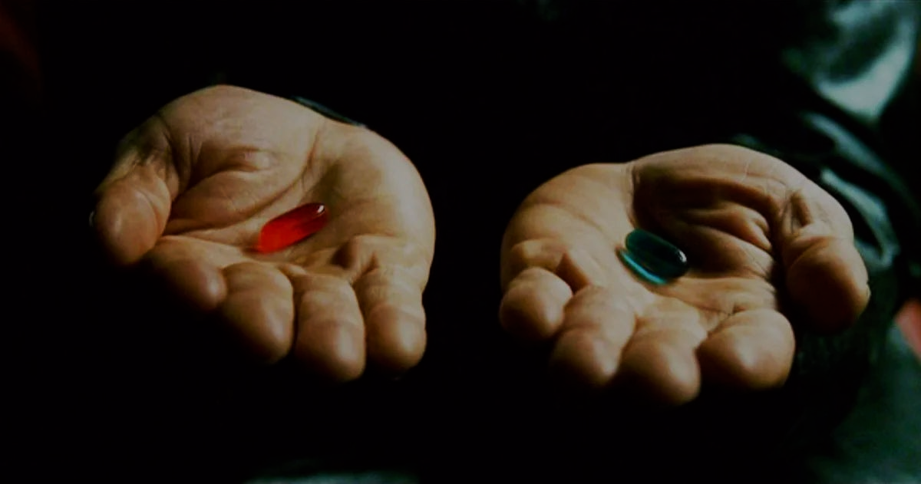
Article 86 AIA / Article 22 GDPR
(when personal data is processed by high-risk AI systems)

Slide 7

Conditions for application
1° presence of ‘automated processing’ (quid?)
2° legal or significantly similar effects (quid?)
Article 22(1) GDPR
Scope of explanation
1° Ad hoc (AI funcitonalities, intended use)
2° Post hoc (effect and rationale of output)
Cf. Wachter et al. “Why a right to explanation of automated decision-making does not exist in the General Data Protection Regulation”, 2 International Data Privacy Law (2017), 1 -25.

Slide 8

Conditions for application
Explainer is a deployer of high-risk AI
human decision based on AI output
decision produces legal ‘or similarly significant’ effects on a person’s situation
impact on health, safety and/or fundamental rights
Article 86 AIA
Scope of explanation
Clear and meaningful explanations on the role of the AI system in the decision-making procedure and the main elements of the decision taken

Slide 9

Article 86 AIA, lex specialis to Article 22 GDPR?
Perhaps
(…provided the defendant is deployer of a high-risk AI system)

Slide 10

Article 86 AIA ‘antechamber’ to Article 9 PLD?
Perhaps
(…provided the defendant is deployer of a high-risk AI system)

Slide 11
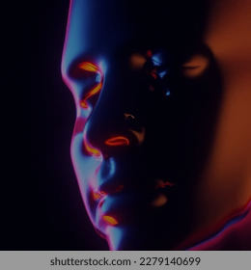
Q. 2: Can litigants effectively prove harm and causation in view of receiving compensation for the harm suffered?
Article 86 AIA / Article 9 PLD

Slide 12
Article 86 AIA / Article 9 PLD
Para. 1. Member States shall ensure that national courts are empowered, upon request of an injured person claiming compensation for damage caused by a defective product (‘the claimant’) who has presented facts and evidence sufficient to support the plausibility of the claim for compensation, to order the defendant to disclose relevant evidence that is at its disposal.

Slide 13
Article 86 AIA / Article 9 PLD
Para. 2. Member States shall ensure that, at the request of a defendant that has presented facts and evidence sufficient to demonstrate the defendant’s need for evidence for the purposes of countering a claim for compensation, the claimant is required, in accordance with national law, to disclose relevant evidence that is at the claimant’s disposal.
Par. 3: Member States shall ensure that the disclosure of evidence pursuant to paragraphs 1 and 2, and in accordance with national law, is limited to what is necessary and proportionate.

Slide 14
Article 10 PLD (Burden of proof)
Probandum
Defectiveness, damage and causal link between the two
Presumptions
1. Presumption of defectiveness:
defendant’s failure to disclose evidence;
the product’s non-compliance with mandatory product safety regulation
harm is casued by an obvious malfunciton
2. Presumption of causality
Product is defective
Damage is typically consistent with the defect concerned
3. Presumption of defectiveness and / or causality
-scientific complexity hinders the proof of defectiveness, harm or both.
- claimant proves likelihood of defect and / or of causality

Slide 15
… but from the vantage point of effectiveness (of the right to access relevant information)
Art. 6 PLD
‘damage’ means material losses resulting from:
(a) death or personal injury, including medically recognised harm to psychological health;
(b) harm to, or destruction of, any property, except:
(i) the defective product itself;
(ii) a product damaged by a defective component of that product;
(iii) property used exclusively for professional purposes.
c) Destruction or corruption of data not used for professional purposes

Slide 16

Art. 22 GDPR
THE ‘PANTHEON’ OF RIGHT(S) TO
INFORMATION, A FACTOR FOR ENHANCED TRUST?
Art. 86 AIA
Art. 8 PLD

