Slide 1


Hereditary Transthyretin Amyloïdosis:
Diagnostic and pitfalls
Société Marocaine de Neurophysiologie Clinique (SMNPH) 2024
Docteur Manon Hustinx
Service Universitaire Neurologie- Centre de Référence des Maladies Neuromusculaires (CRMN)
Liège, Belgium

Slide 2
Disclosures
Sponsoring or research funds : No
Fees or other financial remunerations : WMS
Shareholder : No

Slide 3
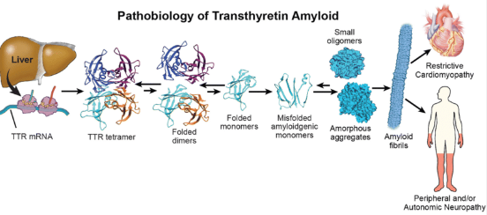
Reminder

Slide 4
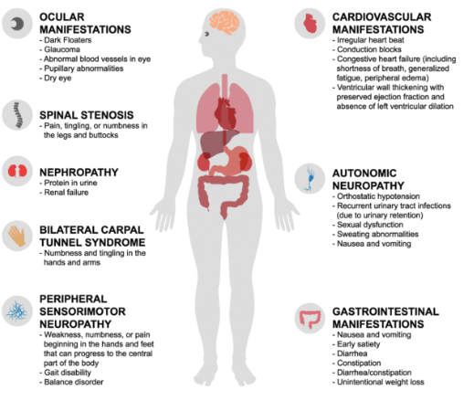
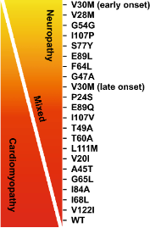
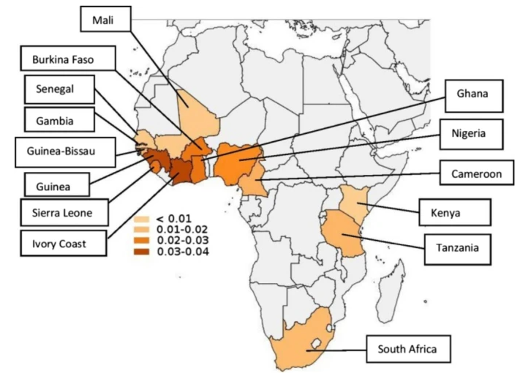
Reminder
Multisystemic disease
Autosomic Dominant
>140 mutations in TTR
Phenotype variability
Africa: V122I (5%)
Fatal disease (life expectancy 3-15 years)
Notes:
V30Met : Portugal, Bresil, Suede, Japon
https://bmcglobalpublichealth.biomedcentral.com/articles/10.1186/s44263-023-00016-3
Substitution valine par isoleucine

Slide 5

Our role?

Slide 6

Case 1
Neuropathy?
Nerve | Distal Motor Latency (ms) | Distal Amplitude (mV) | Proximal Amplitude (mV) | Conduction Velocity (m/s)
R Peroneal | 4,3 (<5) | 3,5 (>3) | 3,4 (>3) | 40 (>40)
R Tibial | 4,5 (<5,5) | 6,1 (>6) | -- | --
R Sural | -- | 17 (>10) | -- | 40 (>40)
R Superf Peroneal | -- | 11 (>10) | -- | 40 (>40)
R Median Motor | 3,7 (<3,8) | 8,1 (>6) | 8,1 (>6) | 51 (>50)
R Median Sens | -- | 36 (>15) | -- | 50 (>50)
R Ulnar Motor | 2,8 (<3,2) | 7,3 (>6) | 7,3 (>6) | 50 (>50)
R Ulnar Sens | -- | 12 (>8) | -- | 50 (>50)

Slide 7
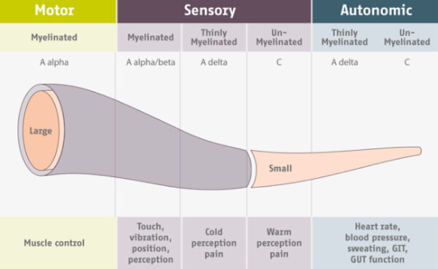
Small fibres?

Slide 8
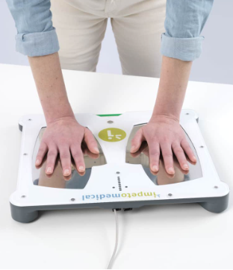
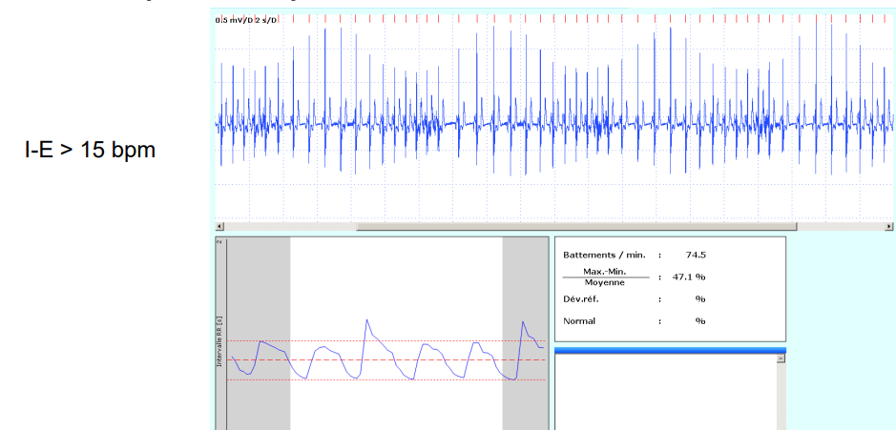
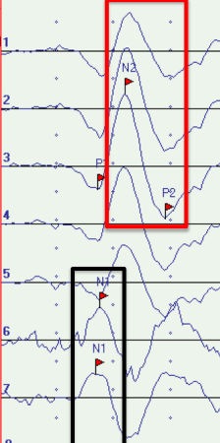
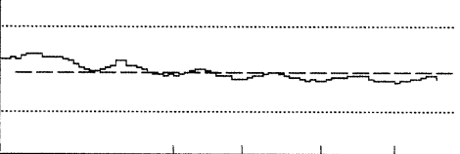
Assessment of small fibres
Sudoscan
Laser Evoked Potentials
Sympathetic skin response (SSR)
Quantitative Sensory Testing (QST)
RR interval
Skin biopsy
…
Notes:
- l;innervation sympathique des glandes sudoripares est de mesurer la conductance électrochimique cutanée
-
-fibres cholinergiques du système nerveux orthosympathique responsables de l;innervation des glandes sudoripares.
- Seuil de détection au froid et à la douleur
-système nerveux parasympathique via la variabilité de la fréquence cardiaque physiologique au repos, à la respiration profonde et à la manœuvre de Valsalva.

Slide 9
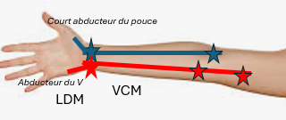
Case 2
Carpal Tunnel Syndrome (CTS) ?
Bilateral surgery
Accountant
Renal Impairment, No diabetes
Nerve | Distal Motor Latency (ms) | Distal Amplitude (mV) | Proximal Amplitude (mV) | Conduction Velocity (m/s)
R Median Motor | 5,1 (<3,8) | 4,8 (>6) | 4,8 | 50 (>50)
L Median Motor | 4,8 (<3,8) | 5,3 (>6) | 5,3 | 50 (>50)
R Median Sens | -- | 9 (>15) | -- | 28 (>50)
Left Median Sens | -- | 11 (>15) | -- | 36 (>50)
R Ulnar Motor | 2,8 (<3,2) | 6,5 (>6) | 6,4 | 50 (>50)
L Ulnar Motor | 2,7 (<3,2) | 6,6 (>6) | 6,6 | 50 (>50)
R Ulnar Sens | -- | 11 (>8) | -- | 50 (>50)
L Ulnar Sens | -- | 8 (>8) | -- | 50 (>50)

Slide 10

CTS - hATTR
Most frequent entrapment neuropathy in upper limbs: prevalence between 2,7 - 5%
→ Contributing factors: obesity, hypothyroidism, diabetes, rheumatoid arthritis, pregnancy
Prevalence of CTS among hATTR between 15 - 62%
→ Greater association in older men (SIR 13,08 in hATTR men between 70 and 79 years >< 6,4 younger men >< absent in women
Initial symptom?
→ p.Leu78His, p.Leu78Arg, p.Lys90Asn, p.Ile104Ser, p.Ile127Val, p.Tyr134His
Higher risk of cardiac involvement (PPV 92,0%)
→ 5 and 9 years after onset
Aus dem Siepen, F. et al. Carpal tunnel syndrome and spinal canal stenosis: harbingers of transthyretin amyloid cardiomyopathy? Clin. Res. Cardiol. 108, 1324–1330 (2019).
Milandri, A. et al. Carpal tunnel syndrome in cardiac amyloidosis: implications for early diagnosis and prognostic role across the spectrum of aetiologies. Eur. J. Heart Fail. 22, 507–515 (2020).
Finsterer, J. et al. Hereditary transthyretin-related amyloidosis. Acta Neurol. Scand. 139, 92–105 (2019).
Notes:
Sir= standardized incidence ratio
Algorythme
Portugal, japon, suisse, bresil
Opacites vitrees, glaucome

Slide 11
Case 3
Walking difficulties
Nerve | Distal Motor Latency (ms) | Distal Amplitude (mV) | Proximal Amplitude (mV) | Conduction Velocity (m/s)
R Peroneal | 4,3 (<5) | 0,9 (>3) | 0,9 (<3) | 28 (>40)
R Tibial | 4,5 (<5,5) | 1,7 (>6) | -- | --
R Sural | -- | NR (>10) | -- | NR (>40)
R Superf Peroneal | -- | NR (>10) | -- | NR (>40)
R Median Motor | 5,1 (<3,8) | 3,9 (>6) | 3,8 (>6) | 37 (>50)
Ulnaire mot D | 3,6 (<3,2) | 5,6 (>6) | 5,6 (<6) | 45 (>50)
Médian sens D | -- | 3 (>15) | -- | 31 (>50)
Ulnaire sens D | -- | 6 (>8) | -- | 45 (>50)

Slide 12
« Axonal and Demyelinating Sensitive and Motor Neuropathy»
Abnormal resting activity
Worsening of axonal loss over a year
Blood results -
CSF proteins >0,5g/l
Pet-CT scan -
→ Steroids : No clinical improvement

Slide 13
Large fibres neuropathies - hATTR
Typical neuropathy : length-dependent sensorimotor axonal polyneuropathy
→ Aspecific: diabetes, toxic, vitamin deficiency…
→ Rapid evolution, idiopathic, RED FLAGS
Most frequent initial diagnosis: Chronic Inflammatory Demyelinating Polyradiculopathy (CIDP)
→ up to 61% depending on the studies
→ mildly elevated CSF proteins < 1g/l
→ Neuropathic pain, no ataxia, dysautonomia
→ No response to treatment
Rarely, SLA-like presentations (1%)
Adams, D. et al. Expert consensus recommendations to improve diagnosis of ATTR amyloidosis with polyneuropathy. J. Neurol. 268, 2109–2122 (2021).
Conceição, I. et al. ‘Red-flag’ symptom clusters in transthyretin familial amyloid polyneuropathy. J. Peripher. Nerv. Syst. 21, 5–9 (2016).
Lozeron, P. et al. Transthyretin amyloid polyneuropathies mimicking a demyelinating polyneuropathy. Neurology 91, e143–e152 (2018).
Sekijima, Y. et al. Diagnosis and management of transthyretin familial amyloid polyneuropathy in Japan: red-flag symptom clusters and treatment algorithm. Orphanet J. Rare Dis. 13, 6 (2018).

Slide 14
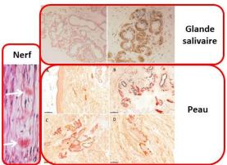
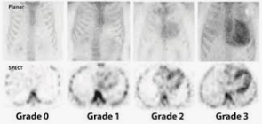
Diagnostic
Molecular diagnosis (TTR)
Biopsies: salivary gland, abdominal fat, skin, nerves, kidneys, myocardium…
→ Low sensitivity, invasive
Bone scintigraphy 99mTc-DPD, 99mTc-PYP, or 99mTc-HMDP (Perugini Score>/=2)
→ Low specificity
Free light chains in plasma/urine, NT-proBNP, renal function tests
Ophtalmological assessment
Cardiac assessment: concentric ventricular hypertrophy >< low voltage ECG
Notes:
Fat : 50%, salivary 75-90%, nerve 80% : https://www.ncbi.nlm.nih.gov/pmc/articles/PMC7692609/
coloration rouge Congo et une biréfringence verte au microscope en lumière polarisée. Il faut typer biochimiquement l’amylose par immunomarquage anti-TTR
3 transthyretin senile ou héréditaire, 1 = AL : https://www.openaccessjournals.com/articles/cardiac-amyloidosis-revealed-by-bone-scintigraphy-12280.html

Slide 15
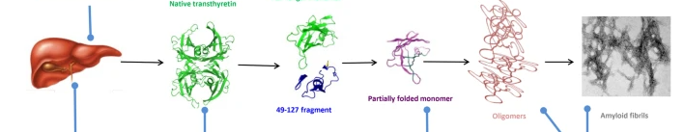
Treatments
TTR synthesis suppression
1) RNA silencing
siRNA:
Patisiran
Vutrisiran
ASO:
Inotersen
Eplontersen
2) Gene editing
- CRISPR-Cas9
TTR stabilizer
Tafamidis
Diflunisal
Acoramidis
Elimination of amyloid deposits
PRX004
NI006

Slide 16


Take home messages
Sensitive symptoms >< normal ENMG
→ Small fibres
CTS
→ bilateral, reoccuring, no contributing factors, RED FLAGS
CIDP
→ No response to treatment
→ Targeted questions
→ Collaboration with surgeons, PMR

Slide 17





Thank you !
mhustinx@citadelle.be

