Slide 1
Pompe disease
Manon Hustinx, MD
CRMN de Liège
15/11/2025

Slide 2
Disclosures
I received a speaking fee for this symposium by Amicus.

Slide 3
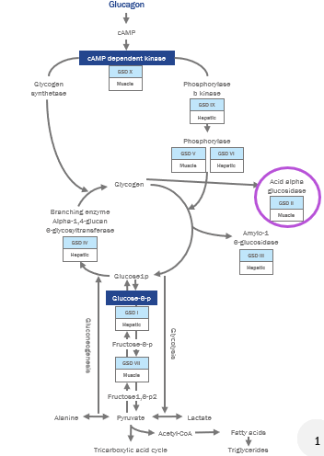
Glycogen storage disease : defect in the alpha-glucosidase enzyme -> excessive glycogen storage in lysosomes and defects in autophagy
=Glycogen storage disease type II or acid maltase deficiency
Recessive mutations in the GAA gene
Over 300 different mutations
Prevalence: 1-9:100,000; rare disease²
Kishnani PS, et al. Genet Med. 2006;8(5):267-288.
Orpha.net. Glycogen storage disease due to acidmaltase deficiency; ORPHA:365; 2023.

Slide 4
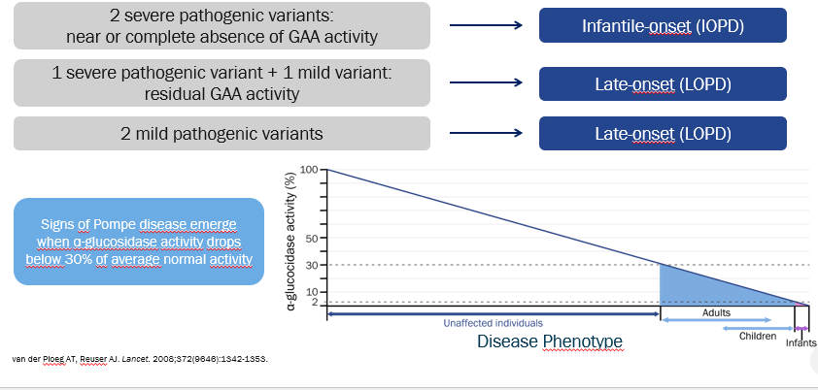
Genotype-Phenotype correlation

Slide 5
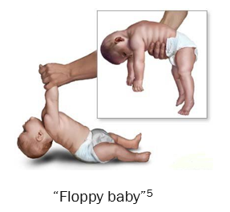
Two clinical phenotypes
Infantile form IOPD
Onset <1y¹
Generalized muscle weakness, hypotonia → Floppy infant²
Multisystemic diease with:
Rapidly progressive cardiac hypertrophy²
Hepatomegaly¹
Tongue hypertrophy³
Respiratory weakness²
Death <1 year (if untreated)³
Anderson CQ, et al. The Journal for Nurse Practitioners. 2020;16(6):442-446.
Hassnan ZA, et al. Orphanet J Rare Dis. 2022;17(1):388.
Kishnani PS, et al. Genet Med. 2006;8(5):267-288.

Slide 6
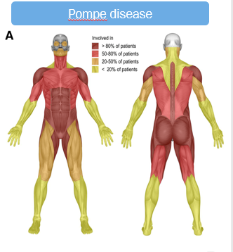
Two clinical phenotypes
Late-onset form LOPD
Onset >1y, infancy to late adulthood¹
Limb-girdle + axial weakness
Respiratory muscle weakness
Both²
Cardiac involvement is typically absent¹
¹Kishnani PS, et al. Genet Med. 2006;8(5):267-288.
²Winkel LP, et al. J Neurol. 2005;252(8):875-884.

Slide 7
-Waddling gait, falls¹
-Not able to run^{1,2}
-Difficulties climbing the stairs or rising from a chair/floor^{1,2}
-Gowers’ sign¹
-Difficulties raising arms above the head^{1,2}
-Scapular winging^{1,2}
-Weak axial muscles with back pain^{2,3}
-Scoliosis¹⁻³
-Dyspnea with efforts¹
-Orthopnea^{1,3}
-Hypoventilation³
-Frequent respiratory infections 3
-Weight loss¹
-Respiratory failure^{1,3}
Proximal weakness
Axial weakness
Respiratory symptoms
Unfamiliar patterns
Unilateral/asymmetrical ptosis⁴ (23%)
Facial muscle weakness⁴ (28%)
Rigid spine³
Dilative arteriopathy, basilar artery dolichoectasia, aneurysms⁵
Al Shehri A, et al. J Neuromuscul Dis. 2022;9(5):661-673.
Haaker G, et al. ScientificWorldJournal. 2014;2014;963861.
Kishnani PS, et al. Genet Med. 2006;8(5):267-288.
van der Beek NA, et al. Orphanet J Rare Dis. 2012;7:88.
Laforêt P, et al. Neurology. 2008 May 27;70(22):2063-6.
Notes:
Matinal headache, bad sleeping, feeling not rested in the morning, fatigue during the day

Slide 8
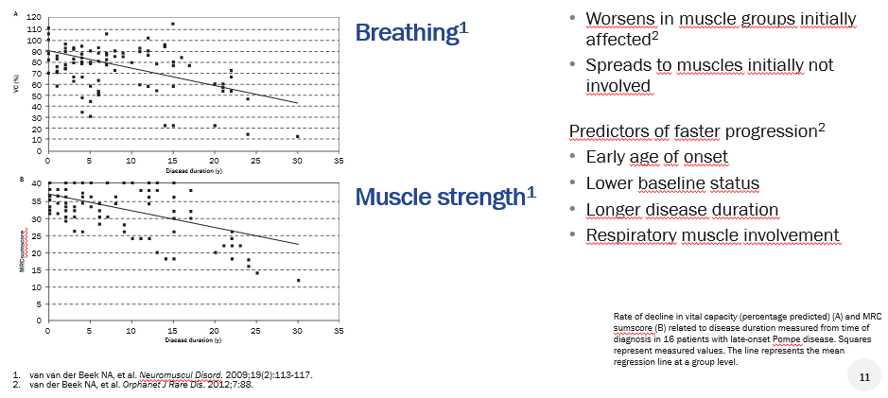
Natural progression

Slide 9
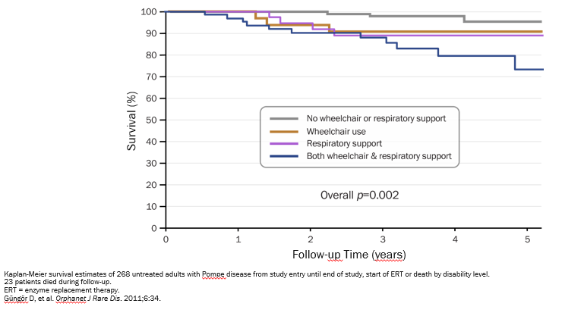
Natural progression

Slide 10
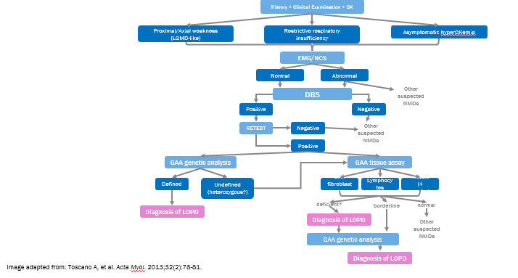
Diagnostic approach
Notes:
Skeletal muscle
(+

Slide 11
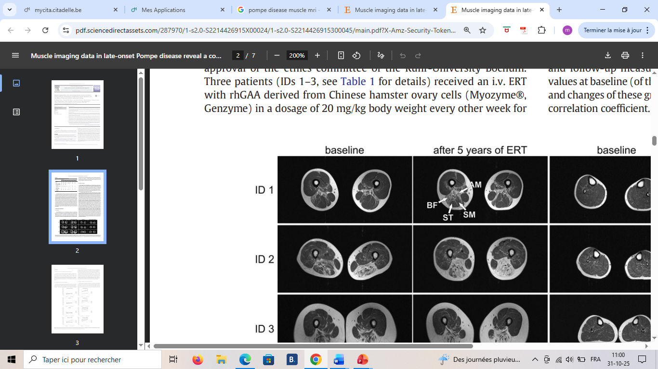
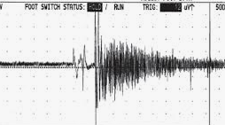
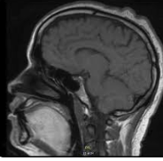
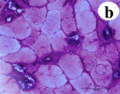
Diagnostic approach
CK
Normal or slightly elevated
<2000 U/L
Notes:
Bright tongue signal, subscapular, gluteus medius, adductor muscles

Slide 12
Clinical case
44y female
Referred by pneumologist : restrictive syndrome
Dyspnea, orthopnea
Proximal weakness: not able to carry her babies, dropping hairdrier, difficulties washing hair, not able to rise from floor, difficulties climbing stairs
Medical history
Ehlers-Danlos
Hypothyroidism
Diverticulitis
Right carotid artery dissection in 2019
Physical examination:
Waddling gait
Gower’s sign
Axial weakness
Moderate limb girdle weakness (MRC 4/5 in deltoids and psoas)
Right facial palsy
Tests
Normal CPK
ENMG: normal

Slide 13
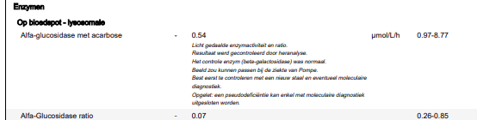
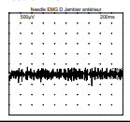
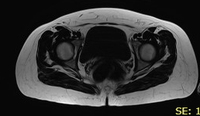
DBS
EMG
Muscle MRI

Slide 14
Take home messages
Glycogen storage disease
Autosomal recessive
IOPD - LOPD
LOPD : Proximal and/or axial weakness +/- respiratory involvement
DBS (+EMG, CK, muscle MRI)
Confirmation with genetic testing and tissue assay
Treatable disease

