Slide 1




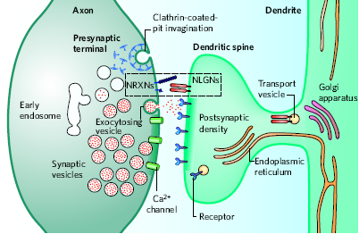
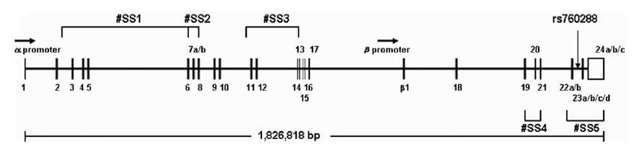
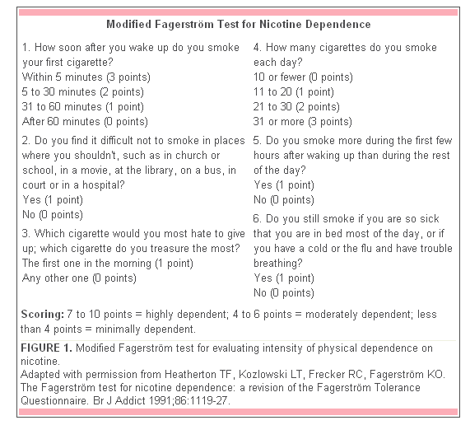
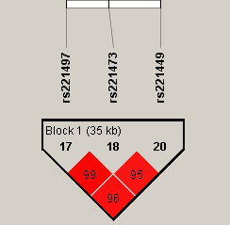
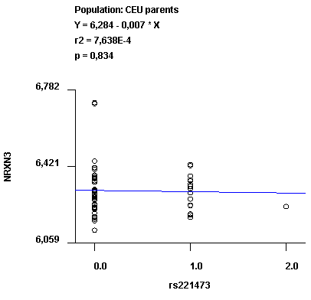

Association of Neurexin 3 (NRXN3) variants with nicotine dependence
Xavier Estivill¹, Monica Gratacos¹, Marta Ribases², Raquel Rabionet¹, Cristina Sanchez-Mora², Carles Arribas³, Sebastian Mora³, Magda Montfort³, Gemma Nieva⁴, Eugeni Bruguera⁴, Miquel Casas⁴ and Elisa Docampo¹
¹Genes and Disease Program, Center for Genomic Regulation (CRG-UPF), CIBER en Epidemiología y Salud Publica (CIBERESP), Barcelona
08003, Catalonia, Spain; ²Psychiatric Genetics Unit, Vall d'Hebron Research Institute (VHIR), Barcelona, Catalonia, Spain; ³Barcelona
Genotyping Node, CeGen-ISCIII, Barcelona, Catalonia, Spain;⁴Department of Psychiatry, Hospital Universitari Vall d’Hebron, Barcelona, Catalonia, Spain
INTRODUCTION
Nicotine dependence has been previously associated with Neurexin 1 gene, and prior studies on Neurexin 3 point towards its pivotal role in alcohol dependence, illegal substance abuse as well as in obesity.
There are three neurexin genes in humans. Neurexins are presynaptic transmembrane proteins that are essential for synapse development and function(Figure1) . Neurexin 3 (NRXN3) is in located in chromosome 14. Two promoters encode for α and β NRXN3;this, in addtion to five canonical sites of alternative splicing give raise to more that 1000 isoforms (Figure2) .
In order to evaluate the possible role of NRXN3 in nicotine dependence susceptibility, we evaluated tagSNPs and candidate SNPs located along the genomic region that contains the NRXN3 gene.
Figure 1: The structure of a excitatory synapse and locations of neurexins and neuroligins. (Image from Thomas C. Südof ,Nature 2008).
MATERIAL AND METHODS
Figure 2: Organisation of the human NRXN3 gene. α NRXN3 mRNA is transcribed from a promoter at the beginning of the gene, whereas β NRXN3 mRNA is transcribed from a promoter located between exons 17 and 21. NRXN3 also presents five canonical sites of alternative splicing (#SS) (Figure taken from Hishimoto et al Human molecular genetics 2007).
157 samples from smoker individuals and 1,439 controls were included.
Nicotine dependence was assessed by Fagerström index (Figure 3 )and the number of cigarettes smoked per day.
All participants were Spanish of Caucasian origin.
Based on the CEU HapMap genotyped SNPs, Tag SNPs covering the genomic region of NRXN3 (1,170 Kb) were selected.
Haploview software was forced to include potential functional variants located near splice sites as well as SNPs that had been previously associated with disease.
45 SNPs were finally included for genotyping with a Veracode assay (Illumina). 5% of the samples were duplicated, and six Hapmap trios and as well as negative controls were included.
Quality control and case-control association analyses were performed with PLINK software.
SNPs with a low genotyping rate (<95%), not fulfilling hardy-Weinberg equilibrium (p<0.05) and with a minimum allelle frequency lower than 5%, as well as samples with a low genotyping rate (<95%), ,were excluded from the association analysis.
Haplotype analysis was performed with SNPassoc package of R software.
Figure 3: Fagerström index.
*Nominal variable
7-10: highly dependent
4-6: moderately dependent
<4: minimally dependent
RESULTS
After quality control, 35 SNPs and 153 cases and 1,425 controls were included for the analyses. No mendelian errrors were detected and concordance was of 100%.
Allelic and genotypic (log-additive model) association test showed that four SNPs were nominally associated with a lower risk of being a smoker. Based on the linkage equilibrium (LD) of the region, we defined 10 blocks.
The haplotype analysis showed that one block of 35 Kb, and consisting of three of the significant SNPs in the single-SNP analysis, was also associated with lower risk of being a smoker (OR = 0.50 [0.31-0.80]; permuted P = 0.037) (Figure4). The three SNPs are located in an intronic region .
In order to evaluate possible association to level of addiction, we found no statistical significant association between Fagerström index (as a quantitative and a nominal variable)and the SNPs evaluated.
No correlations between SNP genotypes and expression levels was found as assessed by Genevar software (http://www.sanger.ac.uk/resources/software/genevar/) (Figure 5).
Evaluation of possible functional effects by the means of Pupasuite 3.1 (http://pupasuite.bioinfo.cipf.es/) (Figure 6) only showed rs221496 and rs221449 highly conserved in comparison with the mouse genome.
Figure 4: 35kb LD block defined by the three associated SNPs
Figure 5: No correlation was found betwween associated SNPs genotype (rs221473) as assessed by genevar software.
SNPeffect
SNPeffect structure (mutations affecting protein structure and dynamics)
SNPeffect processing (mutations affecting protein cellular processing)
SNPeffect functional (mutations affecting functional sites)
Transcription factor binding sites
Transfac TFBS
Jaspar TFBS
OregannoFilter TFBS
miRNA
miRNA sequences
miRNA targets
Promoter regions
Conserved regions
Structural properties
Splice created/disrupted
Exonic splicing enhancer/silences
CONCLUSIONS
Three SNPs located in a an intronic region of NRXN3 showed association with nicotine addiction.
They defined a block of 35 kb showing high conservation across species.
Replication in undergoing in another set of 276 nicotine addiction samples.
Figure 6: SNPs characteristics evaluated by Pupasuite analysis tool.
xavier.estivill@crg.cat
Supported by Generalitat de Catalunya

