Slide 1
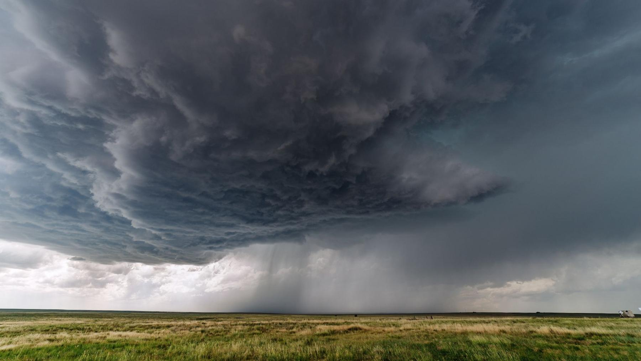


Past and future evolution of synoptic weather patterns leading to extreme precipitation events in Belgium.
Linking synoptic scale events to their local impacts.
EGU General Assembly 2025
02-05-2025
Josip BRAJKOVIC
Nicolas GHILAIN, Sébastien DOUTRELOUP & Xavier FETTWEIS

Slide 2
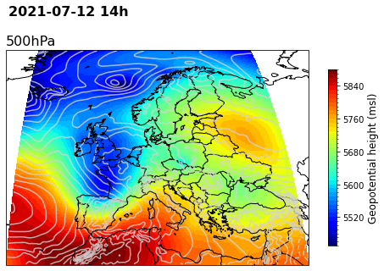
July 2021 Rainfall event
1/8

Slide 3
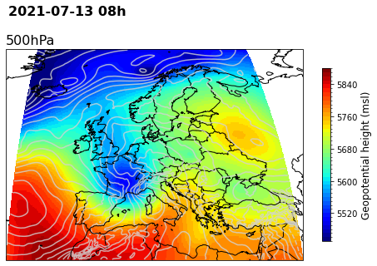
July 2021 Rainfall event
1/8

Slide 4
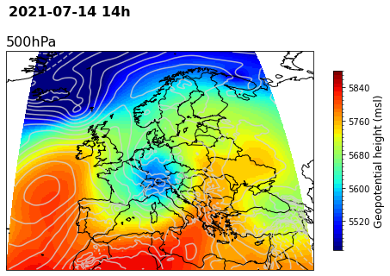
July 2021 Rainfall event
1/8

Slide 5
July 2021 Rainfall event
Cut-off Low
1/8

Slide 6
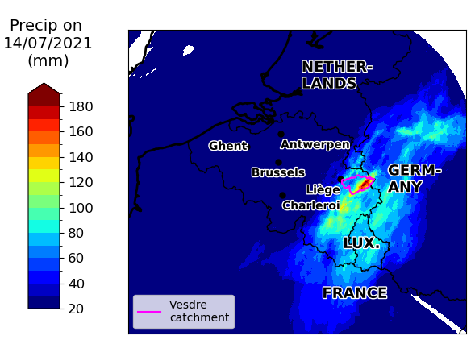
July 2021 Rainfall event
~10-15% of the annual rainfall
1/8

Slide 7
Are those systems impacting Belgium more frequently?
July 2021 Rainfall event
~10-15% of the annual rainfall
1/8

Slide 8
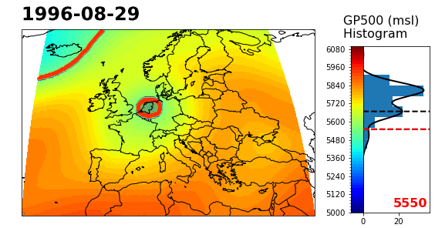
Detection of Cut-off Lows (COL)
2/8

Slide 9
Detection of Cut-off Lows (COL)
2/8

Slide 10
Detection of Cut-off Lows (COL)
2/8

Slide 11
Detection of Cut-off Lows (COL)
2/8

Slide 12
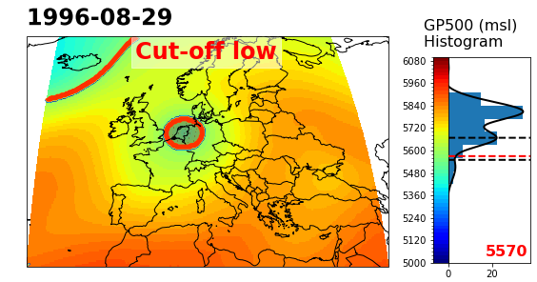
Detection of Cut-off Lows (COL)
2/8

Slide 13
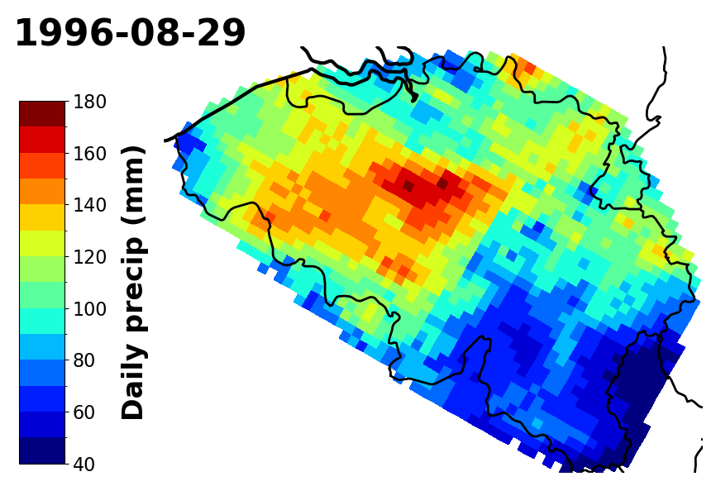
Detection of Cut-off Lows (COL)
Bias-adjusted RCM MAR
(Brajkovic et al., 2025 in prep.)
2/8

Slide 14
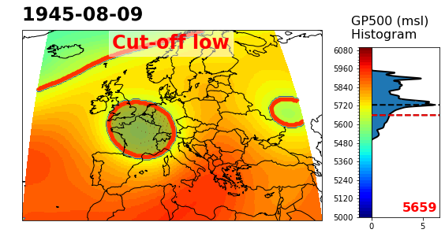
Some past COLs
3/8

Slide 15
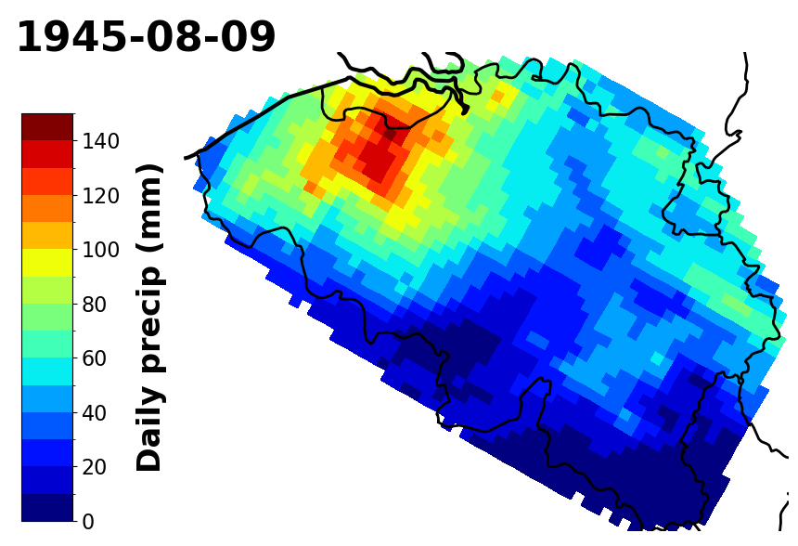
Some past COLs
3/8

Slide 16
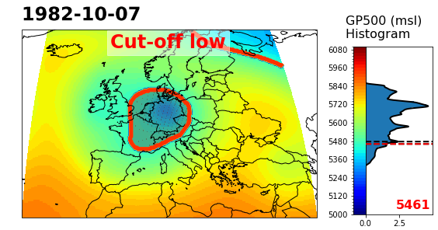
Some past COLs
3/8

Slide 17
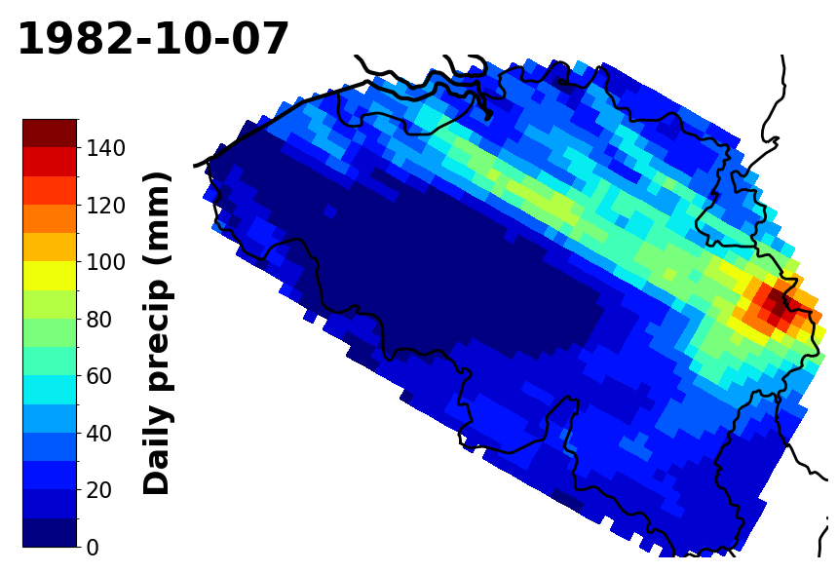
Some past COLs
3/8

Slide 18
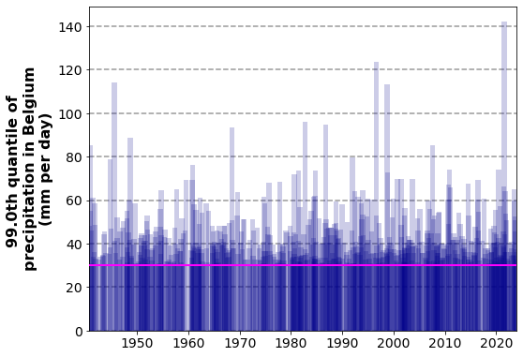
Evolution of COL occurrence (1940-2023)
4/8

Slide 19
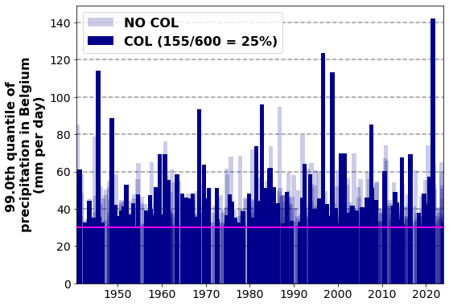
Evolution of COL occurrence (1940-2023)
4/8

Slide 20
Evolution of COL occurrence (1940-2023)
4/8

Slide 21
Evolution of COL occurrence (1940-2023)
4/8

Slide 22
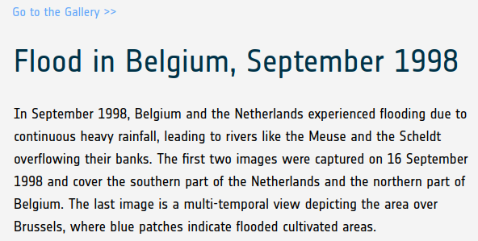
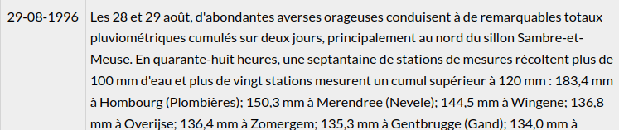
Evolution of COL occurrence (1940-2023)
(Flood in Belgium, September 1998 - Earth Online, n.d.)
(IRM - Inondations, n.d.)
4/8

Slide 23
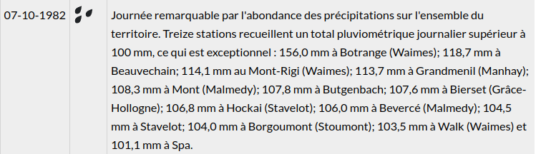
Evolution of COL occurrence (1940-2023)
(IRM - Inondations, n.d.)
4/8

Slide 24
Evolution of COL occurrence (1940-2023)
4/8

Slide 25
Evolution of COL occurrence (1940-2023)
4/8

Slide 26
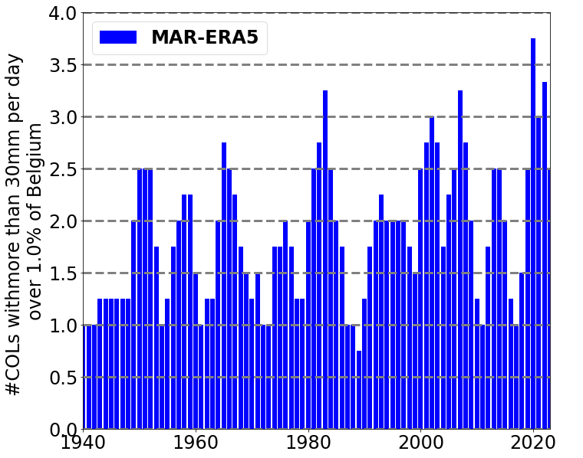
Evolution of COL occurrence (1940-2023)
5/8

Slide 27
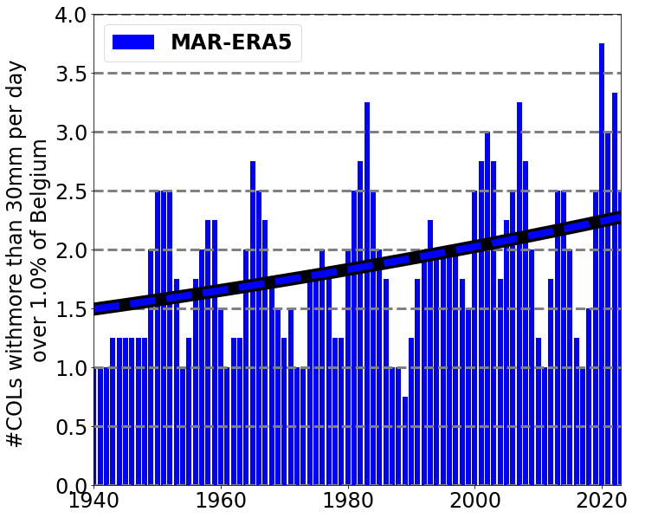
Evolution of COL occurrence (1940-2023)
5/8

Slide 28

Evolution of COL occurrence (1940-2023)
5/8

Slide 29
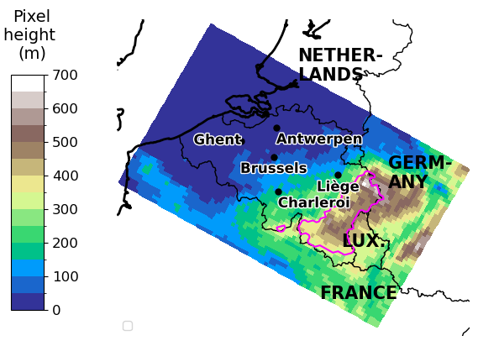
Local Effects
6/8

Slide 30
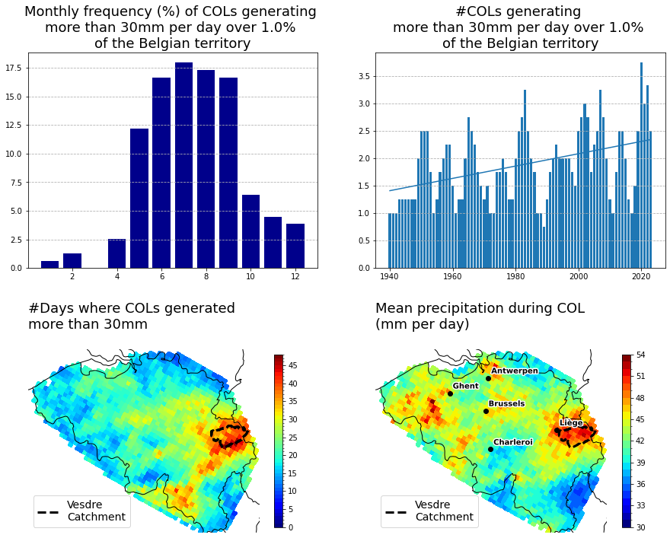
Local Effects
6/8

Slide 31
Local Effects
6/8
6/8

Slide 32
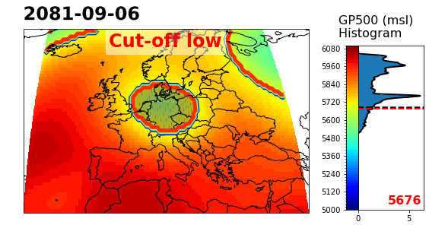
Using ESM (Earth System Model) Data
EC-Earth3-Veg
SSP5-8.5
7/8

Slide 33
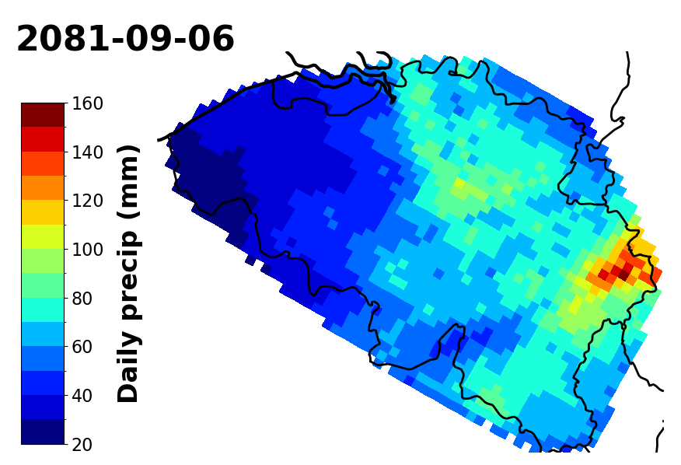
Using ESM (Earth System Model) Data
EC-Earth3-Veg
SSP5-8.5
7/8

Slide 34
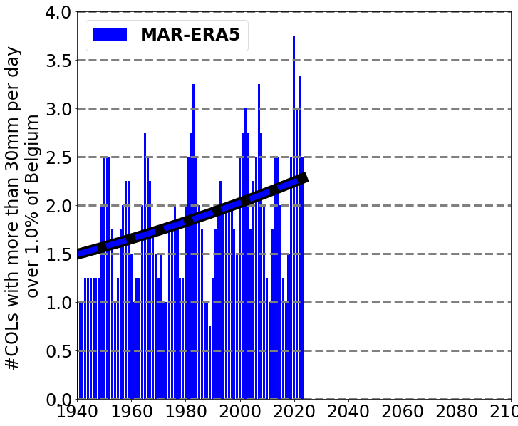
Using ESM (Earth System Model) Data
8/8

Slide 35
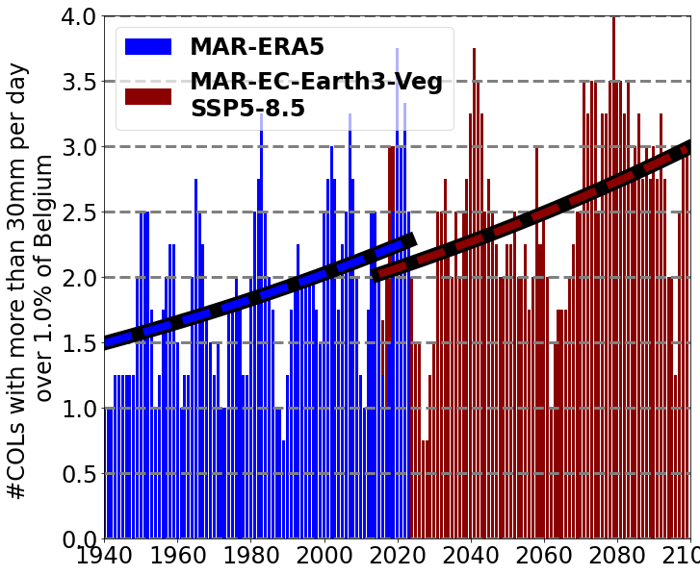
Using ESM (Earth System Model) Data
8/8

Slide 36
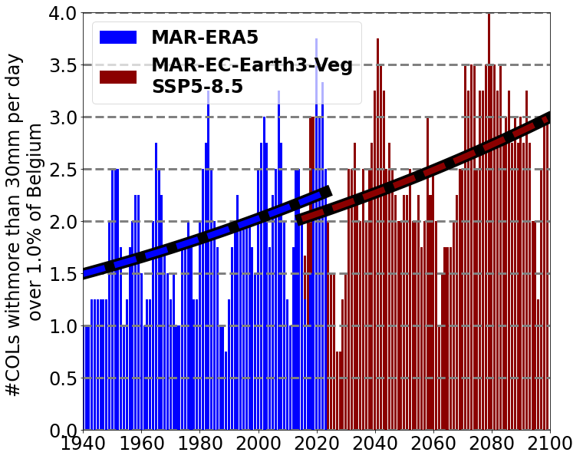

Using ESM (Earth System Model) Data
8/8

Slide 37
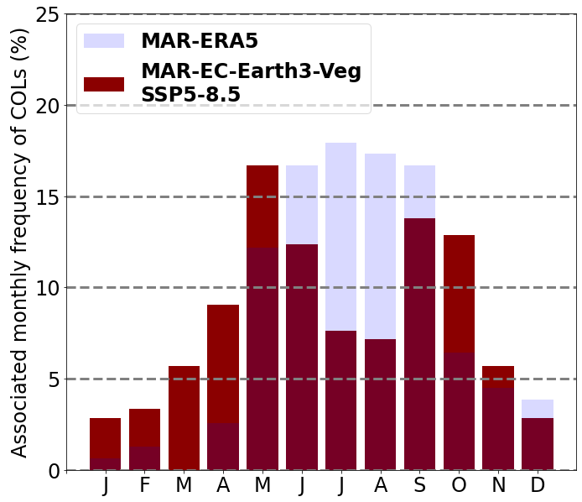
Using ESM (Earth System Model) Data
8/8

Slide 38
Increasing number of COLs in North-Western Europe (Thompson et al., 2024) due to more ample Jet-stream oscillation

Slide 39
Increasing number of COLs in North-Western Europe (Thompson et al., 2024) due to more ample Jet-stream oscillation
Increase in atmosphere moisture retention capacity (Brajkovic et al, 2025 in prep.)

Slide 40
Increasing number of COLs in North-Western Europe (Thompson et al., 2024) due to more ample Jet-stream oscillation
Increase in atmosphere moisture retention capacity (Brajkovic et al, 2025 in prep.)
Tool for discriminating performing models for specific areas

Slide 41


Increasing number of COLs in North-Western Europe (Thompson et al., 2024) due to more ample Jet-stream oscillation
Increase in atmosphere moisture retention capacity (Brajkovic et al, 2025 in prep.)
Tool for discriminating performing models for specific areas
Thank you all!
Josip BRAJKOVIC
Nicolas GHILAIN, Sébastien DOUTRELOUP & Xavier FETTWEIS

Slide 42
Appendix
Josip BRAJKOVIC
Nicolas GHILAIN, Sébastien DOUTRELOUP & Xavier FETTWEIS

Slide 43
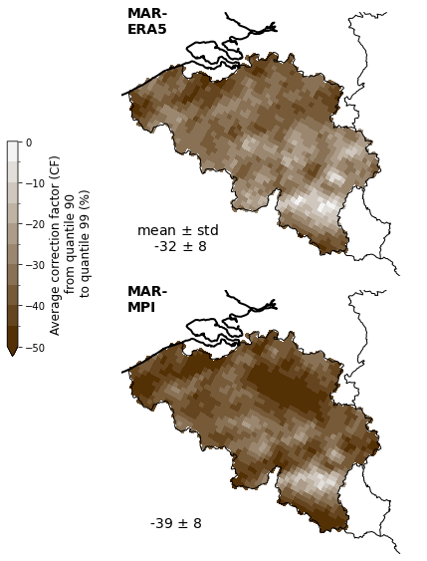
MAR performance

Slide 44
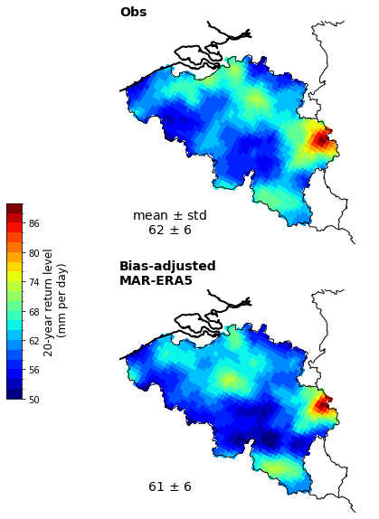
MAR performance

