Slide 1

The role of home and neighborhood in supporting autonomy among older adults: A protocol study
PhD Day 2025 - 2nd December 2025
Maëlle Scouvemont - PhD student
Department of Public Health, University of Liège
Supervisors: Christina Schmidt and Olivier Bruyère
Authors: Maëlle Scouvemont, Christina Schmidt, Charlotte Dautremont, Valériane Tannoia, Gwendoline Schaff, Nikita Beliy, Catherine Elsen, Stéphane Adam and Olivier Bruyère

Slide 2
Context
Evolution in the proportion of people aged 65 and over in the EU-27
Eurostat (2012), Archive: Structure et vieillissement de la population; European Commission (2023),Commission Staff Working Document.

Slide 3
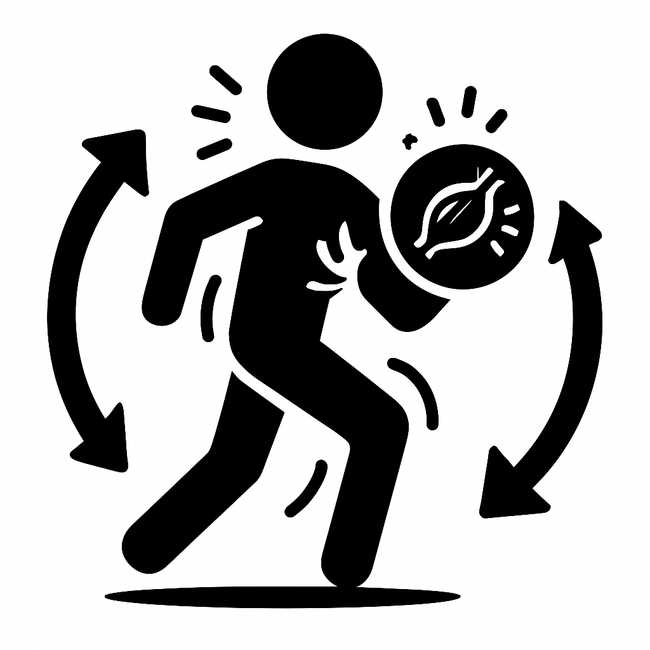
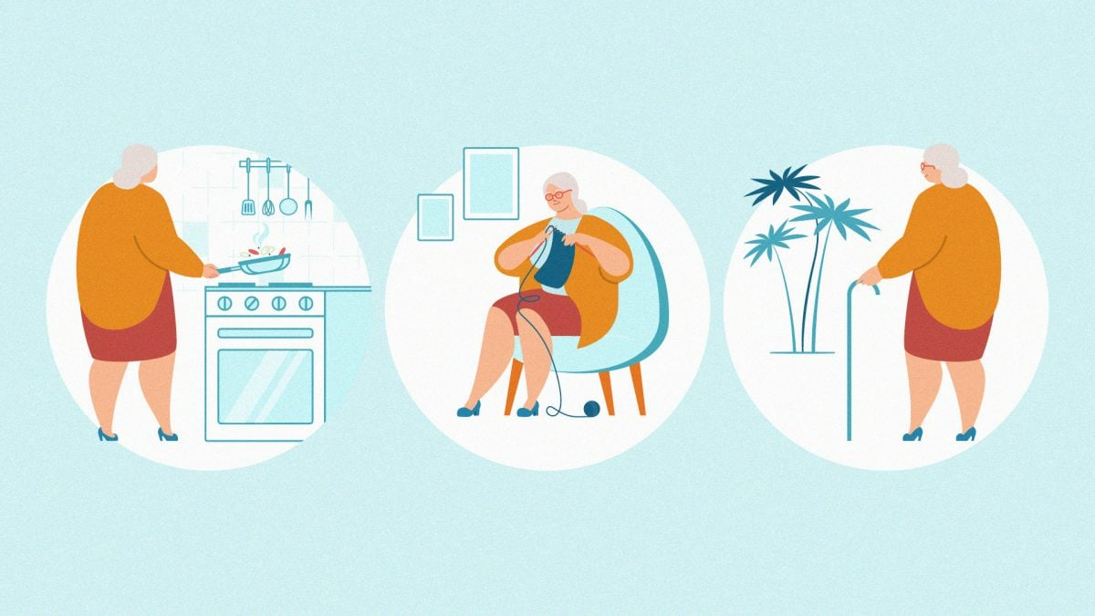

Context
©L’actualité
Stolz et al (2024). J Gerontol A Biol Sci Med Sci.79(1):glad119; Krivanek et al (2021). J Alzheimer Dis. 81(3):871-920; Laan et al (2014). The journal of nutrition, health and aging. 18(9):848-54
Notes:
Source image droite: https://lactualite.com/sante-et-science/vieillissement-comprendre-la-perte-dautonomie/

Slide 4
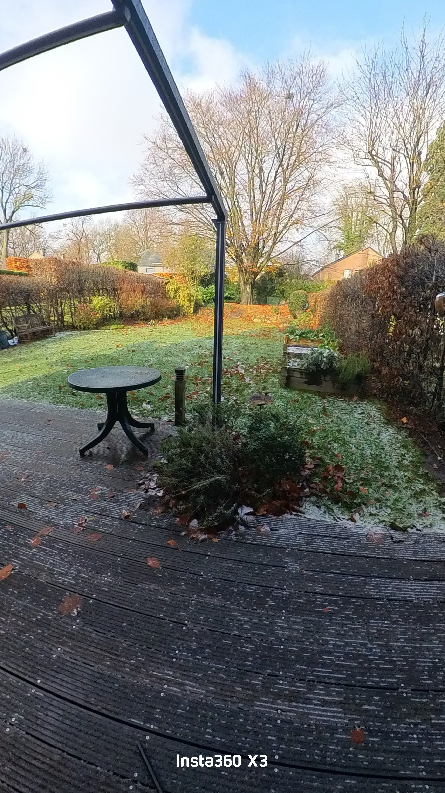
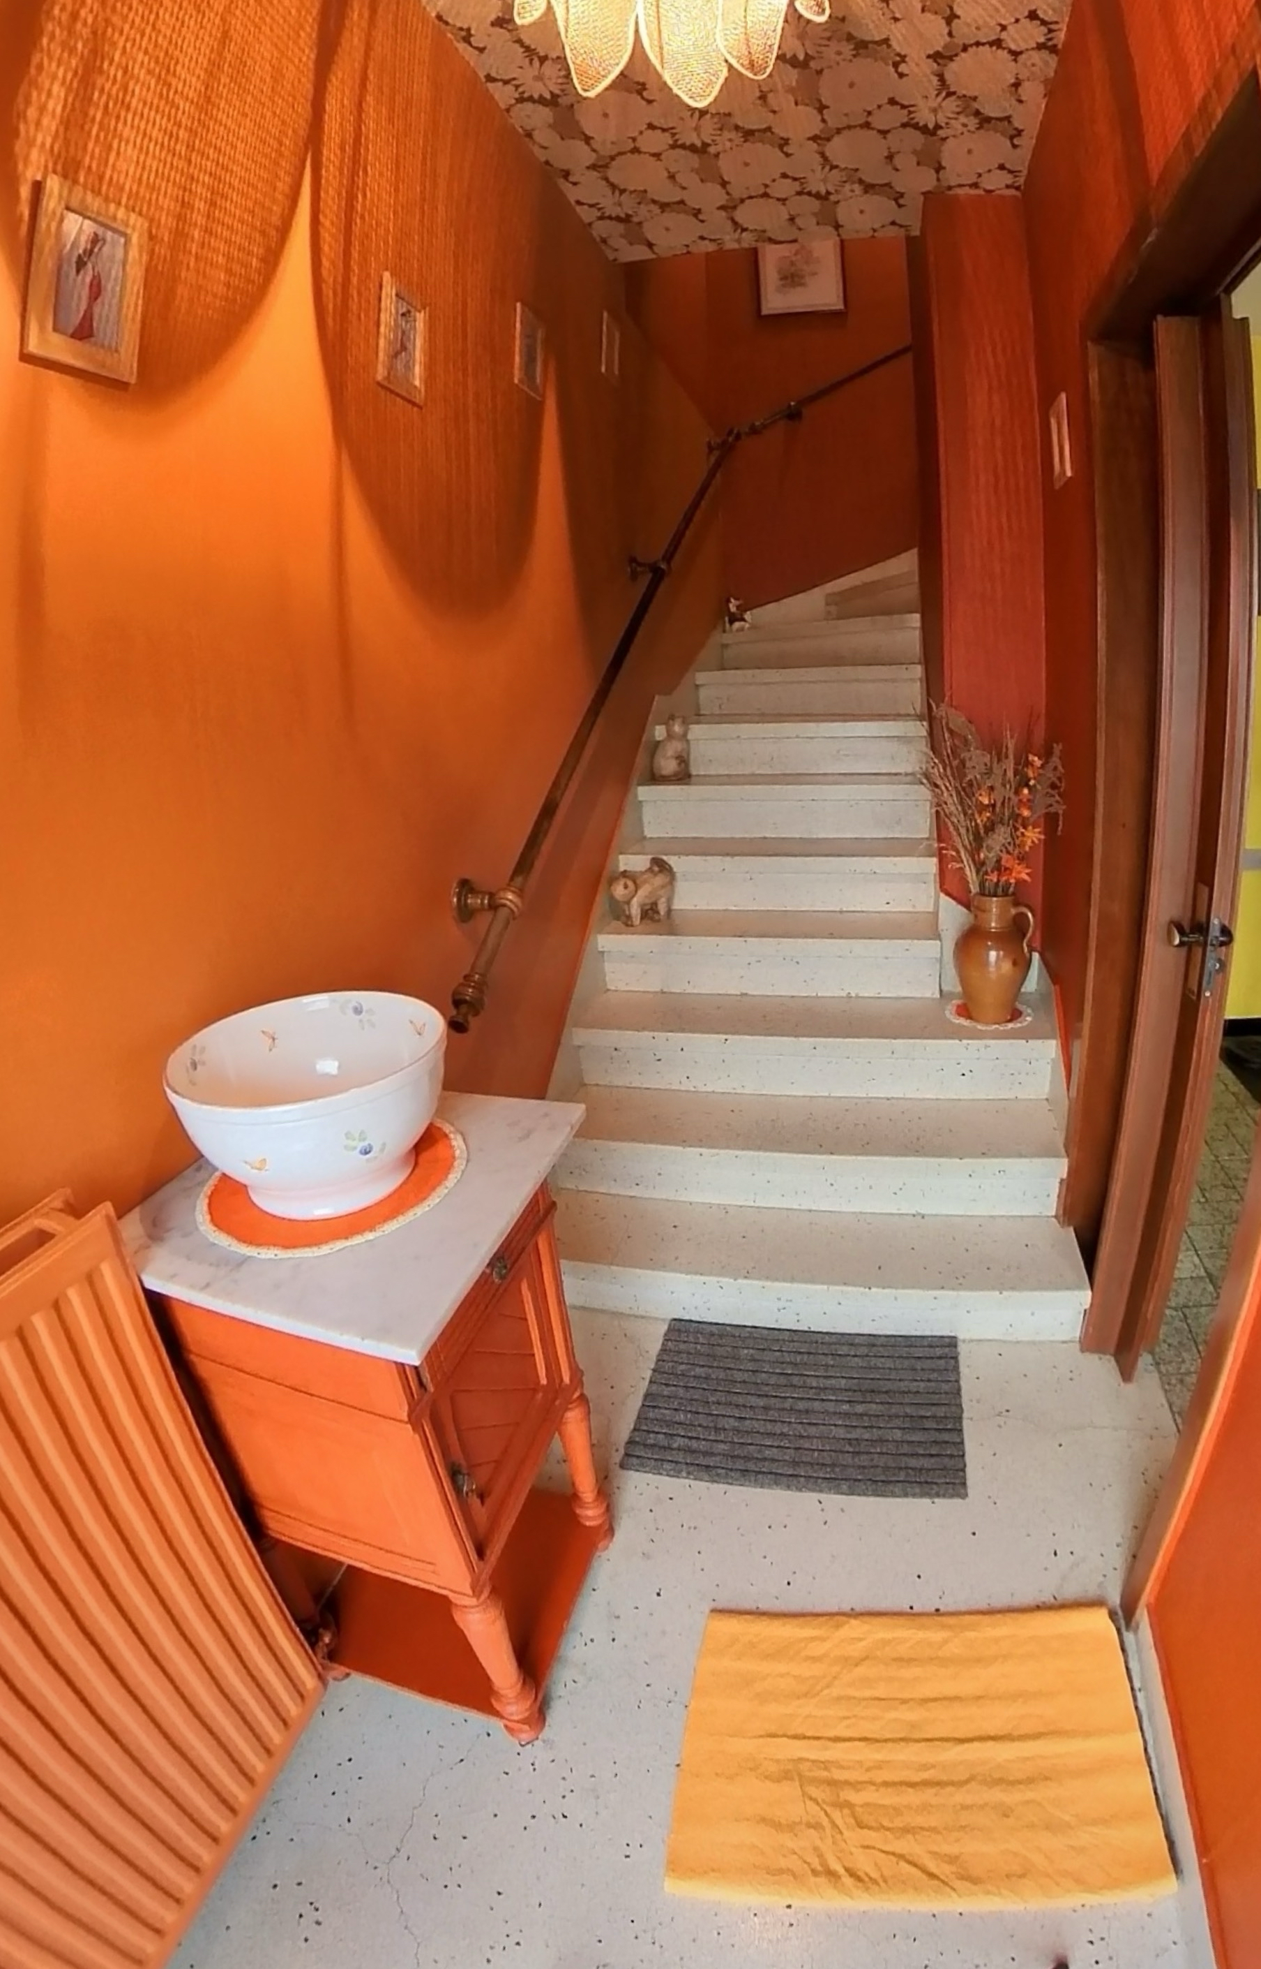
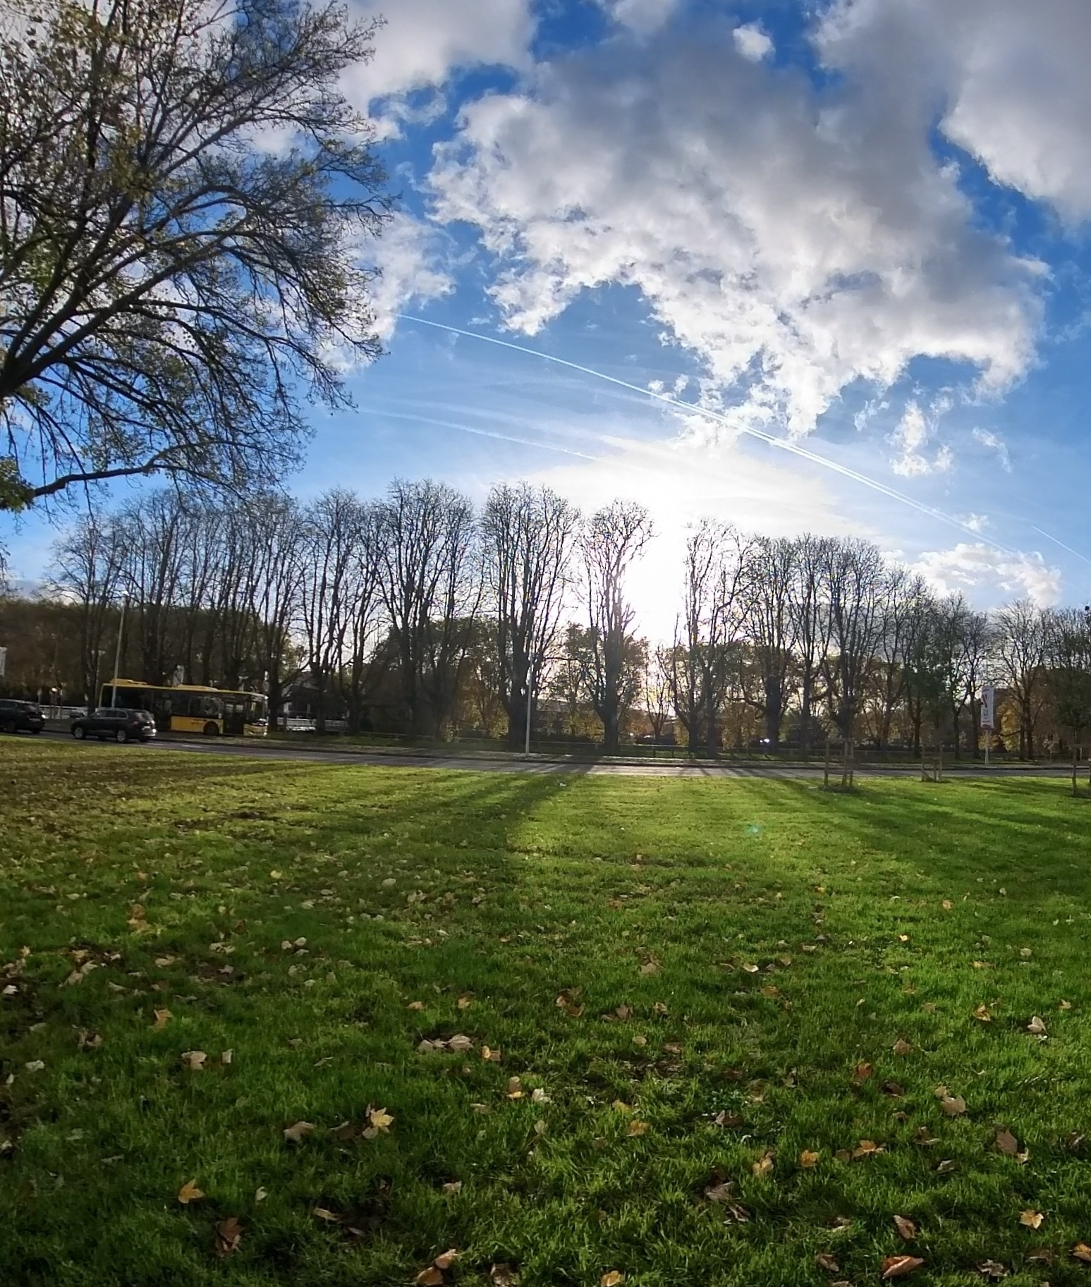
Context
These photographs were all taken at the homes/neighbourhoods of participants of the HabitAge project (ULiège) using an Insta 360 camera, and written consent was obtained for each one.
Meghani et al (2023). PLoS One. 18(11):e0294715, Chen et Al (2022). Social Science & Medicine. 1;292:114560, Rambaldine-Gooding et al (2021). Transport Reviews. 41(5):600-16.

Slide 5
Aim of the study
LIVING ENVIRONMENT (NEIGHBOURHOOD + DWELLING)
PREDICTIVE FACTORS
OF AUTONOMY
Physical stimulation nature
Physical activity
Cognitive stimulation nature
Sleep
Edholm et al (2019). Scandinavian Med Sci Sports. 29(3):415-21; Leng et al (2019). Alzheimer’s & Dementia. 15(8):1039-47; Kline et al (2014). Am J Lifestyle Med. 8(6):375-9

Slide 6

Materials and methods – Who?
≥ 75 years
Residing in the province of Liège
Living independently at home
n=150

Slide 7

Materials and methods – How?
Socio-demographics
Physical activity (PASE)*
Stimulating nature of the living environment (HabitAge team – ULiège)
General health
Sleep
(PSQI, μMCTQ, Epworth Sleepiness Scale)
*Scouvemont, M (15 May 2025). Annals of Physical and Rehabilitation Medicine, 68 (6), 101994.

Slide 8
HabitAge project
Faculty of Applied Sciences
Faculty of Medicine
Faculty of Psychology, logopaedics and Education Sciences
Doctoral project

Slide 9
Materials and methods - Analysis
Physical activity
Stimulation nature of the living environment
Sleep
Model including all relevant covariables and significance level set at 5%.

Slide 10
Materials and methods - Analysis
Physical activity
Simple mediation model
Indirect effect= Path a * Path b
CI using bootstrap at 95%
PROCESS macro (model 4)
Path a
Path b
Stimulation nature of the living environment
Sleep
Path c’
Model including all relevant covariables and significance level set at 5%.
Scouvemont et al (2025). Article accepted in BMC Public Health; Hayes (2022). The Guildford Press. New York. ISBN: 978-1-4625-4903-0.

Slide 11

Results
Participant recruitment: achieved
Data collection: achieved
Data analysis/results: processing

Slide 12
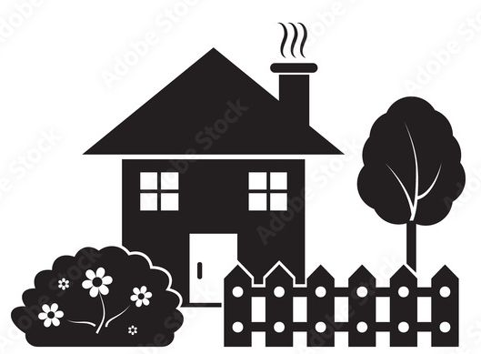


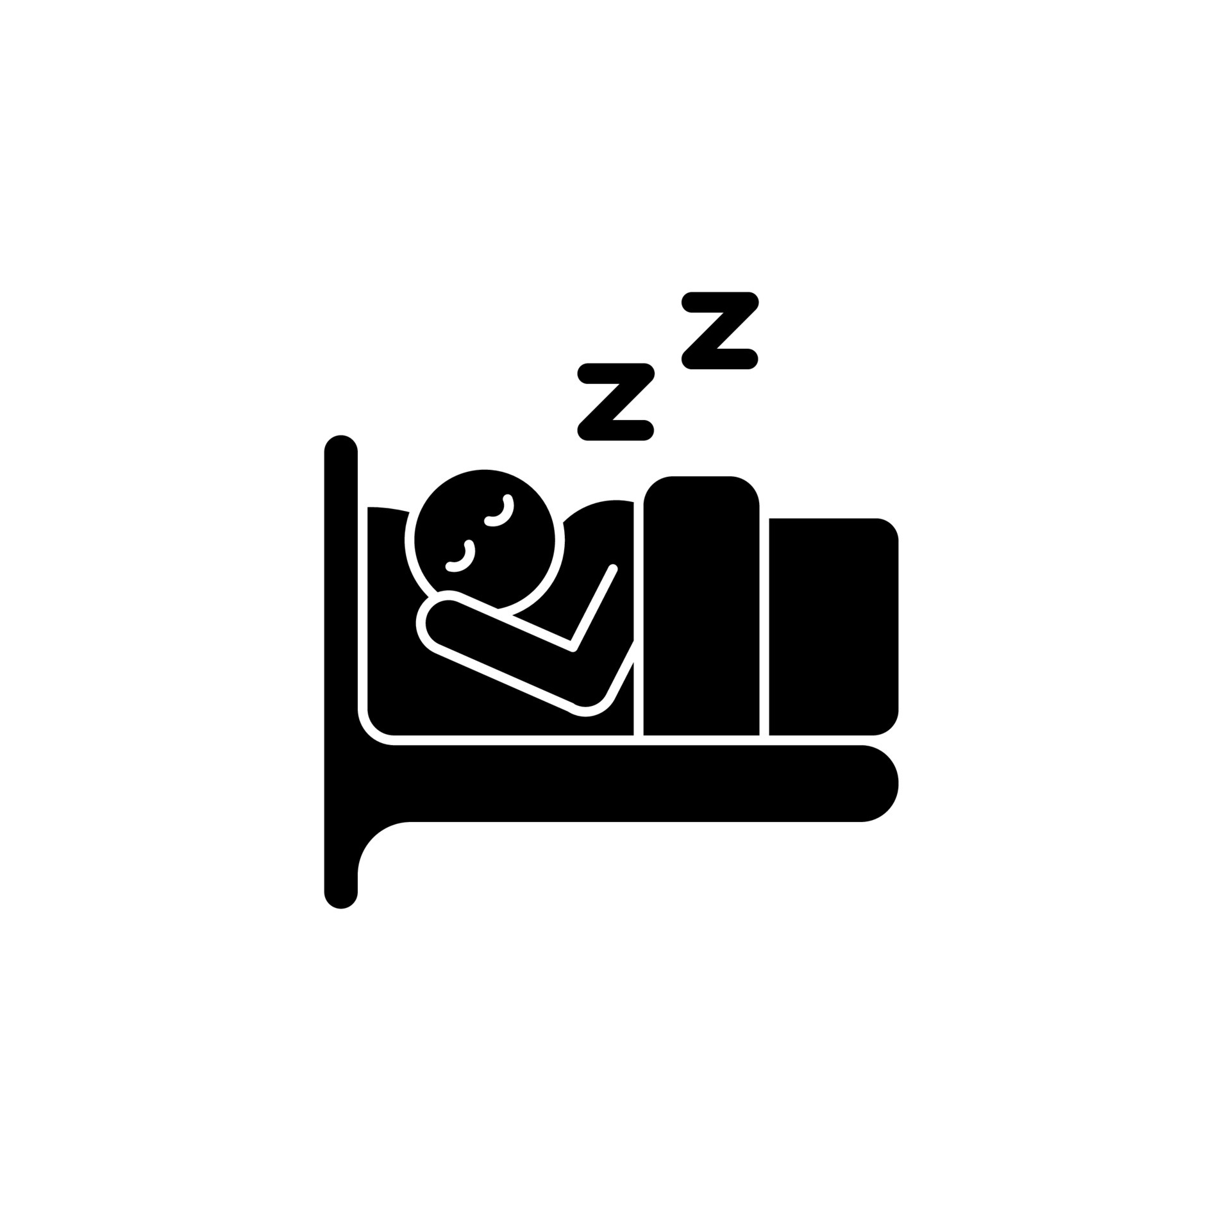


Conclusion
Longitudinal follow-up

Slide 13


Contacts
Maëlle Scouvemont – PhD student
Bât. B23 Santé publique, Epidémiologie et Economie de la santé
Quartier Hôpital
avenue Hippocrate 13
4000 Liège 1
Belgique
maelle.scouvemont@uliege.be
ORCID
0009-0003-7945-7213

