Slide 1
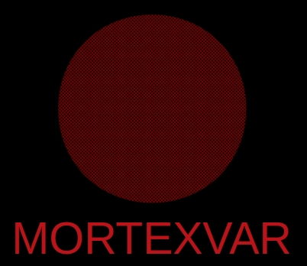
A Man or a God?
Interpreting the First-Person Singular in the Coffin of the Overseer of the Treasury wḫ-ḥtp (MMA 12.182.132a, b)
Jorke Grotenhuis
Universidad de Alcalá, Madrid
jorke.grotenhuis@uah.es
Text Mining the Coffin Texts (TM-CT)

Slide 2
Contents
First-Person singular in the Coffin Texts
Coffin of wḫ-ḥtp
Sign use of 𓀭

Slide 3
First-person singular in the Coffin Texts
Writing strategies:
  A1 𓀀
  M17 𓇋
  Z1 𓏤
  Change to 3rd person (name of owner)
Unique writing strategies:
  A50 𓀻 (only in Deir el-Bersha, the reign of Amenemhat II to Sesostris III)
  A40 𓀭 (only in Meir, the coffin of wḫ-ḥtp)

Slide 4
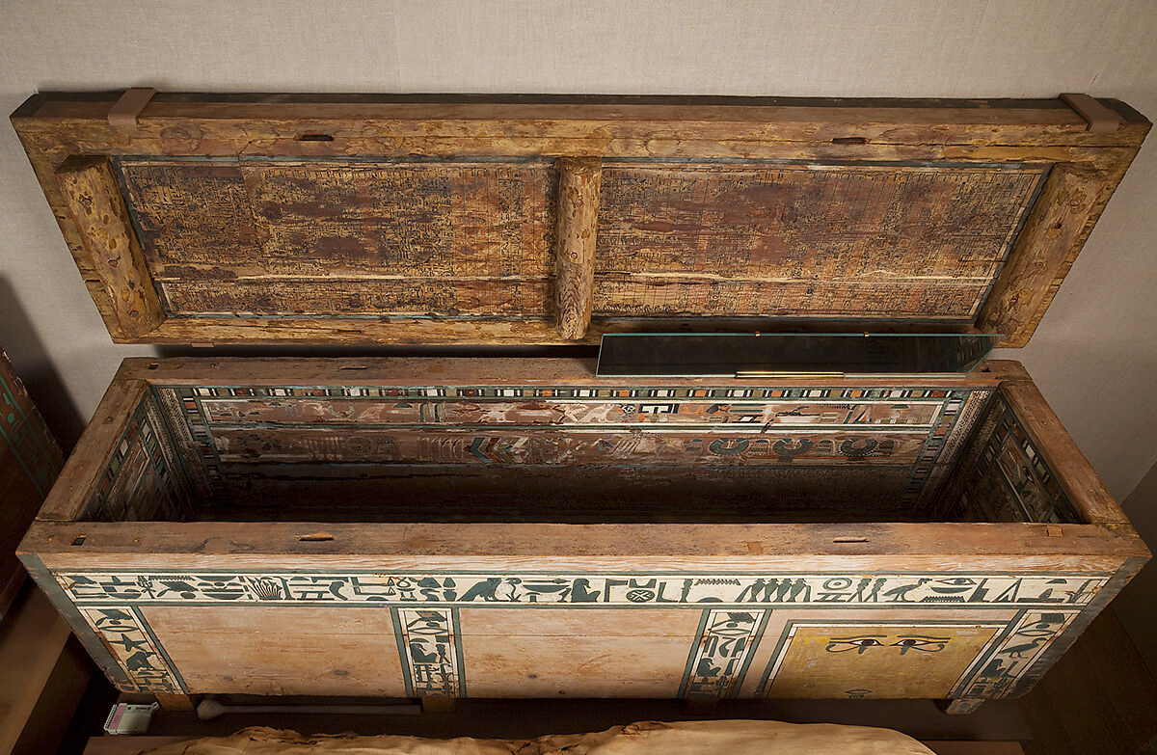
MMA 12.182.132a, b (M1NY)
Coffin MMA 12.182.132a,b (https://www.metmuseum.org/art/collection/search/546303)

Slide 5
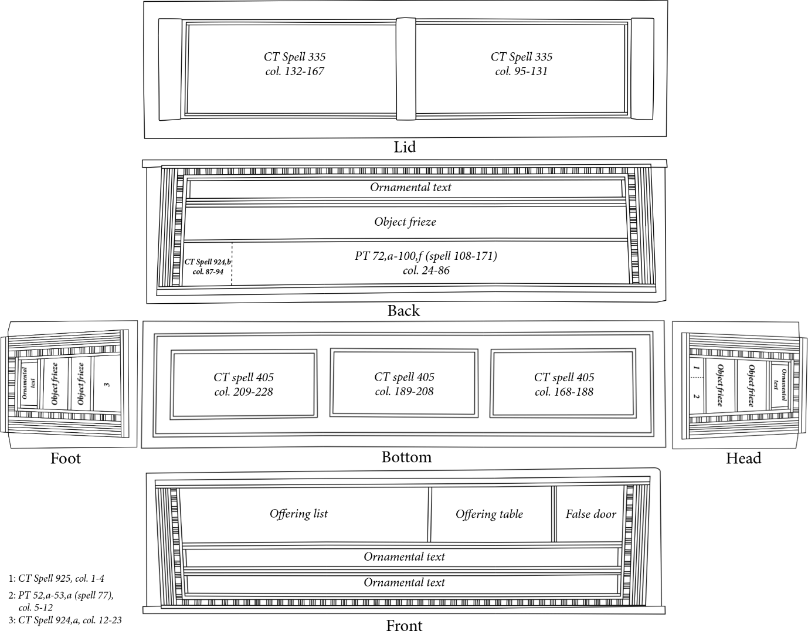
MMA 12.182.132a, b (M1NY)

Slide 6
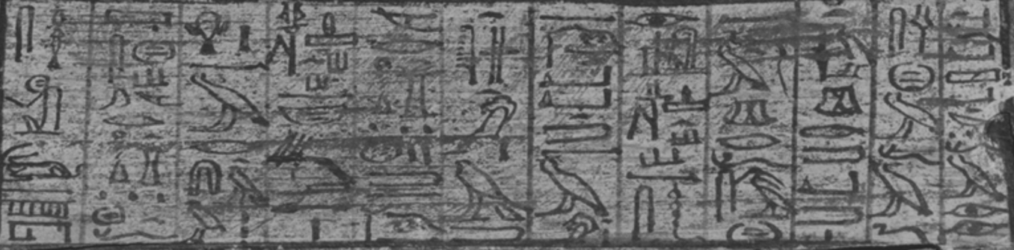
MMA 12.182.132a, b (M1NY)
Meir
Amenemhat II
Cursive script (Fischer type 3a).

Slide 7
MMA 12.182.132a, b (M1NY)
Only two spells are in first person:
  CT spell 335 (lid)
  CT spell 405 (bottom)

Slide 8
First-person in the coffin
Use of (A40) for the first person in New Kingdom only for kings and gods
Could be wḫ-ḥtp considered a god, as a ‘common’ person?

Slide 9
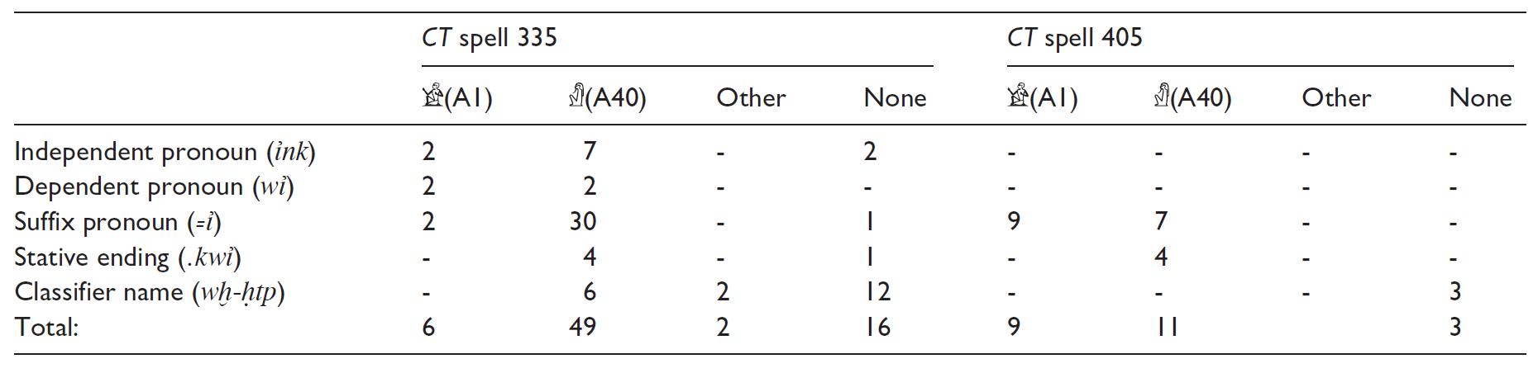
First-person in the coffin
Use of is not structural
  In CT 335, is used in the majority of cases, but not all
  In CT 405, is only used in about half of all cases

Slide 10
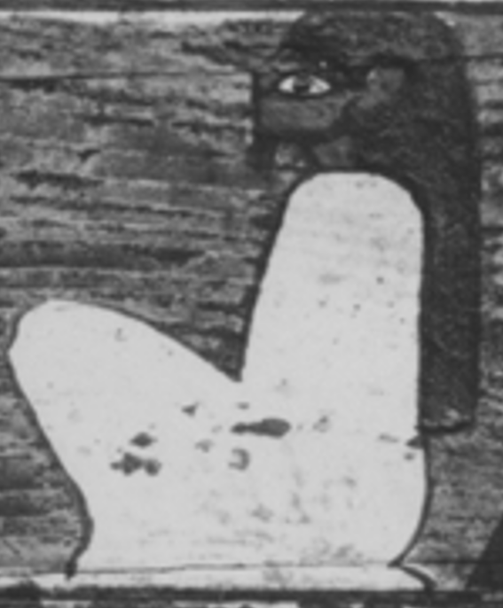
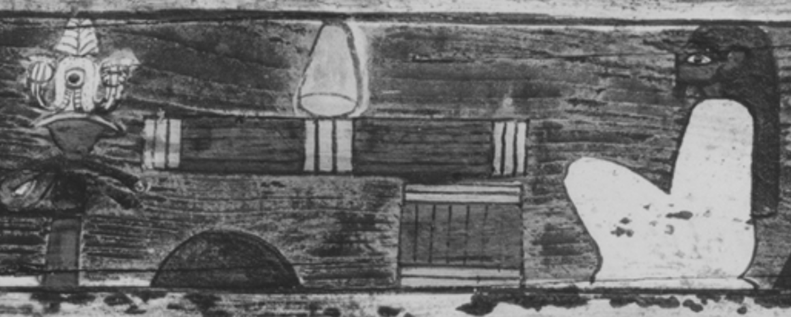
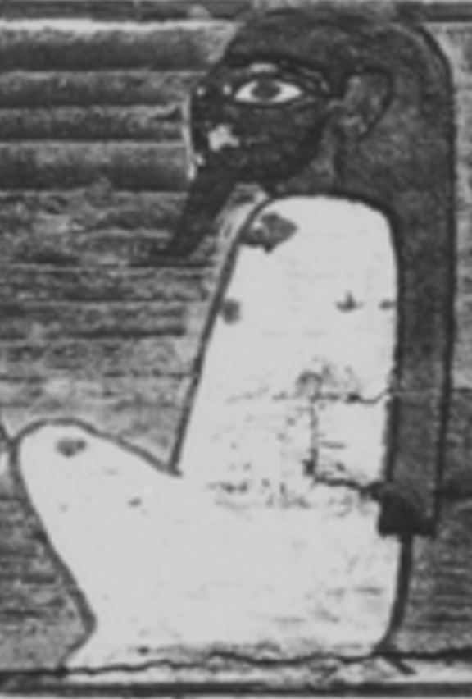
Classifying wḫ-ḥtp
Unique sign (short beard) used twice
  One time in ornamental text
VS

Slide 11
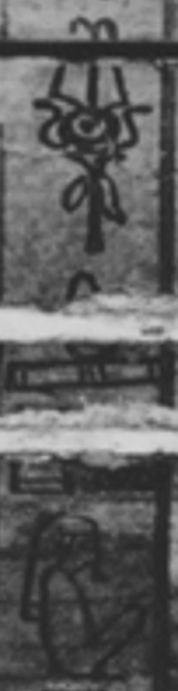
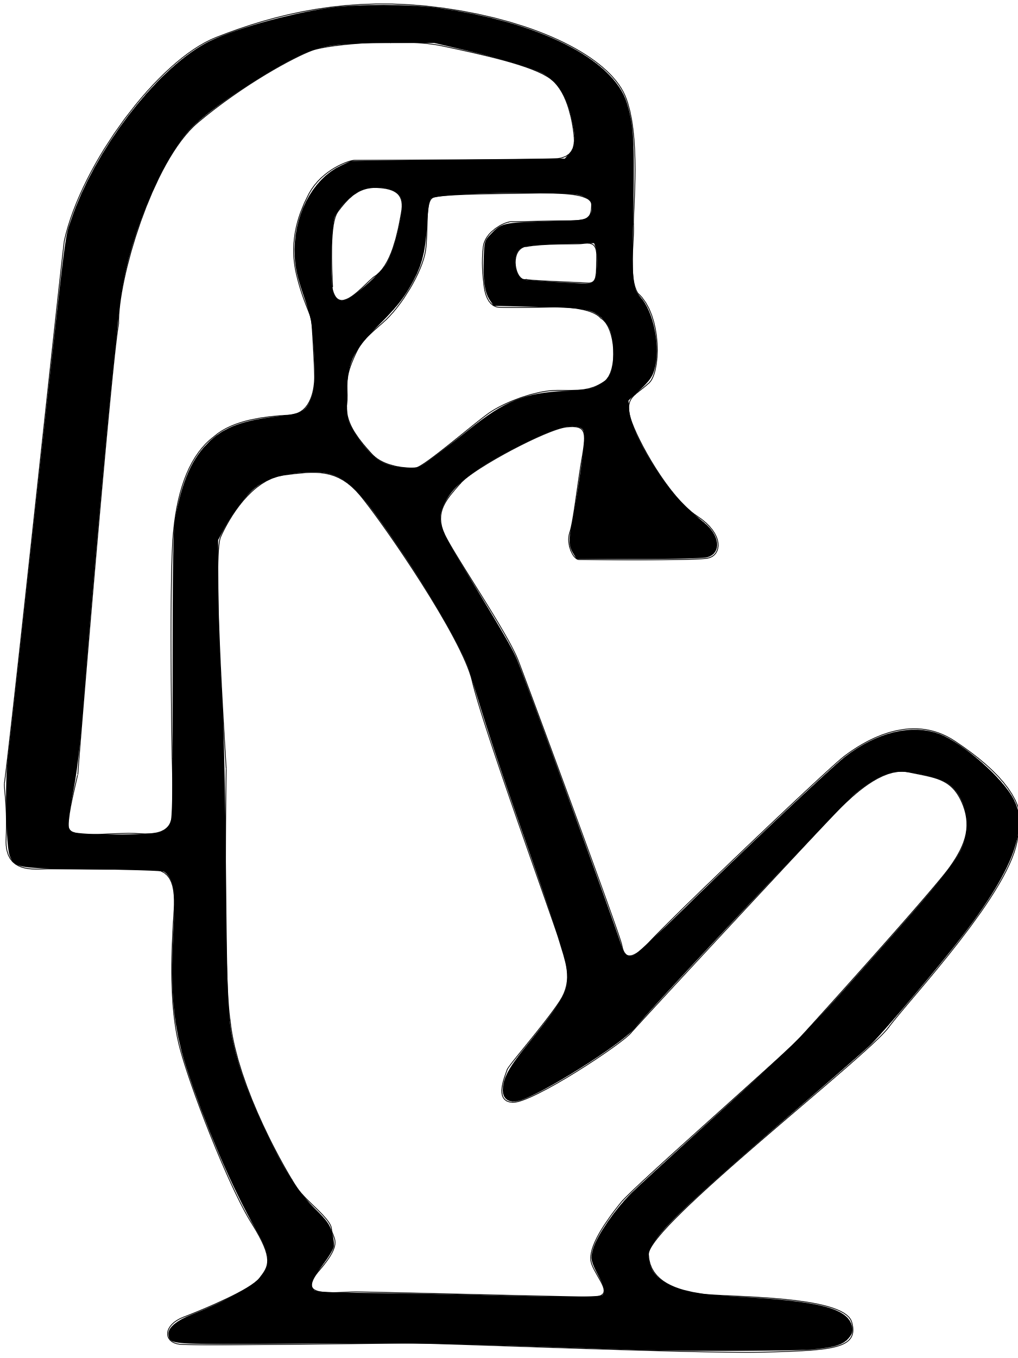
Classifying wḫ-ḥtp
Unique sign (short beard) used twice
  One time in ornamental text
  One time in cursive text

Slide 12
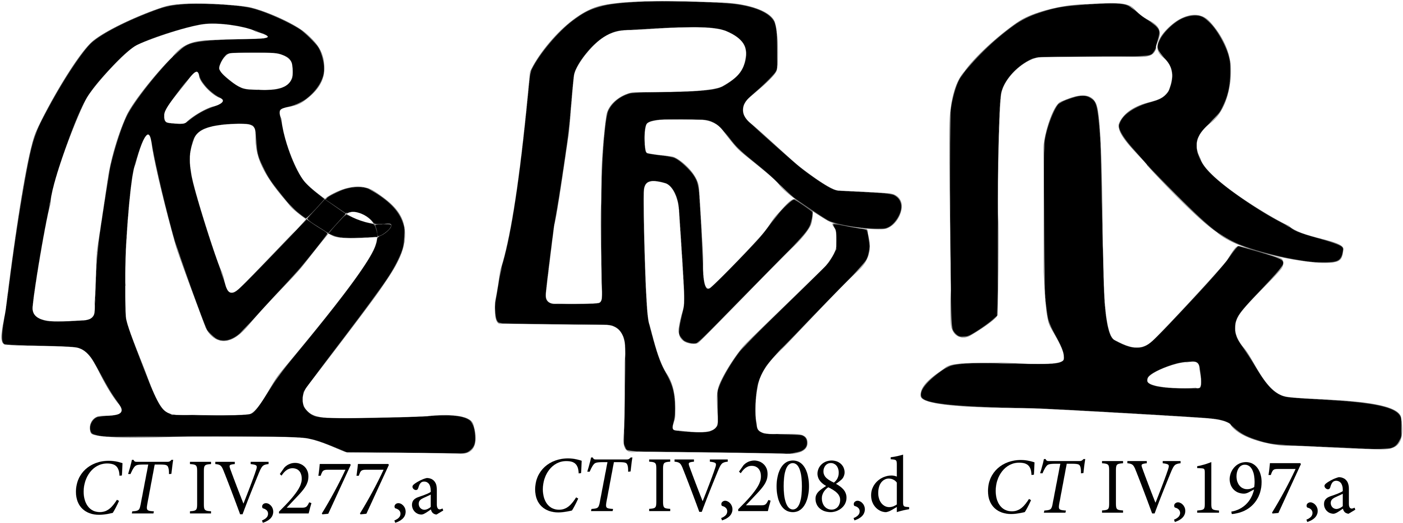
Cursive hieroglyphs
(A40)

Slide 13
Cursive hieroglyphs
(A1)

Slide 14
Cursive hieroglyphs
(A1) vs (A40)

Slide 15
Cursive hieroglyphs
Stroke patter difference
  Back arm / hair
  Front arm / beard

Slide 16
Cursive hieroglyphs
Origin of variation
  Vorlage papyrus transferred to a quick intermediate medium, written in a more cursive hand than used on the coffin, making the accidental switch between the signs more likely
  Similar intermediate mediums known from New Kingdom (draft texts for the duties of the vizier, cursive script for a hieroglyphic text, see Tallet 2005 & 2010)

Slide 17
Conclusions
Not likely that there was intentional reconceptualization, due to lack of structural changes, especially in CT 405
Potential confusion with a similar sign to A40 with a short beard used for the name of the owner
Likely a feature of the more cursive hand of the scribe through an intermediate medium
wḫ-ḥtp was likely not considered divine (beside being an Osiris) but a man as any other elite with a coffin with Coffin Texts

Slide 18
Thank you for your attention!
See the full article in JEA, online first at https://doi.org/10.1177/03075133251349551
Jorke Grotenhuis, A Man or a God? Interpreting the First-Person Singular in the Coffin of the Overseer of the Treasury Wḫ-ḥtp (MMA 12.182.132a, b)

