Slide 1
From Visualization to Coding: Practicing Graphical Loop Invariants in CAFÉ 2.0
Géraldine Brieven, Benoit Donnet
CAFÉ 2.0

Slide 2
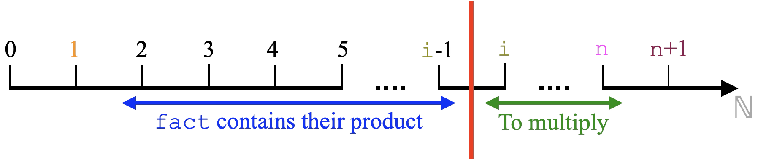

Introduction
Context : CS1 Course
Skills : Problem Solving and Abstract thinking skills
How? : The Graphical Loop Invariant (GLI)
Eg: Compute the factorial of n
Graphical LI:
Loop Invariant (LI):
Each time you implement a loop, all the variables that are handled are characterized (individually and/or with respect to each other).
That variables’ state must be true at each evaluation of the guard loop.
The Graphical Loop Invariant – Géraldine Brieven (gbrieven@uliege.be)
Notes:
The main idea is that to, reflect instructions before and inside the loop, all variables involved in this loop are characterized. After each iteration, this characterization must be recovered. That makes sense as the solution progresses in the same way at each iteration.

Slide 3
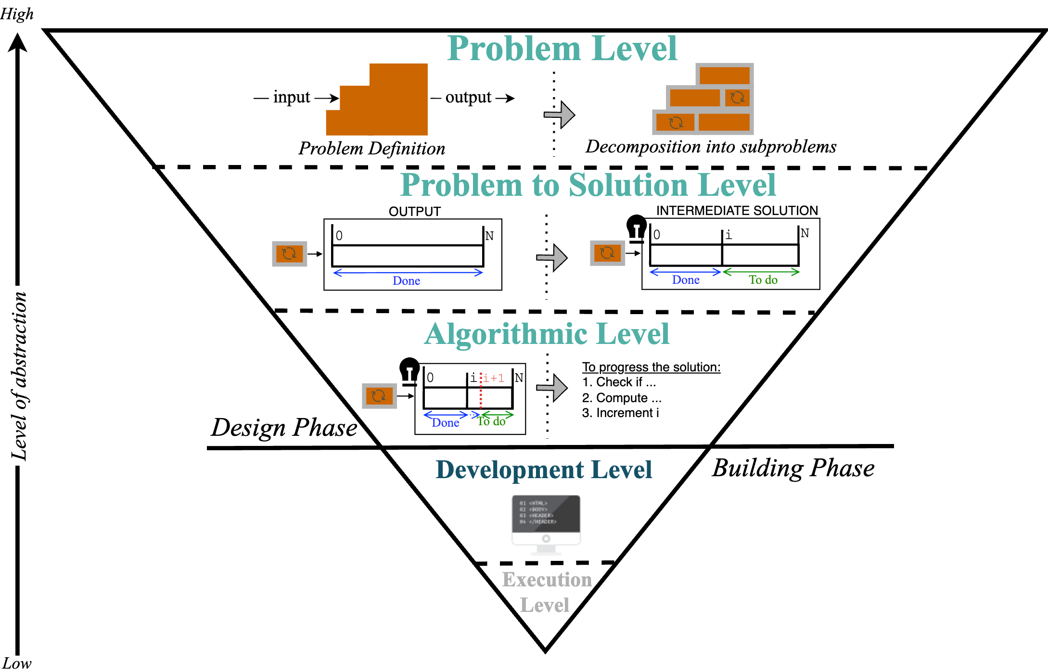
Level of abstraction where the GLI stands
(Graphical) Loop Invariant
For code verification
The Graphical Loop Invariant – Géraldine Brieven (gbrieven@uliege.be)

Slide 4
Agenda
From the GLI to the code
Preliminary
Results
Agenda:
Section 1 | Section 2 | Section 3 | Section 4 | Section 5
Graphical
Loop Invariant
(GLI)
Learning
Tools
Further work
and Conclusion
The Graphical Loop Invariant – Géraldine Brieven (gbrieven@uliege.be)

Slide 5
Agenda
From the GLI to the code
Preliminary
Results
Agenda:
Section 1 | Section 2 | Section 3 | Section 4 | Section 5
Graphical
Loop Invariant
(GLI)
Learning
Tools
Further work
and Conclusion
The Graphical Loop Invariant – Géraldine Brieven (gbrieven@uliege.be)

Slide 6
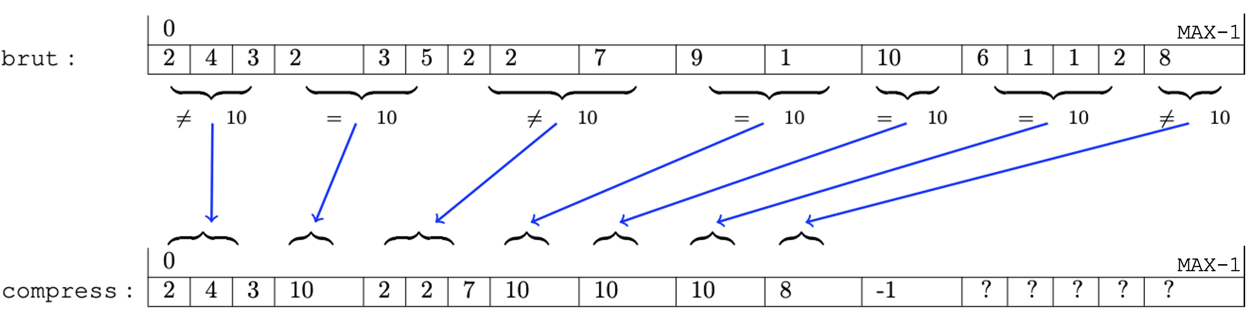
Graphical Loop Invariant through an example
Problem : Compressing an array brut of size MAX based on
sums of 10. The last element of brut is always 11.
11
End of
sequence
11
?
The Graphical Loop Invariant – Géraldine Brieven (gbrieven@uliege.be)

Slide 7
From the output to the intermediate solution (GLI)
The Graphical Loop Invariant – Géraldine Brieven (gbrieven@uliege.be)

Slide 8
Finding a GLI: constant relaxation
Expected Result:
Not modified
0
i
j
MAX
brut:
 | … |  |  | … |  |  |  | 11
Already
compressed in compress
To compress
sum < 10
k
0
MAX
compress:
11
 | … |  |  | … |  |  | …
Result
of the compression
Free Space
Free Space
The Graphical Loop Invariant – Géraldine Brieven (gbrieven@uliege.be)
3

Slide 9
Rules supporting the GLI
Rules 1 & 2 :
0
MAX
brut:
 |  |  |  | … |  |  |  | 11
0
MAX
compress:
 |  |  |  | …
The Graphical Loop Invariant – Géraldine Brieven (gbrieven@uliege.be)

Slide 10
Rules supporting the GLI
Rules 3 & 4 :
2 subzones treated in brut : - What has been compressed
- What is candidate to be compressed
0
i
j
MAX
brut:
 | … |  |  | … |  |  | … | 11
k
0
MAX
compress:
 |  |  | … |  |  |  | …
The Graphical Loop Invariant – Géraldine Brieven (gbrieven@uliege.be)

Slide 11
Rules supporting the GLI
Rule 5 :
0
i
j
MAX
brut:
 | … |  |  | … |  |  |  | 11
Already compressed in compress
sum < 10
k
0
MAX
compress:
 |  |  |  | … |  |  | …
Result of the compression
The Graphical Loop Invariant – Géraldine Brieven (gbrieven@uliege.be)

Slide 12
Rules supporting the GLI
Rule 6 :
Not modified
0
i
j
MAX
brut:
 | … |  |  | … |  |  |  | 11
Already compressed in compress
sum < 10
To compress
k
0
MAX
compress:
 |  |  |  | … |  |  | …
Result of the compression
Free space
The Graphical Loop Invariant – Géraldine Brieven (gbrieven@uliege.be)

Slide 13

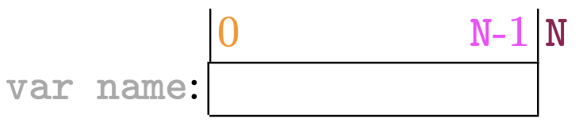
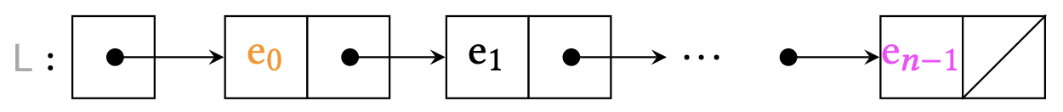
Different possible patterns
Object | Pattern
Number
Array
Integers
Linked List
The Graphical Loop Invariant – Géraldine Brieven (gbrieven@uliege.be)
Notes:
Number composed of digits (or bits…), Integers including numbers …

Slide 14
Agenda
Not modified
From the GLI to the code
Preliminary
Results
s_curr
Section 1
Section 6
Agenda:
Section 1 | Section 2 | Section 3 | Section 4 | Section 5
Learning
Tools
Further work
and Conclusion
Graphical
Loop Invariant
Legend :
  Rule 1
  Rule 2
  Rule 3
  Rule 4
  Rule 5
  Rule 6
Already
discussed
To be discussed
The Graphical Loop Invariant – Géraldine Brieven (gbrieven@uliege.be)

Slide 15
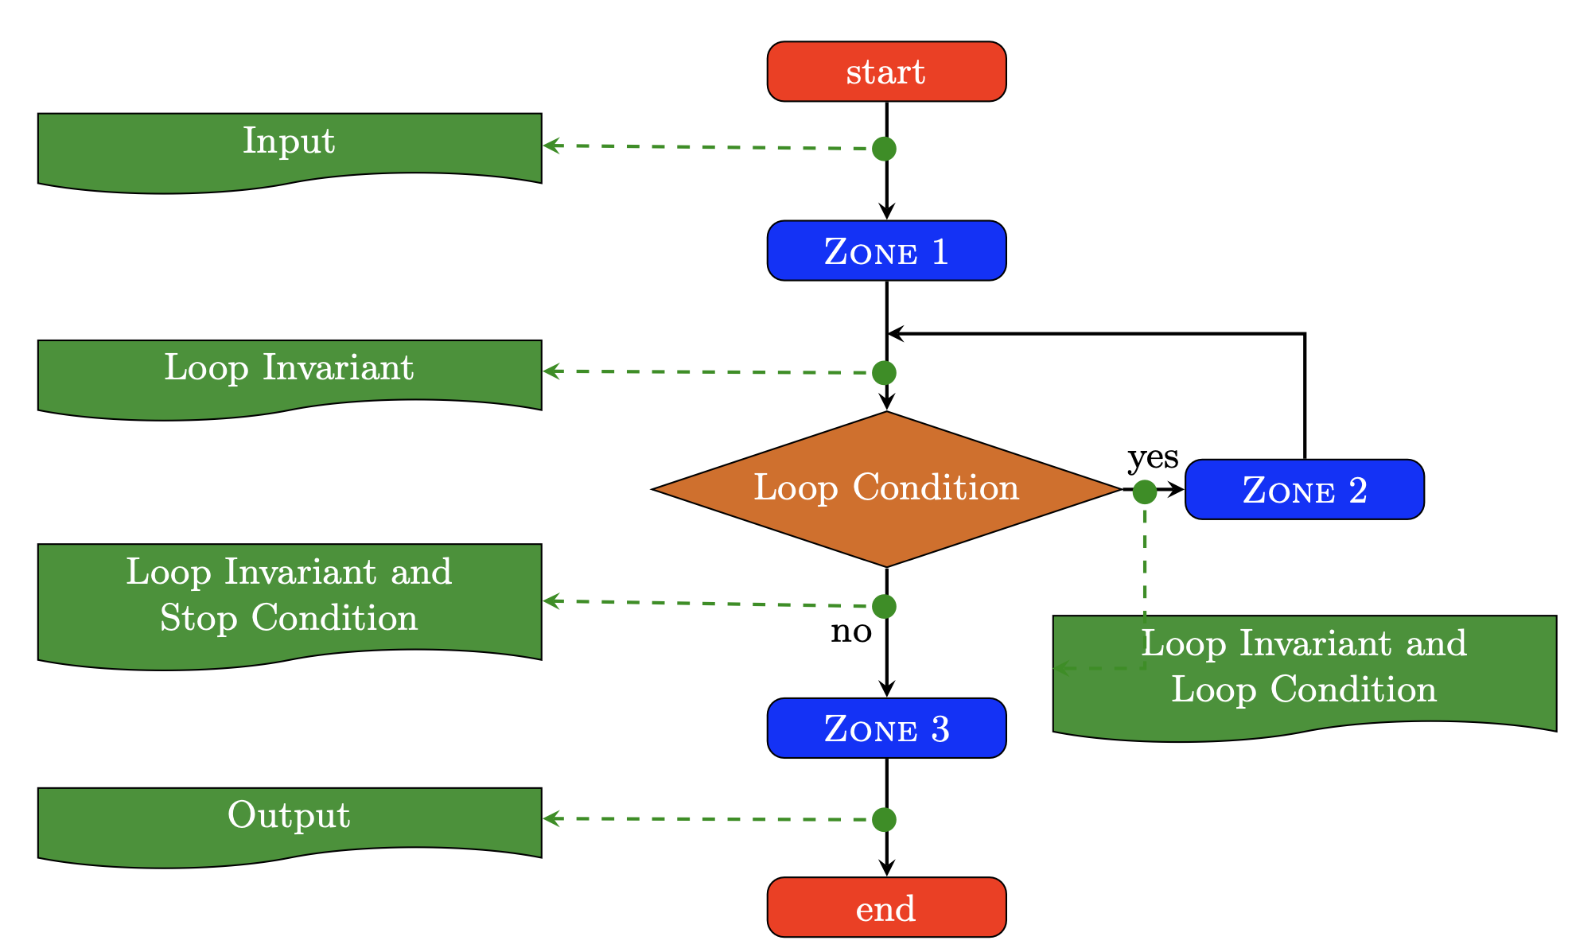
Programming Methodology
Variable initialization
Loop Body
Final instructions
The Graphical Loop Invariant – Géraldine Brieven (gbrieven@uliege.be)
Notes:
In green you see the variable states.

Slide 16
Programming Methodology
Initial State:
j
Variable | Type | Initial value
i
0
MAX
brut:
i
0
0
0
0
 | … |  | … | … | 11
Already compressed in compress
sum <10
To compress
j
unsigned
int
k
sum
0
MAX
compress:
 |  |  |  | …
k
Result of the compression
Free
space
The Graphical Loop Invariant – Géraldine Brieven (gbrieven@uliege.be)
Notes:
Construction progressive du contenu du tableau

Slide 17
Programming Methodology
Final State:
Stopping Condition :
i == MAX && j == MAX
Not modified
i
0
j
MAX
MAX
brut:
 | … |  |  | … |  |  |  | 11
Already compressed in compress
sum < 10
To compress
k
0
MAX
compress:
11
 |  |  |  | … |  |  |  | ...
Result of the compression
Free space
The Graphical Loop Invariant – Géraldine Brieven (gbrieven@uliege.be)

Slide 18
Programming Methodology
Resulting Code :
unsigned int i = 0, j = 0, k=0, sum = 0;
while( !(i==MAX && j==MAX) )
{
sum += brut[j];
j++;
if(sum<=10){
if(sum == 10){ //Compression
compress[k] = 10;
i = j;
}else{ // Copy of element
compress[k] = brut[i];
i++;
j = i;
}
k++;
sum = 0;
}
}
from Initial State
from Final State
0
i
j
MAX
brut:
 | … |  | … | …
Already compressed in compress
sum <10
To compress
From in-loop state
k
0
MAX
compress:
 |  |  |  | …
Result of the compression
Free space
The Graphical Loop Invariant – Géraldine Brieven (gbrieven@uliege.be)
Notes:
| j is always before |i => we first shift j and then may shift i.
More compact:
somme += brut[j++];
if(10<=somme){
if(somme==10){
compress[k++] = 10;
i = j;
}else{
compress[k++] = brut[i++];
j=i;
}
somme = 0;
}

Slide 19
Agenda
Not modified
From the GLI to the code
Preliminary
Results
Section 1
s_curr
Section 6
Agenda:
Section 1 |  |  | Section 4 | Section 5
Section 2
Section 3
Graphical
Loop Invariant
Learning
Tools
Further work
and Conclusion
Legend :
  Rule 1
  Rule 2
  Rule 3
  Rule 4
  Rule 5
  Rule 6
Already
discussed
To be discussed
The Graphical Loop Invariant – Géraldine Brieven (gbrieven@uliege.be)

Slide 20
Learning Tools
PCA = Programming Challenge Activity
GLIDE = Graphical Loop Invariant Drawing Editor
CAFÉ = Correction et Feedback Automatique pour les Étudiants
The Graphical Loop Invariant – Géraldine Brieven (gbrieven@uliege.be)

Slide 21
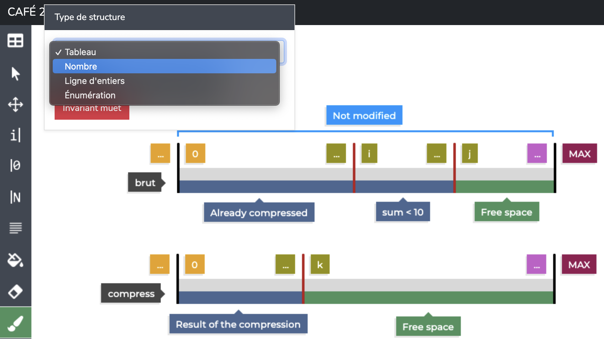
GLIDE (graphical editor)
The Graphical Loop Invariant – Géraldine Brieven (gbrieven@uliege.be)

Slide 22
Programming Challenges Activity
Activity Diagram:
The Graphical Loop Invariant – Géraldine Brieven (gbrieven@uliege.be)

Slide 23
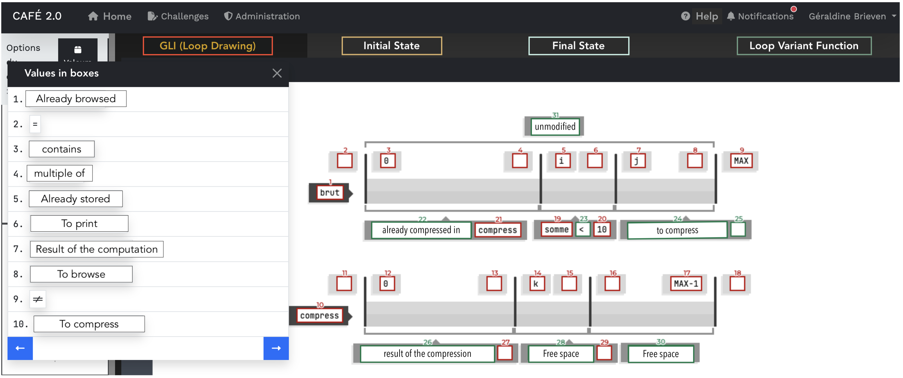
Programming Challenges Activity
Screenshot:
The Graphical Loop Invariant – Géraldine Brieven (gbrieven@uliege.be)

Slide 24
Agenda
Not modified
From the GLI to the code
Preliminary
Results
Section 1
s_curr
Section 6
Agenda:
Section 1 | Section 2 |  |  | Section 5
Section 3
Section 4
Graphical
Loop Invariant
Further work
and Conclusion
Learning
Tools
Legend :
  Rule 1
  Rule 2
  Rule 3
  Rule 4
  Rule 5
  Rule 6
Already
discussed
To be discussed
The Graphical Loop Invariant – Géraldine Brieven (gbrieven@uliege.be)

Slide 25
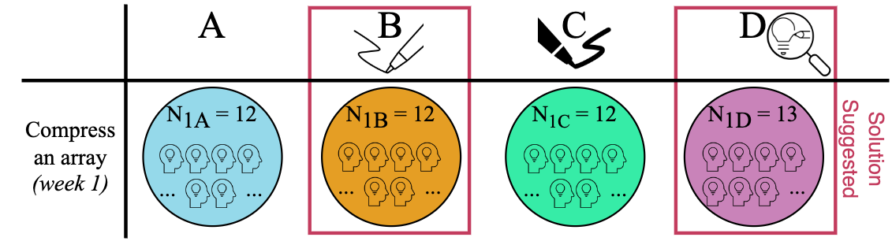
Preliminary Results: Errors
The Graphical Loop Invariant – Géraldine Brieven (gbrieven@uliege.be)

Slide 26
Agenda
Not modified
From the GLI to the code
Preliminary
Results
Section 1
s_curr
Section 6
Agenda:
Section 1 | Section 2 | Section 3
Section 4
Section 5
Graphical
Loop Invariant
Learning
Tools
Further work
and Conclusion
Legend :
  Rule 1
  Rule 2
  Rule 3
  Rule 4
  Rule 5
  Rule 6
Already
discussed
To be
discussed
The Graphical Loop Invariant – Géraldine Brieven (gbrieven@uliege.be)

Slide 27
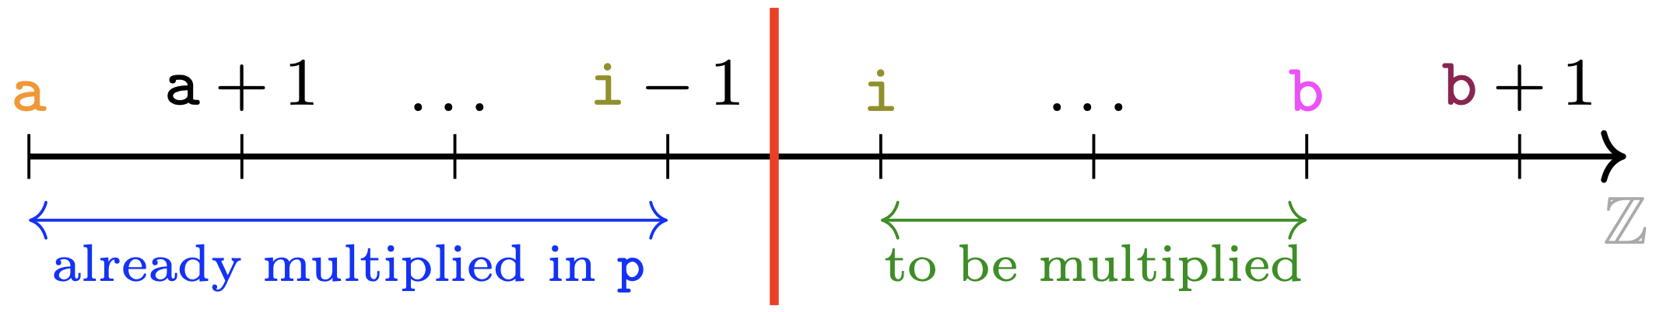



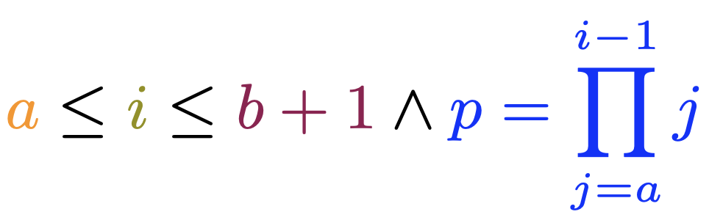


Further Work & Conclusion
Graphical Loop Invariant (Informal)
First year students
Loop Invariant (Formal)
On-going Research
How students actually manage the GLIBP ?
How to smoothly bridge the GLIBP to the Formal Invariant ?
The Graphical Loop Invariant – Géraldine Brieven (gbrieven@uliege.be)

Slide 28
Agenda
Not modified
From the GLI to the code
Preliminary
Results
s_curr
Section 1
Section 6
Agenda:
Section 1 | Section 2 | Section 3 | Section 4
Section 5
Graphical
Loop Invariant
Learning
Tools
Further work
and Conclusion
Legend :
  Rule 1
  Rule 2
  Rule 3
  Rule 4
  Rule 5
  Rule 6
Already
discussed
To be
discussed
The Graphical Loop Invariant – Géraldine Brieven (gbrieven@uliege.be)

Slide 29


Our Research
Visit our research
Contribute to our research
(survey for CS1 teachers)
(It takes 10min to fill in ☺)
The Graphical Loop Invariant – Géraldine Brieven (gbrieven@uliege.be)

Slide 30
Preliminary Results: General
The Graphical Loop Invariant – Géraldine Brieven (gbrieven@uliege.be)

Slide 31

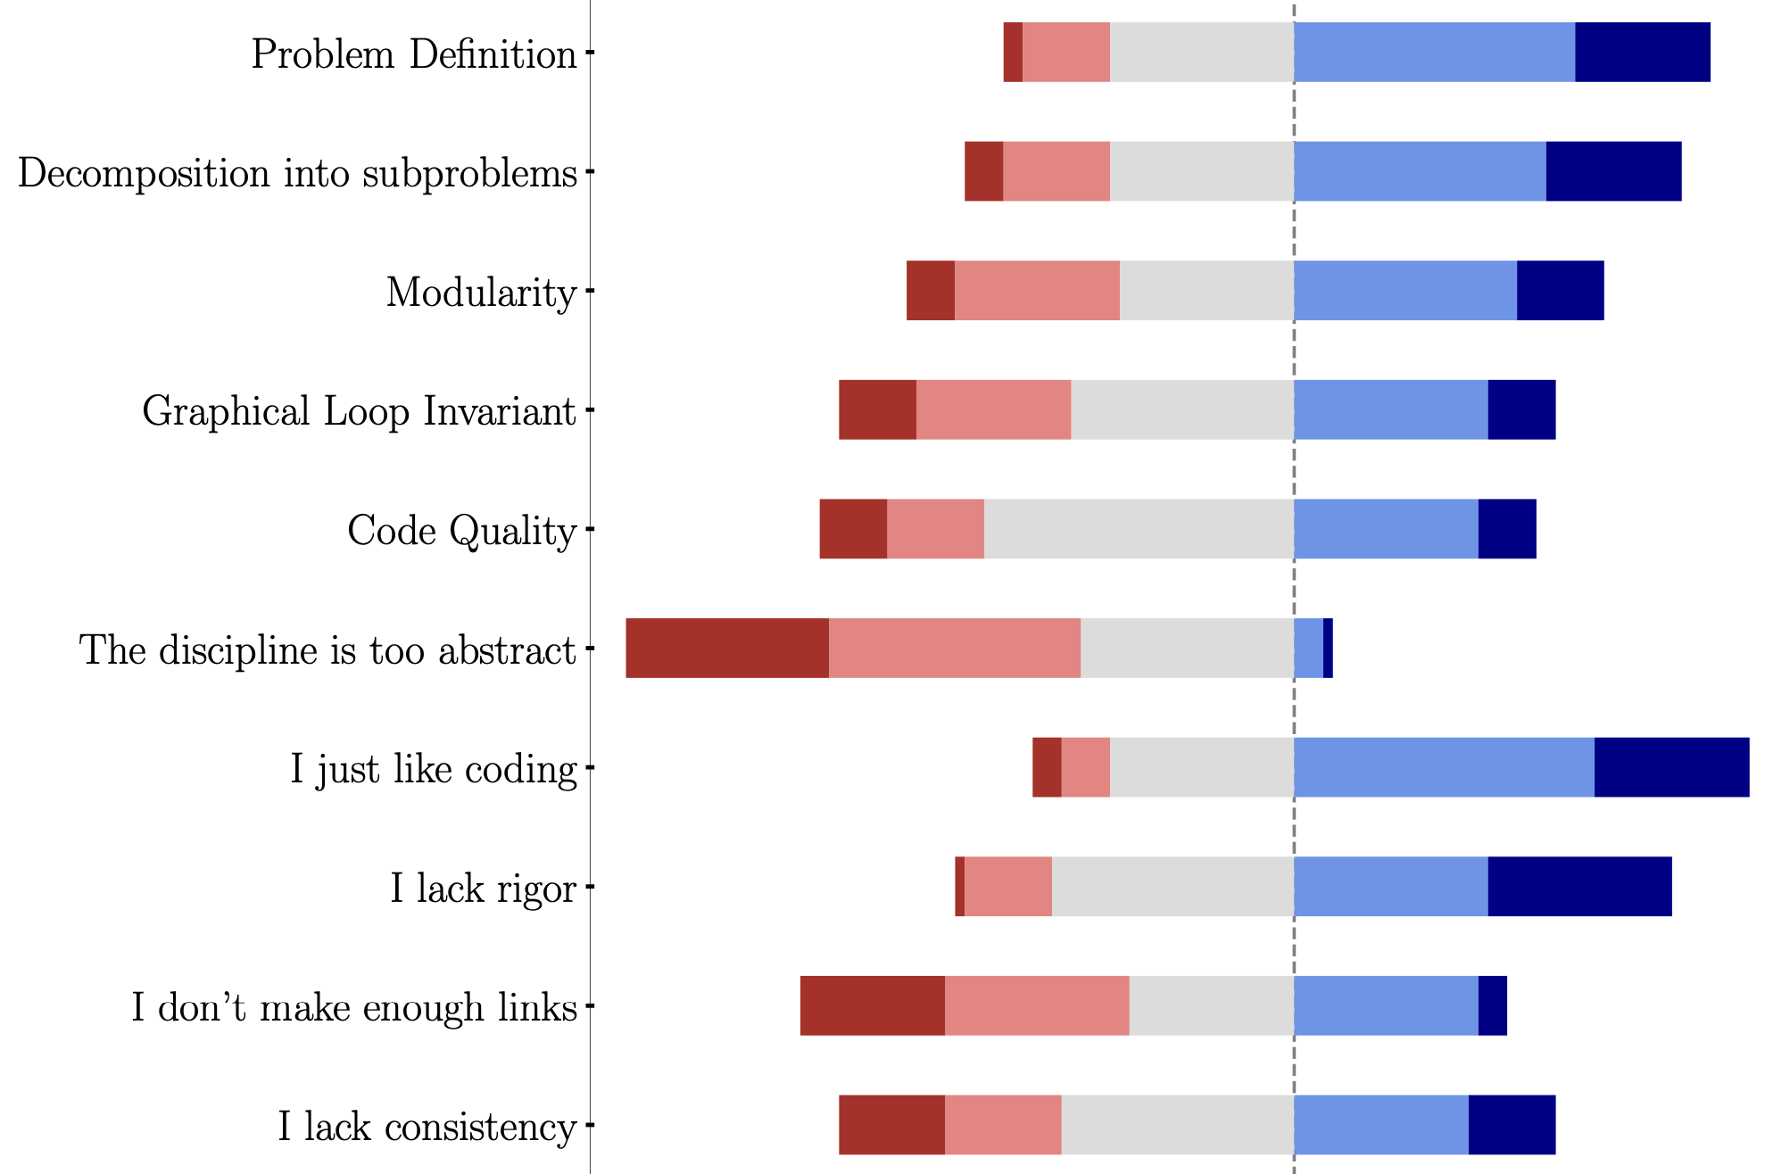
Preliminary Results : Students Perception
Students’ self-assessment
The Graphical Loop Invariant – Géraldine Brieven (gbrieven@uliege.be)

Slide 32
Preliminary Results : Students performance
The Graphical Loop Invariant – Géraldine Brieven (gbrieven@uliege.be)

