Slide 1





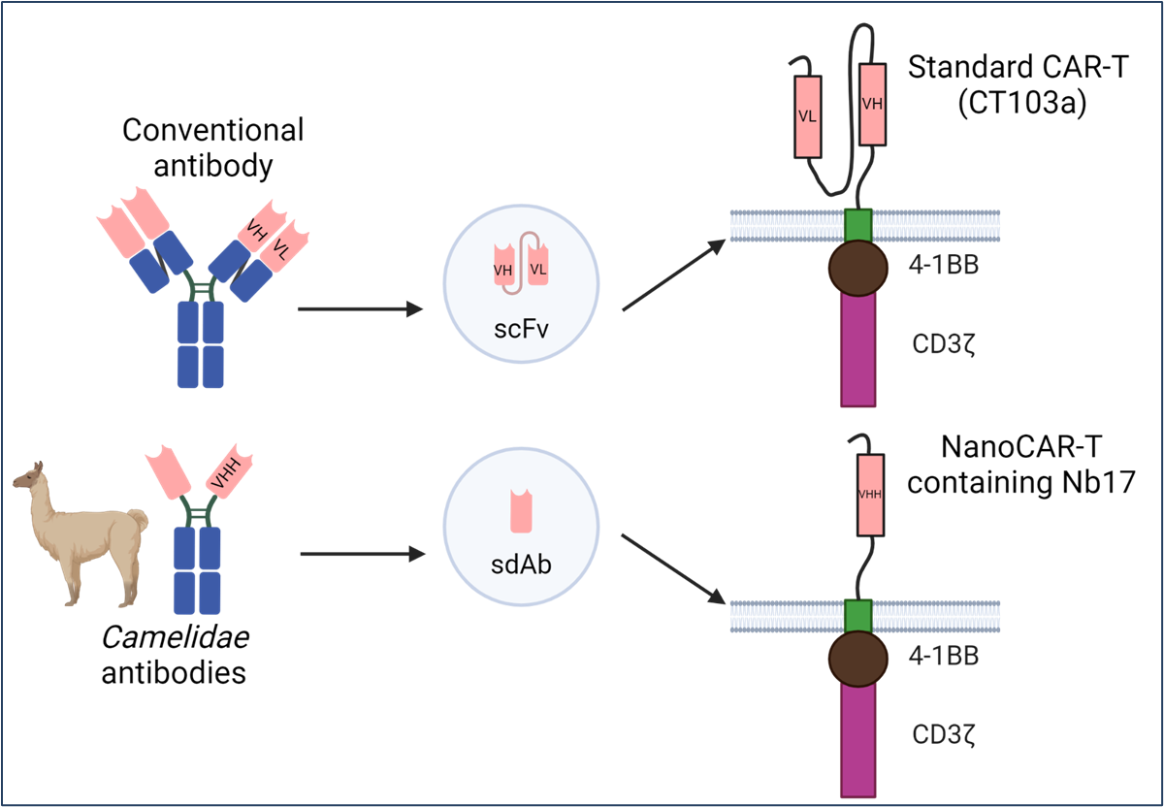
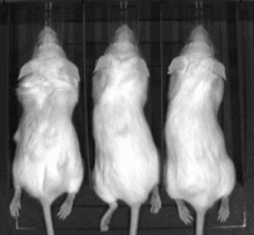
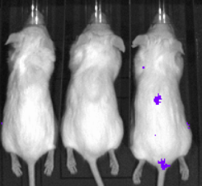
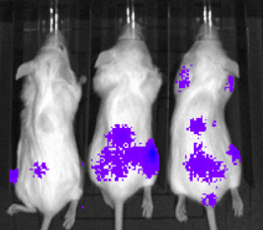
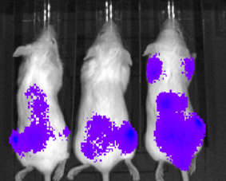
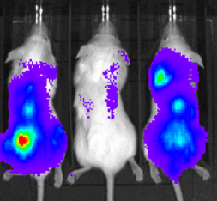

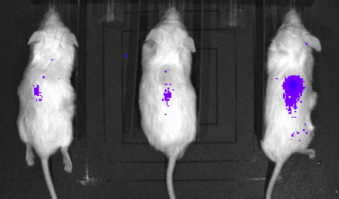
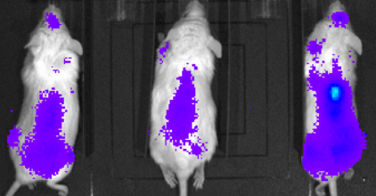
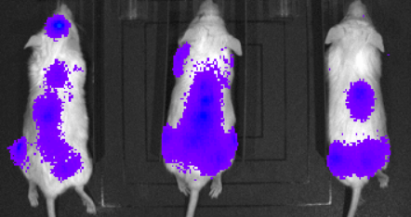
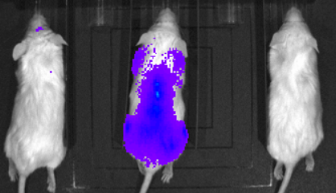
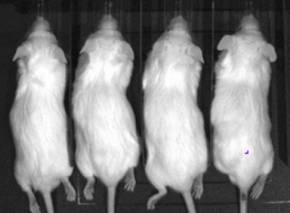
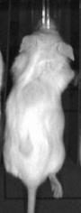
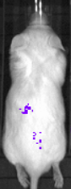
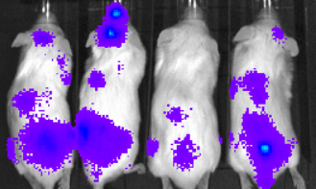
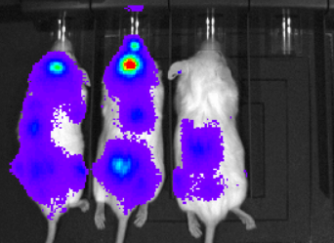

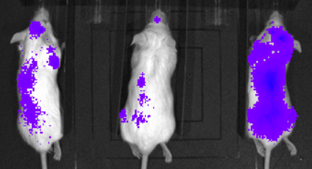
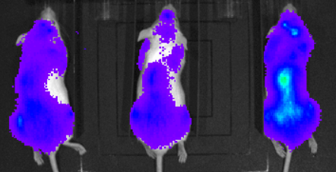
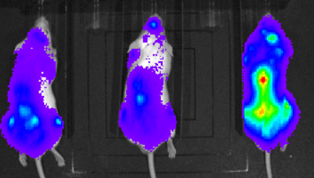
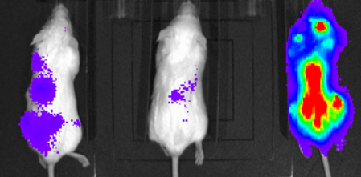
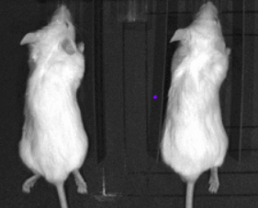
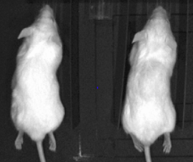
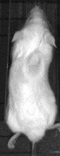
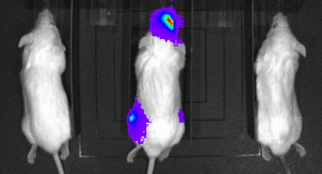
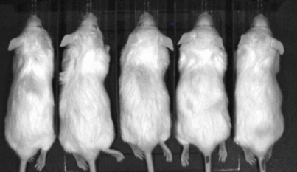
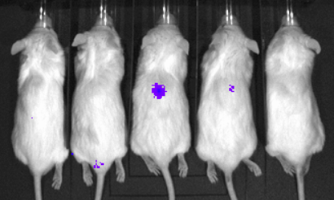
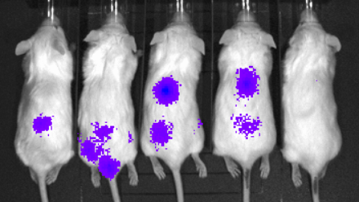
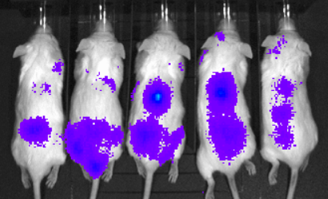
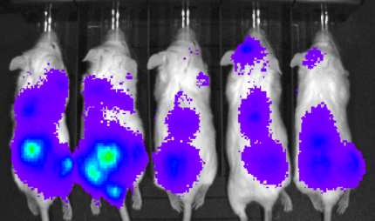
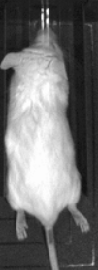
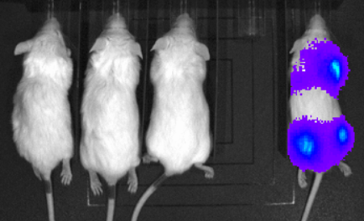
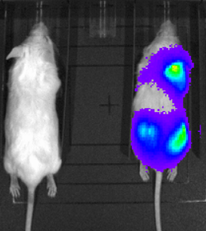
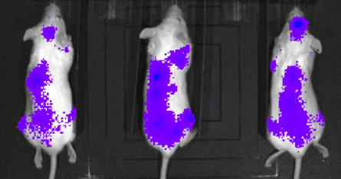
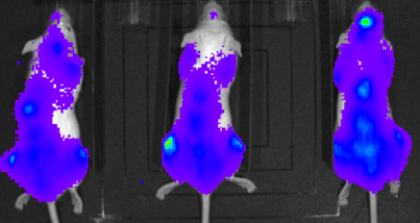
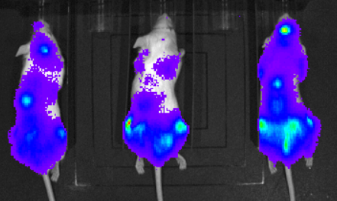
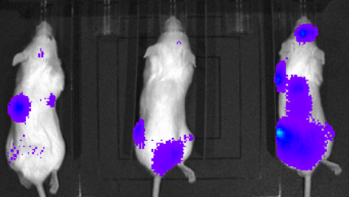
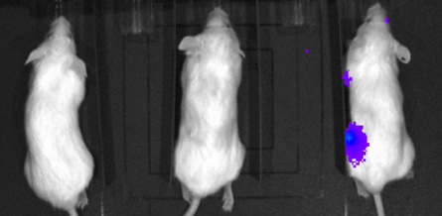
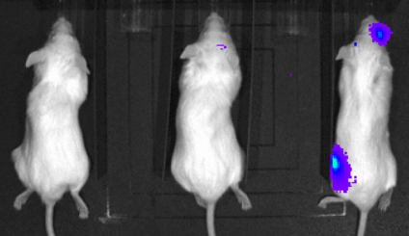
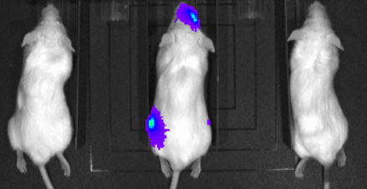
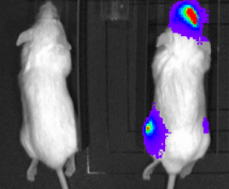
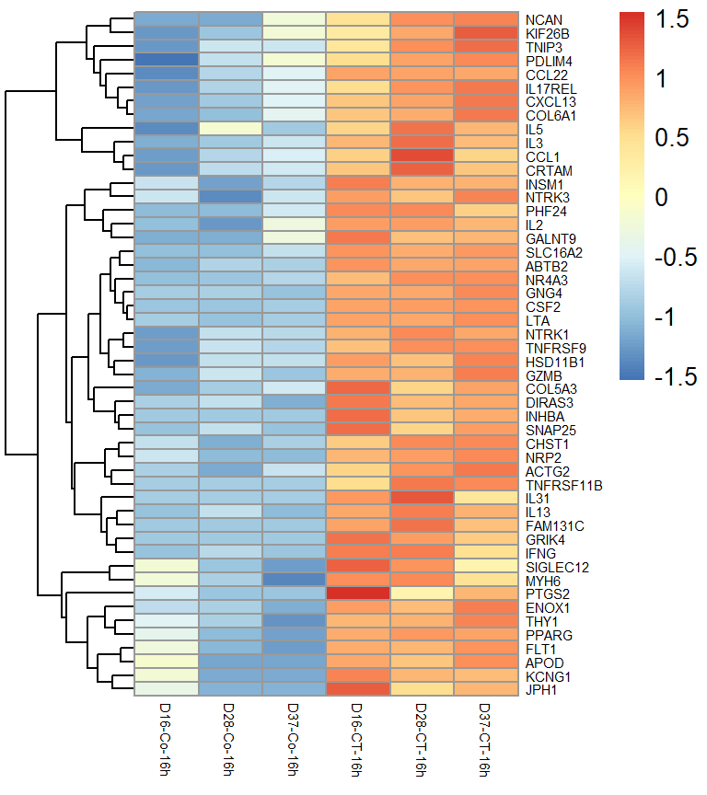
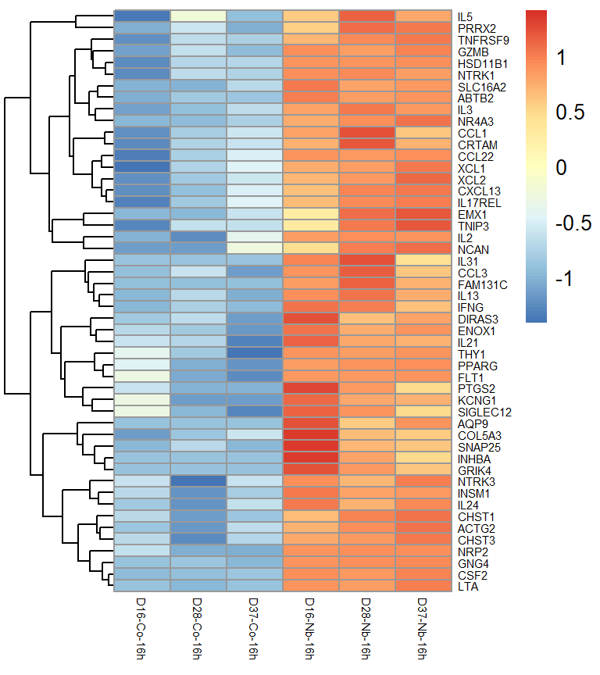
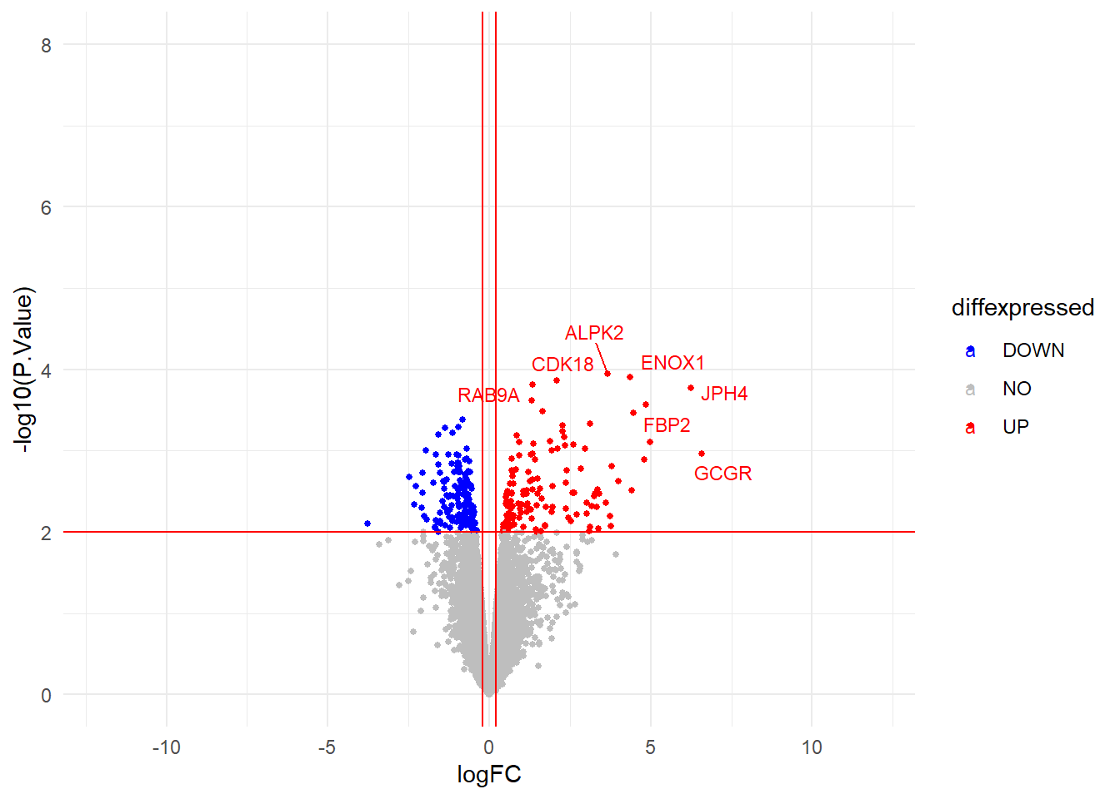
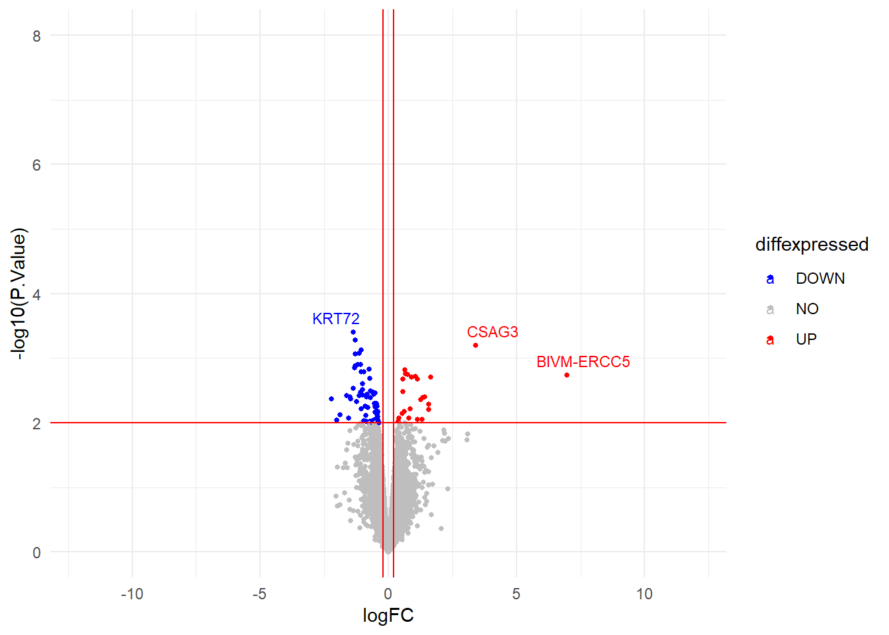
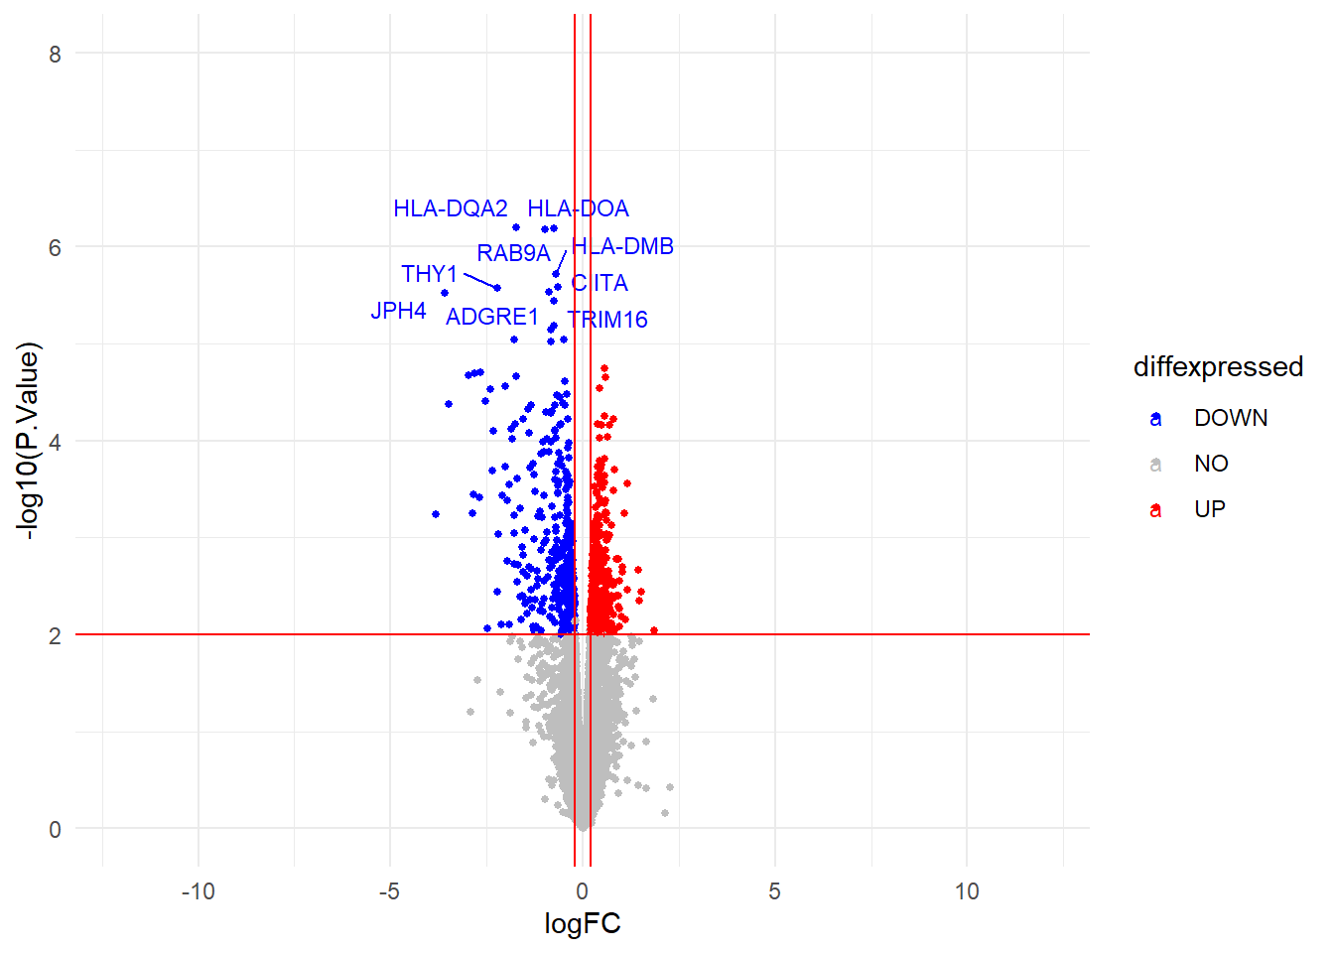
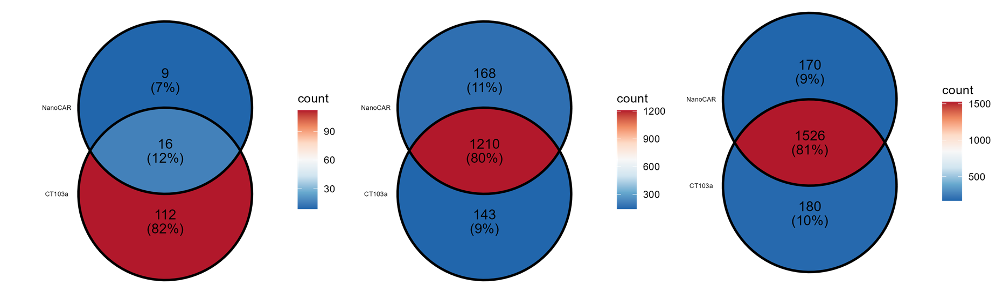
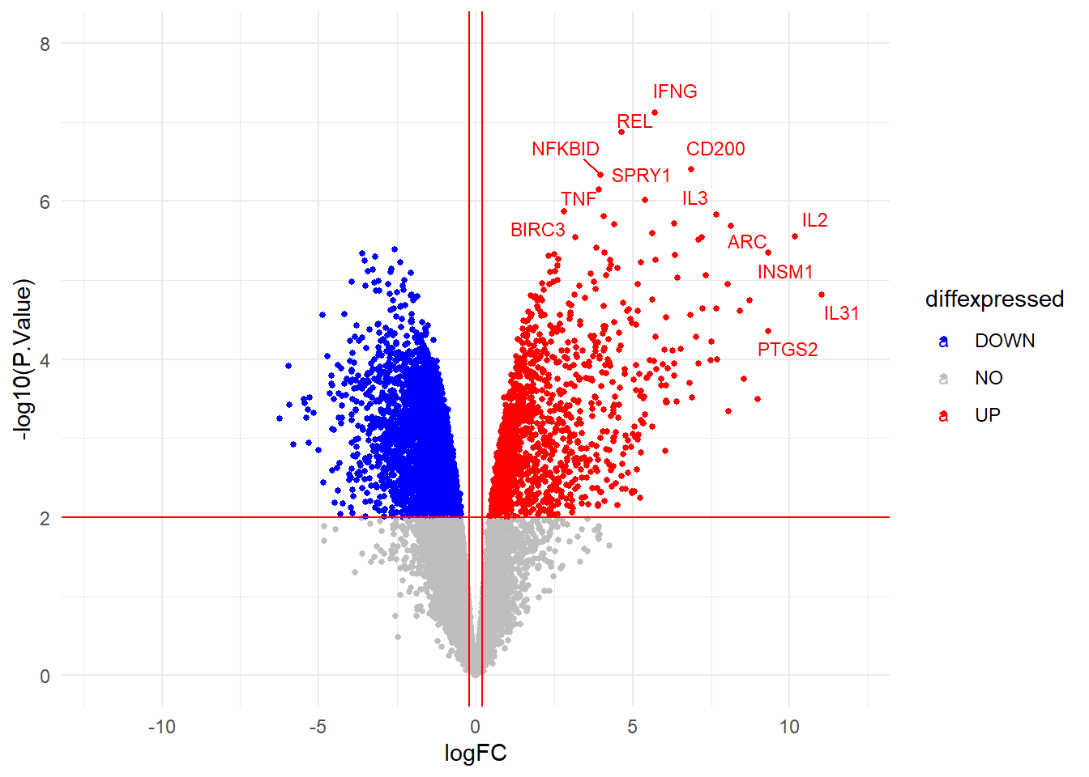

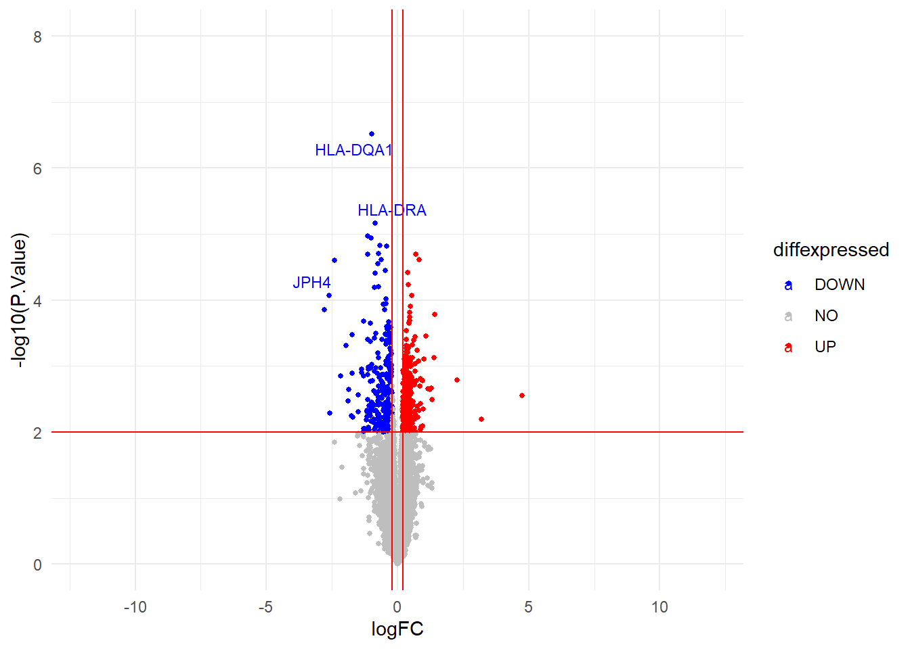
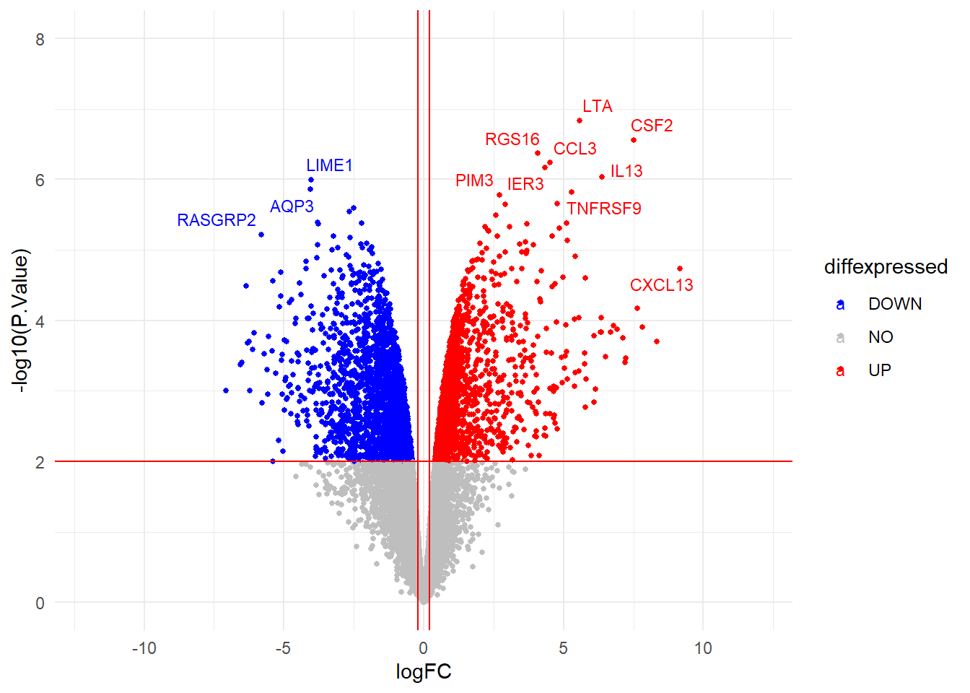

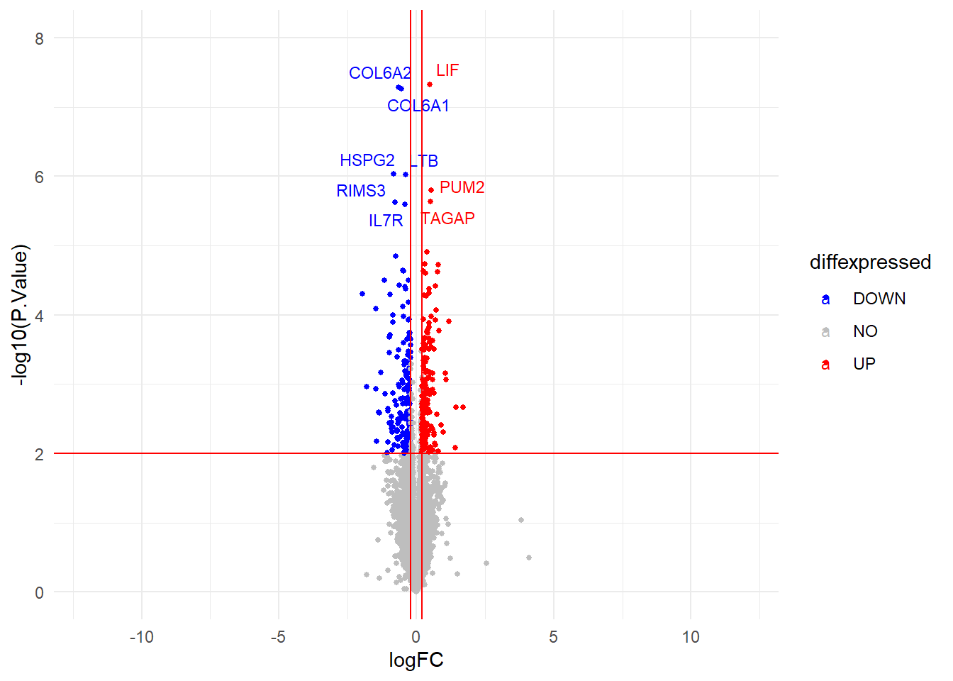

Design of a novel NanoCAR construct that compares well with a conventional ScFv-based CAR targeting BCMA on multiple myeloma
Mégane Jassin¹, Chloé Onkelinx¹, Bianca E Silva¹, Valentina Bocuzzi¹, Alix Block¹, Guillaume Marcion¹, Frédéric Baron^{1,2}, Emmanuel Di Valentin³, Grégory Ehx¹ , Tham Nguyen¹, and Jo Caers^{1,2}
1 Laboratory of Hematology, GIGA-I3, University of Liège, Liège, Belgium
2 Department of Hematology, CHU de Liège, Liège, Belgium
3 Viral Vectors, GIGA, University of Liège, Liège, Belgium
Introduction & Objective
Multiple myeloma (MM) is an incurable hematologic malignancy of plasma cells. Chimeric antigen receptor T lymphocyte (CAR-T) immunotherapy has shown remarkable results in relapse patients. Single-domain antibody (sdAb) offers an excellent alternative to scFv due to the advantage of having a small and stable folding structure, therefore avoiding tonic signaling. Despite the development of numerous nanoCAR-Ts, there is limited data demonstrating the direct differences and their mechanisms of action.
This project aims to characterize and compare the activity of a nanoCAR-T containing the sdAb Nb17 to the ScFv CAR-T CT103a, an FDA-approved CAR-T, to try to elucidate differences of mechanisms between them.
Methods & Results
CT103a and NanoCAR produce cytokines when co-cultured with MM
I
III
Construction of a NanoCAR sequence containing sdAb Nb17
(a)
(b)
*
(c)
(d)
Both CT103a and NanoCAR were generated using lentiviral transduction (a) and showed stable expression on the T cell surface (b). Transduction efficiency was verified by detecting the V5 tag with flow cytometry and CAR surface expression was quantified using QuantibrideTM Beads-PE. To design NanoCAR incoporating Nb17, we evaluated its BCMA-binding specificity with MM cell lines expressing varying BCMA levels (c, d).
This demonstrates a stable and persistent NanoCAR specifically targeting surface BCMA.
(g)
2,500
80
7,000
**
p=0.4727
60
6,000
p=0.0686
5,000
100
2,000
Cytokine production (IL-2, IFNγ and TNFα ) was measured by ELISA after 24-hour co-culture of CT103a, NanoCAR or Mock T cells with MM1.S or K562 (g). Both CAR-T cells produced significantly higher cytokine levels with MM1.S compared to Mock T cells, confirming their enhanced functional response to BCMA⁺ targets.
5,000
4,000
80
1,500
% of V5-tag positive cells
4,000
3,000
60
[IL-2] (pg/mL)
40
Quantification of CARs
% of Nb17 binding capacity
1,000
3,000
Cell surface BCMA
molecules/cell
40
20
2,000
2,000
500
0
1,000
1,000
20
0
Mock
0
CT103a
NanoCAR
0
0
-500
CT103a
NanoCAR
MM1.S
LP-1
LP-1
2,500
OPM-2
MM1.S
OPM-2
3 days after transduction
8 days after transduction
RPMI-8226
MOLP-2
RPMI-8226
MOLP-2
KMS-12-BM
KMS-12-BM
2,000
1,500
[IFNγ] (pg/mL)
II
1,000
In vitro efficacy of CT103a and NanoCAR in killing BCMA-positive MM cell lines
500
(e)
70
(f)
100
**
p=0.1230
***
p=0.0750
The cytotoxic capacity of NanoCAR, CT103a and Mock T cells was evaluated by flow cytometry after co-culture with MM1.S 48 hours at effector-to-target (E/T) ratios of 1/3, 1/1 and 3/1. Killing efficiency improved with higher ratios and longer incubation (e). A 1/1 ratio killing assay confirmed specific targeting of BCMA⁺ cells (MM1.S, RPMI-8226 LP-1) while sparing BCMA⁻ K562 cells (f).
These results demonstrate the efficacy and selectivity of CT103a and NanoCAR as therapeutic strategies for BCMA-expressing malignancies.
0
****
***
****
p=0.0625
-500
60
80
****
***
****
*
50
MM1.S
*
p=0.1359
p=0.0625
p=0.2775
2,000
Mock
60
1,500
40
% of GFP from all cells
% of alive MM1.S
CT103a
40
1,000
30
NanoCAR
20
[TNFα] (pg/mL)
20
0
500
10
CTRL
CTRL
CTRL
CTRL
0
Mock
Mock
Mock
Mock
CT103a
CT103a
CT103a
CT103a
-500
0
24h
48h
24h
48h
24h
48h
NanoCAR
NanoCAR
NanoCAR
NanoCAR
K562
MM1.S
Mock
Medium
CT103a
1/3
1/1
3/1
MM1.S
RPMI-8226
LP-1
K562
NanoCAR
Nb17 + K562
Mock + K562
Nb17 + MM1.S
Mock + MM1.S
CT103a + K562
CT103a + MM1.S
CT103a and NanoCAR eliminate tumors in vivo
Persistence of CAR-T killing ability following repeated antigen challenges
VI
IV
(h)
(l)
x10⁶
Control
x10⁶
x10⁶
NanoCAR
8
Mock
CT103a
8
CAR-T or Mock T cells were co-cultured with MM1.S, RPMI-8226, LP-1 or K562, followed by three rechallegens every two days. Viable cancer cell counts (h) and T/CAR-T proliferation (i) were evaluated by flow cytometry. Both CAR-Ts expanded with BCMA⁺ cells but not with K562 or without tumor cells while Mock T cells showed minimal proliferation in all conditions. These results highlight the sustained persistence and long-term efficacy of both CAR-T cells.
60,000
MM1.S
100,000
RPMI-8226
80,000
LP-1
150,000
K562
6
8
6
80,000
60,000
4
6
4
40,000
60,000
100,000
2
4
2
Number of live tumoral cells
40,000
ROI
1.5
ROI
2
ROI
1.5
20,000
40,000
20,000
50,000
1
1.5
1
20,000
0.5
1
0.5
0
Tumor
Mock
CT103a
NanoCAR
0
Tumor
Mock
CT103a
NanoCAR
0
Tumor
Mock
CT103a
NanoCAR
0
Tumor
Mock
CT103a
NanoCAR
0
0.5
0
15
18
22
26
29
32
34
36
39
0
57
64
22
68
79
90
22
53
67
79
90
32
71
32
34
34
39
50
82
39
61
15
46
15
18
43
46
18
29
43
(i)
100,000
60,000
150,000
30,000
Days
26
29
36
86
26
36
60
74
86
Cohort 1
Days
Days
80,000
(m)
Cohort 2
60,000
40,000
100,000
20,000
15
18
22
26
36
46
60
90
15
18
22
26
36
46
60
90
Number of live T cells
40,000
20,000
50,000
10,000
MM
20,000
0
0
0
0
Mock
Mock
Mock
Mock
CT103a
CT103a
CT103a
CT103a
NanoCAR
NanoCAR
NanoCAR
NanoCAR
Mock + Tumor
48h co-culture
Rechallenging 1
Mock + Tumor
Mock + Tumor
Mock + Tumor
CT103a + Tumor
CT103a + Tumor
CT103a + Tumor
CT103a + Tumor
NanoCAR + Tumor
Rechallenging 2
Rechallenging 3
NanoCAR + Tumor
NanoCAR + Tumor
NanoCAR + Tumor
None
Mock
CT103a and NanoCAR expressed similar set of genes or pathways when co-cultured with
MM1.S for 0h, 4h, or 16h
V
CT103a
Bulk RNA seq compared transcriptional profiles of CT103a, NanoCAR and Mock T cells at 0h, 4h and 16h post-incubation with MM1.S. Mock T cells served as a negative control and CT103a as the comparator. Heatmaps of the top 50 genes at 16h (j) showed upregulation of activation, proliferation and effector function genes in both CAR-T cells. Volcano plots highlighted minimal differences between CT103a and NanoCAR with many upregulated and downregulated genes shared (k, l). Despite similar transcriptional profiles, both CT103a and NanoCAR showed tumor-specific activation mechanisms distinct from Mock T cells.
(j)
(k)
Mock VS CT103a
Mock VS NanoCAR
CT103a VS NanoCAR
(l)
NanoCAR
(n)
(o)
CD27⁺
CD45RA⁻
(Blood)
NanoCAR
Count
100
CD4
(Blood)
CD8
(Blood)
CD4
(BM)
CD8
(BM)
TCM
(Blood)
CD27⁺
CD45RA⁻
(BM)
TEM
(BM)
90
100
p=0.9048
p=0.7302
p=0.4127
p=0.4127
100
p=0.2857
p=0.1905
p=0.1905
p=0.2857
60
Percent survival
0h
30
50
80
80
1.5
60
60
CT103a
0
% of signal
% of signal
1.0
0h
0
20
40
60
80
100
40
40
Days
Control
20
20
0.5
NanoCAR
Count
p=0.0884
**
***
Mock
0
0.0
1200
**
***
CT103a
CT103a
CT103a
CT103a
CT103a
0
*
NanoCAR
NanoCAR
NanoCAR
NanoCAR
NanoCAR
CT103a
CT103a
CT103a
CT103a
-0.5
900
NanoCAR
NanoCAR
NanoCAR
NanoCAR
-1.0
4h
600
-1.5
CT103a
300
MM1.S-GFP-luc were injected intraveinously into NSG mice then treated with Mock T cells, CT103a or NanoCAR-T 16-19 days after tumor injection. Untreated or treated with Mock T cells died within 30-40 days, whereas CAR-T treatments induced complete tumor regression after 10-20 days (l, m). Mice were subsequently minotored for long-term survival. However, some developped graft-versus-host disease. The Kaplan-Meier survival curves shown the MM-related mortality (n). In addition, we evaluated CD4 and CD8 T-cell subsets, and the CD62L⁺ (TEM) and CD62L⁻ (TCM) proportion of the CD27⁺CD45RA⁺ memory population (o). These results suggested both CT103a and NanoCAR-T display anti-MM activity, but may induce xenoreactivity against murine tissues.
4h
NanoCAR
Count
1500
16h
1000
CT103a
500
Mock
CT103a
Mock
NanoCAR
16h
Conclusion(s)
To conclude, we first designed a persistant and stable NanoCAR containing the sdAb Nb17. The specificity of CT103a and the NanoCAR CAR-T cells for BCMA-positive targets while sparing BCMA-negative cells, such as the K562 leukemia cell line, confirmed the potential of CT103a and NanoCAR as effective and selective therapeutic strategies for targeting BCMA-expressing malignancies. Morevoer, both CT103a and the NanoCAR demonstrated sustained persistence and long-term efficacy, suggesting their potential for prolonged tumor control. In addition, the cytokine production highlighted the robust cytotoxic potental and functional activity of CT103a and NanoCAR, confirming their functional readiness to engage and kill target. Also, according to overall bulk RNA seq data, while CT103a and NanoCAR demonstrated similar transcriptional profiles, their distinct gene signatures relative to Mock revealed shared mechanisms of tumor-specific activation. In vivo, CT103a and nanoCAR-T cells eradicated MM1.S tumors.
Thus, our nanoCART demonstrates excellent anticancer efficacy as CT103a in vitro and in vivo.
Acknowledgements
Members of the Laboratory of Hematology
Viral Vector platform (GIGA) – Flow Cytometry platform (GIGA ) – RNA seq platform (GIGA)
Contact Information
Megane JASSIN, PhD Student at the Laboratory of Hematology, University of Liège – GIGA, Belgium
megane.jassin@uliege.be

