Slide 1


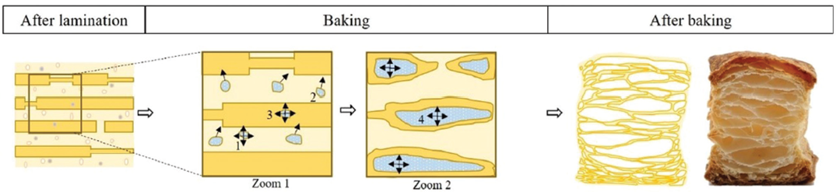
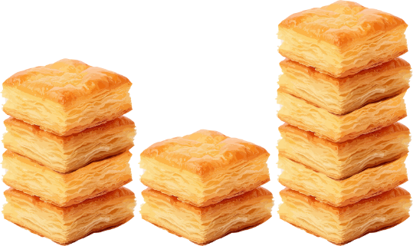
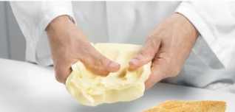
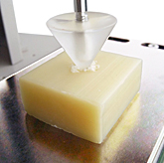
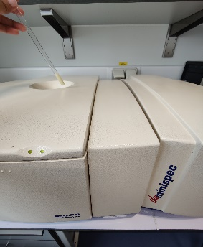
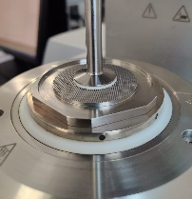
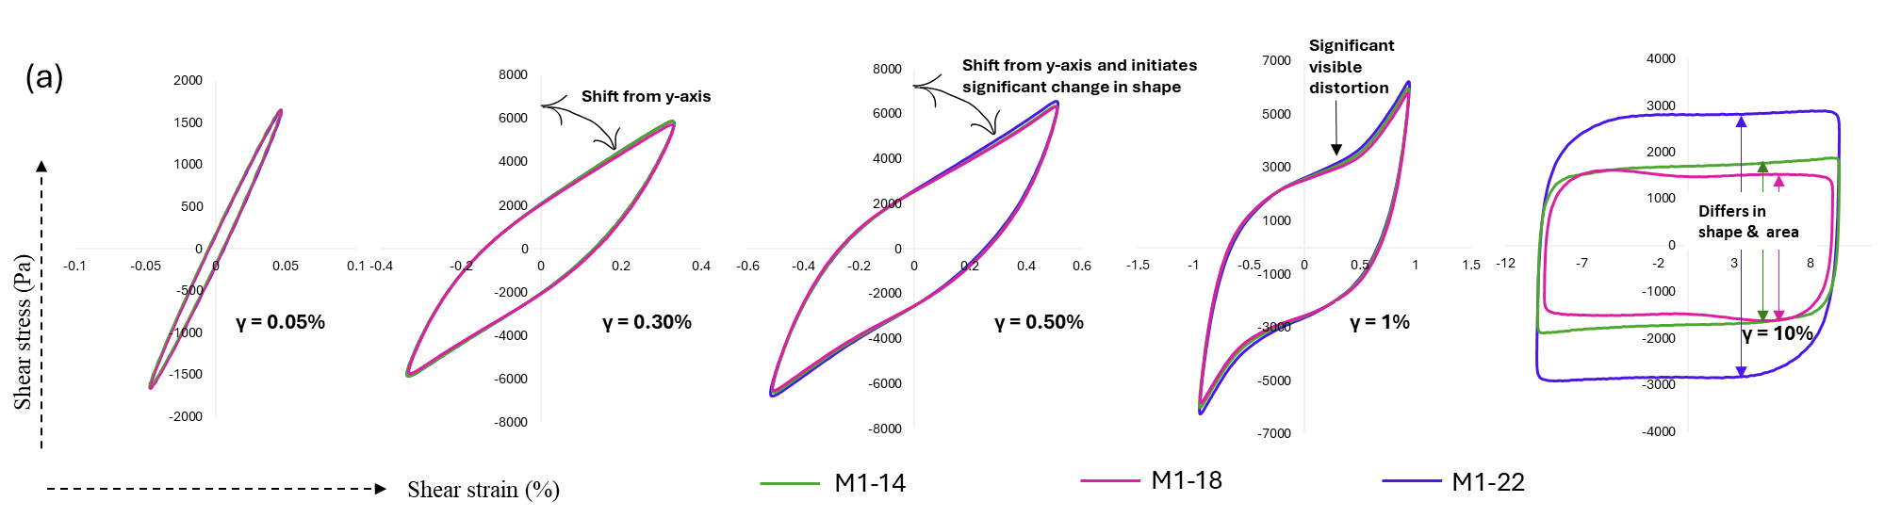
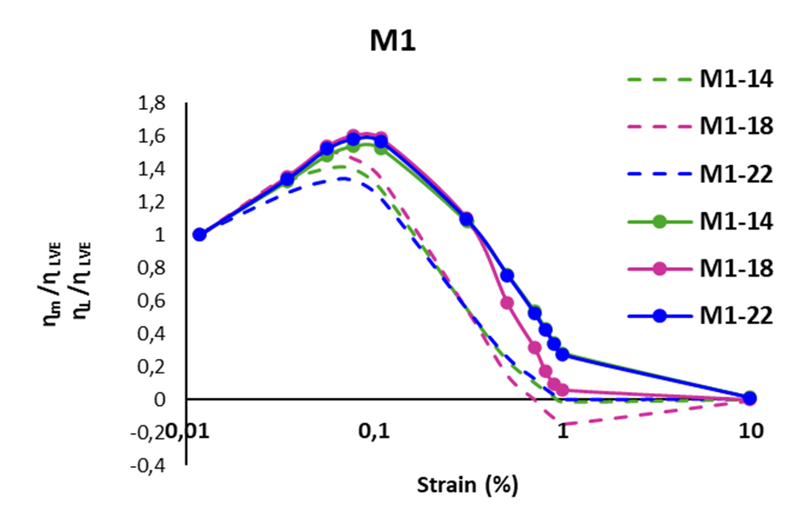
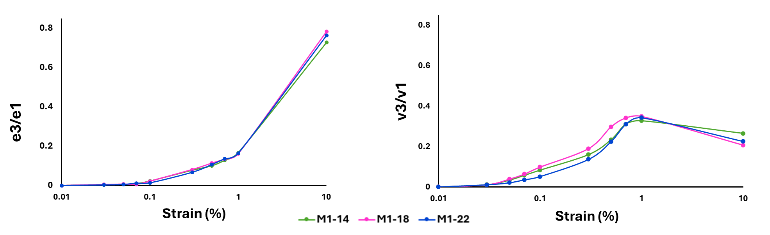
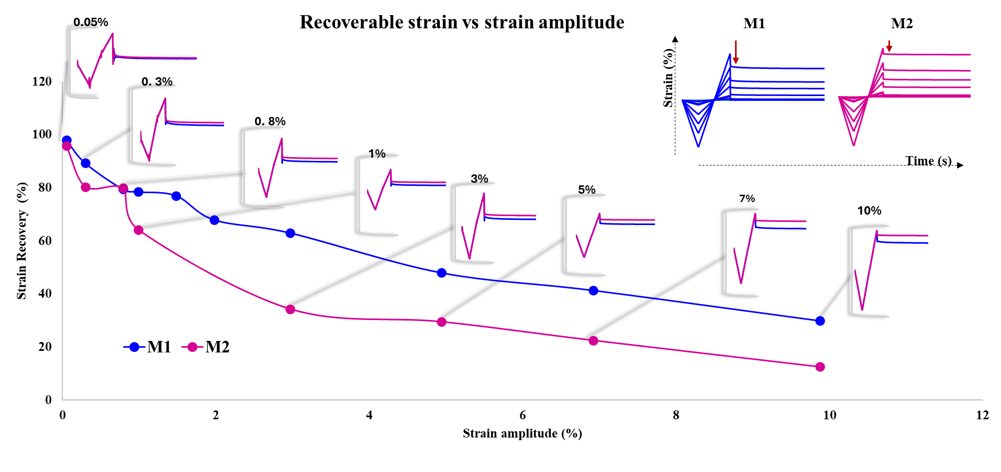
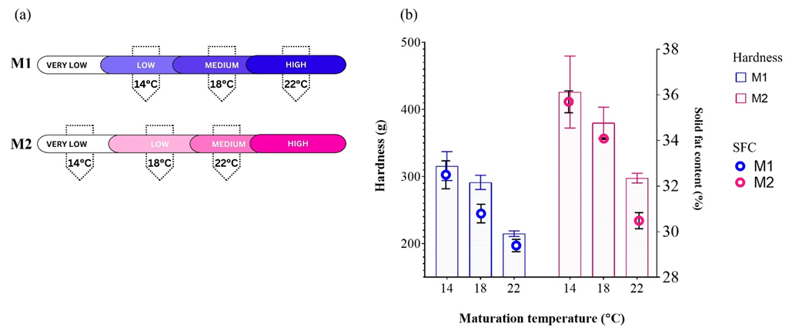
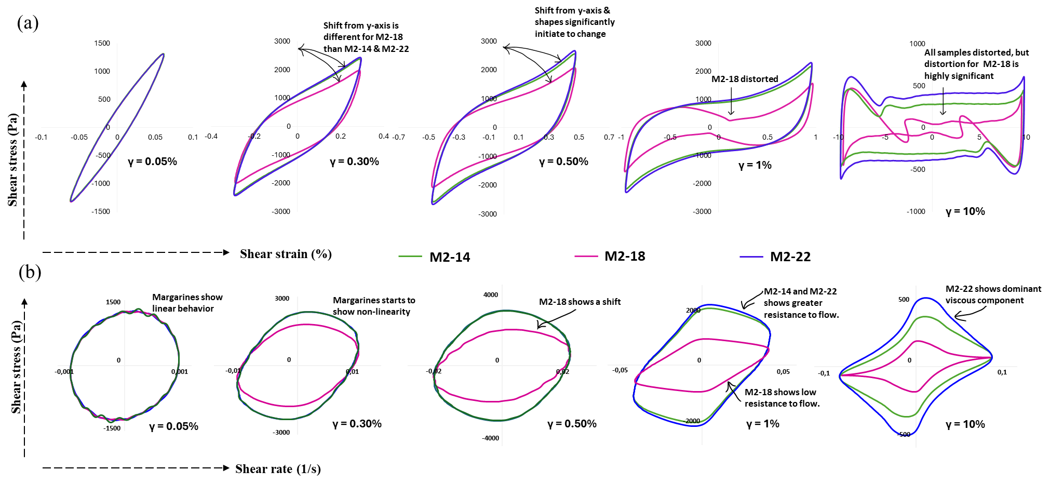
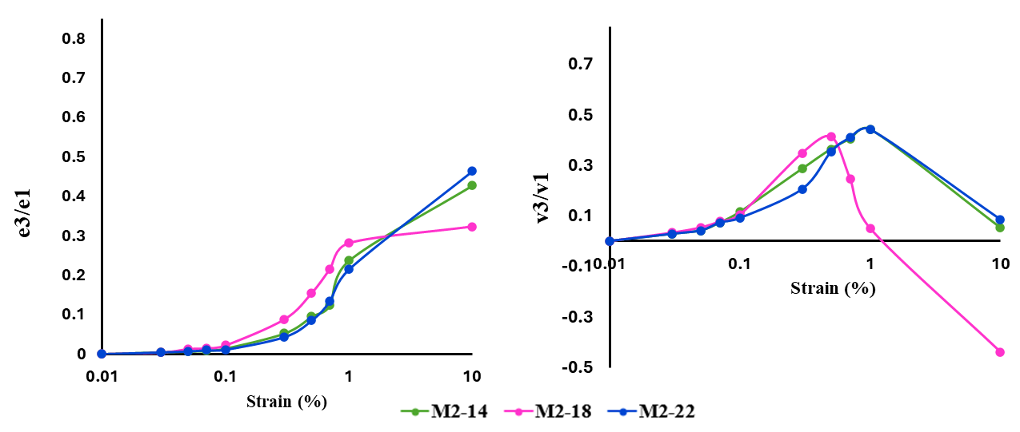
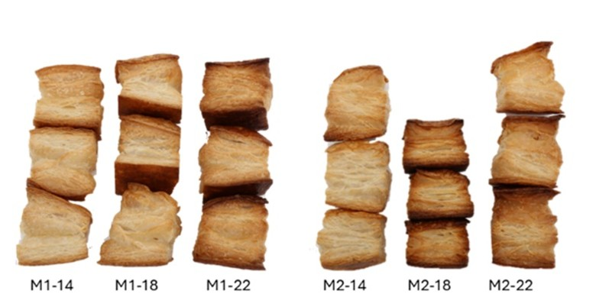
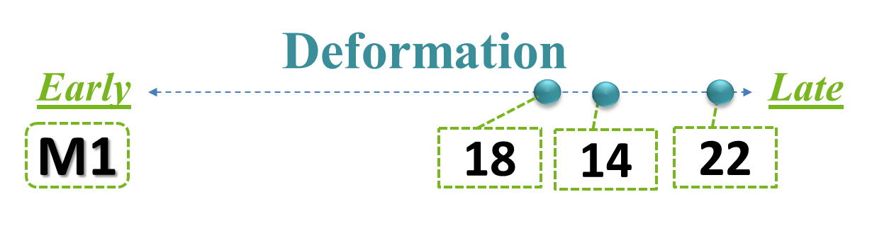
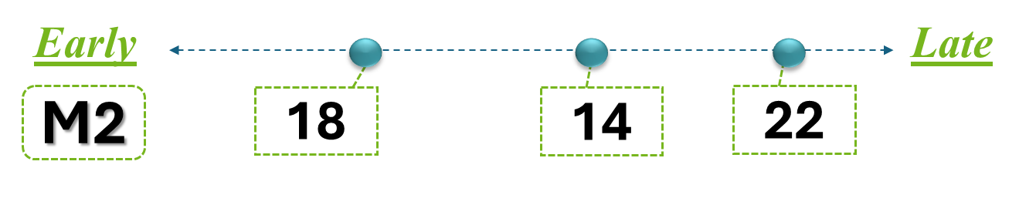

LAOS: Analysis of Puff Pastry Margarine Fat Crystal Network
A. Chakraborty^{*1}, C. Blecker ¹ , V. Van Hoed ², C. Deledicque ², P. Barthelemy ², R. Detry ² , S. Danthine ¹
¹ Liège University, Gembloux Agro-Bio Tech, Belgium.
² Puratos, Industrialaan 25 Puratos nv Zone Maalbeek, 1702 Groot-Bijgaarden, Belgium.
INTRODUCTION
METHODOLOGY
Functional properties of lamination margarine¹:
plastic margarine
Plasticity ~ combination of elasticity & viscosity
Rapid measurement methods industry uses :
    sensory method : thumb tests
    instrumental methods : hardness (TA) and SFC (NMR)
  to understand and predict the plastic nature of margarine.
LAOS (Large Amplitude Oscillatory Shear) method could detect the difference in plasticity for all-purpose and lamination margarine.
ANALYSIS
CONFIRMATION
Sensory method
Instrumental method
Baking performance
Trained panel
Measurements | Equipment – probe
(i) Hardness | Texture analyzer - cone probe (45°)
(ii) Solid fat content | Nuclear Magnetic Resonance
(iii) Rheological test | Rheometer - Serrated parallel plate
PRODUCT
SPECIFICATIONS
Margarine | M1, M2
Composition of margarines | Same
Processing conditions | Slightly different
Maturation temperature* | 14°C, 18°C, 22°C
Storage temperature | 18°C
GAP: Sensitivity of LAOS method has never been tested for margarine for same application (lamination margarine).
OBJECTIVE
LAOS SENSITIVITY TO PREDICT BAKING PERFORMANCES OF SAME COMPOSITION BUT DIFFERENTLY PROCESSED MARGARINE
RESULTS
Elastic Lissajous-Bowditch (L-B)
Dynamic Viscosity
Higher dynamics data acquisition using LAOS analysis
Elastic
Viscous
M2–18 shows a faster onset of decay in strain recovery (after 0.80%) compared to M1–18 (after 1.50%).
M1–18 demonstrates greater elastic energy storage and higher strain recovery at 10% strain amplitude.
Strong fat crystal network in M1–18 maintains structure during lamination and baking.
M2–18 transitions to fluid-like behavior earlier, leading to weak structural integrity in dough layers.
A minimum level of strain recovery is essential for maintaining structure during lamination.
Elastic Lissajous-Bowditch (L-B) loops show that all M1 margarines behave similarly under low and moderate strain, but M1–22 stores and dissipates the most energy at high strain.
M1–18 transitions to a fluid-like state at lower strain than M1–14 and M1–22, making it less stable under stress.
Higher harmonics indicate strong nonlinear elastic response and strain stiffening in all M1 samples, especially at higher strains.
Strain recovery tests coupled with LAOS provide deeper insights into margarine plasticity and time-dependent behavior.
Margarine matured at higher temperatures (22 °C) showed greater plasticity and lower hardness.
M2 samples were more brittle at lower temperatures, with hardness increasing over time due to post-hardening.
Physical and sensory tests predicted baking performance trends, but baking results did not fully match these predictions.
Higher dynamics data acquisition using LAOS analysis
Elastic
Viscous
M2–14 and M2–22 have similar elastic and viscous L-B loop shapes, indicating comparable viscoelastic properties.
M2–18 shows a distorted elastic L-B loop and reduced area, suggesting strong nonlinear behavior.
M2–18's viscous L-B loop area decreases with strain, indicating more fluid-like behavior under stress.
Higher harmonic analysis (e3/e1, v3/v1) indicates M2–18 displays more shear thinning and earlier viscous decay at high strain.
DISCUSSION OVERALL CONCLUSION
Viscous Lissajous-Bowditch (L-B)
Non- linear rheology indicates clear differences within margarine. Linear rheology cannot differentiate.
LAOS is a highly sensitive method.
LAOS can precisely predict plastic properties of lamination margarine.
Plasticity of the product can be improved with different maturation temperature.
Puff pastry height with M1 margarines is consistent across different maturation temperatures.
M2–14 and M2–22 give better rise and volume than M2–18.
M2–18’s uneven fat crystal network leads to poor layer separation and flat pastries.
Uniform crystal network is necessary for good steam release and pastry lift.
Presenter & author
achakraborty@uliege.be

