Slide 1



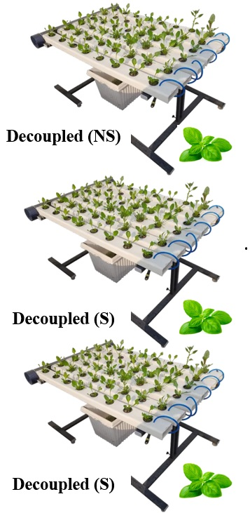
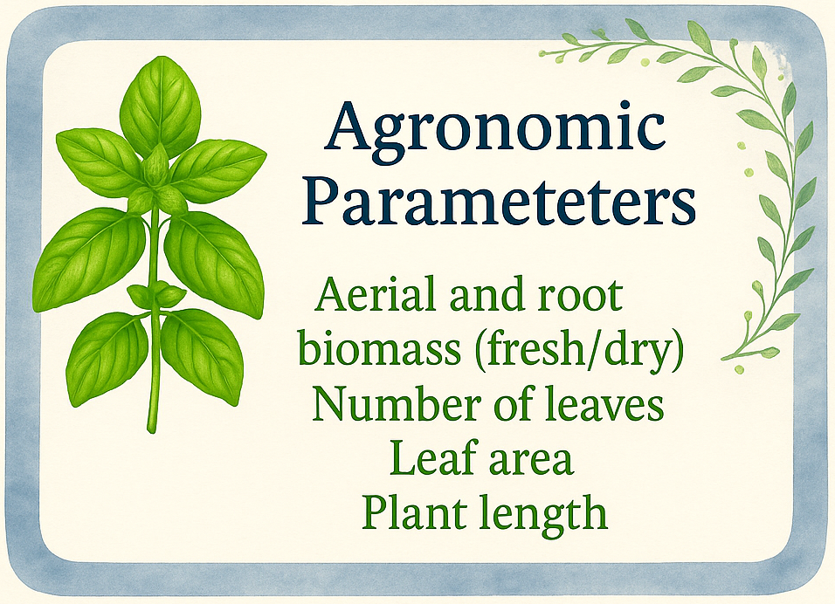
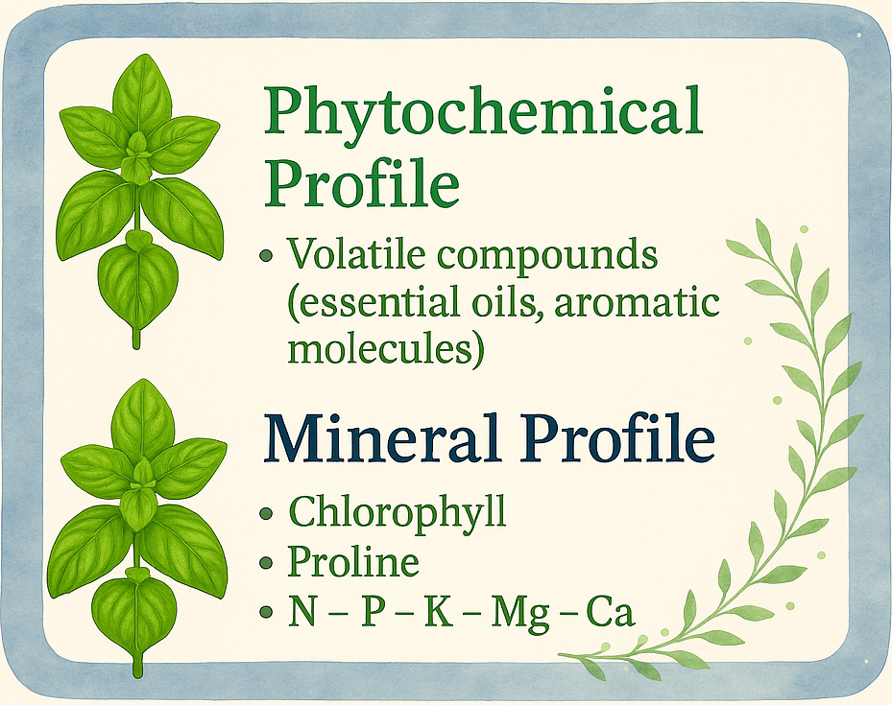
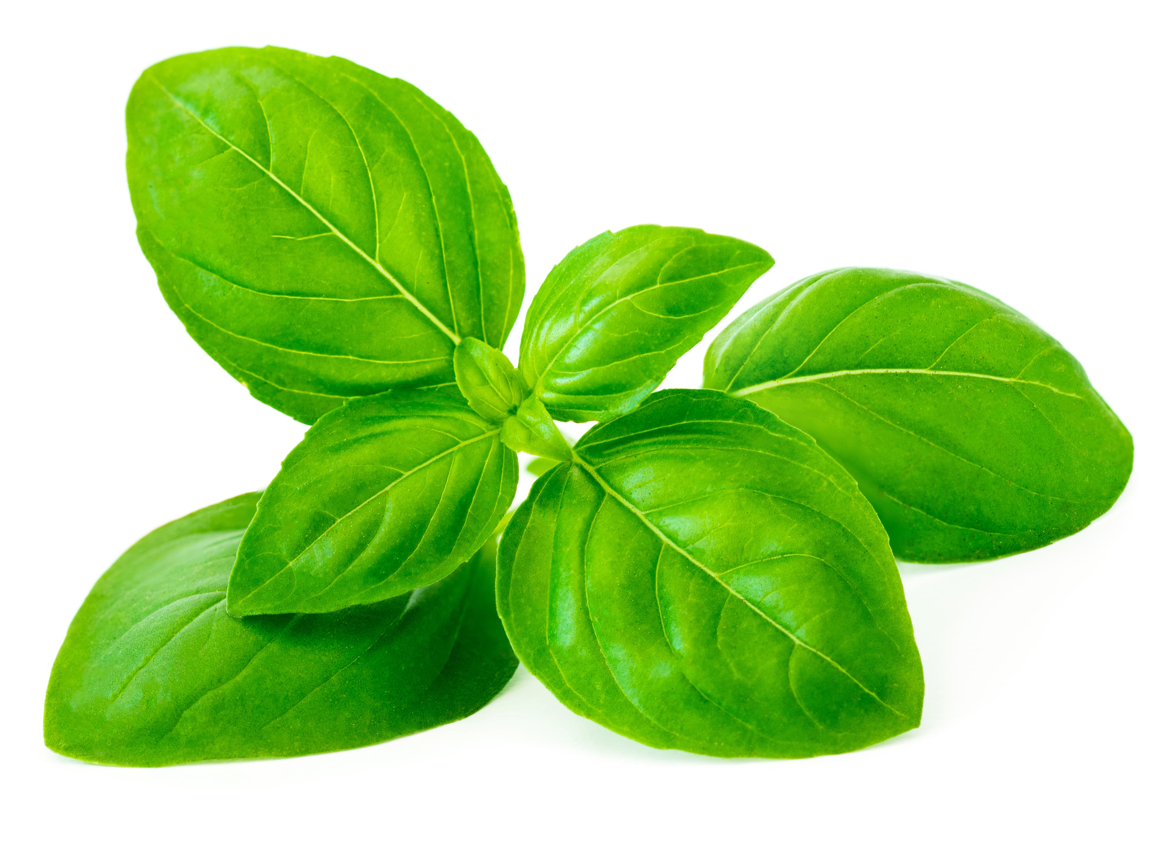
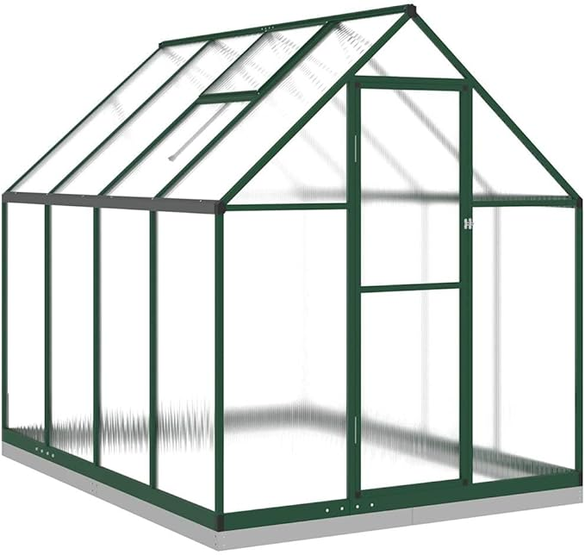

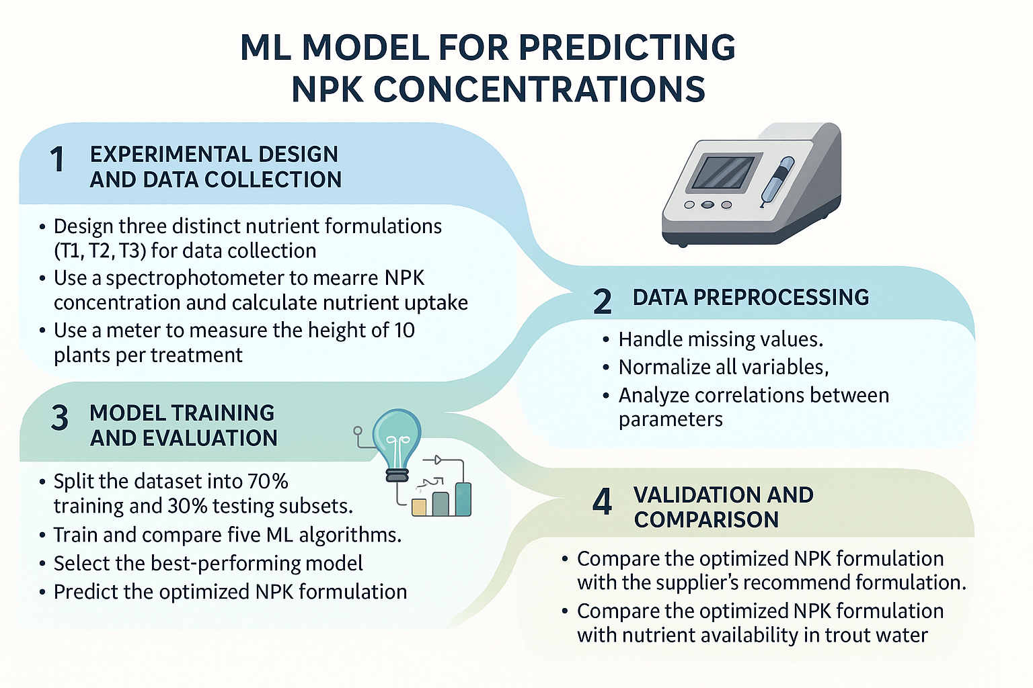


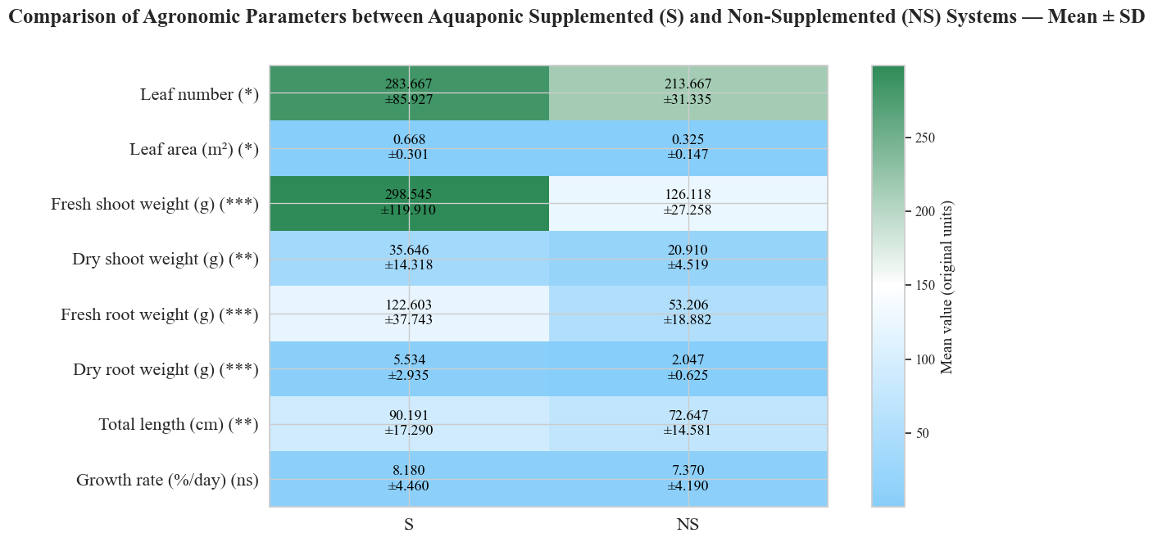
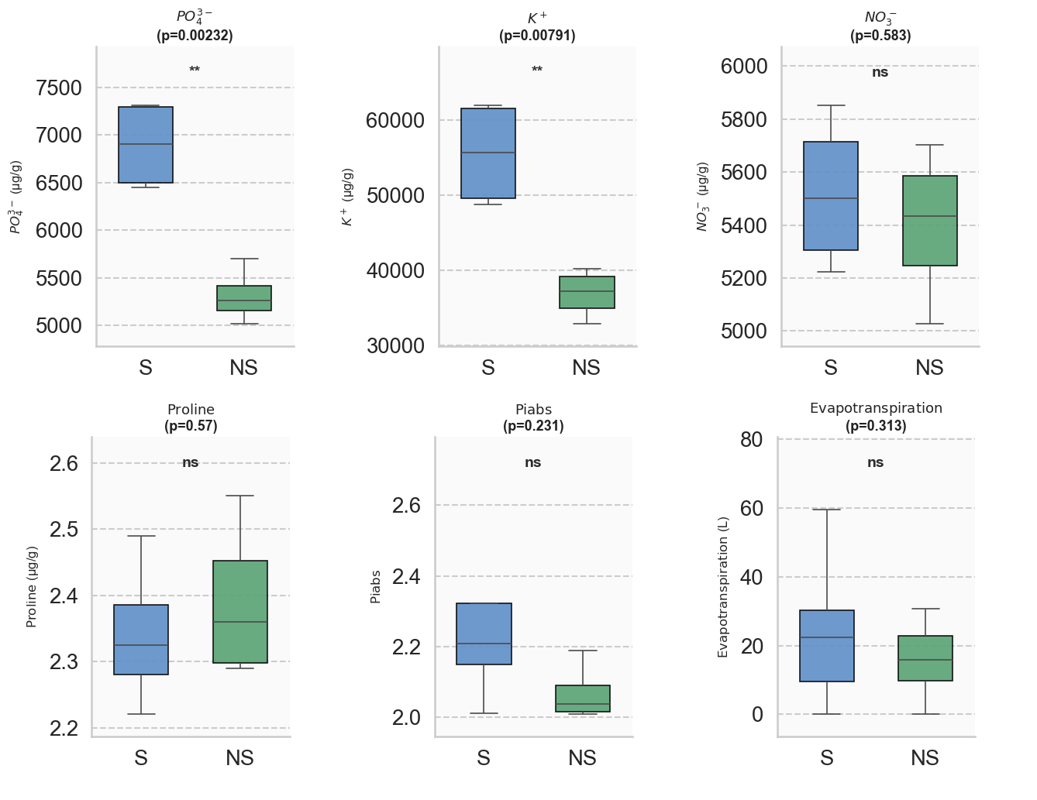
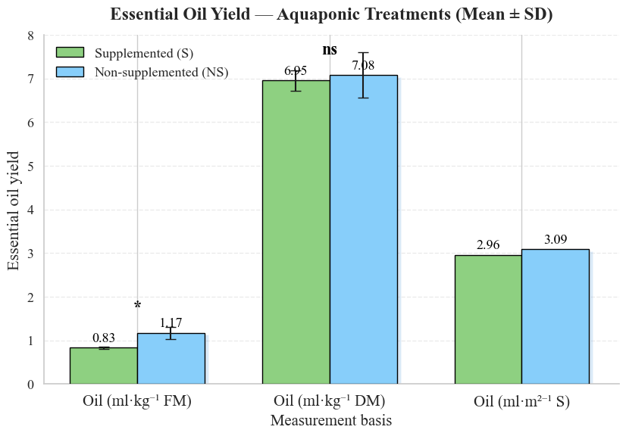
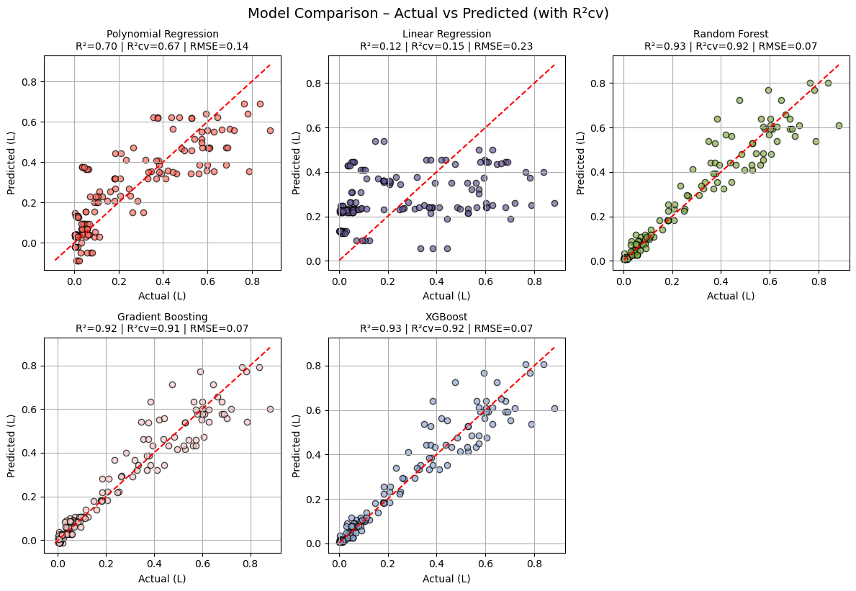
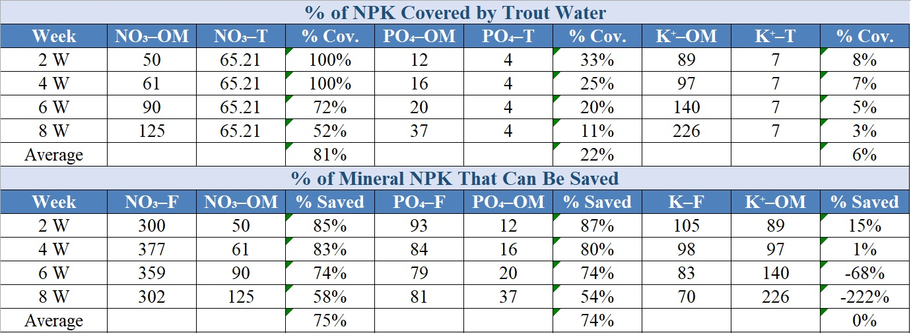
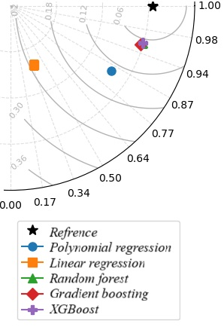
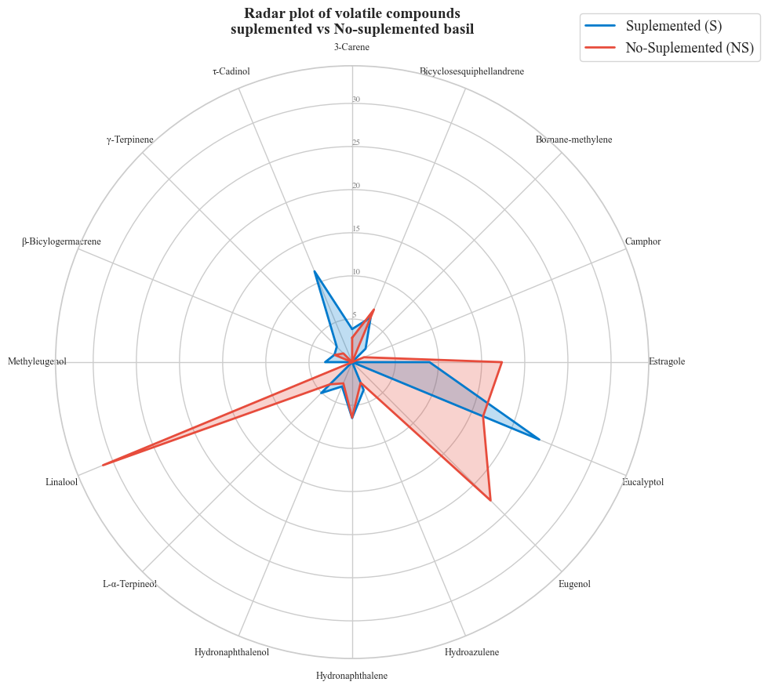
Towards a More Efficient Aquaponic System: Evaluation and Optimization of a Decoupled Trout-Based (Oncorhynchus mykiss) Aquaponics System
Elakrouch Mohammed ¹ *, Mohaddab Marouane ^{4,5} , Elmoussaoui Sarah ³ , Libault Arthur ¹, Rachid Ahmed ² and Jijakli M. Haissam ¹.
¹ Integrated and Urban Plant Pathology Laboratory, Gembloux Agro-Bio Tech, University of Liège, Passages des Déportés 2, 5030 Gembloux, Belgium,
² Electrical Energy and Associated Systems Team, University of Picardie Jules Verne, Chemin du Thil, 80025 Amiens Cedex 1, Amiens, France, ³ Department of Biology and Ecology, Université libre de Bruxelles (ULB), Brussels, Belgium,
⁴ Laboratory of Chemistry of Natural Molecules, Gembloux Agro-Bio Tech, University of Liège, Gembloux, 5030, Belgium,
⁵ Laboratory of Agrifood and Health, Faculty of Sciences and Techniques, Hassan First University of Settat, BP 577, Settat, 26000, Morocco.
1
Introduction
Aquaponics is an integrated, soilless cultivation system that combines aquaculture and hydroponics within a circular resource-efficient environment (Abdul Manan et al., 2025). This approach has gained increasing attention as a sustainable solution to reduce water use, minimize fertilizer dependency, and recycle nutrients through biological processes (Al Tawaha et al., 2025). Within these systems, the balance between fish metabolism, microbial nitrification, and plant nutrient uptake is crucial for maintaining stability and productivity (Hampuwo et al., 2025). In Wallonia, producers have focused on rainbow trout (Oncorhynchus mykiss), a cold-water species requiring around 15 °C, which conflicts with the higher temperatures preferred by nitrifying bacteria (Hampuwo et al., 2025; Natalia Naranjo-Robayo et al., 2025). Moreover, rainbow trout require high water quality with low mineral loads, a condition that may not be optimal for plant nutrition in aquaponic systems. As a result, compromise conditions such as low temperature and high-water renewal rate are implemented, yet their effect on plant performance remains poorly understood (Hampuwo et al., 2025).This study therefore aims to evaluate the agronomic and phytochemical performance of basil (Ocimum basilicum) grown in a decoupled trout-based aquaponic system, while also developing AI models to predict plant growth and optimize nutrient management under these unique conditions.
Methodology
The experiment was conducted in a semi-controlled greenhouse using three decoupled tables operating under the Nutrient Film Technique (NFT):
a non-supplemented table supplied exclusively with water from trout rearing,
(ii) a supplemented table (S-1) receiving a standard mineral formulation according to the supplier’s recommendations, and
(iii) a second supplemented table (S-2) enriched with a distinct NPK formulation.
At the end of the growth cycle, the two main treatments supplemented and non-supplemented (S-1) were compared based on several parameters: agronomic traits (aerial and root biomass — fresh and dry — number of leaves, leaf area, and plant length), essential oil yield, phytochemical profile, and mineral composition (chlorophyll, proline, N, P, K, etc.).In parallel, data on N, P, and K concentrations in the water and plant growth (length) collected from the three tables were used to train five machine learning models: linear regression, polynomial regression, Extreme Gradient Boosting (XGBoost), Random Forest, and Gradient Boosting. These models aimed to predict the optimal NPK concentrations to be supplied to basil every two weeks. The predicted optimal values were then compared with the supplier’s recommendations and the natural nutrient inputs provided by trout water, to assess the potential of aquaponics to reduce dependence on mineral fertilizers.
semi-controlled greenhouse
(S-1)
(S-2)
Figure 1 : Experimental Setup, Comparative Parameters in a Trout-Based Decoupled Aquaponic System, and Machine Learning Workflow for Nutrient Optimization
Results
Overall, the supplemented modality (S1) exhibited markedly higher vegetative growth than the non-supplemented one (NS), with significant increases in both aerial and root biomass, leaf number, and leaf area. At the biochemical level, analysis of plant extracts revealed that phosphorus (P) and potassium (K) concentrations were significantly higher in the supplemented modality, while nitrogen (N) showed no significant difference between treatments. This indicates that trout effluents alone were sufficient to meet the plants’ nitrogen requirements, whereas mineral supplementation mainly increased P and K accumulation. In parallel, proline and Piabs values were slightly higher in the non-supplemented plants, although the differences were not statistically significant (Figure 3). These tendencies suggest a mild nutrient limitation or stress in NS, enough to stimulate certain physiological responses without compromising photosynthetic efficiency. Interestingly, despite the lower vegetative growth, the non-supplemented modality (NS) produced a significantly higher essential oil yield when expressed on a fresh-weight basis. This observation indicates that the mild nutrient stress in NS may have promoted secondary metabolism, leading to greater essential oil accumulation. When expressed on a dry-weight basis, however, both modalities presented similar yields, implying a concentration effect rather than a true increase in biosynthetic activity (Figure 4). Phytochemical analysis further revealed compositional differences between treatments, with linalool (34%), eugenol (25%), and estragole (17%) identified as the predominant compounds, highlighting the aromatic and potential pharmaceutical value of the essential oils produced (Figure 5). .
Figure 2 : Comparison of agronomic parameters between Aquaponic supplemented (S1) and Non- supplemented (NS) systems.
Asterisks indicate the level of statistical significance
(* p ≤ 0.05; ** p ≤ 0.01; *** p ≤ 0.001; ns = not significant).
Figure 3 : Comparison of Mineral profile between Aquaponic supplemented (S) and Non- supplemented (NS) systems.
Table 1 : The table presents the percentage of NPK covered by trout water and the potential reduction in mineral fertilizer needs, as predicted by the best-performing model.
Figure 4 : Essential Oil Yield – Aquaponic Treatments.
Figure 6 : Machine Learning Models Comparison for Predicting Basil Growth in a Trout-Based Aquaponic System.
OM = Optimal Model, T = Trout water, F = Supplier formulation
Combining the measurements of nitrogen (N), phosphorus (P), and potassium (K) concentrations with basil growth data (plant length) and linking them to various machine learning models, it was observed that the linear regression model failed to capture the relationship between nutrient levels and growth variation (Figure 6). This result is consistent with the non-linear nature of the phenomenon under study.
In contrast, the polynomial regression model was able to better represent this relationship, achieving an accuracy of approximately 70 %. Decision tree–based models such as Random Forest, XGBoost, and Gradient Boosting exhibited much higher performance, accurately detecting the influence of NPK on basil growth, with prediction accuracies exceeding 90 %.
Based on these results, the best-performing model among the five tested was selected to predict the optimal nutrient concentrations to be supplied to basil every two weeks (Table 1). When comparing these optimal values with the nutrient concentrations provided by the trout rearing water, it was found that the latter covered approximately 80 % of nitrogen, 22 % of phosphorus, and 6 % of potassium requirements. Furthermore, by precisely adjusting nutrient inputs according to the model’s recommendations, it would be possible to achieve up to 75 % savings in nitrogen and phosphorus without compromising basil growth.
Figure 5 : Radar plot of volatile compounds supplemented vs no-supplemented basil.
Conclusions
This study highlights the agronomic, mineral, and phytochemical potential of basil (Ocimum basilicum) cultivated in a decoupled trout-based aquaponic system under temperate conditions. The comparison between supplemented and non-supplemented modalities demonstrated that while mineral supplementation significantly enhanced biomass and nutrient content, plants grown exclusively with trout water achieved comparable growth dynamics and even higher essential oil yields on a fresh weight basis. The integration of machine learning approaches, particularly decision tree–based models (Random Forest, XGBoost, Gradient Boosting), enabled the accurate prediction of basil growth in relation to NPK concentrations, achieving over 90 % predictive accuracy. These models revealed that trout water naturally provides up to 80 % of nitrogen, 22 % of phosphorus, and 6 % of potassium needs. Optimizing nutrient management according to model recommendations could therefore reduce nitrogen and phosphorus supplementation by approximately 75 % without compromising plant performance. Overall, this research demonstrates the strong potential of data-driven aquaponic systems to minimize fertilizer dependence while maintaining both agronomic productivity and phytochemical quality. It also provides a methodological framework for integrating artificial intelligence into the optimization of nutrient management in sustainable soilless farming systems.
Conclusions & prospects
References
Abdul Manan et al. – Aquaponics as a sustainable solution for food security. (2025), https://doi.org/10.46754/ps.2025.01.004.
Al Tawaha et al. – Optimizing NPK in decoupled aquaponic systems. (2025), https://doi.org/10.3390/nitrogen6010003.
Hampuwo et al. – Thermal stress effects on trout metabolism and genes. (2025), https://doi.org/10.1093/conphys/coaf025.
Naranjo-Robayo et al. – Role of nitrifying bacteria in nutrient cycling. (2025), https://doi.org/10.31910/rudca.v28.n1.2025.2653.

