Slide 1





Comparison of representational similarity of episodic memory traces at encoding and retrieval in younger and healthy older adults
EOS 23-24 Jan 2023
Zoltán Apa

Slide 2



Memory sensitivity during aging
General aim:
Investigating the characteristics of neural substrates of episodic memory
recognition task during aging
Are encoding and retrieving neural traces of episodic memory changing between younger and older adults?

Slide 3
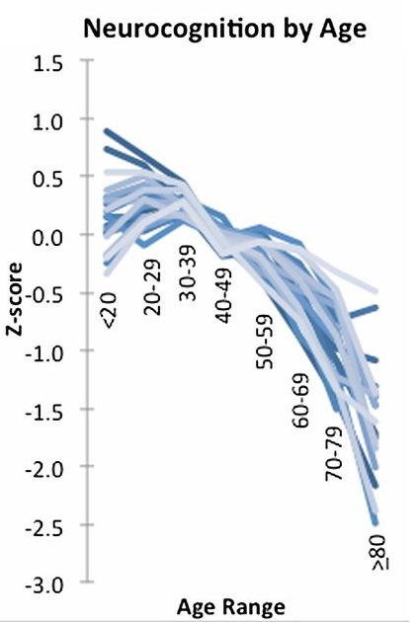
Decrease of recognition in aging
Why?
Reduced asymmetry for encoding and retrieval during aging
Poor sensorimotor capacity during information encoding implies low recognition performance
Glahnet et al., 2013
Tulving et al., 1993

Slide 4
Participants
 | Young | Older | t(116)
N | 53 (24F) | 63 (34F)
Age | 23,6 (3,07) [ 19-31] | 66,2 (4,42) [60-75] | ***(t=58.91; p<.001)
Education | 15.2 (1.8) [12-18] ¹ | 14,7 (2,75) [10-25] ² | NS (t=0.88; p=.38)
Mattis | - | 140.98 (2,56) [135-144] ³ | -
Note. ¹ N=46; ² N= 57, ³ N=54
Right-handed (from the Edinburgh laterality test)
No report of neurological or psychiatric disorder
Anxiety and depression levels below cut-off scores (BDI)
Free from medications known to affect the central nervous system
Older adults: Score to the Mattis Dementia Rating Scale> 130

Slide 5
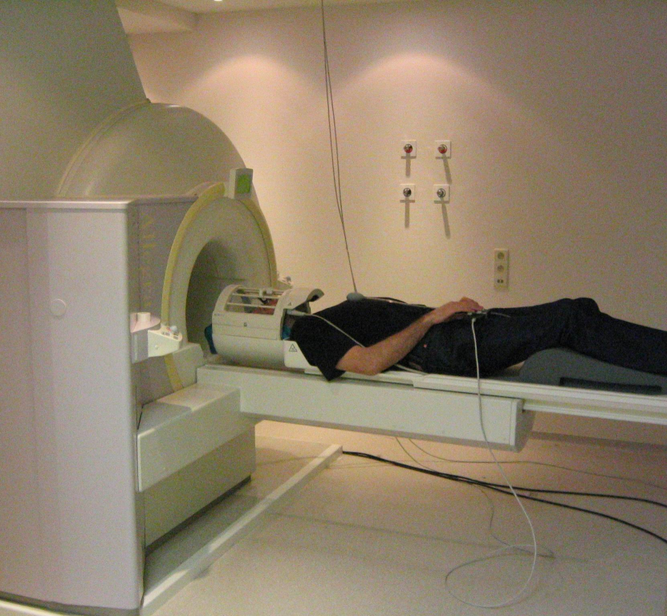
Procedure: MRI data acquisition
3 T Siemens scanners
T1-weighted anatomical images
T2* weighted echoplanar images (EPI)

Slide 6
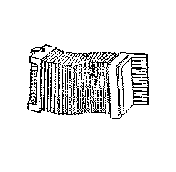
Procedure: image acquisition
ENCODING SESSION
TEST SESSION
Hard condition: 1 presentation of each picture
Easy condition: 2 presentations of each picture
100 items / condition
+
+
200 old and 100 new pictures
+
+
500 ms
500 ms
500 ms
→ « Remember (R)? Know (K)? New (N)? »
500 ms
4000 ms maximum
Yes?
No?
3000 ms
→ « Would the object fit into a shoebox? »
3000 ms minimum

Slide 7
Image Preprocessing
Reorientation
Motion correction and distortion
Co-registration (Functional to Structural)
DARTEL (Study specific template)
Normalization of functional data (using Flow field)

Slide 8
Methodological approach
How to efficiently assess neuronal activity patterns
1) between stimuli and conditions ?
2) across voxels ?
3) between younger and older adults ?
Using RSA to create Encoding-Retrieval Similarity (ERS) maps
Multivariate Pattern Analyses (MVPA) employ voxel-by-voxel variability to explain cognition
  Representational similarity analyses (RSA) is a dependent measure to the extent of voxel pattern similarity activity across distinct experimental conditions
Popal et al., 2019

Slide 9
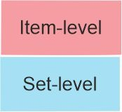
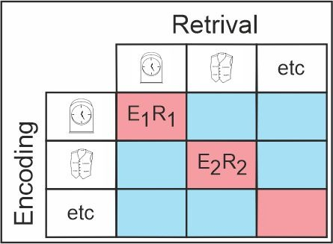
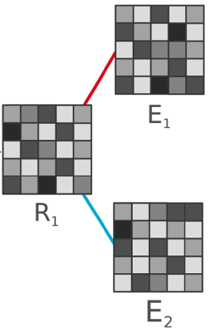
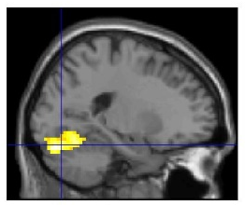
Encoding-Retrieval Similarity (ERS)
ERS was computed for each trial at item and set levels
Item-level (average ERS for given picture)
- brain activity similarity patterns between encoding and retrieval for an item (a particular picture)
Set-level (average ERS between a given trial vs. all other trials)
- retrieval brain activity similarity patterns associated with brain activity at encoding of the remaining items (remaining pictures)
We employed a voxel-vise searchlight procedure for similarity calculations
Item and Set maps were obtained by averaging corresponding cells in the ERS matrix
Item and Set maps were Fisher-Transformed and sent to SPM12 for group analyses
Ritchey, et al. 2013
Folville, Et al. 2020

Slide 10
Statistical analyses
SPM12 Full factor ANOVA on ERS maps
  similarity patterns between groups (older/younger) and trials (item/set)
Contrast selection
  Determining possible similarity patterns
  (Y_item – Y_set) – (O_item – O_set)

Slide 11
Statistical analyses
Full factor ANOVA on ERS maps
  similarity patterns between groups (older/younger) and trials (item/set)
Contrast selection
  Determining possible similarity patterns
  (Y_item – Y_set) – (O_item – O_set)
  Subtracting set level from the item level for both age groups

Slide 12
Statistical analyses
Full factor ANOVA on ERS maps
  similarity patterns between groups (older/younger) and trials (item/set)
Contrast selection
  Determining possible similarity patterns
  (Y_item – Y_set) – (O_item – O_set)
  To assess age groups similarity pattern differences
  we further subtracted one age group from the other

Slide 13
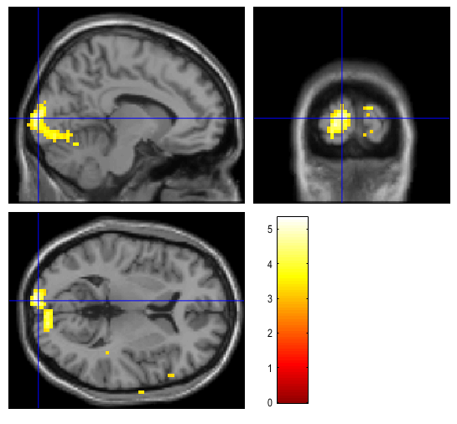
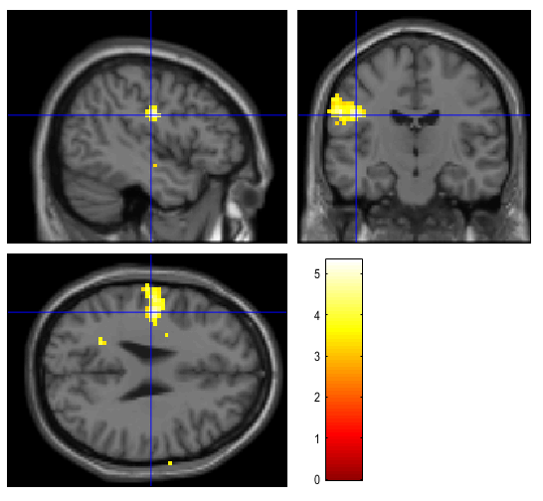
Results
Behavioral results
Lower performance in the older group, accuracy (p<0.01) and reaction time (p<.001)
Imaging results
(Y_item – Y_set) – (O_item – O_set)
(O_item – O_set) - (Y_item – Y_set)
/
(p<0.05 corrected at voxel level; figure displayed at p<0.001 uncorrected)
Larger encoding-retrieval similarity in young by comparison to older in left occipital pole and left post-central

Slide 14
DISCUSSION
Less specific similarity patterns of memory traces for pictures between encoding and recognition
denoted by lower ERS values in older adults
  The localization of ERS changes were associated with the occipital pole (processing of visual characteristics of objects) and the postcentral area (embodied cognition)
  This aging effect on recognition performance could be the result of poor visual and sensorimotor encoding processes resulting in less distinctive memory traces

Slide 15
Perspectives
Multivariate pattern similarity analysis technique
A resourceful tool to investigate memory performance differences during adulthood in future studies
Differences of neural representations between encoding and recognition
A relevant successful memory predictor?
Exploring incidental learning encoding-retrieval neural similarity patterns
A way to better understand memory functioning?

Slide 16
Stroop Study
Objective
-Based on previous research (Manard et al., 2017), we aim to investigate neural similarity patterns in older and younger adults involved in proactive and reactive control strategies
Participants
n=133 (old=70; young=63)
Procedure
  Participants underwent a modified fMRI STROOP task
  Preliminary sorting and Multivariate analyses script development
  RSA computational analyses to decipher cortical representational similarities of task dependent conditions between young and older adults

Slide 17
THANK YOU !

