Slide 1

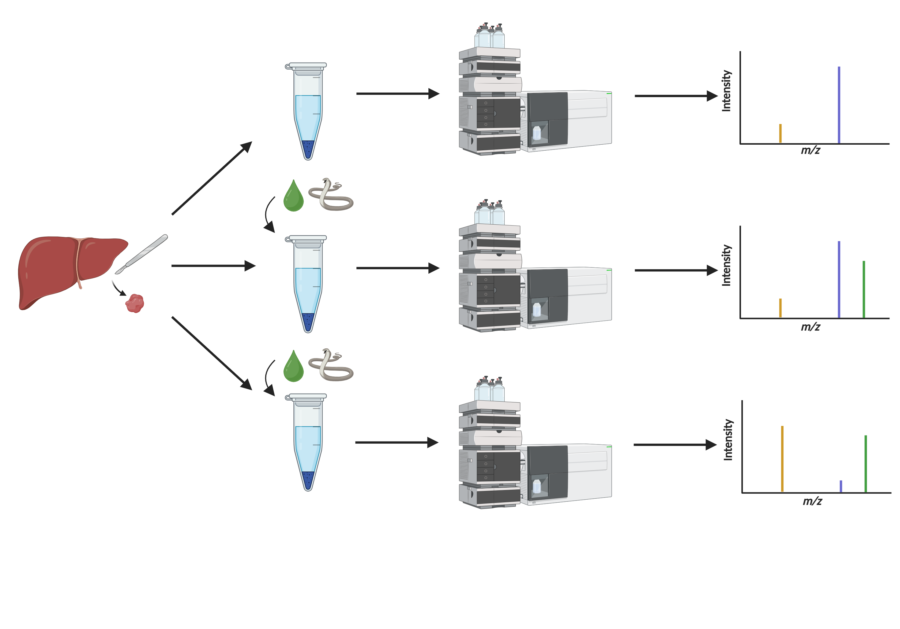
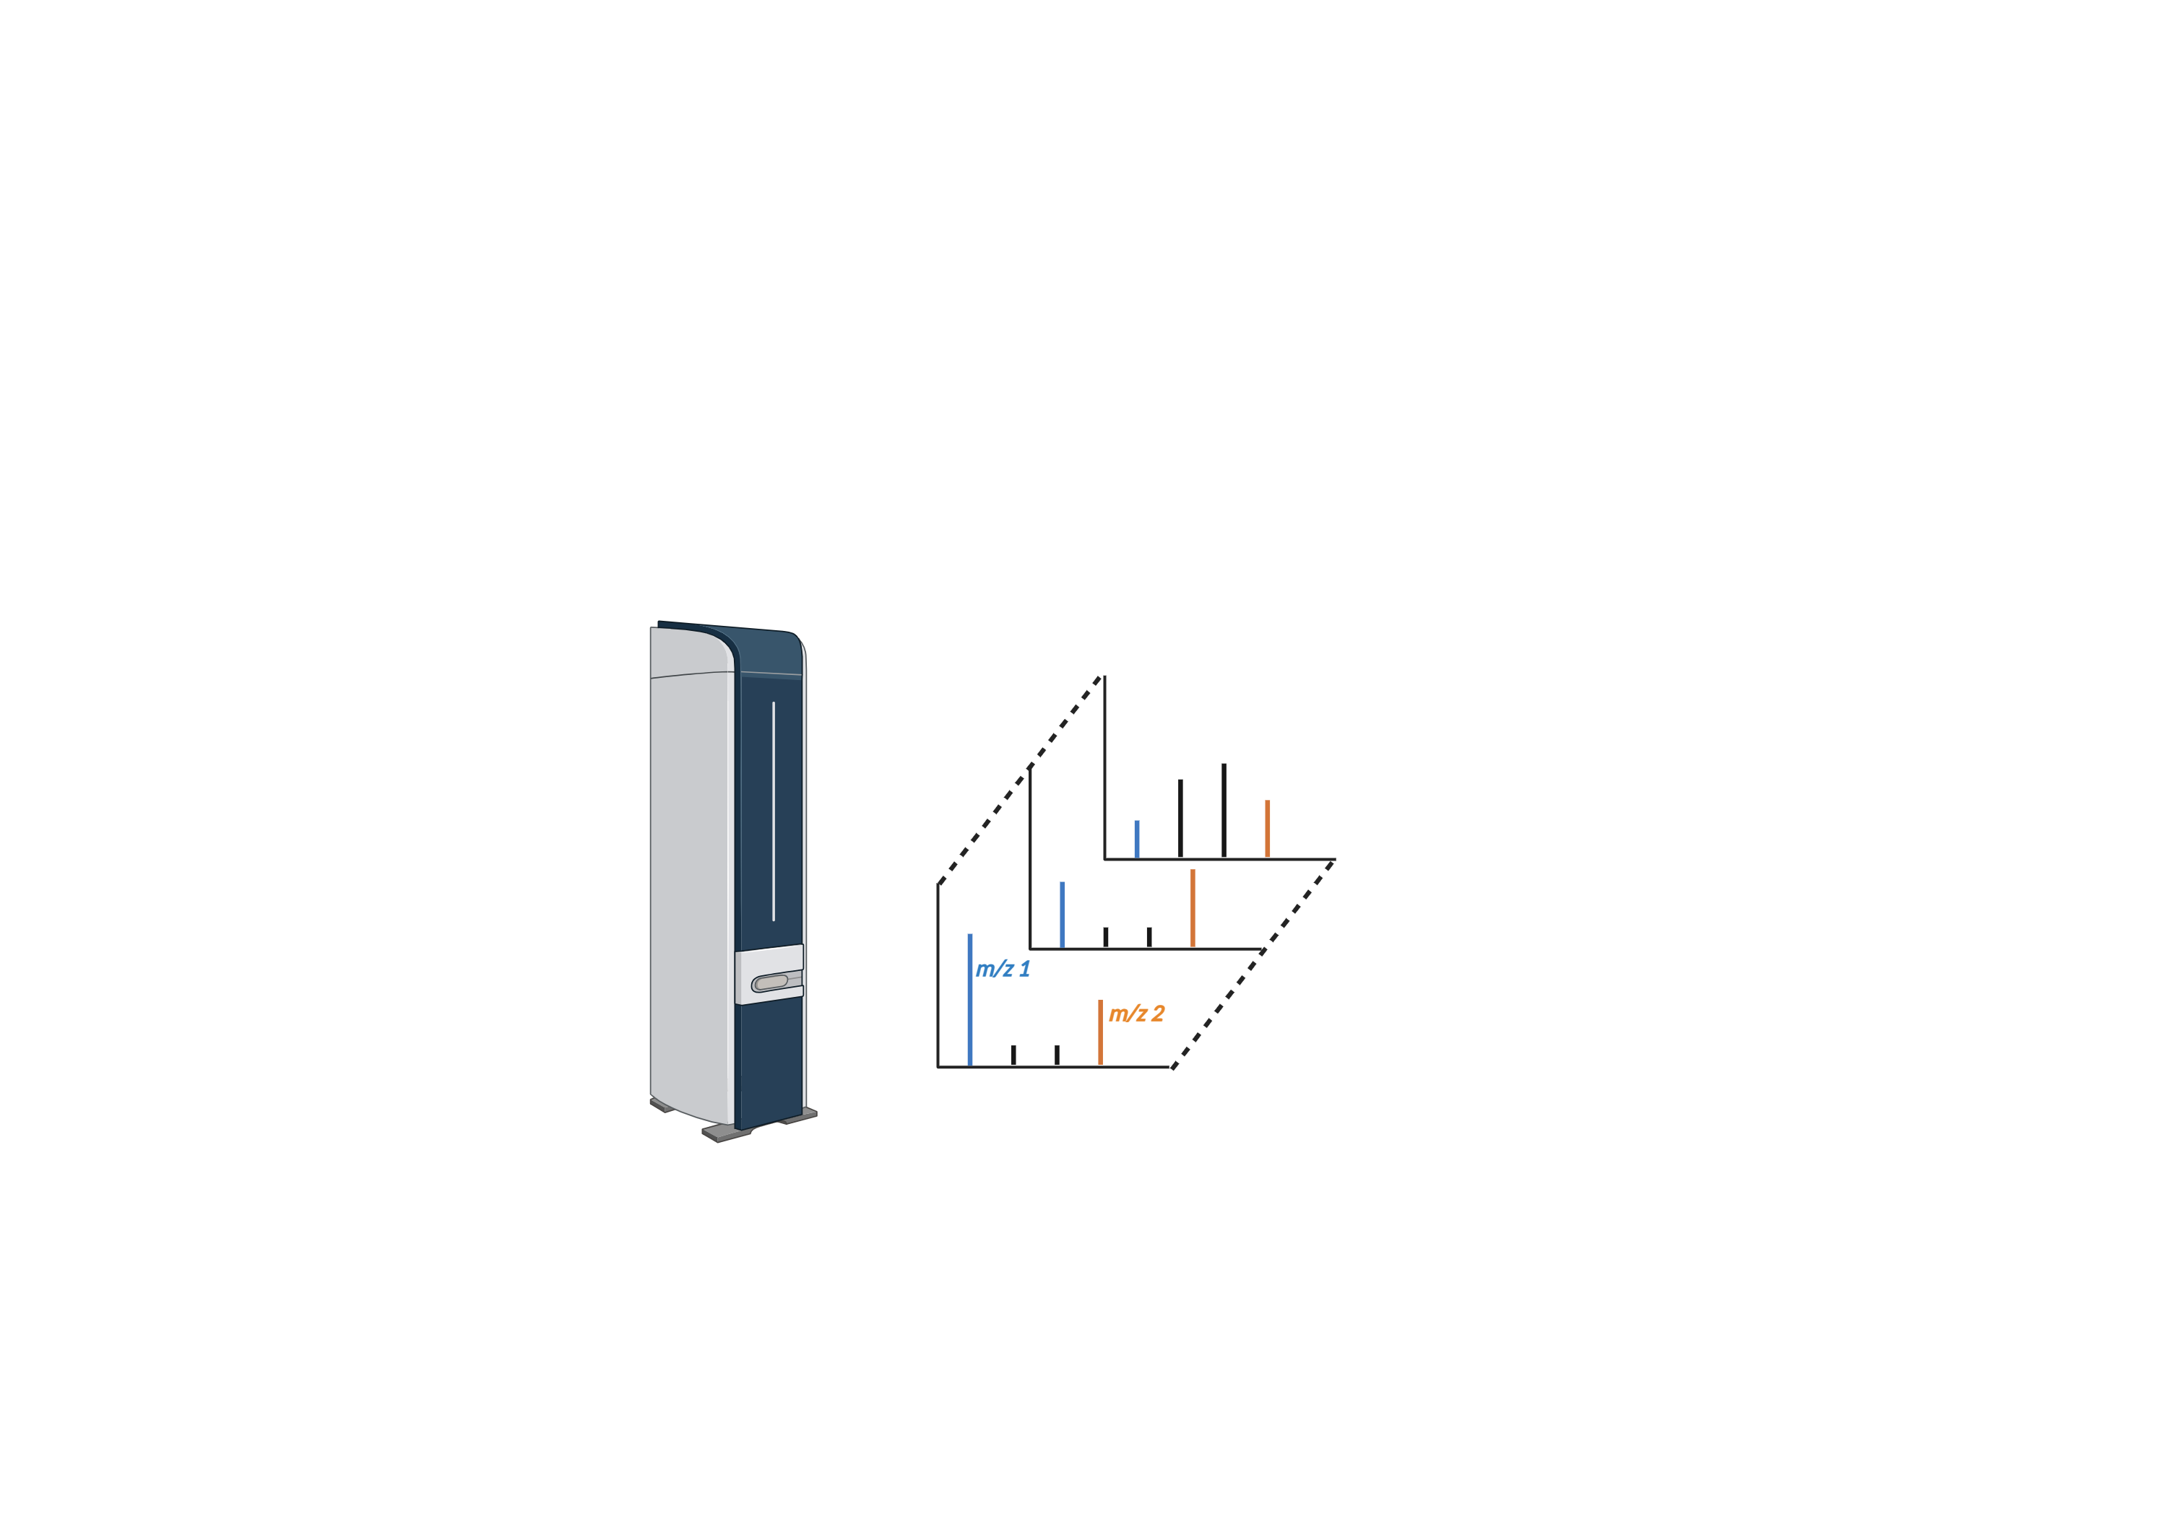

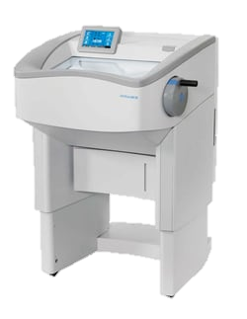

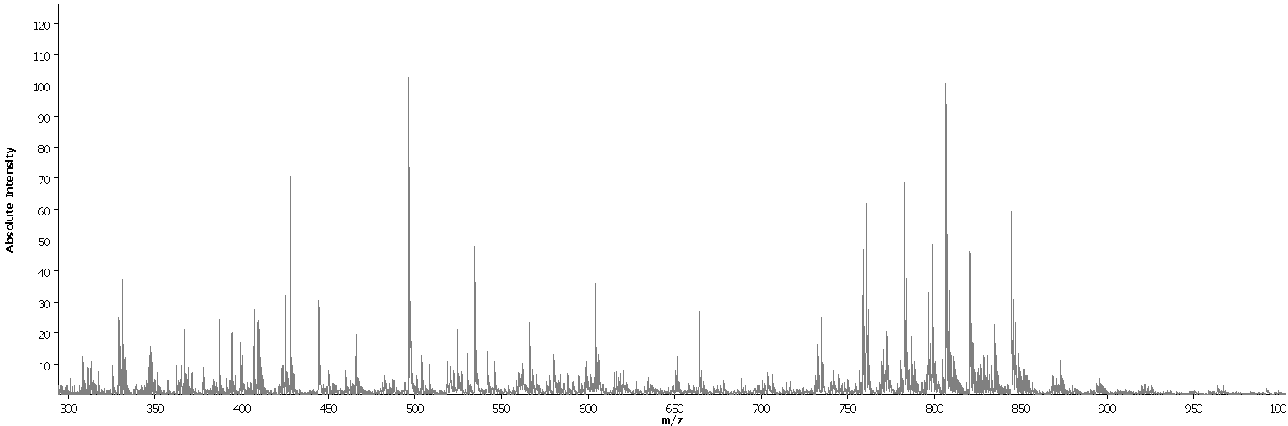
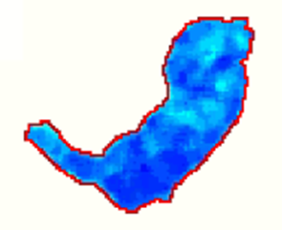
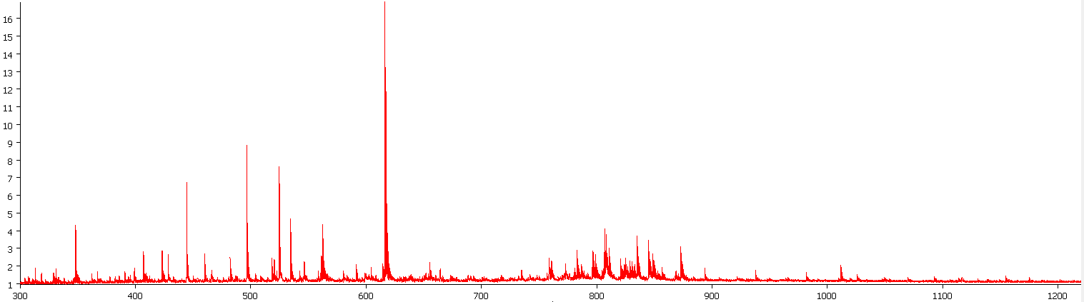
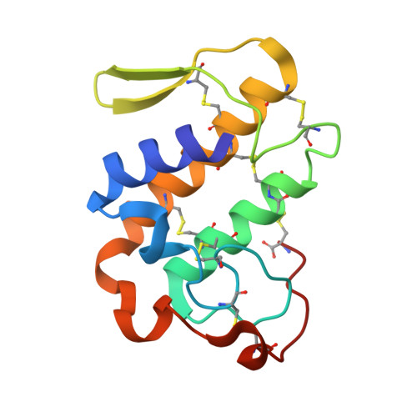
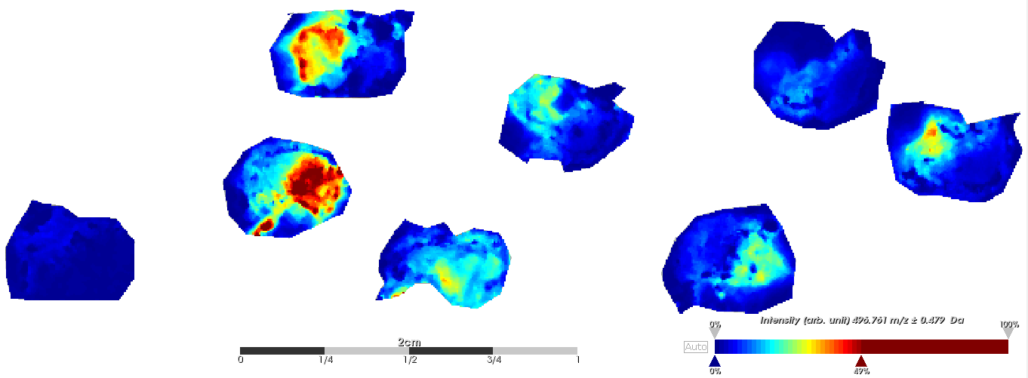
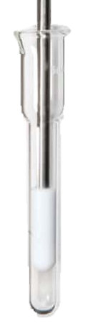
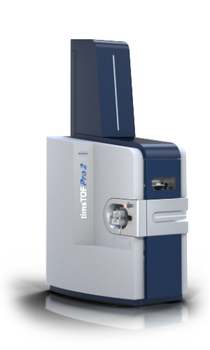
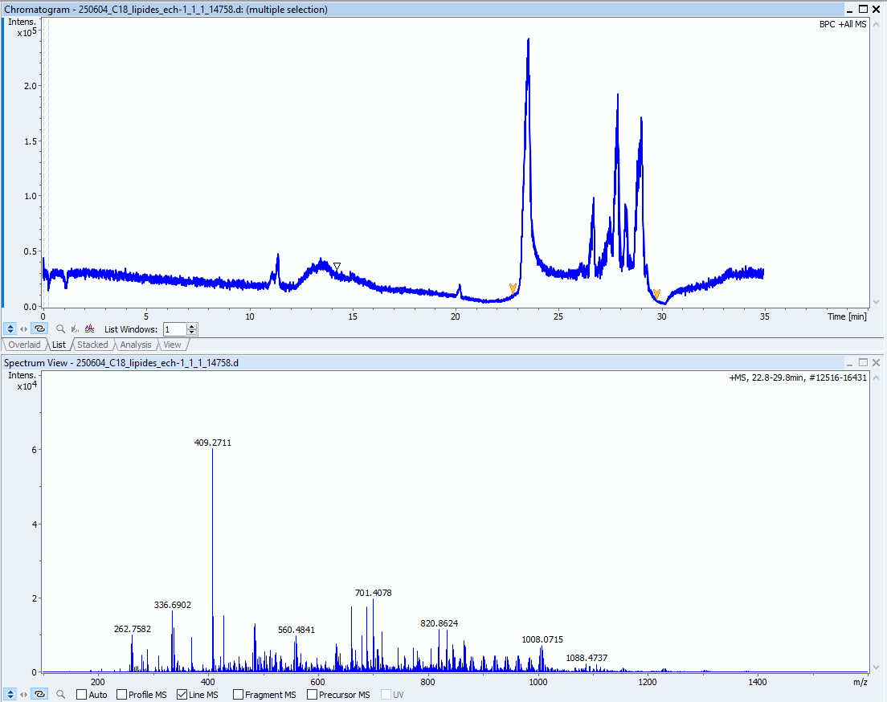
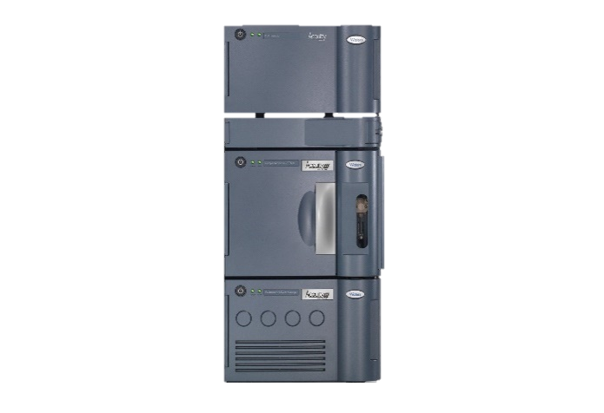
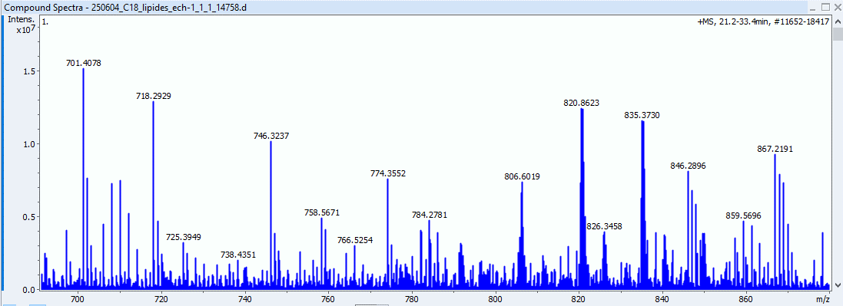
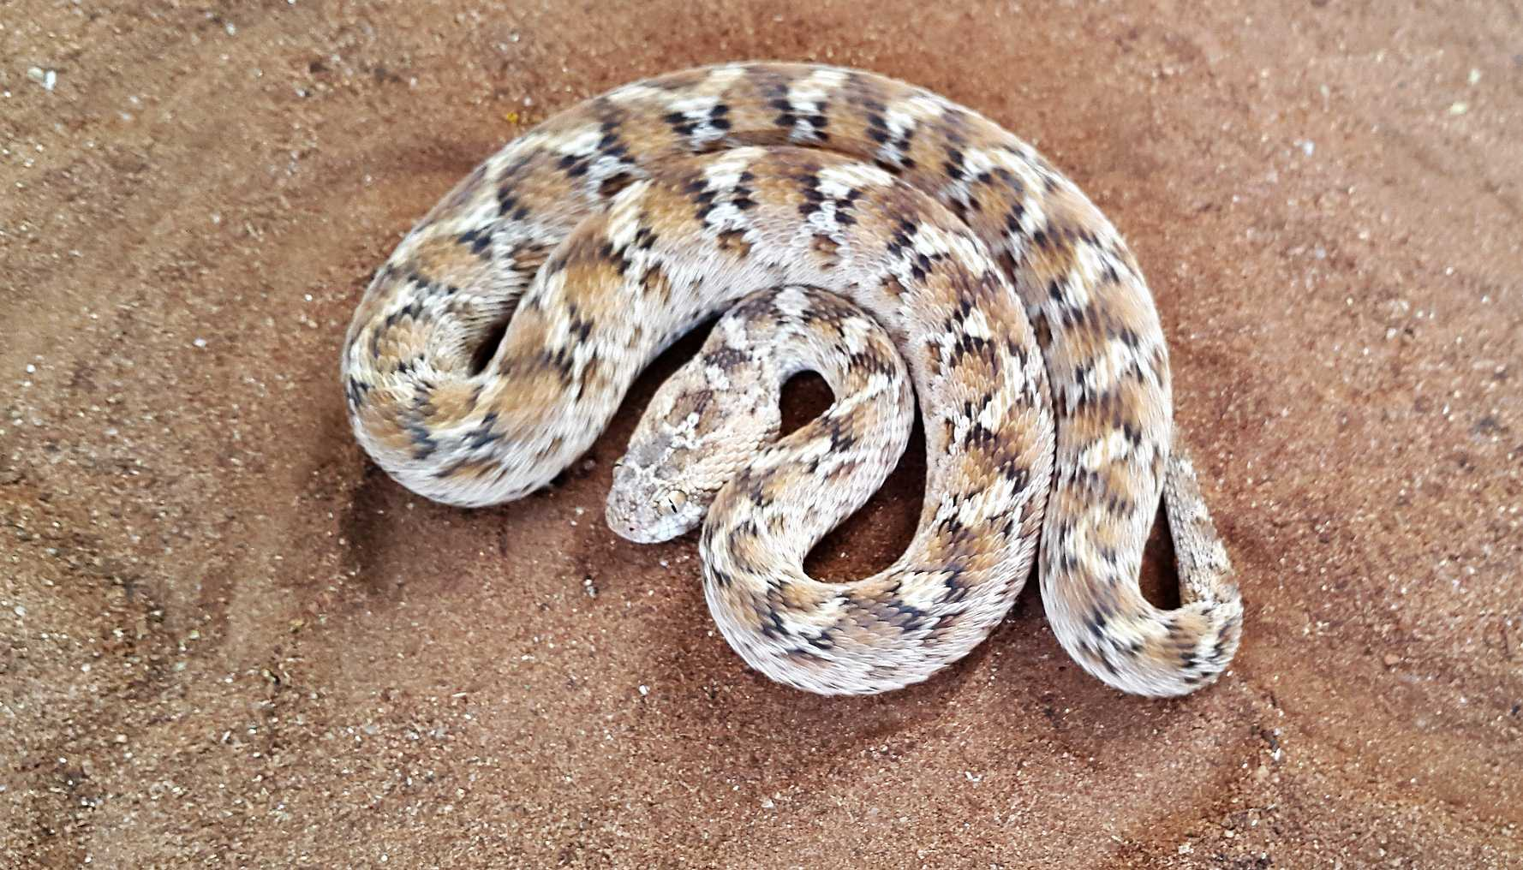

Mass Spectrometry-Based Imaging and Molecular Profiling of Snake Venom Effects on Murine Tissues
Bastiaens Quentin, Axel de Monts de Savasse, Virginie Bertrand, Loïc Quinton
Mass Spectrometry Laboratory, MolSys Research Unit, Quartier Agora, University of Liège, Allée du Six Août 11, B-4000 Liège, Belgium
Contact: q.bastiaens@uliege.be
Introduction
Snake envenomation is a Neglected Tropical Disease causing > 100,000 deaths annually. Snake venoms are complex mixtures rich in proteinaceous toxins with neurotoxic, hemotoxic, and cytotoxic effects that can damage multiple organs ¹.
This project aims to develop a mass spectrometry (MS)-based workflow to investigate the molecular impact of venom on murine tissues such as muscle, liver, heart, and brain. Venom exposure is simulated ex vivo, followed by analysis to assess molecular disruptions. Inhibitors and antivenoms are also tested to evaluate their protective effects.
The study combines two MS approaches: Matrix-Assisted Laser Desorption/Ionization Mass Spectrometry Imaging (MALDI-MSI), to visualize the spatial distribution of venom and host-response molecules across tissue sections; and Liquid Chromatography coupled with Tandem Mass Spectrometry (LC-MS/MS), to identify specific toxins and affected host molecules.
Together, these techniques offer both spatial and molecular insights into venom-induced damage and therapeutic efficacy, advancing our understanding of venom pathology and antivenom action.
Imaging: Materials & methods and results
Cryo-microtome
Inactivated
Matrix deposition
MS acquisition
Mouse muscle slices
PLA2s degrade phospholipids into lysophospholipids ²
Imaging the venom activity is possible ! At least with PLA2s activity
Next step: spray the venom rather than add it dropwise
15
m/z 496.420
Lyso-PCs
Venom phospholipases A2
m/z 806.581
PCs
Absolute intensity
10
5
m/z
300
400
600
800
1000
Intensity
ion 496.42 m/z
Kendrick plots can be used to separate matrix ions and potential contaminants from the valuable data ⁴
Facilitates identification and classification of the ions into structural families
Control (ion 496.24 m/z)
Pure EcLe venom (ion 496.42 m/z)
EcLe venom + antitoxin (ion 496.42 m/z)
Venom effect (ion 806.58 m/z)
Venom effect (ion 496.42 m/z)
Varespladib + venom (2.5 µg)
R² = 0.9847
?
?
Expected trend
Quantity of venom affects logarithmically the intensity of the ions
Varespladib inhibition of PLA2s can be imaged as well.
Absolute intensity
Absolute intensity
Intensity ratio for LPC/PC
R² = 0.9813
?
Phosphatidyl intensity decreases
Lyso-Phosphatidyl intensity increases
Lyso-phosphatidyl intensity increases ?
Quantity of venom (µg)
Quantity of venom (µg)
Quantity of anti-PLA2s nM-ng
LC-MS: Materials & methods and results
Liver extract
Grounding
Phase separation
LC-MS acquisition
Chromatogram (BPC)
Lipid elution region
6
Mass spectrum
Extracted from 22 – 30 min
718,2929
PS
806,6019
PC
835,3730
PI
2
Intensity (x10⁴)
Intensity (x10⁵)
1
2
5 | 10 | 15 | 20 | 25 | 30
Time(min)
200 | 400 | 600 | 800 | 1000
m/z
Perspectives
Comparative Analysis of Necrotic Snake Venoms Effects coming from multiple species known to induce tissue necrosis (e.g., Naja spp., Echis spp., etc.).
Kinetic Studies of Venom Activity by varying incubation periods to elucidate the kinetics of necrosis induction.
Use of HPLC Purified and Fractionated Venom Components to assess the activity of individual fractions and purified toxins.
Toxin-Tissue Interaction Mapping by exploring different combinations of specific venom toxins with various tissue types.
Molecular Identification via Mass Spectrometry: Utilize tandem mass spectrometry (MS/MS) to identify and confirm the molecular identity of active venom components responsible for necrotic activity.
Biomarker Discovery: Identify potential biomarkers associated with venom-induced necrosis to support diagnostics and therapeutic development.
1 : WHO. Snakebite envenoming. 8 January 2024 https://www.who.int/news-room/fact-sheets/detail/snakebite-envenoming (2023)
2 : Sun, G.Y et al. (2021) Dynamic Role of Phospholipases A2 in Health and Diseases in the Central Nervous System. Cells
3: Ser49-PLA2 (ecarpholin S) from Echis carinatus https://www.rcsb.org/structure/2QHE
4: Redureau, D. et al. (2025) Organ-resolved lipid mapping in Steatoda nobilis spider model using high-resolution mass spectrometry imaging and Kendrick mass defect analysis. Front. Chem.

