Slide 1




The linguistic foundations of verbal working memory: further evidence from syntactic knowledge effects
Hong Xiao, Pauline Querella, Judith Schweppe, Steve Majerus
Univerisé de Liège
BAPS 2024.05.31
Notes:
Good afternoon, I will now present a study examining the impact of syntactic knowledge on verbal WM.

Slide 2
LANGUAGE SYSTEM & VERBAL WORKING MEMORY
Language System
Lexico-Semantic Knowledge
Words vs. Nonwords
e.g., book vs. boof
(Hulme,1991; Jefferies et al., 2006a,b)
High vs. Low frequency words
e.g., boat vs. boot
(Kowialiewski & Majerus, 2020)
Words with high vs. low imageability
e.g., foot vs. form
(Majerus & Vander Linden, 2003)
Verbal Working Memory
Sub-lexical Phonological Knowledge
Nonwords with high vs. low phonotactic frequency
(Majerus et al., 2004)
Notes:
Verbal working memory is considered to be highly connected with the language system.
Previous research found better recall performance for words than non-words, for high frequency words than low frequency words or for highly imageable words than low imageable words. These findings suggest that lexico-semantic knowledge stored in language system supports verbal working memory.
Also, sub-lexical phonological knowledge can influence verbal WM as research has found better recall performance for nonwords with high phonotactic frequency patterns than for nonwords with low phonotactic frequency patterns.
Example in French
kubtal vs. chobtonv

Slide 3
LANGUAGE SYSTEM & VERBAL WORKING MEMORY
Language System
Lexico-Semantic Knowledge
Sub-lexical Phonological Knowledge
Verbal Working Memory
Individual Word
Grammar (between words order)
Syntactic Knowledge
Notes:
While lexico-semantic and sub-lexical phonological knowledge mainly concerns knowledge about individual words, there is another important type of knowledge that contains knowledge about multiple words and their ordering, which is syntactic knowledge. However, there is little research on the relationship between verbal working memory and syntactic knowledge.

Slide 4
LANGUAGE SYSTEM & VERBAL WORKING MEMORY
Verbal Working Memory
(Lee & Estes, 1979, Burgess & Hitch, 1999, Majerus, 2009)
Item Information
Memory for the items themselves.
Concerning the phonological and semantic aspects at the word level.
Language System
Apple and Pear
Serial Order Information
Memory for the order of those items.
Concerning the temporal order of occurrence of each word in the list, i.e., its within-list serial positions.
Apple is before Pear
Notes:
Verbal working memory is indeed considered to involve storage of at least two kinds of information, item and serial order information.
Item information is memory for the item themselves, concerning the phonological and semantic characteristics of individual words. While serial order information is memory for the order of those items, that is, their serial position within a list of sequentially presented items.
For example, when I say, “apple pear”. Item information is the word “apple” and the word “pear”. Serial order information is the fact that “apple” was presented before ”pear”.

Slide 5
LANGUAGE SYSTEM & VERBAL WORKING MEMORY
Language System
Verbal Working Memory
Lexico-Semantic Knowledge
Item Information
Sub-lexical Phonological Knowledge
Memory for the items themselves.
Behavioral evidence
(Majerus & D’Argembeau, 2011)
Neuropsychological evidence
(Majerus, 2009)
Neuroimaging evidence
(Majerus et al., 2006, 2010)
Syntactic Knowledge
Serial Order Information
Memory for the order of those items.
Notes:
A number of behavioural, neuropsychological, and neuroimaging studies have shown the sub-lexical phonological and lexico-semantic knowledge support mainly item information in verbal working memory but less so serial order information.

Slide 6
LANGUAGE SYSTEM & VERBAL WORKING MEMORY
Language System
Verbal Working Memory
Lexico-Semantic Knowledge
Item Information
Sub-lexical Phonological Knowledge
Memory for the items themselves.
Individual Word
Between-words Order
Serial Order Information
Memory for the order of those items.
Syntactic Knowledge
Notes:
Therefore, the question of syntactic influences on verbal WM is of particular interesting, as this type of knowledge might impact the storage of serial order information in WM, not only of item information like most of the other psycholinguistic effects just mentioned before.
While, so far, only a few studies have examined the impact of syntactic knowledge on verbal WM, with surprisingly no clear effect on serial order recall in WM.

Slide 7
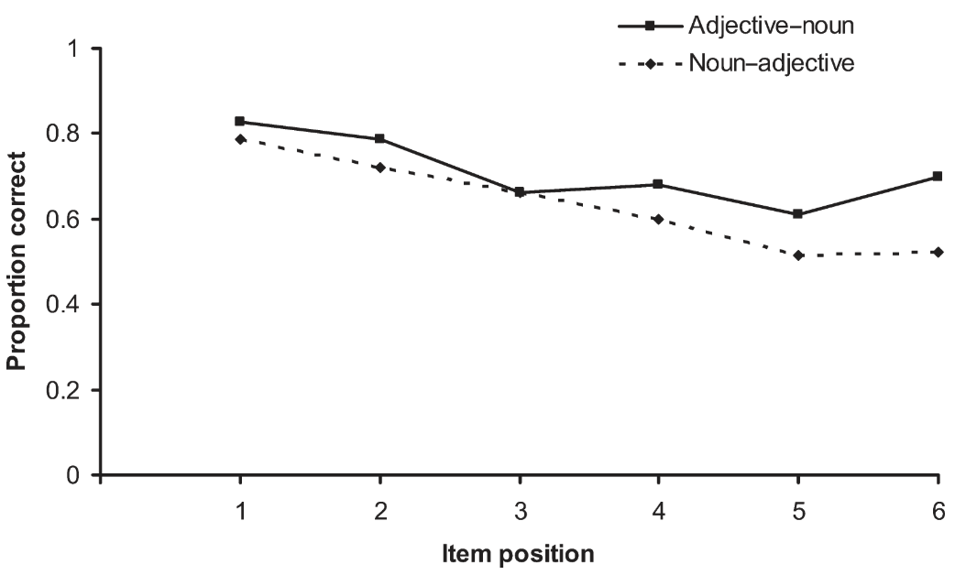
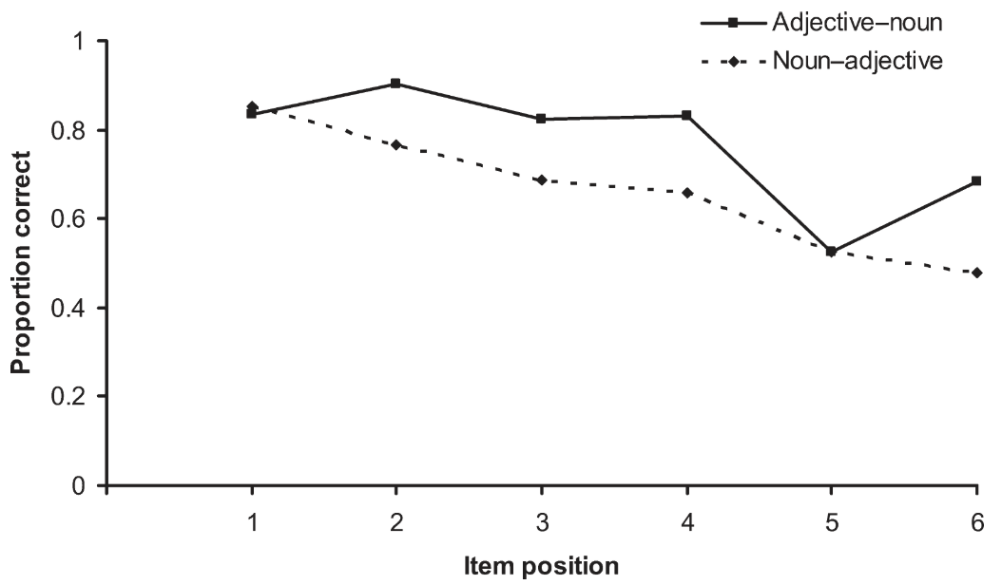
SYNTACTIC KNOWLEDGE & VERBAL WORKING MEMORY
🇬🇧
Correct Syntax:
Adjective-noun order (e.g., little girl vs. girl little)
Adjective-noun | graceful | cider | stinigy | hallway | fluffy | cow
Noun-adjective | window | itchy | penguin | rainy | tonsil | misty
Better recall perfomance of adjective-noun pairs than noun-adjective pairs
Without distinguishing item and order information in verbal WM
Perham et al., 2009
Notes:
Perham and his colleagues compared immediate serial recall task for lists of adjective-noun or noun-adjective pairs.
In English, adjectives aways occur before nouns, like little girl, while adjectives following nouns is syntactic incorrect, like girl little.
Their results showed that better recall performance for adjective-noun pairs than noun-adjective pairs, but they did not distinguish item and serial order aspects of to-be-recalled information.

Slide 8
SYNTACTIC KNOWLEDGE & VERBAL WORKING MEMORY
🇩🇪
Correct Syntax:
Adjective-noun order (e.g., kleines Mädchen vs. Mädchen kleines)
Correct inflection (e.g., kleines Mädchen vs. kleiner Mädchen )
Experiment 1 Inflected vs. Uninflected adjectives
Uninflected | Adjective-noun | wässrig | Löwe | stürmisch | Banane | besiegt | Mantel
 | Noun-adjective | Löwe | wässrig | Banane | stürmisch | Mantel | besiegt
Inflected | Adjective-noun | wässriger | Löwe | stürmische | Banane | besiegter | Mantel
 | Noun-adjective | Löwe | wässriger | Banane | stürmische | Mantel | besiegter
Experiment 2 Congruently vs, Incongruently Inflected adjectives
Congruently Inflected | Adjective-noun | wässriger | Löwe | stürmische | Banane | besiegter | Mantel
 | Noun-adjective | Löwe | wässriger | Banane | stürmische | Mantel | besiegter
Incongruently Inflected | Adjective-noun | wässrige | Löwe | stürmisches | Banane | besiegtes | Mantel
 | Noun-adjective | Löwe | wässriges | Banane | stürmisches | Mantel | besiegte
Schweppe et al., 2022
Notes:
Later, Schweppe and her colleagues conducted the same experiment but in German language.
In German, like in English, adjectives always precede the nouns. Furthermore, they manipulated adjective inflection.

Slide 9
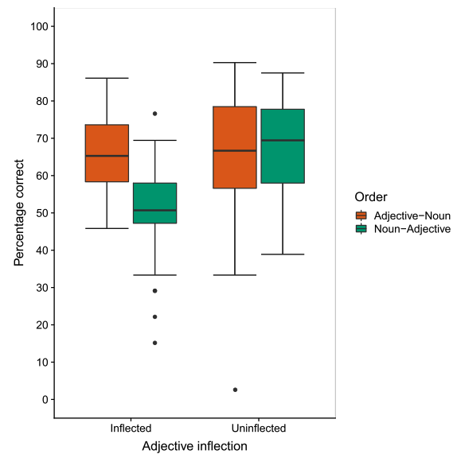
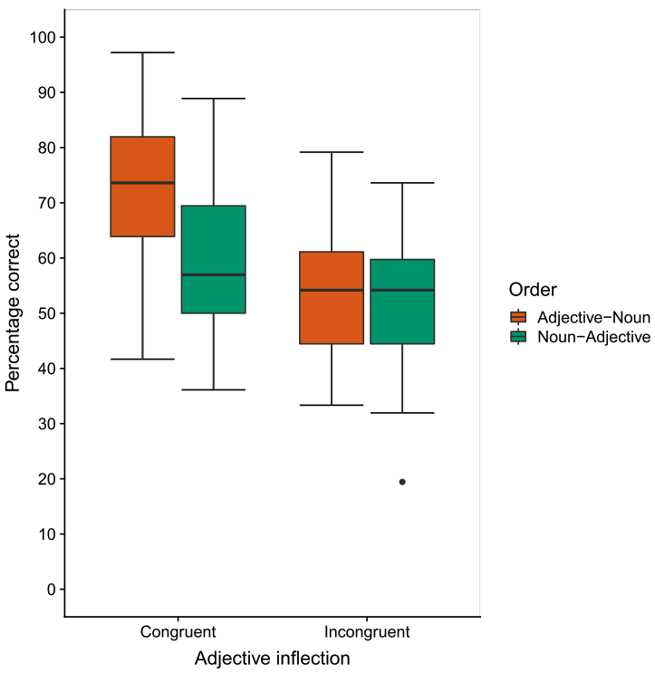
SYNTACTIC KNOWLEDGE & VERBAL WORKING MEMORY
🇩🇪
Correct Syntax:
Adjective-noun order (e.g., kleines Mädchen vs. Mädchen kleines)
Correct inflection (e.g., kleines Mädchen vs. kleiner Mädchen )
Better item recall performance of adjective-noun pairs than noun-adjectvie pairs
Only when adjectives are correctly inflected.
Schweppe et al., 2022
Notes:
They distinguished between item and order memory. And they found better item recall performance of adjective-noun pairs than noun-adjective pairs, particularly when adjectives were correctly inflected, but no impact on order recall.

Slide 10
SYNTACTIC KNOWLEDGE & VERBAL WORKING MEMORY
🇫🇷
Correct Syntax:
Regular adjective-noun order Adjective anteposition (e.g., petit chien vs. chien petit) Adjective postposition (e.g., manteau orange vs. orange manteau)
Correct inflection (e.g., petit chien vs. petite chien)
The use of a more flexible grammar such as French may present a better opportunity for examining adjective order migrations and errors within a verbal WM task.
Correct Inflection | Regular | Anteposition | importante | bière | nouvelle | paupière | joyeuse | casserole
 |  | Postposition | vipère | brillante | myrtille | jalouse | vanille | glissant
 | Irregular | Anteposition | familier | muguet | naïf | soda | sec | coussin
 |  | Postposition | serrure | élégante | texture | grande | résine | seconde
Incorrect Inflection | Regular | Anteposition | première | terroir | légère | carnaval | précieuse | fleuve
 |  | Postposition | chorale | creux | cannelle | compétent | patate | naïf
 | Irregular | Anteposition | sec | écharpe | familier | amande | glissant | vanille
 |  | Postposition | silicone | seconde | acier | longue | béret | joyeuse
Querella & Majerus, 2023
Notes:
Recently, Querella and Majerus conducted the same experiment in French in order to determine whether the results observed by Schweppe are specific for German, in which only adjective before noun is legal.
In French, adjective-noun order is more flexible. An adjective can both precede or follow a noun, depending on its specific characteristics. For example, short adjectives tend to be in anteposition, but colour adjectives are generally in postposition.
They suppose, to use a more flexible grammar language such as French may present a better opportunity to understand the effect of syntactic knowledge on order recall performance, by examining adjective order migrations and errors in a verbal WM task.

Slide 11
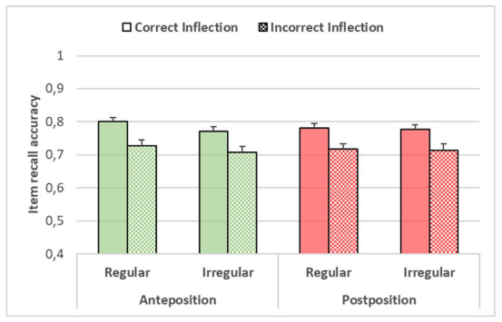
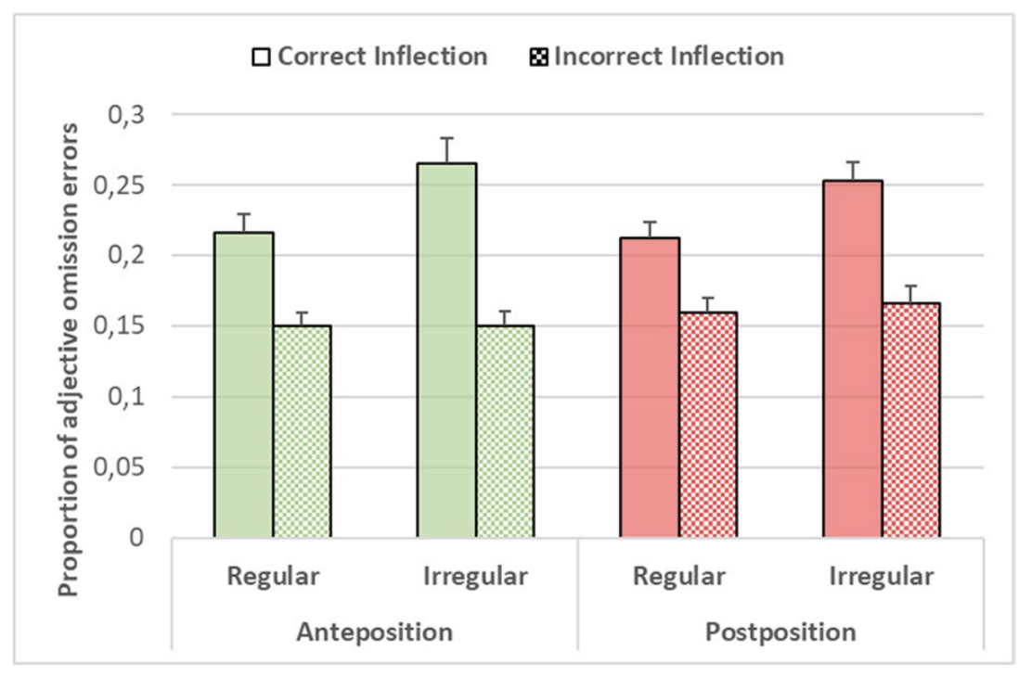
SYNTACTIC KNOWLEDGE & VERBAL WORKING MEMORY
🇫🇷
Correct Syntax:
Regular adjective-noun order Adjective anteposition (e.g., petit chien vs. chien petit) Adjective postposition (e.g., manteau orange vs. orange manteau)
Correct inflection (e.g., petit chien vs. petite chien)
Better item recall perfomance of adjetive and noun pairs in regular order than irregular order.
More omission error of adjectives in irregular order than regular order.
Querella & Majerus, 2023
Notes:
Interestingly, like Schweppe’s study with German stimuli, the data from this research with French stimuli also observed an impact only on item recall of adjective-noun order regularity.
The robust impact of syntactic regularity on item recall shows the importance and strength of this effect, as it reflects an increase of omission errors of adjectives in irregular order.

Slide 12
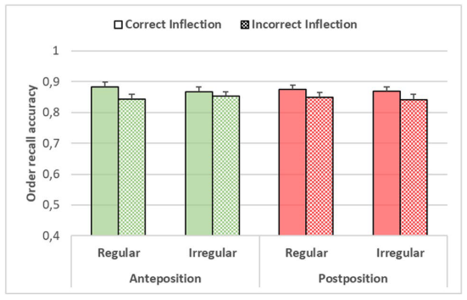
SYNTACTIC KNOWLEDGE & VERBAL WORKING MEMORY
🇫🇷
Correct Syntax:
Regular adjective-noun order Adjective anteposition (e.g., petit chien vs. chien petit) Adjective postposition (e.g., manteau orange vs. orange manteau)
Correct inflection (e.g., petit chien vs. petite chien)
Better item recall perfomance of adjetive and noun pairs in regular order than irregular order.
Querella & Majerus, 2023
Notes:
However, the lack of impact of a sequential type of knowledge on serial order recall remains puzzling.

Slide 13
SYNTACTIC KNOWLEDGE & VERBAL WORKING MEMORY
Syntactic Knowledge
Item Information
The lists prevented the expression of an impact on order recall:
ADJ + N, ADJ + N, ADJ + N
OR
N + ADJ, N + ADJ, N + ADJ
German | wässrig | Löwe | stürmisch | Banane | besiegt | Mantel
French | importante | bière | nouvelle | paupière | joyeuse | casserole
Recall performance was improved or affected by the redundant and predictable nature of the WM list with pairs in same order.
Notes:
One possibility is that a methodological characteristic of the lists prevented the expression of an impact on order recall.
In both Schweppe and Querella studies, within a given list, adj-noun order was predictable as all pairs were anteposition or postposition pairs relative to the adjective.
This predictability of adjective-noun order may actually have prevented syntactic knowledge to impact order recall.

Slide 14
SYNTACTIC KNOWLEDGE & VERBAL WORKING MEMORY
Syntactic Knowledge
Verbal Working Memory
Mixed adjective-noun pairs
ADJ + N, N + ADJ, ADJ + N
OR
N + ADJ, ADJ + N, N + ADJ
OR
…
Reducing the predictability of the position of the adjective within each pair for a given list.
Syntactic knowledge supports verbal working memory from serial order information
Notes:
So, we tested this hypothesis in the present study.
I will present two experiments in which we used the same stimuli as Querella and Majerus, but we mixed adjective-noun and noun-adjective pairs.
For example, in a given memory list, there could be an adjective-noun pair followed by a noun-adjective pair followed again by an adjective-noun pair, greatly reducing the predictability of the position of the adjective within each pair for a given list.

Slide 15



EXPERIMENT 1
🇫🇷
Correct Syntax:
Preferred adjective-noun order Adjective anteposition (e.g., petit chien vs. chien petit) Adjective postposition (e.g., manteau orange vs. orange manteau)
ADJ + N, N + ADJ, ADJ + N
OR
N + ADJ, ADJ + N, N + ADJ
OR
…
Mixing anteposition and postposition adjective-noun pairs in one list.
350ms
1000ms
Preferred list
grand
titane
sale
silence
orteil
agressif
16 lists with 3 adjective and noun pairs
Non-preferred list
titane
grand
silence
sale
agressif
orteil
93 participants
16 lists with 3 pairs reversed from preferred pairs
Notes:
In experiment 1, we created lists containing adjective and nouns in preferred order, but by mixing antepositional and postpositional adjective-noun pairs in one list. By reversing the order of pairs, we created the non-preferred list.
Participants were presented 3 adjective-noun/noun-adjective pairs and recalled the words in presentation order immediately after. The order of preferred/non-preferred lists was alternated between participants.
In total, 93 participants participated in Experiment 1.

Slide 16
EXPERIMENT 1
Preference BF₁₀ = 23.530
Preference BF₁₀ = 33893.098
Notes:
As in previous studies, we found better item recall performance for adjective-noun pairs in preferred order than non-preferred order, whether the adjectives are in anteposition or postposition.
However, this time, we also observed an impact on order recall, with better order recall performance of adjective-noun pairs in preferred order than non-preferred order.

Slide 17
EXPERIMENT 1
Preference + Adjective position + Preference * Adjective position BF₁₀ = 65.990
Preference BF₁₀ = 596.351
Notes:
Furthermore, when running an error analysis, we observed, on the one hand, and as in previous studies more omission errors of adjective-noun pairs in non-preferred order.
But we observed also more order errors for adjective-noun pairs in non-preferred order, adjectives migrating to preferred positions during recall in non-preferred lists,

Slide 18
EXPERIMENT 1
Better item and order recall perfomance of adjective-noun pairs in syntactic preferred order than non-preferred.
Order recall performance was affected by the predictable nature of the WM list with pairs in same order.
Syntactic Knowledge
Verbal Working Memory
Item Information
Serial Order Information
Notes:
In sum, in Experiment 1, we observed better recall performance for both item and order information, suggesting that the lack of impact of syntactic regularity on order recall in the previous studies was due to the predictability of the position of the adjectives in the lists.

Slide 19
EXPERIMENT 2
🇩🇪
Correct Syntax:
Adjective-noun order (e.g., kleines Mädchen vs. Mädchen kleines)
ADJ + N, N + ADJ, ADJ + N
OR
N + ADJ, ADJ + N, N + ADJ
OR
…
Mixing adjective-noun and noun-adjective pairs in one list.
Mixing preferred and non-preferred pairs in one list.
Notes:
Experiment 2 is a control experiment for an ongoing study, which tests the same hypothesis with German lists.
In German, due to the deterministic rules of adjective positions, when using lists with mixed adjective-noun/noun-adjective pairs, we are also mixing the regularity of the pairs within the same lists, as a noun-adjective pair in German will necessarily be syntactically illegal.

Slide 20

EXPERIMENT 2
🇫🇷
Correct Syntax:
Preferred adjective-noun order Adjective postposition (e.g., manteau orange vs. orange manteau)
ADJ + N, N + ADJ, ADJ + N
OR
N + ADJ, ADJ + N, N + ADJ
OR
…
Mixing adjective-noun and noun-adjective pairs in one list.
Mixing non-preferred and preferred pairs in one list.
350ms
1000ms
List 1
soda
naïf
entier
progrès
thé
content
16 lists with 3 adjective and noun pairs
List 2
naïf
soda
progrès
entier
content
thé
84 participants
16 lists with 3 pairs reversed from list 1
* Green means correct syntax, orange means incorrect syntax.
Notes:
Therefore, we ran a final experiment in French were the lists not only mixed anteposition and postposition of adjectives, but also the preferred/non-preferred status of the pairs.
Otherwise, the procedure was exactly the same as for Experiment 1.
In total, 84 participants were recruited in Experiment 2.

Slide 21
EXPERIMENT 2
BF₁₀ = 0.211
BF₁₀ = 877.613
Adjective-nouns pairs being perceived as unrelated, when there is one non-preferred, linguistically implausible pair in the list.
The impact of syntactic on item and order recall stems from different sources, as the impact on order recall remains robust.
Notes:
As in Experiment 1, we again found better order recall performance for adjective-noun pairs in preferred syntactic order versus non-preferred order. But, different from all the previous studies, this time we did not observed any impact on item recall anymore.
Actually, we observed, when mixing preferred/non-preferred pairs in the same list, recall for preferred pairs decreases at the item level, relative to previous experiment. This could be due to all adjective-nouns pairs being perceived as unrelated, when there is one non-preferred, linguistically implausible pair in the list.
This however also means that the impact of syntactic on item and order recall stems from different sources, as the impact on order recall remains robust.

Slide 22
CONCLUSION
Language System
Verbal Working Memory
Between-words Order
Serial Order Information
Concerning the temporal order of occurrence of each word in the list, i.e., its within-list serial positions.
Syntactic Knowledge
Lexico-Semantic Knowledge
Sub-lexical Phonological Knowledge
Item Information
Concerning the phonological and semantic aspects at the word level.
Individual Word
Notes:
In conclusion, our study first time found the evidence for the impact of syntactic knowledge on verbal working memory, only from serial order information, without item information.
These results support the independent role of syntactic knowledge in serial order information, contributing to a deeper understanding of the intricate relationship between linguistic and WM systems.
While this effect in other languages needs further exploration and further provement.

Slide 23




Steve Majerus
Judith Schweppe
Pauline Querella
Hong Xiao
📧 hong.xiao@uliege.be
Notes:
At last, I would like to thank to my colleagues with their efforts and generous helps on this study.

Slide 24
The linguistic foundations of verbal working memory: further evidence from syntactic knowledge effects
Hong Xiao, Pauline Querella, Judith Schweppe, Steve Majerus
Univerisé de Liège
BAPS 2024.05.31
📧 hong.xiao@uliege.be
Notes:
Thank you for your listening.

