Slide 1



Greenhouse gas balance for a sugar beet crop in Belgian Hesbaye
Pr. Longdoz Bernard, Beauclaire Q. and Heinesch B.
Bernard.Longdoz@uliege.be
Notes:
Good morning, everyone, I’m BL, Professor at GxABT which is a faculty of the University of Liège. My colleagues and I specialize in quantifying GHG fluxes exchanged by the terrestrial ecosystems.
Today, I will present data collected from an agricultural plot in the Hesbaye region of Belgium where sugar beet is part of the crop rotation.

Slide 2
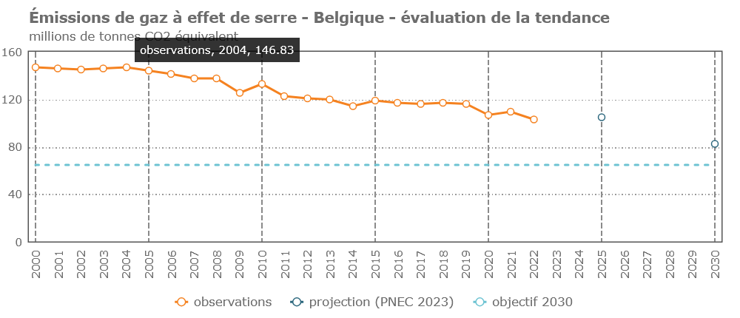
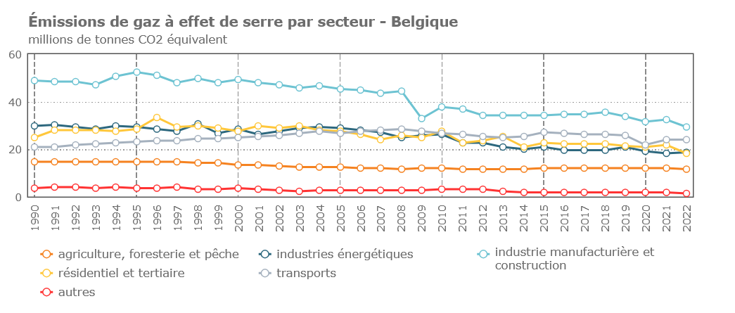
Introduction: Reducing GHG emissions (CO₂, CH₄, N₂O)
Notes:
As you know, Europe, and Belgium in particular, has committed to a policy of reducing its greenhouse gas emissions. Looking at the figures for Belgium, we can see that we have been on a downward trend since 2000. However, projections for 2030 suggest that, even with current efforts, emissions will remain above the desired levels represented by this point, to avoid severe climate impacts.
I would like to point out that these curves represent the sum of emissions of the three main GHGs, namely carbon dioxide (CO₂), methane (CH₄) and nitrous oxide (N₂O).
In the figure below, you can see that agriculture, represented by the orange curve, is not the primary source of GHGs in Belgium, but its contribution is significant. Reducing its climate footprint is therefore a key challenge for the sector.

Slide 3

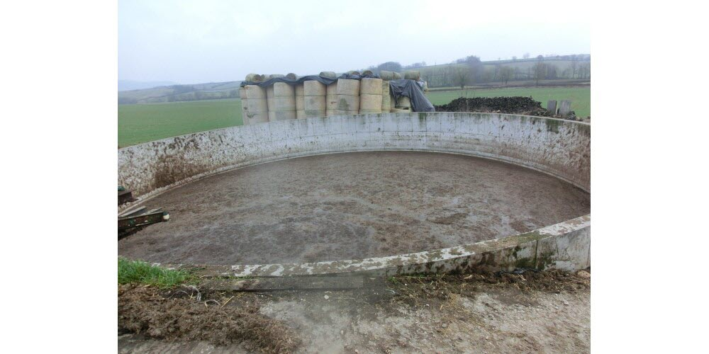
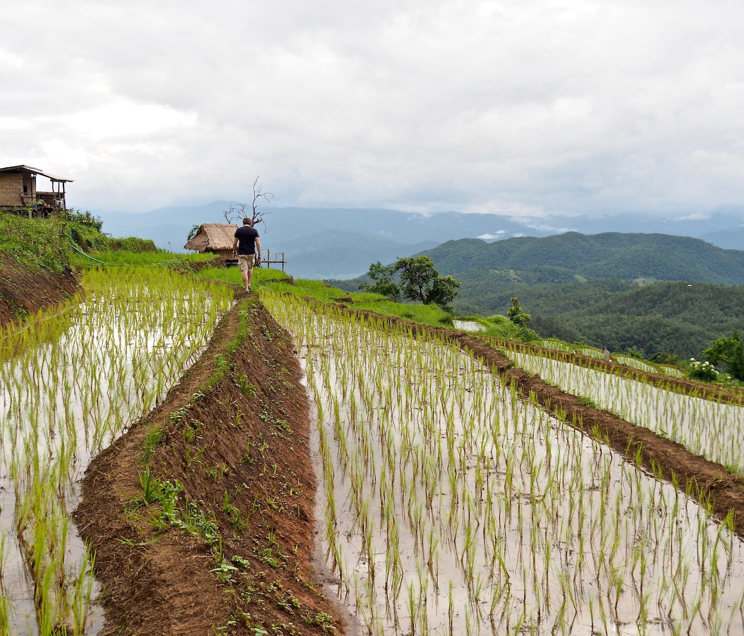
Introduction: How agriculture can improve its GHG balance ?
Reducing CH₄, N₂O and CO₂ emissions + maximise CO₂ absorption
Reducing CH₄ emissions
Notes:
So how can agriculture reduce its climate footprint, so how can it reduce its GHG emissions?
This can be broken down into three areas: reducing methane emissions, reducing nitrous oxide emissions and improving carbon dioxide balance by reducing emissions of this gas and maximizing its absorption.
As far as methane is concerned, this is beyond the scope of this seminar, as it is mainly a problem related to livestock, manure management and rice paddies.

Slide 4
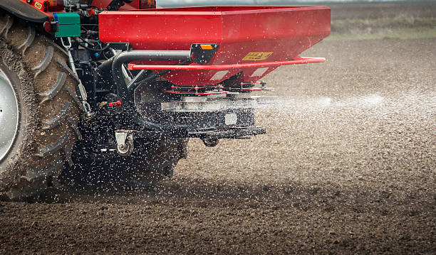
Introduction: How agriculture can improve its GHG balance ?
Reducing CH₄, N₂O and CO₂ emissions + maximise CO₂ absorption
Reducing N₂O emissions
Notes:
For nitrous oxide emissions, these are linked to the mineral fertilizer used, and our results will show the relationship between the quantities applied and the level of the N₂O emissions for the agricultural plot we studied.

Slide 5
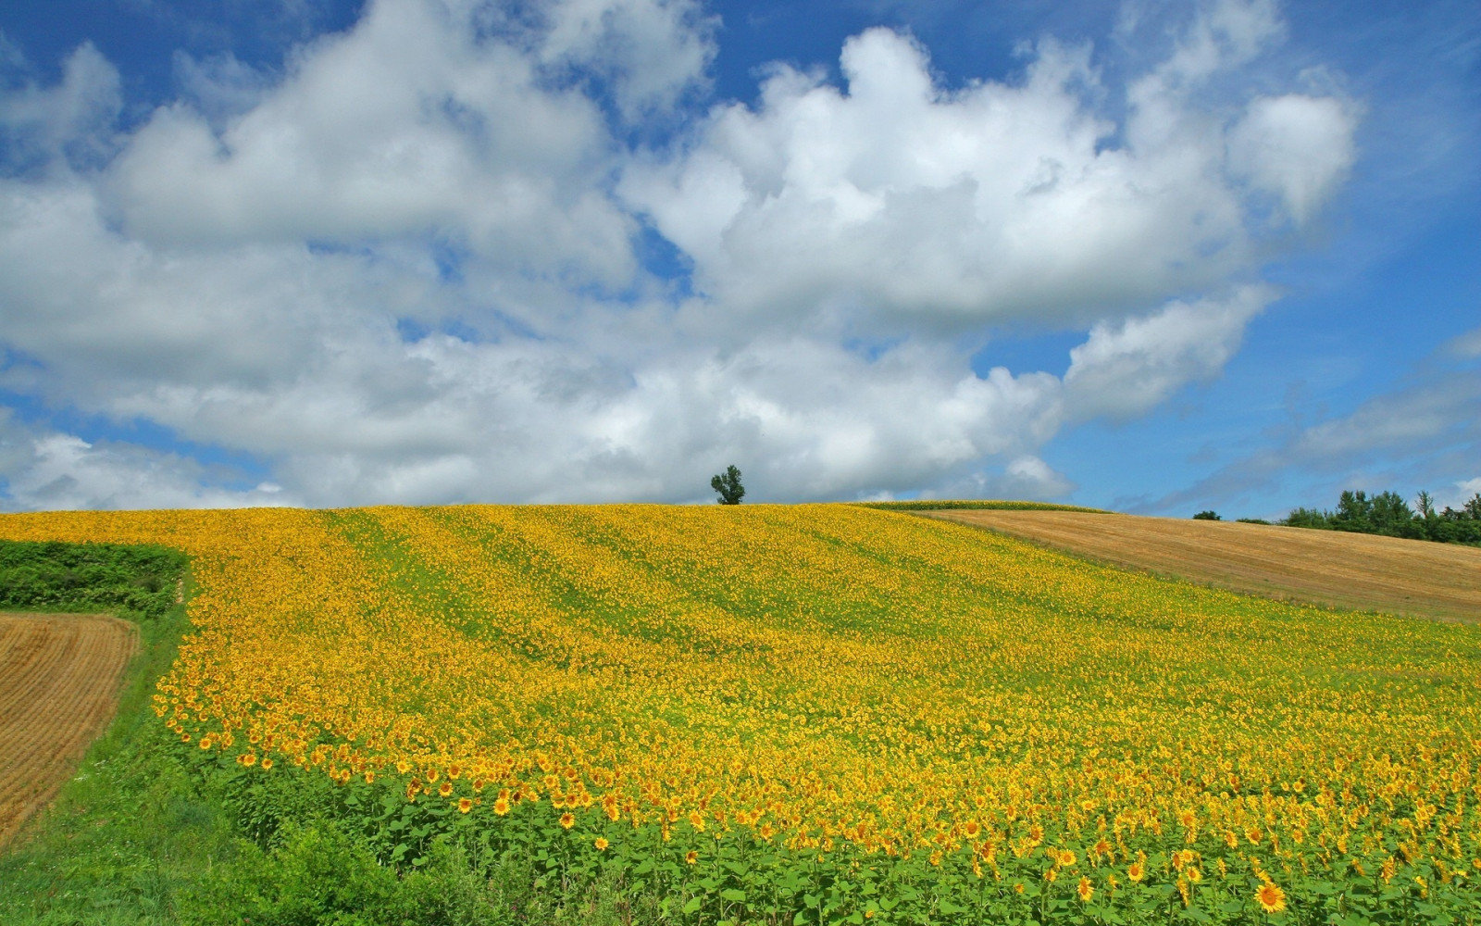
Introduction: How agriculture can improve its GHG balance ?
Reducing CH₄, N₂O and CO₂ emissions + maximise CO₂ absorption
Improve the C budget of agricultural soil
Respiration: Soil + Vegetation
Photosynthesis
Organic fertilization
Harvest
Notes:
Finally, with regard to CO₂, it is necessary to consider 4 fluxes Firstly, photosynthesis by vegetation. Secondly, respiration by this aerial vegetation combined with respiration by the soil, which itself contains a portion linked to root activity but also a significant contribution linked to the mineralization of organic matter by micro-organisms. Furthermore, it can be assumed that all carbon removed from the plot during harvesting will be released back into the atmosphere as CO2 after being used by humans, livestock or micro-organisms. Similarly, the carbon provided by organic fertilization corresponds to CO2 that was previously absorbed from the atmosphere.
Improving the climate footprint of the ecosystem requires then maximizing the photosynthesis and carbon import and reducing as much as possible respiration and harvest, this means improve the carbon storage in the soil.

Slide 6
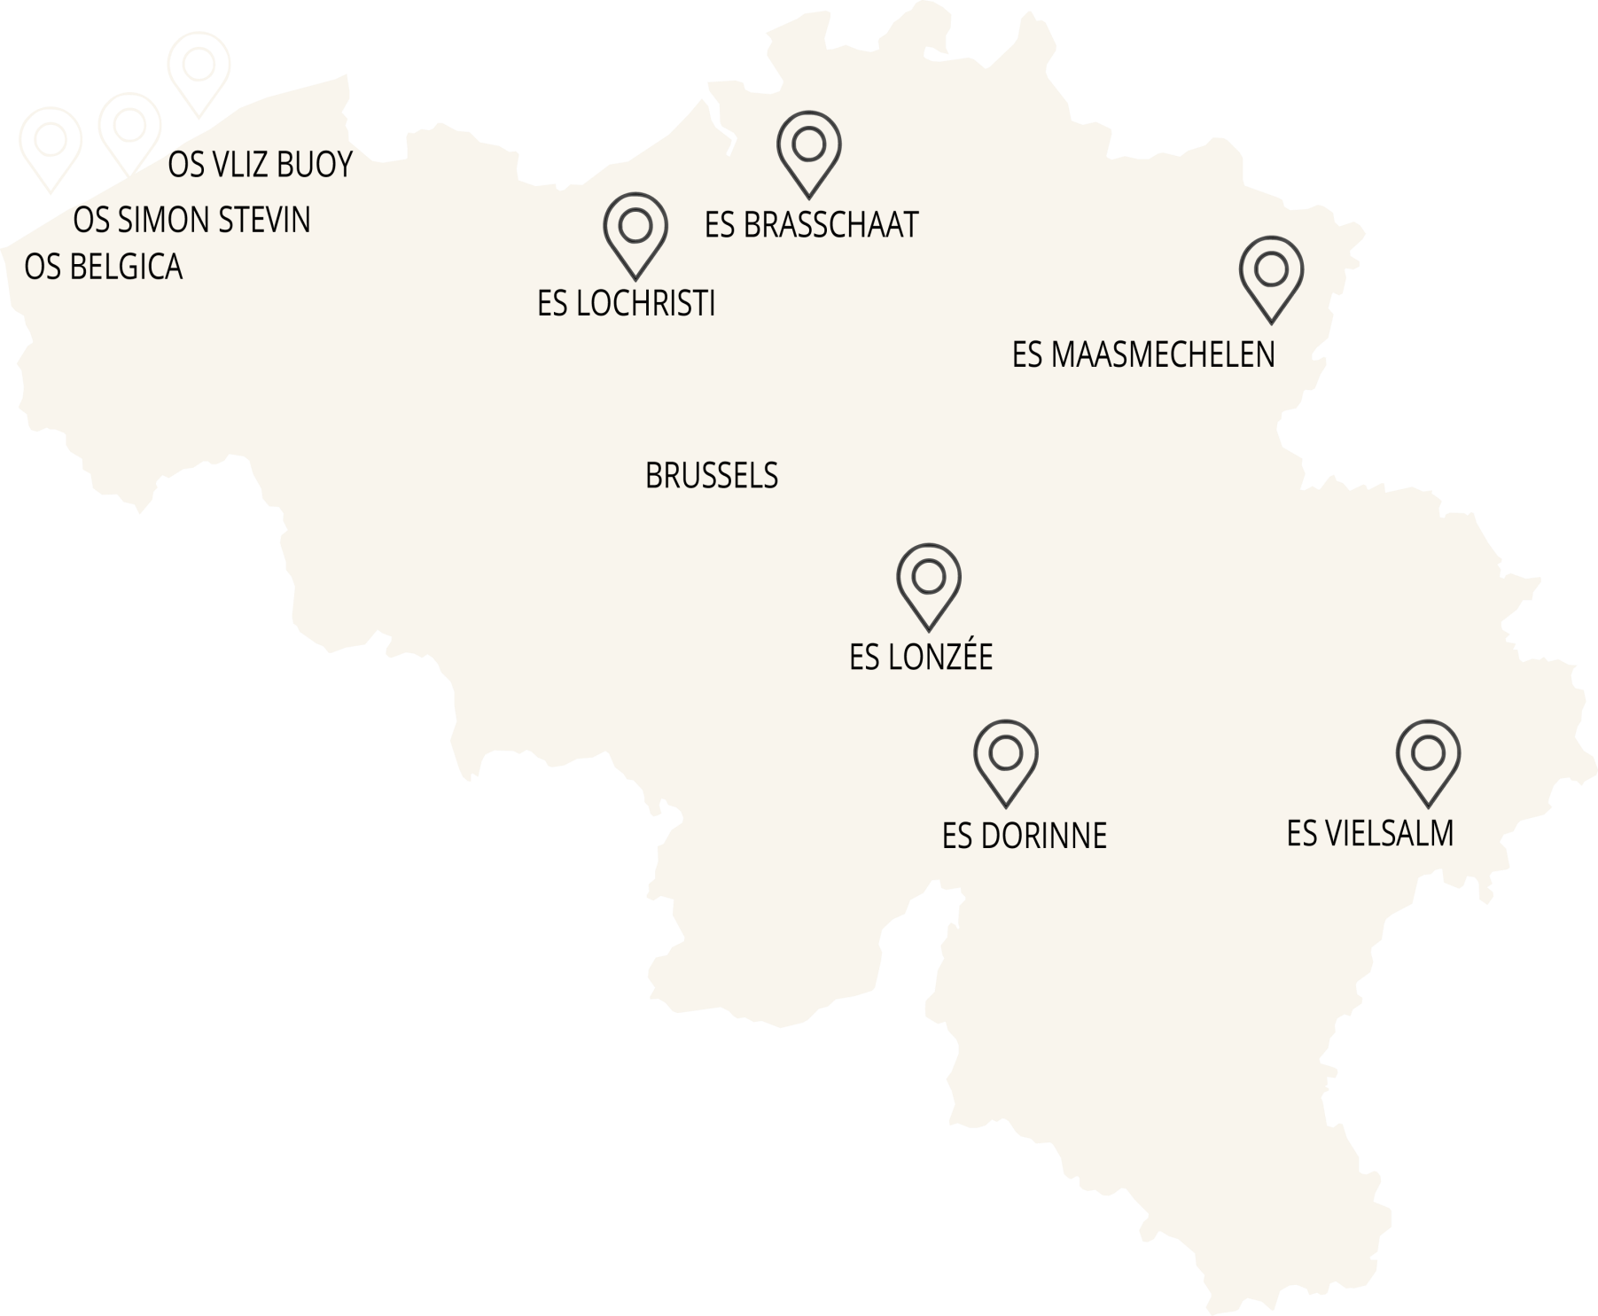
Measurements of N₂O and CO₂ net fluxes
Lonzée
Walloon Terrestrial Ecosystem sites
3 sites representatives of Walloon land use:
1 Crop (Lonzée)
1 Grassland (Dorinne)
1 Forest (Vielsam)
Notes:
Our study site is located in Lonzée, a small town in the Hesbaye region, about 40 km southeast of Brussels. This site is part of the ICOS Belgium network which consists of 6 stations and is itself integrated into a broader European and global network of similar measurement stations.

Slide 7
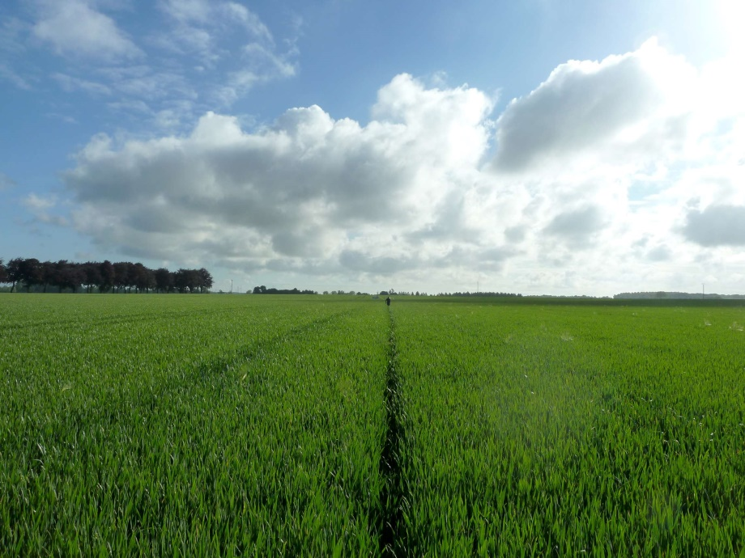
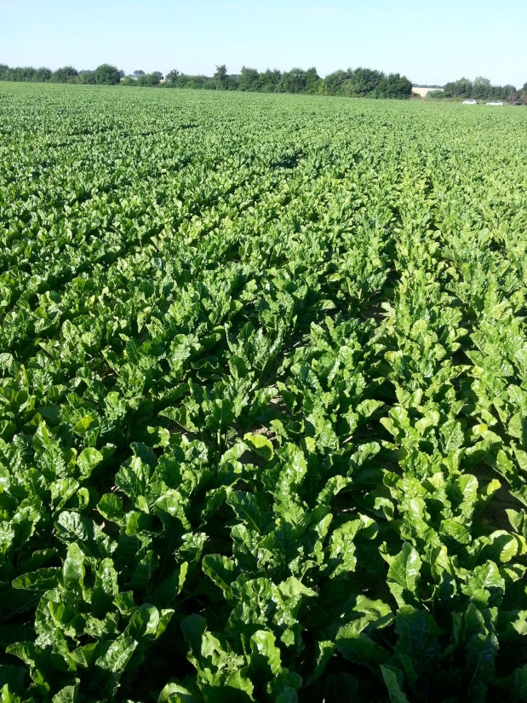
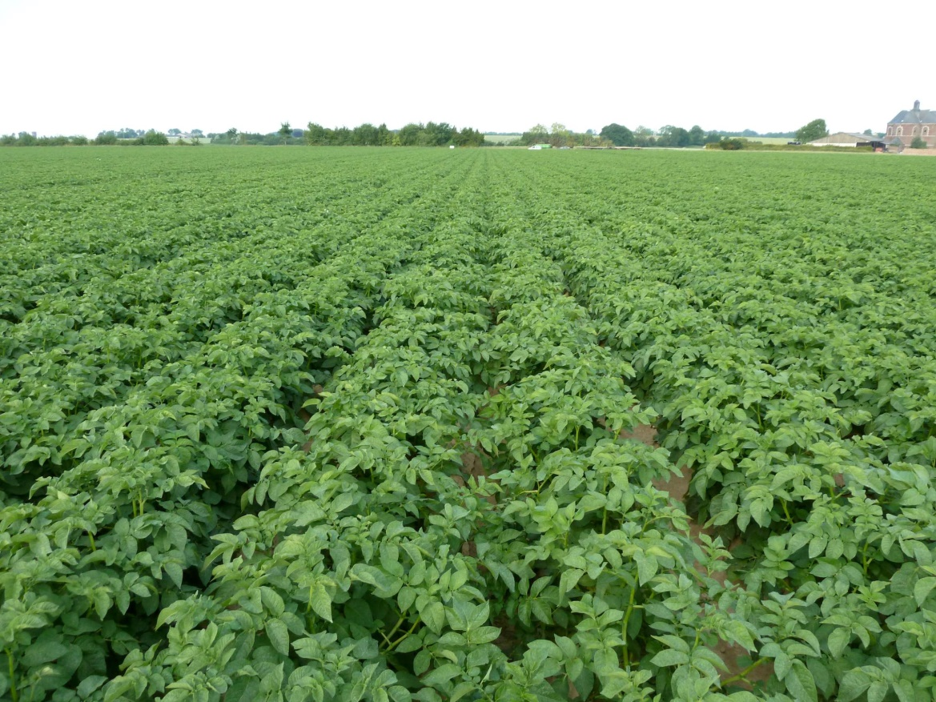
Lonzée
(typical Walloon field crop)
Rotation : Winter wheat – Potatoes - Winter wheat - Sugar beet (2012 Maize)
12 ha
Luvisol (FAO)
SOC stock:
4.67 ± 0.19 kg m⁻²
over 0–30 cm
3 X Intercrop :
2009-2013-2015
Mostard
Fertilization :
mineral N (3 X yr⁻¹)
180-200 kg ha⁻¹ yr⁻¹
Notes:
Since 2004 when we began our measurements, the plot has followed a typical Walloon crop rotation: winter wheat, potatoes, winter wheat again, and finally sugar beet, with mustard often used as an intermediate cover crop after wheat harvest. The soil is characterized by a thick layer of silt and the farmer follows conventional practices with regular mineral nitrogen fertilisation.

Slide 8
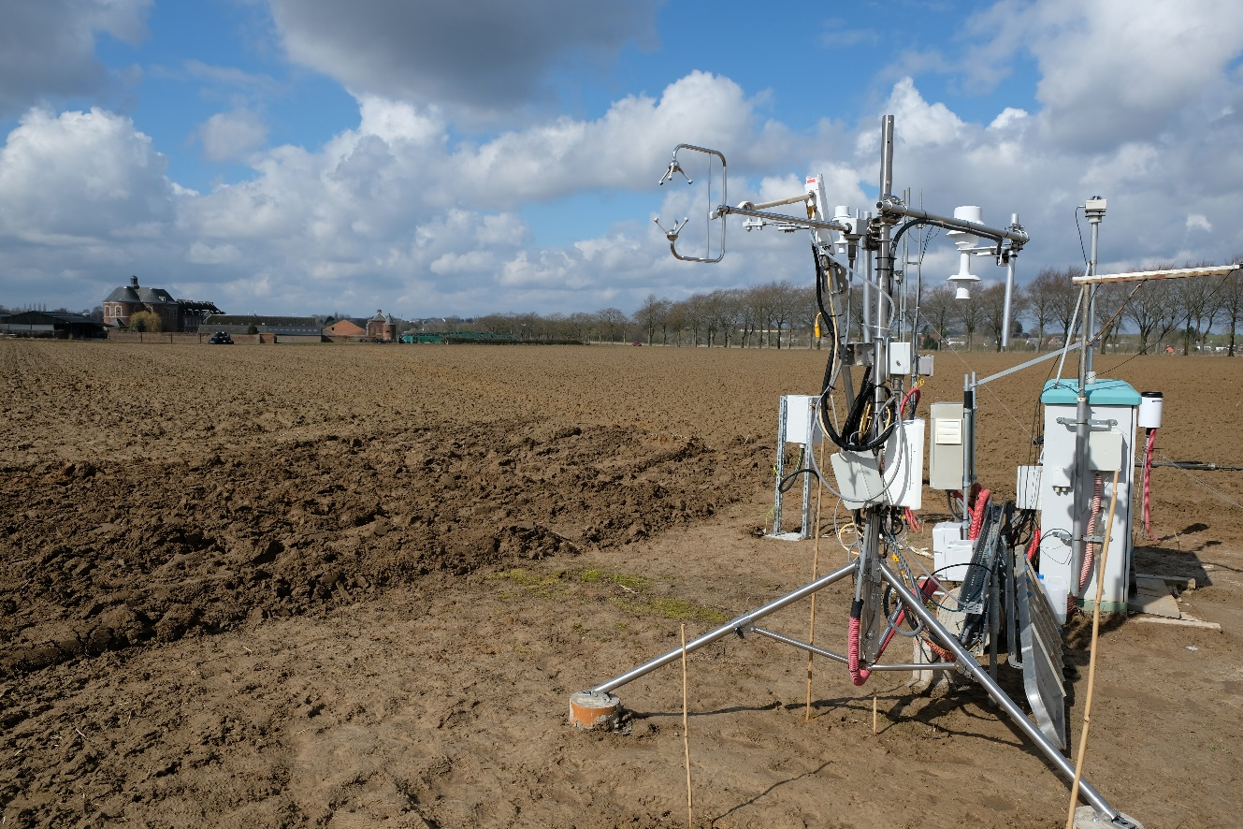
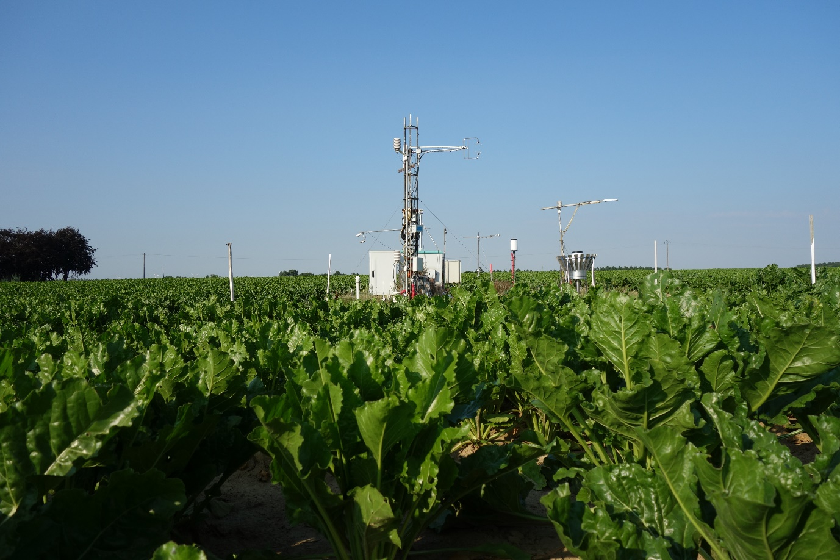
Measurements of N₂O and CO₂ net fluxes
Lonzée (Belgium)
Measurements started in 2004
Notes:
Here is the measuring station we installed in 2002 in the middle of the 12-hectare plot. This station measures GHG fluxes at the interface between the ecosystem and the atmosphere, as well as the ecosystem's evapotranspiration and all the energy fluxes exchanged by this ecosystem. The station operates continuously, 24 hours a day, 7 days a week

Slide 9
Measurements of N₂O and CO₂ net fluxes
Continuous net flux (1 value per half-hour)
Eddy Covariance post-processing
Gaz analyser
10 hz or more
Vertical wind speed
10 hz or more
+ Meteorological conditions
Edaphic conditions
Follow up of aerial biomass
Soil characteristics
Lateral flows (inputs, harvest)
Notes:
How are GHG fluxes quantified? With measurements of vertical wind speed and target gas concentration. The product of these two variables directly gives the value of the flux. However, as these two variables vary very rapidly over time, measurements must be taken at a frequency of more than 10 hertz, which means that instruments measure vertical wind speed and GHG concentration more than 10 times per second with a fairly high degree of accuracy.
The vertical component of wind speed is measured using a sonic anemometer. This device is equipped with sensors capable of emitting and receiving ultrasonic waves, the propagation speed of which allows to determine the speed of the air.
The gas analyzer is based on the principle of infrared absorption by these gases. Air is sucked through this tube into the measuring cell, where sensor measures the absorption rate of infrared and transform this absorption into concentration.
Once these two variables have been measured, the data undergoes post-processing to obtain an average flux over a half-hour period, known as the eddy covariance flux. This operation is repeated continuously 24 hours a day, 7 days a week.
In addition to these eddy covariance data, the station provides meteorological data as well as soil temperature and humidity. All of this is to try to explain the temporal variability of CO2 and N2O fluxes.
We also monitor above-ground biomass, soil characteristics, and all elements that are added to or removed from the plot, particularly those that contain carbon and nitrogen.

Slide 10
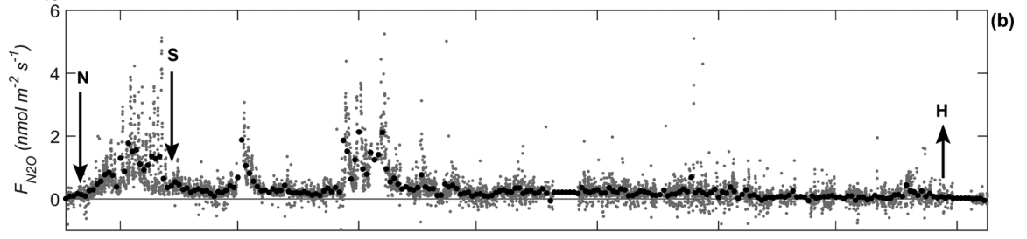
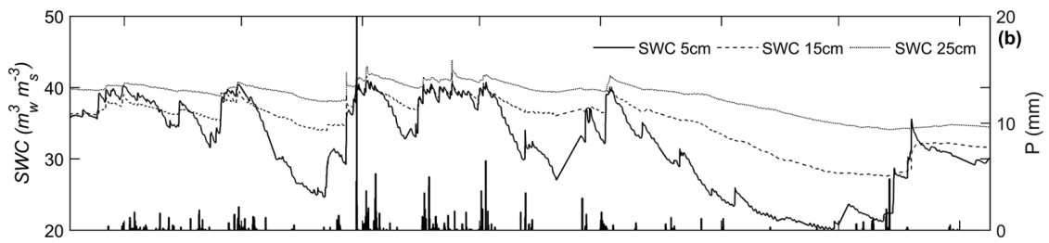
N₂O emissions
Positive flux = emission
1/4
1/5
1/6
1/7
1/8
1/9
1/10
1/11
2016: Beta Vulgaris L. cv Lisanna from KWS
Lognoul 2019; https://orbi.uliege.be/bitstream/2268/245609/1/Lognoul%20et%20al_AFM_2019.pdf
High emissions if:
Long period between fertilization application and sowing
Wet soil (especially during 1.)
Notes:
Let’s examine the temporal evolution of N₂O fluxes during the 2016 sugar beet growing season from mid-March and mid-November. The fluxes are in nanomoles of N2O per m² per second, and positive values represent emissions. The three arrows show the date of fertilization with ammonium nitrate at a dose of 135 kg of nitrogen per hectare, the sowing date and the harvest date.
The graph below shows the change in soil water content at different depths over the same period, with rainfall shown as vertical bars.
You can see that most of the time, the N2O flux is very low, with the exception of a few peaks. The first peak is quite long and occurs immediately after fertilization. This nitrogen input activates the microorganisms responsible for nitrification and denitrification, both of which generate N2O emissions. This peak fades after sowing, as the seeds are then the main user of nitrogen. However, there are still two peaks in the periods following sowing, which are times of high soil moisture following rainfall. During these periods, nitrogen remains available and soil moisture activates microorganisms.
In conclusion, N₂O emissions are highest between fertilization and sowing. Minimizing this interval, and avoiding wet soil conditions during this period, can significantly reduce emissions.

Slide 11
N₂O emissions
1/4
1/5
1/6
1/7
1/8
1/9
1/10
1/11
Total N2O emissions between fertilization and harvest :
1.83 ( ± 0.21) kg N-N₂O ha⁻¹ corresponding to 1.2% of N supplies
or in terms of warming potential its equivalent to an emission of :
20.8 gC_{éq} m⁻² growing season⁻¹ (or yr⁻¹)
Notes:
The cumulative value of nitrous oxide emissions between fertilization and harvest corresponds to 1.83 kg of nitrogen, or 1.2% of the amount of nitrogen that was initially spread.In terms of climate impact, i.e., global warming potential, this N2O flux corresponds to emissions of 20.8 grams of carbon equivalent.

Slide 12
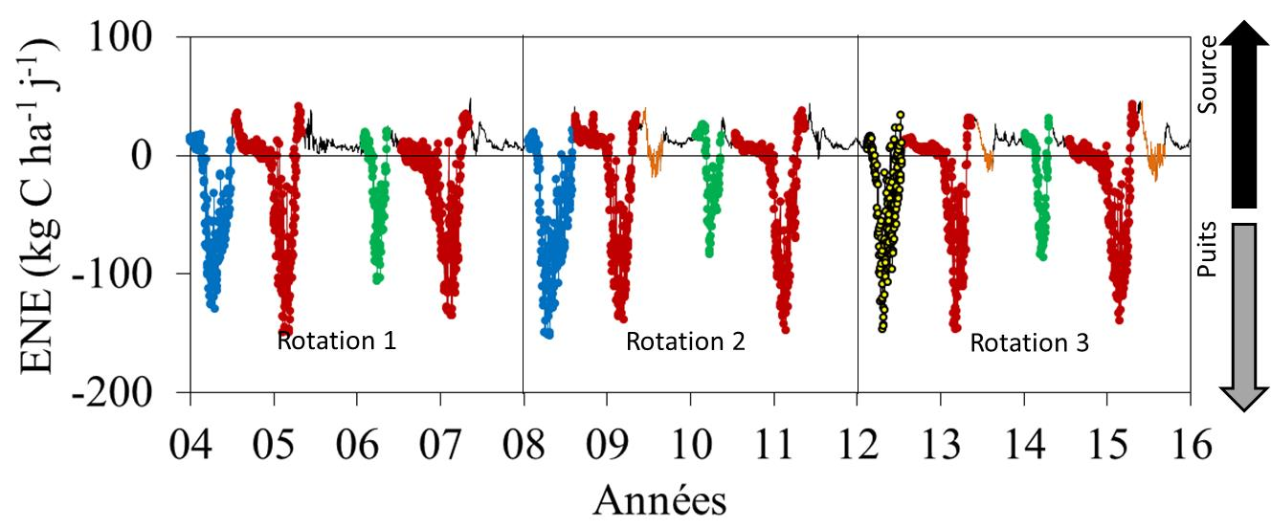
Carbon budget
Winter wheat
Sugar Beet
Potato
Maize
Mustard
Respiration
Net Ecosystem Exchange (NEE)
Photosynthesis
Net Biome Productivity = NEE – C import + C export
Notes:
For carbon, the net CO₂ flux, or "net ecosystem exchange" (NEE), reflects the balance between photosynthesis (negative flux, as CO₂ is absorbed) and respiration (positive flux, as CO₂ is released). Over a year of sugar beet cultivation, initially the flux is positive because the soil is bare. As vegetation grows, photosynthesis dominates, and the flux becomes negative, with fluctuations due to changes in the leaf area and soil and weather conditions. Finally, after harvest, the flux returns to positive because it’s bare soil again.
You can see that the NEE dynamics for sugar beet are similar to those for winter wheat and potatoes, but the intensity of photosynthesis is lower for the latter. You can also see that when mustard is used as an intermediate crop, it reduces CO2 emissions during the autumn and winter.
To assess the full carbon balance, which is called net productivity of the biome, we account for carbon exports so harvest, and imports so organic fertilization.

Slide 13
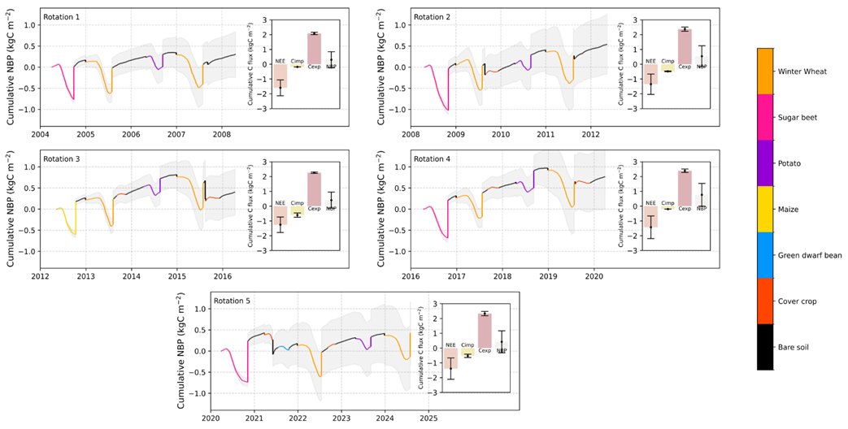
Carbon budget
Notes:
To visualize the NBP, this graph representes its cumulative value over time for the five four-year rotations since 2004. In other words, for a year of sugar beet in pink, it starts in with CO2 emissions as respiration dominates, and this is the cumulative value of CO2 emitted before photosynthesis becomes more important than respiration. Next, photosynthesis allows the curve to descend and just before the harvest, the cumulative value of the net flux shows that the plot has absorbed 0.7 kg of carbon per square meter. Finally, at harvest time, we assume that the exported carbon is a source because it ends up fairly quickly in the form of CO2, as already said.
You can see that at the end of the season, the balance here is close to zero, i.e. the carbon that leaves in the harvest is equal to the net amount of carbon stored in the ecosystem, or if you prefer, equal to the amount stored in the sugar beet minus that lost by the soil's organic matter.

Slide 14
Carbon budget
First 2 SB growing seasons close to neutral: Net C accumulated in ecosystem is exported (transformed into CO₂)
2 last SB growing : plot became C-source (due Rsoil ↗ to t° elevation ?)
Bare soil before – after SB ⇒ plot = C-source
Notes:
This happens again in the second sugar beet season, so these two growing seasons can be considered as carbon neutral. But in the third and fourth seasons, the plot becomes a source of C, as the end of the pink curve is above zero. This may be due to an increase in soil respiration caused by global warming, which increases microbial activity.
If the assessment is made over a full year, we must then take also into account the periods of bare soil before and after sugar beet cultivation, and obviously these periods are significant sources of CO2 and will systematically make the carbon budget positive (i.e. a net emission).

Slide 15
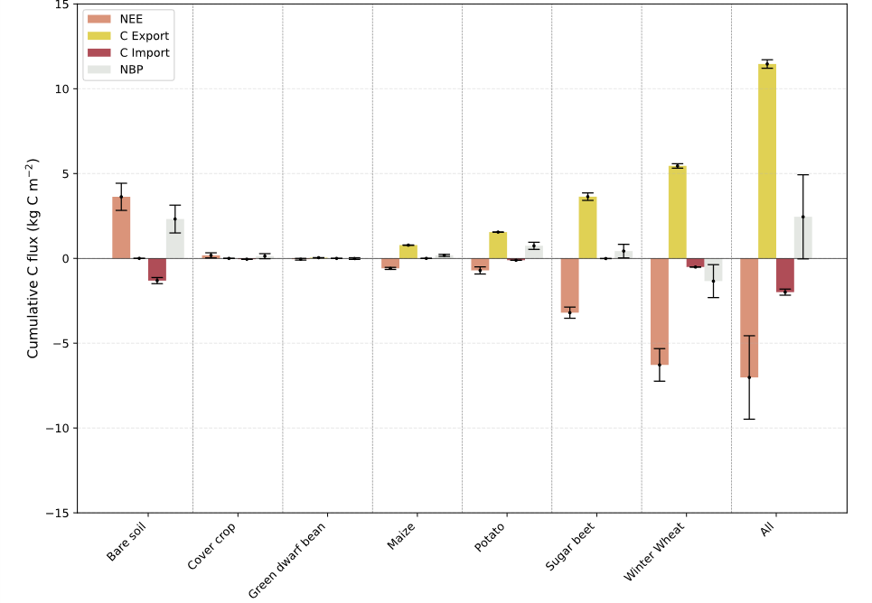
Carbon budget
Over 5 rotations:
NBP SB = 110 ± 100 gC m⁻² growing season⁻¹
NBP Bare soil = 115.5 ± 41 gC m⁻² yr⁻¹
Notes:
Let us now look at the cumulative carbon budget figures for the four growing seasons of sugar beet. The cumulative NEE without the bare soil period is 440 grams of carbon per square meter, so an average of 110 grams of carbon per square meter per growing season, with a significant degree of uncertainty that is almost equal to the source value.
As a first approximation, we could say that the contribution of bare soil before and after cultivation is around one-twentieth of the cumulative total obtained over the 20 years of cultivation. This would give a value of 115 grams of carbon per square meter per year. If we add these two contributions together, we see that our plot emits around 225 grams of carbon per square meter per year.
To give you an idea of what this represents, we have measurements from a beech forest in eastern France, which absorbs around 250 gC per square meter per year. So opposite fluxes with close amplitude…

Slide 16
Conclusion
Lonzée Sugar beet: GHG emission
N₂O: 20.8 gC_{éq} m⁻² growing season⁻¹
CO₂ vegetation & bare soil ≈ 225 gC m⁻² yr⁻¹
Soil respiration plays a major role !
Notes:
In conclusion, when our plot is used to produce sugar beet, it is a source of GHG emissions, with N2O emissions being significant but lower than CO2 emissions. We can see that CO2 emissions are becoming increasingly important during the growing season, and that this is exacerbated by periods of bare soil. We can see that soil respiration and its dependence on temperature are key factors in understanding this balance and its assessment.

Slide 17

Notes:
Thank you very much for listening, and I am ready to answer your questions.

