Slide 1
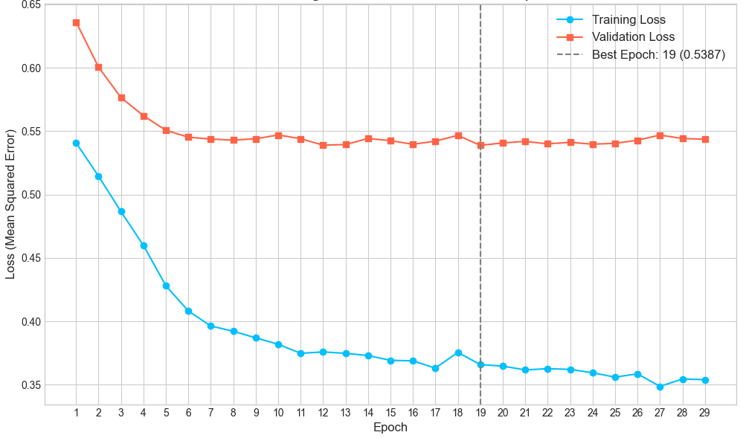
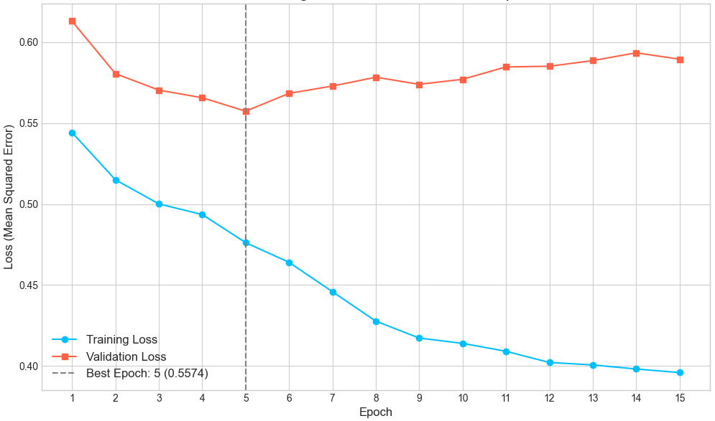
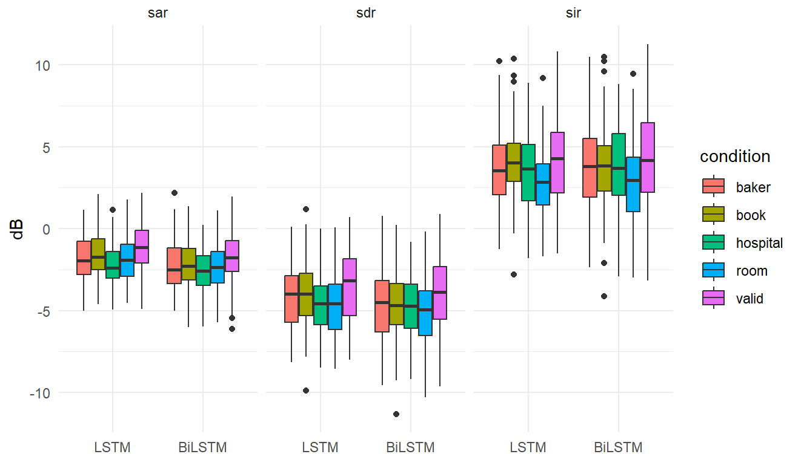
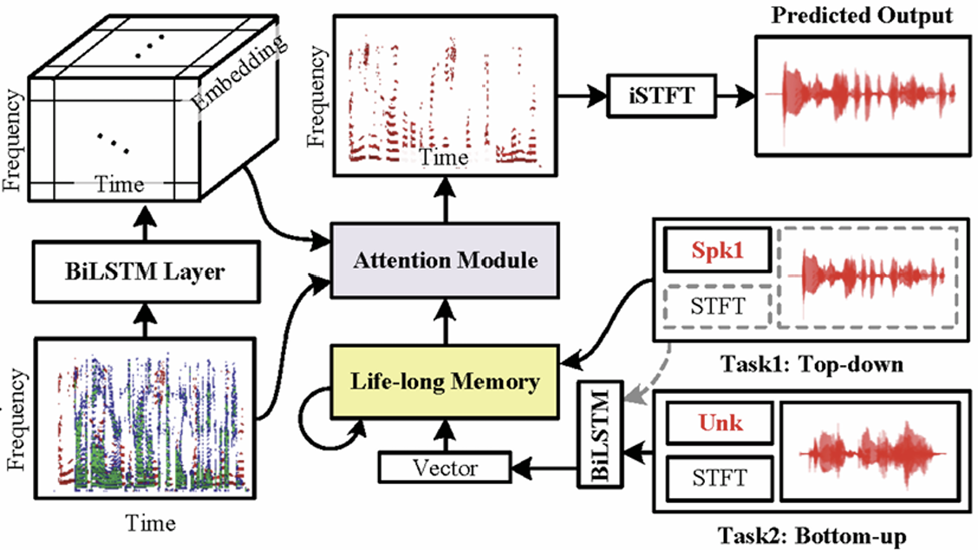

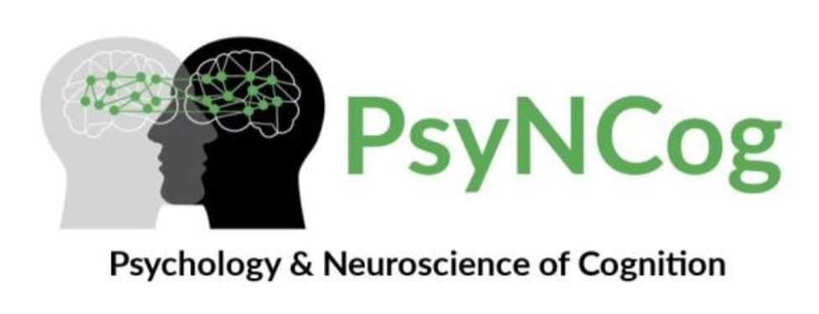
Modeling selective auditory attention using computational neural networks
Marion Balla¹, Jacques Sougné²
¹ University of Liège, GIGA Research, GIGA-CRC Human Imaging Unit, Physiology of Cognition Lab
² Psychology & Neuroscience of Cognition Research Unit, University of Liège
mballa@uliege.be
Introduction
Results
Computational models are increasingly viewed as in silico brain proxies, due to their ability to exhibit human-like behavior¹. Although visual processing is highly advanced², existing auditory models still face challenges in capturing both top-down mechanisms (such as selective attention) and bottom-up dynamics (like the cocktail party effect) in noisy, multi-source environments³. This study compares Xu et al.’s auditory attention model and an LSTM variant in a cocktail-party scenario with simultaneous target and distractor speakers, using a dataset that we developped.
Models’ learning curves:
BiLSTM LSTM
MANOVA:
- Model : Pillai = 0.0718, F(3, 976) = 25.1789, p < .0001
- Condition : Pillai = 0.0894, F(12, 2934) = 7.5171, p <.0001
- Interaction : Pillai = 0.0022, F(12, 2934) = 0.1864, p = .9989
Planned contrast (interference of learned words):
- t(978) = 4.574, p < .0001, estimate = .672 dB
Both models converged rapidly, reaching optimal validation performance at epoch 19 (BiLSTM) and epoch 5 (LSTM). The LSTM model had slightly but significantly better performances. The presence, in the distractor’s speech, of words that were presented in the target’s speech during the training phase significantly impacted the models’ performances, compared to baseline condition.
Methods
Original model’s architecture:
Training phase: The models were trained on a dataset in which the target’s speech contained recurrent words (4).
Testing phase: We placed these recurrent words in the distractor’s speech to assess their influence on the models’ performances.
There were 5 testing sets (=conditions): one for each word tested (4), and one baseline (no relevant word in the distractor’s speech).
Analyses: Hypothesis-driven:
MANOVA: main effects (model, condition) & interaction
Contrast: does the presence of ‘known’ words in the distractor’s speech impair performance ?
INPUT
Set | Samples
Training | 2700
Validation | 300
Testing | 5 x 100
Discussion
The simpler architecture (LSTM) outperformed the BiLSTM in accuracy and training speed, suggesting the added bidirectionnal complexity was inefficient for this task. Interference from previously seen words might indicate an informational masking, however the lack of influence from words presentation frequency in the training set would require further study.
References
¹Tuckute et al. (2024). Language in brains, minds and machines. Annu. Rev. Neuro.
²Wichmann et al. (2023). Are DNN adequate behavioural models of human visual perception ? Annu. Rev. Vi. Sci.
³Zmolikova et al. (2023). Neural target speech extraction: An overview. IEEE Signal Process. Mag.
⁴Xu et al. (2018). Modeling attention and memory for auditory selection in a cocktail party environment. Proceedings of AAAI.

