Slide 1

The clean-tech revolution led by China
And why the latest Chinese tech moves may
change everything in the energy sector, forever.
December 2025
Prof. Dr. Ir. Damien Ernst
Co-authors: Dr. Ir. Victor Dachet and Mr. Thibaut Téchy.

Slide 2
China as the leading technological nation on Earth in both scale and quality
“A complete railway station, including a new high-speed line, was rebuilt overnight in just 8 hours by 1,500 workers.”
“A new generation of hospitals operates without on-site doctors.
They work remotely via high-bandwidth telemedicine platforms.”
“Everyday transactions are now handled through QR codes or facial recognition; credit cards are considered outdated.”
“12 million university graduates per year (more than the entire population of Belgium), including 3.5 million engineers.”
“China trains 50% of the world’s AI engineers and develops 70% of all large language models currently deployed.”
More information and analysis in: Coppens, P. (2025). Keynote on China’s race for technology supremacy [Video]. Nexxworks.
2

Slide 3

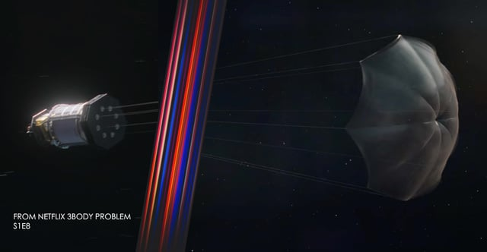
From fiction to reality: the 3 Body Problem
Pushing science and technology to their absolute limits is deeply rooted in modern Chinese culture. You even find it reflected in their major works of fiction.
The 3 Body Problem tells the story of how humanity, confronted with an extremely advanced extraterrestrial civilisation, pools its resources, reinvents its research methods, and launches engineering projects of unprecedented scale.
Inventing a nuclear propulsion system to propel a spacecraft out of the solar system.
3

Slide 4
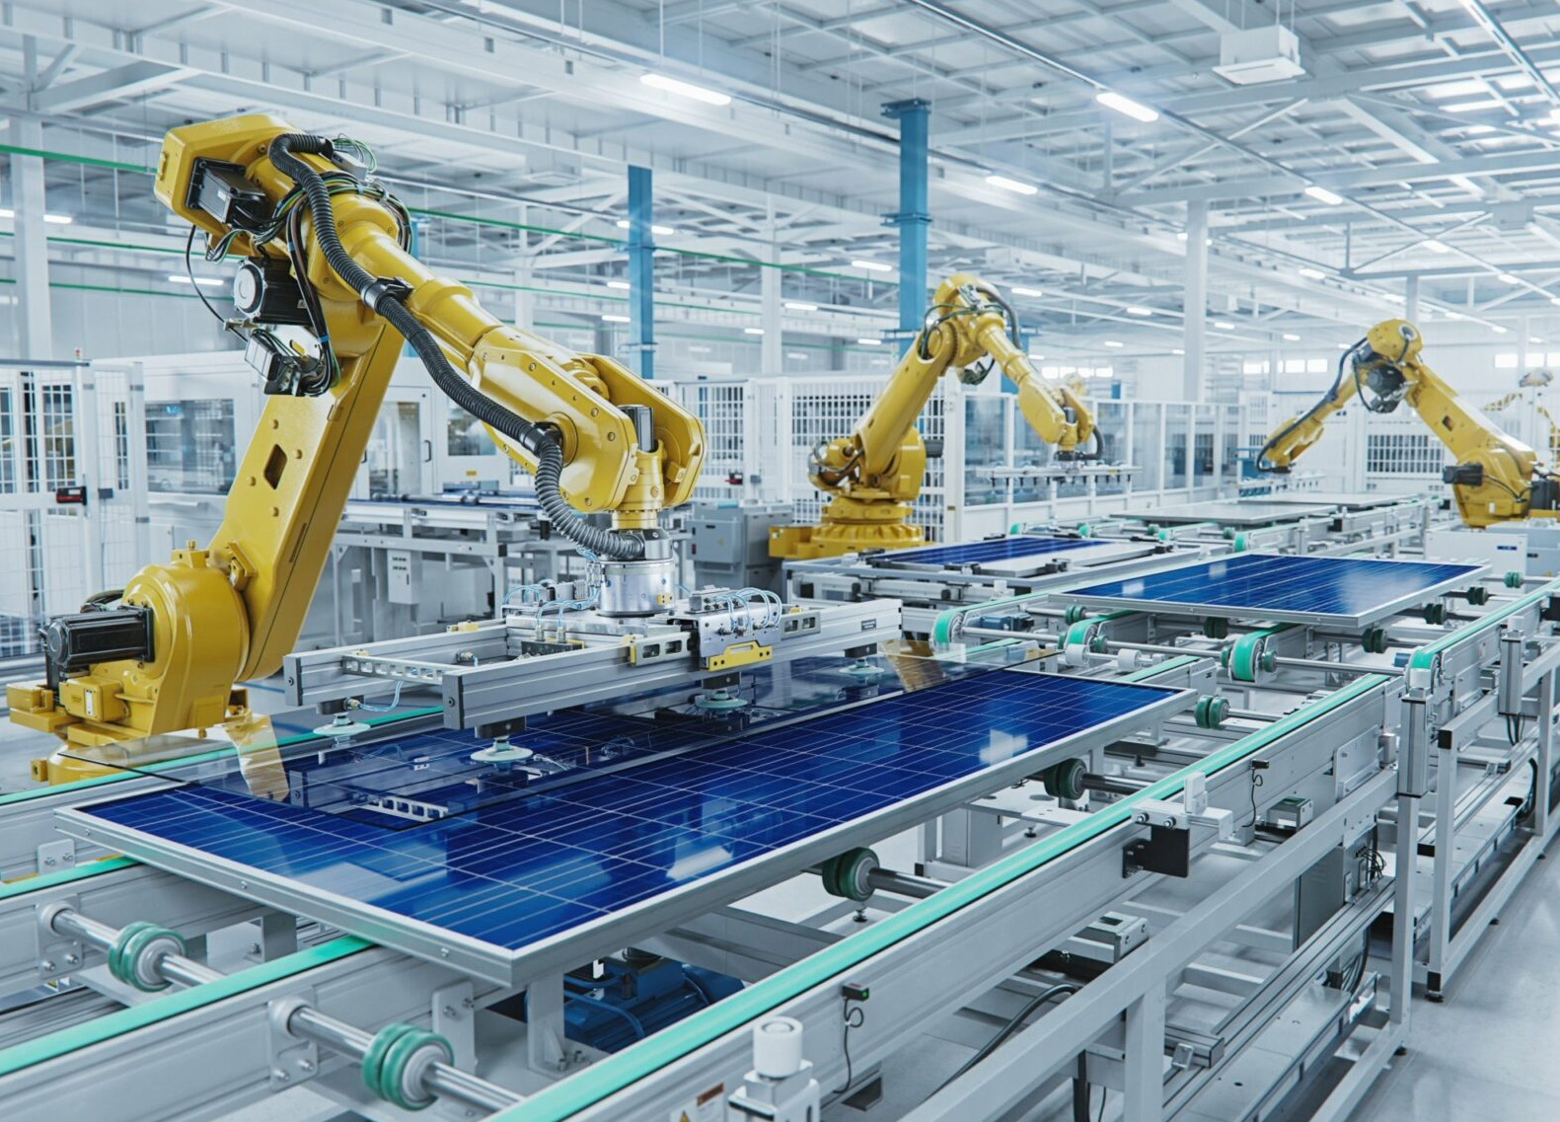
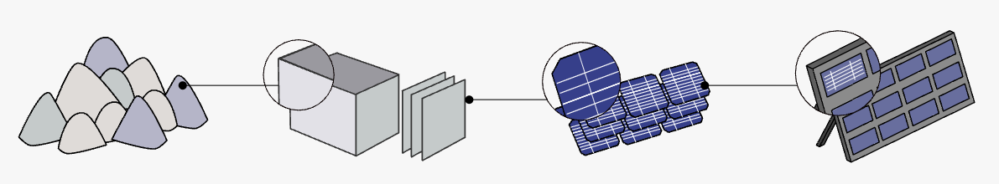
China is championing all sectors of the PV industry
China dominates every segment of the photovoltaic (PV) supply chain, from polysilicon to wafers, cells, and panels.
China’s share in global manufacturing capacity in various sectors of the PV industry^{[1]}
[1] Figure adapted from: Zissler, R. (December 2024). Progress in Diversifying the Global Solar PV Supply Chain. Renewable Energy Institute.
4

Slide 5
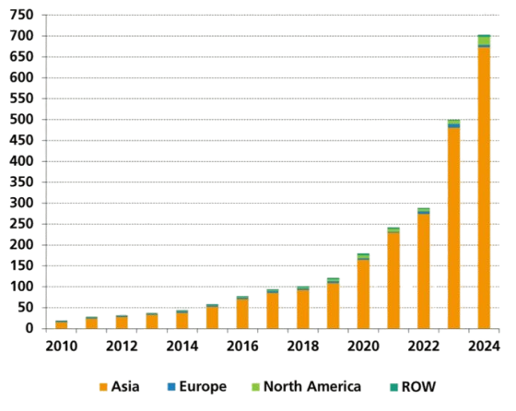
Excellent Chinese PV technology produced in large quantities
Global annual PV module production (in GWp)
by region^{[1]}
In 2024 alone, China produced over 650 GWp of PV modules.
Global installed PV capacity reached just above 2.2 TW that same year.
This means that in a single year, China manufactured nearly one-third of all PV capacity installed worldwide.
[1] Figure from: Fraunhofer Institute for Solar Energy Systems. (31 October 2025). Photovoltaics Report.
5

Slide 6

China collapsing PV prices
China forced PV prices to collapse as a result of three main elements:
Excellent technology, driven by the world’s largest pool of engineers and scientists;
Mass-manufacturing capacity, unmatched anywhere else;
Intense competition within China’s own domestic market.
As a result, global mainstream PV module prices have fallen to 0.10 €/Wp.
Module class | Global PV module price (€/Wp)^{[1]}
 | October 2025 | January 2025 | October 2016
High efficiency | 0.12 | 0.13 (-8%) | 0.60 (-400%)
Full black | 0.13 | 0.13 (0%) | 0.54 (-315%)
Mainstream | 0.10 | 0.11 (-5%) | 0.46 (-360%)
Low cost | 0.05 | 0.06 (-15%) | 0.34 (-580%)
[1] Data from: PV Magazine International. (n.d.). Module Price Index.
6

Slide 7
China is also the world leader in battery manufacturing
Among the many battery manufacturers in China, several firms stand out: CATL, BYD, CALB, Gotion, EVE Energy, and more. These are large-scale cell and pack producers supplying both electric-vehicle (EV) makers and grid storage.
In 2024, the average worldwide battery-pack price was estimated at 115 US$/kWh.
By late 2024, Chinese battery manufacturers achieved a historic low, with pack prices falling to 94 US$/kWh.
Average price trend for lithium-ion battery packs and cells (2024 US$/kWh)^{[1]}
[1] Figure adapted from: BloombergNEF. (2024, 10 December 2024). Lithium-Ion Battery Pack Prices See Largest Drop Since 2017, Falling to $ 115 per Kilowatt-Hour.
7

Slide 8
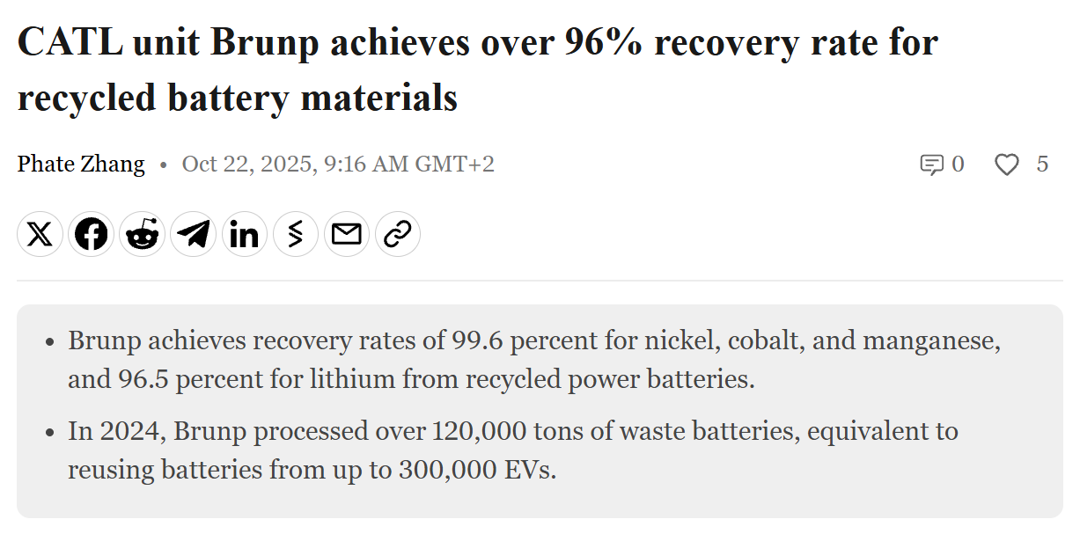
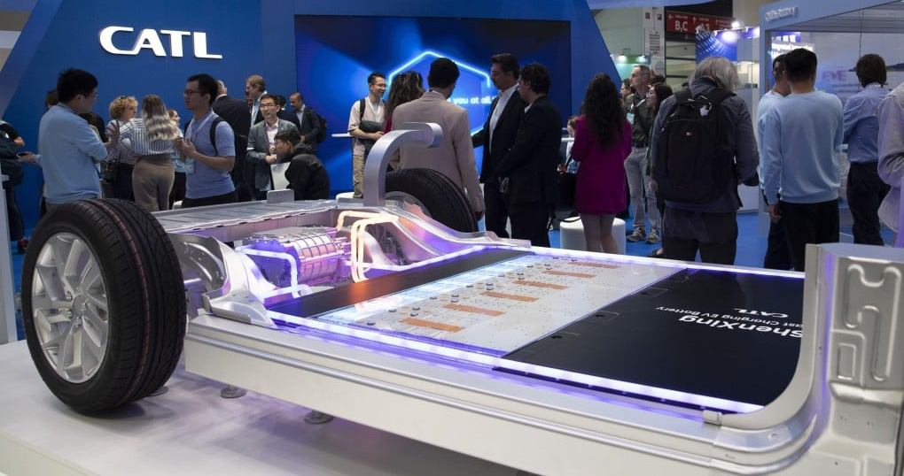
Example of an impressive champion in the battery sector: CATL
From January to October 2025, global EV battery installations reached 933.5 GWh. CATL ranked first with 355.2 GWh, representing 38 % of the world market.
CATL is also a global leader in battery recycling. The company has developed a “mine-to-battery-to-recycling” model, with lithium recovery rates exceeding 90 %.
8

Slide 9
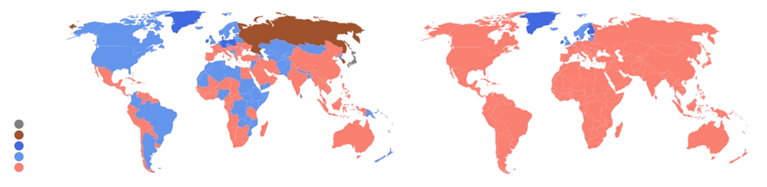
A first consequence of clean-tech advances:
PV modules will soon dominate global electricity production
A recent study published in Nature Communications^{[1]} reinforces that solar PV is expected to become the cheapest source of electricity in most parts of the world, even when both short-term lithium-ion storage and long-term hydrogen storage are included in the system costs.
Cheapest energy in 2023
Cheapest energy in 2027
Coal
Nuclear
Offshore wind
Onshore wind
Solar
[1] Reference to the study: Nijsse, F.J.M.M., Mercure, JF., Ameli, N. et al. (2023). The Momentum of the Solar Energy Transition. Nature Communications,14, 6542.
9

Slide 10
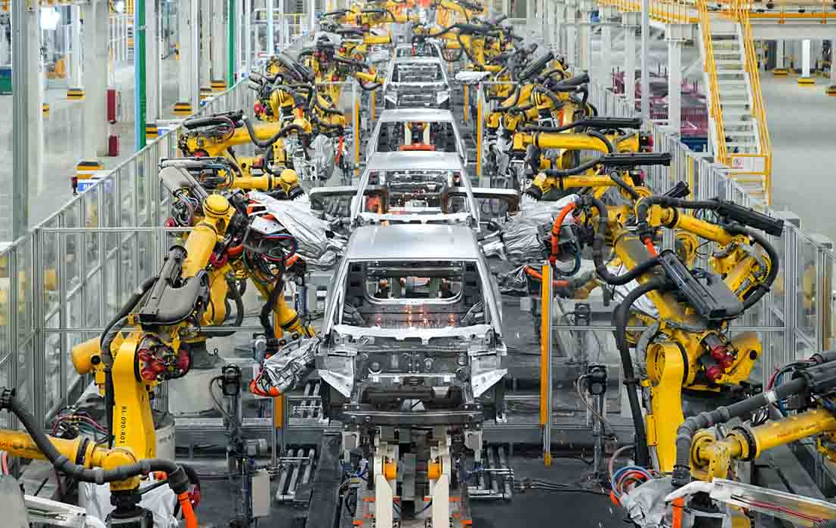
A second consequence of clean-tech advances:
Surface mobility will be fully electric
Thanks to batteries that are becoming extremely cheap, electric vehicles are rapidly becoming affordable, especially in China. An example is the EV maker BYD, which launched the 500-km-range Qin Plus EV in early 2024 in China at a price of US $15,000.
BYD’s industrial model that explains this performance:
BYD manufactures nearly 75% of a vehicle’s components in house;
The BYD Xi’an factory operates at around 97% automation;
A new EV rolls off the production line every 51 seconds.
10

Slide 11
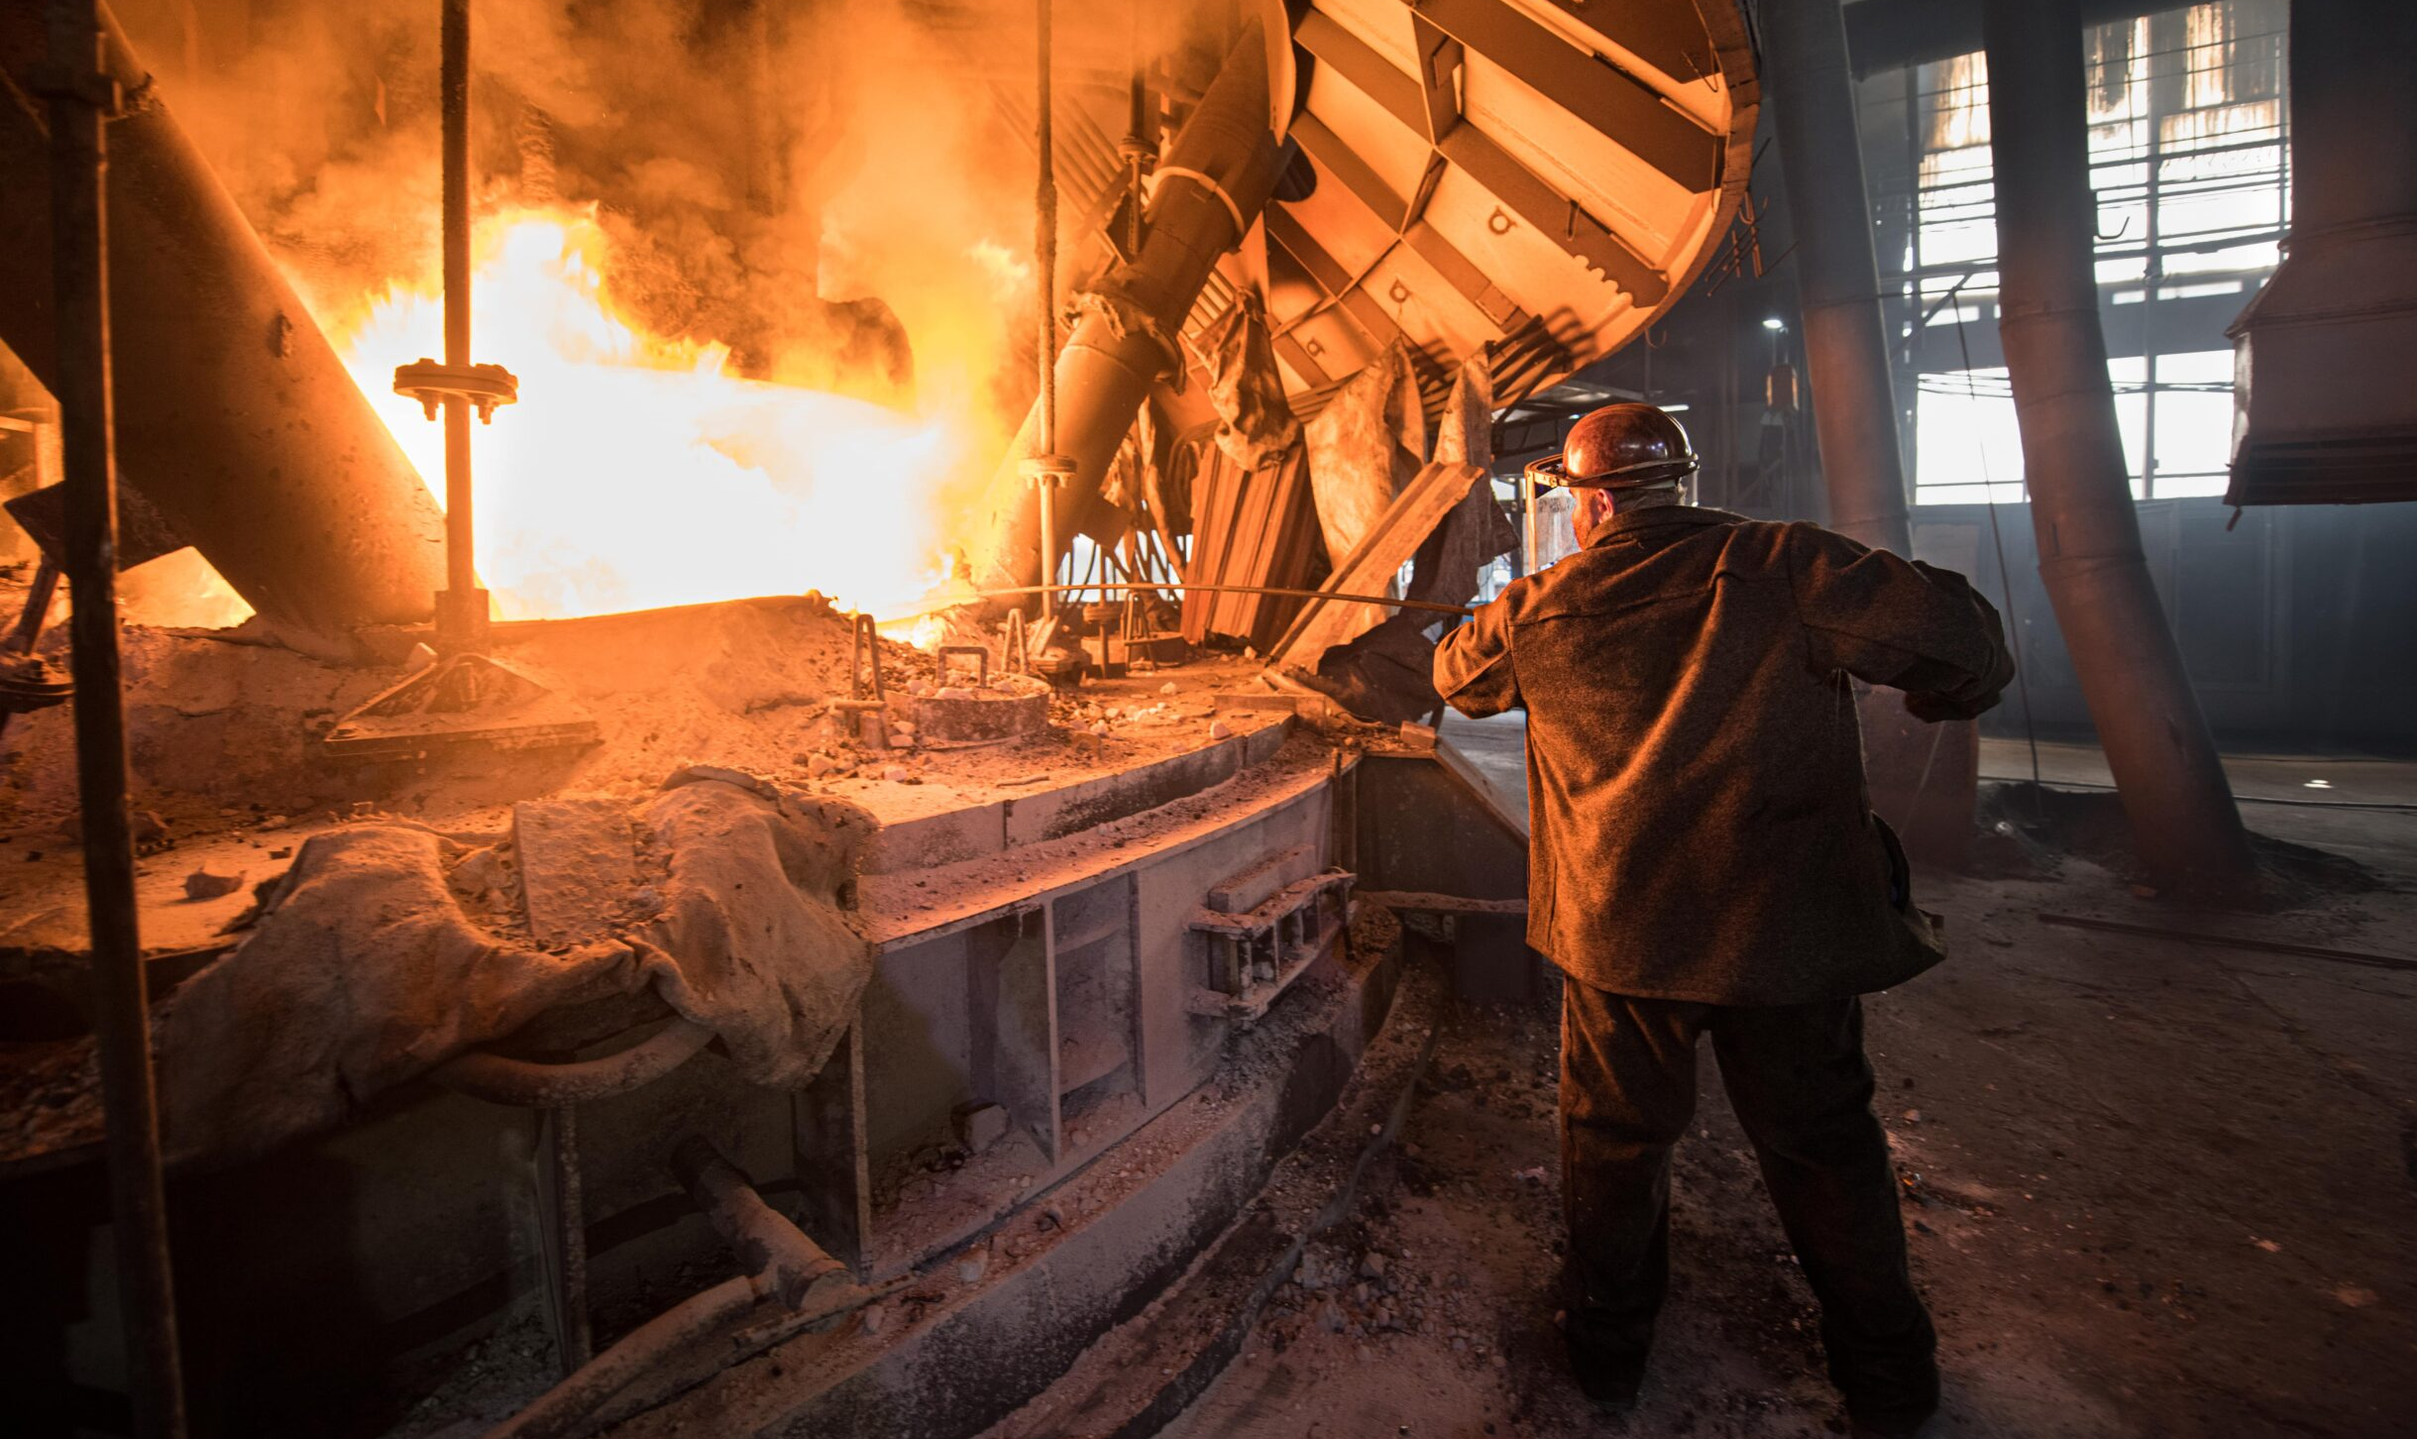

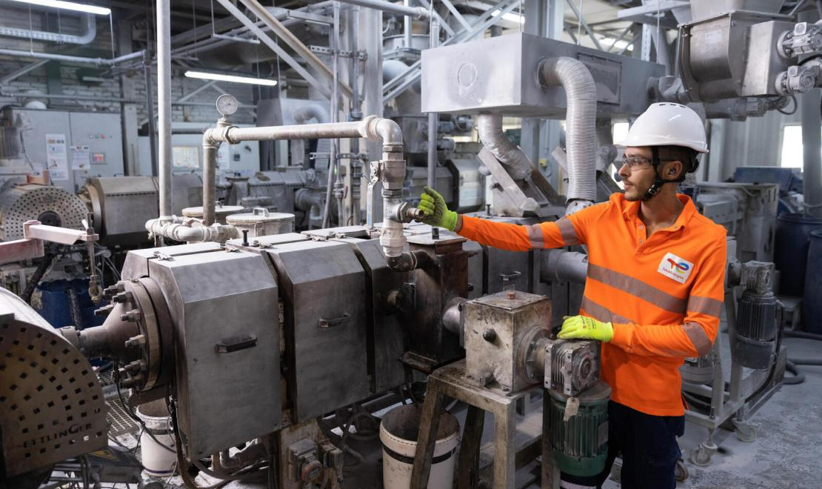

The last barrier before the fall of fossil fuels
With electricity becoming very cheap and batteries enabling full electrification of surface mobility, only a few sectors cannot be electrified and therefore still require molecules. These molecules are currently produced from fossil-fuel resources.
Heavy industry
Agriculture
Chemical industry
Air transport
Methane,
for iron ore reduction
Ammonia,
for nitrogen fertilizers
Methanol,
for plastics
Saturated hydrocarbon,
for kerosene
We believe that Chinese clean-tech is now approaching the point where these molecules can be synthesised directly from electricity at costs competitive with today’s fossil fuel-based production.
11

Slide 12
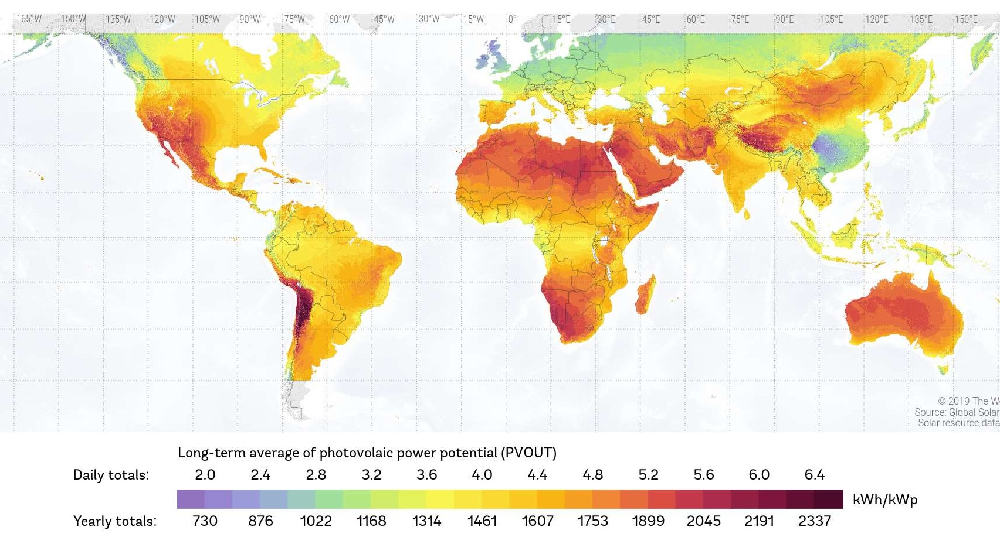
How will it happen?
Step 1
Producing cheap electricity in sunny regions with PV modules
As mentioned earlier, PV combined with batteries is the cheapest way to produce electricity in sunny regions. But how cheap is it really? Let us consider a 1 MWp PV solar plant located in a very-high-irradiation region and equipped with batteries
We adopt the following assumptions:
(i) The capacity factor is 25%;
(ii) The production profile of each day is constant throughout the year;
(iii) The battery system should store half of the daily power output to ensure constant supply of electricity;
(iv) The costs of PV and batteries are estimated at 0.10 €/Wp and 100 €/kWh, respectively.
High photovoltaic power potential regions
12

Slide 13
Since a 1 MWp PV solar plant produces:
1 × 0.25 × 24 = 6 MWh/day, we size the battery system at 3 MWh.
The total investment cost (CAPEX) for the solar plant and the battery system is therefore:
(0.10 × 1,000,000) + (3 × 1,000 × 100) = 400,000 €.
Assuming there are no battery losses, the total electricity generated over 20 years is:
1 × 8,760 × 20 × 0.25 = 43,800 MWh.
This yields an average CAPEX cost of:
400,000 / 43,800 ≈ 9 €/MWh.
A CAPEX cost of 9 €/MWh for electricity produced by a PV+battery installation in sunny regions is extremely competitive when compared with current energy-market prices.
Energy | Price | Source | Date
Natural gas (Dutch TTF Futures) | ≈ 27 €/MWh | ICE Endex | 08/12/2025
Electricity (CAL-26) | ≈ 76 €/MWh | elexys.be | 08/12/2025
Crude oil (US Brent) | ≈ 33 €/MWh^{[1]} | oilprice.com | 08/12/2025
[1] With a barrel of oil priced at 62 US$, an energy content of 1.62 MWh per barrel, and an exchange rate of 1 € = 1.16 US$, the cost per MWh is computed as follows: (62/1.16)/1.62 ≈ 33 €/MWh.
13

Slide 14
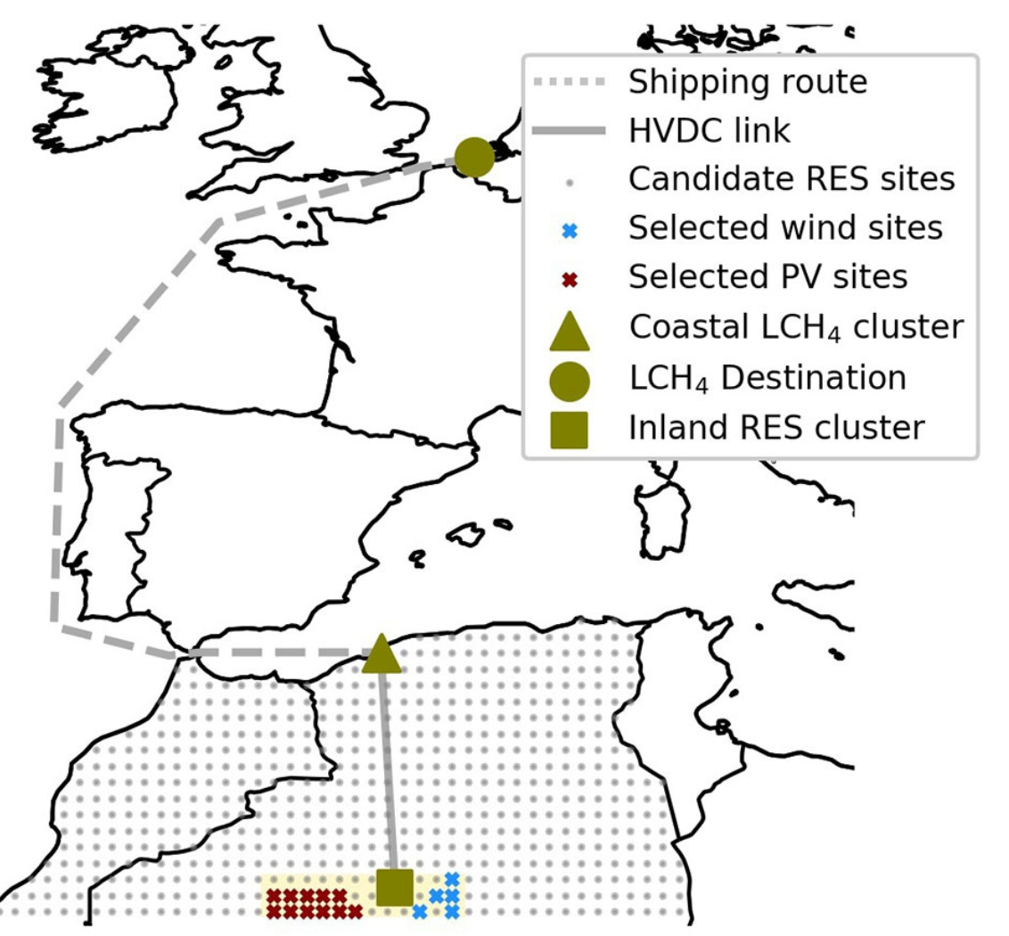
Step 2
Transforming this cheap electricity into energy-rich molecules
Abundant and high-quality renewable resources in regions located far away from load centers can be harvested at very low cost. This low-carbon energy can then be converted into energy-rich molecules and transported over long distances to supply large load centers.
An example of step 2:
(i) Solar and wind energy is harvested in the Algerian desert;
(ii) It is transported to the coast via an HVDC link;
(iii) It is converted into e-methane and then shipped to Belgium for consumption.^{[1]}
[1] Energy could also be transported using battery ships. More information in this paper: Dachet, V., Maio, A., Counotte, P., & Ernst, D. (2025). Remote Renewable Energy Hubs in the High Seas: A battery-based fully-electric ecosystem. ORBi-University of Liège.
14

Slide 15

Step 3
Using these energy-rich molecules in load centers as a substitute of fossil molecules
Physico-chemical properties of e-molecules are identical to those of their conventional fossil-based counterparts; only the production process differs.
E-molecules therefore serve a dual role:
Low-carbon fuels: They act as drop-in substitutes for conventional hydrocarbons;
Energy carriers: They enable the storage and long-distance transport of low-carbon energy.
15

Slide 16
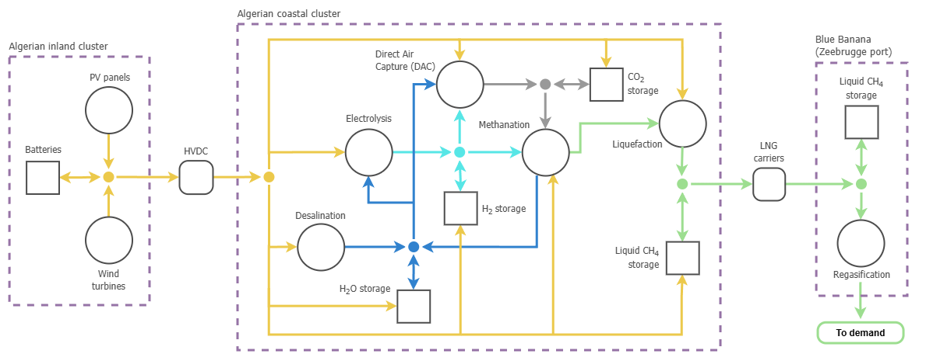

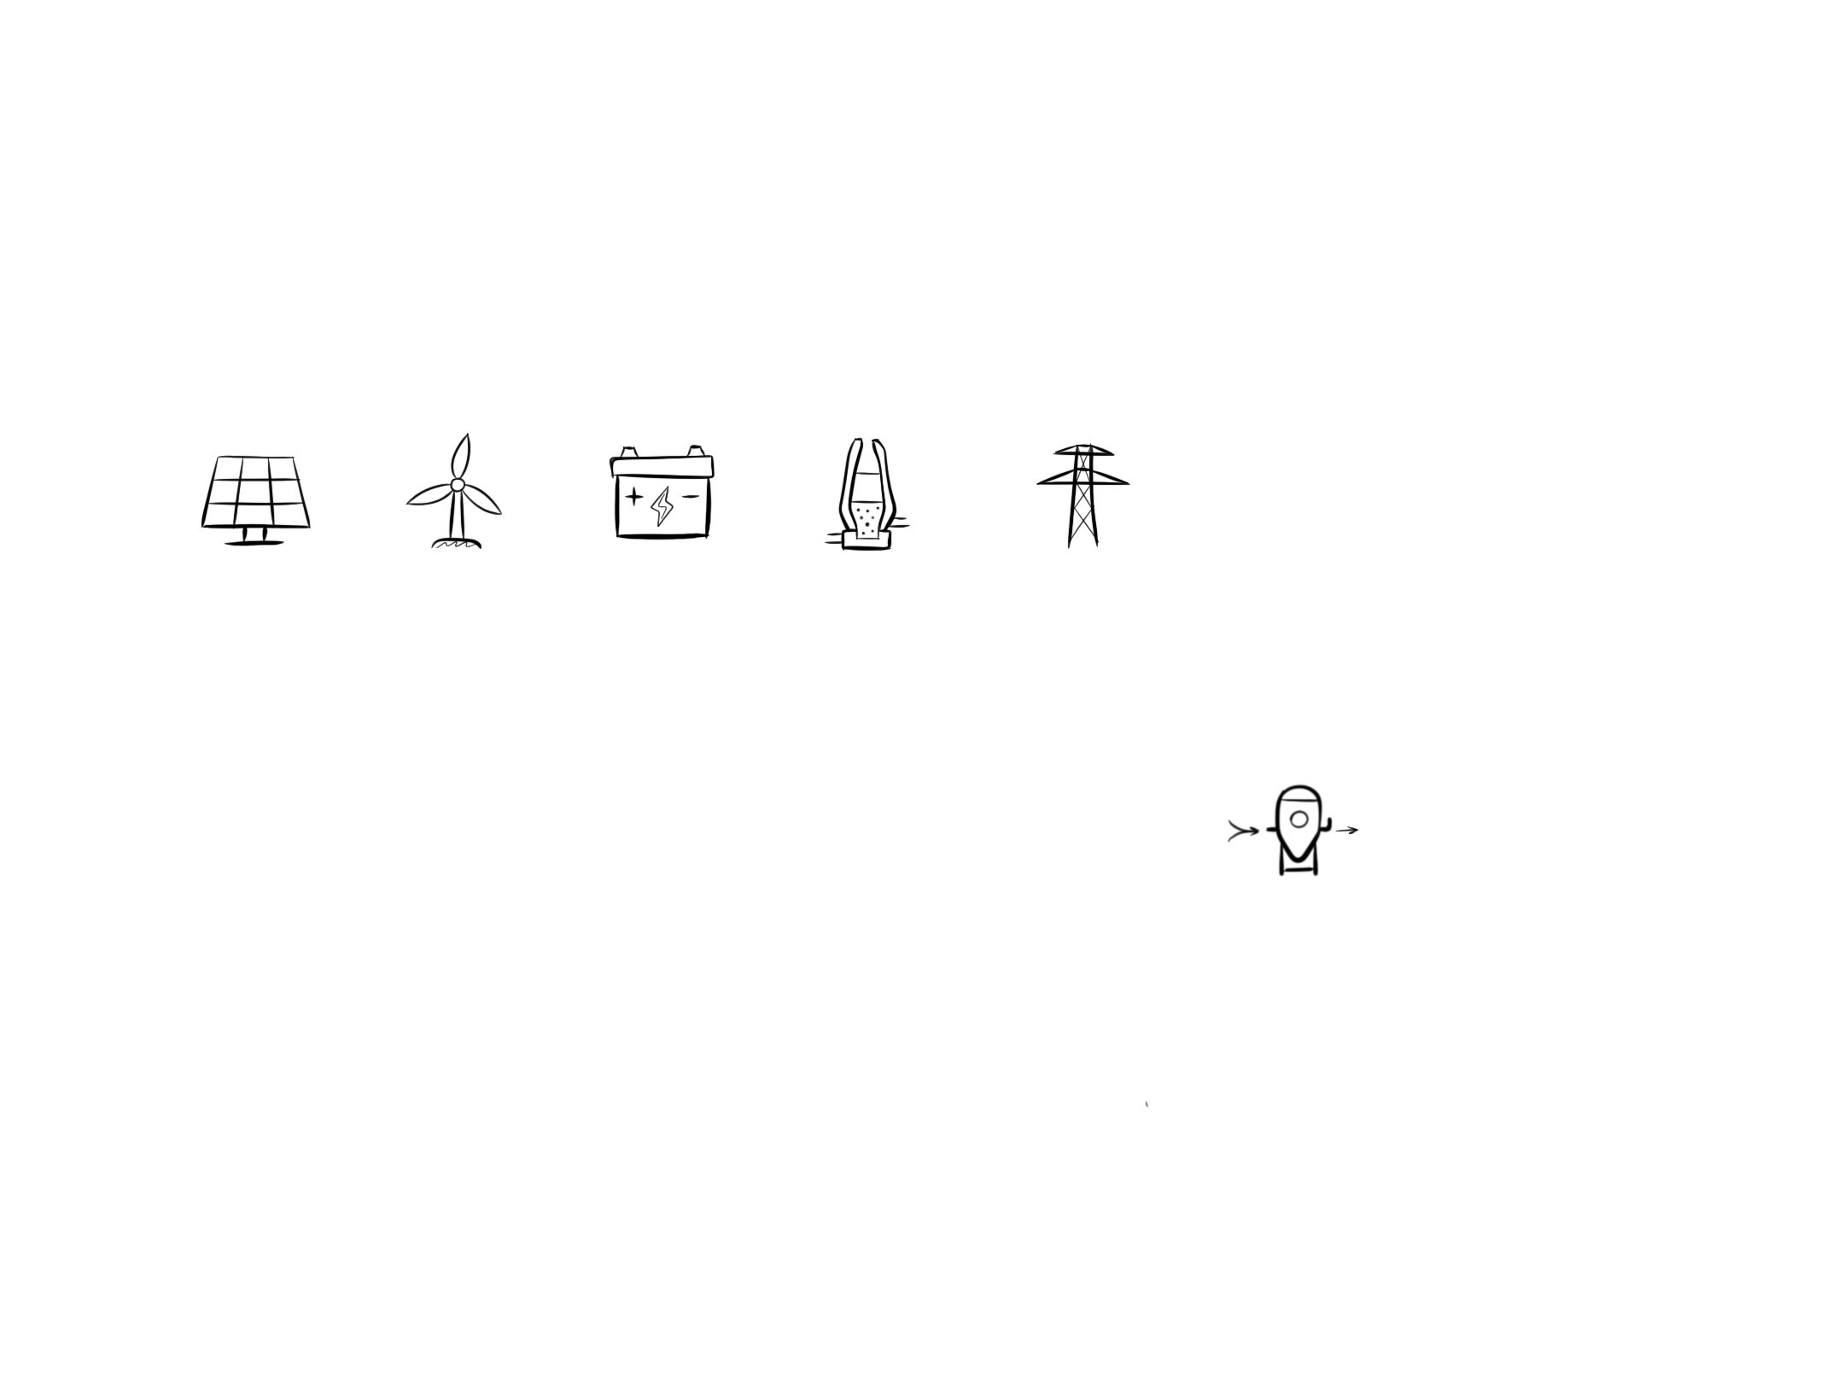
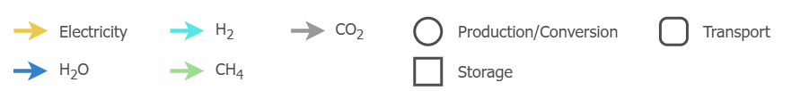
The three-step process which forms the basis of
the Remote Renewable Energy Hub (RREH) concept
Step 1
Step 2
Step 3
CO₂
CO₂
CH₄
H₂
CH₄
H₂O
[1] The term Remote Renewable Energy Hub (RREH) is defined in: Dachet, V., Dubois, A., Miftari, B., Fonteneau, R., & Ernst, D. (19 December 2024). Remote Renewable Energy Hubs: a Taxonomy. Energy Reports, 13, 3112-2120.
16

Slide 17
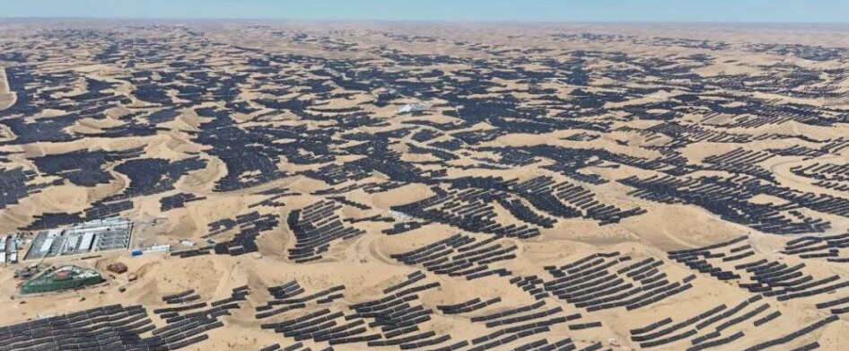
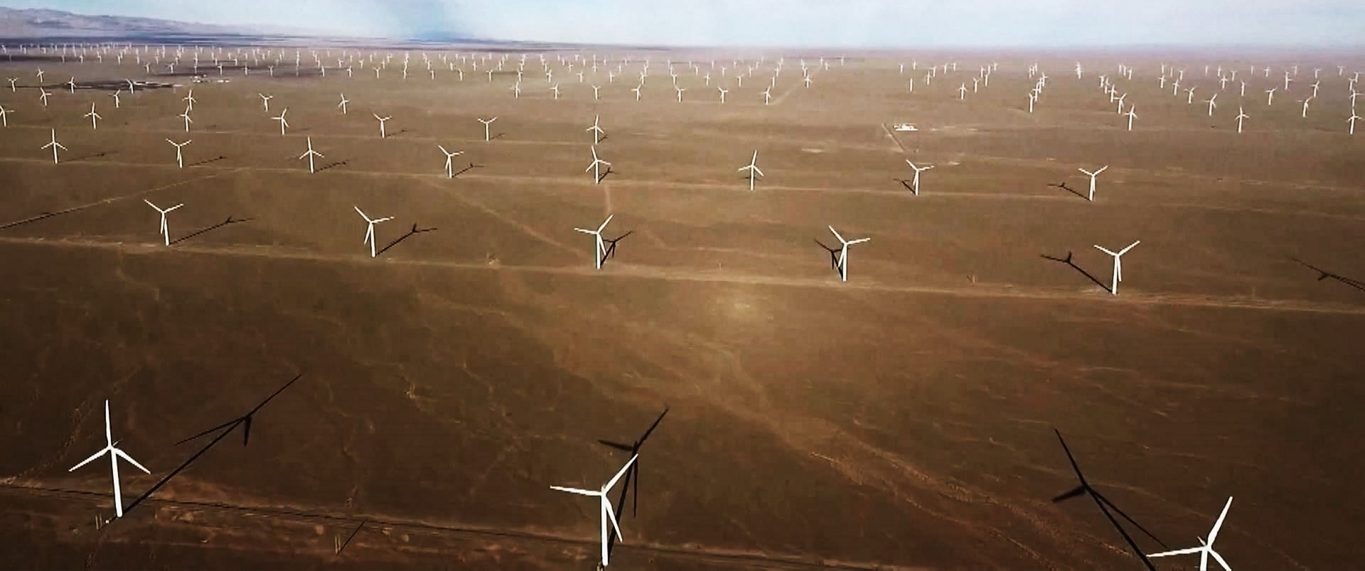
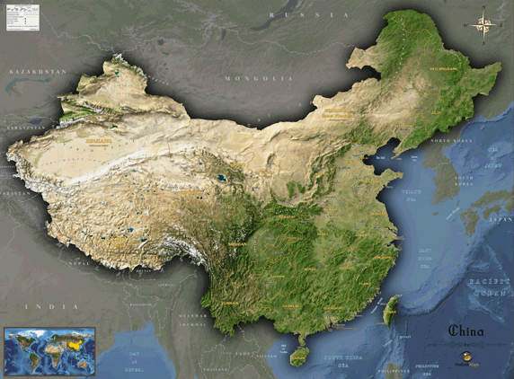
China is already leading the race for RREHs
The Chinese have already understood the strategic value of harvesting cheap renewable energy in remote regions. They transmit power generated in the western regions of China back to the major load centers on the eastern coast through long-distance transmission lines (Step 1).
One of their latest tech moves consists of investing investing heavily in all the technologies needed to synthesise energy-rich molecules at very low cost (Step 2).
Electricity generated at the Xinjiang PV farm (3.5 GW, 2024) and the Gansu wind farm (10.45 GW, 2025) is transmitted over more than 3,000 km.
17

Slide 18
Final words
The clean-tech industry has already won the economical battle for the production of electricity and for electrifying several loads traditionally powered by fossil fuels (surface mobility, heating through heat pumps, etc.).
It is now on its way to fully collapsing the fossil fuel industry thanks to the concept of remote renewable energy hubs for synthesising energy-rich molecules.
18

Slide 19
Laboratory references on RREHs (1/2)
Mokeddem, S., Miftari, B., Dachet, V., Derval, G., & Ernst, D. (2025). Distributed e-fuel hubs: Concept and case study. ORBi-University of Liège. https://hdl.handle.net/2268/327044
Ernst, D., Dachet, V., Larbanois, A., Mokeddem, S., & Vassallo, M. (2025). Le monde de l’énergie : des problèmes, mais toujours des solutions. Conférence donnée dans le cadre d’un événement organisé par Phoenix Contact, Namur, Belgium. https://hdl.handle.net/2268/332008
Dachet, V., & Ernst, D. (2025). Remote Renewable Energy Hub: a concept for improving energy security. Working session on decarbonization between the Walloon Parliament (Belgium) and the Parliament of North Rhine Westphalia (Germany), Namur, Belgium. https://hdl.handle.net/2268/329187
Dachet, V., Maio, A., Counotte, P., & Ernst, D. (2025). Remote renewable energy hubs in the high seas: A battery-based fully-electric ecosystem. ORBi-University of Liège. https://hdl.handle.net/2268/327232
Dachet, V., Dubois, A., Miftari, B., Fonteneau, R., & Ernst, D. (2024, December 19). Remote Renewable Energy Hubs: a Taxonomy. Energy Reports, 13, 3112-2120. https://hdl.handle.net/2268/309761
Dachet, V., Benzerga, A., Coppitters, D., Contino, F., Fonteneau, R., & Ernst, D. (2024). Towards CO2 valorization in a multi remote renewable energy hub framework with uncertainty quantification. Journal of Environmental Management, 363, 121262. https://hdl.handle.net/2268/309679
Dachet, V., Lokotar, I., & Ernst, D. (2024). Les Centres d’Énergie Renouvelable Distants (CERD). Une opportunité de leadership que l’Europe doit saisir. Confrontations Europe. https://hdl.handle.net/2268/318391
19

Slide 20
Laboratory references on RREHs (2/2)
Dauchat, L., Dachet, V., Fonteneau, R., & Ernst, D. (2024). Waste heat recovery in remote renewable energy hubs. Proceedings of ECOS 2024 - The 37th International Conference on Efficiency, Cost, Optimization, Simulation and Environmental Impact of Energy Systems, Rhodes, Greece. https://hdl.handle.net/2268/313825
Fonder, M., Counotte, P., Dachet, V., de Séjournet, J., & Ernst, D. (2024, March 15). Synthetic methane for closing the carbon loop: Comparative study of three carbon sources for remote carbon-neutral fuel synthetization. Applied Energy, 358. https://hdl.handle.net/2268/307481
Lambin, C., Fettweis, X., Kittel, C., Fonder, M., & Ernst, D. (2022). Assessment of future wind speed and wind power changes over South Greenland using the MAR regional climate model. International Journal of Climatology. https://hdl.handle.net/2268/288534
Berger, M., Radu, D.-C., Detienne, G., Deschuyteneer, T., Richel, A., & Ernst, D. (2021). Remote renewable hubs for carbon-neutral synthetic fuel production. Frontiers in Energy Research. https://hdl.handle.net/2268/250796
Radu, D.-C., Berger, M., Fonteneau, R., Hardy, S., Fettweis, X., Le Du, M., Panciatici, P., Balea, L., & Ernst, D. (2019). Complementarity assessment of South Greenland katabatic flows and West Europe wind regimes. Energy, 175, 393-401. https://hdl.handle.net/2268/230016
Chatzivasileiadis, S., Ernst, D., & Andersson, G. (2013). The global grid. Renewable Energy, 57, 372-383. https://hdl.handle.net/2268/144423
20

