Slide 1
Mining the Minds of Science
Transforming Open Science into Strategic Intelligence with Open Source
Valentin Angenot
Pierre Dosquet
Michael Ghilissen
Ashwin Ittoo

Slide 2
Motivation
ORBI valuable repository of scientific knowledge
Leveraged for strategic decision-making
Research Governance
Mining ORBI's contents
Detecting emerging trends, new research areas
Determining promising investment areas
Identifying areas for interdisciplinary research
Notes:
ORBi. This corpus represents a goldmine for the University of Liege. It comprises more than 62,000 scientific abstracts, each associated with detailed information such as authorship, publication date, or journal source.
This resource contains all the elements required to detect emerging and declining research areas, invest early in promising topics or support declining but strategically significant domains. It could also be used to map interdisciplinary flows, to identify key contributors within each field, to assess which journals enhance institutional visibility, and to detect opportunities for meaningful collaboration.

Slide 3
ORBI
Business Problem
Exploring Large Corpora for Strategic DM →Scientific Literature for Research Governance
AI-Driven Solution
Generation of underlying topics
Topics as basis of KPIs, trends, resource allocation, temporal tracking
Data
AI = ML
Automatic inference of topics from texts
Unsupervised ML, method: LDA
(contrast with Supervised ML)
LDA tries to reconstruct and optimize different probabilities of topics-words, documents-topics
Topic Augmentation: Analysis, Synthesis, Labeling & Hierarchisation
GenAI : LLM,
Explain briefly GenAI (vs. supervised, vs. unsupervised)

Slide 4
Key Issue: Uncovering Actionable Information
Unstructured textual contents
Focus on abstracts: more representative, concise vs. entire texts
Corpus size: 62 077
Multilingual: English dominating (79.2%), (19.4%), Italian, Dutch, Spanish, German, Chinese, and several other languages
Metadata preserved
Authors, title, journal name, publication year, ORBi category, DOI and handle
Enrich visualization tasks
Notes:
Uncovering meaningful information, latent in ORBI's contents

Slide 5
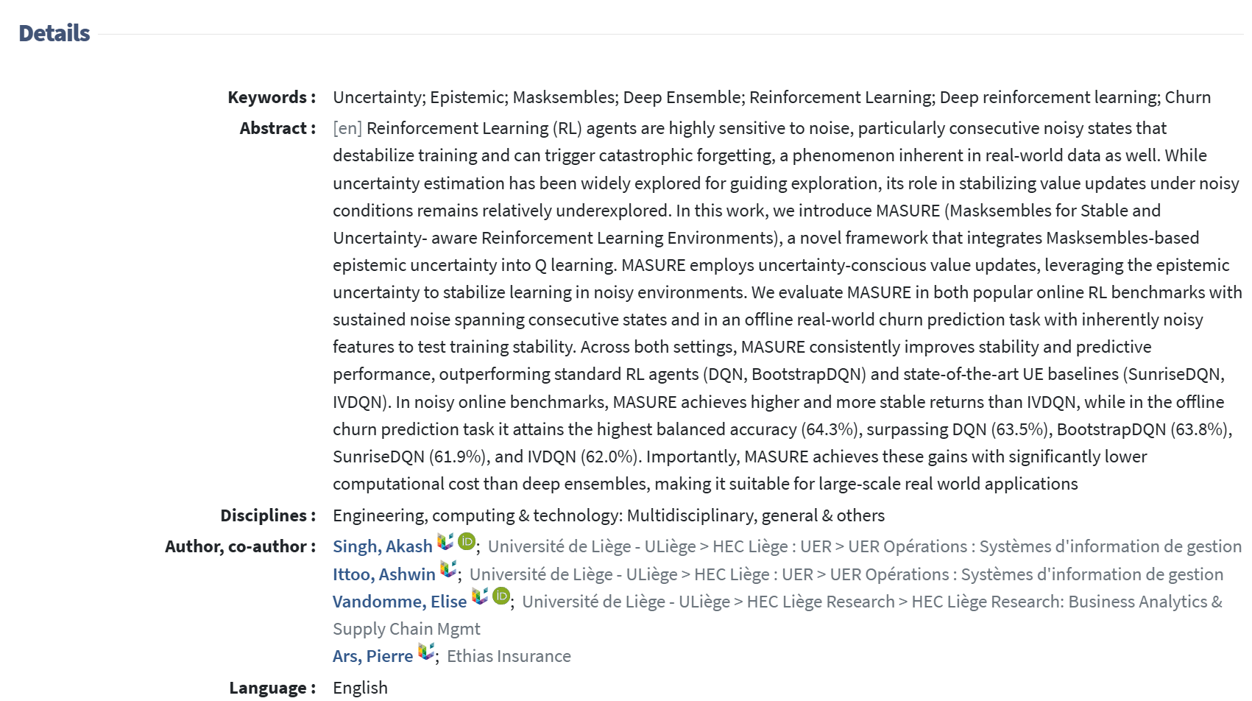
Show abstract illustration

Slide 6
Goal: Uncovering Latent Topics
Uncover underlying themes (topics) from ORBI astracts
What is being discussed in abstracts
Not explicitly mentioned → latent topics
Classify abstracts according to topics
Themes discovered
Semantically richer than keyword classification
No requirement to corroborate with predefined human classifications
Challenge predefined, static human classifications

Slide 7
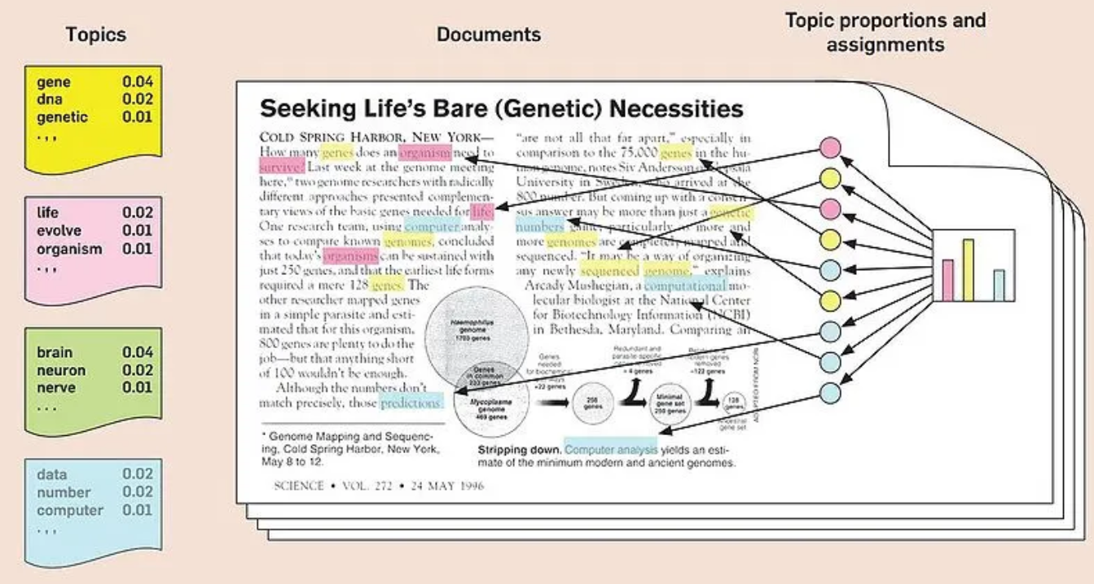
Unsupervised Machine Learning for Topic Inference
Themes are unknown
Abstracts unlabelled, keywords limited
Unsupervised Machine Learning
Algorithm infers underlying probabilistic distribution
Learns distribution generating groups of words from corpus
No human input, learning from raw data

Slide 8


GenAI
GenAI after Topic Inference
Topic Interpretation
Topic Labelling
No GPT-based model

Slide 9
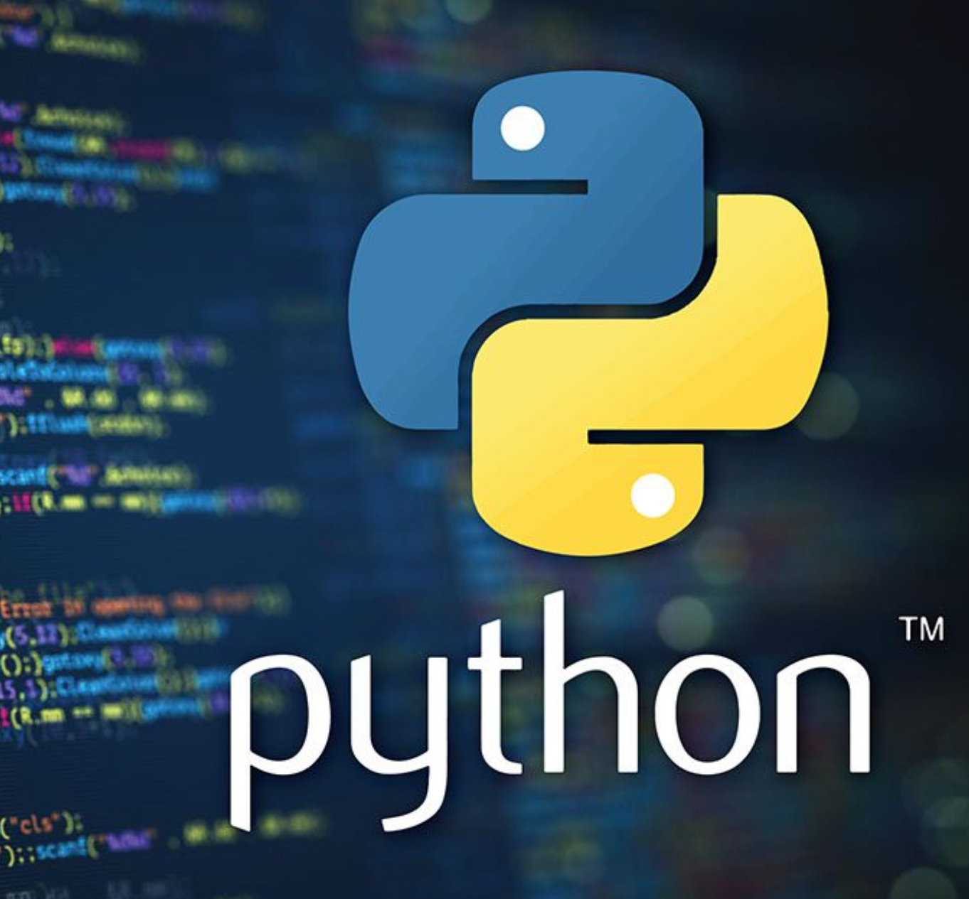

Open Source: Implementation & Demo
Core machine learning code-base & libraries
Python/PyTorch
Interpreting Discovered Topics
Llama (LLM from Meta)
User-Interface
React JS
DEMO
Beta-test phase
Not (yet) in production

Slide 10
Open Science
Open Science: organizing and sharing scientific research across the entire research lifecycle
Open access (data)
Open source (methods)
Open Access: free of access charges or other barriers
Enables a plethora of applications
Open Access datasets : NASA, NIH, and EU portals
Climate models, genomics, epidemiology, social science
Private & public
Several initiatives
Open Source: methods to view, use, modify, and distribute
Enables applications without relying on commercial tools.
Pytorch (Python) for deep learning,
LLMs (open weight) for language/multimodal tasks and reasoning
Neo4J for graphical intelligence and scientific networks
Langchain RAG for literature-grounded AI
Qdrant VectorDB for vector search and embeddings
Notes:
everything accelerates. If the data are open, someone, somewhere, will do something brilliant, strange, or wonderfully unexpected with them.
We’re drowning in opportunity—and for once, that’s a good problem

Slide 11
Open Science
AI refers to a new crop of content generation technologies, becoming a novel research paradigm.
Yet, the development of OS lags considerably behind the AI era due to the loss of academic leadership and insufficient motivation to pursue openness within the industrial sector.
Strong international movement towards OS in AI
Meta
DeepSeek
-> sharing your model weights doesn’t destroy your competitive advantage… it multiplies it.
Open Science AI is not just a tool; it's a catalyst for scientific breakthroughs
* https://tinyurl.com/4r3ws74t
“Open source software often becomes an industry standard,” Zuckerberg told investors on an earnings call on Feb. 1. “When companies standardize on building with our stack, that then becomes easier to integrate new innovations into our products.”*
Notes:
Open AI supercharges open science. It’s not a tool—it’s a catalyst. It turns scattered information into structured intelligence. It maps the invisible. It finds the patterns humans would miss. And it lets us ask bold new questions—without waiting for someone else's permission.

Slide 12
Innovation at the Intersections
Open Source offers a decentralized, collaborative, and highly accelerated approach to innovation
The Power of externalization→ Community-led development
The DNA Detection Challenge—cracked through global collaboration
The Toxicology Mystery—solved by interdisciplinary insights
Finding Longitude at Sea—achieved not by astronomers, but by a self-taught clockmaker
Innovation happens where disciplines & community meet
Distributed intelligence
Diverse perspectives
Radical notion that your solution provider might come from anywhere
Notes:
The lesson? Your next breakthrough collaborator might not be in your department. Or your country. Or your discipline.
Distributed Intelligence
Open ecosystems harness the intelligence of many. Not “centralized genius,” but collective problem-solving. Distributed intelligence produces ideas that no single institution could generate. It's messy. It's vibrant. It's powerful.

Slide 13
Open Access Acceleration
AI & OS have transformed scientific publishing, which has simultaneously experienced a massive shift toward Open Access
Experiments and code now live on GitHub
Researchers are leaving high-cost publishers
Open-access journals are gaining recognition
Preprints move faster than journals can typeset
-> Knowledge now moves at internet speed.
AI addresses Open Access challenges
Volume: Automated analysis and synthesis
Language: Real-time translation
Discovery: Semantic and intelligent search
Quality: Duplicate detection and citation analysis
Insight: Summaries, dataset analytics, research direction finding
-> AI transforms open access into open intelligence.
Notes:
Knowledge flows have become torrents.
AI turns open access into open intelligence.

Slide 14
OS AI Tools for You
AI Type | Representative Tools
Machine Learning | PyTorch, TensorFlow, Scikit-Learn
Large Language Models (LLMs) and NLP Tools | HuggingFace Transformers, Llama, BLOOM
Graph Databases and Knowledge Representation | LangChain, LangGraph, RAG, Neo4J
Vector Databases and Search | Qdrant
Computer Vision and Multimodal AI | Stable Diffusion, OpenCV, Yolo
Speech and Audio Processing | Wav2Vec, Whisper (OpenAI), AudioCraft (Meta AI)
Reinforcement Learning and Robotics | OpenAI Gym, Stable-Baselines3
Other Key Initiatives & Tools | ONNX (Open Neural Network Exchange), Apache Spark
Notes:
The toolbox available to any researcher today is extraordinary—and free. You already have access to world-class tools used by industry and academia alike. Many of them run on your laptop. All of them extend your reach far beyond what was possible just a few years ago.

Slide 15
OS in EU
Europe is embracing Open Source + AI .
Europe's strategy centers on a coordinated approach, aiming to strengthen its global competitiveness.
The flagship initiative: RAISE (Resource for AI Science in Europe)—a virtual institute uniting talent, compute, and data for every European researcher.
A shared infrastructure to keep Europe competitive globally.

Slide 16
Conclusion
Open Access + Open Source = accelerated discovery
ORBI demonstrates mining scientific intelligence without commercial gatekeepers
Community innovation beats siloed approaches—every time.
Scientific brilliance is distributed globally
Your next breakthrough researcher could be anywhere, speaking any language
Distributed intelligence beats centralized control.
Bottom Line: Science advances fastest when knowledge flows, tools are shared, and communities collaborate.
Open Science isn't just ethical—it's exponentially smarter.
Notes:
Open Science isn’t just more ethical. It’s not just more democratic. It’s not even just more cost-effective.
It’s exponentially smarter.

