Slide 1

Ranschburg unrepeated: A failure to replicate
Robin Remouchamps¹, Steve Majerus ¹, Benjamin Kowialiewski ^{1,2}
¹University of Liège, Belgium
²Fund for Scientific Research – F.R.S.-FNRS, Brussels, Belgium

Slide 2
Introduction
Ranschburg effect:
The second occurrence of a repeated item in a memory list is generally associated with lower recall performance compared to the same target item in a control list.
Repeated
B R K R X N T
Non-repeated
B R K S X N T
(Henson, 1998a; Jahnke, 1969b; Kahana & Jacobs, 2000; Logan, 2021; Wickelgren, 1965)

Slide 3
Introduction
Ranschburg effect:
Seemingly well replicated effect in working memory
Symptomatic of the response suppression mechanism

Slide 4
Introduction
Response suppression:
Once an item is recalled, it is discarded from memory.
This will prevent elements already recalled from being recalled again.
Item in memory
Item in memory after recalling the 1st item
B R K S
R K S
(Henson, 1998a; Lewandowsky, 1999)

Slide 5
Hypotheses
Predictions:
If the Ranschburg effect is explained by response suppression, it should depend on recall order rather than encoding order.

Slide 6
Hypotheses
Manipulating the direction of recall:
Encoded sequence:
BRKRXNT
Forward recall:
BRKRXNT
Backward recall:
TNXRKRB
Different repetition positions
1 2 3 4 5 6 7
All the experiments were done with the online platform Prolific.

Slide 7
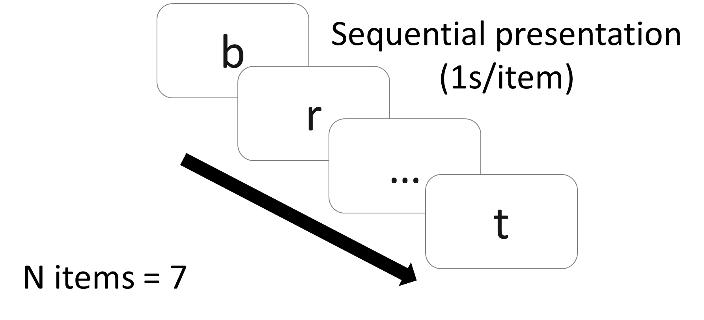
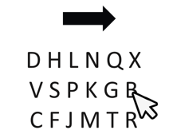
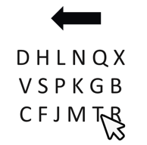
Methods: Experiment 1
Order reconstruction task:
Encoding
Retrieval
Forward recall
Backward recall
Repeated
Non-Repeated
b r k r x n t
b r k s x n t
Participants reproduced the sequence by clicking on each letter in the original or reversed order.

Slide 8
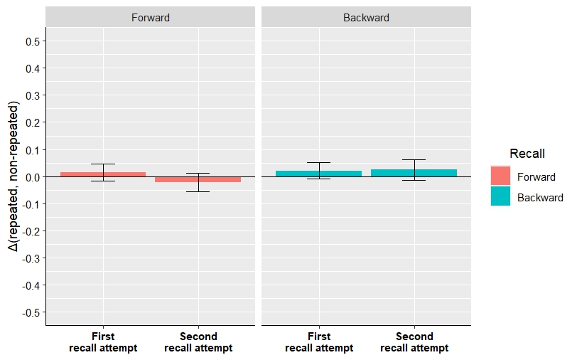
Results: Experiment 1
Experiment 1:
Order reconstruction task (N = 40)
Score
Δ(repeated, non-repeated)
repeated
BRKRXNT
–
non-repeated
BRKSXNT
Negative score = inhibition effect
BF₀₁ = 3.938
BF₀₁ = 2.457
BF₀₁ = 2.436
BF₀₁ = 2.797

Slide 9
Discussions: Experiment 1
No Ranschburg effect was observed in Experiment 1.
Specific result for an order reconstruction task?
Vast majority of studies exploring the Ranschburg effect used an immediate serial recall.

Slide 10
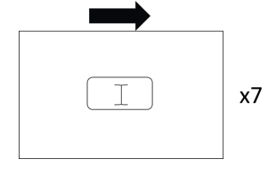
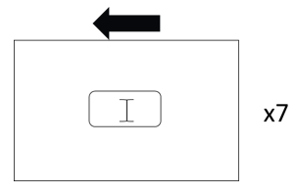
Methods: Experiment 2
Immediate serial recall task:
Encoding
Retrieval
Forward recall
Backward recall
Repeated
Non-Repeated
b r k r x n t
b r k s x n t
Participants recalled the letters from memory by typing them one at a time on the keyboard, in either the original or reversed order.

Slide 11
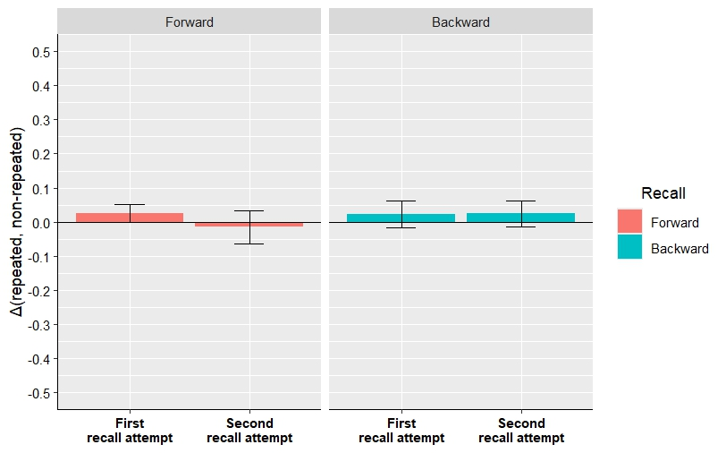
Results: Experiment 2
Experiment 2:
Immediate serial recall task (N = 40)
Score
Δ(repeated, non-repeated)
repeated
BRKRXNT
–
non-repeated
BRKSXNT
Negative score = inhibition effect
BF₀₁ = 1.046
BF₀₁ = 3.042
BF₀₁ = 4.897
BF₀₁ = 2.689

Slide 12
Discussions: Experiment 2
Still no Ranschburg effect
Specific result due to the recall direction manipulation?
Majority of studies don’t manipulate the recall direction.

Slide 13
Methods: Experiment 3
Immediate serial recall task:
Encoding
Retrieval
Forward recall
Repeated
Non-Repeated
b r k r x n t
b r k s x n t
Participants recalled the letters from memory by typing them one at a time on the keyboard, in either the original or reversed order.

Slide 14
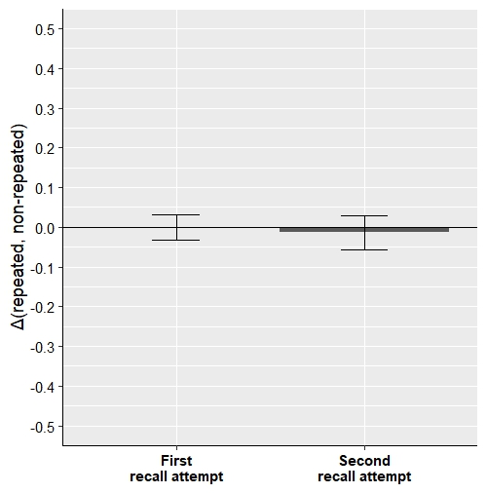
Results: Experiment 3
Experiment 3:
Immediate serial recall task (N = 40)
Score
Δ(repeated, non-repeated)
repeated
BRKRXNT
–
non-repeated
BRKSXNT
Negative score = inhibition effect
BF₀₁ = 5.862
BF₀₁ = 4.814

Slide 15
Discussions: Experiment 3
Once more, positive Bayesian evidence for the absence of a Ranschburg effect

Slide 16
General discussion
We didn’t replicate the Ranschburg effect
no clear explanations
- Inflated effect size in previous studies ?
- Most studies investigated both facilitatory and inhibitory effects ?
- Scoring methods ?
- Publication bias ?

Slide 17
General discussions
2. Our results question the response suppression mechanism
If the response suppression exists, the Ranschburg effect is unlikely to be symptomatic of it.

Slide 18
Conclusions
These results question the importance of the Ranschburg effect as a benchmark for working memory models

Slide 19
Thank you for your attention!

Slide 20
References
Henson, R. N. A. (1998a). Item repetition in short-term memory: Ranschburg repeated. Journal of Experimental Psychology: Learning, Memory, and Cognition, 24, 1162‑1181. https://doi.org/10.1037/0278-7393.24.5.1162
Jahnke, J. C. (1969b). The Ranschburg effect. Psychological Review, 76, 592‑605. https://doi.org/10.1037/h0028148
Kahana, M. J., & Jacobs, J. (2000). Interresponse times in serial recall: Effects of intraserial repetition. Journal of Experimental Psychology: Learning, Memory, and Cognition, 26(5), 1188‑1197. https://doi.org/10.1037/0278-7393.26.5.1188
Kowialiewski, B., & Oberauer, K. (2024). Testing the response suppression mechanism of working memory. Journal of Experimental Psychology: Learning, Memory, and Cognition. https://doi.org/10.1037/xlm0001359
Logan, G. D. (2021). Serial order in perception, memory, and action. Psychological Review, 128(1), 1‑44. https://doi.org/10.1037/rev0000253
Wickelgren, W. A. (1965). Short-term Memory for Repeated and Non-repeated Items. Quarterly Journal of Experimental Psychology, 17(1), 14‑25. https://doi.org/10.1080/17470216508416404
Lewandowsky, S. (1999). Redintegration and Response Suppression in Serial Recall: A Dynamic Network Model. International Journal of Psychology, 34(5‑6), 434‑446. https://doi.org/10.1080/002075999399792

Slide 21
Serial position curves for each experiment
Experiment 3:
Immediate serial recall task
Experiment 1:
Order reconstruction task
Experiment 2:
Immediate serial recall task

