Slide 1

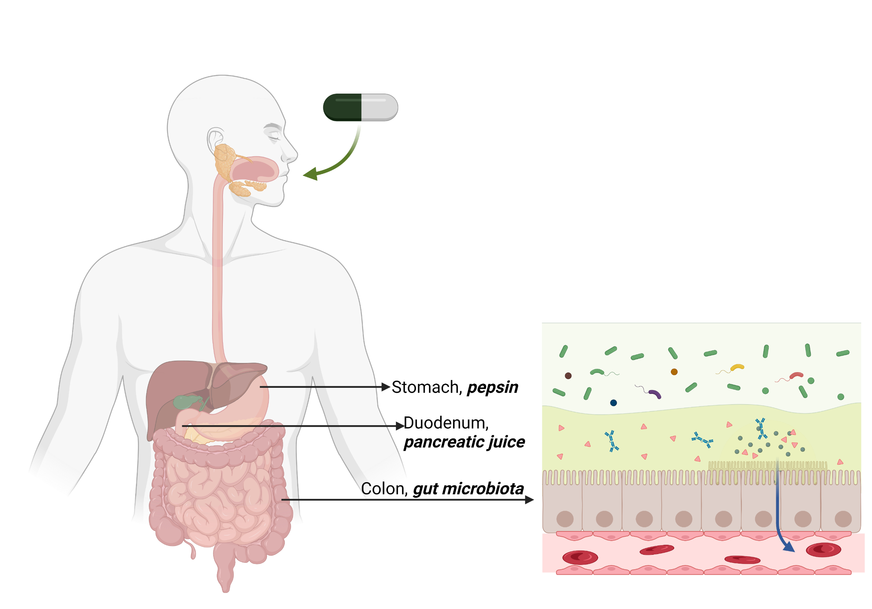
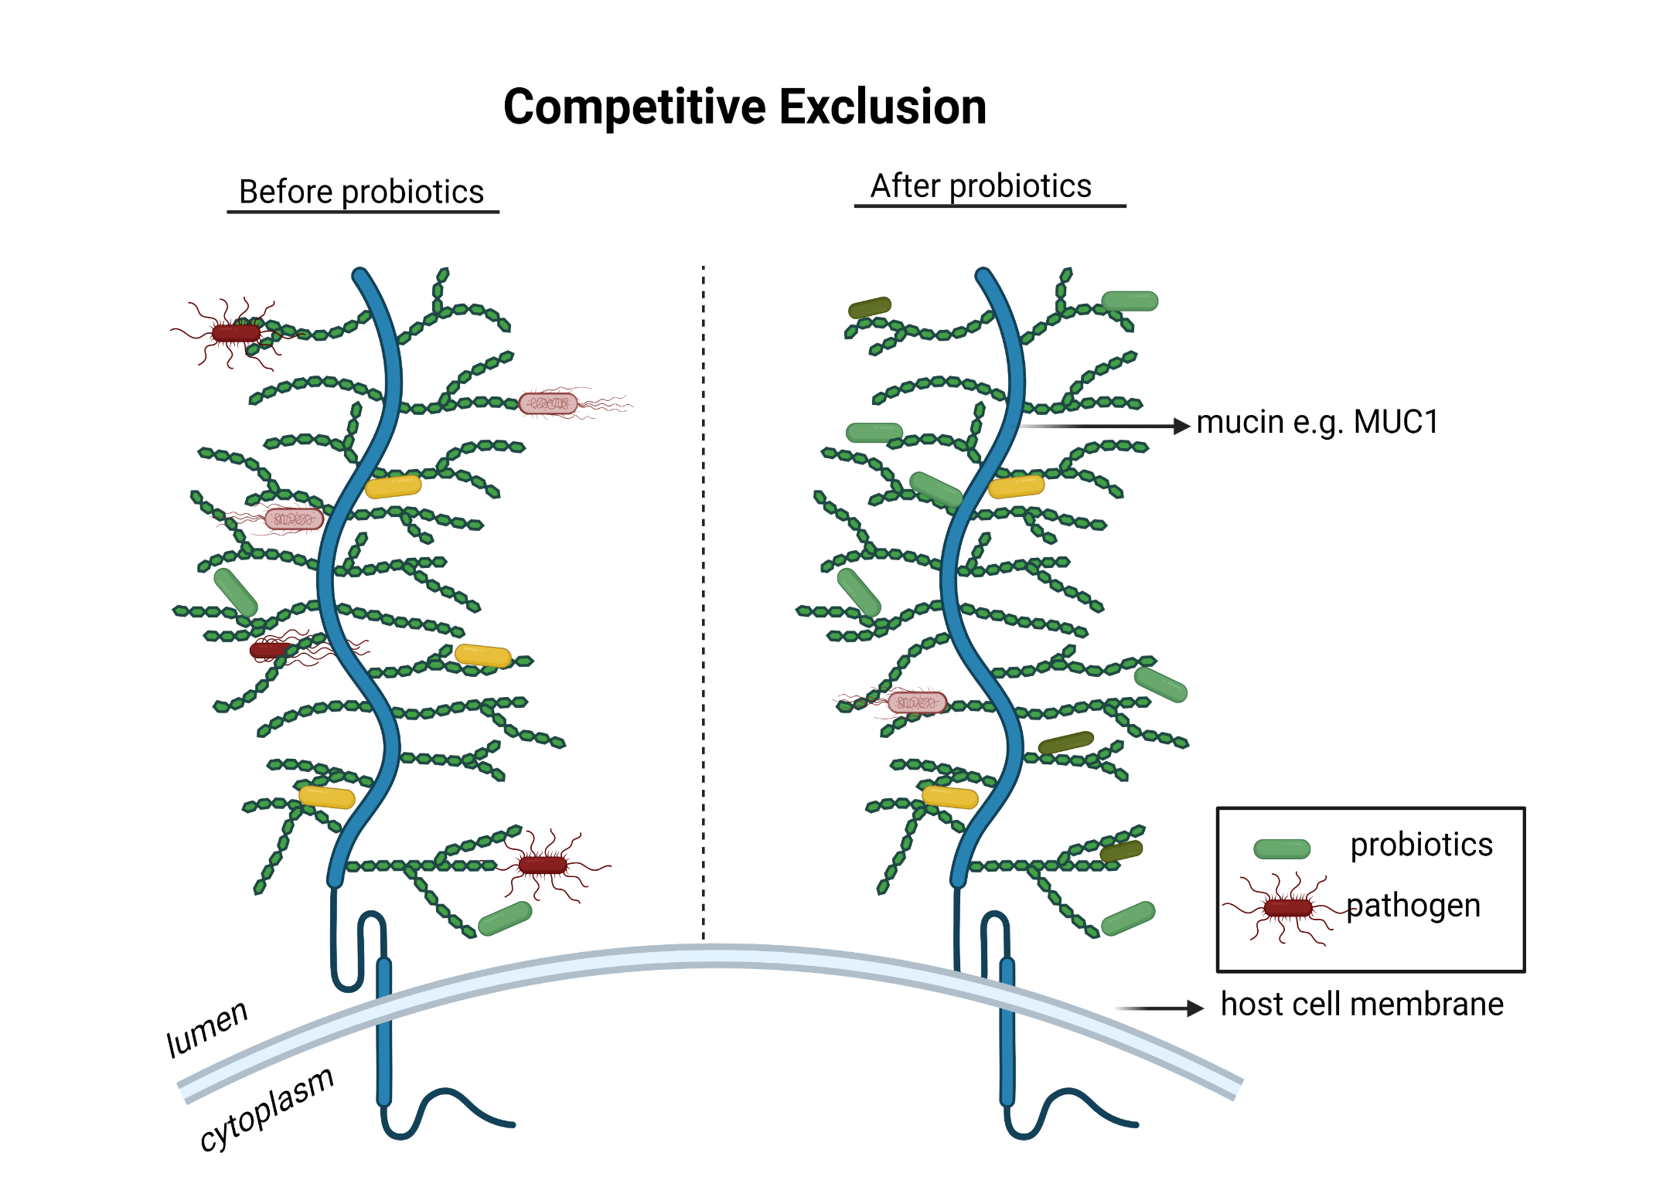
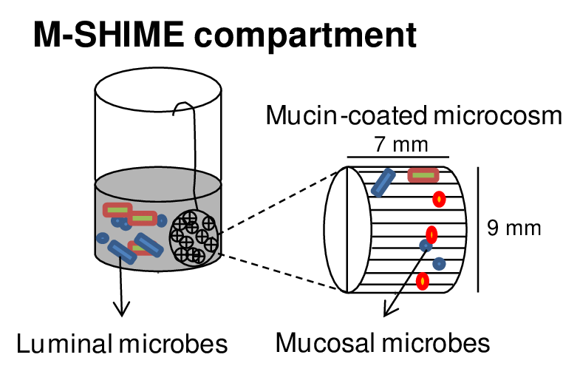
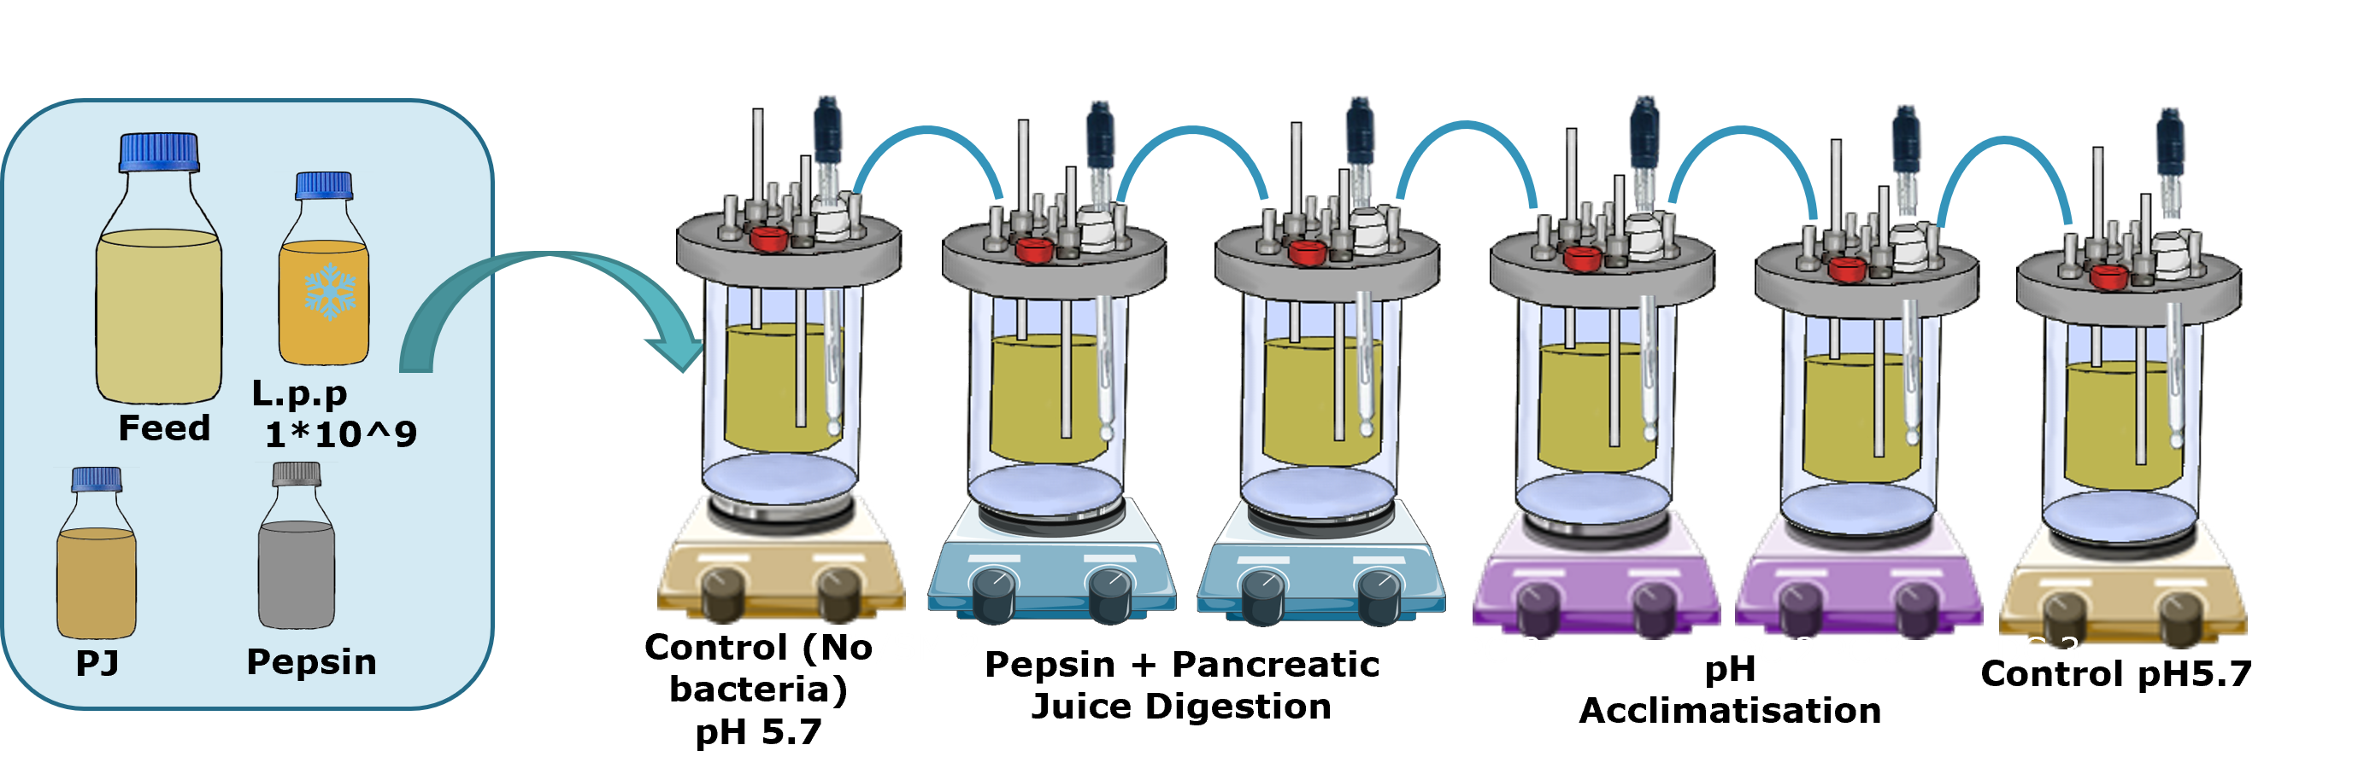
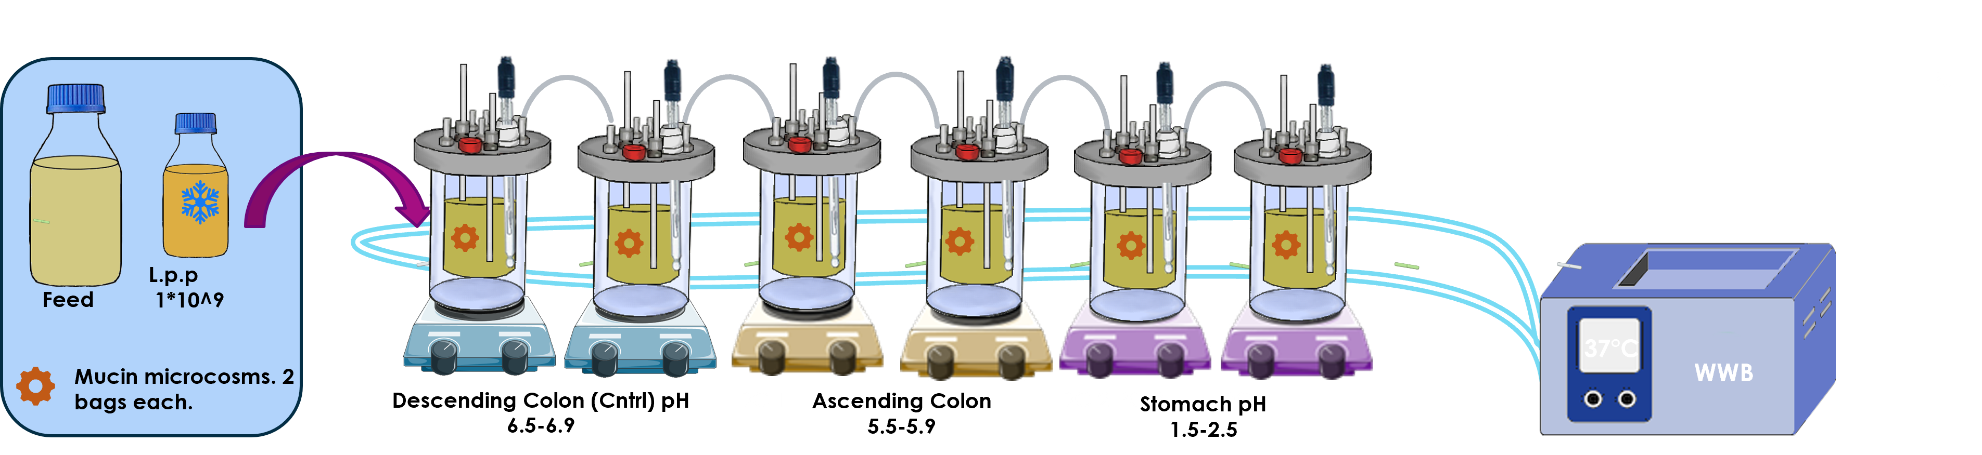
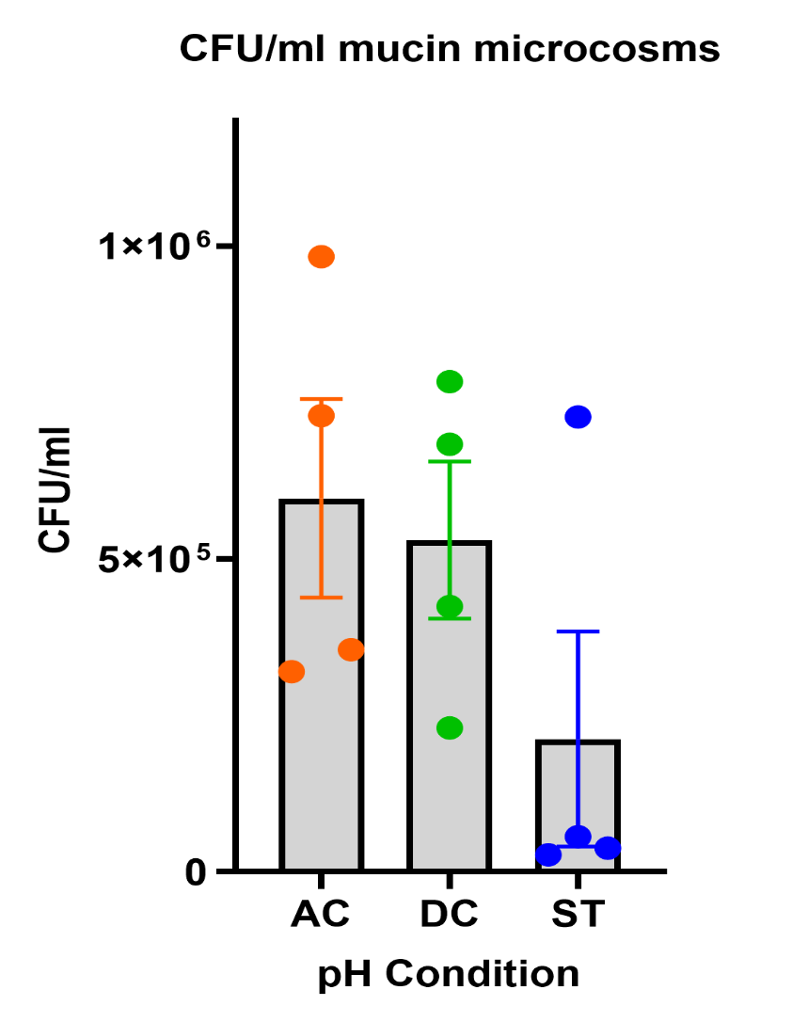
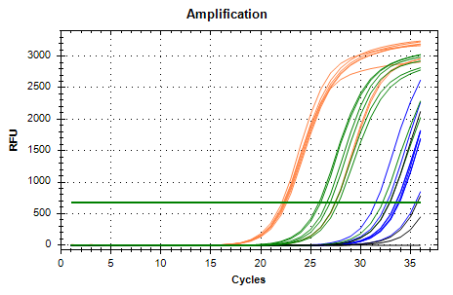
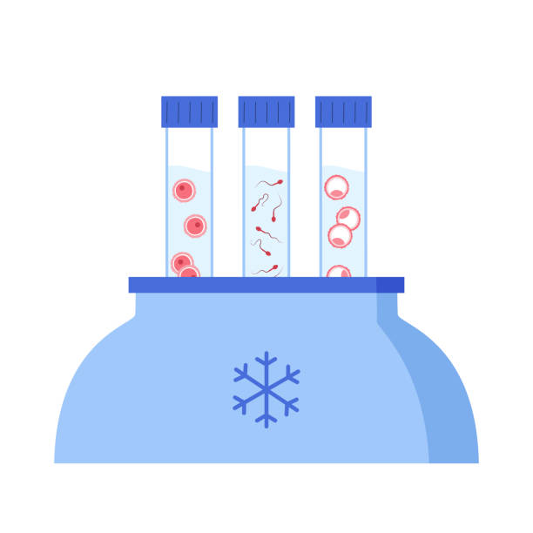
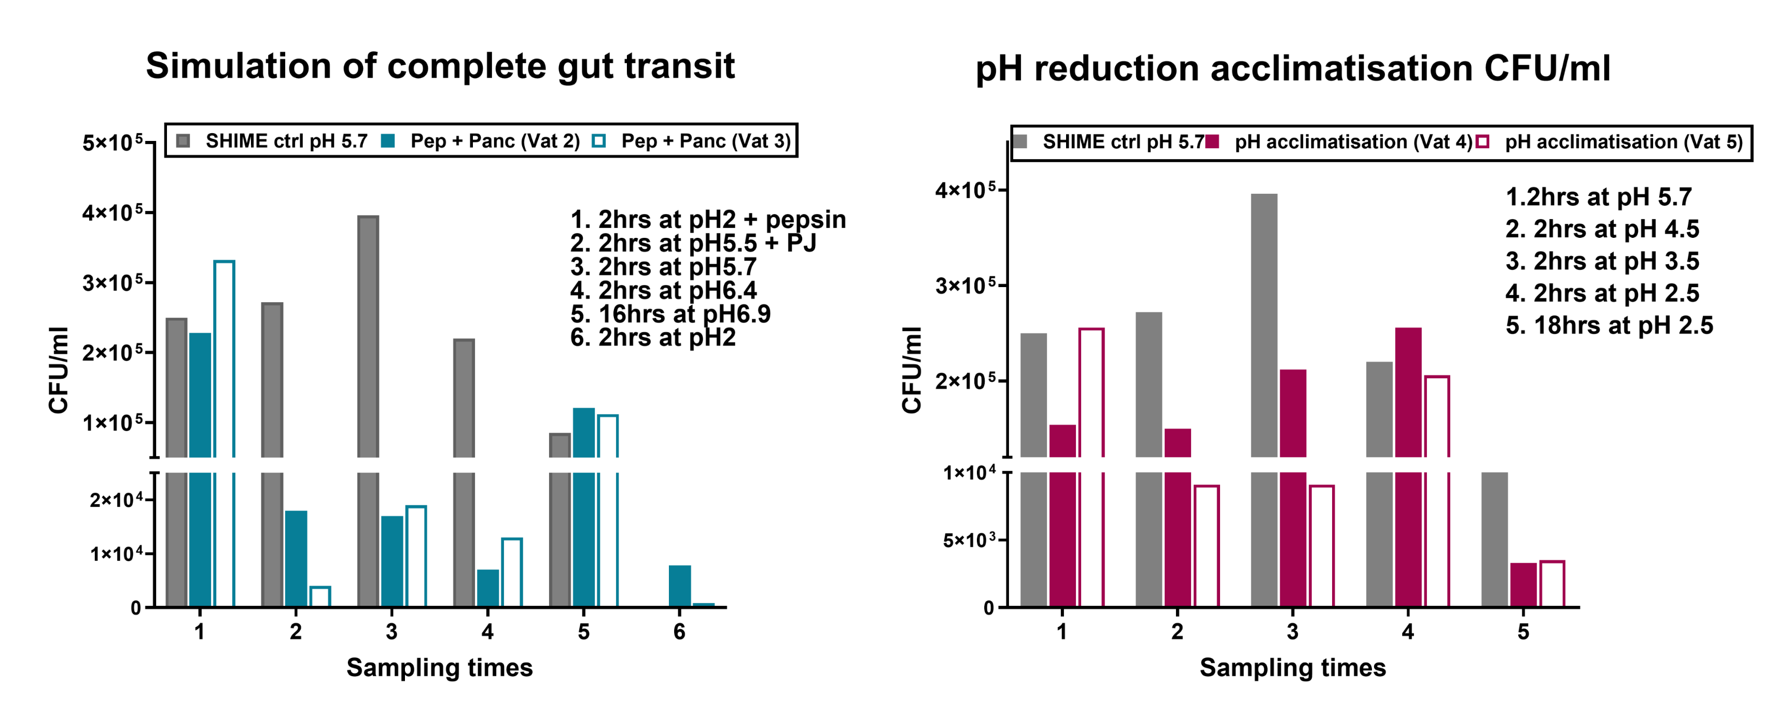
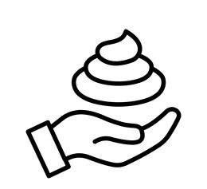
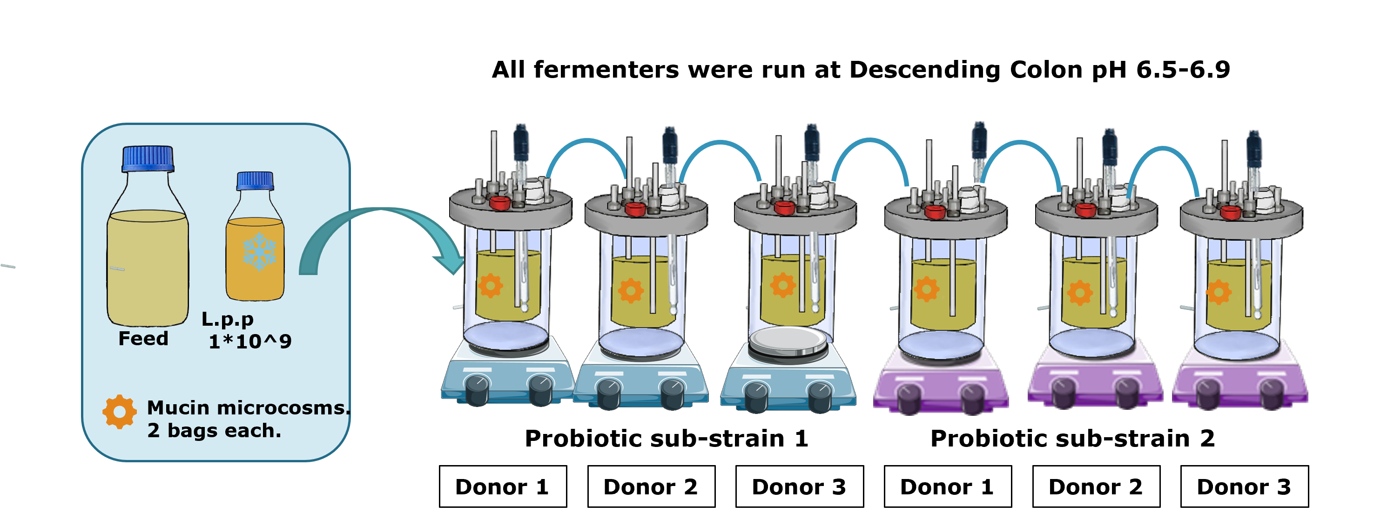
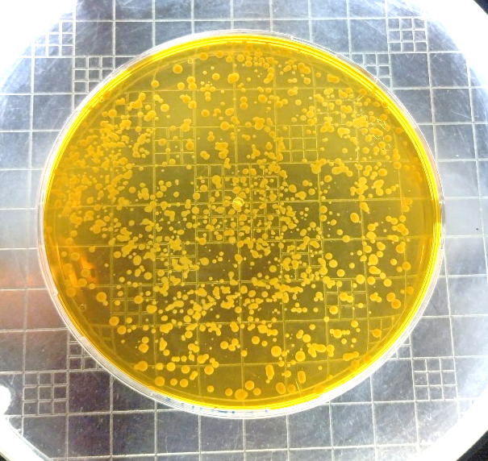
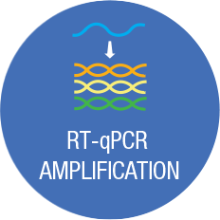
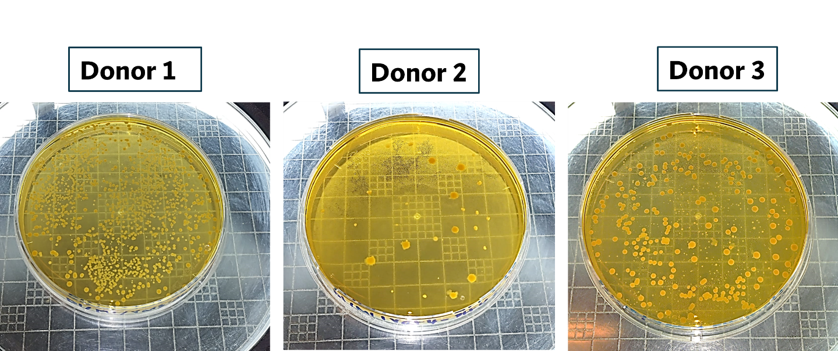
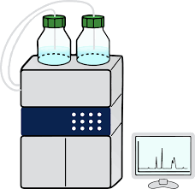






In vitro process for adapting the probiotic Lactiplantibacillus plantarum with enhanced mucus adhesion properties using the SHIME gastrointestinal model
Brunette Katsandegwaza*, Cindy Staerck, Sébastien Crevecoeur, Irma Gonza, Martine Schroyen, Céline Antoine, Patrice Filee, Véronique Delcenserie*.. . bkatsandegwaza@uliege.be . *University of Liège, Department of Food Science, Belgium.
Gastrointestinal Challenges for Probiotics
Significance of Probiotic-Mucin Interactions
Probiotics encounter different challenges before reaching the colon(1,2). These include:
Dynamic pH changes.
Digestive enzymes.
Pancreatic juice.
Host gut microbiota.
Host immune system
The ability of a probiotic to adhere to colonic mucus is of important significance to efficient impact(3) Probiotic adherence results in:
Colonization.
Competitive exclusion of pathogens
Increased residence time.
Increased probiotic efficiency.
In this study, we use the challenges faced by probiotics for positive selection of viable sub-strains (of L.p.p) with improved mucus adhesion potential.
1. Exposure of L.p.p to different gastric pH conditions demonstrates a small fraction of L.p.p capable of mucus adhesion at low pH!
2. Survival Experimental plan: Gut-transit simulation through exposure to pH, pepsin and pancreatic juice.
Mucin microcosm CFU/ml (MRS agar)
qPCR Amplification
Biobanking
Favorable probiotic strains should demonstrate the ability to transverse through the gut digestive system with intact viability and metabolic activity(4). Bacterial cells capable of adhering to mucin at pH 2.5 ( no pepsin) were exposed to a simulated gut transit survival experiment.
L.p.p was exposed to:
Pepsin + pancreatic juice digestion, with concomitant pH adjusting. From pH2 (pepsin), to pH 5.5 ( after addition of pancreatic juice). Eventually maintained to pH 5.7 and pH6.9 to mimic the colon pH.
In parallel, a pH reduction was carried out to create a bottle neck in selective pressure for individual bacterial cells capable of surviving pH reduction (no pepsin and pancreatic juice were added to this parallel experiment)
3. Pepsin presence protects L.p.p from harsh low pH, while pancreatic juice addition is unfavorable for L.p.p survival.
4. Eight (8) sub-strains of interest from prior experiments were selected to assess their potential impact on human gut microbiota.
Mucin microcosm CFU/ml (MRS agar)
qPCR Amplification
Biobanking
Mucin microcosm CFU/ml (MRS agar)
Short Chain Fatty Acids Analysis
Genomics
Conclusion
References
1. Using the SHIME system, we exposed our probiotic to different environmental pressures with a potential to affect the viability of a probiotic and prevent adhesion to colon mucus.
2. 8-sub-strains that could withstand all the adverse effects, while maintaining the affinity to adhere to colon mucus, were isolated and are being further characterized for impact on gut microbiota and host health!
1. Han S, Lu Y, Xie J, Fei Y, Zheng G, Wang Z, Liu J, Lv L, Ling Z, Berglund B, Yao M, Li L. Probiotic Gastrointestinal Transit and Colonization After Oral Administration: A Long Journey. Front Cell Infect Microbiol. 2021 Mar 10;11:609722. doi: 10.3389/fcimb.2021.609722. PMID: 33791234; PMCID: PMC8006270.
2. Bafeta, A., Koh, M., Riveros, C., & Ravaud, P. (2018). Harms Reporting in Randomized Controlled Trials of Interventions Aimed at Modifying Microbiota: A Systematic Review. Annals of internal medicine, 169(4), 240–247. https://doi.org/10.7326/M18-0343.
3. Maragkoudakis, P. A., Zoumpopoulou, G., Miaris, C., Kalantzopoulos, G., Pot, B., & Tsakalidou, E. (2006). Probiotic potential of Lactobacillus strains isolated from dairy products. International Dairy Journal, 16(3), 189–199. https://doi.org/10.1016/J.IDAIRYJ.2005.02.009
4. Ayyash, M. M., Abdalla, A. K., AlKalbani, N. S., Baig, M. A., Turner, M. S., Liu, S. Q., & Shah, N. P. (2021). Invited review: Characterization of new probiotics from dairy and nondairy products—Insights into acid tolerance, bile metabolism and tolerance, and adhesion capability. Journal of Dairy Science, 104(8), 8363–8379. https://doi.org/10.3168/JDS.2021-20398

