Slide 1


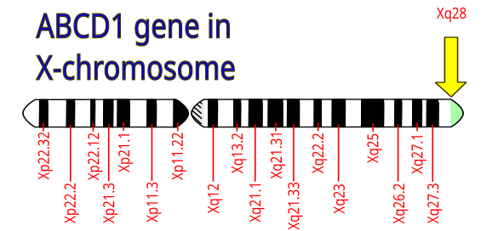
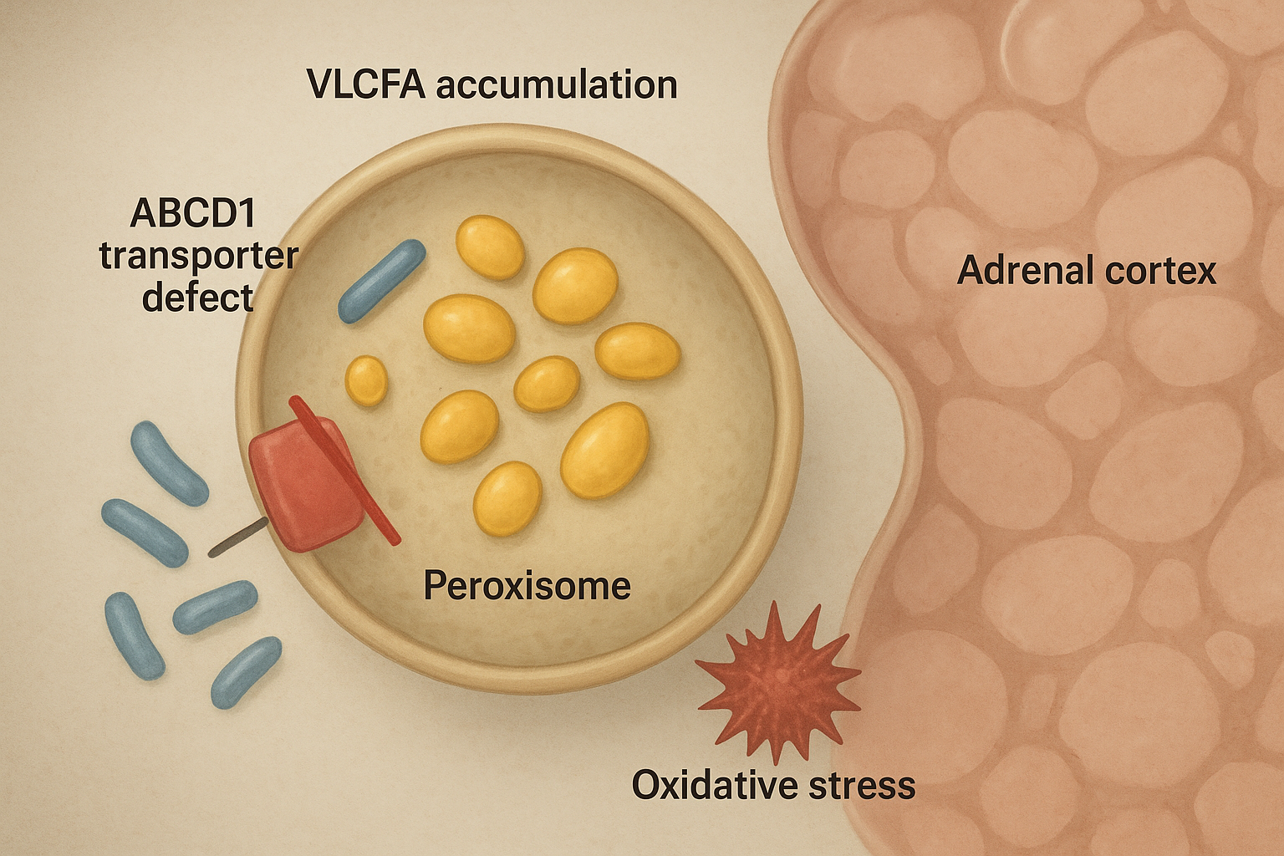
From Addison’s Crisis and Hashimoto Thyroiditis to X-Linked Adrenomyeloneuropathy:
A 17-Year Journey to Diagnosis with a Novel ABCD1 Variant
P13
Pr H Valdes Socin, Dr Hansen I, Pr Debray FG, Pr Daly AF, Pr Petrossians P
Centre Hospitalier Universitaire de Liège, Liège, Belgium, * email: hg.valdessocin@chuliege.be
Introduction:
X-linked adrenoleukodystrophy (ALD) is a peroxisomal disorder caused by pathogenic variants in ABCD1. Loss of peroxisomal ATP-binding cassette transporter D1 (ALDP) impairs β-oxidation of very-long-chain fatty acids (VLCFAs), leading to their toxic accumulation in adrenal cortex, nervous system, and gonads. Clinical phenotypes range from isolated adrenal insufficiency to cerebral inflammatory demyelination (cALD) and adrenomyeloneuropathy (AMN). AMN is the most frequent adult presentation, characterized by progressive spastic paraparesis, sensory ataxia, and sphincter dysfunction. Although autoimmune endocrinopathies may coexist, they are usually unrelated.
Case Report:
A male presented at age 17 with skin hyperpigmentation and Addisonian crisis. Laboratory testing revealed markedly elevated ACTH (4905 pg/mL) and severely reduced cortisol (<25 ng/mL). Adrenal autoantibodies were negative, and CT showed bilateral adrenal atrophy, consistent with non-autoimmune primary adrenal insufficiency. Concurrent hypothyroidism due to Hashimoto thyroiditis was diagnosed. He was treated with hydrocortisone, fludrocortisone, and levothyroxine.
By age 30, he developed progressive neurological symptoms. Neurophysiology demonstrated pyramidal signs and disrupted corticospinal conduction, compatible with early AMN. Persistent Addison’s disease without autoantibodies raised suspicion of ALD. VLCFA testing confirmed the biochemical signature, and genetic analysis identified a hemizygous ABCD1 missense variant c.1939G>C (p.Ala647Pro), predicted to be pathogenic. Current therapy includes levothyroxine, fludrocortisone, and hydrocortisone
Discussion:
This case illustrates the natural history of AMN: endocrine dysfunction in adolescence followed years later by spinal cord involvement. The co-occurrence of Hashimoto thyroiditis is considered incidental. The c.1939G>C (p.Ala647Pro) variant disrupts ALDP function, preventing peroxisomal import of VLCFAs and impairing their β-oxidation, resulting in multisystem damage. Such pathophysiology explains the combination of adrenal insufficiency, progressive myelopathy, and potential gonadal dysfunction.
Emerging therapies aim to modify disease progression. Leriglitazone, a PPAR-γ agonist, is under investigation for slowing neurodegeneration in AMN by modulating peroxisomal metabolism and neuroinflammation. Elivaldogene autotemcel (Skysona), an autologous lentiviral gene therapy, has been FDA-approved for early active cerebral ALD, restoring ABCD1 function in hematopoietic stem cells and brain microglia.
Conclusions:
Primary adrenal insufficiency in young males, particularly when autoimmune markers are negative, should prompt evaluation for ALD with VLCFA assay and ABCD1 sequencing. Early recognition is essential for neurological monitoring, family counseling, and potential access to emerging disease-modifying therapies. This novel ABCD1 variant expands the genetic spectrum of AMN and underscores the importance of considering ALD in atypical endocrine and neurological presentations.

Slide 2
