Slide 1


What code(s) for the representation of
serial order in verbal WM?
Steve Majerus
www.psyncog.uliege.be
Notes:
Ajouter figure de synthèse en arrière-fond

Slide 2
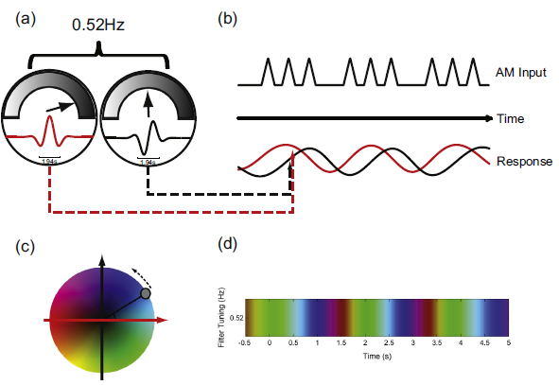
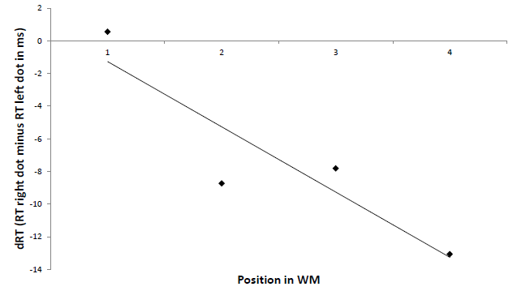
Serial Order : Time vs. space
Dynamic contextual/temporal codes
Burgess & Hitch, 1992, 1999, 2006; Brown et al., 2000; Hartley et al., 2016; Logan & Cox, 2023; Oberauer, 2018 …
Long-term spatial codes
Abrahamse et al., 2013; Guida & Campitelli, 2019; Fischer-Baum & Benjamin, 2014, Van Dijck & Fias, 2011; …
Item1 Item2 Item3 Item4 Item5

Slide 3

Spatial codes – Study 1 - encoding
Exp. 1.1 – 1.4
Left-to-right presentation
Right-to-left presentation
2
2
4
4
7
7
. . .
. . .
6
6
Canonical (left → right) vs non-canonical (right → left) encoding
7 item lists
ISR
N=57
Xiao et al., in preparation

Slide 4
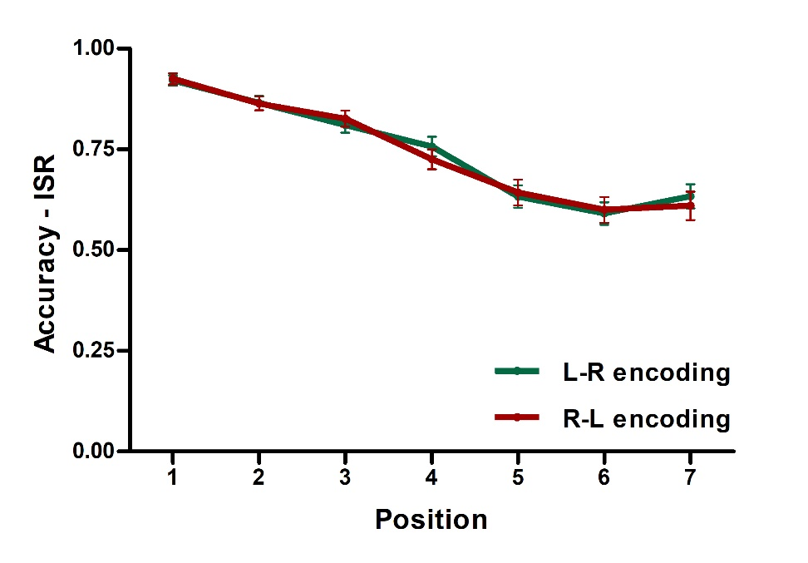
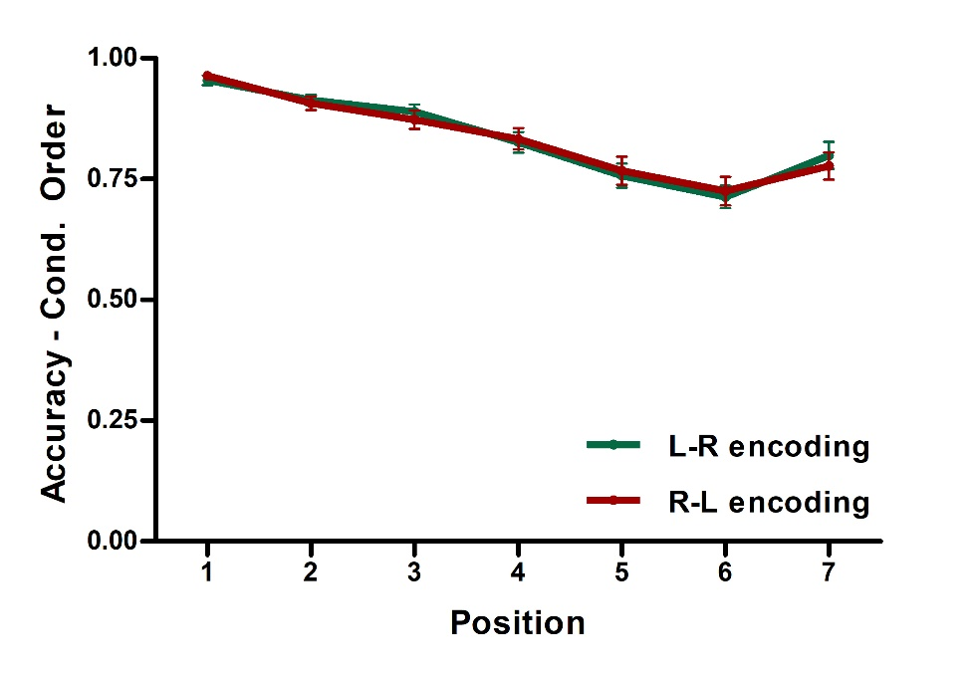
Spatial codes – Study 1 - encoding
Model: Position
BF₁₀ = 1.825×10⁺⁶¹
Model: Position
BF₁₀ = 2.533×10⁺³⁶
COND: BF₀₁> 6
COND*POSITION: BF₀₁> 3
COND: BF₀₁> 6
COND*POSITION: BF₀₁>10
Results replicated in four variants of the paradigm (ISI 500ms – 1000 ms; words – digits)

Slide 5

Spatial codes – Study 2 - recall
Exp. 2.1
2
Presentation duration : 1000ms
ISI duration : 500ms
4
7
. . .
6
Cue
Cue:
recall by typing from left-to-right
Recall
Cue :
recall by typing from right-to-left
Canonical (left → right) vs non-canonical (right → left) recall
7 item lists
ISR
N=44

Slide 6
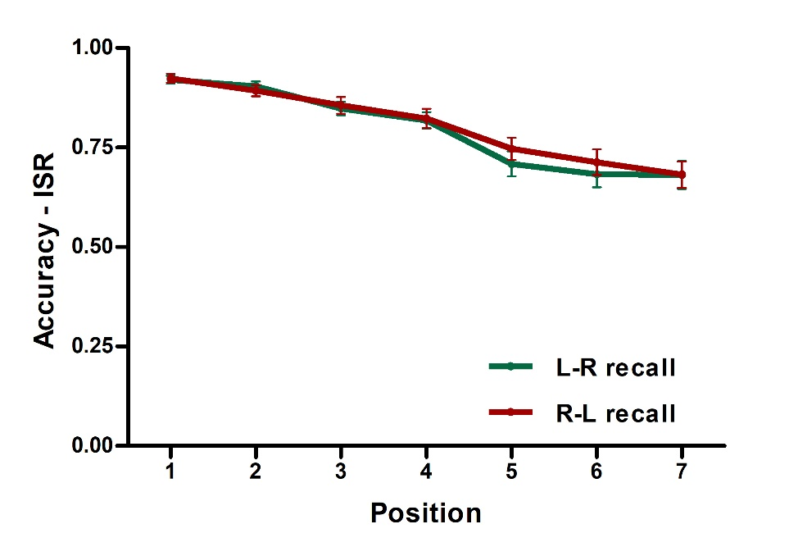
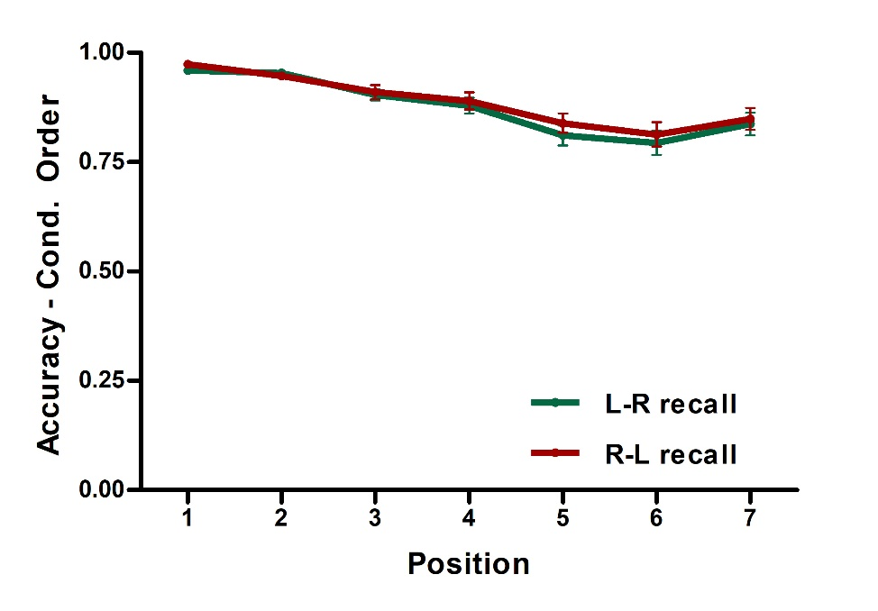
Spatial codes – Study 2 - recall
COND: BF₀₁> 10
COND*POSITION: BF₀₁>10
COND: BF₀₁= 2.5
COND*POSITION: BF₀₁>10

Slide 7
Spatial codes – Study 2 – recall
Exp. 2.2
Left-to-right presentation
Right-to-left presentation
2
2
4
4
7
7
. . .
. . .
6
6
Spatially cued recall
Canonical (left → right) vs non-canonical (right → left) encoding
7 item lists
Cued recall
N=43

Slide 8
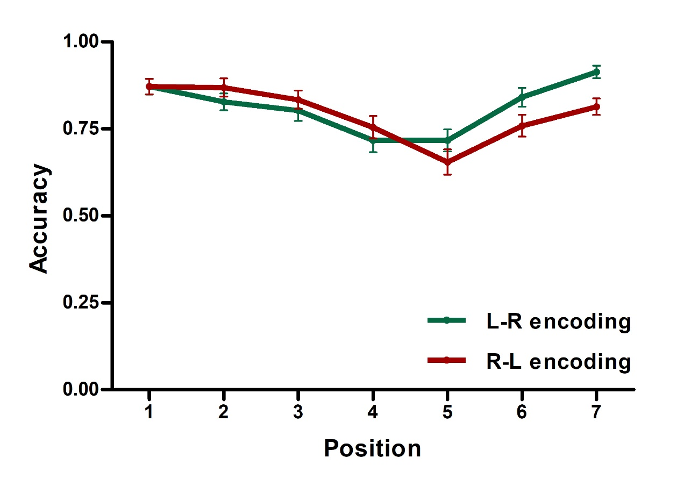
Spatial codes – Study 2 - recall
COND: BF₀₁> 3
COND*POSITION: BF₁₀ > 30

Slide 9

Spatial vs temporal codes – Study 3
N=45
Temporal - regular
ISI = 500ms
ISI = 250-750ms
Temporal - irregular
Spatial - canonical
ISI = 500ms
Spatial – non-canonical
Attout et al., in preparation

Slide 10
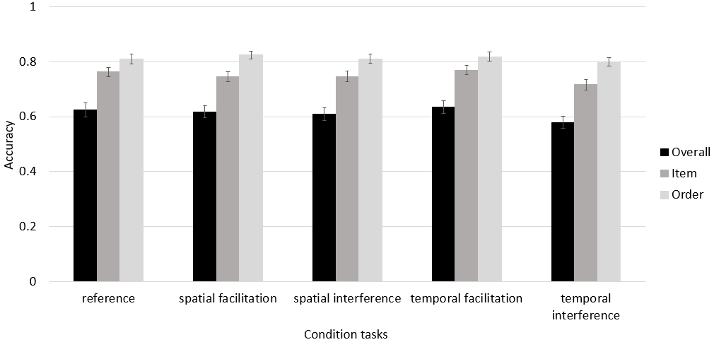
Spatial vs temporal codes – Study 3
spatial - canonical
spatial - noncanonical
temporal - regular
temporal - irregular
BF₀₁ > 3
BF₀₁ > 3
BF₀₁> 3
BF₁₀ > 5

Slide 11
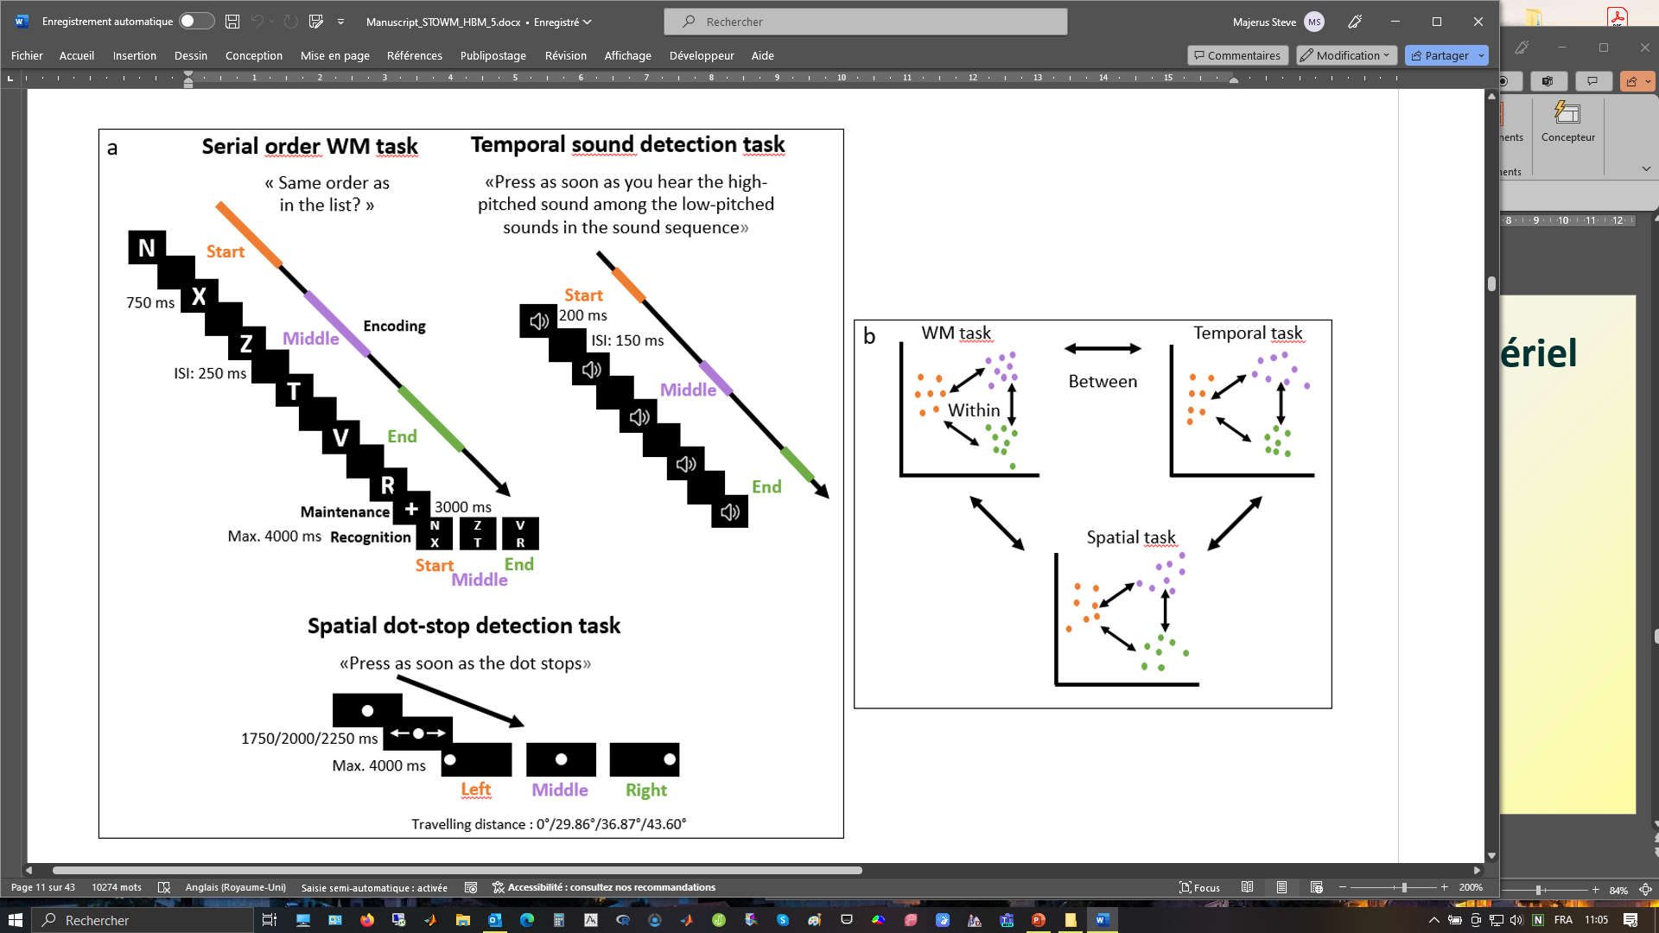
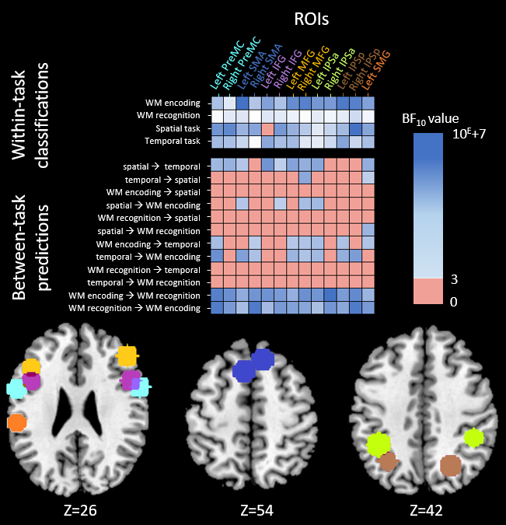
Spatial vs temporal codes – Study 4
Serial order probe recognition
Spatial localizer – Dot detection
Temporal localizer – Tone detection
Spatial & temporal localizers
Neural prediction of serial position
N=29

Slide 12
Spatial vs temporal codes – Study 4
Attout et al., submitted
Robust prediction of serial position during encoding by temporal localizer

Slide 13
Conclusions
Limited, task-dependent evidence for spatial codes
Evidence for temporal codes, during WM encoding
Evidence for other types of codes
activation patterns supporting bound item-order representations (Botvinick & Plaut, 2006; Xie et al., 2022)
linguistic (Poster 27 – Hong Xiao et al.)

Slide 14


Thank you!
Hong Xiao
Lucie Attout
Benjamin Kowialiewski

Slide 15
Spatial vs temporal codes – Study 3
Exp. 3.1
N=45
Temporal - regular
ISI = 500ms
ISI = 250-750ms
Temporal - irregular
Spatial - canonical
ISI = 250-750ms
Spatial – non-canonical

Slide 16
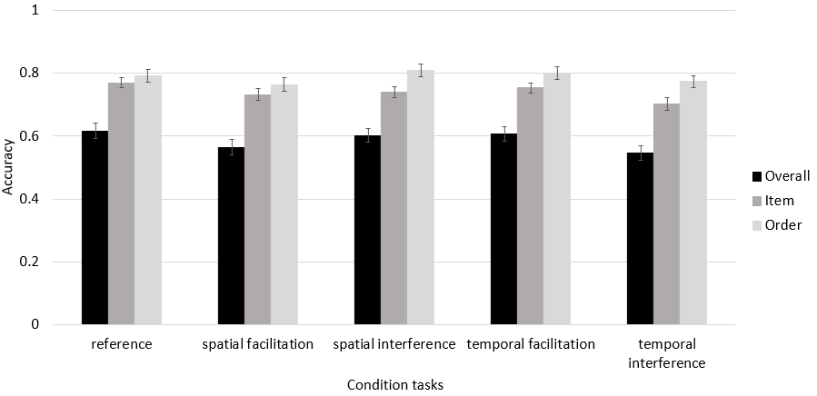
Spatial vs temporal codes – Study 4
spatial - canonical
spatial - noncanonical
temporal - regular
temporal - irregular
BF₁₀ > 40
BF₀₁ > 3
BF₀₁> 3
BF₁₀ > 40
Attout et al., in preparation

