Slide 1
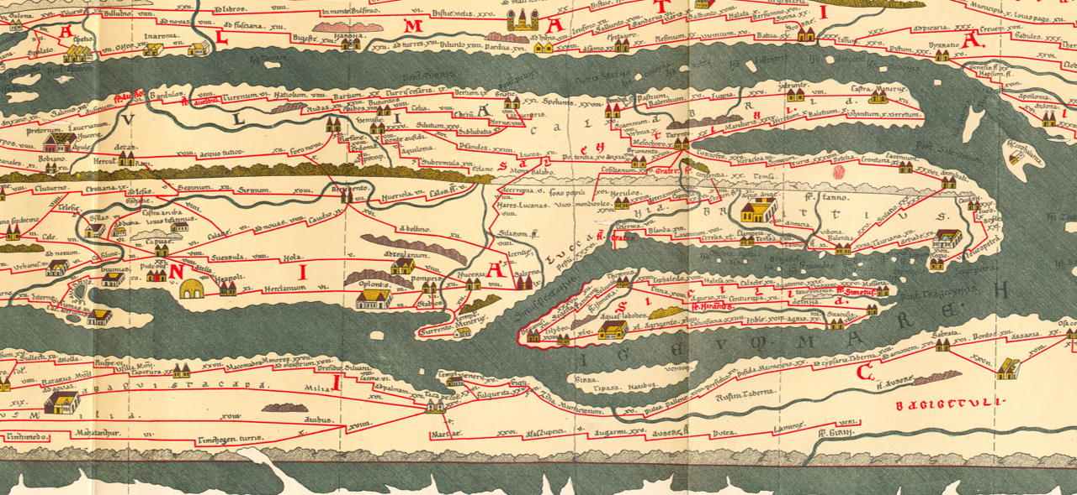
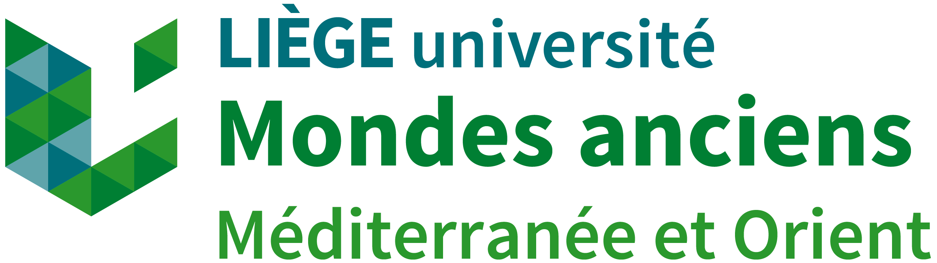
What Happens When Two Languages Share the Same Stone ?
Greek-Latin Contact and Identities in Southern Italian Epitaphs
Oxford Epigraphy Workshop
17th November 2025
Hugo SIMONS – Assistant-PhD Candidate
University of Liège – UR Mondes anciens
Contact: hugo.simons@uliege.be

Slide 2
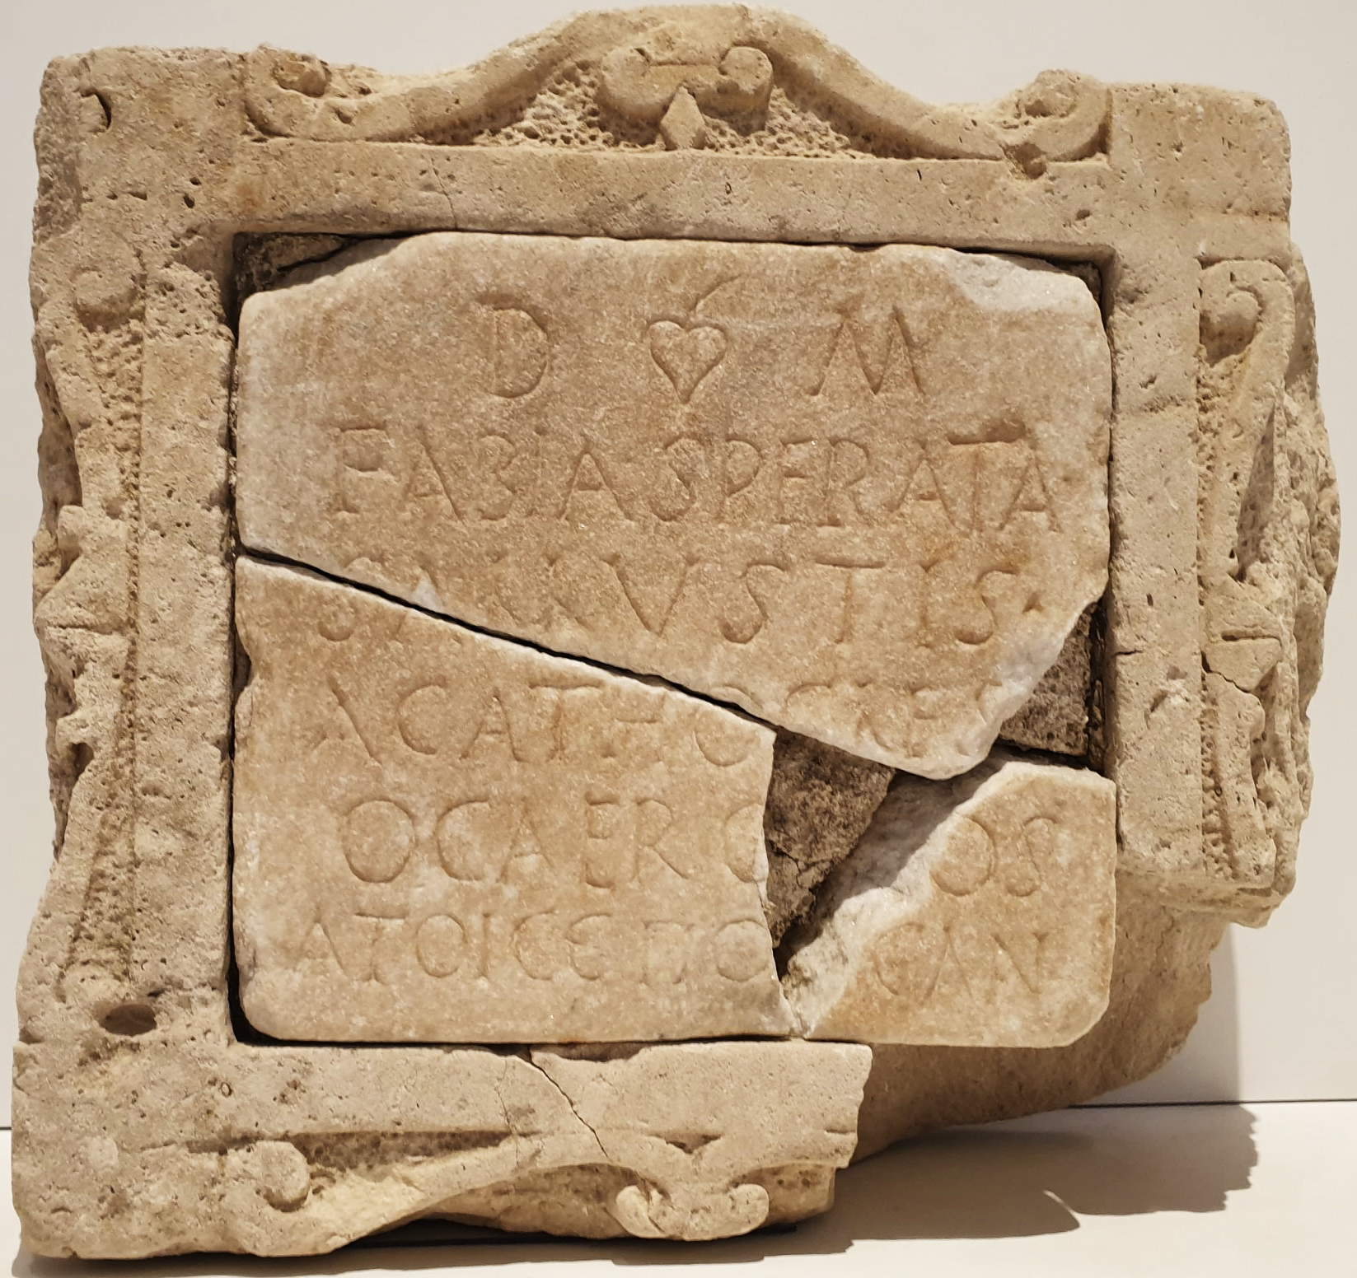
Languages in contact
What happens when two languages share the same stone?
How do Greek and Latin interact in funerary inscriptions?
What do these linguistic choices reveal about:
  Identity (social, cultural, legal)
  Bilingual practices (code-switching, transliteration, etc.)
  Epigraphic habits in a multilingual environment
G.J. Oliver, “An Introduction to the Epigraphy of Death: Funerary Inscriptions as Evidence”, in G.J. Oliver (ed.), The Epigraphy of Death, Liverpool, 2000, p. 1-23.
G. Tozzi, “Epigrafi bilingui a Roma. Traduzione, compresenza e trascrizioni tra greco e latino”, Axon 3.2 (2019), p. 411-428.<
Fig. 1. © Museo Archeologico Nazionale Reggio Calabria, 2021

Slide 3
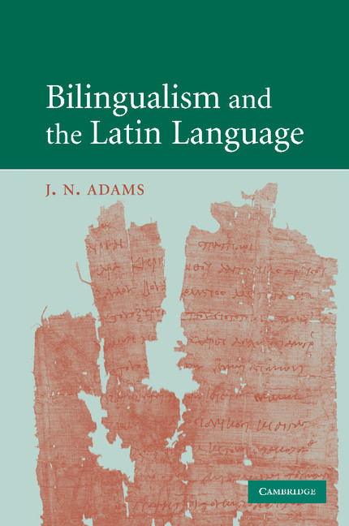
How to proceed?
Establishing a selection and discussing methodological principles
Inscriptions from Southern Italy:
Chronology: Late 1st c. BC–3rd c. AD
Focus: Epitaphs showing Greek–Latin contact phenomena
Epigraphic analysis combined with socio-linguistic perspective:
Leiwo (2002), Adams (2003), Mullen (2013), Tozzi (2019), Mullen (2023)
Attention to linguistic strategies, cultural context, and identity markers
A. Mullen, Southern Gaul and the Mediterranean, Cambridge, 2013.
A. Mullen, Bilingualism in Digital Epigraphy [Online], 2023, available at: https://latinnow.eu/
2023/09/22/bilingualism-in-digital-epigraphy/.
G. Tozzi, “Epigrafi bilingui a Roma. Traduzione, compresenza e trascrizioni tra greco e latino”,
Axon 3.2 (2019), p. 411‑428.
Fig. 1. © Cambridge University Press; J.N. Adams (2003)
Fig. 2. © Cambridge University Press; A. Mullen (2013)
J.N. Adams, Bilingualism and the Latin Language, Cambridge, 2003.
M. Leiwo, “From Contact to Mixture”, in J.N. Adams, M. Janse & S. Swain (ed.), Bilingualism in Ancient Society, Cambridge, 2002, p. 168‑194.

Slide 4
Leiwo (2002)
Micro-level perspective
Focus:
Epigraphical records
Christian & Jewish communities (3rd–6th c. AD, Italy)
Approach:
Textual and contextual details:
  very fine-grained categorisation
Strength:
First attempt at establishing such typology
Useful for complex cases requiring precision
Limitation:
Breaks phenomena into many small categories
  hard to see the bigger picture
Lacks macro-level synthesis
Leiwo (2002) | A. Same text in two languages (L/G or G/L) B. Almost same info in two languages (L|G or G|L) C. Different info in two languages (L+G or G+L) D. Code-switching (intra/inter-sentential) (L–G or G–L) E. Transliteration (Lg or Gl) F. Morphological code-mixing (LGmorph or GLmorph) G. Graphic code-mixing (LGphon or GLphon) H. Phonological code-mixing (LGgraph or GLgraph) I. Lexical code-mixing (LGlex or GLlex) J. Translation and transference (LGtrans or GLtrans) K. Abbreviated formulae (Lf or Gf)
M. Leiwo, “From Contact to Mixture”, in J.N. Adams, M. Janse & S. Swain (ed.), Bilingualism in Ancient Society, Cambridge, 2002, p. 168‑194.

Slide 5
Adams (2003) & Mullen (2013)
Macro-level perspective
Approach:
Broader, macro-level view
Language contact seen as a continuum
Strength:
First systematic attempt at a macro-level typology
Flexible framework for large corpora
Useful for quick classification
Limitation:
Less attention paid to micro-level details
Mullen’s revision:
Refines title of category 2
Moves code-switching from 3 to 2 to clarify what are “mixed-language” texts
Adams (2003) | 1. Bilingual texts | 2. Texts implicitly reflecting bilingual situations | 3. Mixed-language texts | 4. Transliterated
 | Two separate parts in different languages and ‘a content which is usually, at least in part, common to both’ | ‘An “implicitly bilingual” text is on the face of it in a single language, but there is reason to think that another language played a part in its formation’ | Texts showing any form of code-switching or code-mixing | Composed in language A, but the script is that of language B
Revised | 1. Bi- (/ tri-) version bi- (/ tri-) lingual texts | 2. Texts displaying bilingual phenomena | 3. Mixed-language texts | 4. Transliterated texts
 | As above (plus specification of number of versions and languages) | Composed in language A, but showing interference/code-switching/borrow-ing from language B | 3a Written in genetically mixed languages or 3b codes that are so mixed that it is impossible to identify the dominant language | As above. Can involve texts displaying bilingual phenomena or bi-version bilingual texts
J.N. Adams, Bilingualism and the Latin Language, Cambridge, 2003.
A. Mullen, “Multiple languages, multiple identities”, in A. Mullen & P. James (ed.), Multilingualism in the Graeco-Roman Worlds, Cambridge, 2012, p. 1‑35.
A. Mullen, Southern Gaul and the Mediterranean, Cambridge, 2013.

Slide 6
Tozzi (2019)
Macro-level perspective
Focus:
Pagan inscriptions (Republican period–Late Empire, Rome)
Approach:
Cultural framework emphasized
Warns against overly rigid typologies
Strength:
Highlights cultural dimension in bilingual inscriptions
Limitation:
Adds little extra cultural analysis
Distinction between “parallel” and “juxtaposed” texts as macro-categories seems unnecessary
Tozzi (2019) | 1. Parallel bilingual texts | 2. Juxtaposed bilingual texts
 | “Bilingual” inscriptions in the strict sense, i.e. two identical texts, one of which is a translation of the other, or two similar texts with minor additions or slight variations in one of the two versions | Two different texts, one in Greek and the other in Latin, juxtaposed in various ways on the same medium (among these, funeral dedications in prose, usually in Latin, associated with an epigram, usually in Greek, are particularly noteworthy)
 | 3. Inscriptions in one language containing lexical elements from another | 4. Transliterated texts
 | As above (plus specification of number of versions and languages) | Texts in Latin written entirely or partly in the Greek alphabet (in some cases these are also isolated letters) or, much less frequently, Greek texts written in the Latin alphabet
G. Tozzi, “Epigrafi bilingui a Roma. Traduzione, compresenza e trascrizioni tra greco e latino”,
Axon 3.2 (2019), p. 411‑428.

Slide 7
Mullen (2023)
Macro & micro integration
Approach:
Combines macro-level and micro-level perspectives
Includes script-related phenomena (graphic interference, script choice)
Strength:
Captures fine-grained linguistic variation while situating details within broader structural patterns
Adds materiality dimension (script, layout)
Internal coherence providing a strong analytical value across diverse corpora
Most comprehensive and operational model for multilingual epigraphy
Mullen (2023) | 1. Bi-version bilingual text: a. duplicating; b. partial; c. overlapping; d. complementary 2. Text with bilingual phenomena: a. code-switching (tag-switching; inter-sentential; intra-sentential [lexical; syntactic; morphological; phonetic]); b. interference [idem]; c. borrowing [idem + calque; loan-shifting]; d. translingualism 3. Mixed-language text 4. Translingual text 5. Biscriptal text 6. Transliterated text 7. Text with biscriptal phenomena: a. graphic interference; b. transliteration; c. graphic borrowing or code-switching
A. Mullen, Bilingualism in Digital Epigraphy [Online], 2023, available at: https://latinnow.eu/
2023/09/22/bilingualism-in-digital-epigraphy/.
= A. Mullen, “Appendix 1. Texts Reflecting Bi/multilingualism”, in A. Mullen & A. Willi (ed.), Latinization, Local Languages, and Literacies in the Roman West, Oxford, 2024, p. 413-415.

Slide 8
Adams (2003) & Mullen (2013)
Macro-level perspective
Approach:
Broader, macro-level view
Language contact seen as a continuum
Strength:
First systematic attempt at a macro-level typology
Flexible framework for large corpora
Useful for quick classification
Limitation:
Less attention paid to micro-level details
Mullen’s revision:
Refines title of category 2
Moves code-switching from 3 to 2 to clarify what are “mixed-language” texts
Adams (2003) | 1. Bilingual texts | 2. Texts implicitly reflecting bilingual situations | 3. Mixed-language texts | 4. Transliterated
 | Two separate parts in different languages and ‘a content which is usually, at least in part, common to both’ | ‘An “implicitly bilingual” text is on the face of it in a single language, but there is reason to think that another language played a part in its formation’ | Texts showing any form of code-switching or code-mixing | Composed in language A, but the script is that of language B
Revised | 1. Bi- (/ tri-) version bi- (/ tri-) lingual texts | 2. Texts displaying bilingual phenomena | 3. Mixed-language texts | 4. Transliterated texts
 | As above (plus specification of number of versions and languages) | Composed in language A, but showing interference/codeswitching/ borrowing from language B | 3a Written in genetically mixed languages or 3b codes that are so mixed that it is impossible to identify the dominant language | As above. Can involve texts displaying bilingual phenomena or bi-version bilingual texts
J.N. Adams, Bilingualism and the Latin Language, Cambridge, 2003.
A. Mullen, “Multiple languages, multiple identities”, in A. Mullen & P. James (ed.), Multilingualism in the Graeco-Roman Worlds, Cambridge, 2012, p. 1‑35.
A. Mullen, Southern Gaul and the Mediterranean, Cambridge, 2013.
S. Poplack, “‘Sometimes I’ll start a sentence in Spanish Y TERMINO EN ESPAÑOL’: Toward a Typology of Code-Switching”, Linguistics 51 (2013), p. 11-14.

Slide 9
Mullen (2023)
Macro & micro integration
Approach:
Combines macro-level and micro-level perspectives
Includes script-related phenomena (graphic interference, script choice)
Strength:
Captures fine-grained linguistic variation while situating details within broader structural patterns
Adds materiality dimension (script, layout)
Internal coherence providing a strong analytical value across diverse corpora
Most comprehensive and operational model for multilingual epigraphy
Mullen (2023) | 1. Bi-version bilingual text: a. duplicating; b. partial; c. overlapping; d. complementary 2. Text with bilingual phenomena: a. code-switching (tag-switching; inter-sentential; intra-sentential [lexical; syntactic; morphological; phonetic]); b. interference [idem]; c. borrowing [idem + calque; loan-shifting]; d. translingualism 3. Mixed-language text 4. Translingual text 5. Biscriptal text 6. Transliterated text 7. Text with biscriptal phenomena: a. graphic interference; b. transliteration; c. graphic borrowing or code-switching
A. Mullen, Bilingualism in Digital Epigraphy [Online], 2023, available at: https://latinnow.eu/
2023/09/22/bilingualism-in-digital-epigraphy/.
= A. Mullen, “Appendix 1. Texts Reflecting Bi/multilingualism”, in A. Mullen & A. Willi (ed.), Latinization, Local Languages, and Literacies in the Roman West, Oxford, 2024, p. 413-415.

Slide 10
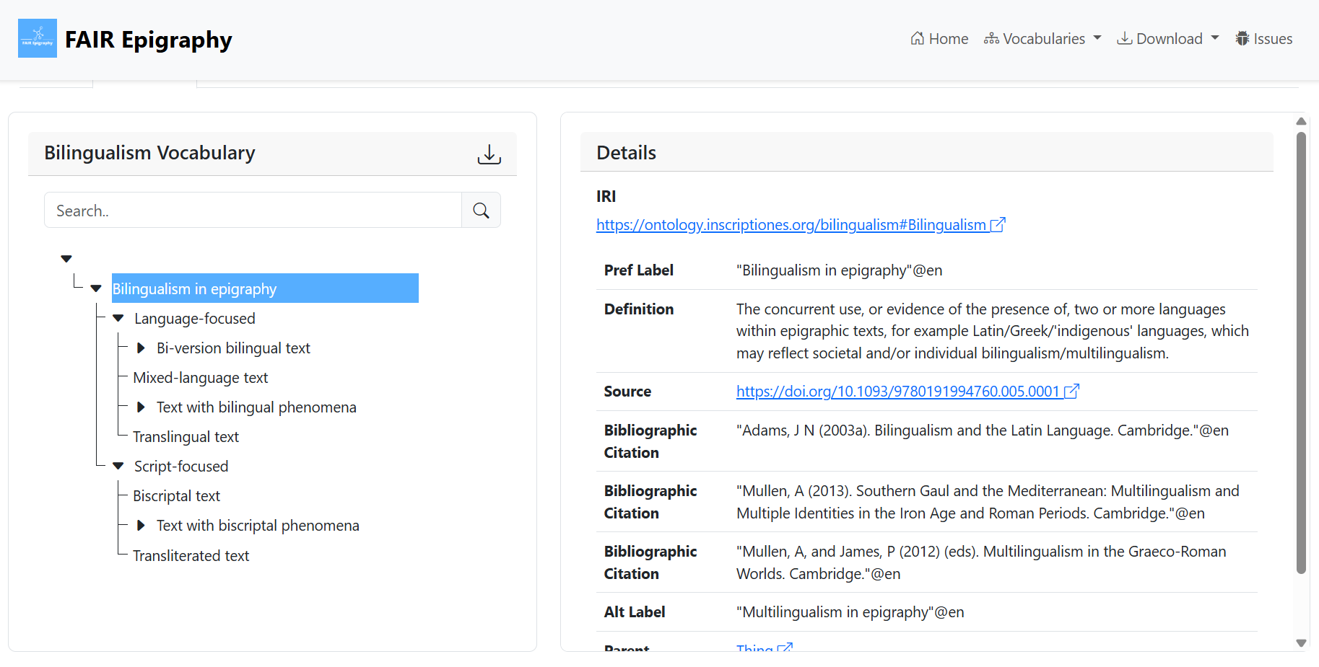

An unexpected addendum
The FAIR Epigraphy project
A. Mullen, FAIR Epigraphic Vocabularies: Bilingualism in epigraphy (1.0.0) [Data set]. Zenodo, 2025, available at: https://doi.org/10.5281/zenodo.17569510.

Slide 11
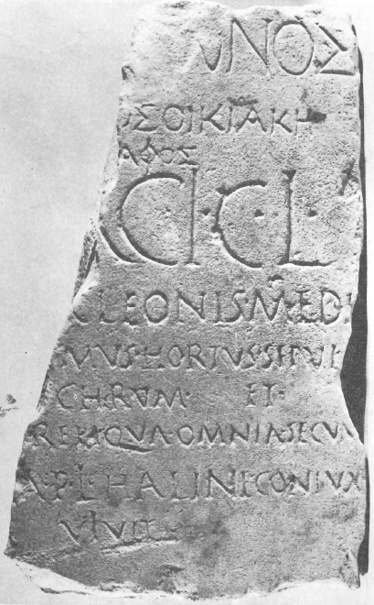
Bi-version bilingual texts
Spinazzola. Cleon’s bilingual epitaph (1st c. BC–1st c. AD)
Definition:
Two separate parts in different languages, sharing (at least partly) the same content
  → Duplicating, Partial, Overlapping, Complementary
Greek: metrical form, cultural prestige, professional identity (medicus)
Latin: legal status (tria nomina), freedman condition, wife’s name
Interpretation:
Composite identity → Greek = cultural and professional capital; Latin = social integration
M. Chelotti, “Iscrizioni latine inedite dal territorio di Spinazzola (Bari)”, in A.A. V.V., Epigrafia e territorio, politica e società, Bari, 1983, p. 15-46.
J. Kaimio, The Romans and the Greek Language, Helsinki, 1979, p. 322.
A. Martin, “À propos d’une inscription bilingue d’Apulie”, Epigraphica 46 (1984), p. 194‑198.
É. Samama, Les médecins dans le monde grec, Genève, 2003, p. 5-6.
Fig. 1. © M. Chelotti (1983)

Slide 12
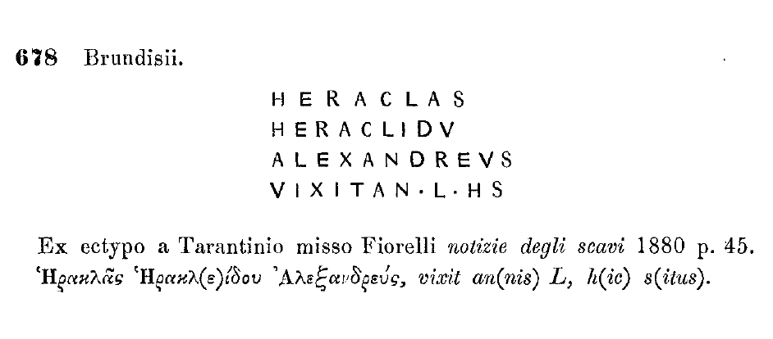
Text with bilingual phenomena
Brindisi. Heraklas of Alexandria’s bilingual epitaph (1st c. AD)
Intra-sentential code-switching: Latin and Greek sections belong to a same syntactic unit
Greek for name, patronymic, origin
Latin formula: vixit an(nis) L h(ic) s(itus)
Interpretation:
Greek = personal identity
Latin = conformity to Roman epigraphic norms
Latin script:
Writer’s lack of dual competence?
Mixed identity willingly displayed?
F. Ferrandini Troisi, Iscrizioni Greche d’Italia. G Puglia, Roma, 2015, p. 57, no. 51
L. Gasperini, “Presenze ellenofone nel Brundisino”, in M. Lombardo & C. Marangio (ed.), Il territorio Brundisino, Mesagne, 1998, p. 58-59.
E.A. Meyer, “Explaining the Epigraphic Habit in the Roman Empire: The Evidence of Epitaphs”, JRS 80 (1990), p. 75.
Fig. 1. © IG XIV, 678
Strabo, VI.3.7: Ἐν δὲ τοῖς ἀπὸ τῆς Ἑλλάδος καὶ τῆς Ἀσίας διαίρουσιν εὐθύπλοια μᾶλλόν ἐστιν ἐπὶ τὸ Βρεντέσιον, καὶ δὴ καὶ δεῦρο πάντες καταίρουσιν, οἷς εἰς τὴν Ῥώμην πρόκειται ὁδός, “In the case of those who sail across from Greece or Asia, the more direct route is to Brentesium, and, in fact, all who propose to go to Rome by land put into port here” (Trans. H.L. Jones, 1924, LCL 182).

Slide 13
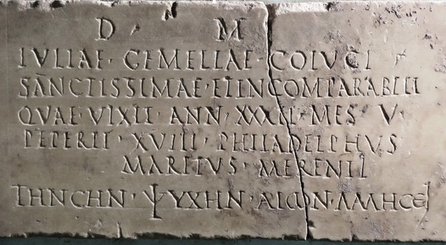
Text with bilingual phenomena
Pozzuoli. Iulia Gemella’s bilingual epitaph (2nd c. AD)
Inter-sentential code-switching: Distinct linguistic segments follow one another
Latin main text following closely Roman practice
A notable remark about fecundity
Greek closing verse
Interpretation:
Greek adds emotional tone, possibly intimacy
Testimony of integration and cultural negotiation
Fig. 1. © Museo Archeologico Nazionale di Napoli, depositi – inv. 3451
J.N. Adams, Bilingualism and the Latin Language, Cambridge, 2003, p. 363.
R. De Vita, “Peregrini e forestieri dall’Oriente greco: l’uso della lingua greca a Puteoli”, AION 23‑24 (2016), p. 262.
A. Rizakis, “New Identities in the Greco-Roman East: Cultural and Legal Implications of the Use of Roman Names”, in R. Parker (ed.), Changing Names: Tradition and Innovation in Ancient Greek Onomastics, Oxford, 2019, p. 239 n. 13.

Slide 14
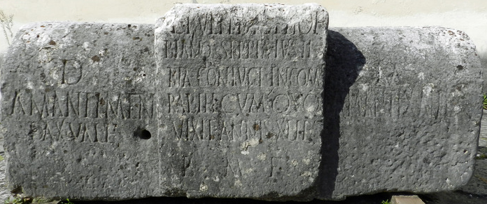
Text with bilingual phenomena
Pietradefusi. Lucius Pullidius Phoebianus’s bilingual epitaph (2nd–3rd c. AD)
Tag-switching: Insertion of a short element from a different language into a monolingual text
Latin main text
Greek χαῖρε in side panel
Man’s name pointing to a Greek affiliation
Interpretation:
Dialogue between husband and wife
Composite identity
I. Kajanto, Supernomina. A study in Latin epigraphy, Helsinki, 1966, p. 64.
M. Kajava & H. Solin, “Le iscrizioni aliene del Museo Irpino”, Epigraphica 59 (1997), p. 331-333, no. 20.
Fig. 1. © Museo provinciale Irpino di Avellino

Slide 15
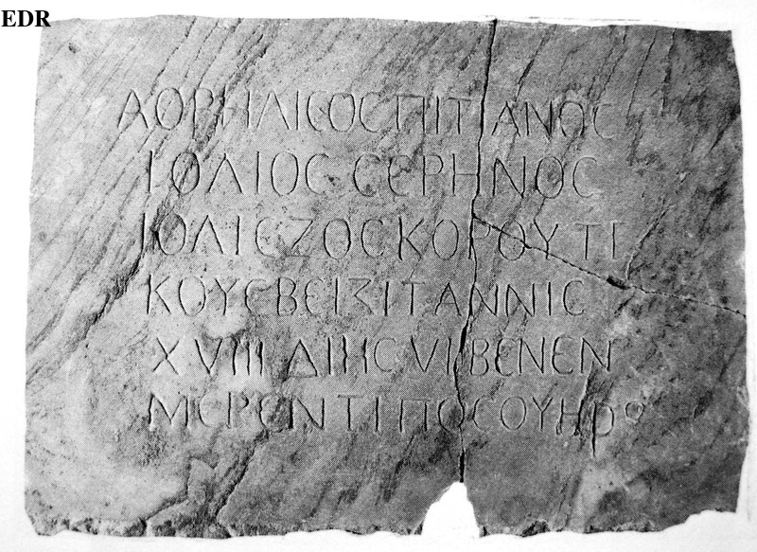
Translit. & biscriptal phenomena
Pozzuoli. Iulia Dioscorutis’ epitaph (2nd c. AD)
Affected by Greek phonology:
  Ιολιε for Iuliae
  Ζοσκορουτι for Dioscoruti
  2nd c. AD: ζ- > di- in substandard Latin (reverse process here)
Very close to the Roman usual practice
Written in Greek characters
  Intended for ‘fellow bilinguals’?
Roman numerals (XVIII, VI)
  Habit of the workshop?
F. Biville, “La graphie des noms propres en contexte multilingue”, in C. Ruiz Darasse (ed.), Comment s’écrit l’autre ?, Bordeaux, 2020, p. 22‑23.
M. Leiwo, “The Mixed Languages in Roman Inscriptions”, in H. Solin, O. Salomies & U.-M. Liertz (ed.), Acta Colloquii Epigraphici Latini, Helsinki, 1995, p. 296.
Fig. 1. © Ann Arbor (USA), Kelsey Museum of Archeology

Slide 16
A (final) multilayered testimony
Reggio Calabria. Fabia Sperata’s and Sallustius Agathocles’ epitaph (2nd–3rd c. AD)
Combines various phenomena:
  Latin + Greek segments
  Code-switching (inter-sentential)
  Transliteration (Greek in Latin script)
  Script-switch
Key Features:
  Latin opening: D(is) M(anibus) + names
  Greek nickname in Latin script: o cae Rodios (ὁ καὶ Ῥόδιος)
  Final line in Greek script: ἁτοῖς ἐπόησαν (sibi fecerunt)
Result of a deliberate choice
Reflects mobility & Eastern connections
C. Consani, “The Greek of Italy between archaism, internal evolution and contact phenomena”, Graeco-Latina Brunensia 2 (2016), p. 111.
L. D’Amore, Iscrizioni greche d’Italia. Reggio Calabria, Roma, 2007, p. 67, no. 38.
F. Mosino, “Il più antico testo grecanico della Calabria (CIL X, 11)”, Klearchos 22 (1980), p. 111‑115.
Fig. 1. © Museo Archeologico Nazionale Reggio Calabria, 2021

Slide 17
To quickly conclude…
Latin and Greek intertwined
Epitaphs = spaces of negotiation
Between languages, scripts, and identities
Language choice rarely neutral
  Greek: cultural prestige, personal origin, professional identity
  Latin: legal status, integration into Roman norms
Composite identities
Bilingualism as a symbolic tool, not random mixing
A wide range of interrogations
  Levels of bilingual competence
  Role of stonecutters and intermediaries
  Audience: for whom were these texts intended?
  Individual mobility

