Slide 1
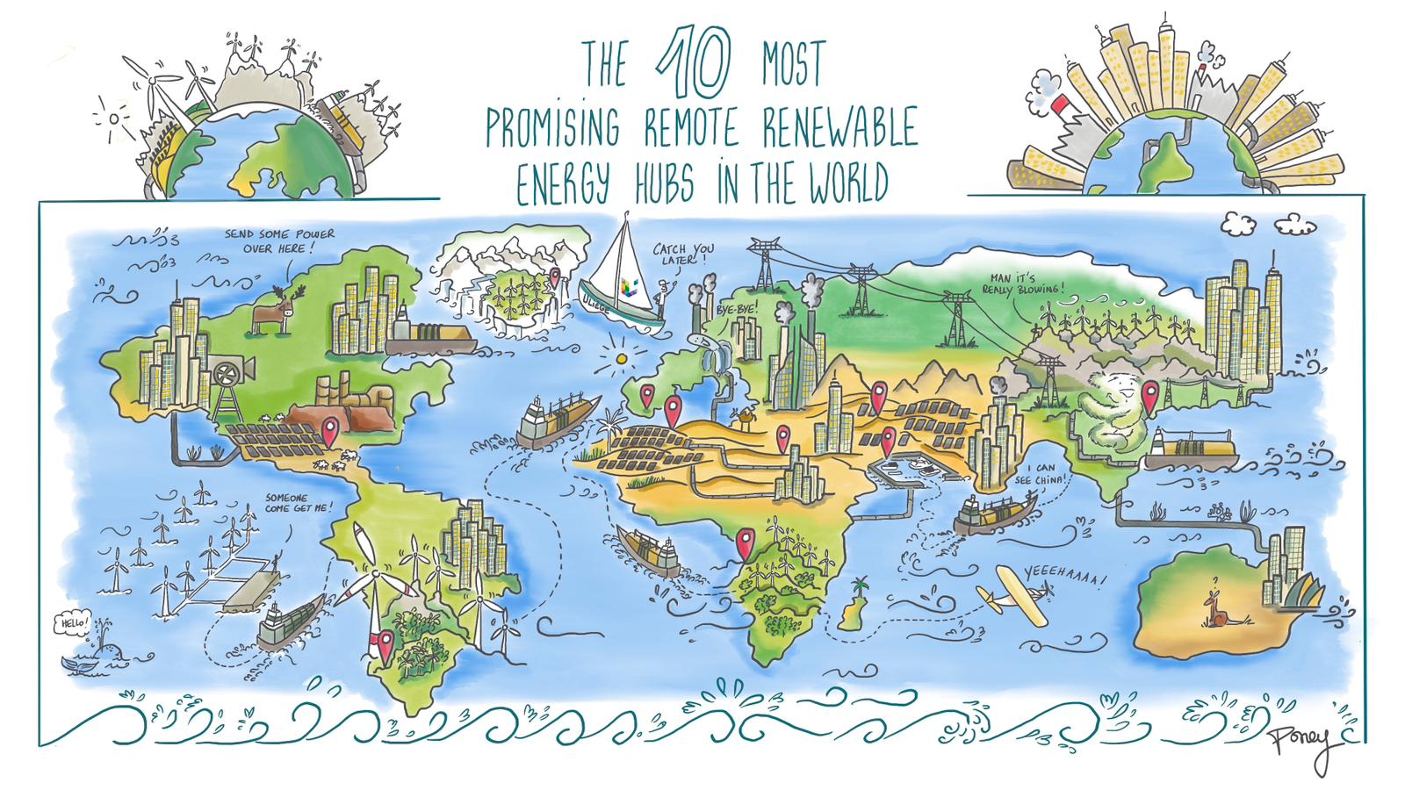
Authors: Ir. Victor Dachet, Prof. Dr. Ir. Damien Ernst and M. Thibaut Techy
Notes:
The world’s 10 most promising Remote Renewable Energy Hubs

Slide 2
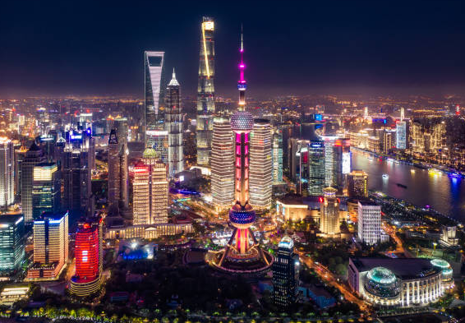
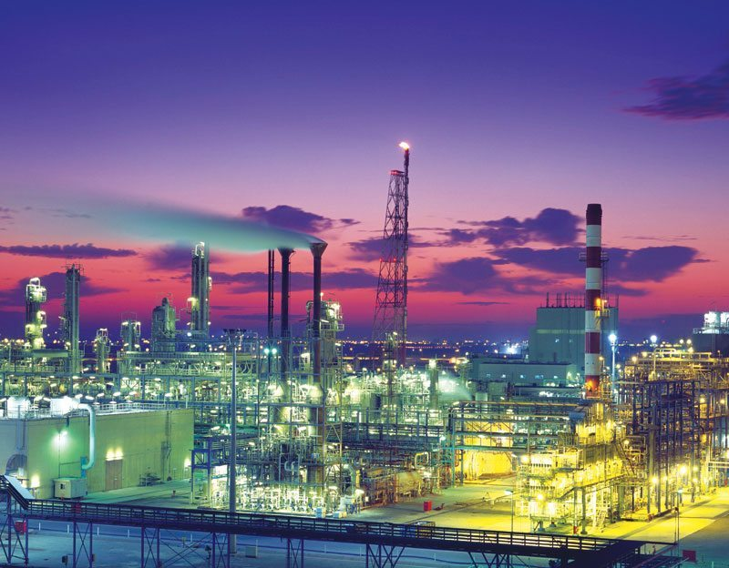
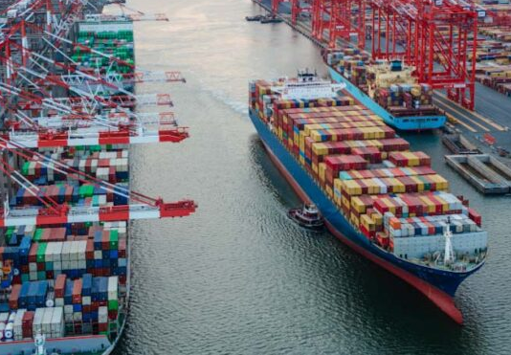
Energy consumption is not evenly distributed across the world. It is concentrated in specific regions referred as load centers.
A load center can be characterized by:
a high population density;
large urban and industrial areas;
major logistical infrastructure.
Examples of major consumption centers around the world.
East Asia – Shanghai Towers.
Middle East – Jubail Industrial City.
East Coast USA – Port of New York.
2

Slide 3

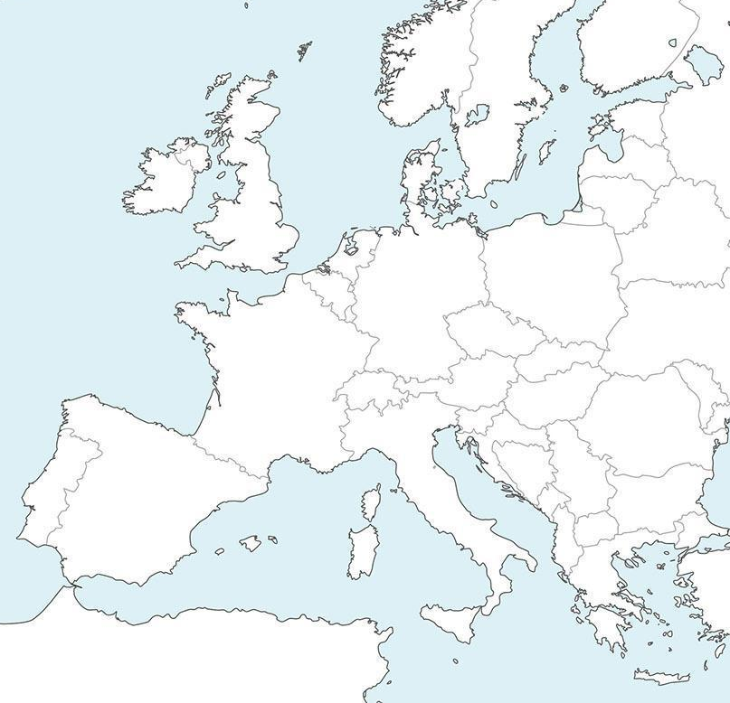

In Europe, the Blue Banana is one of the major load centers. It stretches from northern Italy to southern England.
THE BLUE BANANA
More than 110 million inhabitants.
European industrial corridor: steel, metallurgy, automotive, chemical and petrochemical industries.
Major ports: Rotterdam, Antwerp, Hamburg, Le Havre, Genova.
International airports: Frankfurt, Schiphol, Heathrow.
3

Slide 4

Load centers are not only the main hubs of energy demand, particularly for electricity. In the near future, they will also become the areas where e-fuel demand is the highest.
E-fuels are produced from low-carbon electricity. They include:
e-molecules such as e-hydrogen (H₂), e-ammonia (NH₃), e-methane (CH₄), and e-methanol (CH₃OH);
synthetic fuels such as e-gasoline and e-SAF (Sustainable Aviation Fuel).
From a physico-chemical standpoint, these e-fuels are identical to their conventional fossil-based counterparts; only the production process differs.
4

Slide 5



E-hydrogen is obtained through water electrolysis, a process that splits water molecules into hydrogen and oxygen using electricity from renewable sources.
It serves as the feedstock for producing most other e-fuels. It enables the synthesis of:
e-ammoniac (N₂ + 3H₂ → 2NH₃):
About 80% of global ammonia production is used to make nitrogen fertilizers, essential for modern agriculture^{[1]}.
e-methane (CO₂ + 4H₂ → CH₄ + 2H₂O):
It is the main component of natural gas and can be injected into existing grids to produce heat and power.
e-methanol (CO₂ + 3H₂ → CH₃OH + H₂O):
Used as a base chemical for organic synthesis (plastics, solvents) and increasingly as a marine fuel or an intermediate for e-gasoline.
[1] Data from Nosherwani, S. A., & Neto, R. C. (2021). Techno-economic assessment of commercial ammonia synthesis methods in coastal areas of Germany. Journal of Energy Storage, 34, 102201.
5

Slide 6
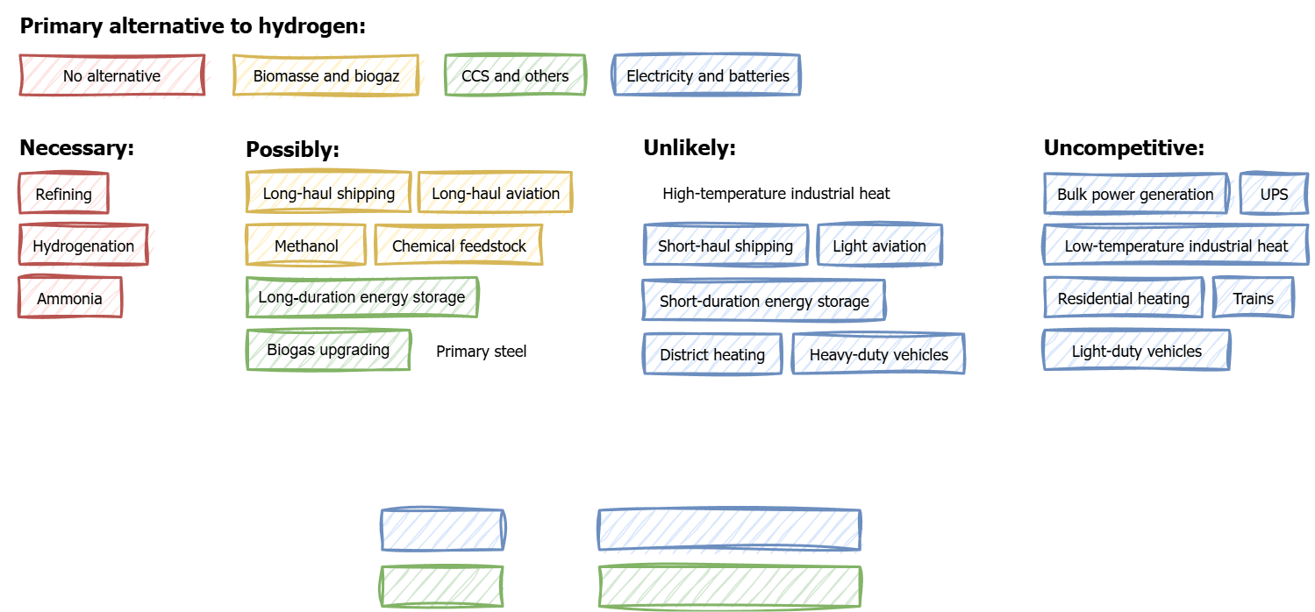
E-hydrogen itself can also be used as a final product, among others in the steel industry, where it can replace coke in blast furnaces or be used in direct reduction processes (DRI)^{[1]}, enabling the production of low-carbon steel.
The following figure^{[2]} illustrates the various uses of e-hydrogen, ranked by their degree of economic relevance: some are essential, others possible but competing, while several remain unlikely or non-competitive.
[1] Direct Reduced Iron (DRI) refers to the process of extracting oxygen from iron ore without using a blast furnace, by employing a reducing gas (traditionally natural gas or hydrogen).
[2] Figure adapted from Johnson, N., Liebreich, M., Kammen, D. M., Ekins, P., McKenna, R., & Staffell, I. (2025). Realistic roles for hydrogen in the future energy transition. Nature. The acronyms CCS and UPS stand for Carbon Capture and Storage and Uninterruptible Power Supply, respectively.
6

Slide 7

E-hydrogen and the e-fuels derived from it are expected to become key energy carriers for decarbonizing uses and sectors that lack credible low-carbon alternatives. However, the demand from major load centers worldwide cannot be met solely with their local renewable resources, which are limited in both quality and available land for new installations.
One solution is to produce low-carbon electricity and e-fuels in remote regions of the world with abundant renewable resources.
These are known as Remote Renewable Energy Hubs (RREHs)^{[1]}.
[1] The term Remote Renewable Energy Hub (RREH) is defined in Dachet, V., Dubois, A., Miftari, B., Fonteneau, R., & Ernst, D. (2024, December 19). Remote Renewable Energy Hubs: a taxonomy.
Energy Reports, 13, 3112-2120.
7

Slide 8

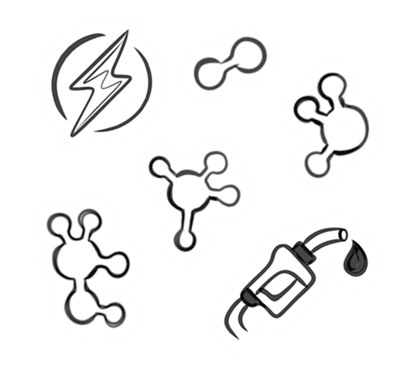
An RREH is a site that harnesses resources such as solar and wind to produce large amounts of low-carbon electricity.
This low-carbon electricity can then for example be used on-site to synthesize e-fuels.
PRODUCTION
H₂
NH₃
electricity
CH₄
CH₃OH
fuels
Energy carriers produced in the RREH.
8

Slide 9

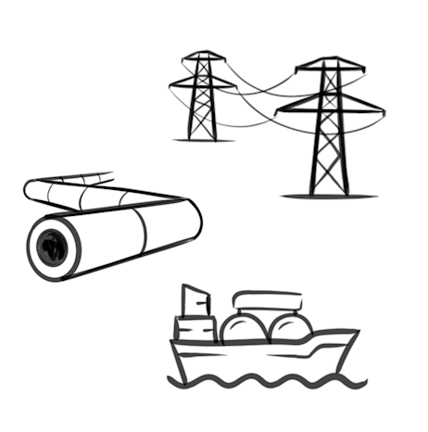

An RREH involves transporting the energy produced to one or more load centers, either through the electric grid (onshore or submarine cables), by pipeline, or by sea (LNG and tanker ships).
PRODUCTION
TRANSPORT
H₂
NH₃
electric grid
electricity
CH₄
pipeline
CH₃OH
LNG carrier
fuels
Energy carriers produced in the RREH.
Networks and transport modes.
9

Slide 10


In load centers, e-fuels can contribute to decarbonizing several strategic industrial and transport sectors.
They can replace fossil fuels in aviation and maritime transport, serve as feedstock for the chemical industry, and support low-carbon steelmaking, fertilizer production, and refining processes.
PRODUCTION
TRANSPORT
CONSUMPTION
H₂
NH₃
electric grid
aviation
electricity
steelmaking
CH₄
pipeline
CH₃OH
refining
fuels
LNG carrier
fertilizers
chemical feedstock
Energy carriers produced in the RREH.
Networks and transport modes.
End-use sectors of energy carriers.
10

Slide 11

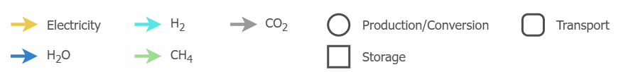
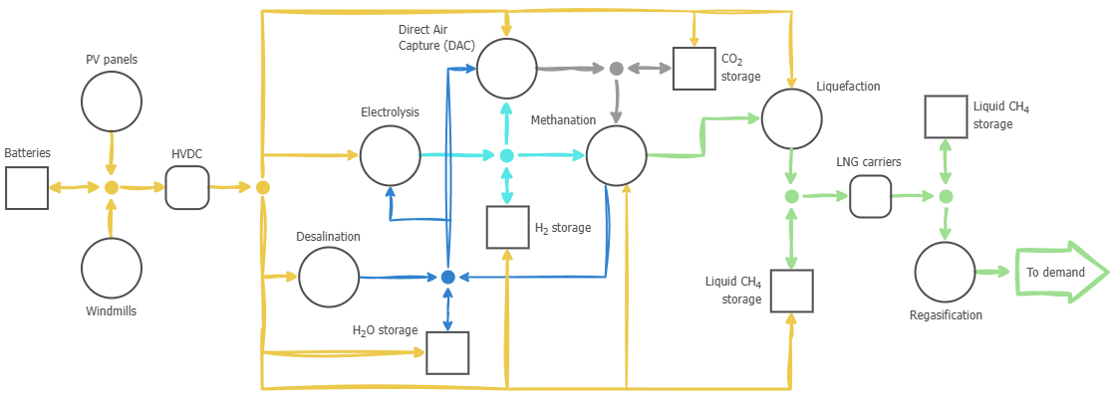

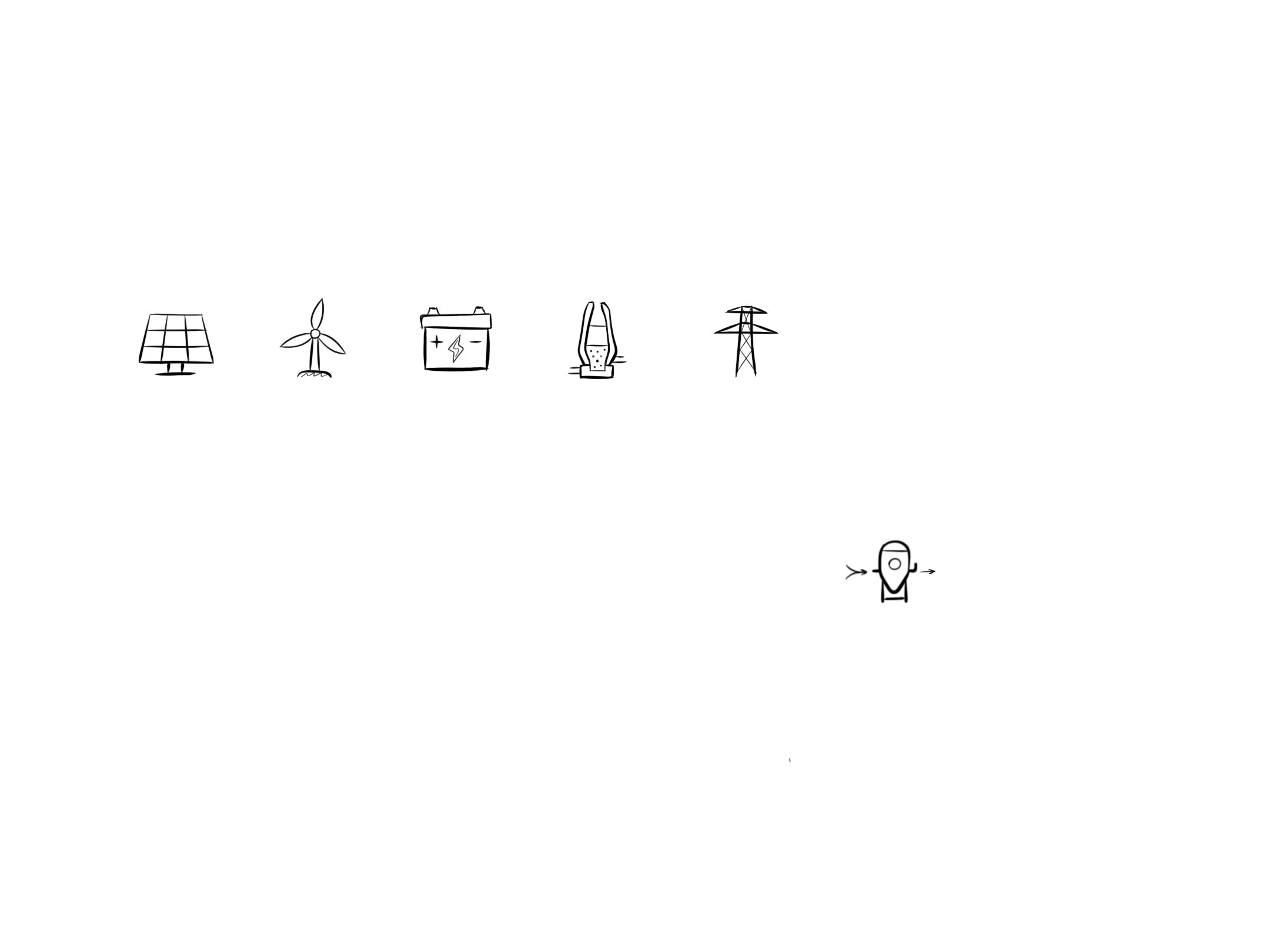
Example of an RREH dedicated to e-methane production
CO₂
CO₂
CH₄
H₂
CH₄
H₂O
The term LNG stands for Liquefied Natural Gas.
11

Slide 12
Criteria for a good RREH
What makes a region a good candidate for hosting a Remote Renewable Energy Hub?
As we saw earlier, the first requirement is to have abundant renewable resources to produce a sufficient amount of e-fuels.
This defines our first criterion: C1 – Renewable potential.
But this is not the only aspect to consider. To fully assess the relevance of a region, we also take into account four additional criteria:
C2 – Land availability;
C3 – Existing infrastructure;
C4 – Financing conditions and competitiveness;
C5 – Energy sovereignty.
Together, these five criteria form the analytical framework that will allow us to compare the regions studied.
12

Slide 13

C1 – Renewable potential
Ability of a region to generate large amounts of low-carbon electricity thanks to high-quality renewable resources.
Examples of aspects to consider:
Quality of available resources: for example, solar irradiance, wind speed and regularity, etc.
Capacity factor: ratio between the amount of electricity generated over a given period, e.g. a year, by a renewable technology and the amount it could have produced if operating at maximum capacity during the same period. It reflects how efficiently a given resource is harnessed by a given technology.
Complementarity and predictability of resources: these two aspects can help reduce and/or optimize storage needs (batteries, tankers, etc.).
13

Slide 14

C2 – Land availability
Ability of a region to mobilize large areas suitable for the installation of renewable and industrial facilities.
Examples of aspects to consider:
Usable area: land that can realistically be developed for large-scale projects, excluding protected zones, densely populated areas, or sites physically unsuitable for construction (mountains, unstable soils, etc.).
Social acceptance: level of support or opposition from local communities.
14

Slide 15

C3 – Existing infrastructure
Ability of a region to rely on existing infrastructure to support the development of an RREH and the transport of the electricity and/or e-fuels it produces toward load centers.
Examples of aspects to consider:
Energy networks: existence and quality of power lines, pipelines, or interconnections that allow energy to be transported locally or to other load centers.
Ports and logistics: availability of maritime, rail, or road transport infrastructure to (i) deliver equipment and workforce, and (ii) ship e-fuels to load centers.
15

Slide 16

C4 – Financing conditions and competitiveness
Ability of a region to provide an economic, political, and financial environment attractive for developing RREHs, while ensuring competitive electricity and/or e-fuel costs.
Examples of aspects to consider:
Competitiveness : ability to produce electricity and/or e-fuels at competitive prices compared to other regions of the world, for instance thanks to low labour costs or higher productivity.
Access to capital: level of attractiveness to investors (private, institutional, etc.). A key indicator of capital accessibility is the cost of capital.
Economic, political, and legal stability: existence of independent institutions (e.g. central banks) and a regulatory framework for e-fuels, enabling their certification, integration into national decarbonization targets, and international trade.
16

Slide 17

C5 – Energy sovereignty
Criterion related to a load center, assessing the ability of an RREH to strengthen its low-carbon energy security while maintaining affordability.
Examples of aspects to consider:
Supply diversification: extent to which an RREH adds a new source of low-carbon electricity or e-fuels, reducing dependence on a limited number of suppliers.
Supply security: ability of the RREH to reliably fulfil its long-term supply contracts for low-carbon electricity or e-fuels.
Strategic partnerships: opportunity to build lasting relationships between the RREH and the load center through shared low-carbon infrastructure projects.
17

Slide 18

We will now travel through ten regions of the world that, at first glance, show interesting potential for the development of RREHs.
Each region will be assessed according to the five criteria introduced earlier, taking the Blue Banana as the reference load center^{[1]}.
The evaluation follows a colour code:
🟢 Clear strength — very favourable conditions
🟡 Moderate potential — some limitations
🟠 Possible interest — major constraints
Throughout this journey, we will combine historical insights, technical analysis, and economic perspectives to understand the strengths and weaknesses of each region.
[1] The assessment is qualitative and comparative: each region is evaluated in relation to the others in the selection.
18

Slide 19
Multi-criteria analysis
of a selection of ten regions

Slide 20
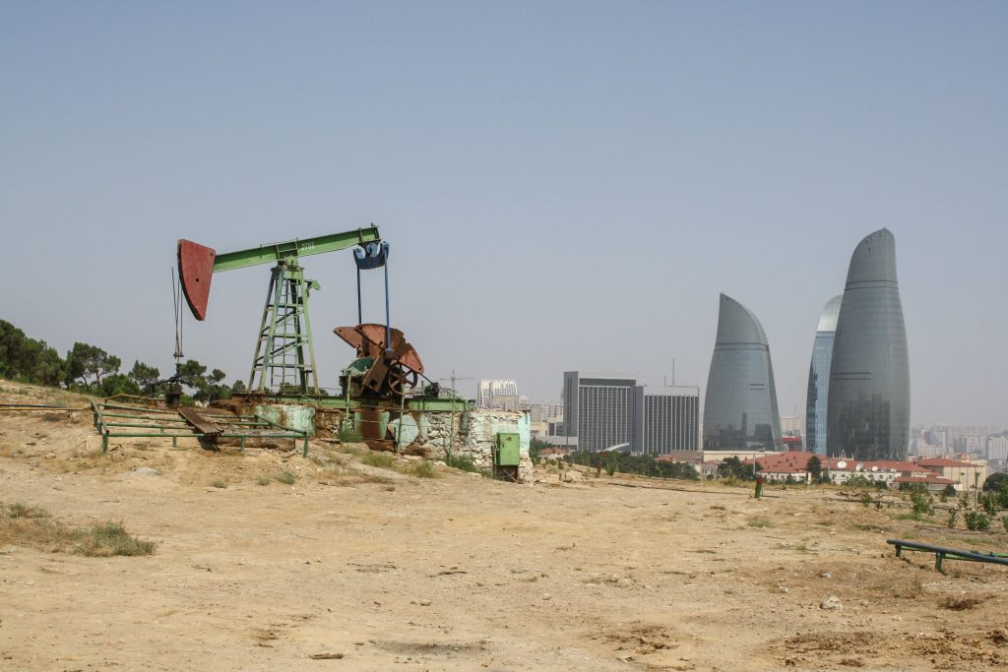
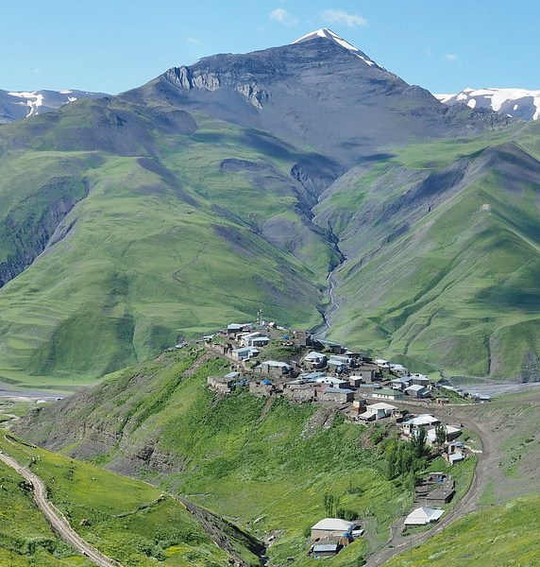
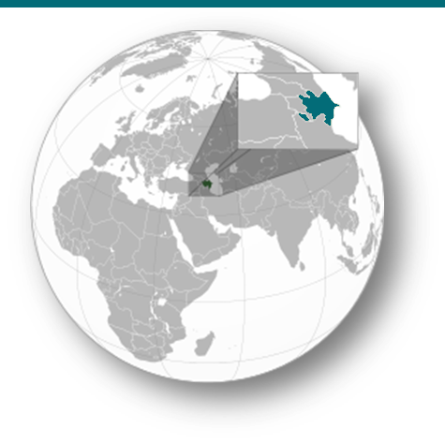
Azerbaijan
The cradle of the oil era
In the 19th century, its capital Baku became one of the world’s first major oil production centers. More recently, the country has established itself as a gas supplier to Europe.
20

Slide 21



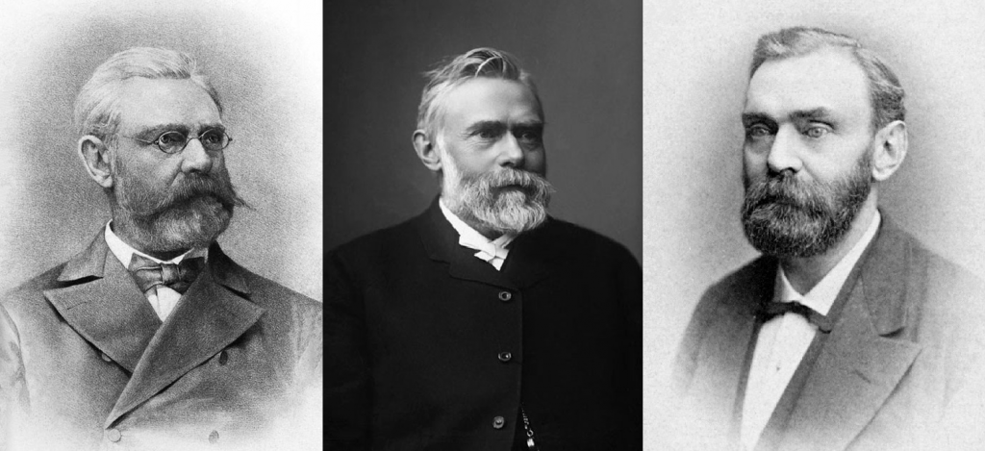
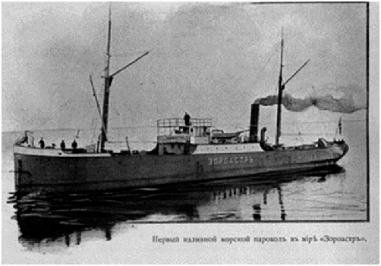
The Nobel brothers played a major role in the industrialization of Baku. They introduced modern refining techniques and new means of transport, such as the first oil pipelines and the world’s first motorized oil tanker, the Zoroaster, designed to sail on the Caspian Sea.
It was also in Baku that the world’s first commercial oil well was drilled in 1846.
Robert Nobel
(1829 – 1896)
Alfred Nobel
(1833 – 1896)
The Zoroaster (1878)
21

Slide 22
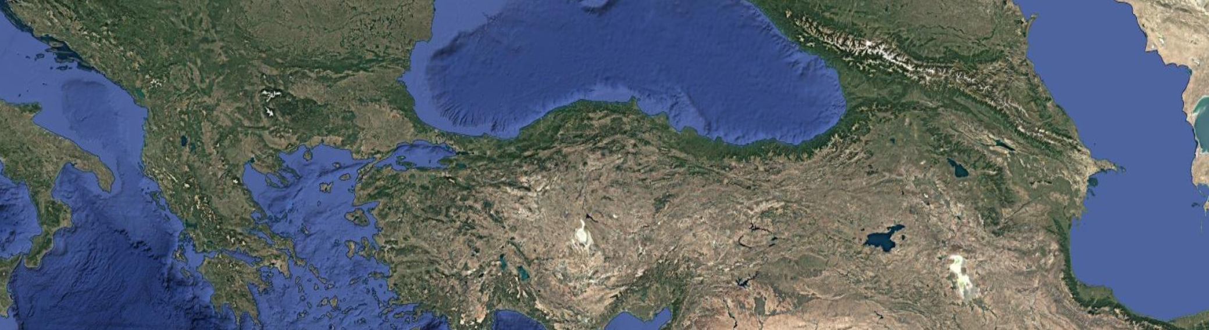

Even today, Azerbaijan remains a major player in the hydrocarbon sector and continues to take part in large energy projects.
One of them, the Southern Gas Corridor (SGC), delivers gas from the Caspian Sea to Italy through more than 3,500 km of pipelines crossing six countries. Commissioned in 2021, the project has already mobilized nearly €40 billion in investments from a broad international consortium.
South Caucasus Pipeline
Trans Adriatic Pipeline
Trans-Anatolian Pipeline
Shah Deniz field
22

Slide 23
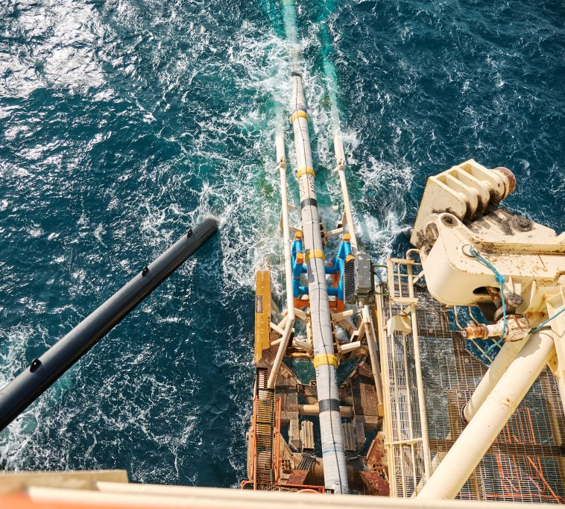
The Trans Adriatic Pipeline (TAP), the final segment of the SGC leading to Italy, has an initial capacity of 289 GWh/day^{[1]}.
E-methane produced by an RREH in Azerbaijan could be injected into the SGC and subsequently into the European gas network, thanks to the chemical compatibility between synthetic methane and natural gas.
Natural gas from Azerbaijan contains roughly 93 % methane^{[2]}.
The subsea section of the TAP reaches a depth of 810 m in the Adriatic Sea.
[1] According to the official TAP website, the initial capacity is 10 billion cubic meters per year (10⁹ m³). Considering the higher heating value of natural gas (10.55 kWh/m³), this corresponds to about 289 GWh/day, equivalent to the daily gas consumption of roughly 8.5 million households (assuming 10,000 kWh/year per household).
[2] The composition of natural gas varies depending on the field. Azerbaijani gas typically contains ~93.05 % methane, ~3.22 % ethane, ~1.50 % propane, ~0.44 % n-butane, ~0.29 % iso-butane, ~0.08 % CO₂, and ~0.085 % nitrogen.
23

Slide 24
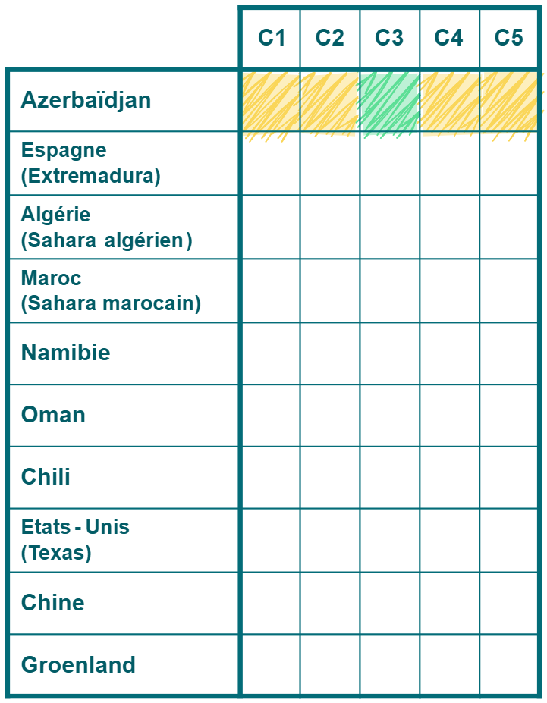
Assessment of an RREH in Azerbaijan
🟡 C1 – Renewable potential
High solar and wind potential, though lower than in several other regions analysed.
🟡 C2 – Land availability
High population density;
Available land smaller than in other regions of our analysis.
🟢 C3 – Existing infrastructure
Industrial port of Baku;
Well-developed gas network and a satisfactory power grid.
🟡 C4 – Financing conditions and competitiveness
Existing financial partnerships (BP, SOCAR, UE^{[1]}).
🟡 C5 – Energy sovereignty
Contributes to the diversification of gas supplies;
Limited by regional geopolitical risks and dependence on a single corridor.
Azerbaijan
[1] Under the European Neighbourhood Policy (ENP) and the Eastern Partnership (EaP), the European Investment Bank has invested more than €96 million in Azerbaijan.
24

Slide 25
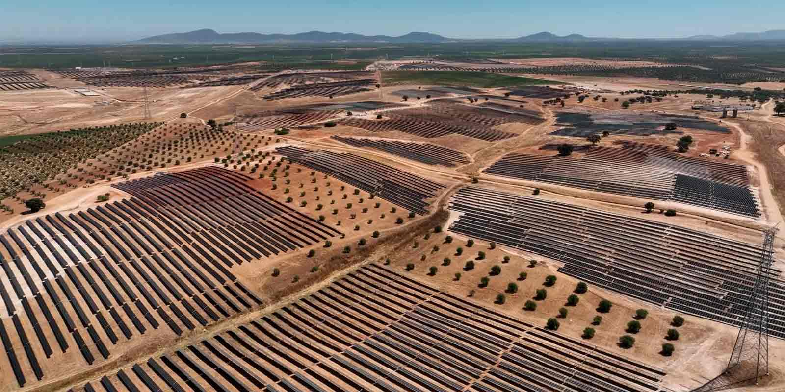
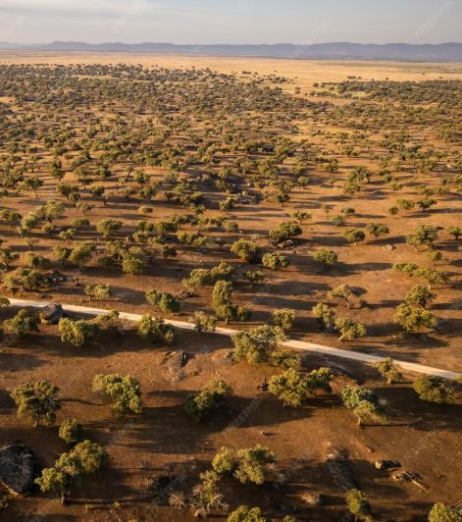
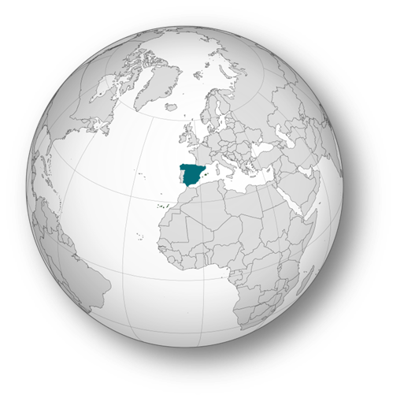
Spain
A solar resource within Europe’s reach
Even within Europe, some regions are already well positioned to host RREHs, such as Extremadura in Spain.
25

Slide 26
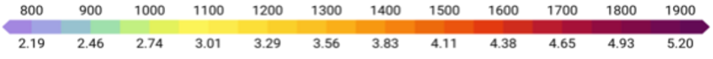
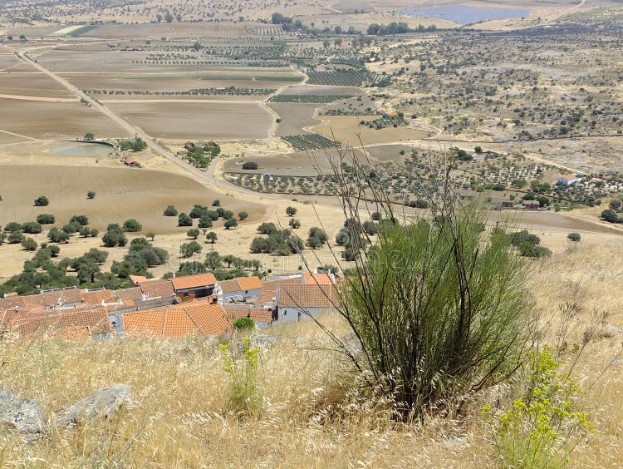


Extremadura combines high solar irradiance with vast land availability. This is a rather unique combination in Europe.
Long-term average photovoltaic production potential, period 1994–2020^{[1]}.
Annual totals
kWh/kWp^{[2]}
Daily totals
Extremadura
[1] Figure by Solargis.
[2] kWp (kilowatt-peak): maximum power output of a photovoltaic panel under standard conditions (1,000 W/m², 25 °C).
kWh/kWp: amount of electricity produced per kilowatt-peak installed over a given period.
26

Slide 27
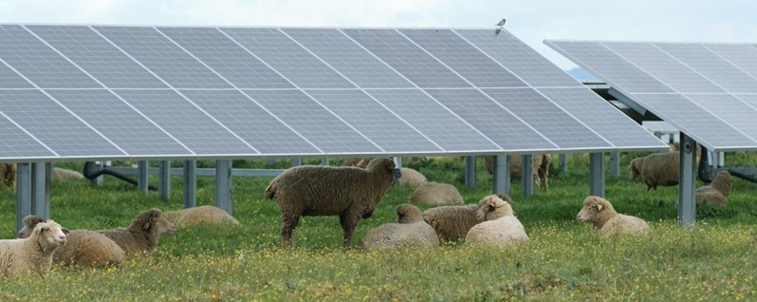
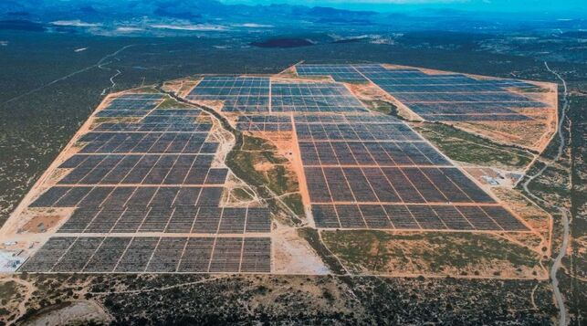
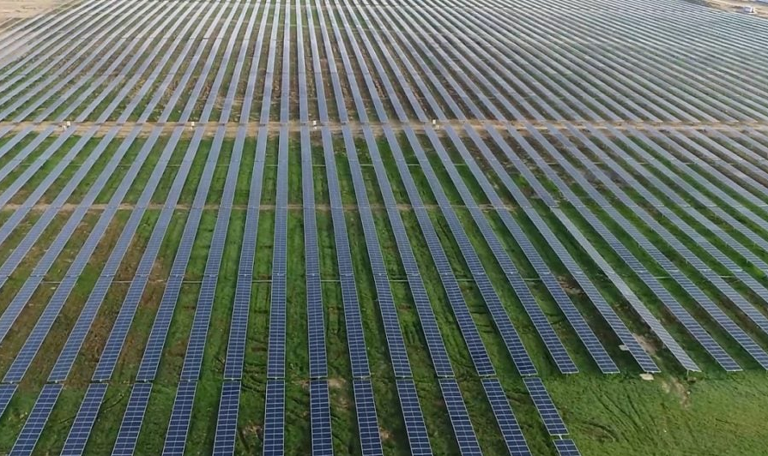
Extremadura is one of the few European regions where large-scale photovoltaic (PV) solar farms can be realistically developed.
Núñez de Balboa PV plant (500 MW), 2020.
Francisco Pizarro PV plant (590 MW), 2022^{[1]}.
[1] The Francisco Pizarro plant illustrates an agrivoltaic model, where PV panels are arranged to allow continued sheep farming on-site..
27

Slide 28
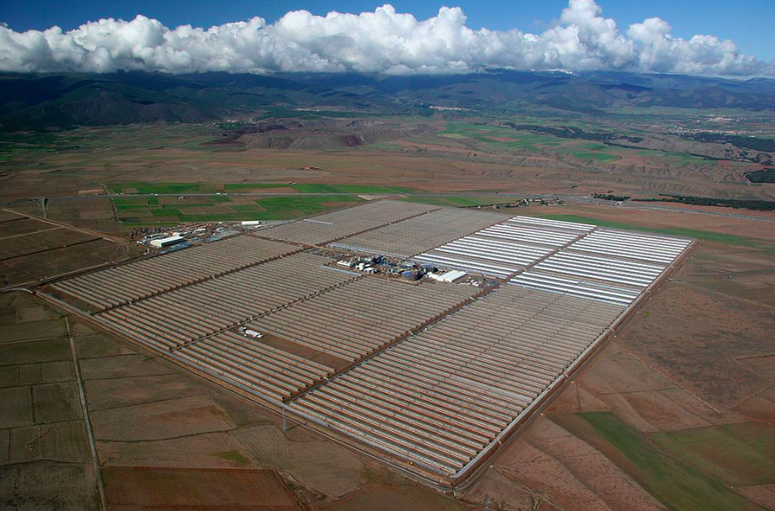
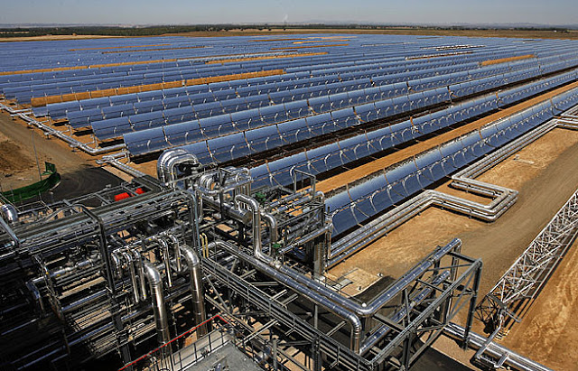
Concentrated Solar Power (CSP) is another solar technology deployed in Extremadura.
It relies on parabolic mirrors that concentrate solar energy onto a receiver. The captured heat warms a heat transfer fluid, which then transfers its energy to water in a heat exchanger. The resulting steam drives a turbine to generate electricity^{[1]}.
Extresol CSP plant (150 MW), 2010.
[1] At Extresol, the heat is stored in molten salts, allowing for dispatchable power generation that can continue even at night..
28

Slide 29
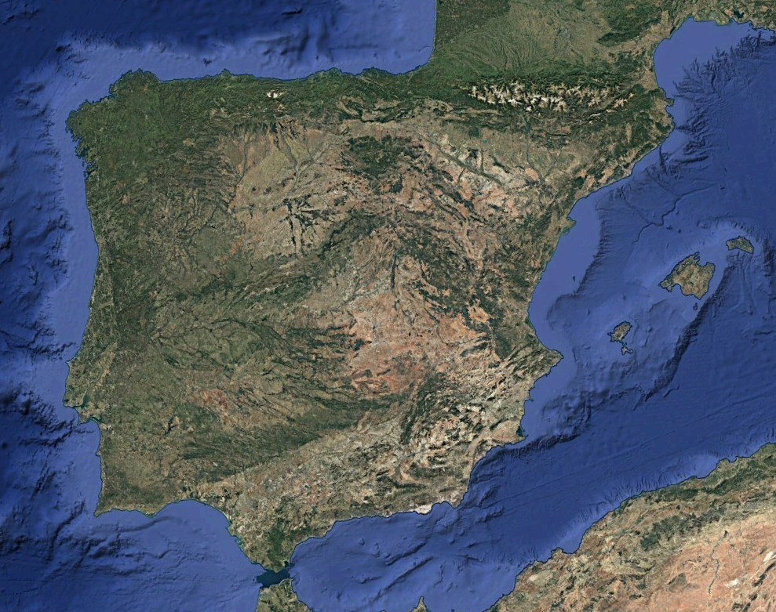
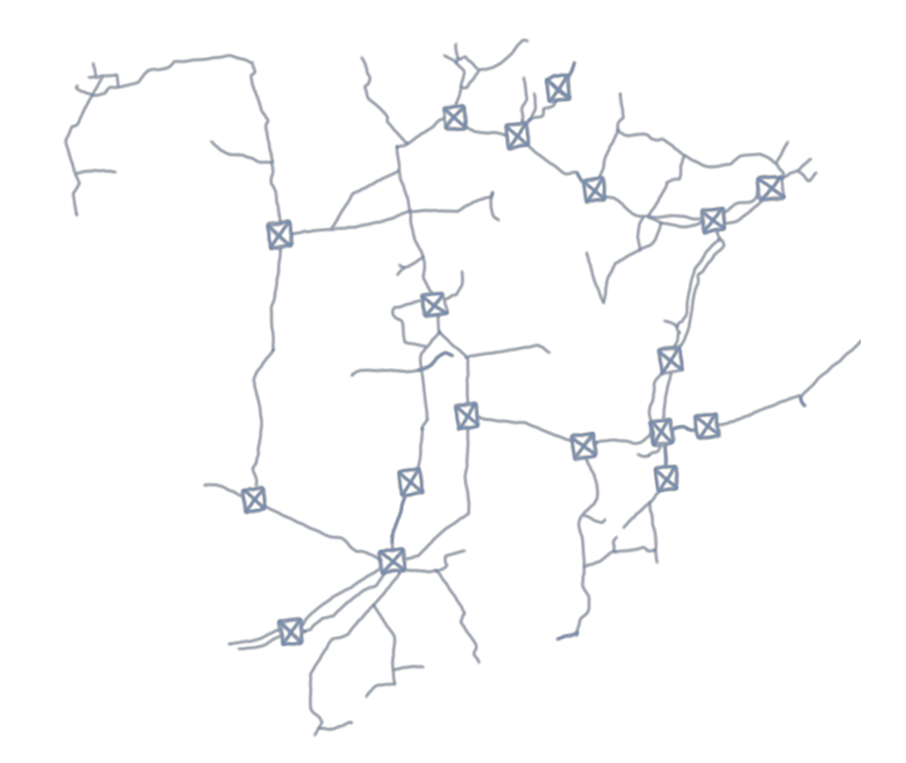
Spain has one of the most developed gas networks in Europe, operated by Enagás, which includes six LNG terminals (El Musel, Bilbao, Barcelona, Sagunto, Cartagena, and Huelva).
El Musel
Bilbao
Barcelona
Sagunto
In 2023, Enagás reported a record gas export to France on May 17, through the Irún and Larrau interconnections, reaching a daily volume of 261.5 GWh^{[1]}.
Cartagena
Huelva
[1] Data from Enagás. (2023, December 29). In 2023, demand for natural gas reached 325.4 TWh.
29

Slide 30
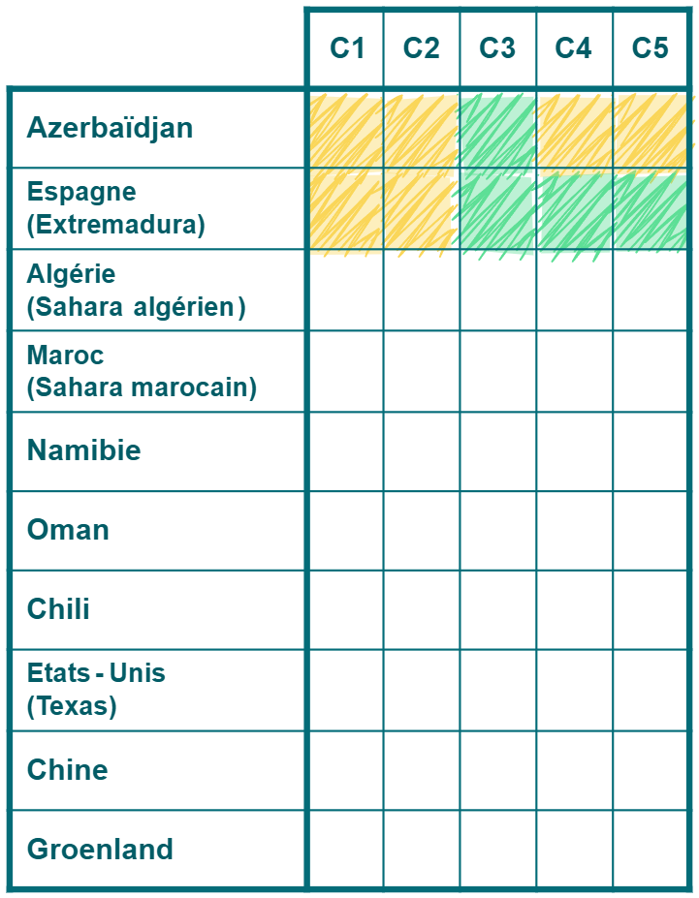
Assessment of a RREH in Spain (Extremadura)
🟡 C1 – Renewable potential
High solar and wind potential, although lower than in some other regions of this analysis.
🟡 C2 – Land availability
Low population density;
Available land area smaller than in several other regions of the analysis.
🟢 C3 – Existing infrastructure
Export possible via Enagás’s six industrial ports with LNG terminals;
Dense gas network and electricity grid connected to ENTSO-E.
🟢 C4 – Financing conditions and competitiveness
Very favourable financing supported by the EU;
Strong competitiveness within Europe.
🟢 C5 – Energy sovereignty
Local production within EU territory;
Geographical proximity to the Blue Banana.
Azerbaijan
Spain
(Extremadura)
30

Slide 31
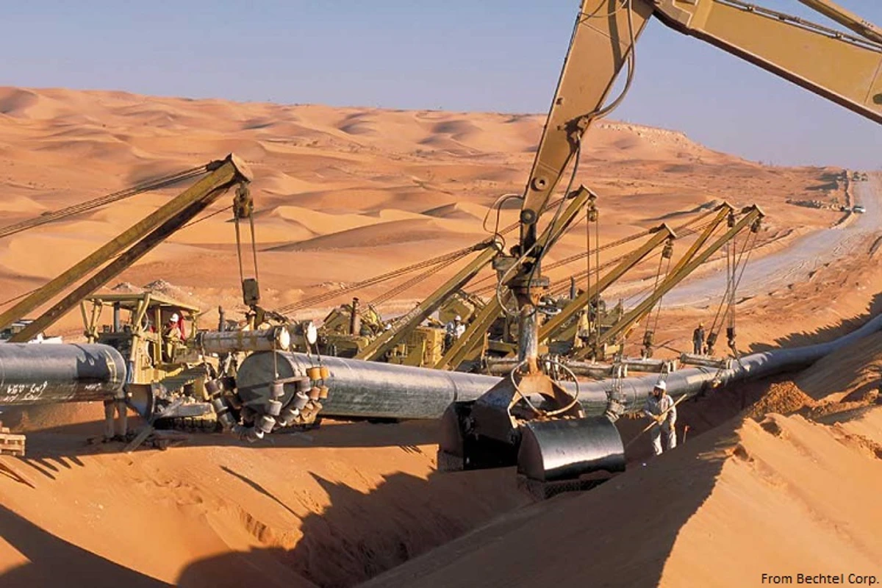
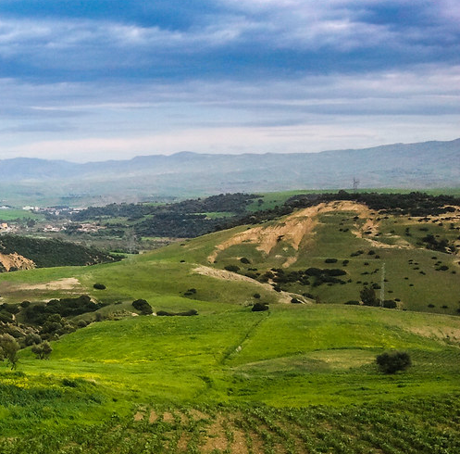
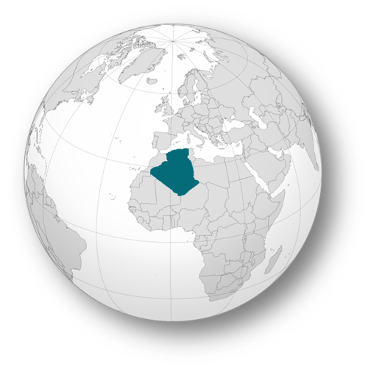
Algeria
A desert close to Europe
Algeria benefits from a mature gas network connected to Europe through Spain and Italy. Alongside this strong infrastructure, the country also holds vast renewable potential in the Sahara Desert.
31

Slide 32
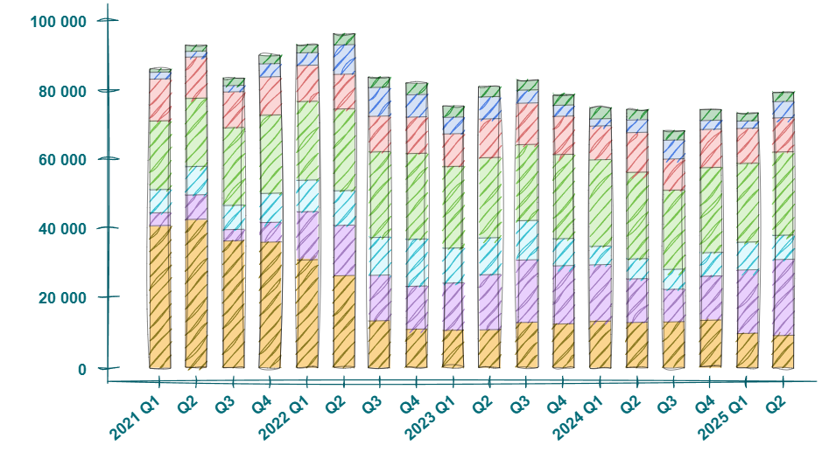
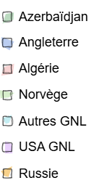
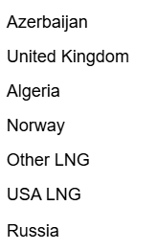
Algeria is directly connected to Spain by two gas pipelines: Medgaz (289 GWh/jour) and Maghreb–Europe Pipeline (347 GWh/day), deactivated since 2021^{[1]}. It also supplies Italy via the TransMed pipeline (954 GWh/day).
Natural gas imports (in million cubic meters) for European consumption^{[2]}.
[1] The Maghreb–Europe pipeline, which crosses Morocco, was deactivated in October 2021 following the breakdown of diplomatic relations between Algeria and Morocco.
[2] Figure adapted from European natural gas imports. (2025, September 3). The Brussels-based economic Think Tank. Bruegel.
32

Slide 33

The Algerian Sahara is one of the most intense solar regions in the world, with an average irradiation of 250 W/m².
Despite this potential, Algeria still produces most of its electricity from natural gas, mainly through Sonelgaz^{[1]}. A few pilot solar projects have emerged such as the Hassi R’Mel gas–CSP hybrid power plant (2011), but large-scale deployment remains limited.
The country has nevertheless expressed its ambition to harness its solar potential, aiming for 15 GW of installed capacity by 2035^{[2]}.
Why does a country with such exceptional solar potential attract so few renewable projects?
[1] Sonelgaz is the Algerian national electricity and gas company, responsible for power generation and distribution nationwide.
[2] Data from CleanTech. (2025, 14 Mai). Algeria solar PV market report: Policy update, market size, forecast 2025-2030.
33

Slide 34
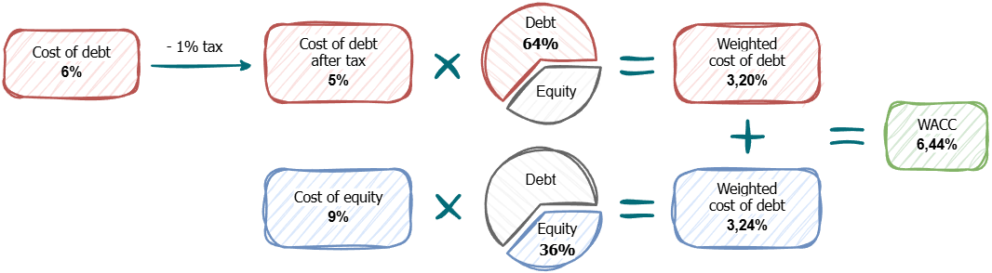
As mentioned in the introduction, a country’s economic, political, and regulatory stability directly affects its financing conditions (C4). This stability is reflected in the Weighted Average Cost of Capital (WACC), which combines two main components:
The cost of debt, corresponding to money borrowed from banks or financial institutions (usually reduced after tax);
The cost of equity, corresponding to the return expected by shareholders on the capital they invest.
Calculation of the cost of capital for renewable energies in the United States^{[1]}.
- 1% tax shield
[1] Figures from Damodaran. The data on the website are compiled from multiple sources and updated in January, 2025.
34

Slide 35
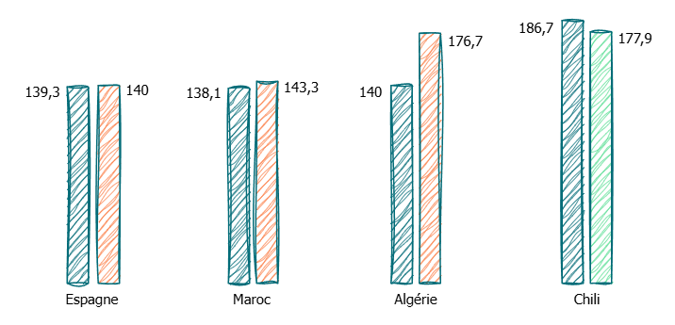
Each component is weighted according to its share in the project’s financing structure. The riskier a country is perceived to be, the higher the risk premium demanded by investors, which in turn increases the WACC.
A high WACC leads to more expensive financing and thus a higher production cost for e-fuels. Conversely, a stable and predictable framework lowers the cost of capital and improves the competitiveness of RREH projects.
Comparison of the Levelized Cost of Energy (€/MWh) with a constant WACC (7%) and with a location-specific WACC for e-methane export^{[1]}.
+ 26,2%
-4,7%
+ 0,5%
+ 3,8%
Spain
WACC: 7,1%
Morocco
WACC: 7,3%
Algeria
WACC: 10,7%
Chile
WACC: 6,3%
WACC: 10,7%
[1] Figure adapted from Dachet, V., Ooms, G., Lambert, M., & Ernst, D. (2025). On the importance of the cost of capital in the emergence of Remote Renewable Energy Hubs. ORBi-University of Liège.
35

Slide 36
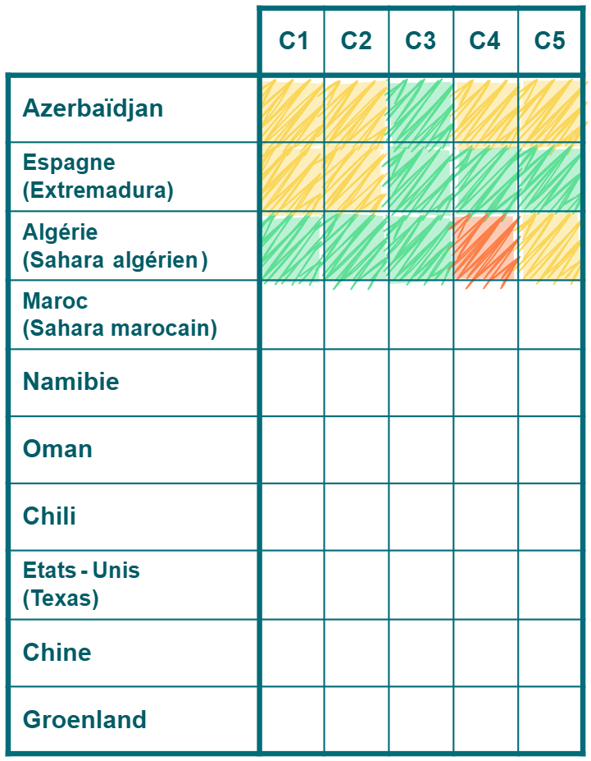
Assessment of an RREH in Algeria (Algerian Sahara)
🟢 C1 – Renewable potential
Very high solar potential.
🟢 C2 – Land availability
Very low population density;
Large desert areas available.
🟢 C3 – Existing infrastructure
Industrial ports with LNG terminals at Arzew and Skikda; Extensive gas network, adequate power grid.
🟠 C4 – Financing conditions and competitiveness
Challenging financing conditions, limited EU support outside gas;
High WACC.
🟡 C5 – Energy sovereignty
Major fossil gas supplier to Europe. Need to prioritize other RREHs for low-carbon imports or gradually replace part of fossil gas with decarbonized sources.
Azerbaijan
Spain
(Extremadura)
Algeria
(Algerian Sahara)
36

Slide 37

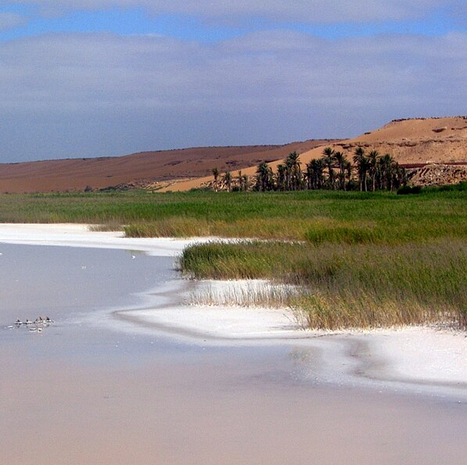
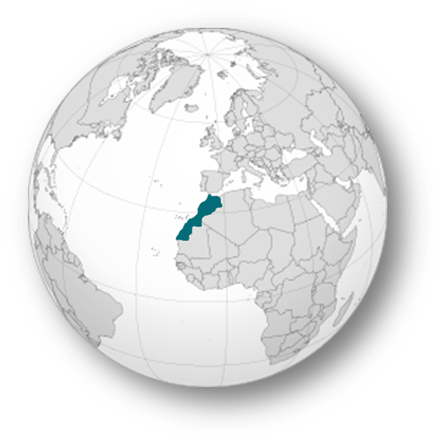
Morocco
A strategic relationship with Europe
Like Algeria, Morocco is connected to Europe through gas pipelines. It also benefits from direct electricity interconnections with Spain.
37

Slide 38
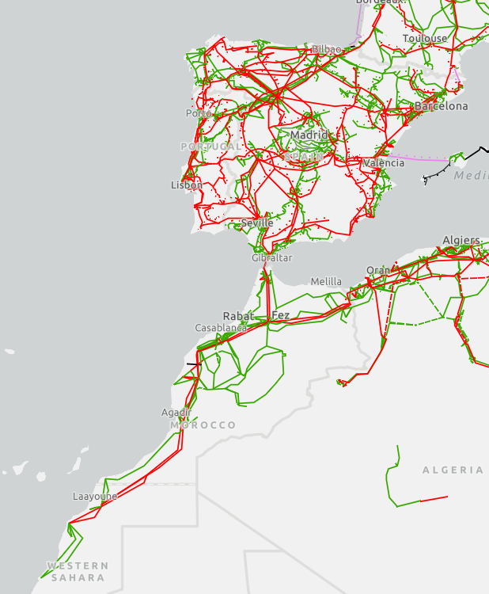
Electric grids in Morocco and Spain^{[1]}.
Morocco’s power grid is connected to Spain through two high-voltage alternating current (HVAC) submarine interconnectors, with a total capacity of 1,400 MW, crossing the Strait of Gibraltar.
The grid already extends as far south as Western Sahara, allowing in the future for renewable electricity generated there to be transmitted northward.
However, major reinforcements would be required to enable large-scale exports to Europe.
220 kV transmission line
380-400 kV transmission line
[1] Figure from Cassetti, G., & Annunziata, F. (2024). Setting the scene for an interconnected, renewable mediterranean energy system. ECCO.
38

Slide 39
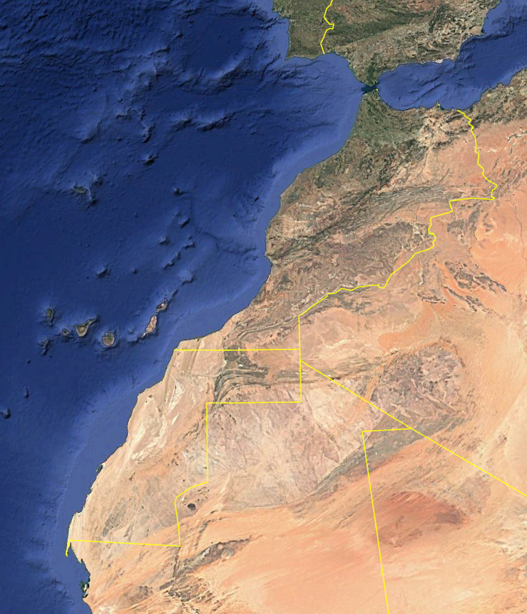

How large would a solar PV farm in the Moroccan Sahara need to be to cover the entire electricity demand of the EU?
The European Union’s average electricity consumption is 2,700 TWh/year. To meet this demand, around 4,500 km² of solar panels would be required, assuming a solar irradiance of 270 W/m² and a 25% capacity factor.
If we double this area to include roads and spacing between panels, the total footprint would represent about 3.4% of Western Sahara’s total surface area (266,000 km²).
Representation of a 9,000 km² solar PV farm.
39

Slide 40
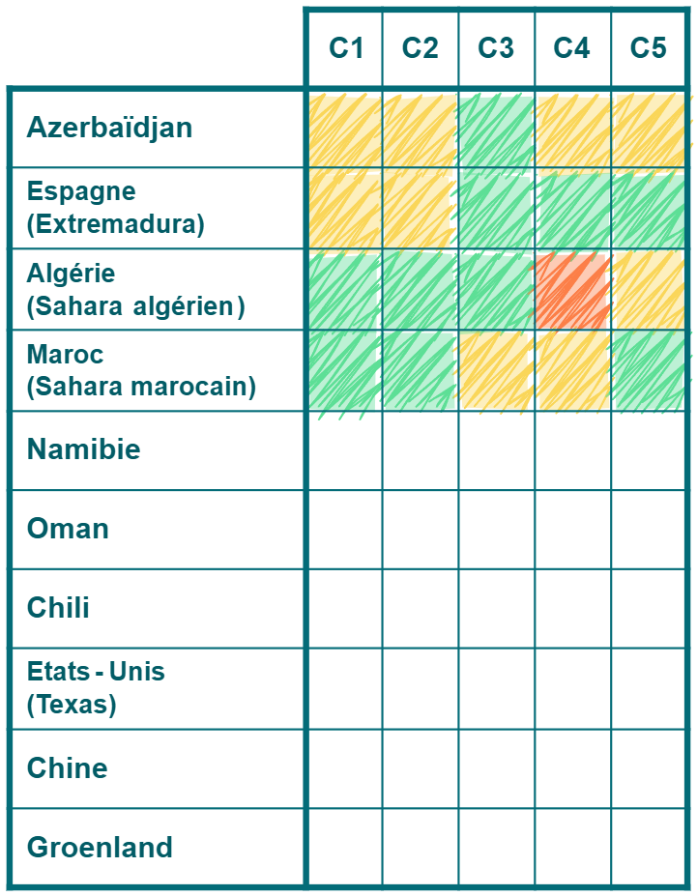
Assessment of an RREH in Morocco (Moroccan Sahara)
🟢 C1 – Renewable potential
Very high solar and wind potential.
🟢 C2 – Land availability
Very low population density;
Over 300,000 hectares identified for H₂ project^{[1]}.
🟡 C3 – Existing infrastructure
Tan-Tan port (southern Morocco) under modernization;
Limited gas network, but electricity grid interconnected with Spain.
🟡 C4 – Financing conditions and competitiveness
Strong financial support from the EU (EIB, KfW, REPowerEU).
🟢 C5 – Energy sovereignty
Advanced status under the European Neighbourhood Policy (ENP);
Contributes to diversifying energy sources and strengthens the EU’s energy security without creating excessive dependency.
Azerbaijan
Spain
(Extremadura)
Algeria
(Algerian Sahara)
Morocco
(Moroccan Sahara)
[1] Information from Bruneau J.,, & Tariki Z. (2024). Hydrogen law, regulations & strategy in Morocco. CMS.
40

Slide 41


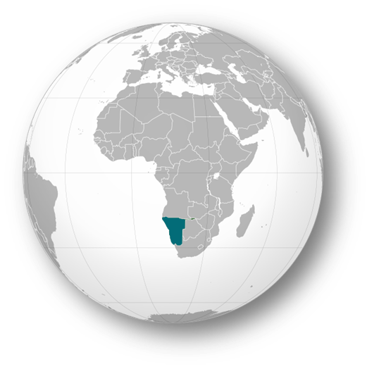
Namibia
The EU’s pilot e-hydrogen partner
Energy produced in an RREH can be transported as electricity or gas. Another option is to export it in the form of e-hydrogen or e-ammonia.
41

Slide 42

The volumetric energy density of hydrogen is very low. At atmospheric pressure, gaseous hydrogen contains about 3 kWh/m³, occupying roughly 3.5 times more volume than methane for the same energy content.
To reduce the transport volume, hydrogen can be converted into ammonia via the Haber–Bosch process^{[1]}, which offers a higher energy density.
1 m³ of methane_{(g)} contains ~10,5 kWh.
To obtain the same energy with hydrogen_{(g)} (~3 kWh/m³),
~3,5 m³ are needed.
With ammonia_{(g)} (~4,2 kWh/m³), ~2,5 m³ are needed.
[1] The Haber–Bosch process, developed in the early 20th century by Fritz Haber and Carl Bosch, synthesizes ammonia (NH₃) from nitrogen (N₂) and hydrogen (H₂) under high pressure (150–250 bar) and high temperature (400–500 °C).
42

Slide 43
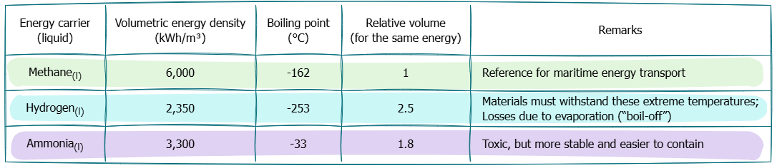
Pipeline or tanker transport mainly concerns energy carriers in liquefied form. In this state, the volumetric energy density increases significantly, but at the cost of stringent cryogenic conditions, especially for hydrogen liquefaction^{[1]}.
E-ammonia offers a good compromise: it liquefies easily, has a satisfactory energy density, and can be transported using infrastructure similar to that of LNG (Liquefied Natural Gas).
[1] Gases become liquid only when the intermolecular attractive forces (Van der Waals forces) are strong enough to hold the molecules together. Hydrogen, being a very light and simple molecule (two protons, two electrons), has extremely weak intermolecular forces. As a result, it requires very low temperatures for the molecules to stop repelling each other and condense into a liquid.
43

Slide 44

Once transported to the consumption center, e-ammonia can be used in two main ways:
Cracked back into hydrogen, which can then serve as a feedstock or energy carrier (overall efficiency of 52%);
Used directly for end-use applications such as nitrogen fertilizer production or marine fuel (overall efficiency of 69%).
Energy retained at each stage of the electricity → NH₃ → H₂ chain^{[1]}.
100%
Electrolysis
75%
Haber-Bosch
70%
Transport^{[2]}
69%
Cracking
52%
[1] Assumptions based on Spatolisano, E., Pellegrini, L. A., De Angelis, A. R., Cattaneo, S., & Roccaro, E. (2023). Ammonia as a carbon-free energy carrier: NH3 cracking to H2. Industrial & Engineering Chemistry Research, 62(28), 10813–10827.
[2] The logistical efficiency is generally assumed to be around 99%, as maritime transport losses of liquid NH₃ (evaporation, boil-off, refrigeration system consumption) remain low. Losses are <1% for short routes (Morocco–Europe, 2–3 days) but can reach 3–5% for long routes (Chile–Europe, 20–30 days).
44

Slide 45
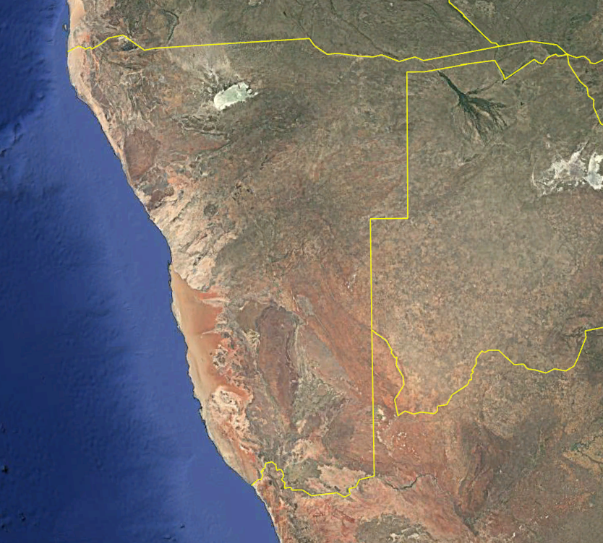
Namibia aims to become a global hub for e-hydrogen and e-ammonia production, leveraging its strong solar and wind potential as well as its strategic coastal location.
Three development poles have been identified (Lüderitz, Walvis Bay, and Cape Fria), each linked to port infrastructure projects designed to enable e-ammonia exports.
Lüderitz
Walvis Bay
Cape Fria
45

Slide 46
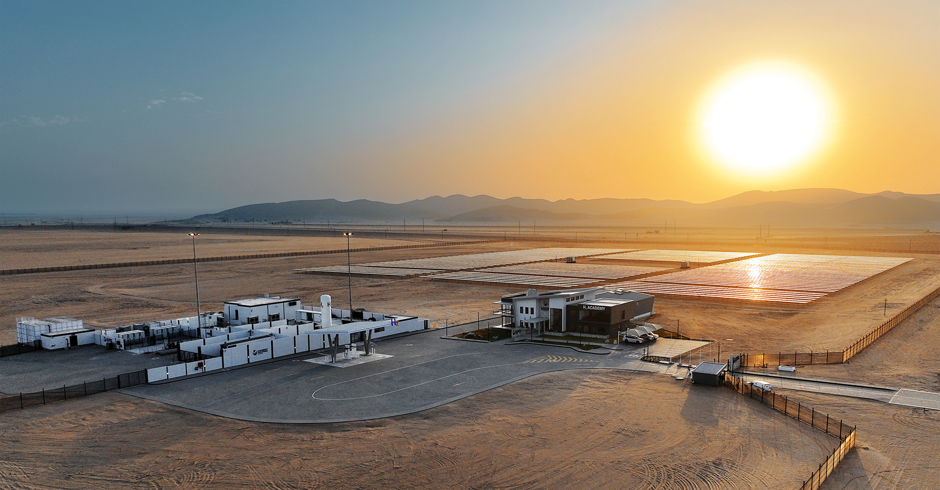

The Cleanergy Solutions Namibia project is a pilot site developed near Walvis Bay by CMB.Tech^{[1]} and the Namibian industrial group Ohlthaver & List.
It combines a 5 MW renewable installation with a 5 MW electrolyzer. A public hydrogen refuelling station is integrated on-site for local applications.
The project also hosts the H₂ Academy, which aims to develop the local skills needed for Namibia’s future e-hydrogen sector.
[1] CMB.Tech is a subsidiary of the Compagnie Maritime Belge (CMB) group, specializing in hydrogen applications. It develops dual-fuel (diesel/H₂) ships, ferries, and trucks, and leads hydrogen production and distribution projects in Antwerp, Amsterdam, and Namibia.
46

Slide 47

Assessment of an RREH in Namibia
🟢 C1 – Renewable potential
Very high solar and wind potential.
🟢 C2 – Land availability
Very low population density;
Large desert areas available.
🟠 C3 – Existing infrastructure
Small ports in Lüderitz, Walvis Bay, and Cape Fria;
No gas network, limited electricity grid.
🟡 C4 – Financing conditions and competitiveness
Financing supported by the EU (strategic partnership since 2022);
Significant logistical costs.
🟢 C5 – Energy sovereignty
Diversification of the EU’s energy partnerships beyond the Maghreb;
Bilateral hydrogen agreements with the EU strengthen long-term supply security.
Azerbaijan
Spain
(Extremadura)
Algeria
(Algerian Sahara)
Morocco
(Moroccan Sahara)
Namibia
47

Slide 48



Oman
Already on the path to e-hydrogen exports
Located between Rotterdam and Singapore, two of the world’s main liquefied natural gas (LNG) bunkering ports, Oman is well-positioned to become a major player in e-hydrogen exports.
48

Slide 49

Oman is multiplying projects related to e-hydrogen and e-ammonia, spread across several port areas.
Sohar : Existing petrochemical hub, with ongoing discussions to convert part of the facilities to e-hydrogen and derivative production.
Duqm : Port hosting the Hyport Duqm project, developed by OQ (Oman), DEME (Belgium), BP (United Kingdom), and Uniper (Germany). The project is progressing in phases, with a pilot electrolysis stage of 10–15 MW^{[1]}.
Salalah : SalalaH2 project aiming to produce around 1 Mt/year of green e-ammonia, currently in development with a Final Investment Decision (FID) expected around 2026^{[2]}.
Sohar
Duqm
Salalah
[1] Data from Prabhu, C. (2025, May 13). Oman’s OQAE plans e-hydrogen pilot in Duqm. Oman Observer.
[2] Data from Rouwenhorst, K. (2025, 26 Juin). SalalaH2: export-focused renewable mega-project targets FID in 2026. Ammonia Energy Association. The FID (Final Investment Decision) marks the point when investors and partners formally commit to the project’s construction.
49

Slide 50


The ports of Duqm and Salalah are rapidly expanding, surrounded by vast desert areas suitable for the installation of large-scale solar and wind capacities^{[1]}.
Duqm
Salalah
[1] The Hyport Duqm project covers an area of approximately 150 km² within the Special Economic Zone Authority at Duqm (SEZAD), including both the renewable production sites and adjacent industrial zones (Oman Observer, 2023).
50

Slide 51



What will these projects in Oman look like in the long run?
PV and wind installations supply power to electrolyzers producing e-hydrogen. This hydrogen is either converted into e-ammonia and exported through port terminals, or used locally to develop industries such as low-carbon steel production.
N₂
N₂
H₂
NH₃
NH₃
H₂O
51

Slide 52

Assessment of an RREH in Oman
🟢 C1 – Renewable potential
Very high solar and wind potential.
🟢 C2 – Land availability
Over 150,000 hectares identified for hydrogen projects.
🟡 C3 – Existing infrastructure
Ports of Sohar and Duqm under development;
Existing ammonia terminal at Salalah;
Developed gas pipeline network (4,000 km), fragmented electricity grid.
🟢 C4 – Financing conditions and competitiveness
Attractive region (BP, Uniper, Germany, Japan, India); Projected very low energy costs.
🟡 C5 – Energy sovereignty
Export potential for e-ammonia (see the Memorandum of Understanding on energy cooperation signed in May 2022 with the EU);
Export strategy targeting multiple markets, including Asia.
Azerbaijan
Spain
(Extremadura)
Algeria
(Algerian Sahara)
Morocco
(Moroccan Sahara)
Namibia
Oman
52

Slide 53



Chile
World’s first e-gasoline production
Hydrogen is not only used to produce e-ammonia for export. It can also be converted into methanol, a molecule primarily used in transport fuels.
53

Slide 54








Chile has seen the development of numerous solar and wind power plants, as well as the world’s first e-gasoline demonstration plant: the Haru Oni project, led by HIF (Highly Innovative Fuels).
CEME 1 PV plant (480 MW), 2024.
Haru Oni plant, 2022.
El Arrayán Wind plant (115 MW), 2014.
54

Slide 55

At Haru Oni, e-gasoline production relies on wind power that feeds an electrolyzer to produce e-hydrogen. This hydrogen is then combined with CO₂ to form e-methanol, which is subsequently converted into e-gasoline.
The plant has a production capacity of 130,000 liters of e-gasoline per year, equivalent to 1,157 MWh^{[1]}.
[1] Data from HIF Global. (2021). Haru Oni: A large-scale e-Fuels production project in Chile. The value in MWh is calculated based on a gasoline lower heating value (LHV) of 8.9 kWh per liter.
55

Slide 56

Today, the CO₂ used at Haru Oni mainly comes from local biogenic sources, such as industrial by-products (for example, brewery fermentation)^{[1]}.
In the long term, the site plans to adopt Direct Air Capture (DAC), a technology that extracts CO₂ directly from the atmosphere to produce low-carbon fuel.
[1] Information from the official HIF Global website.
Figure adapted from Dutch Energy Solutions (2021, September 26). Siemens Energy - Haru Oni Project. Dutch Energy Solutions.
56

Slide 57


DAC is a recent technology: while its chemical principles have been known for several decades, large-scale systems have only emerged recently.
The world’s largest DAC site, Mammoth, was commissioned in Iceland in 2024 by Climeworks, with a reported capacity of 36,000 tons of CO₂ per year^{[1]}.
Mammoth DAC plant in Hellisheiði, Iceland^{[2]}.
[1] Data from Climeworks AG. (2024, February 29). Climeworks switches on world’s largest direct air capture plant.
[2] The CO₂ captured by the Mammoth plant is intended for geological sequestration rather than e-fuel production..
57

Slide 58


Porsche is the main investor in the Haru Oni project. It plans to use e-gasoline primarily in motorsport, to demonstrate the potential of synthetic fuels in combustion-engine competitions.
However, motorsport is already shifting toward electrification: in 2018, the fully electric VW I.D. R driven by Romain Dumas set a new record at Pikes Peak with a time of 7 min 57.148 s, beating all combustion engines.
Porsche 911^{[1]}.
VolksWagen I.D. R.
[1] By the end of 2023, during testing, a modified Porsche 911 successfully climbed the highest volcano in Chile using e-gasoline produced at Haru Oni.
58

Slide 59

Assessment of an RREH in Chile
🟢 C1 – Renewable potential
Very high solar and wind potential.
🟢 C2 – Land availability
Very low population density;
Atacama Desert area available.
🟡 C3 – Existing infrastructure
Industrial ports with LNG terminals in Valparaíso and Antofagasta;
Limited gas network, electricity grid not interconnected with neighbouring countries.
🟢 C4 – Financing conditions and competitiveness
Support from Germany/EU;
One of the most competitive, despite being far from the EU.
🟡 C5 – Energy sovereignty
Strong cooperation with Germany;
Export strategy targeting multiple markets, including the Americas and Asia.
Azerbaijan
Spain
(Extremadura)
Algeria
(Algerian Sahara)
Morocco
(Moroccan Sahara)
Namibia
Oman
Chile
59

Slide 60



The United States
Emerging leader in e-SAF
The state of Texas combines a vast industrial network with access to the Gulf of Mexico. It is home to the Pathfinder Project, which is the world’s first commercial e-SAF (Sustainable Aviation Fuel) plant.
60

Slide 61


The Pathfinder Project produces e-diesel, e-naphtha, and e-SAF. It was launched by Infinium in 2023. CO₂ capture is carried out from the flue gases of a nearby industrial facility (Howard Energy Partners)^{[1]}.
The captured CO₂ is then purified and reused as a feedstock for e-fuel synthesis.
Pathfinder
Project
Howard Energy Partners.
[1] Information from Infinium. (2025, May 12). Infinium’s Project Pathfinder is world’s first fully operational e-fuels facility.
61

Slide 62


E-SAF is currently the best solution to decarbonize aviation, as it has the same properties as fossil kerosene and can be used in existing engines.
Concept. Airbus ZEROe project.
Hydrogen aircraft:
Replacing the 76,860 liters of kerosene used by a Boeing 747 on a New York–Brussels flight would require about 283,000 liters of liquid hydrogen. The low volumetric energy density of hydrogen would demand enormous tanks.
Electric aircraft:
Current batteries store 270 Wh/kg, compared to 12,000 Wh/kg for kerosene. Even with future batteries reaching 1,000 Wh/kg, their range would still be limited to 3,000 km, far from the 7,838 km needed for a New York–Brussels flight.
E22 Spark, Infinitus Aero, 2023.
[1] Data from course notes: Ernst, D. (2025, June 6). Energy and sustainable development.
62

Slide 63

Let us imagine replacing all fossil kerosene consumption in the United States with e-SAF produced from PV electricity in Texas. What surface area of solar PV farm would be required to cover the daily needs of the U.S. aviation sector?
Let us assume the following:
The U.S. aviation sector consumes 1.7 million barrels of kerosene per day;
Each barrel contains 1.6 MWh of energy;
PV panels in Texas produce an average of 50 W/m²;
The electricity → e-SAF conversion efficiency is 50 %;
The total farm area is doubled compared to the PV panel surface to account for pathways, spacing, and maintenance zones.
Under these assumptions, the total PV farm area would be approximately 9,000 km², or 1.2 % of the surface area of the state of Texas.
[1] Exercise adapted from course notes: Ernst, D. (2025, June 6). Energy and sustainable development.
63

Slide 64

The Infinium’s second plant Roadrunner Project is under construction in Texas. It will produce the equivalent of around 495 barrels per day, which represents only 0.03% of the U.S. aviation sector’s daily fuel consumption (1.7 million barrels/day)^{[1]}.
This serves as technical proof of concept for the e-fuel industry, but a massive scale-up of such projects will be required to reach meaningful volumes.
[1] A capacity of 23,000 tons per year is announced for Project Roadrunner. Assuming a kerosene density of 0.8 kg/L, this corresponds to approximately 495 barrels per day (1 barrel = 159 liters).
64

Slide 65

Assessment of an RREH in the United States (Texas)
🟢 C1 – Renewable potential
Very high solar and wind potential.
🟡 C2 – Land availability
Low population density;
Less available land compared to other regions in our analysis.
🟢 C3 – Existing infrastructure
Ports with LNG terminals at Quintana Island and Cheniere; Deepwater ammonia terminal in Houston;
Highly developed gas network, ERCOT electric grid.
🟢 C4 – Financing conditions and competitiveness
IRA funding and abundant capital, no EU support;
Very low costs.
🟠 C5 – Energy sovereignty
Capable of exporting e-fuels on a large scale, but production will primarily serve the domestic market.
Azerbaijan
Spain
(Extremadura)
Algeria
(Algerian Sahara)
Morocco
(Moroccan Sahara)
Namibia
Oman
Chile
The United States
(Texas)
65

Slide 66



China
Toward the creation of giant RREHs
China is deploying a massive decarbonization strategy based on the development of RREHs within its own territory, combining vast PV and wind farms.
66

Slide 67



Most of China’s electricity demand and major consumption centers are located in the east, along the industrial coast. Conversely, the country’s largest renewable resources are found in the northwest, where wind and solar conditions are most favourable.
One notable example is the Gansu wind farm, with a current installed capacity of around 10 GW. The complex includes over 7,000 wind turbines spread across an area of approximately 39,000 km².
Gansu
Gansu wind farm (10,45 GW), 2025.
67

Slide 68


At first, a very large share of the electricity generated in Gansu was not used, due to insufficient transmission capacity or local demand. In 2015, up to 39% of wind power production was curtailed (not fed into the grid) because of transmission network limitations.
To address this issue, China built a 2,383 km ultra high-voltage direct current (UHVDC) line connecting Jiuquan to Hunan Province, enabling better integration of production into the main grid.
Gansu
Jiuquan converter station.
68

Slide 69



In 2024, a 3.5 GW solar PV farm was commissioned in the Xinjiang region, covering about 133 km².
It is connected to the grid through the Changji–Guquan line, an UHVDC link capable of transmitting up to 12 GW over 3,324 km at a voltage of 1.1 million volts^{[1]}.
Changji–Guquan line, 2018.
Xinjiang
Xinjiang PV farm (3,5 GW), 2024.
[1] Information from NS Energy. (2020, February 24). ). Changji-Guquan UHVDC Transmission Project.
69

Slide 70

These UHVDC lines fit into an even more ambitious vision: the Global Grid, a concept introduced in 2013 by Spyros Chatzivasileiadis, Damien Ernst, and Göran Andersson^{[1]}.
They proposed the creation of a worldwide electricity network connecting producers and consumers across continents through terrestrial and submarine UHVDC backbones.
The State Grid Corporation of China (SGCC) later took up this idea, structuring and promoting this planetary interconnection^{[2]}.
By linking RREHs to major consumption centers, the Global Grid would:
smooth fluctuations in renewable electricity generation and demand at the global scale;
reduce the overall cost of renewable electricity.
[1] More information: Chatzivasileiadis, S., Ernst, D., & Andersson, G. (2013). The global grid. Renewable Energy, 57, 372-383.
[2] Additional information on SGCC’s international investments:: https://eng.yidaiyilu.gov.cn/stategrid.htm
70

Slide 71

Assessment of an RREH in China
🟢 C1 – Renewable potential
Very high solar and wind potential.
🟢 C2 – Land availability
Very low population density in some regions;
Desert areas available.
🟢 C3 – Existing infrastructure
Extensive port network with LNG terminals;
Rapidly expanding gas network and the largest power grid in the world.
🟢 C4 – Financing conditions and competitiveness
Strong state-backed financing, no EU support;
Very low costs.
🟠 C5 – Energy sovereignty
China is deploying a decarbonization strategy focused on its domestic market. The production of e-fuels primarily aims to meet its own industrial and energy demand.
Azerbaijan
Spain
(Extremadura)
Algeria
(Algerian Sahara)
Morocco
(Moroccan Sahara)
Namibia
Oman
Chile
The United States
(Texas)
China
71

Slide 72



Greenland
An exceptional yet isolated wind potential
The Global Grid concept makes it possible to envision RREHs in remote locations. A backbone connecting Europe and the United States could harness and export Greenland’s exceptional wind resources.
72

Slide 73


In Greenland, the wind potential is exceptional thanks to katabatic winds.
These cold winds, formed by air descending from glaciers toward coastal areas, are both powerful and steady, creating ideal conditions for wind power generation.
A potential capacity factor of over 65% has been estimated in southern Greenland based on simulated meteorological conditions^{[1]}.
Cold air layer over the ice.
Warmer air layer over the ocean.
Acceleration up to 300 km/h.
Katabatic winds formation.
[1] More information in: Lambin, C., Fettweis, X., Kittel, C., Fonder, M., & Ernst, D. (2022, May 25). Long term wind speed and wind power change analysis over South Greenland using the regional climate model MAR. EGU 2022.
73

Slide 74


In 2020, the Katabata Project was organized by a team from the University of Liège^{[1]}.
It involved the installation of three AWS310 meteorological stations in southeastern Greenland to collect in situ wind data.
Xavier Fettweis, Michaël Fonder and Damien Ernst.
One of the AWS310 stations.
[1] More information in Radu, D.-C., Berger, M., Fonteneau, R., Hardy, S., Fettweis, X., Le Du, M., Panciatici, P., Balea, L., & Ernst, D. (2019). Complementarity assessment of South Greenland katabatic flows and West Europe wind regimes. Energy, 175, 393-401.
74

Slide 75




Some photos from the Katabata Project expedition
75

Slide 76

Assessment of an RREH in Greenland
🟢 C1 – Renewable potential
Very high wind potential.
🟢 C2 – Land availability
Very low population density;
Large areas of available land.
🟠 C3 – Existing infrastructure
Modest-sized port in Nuuk;
No gas network, very limited electrical grid.
🟡 C4 – Financing conditions and competitiveness
Financing dependent on Denmark/EU;
Uncertain economic feasibility, as no major industrial projects exist yet.
🟢 C5 – Energy sovereignty
Politically stable territory closely linked to Denmark.
Azerbaijan
Spain
(Extremadura)
Algeria
(Algerian Sahara)
Morocco
(Moroccan Sahara)
Namibia
Oman
Chile
The United States
(Texas)
China
Greenland
76

Slide 77
Conclusion of the assessment

Slide 78

No region scores green across all criteria. The “perfect” RREH for the Blue Banana does not exist among those considered.
However, the Blue Banana could enhance its energy supply security by diversifying its sourcing across several RREHs, while leveraging the specific strengths of each.
Let us end this presentation by emphasizing that beyond being a remarkable tool for decarbonizing our economies, RREHs also hold the potential to:
strengthen energy interconnections between continents;
foster technological cooperation;
stimulate regional industrial ecosystems built around e-fuels;
reshape global energy dynamics.
78

Slide 79

But why limit ourselves to land-based RREHs?
One could imagine, for instance, a mobile floating structure equipped with a wind turbine. The electricity produced would directly power an integrated mini-plant synthesizing green hydrogen stored onboard. A tanker ship would then come to collect the hydrogen and transport it to shore.
79

Slide 80
Laboratory references (1/2)
Mokeddem, S., Miftari, B., Dachet, V., Derval, G., & Ernst, D. (2025). Distributed e-fuel hubs: Concept and case study. ORBi-University of Liège.. https://hdl.handle.net/2268/327044
Ernst, D., Dachet, V., Larbanois, A., Mokeddem, S., & Vassallo, M. (2025). Le monde de l’énergie : des problèmes, mais toujours des solutions. Conférence donnée dans le cadre d’un événement organisé par Phoenix Contact, Namur, Belgium. https://hdl.handle.net/2268/332008
Dachet, V., & Ernst, D. (2025). Remote Renewable Energy Hub: a concept for improving energy security. Working session on decarbonization between the Walloon Parliament (Belgium) and the Parliament of North Rhine Westphalia (Germany), Namur, Belgium. https://hdl.handle.net/2268/329187
Dachet, V., Maio, A., Counotte, P., & Ernst, D. (2025). Remote renewable energy hubs in the high seas: A battery-based fully-electric ecosystem. ORBi-University of Liège. https://hdl.handle.net/2268/327232
Dachet, V., Dubois, A., Miftari, B., Fonteneau, R., & Ernst, D. (2024, December 19). Remote Renewable Energy Hubs: a Taxonomy. Energy Reports, 13, 3112-2120. https://hdl.handle.net/2268/309761
Dachet, V., Benzerga, A., Coppitters, D., Contino, F., Fonteneau, R., & Ernst, D. (2024). Towards CO2 valorization in a multi remote renewable energy hub framework with uncertainty quantification. Journal of Environmental Management, 363, 121262. https://hdl.handle.net/2268/309679
Dachet, V., Lokotar, I., & Ernst, D. (2024). Les Centres d’Énergie Renouvelable Distants (CERD). Une opportunité de leadership que l’Europe doit saisir. Confrontations Europe. https://hdl.handle.net/2268/318391
80

Slide 81
Laboratory references (2/2)
Dauchat, L., Dachet, V., Fonteneau, R., & Ernst, D. (2024). Waste heat recovery in remote renewable energy hubs. Proceedings of ECOS 2024 - The 37th International Conference on Efficiency, Cost, Optimization, Simulation and Environmental Impact of Energy Systems, Rhodes, Greece. https://hdl.handle.net/2268/313825
Fonder, M., Counotte, P., Dachet, V., de Séjournet, J., & Ernst, D. (2024, March 15). Synthetic methane for closing the carbon loop: Comparative study of three carbon sources for remote carbon-neutral fuel synthetization. Applied Energy, 358. https://hdl.handle.net/2268/307481
Lambin, C., Fettweis, X., Kittel, C., Fonder, M., & Ernst, D. (2022). Assessment of future wind speed and wind power changes over South Greenland using the MAR regional climate model. International Journal of Climatology. https://hdl.handle.net/2268/288534
Berger, M., Radu, D.-C., Detienne, G., Deschuyteneer, T., Richel, A., & Ernst, D. (2021). Remote renewable hubs for carbon-neutral synthetic fuel production. Frontiers in Energy Research. https://hdl.handle.net/2268/250796
Radu, D.-C., Berger, M., Fonteneau, R., Hardy, S., Fettweis, X., Le Du, M., Panciatici, P., Balea, L., & Ernst, D. (2019). Complementarity assessment of South Greenland katabatic flows and West Europe wind regimes. Energy, 175, 393-401. https://hdl.handle.net/2268/230016
Chatzivasileiadis, S., Ernst, D., & Andersson, G. (2013). The global grid. Renewable Energy, 57, 372-383. https://hdl.handle.net/2268/144423
81

