Slide 1
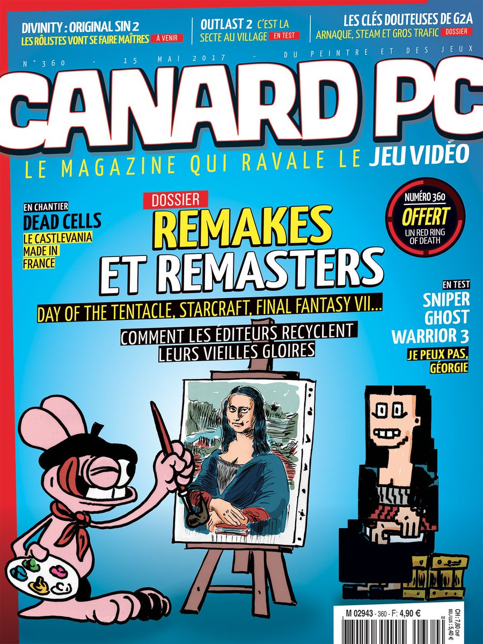
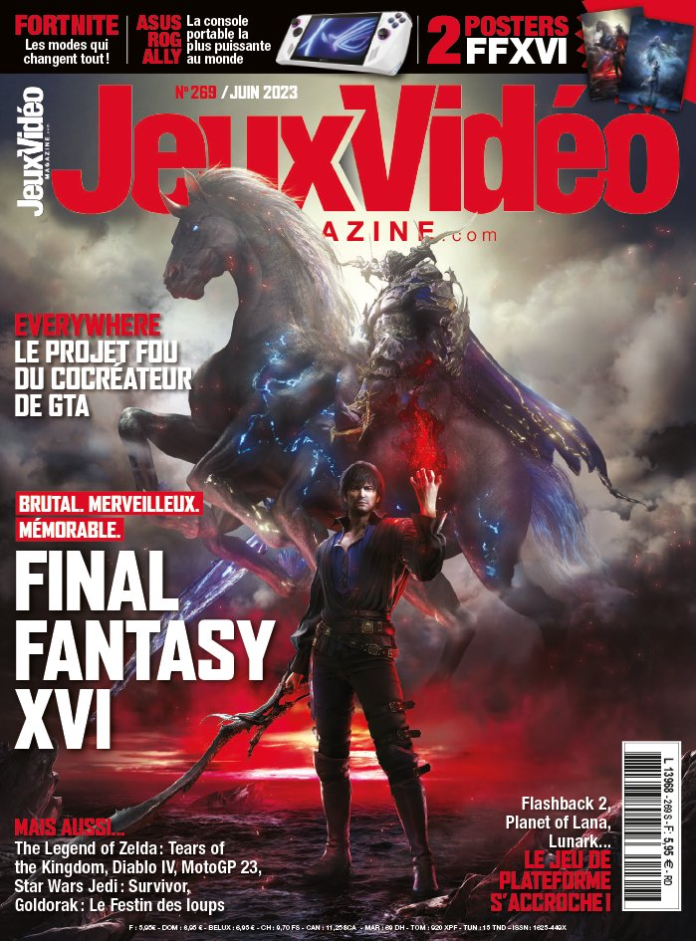
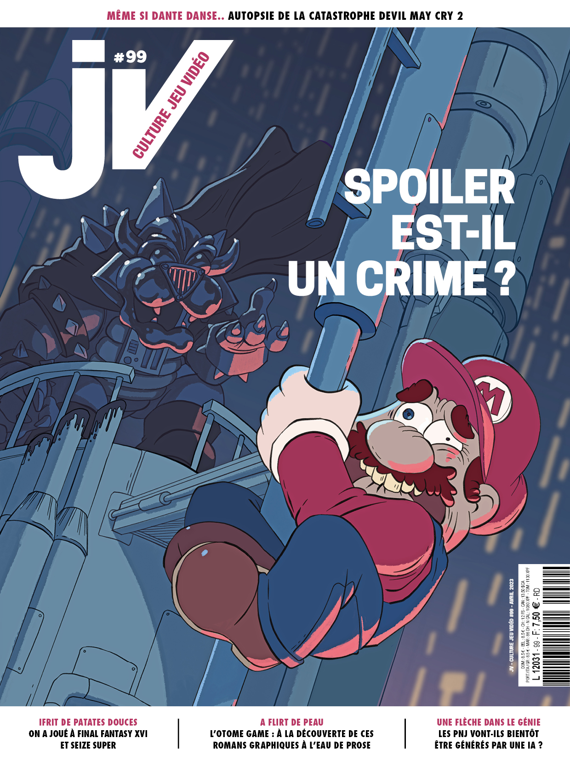
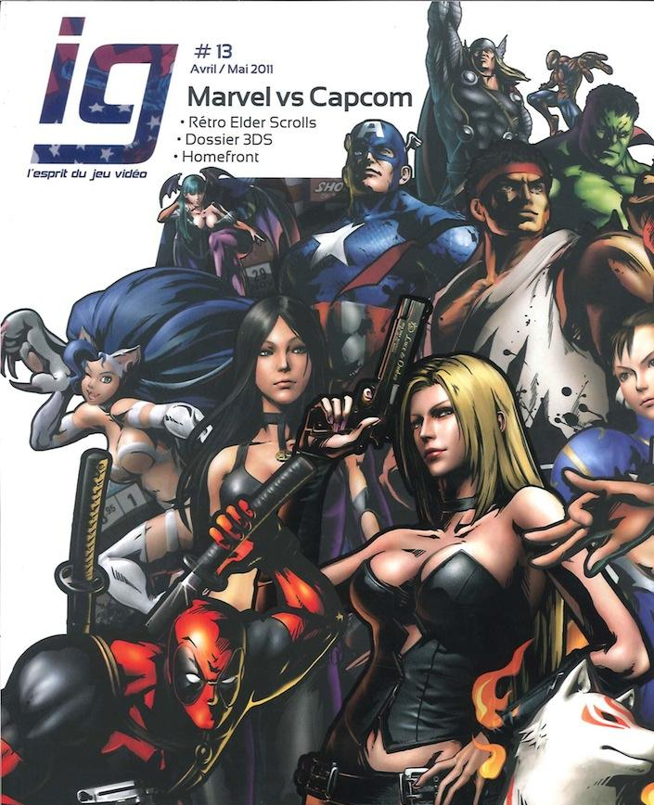
Reinventing Magazine Ethos in Times of Crisis
The Case of French Videogame Journalism
Boris KRYWICKI - Université de Liège, Liège Game Lab
Notes:
Hello everyone, and thank you to the organizers for this opportunity. My research focuses on the French video game press, and today I’ll show how these magazines reinvented their ethos during a time of crisis.

Slide 2

How magazines were forced to adapt
The digitization and consolidation of media industries have profoundly reshaped the magazine format, threatening its physical presence and undermining traditional economic models. Once central to the construction of niche communities, magazines must now assert their relevance in a media ecosystem dominated by real-time information flows and a culture of free access (Sonnac, 2009). This transformation is especially acute in marginalized subfields like videogame journalism, which has long been criticized for its perceived lack of independence and professionalism (Nieborg and Sihvonen, 2009).
Notes:
The digitization and consolidation of media industries have profoundly reshaped the magazine format, threatening its physical existence and undermining traditional economic models. Once central to building niche communities, magazines now operate in an ecosystem dominated by real-time news and free access. This shift is especially visible in marginalized fields like video game journalism, long criticized for its dependence on industry actors.

Slide 3

Video game press’ resurrection
We analyze three key dynamics of this reinvention:
editorial narratives that frame the subfield as undergoing renewal
(2) explicit critiques of industry actors, especially in coverage of professional trade shows, which typically reproduce hagiographic representations (Carlson, 2009)
(3) a conscious refusal of exhaustive coverage in favor of targeted, high-value content, allowing journalists to assert an adaptive role.
Notes:
My argument is that the resilience of these magazines lies not in their material form but in the capacity of their journalists to reinvent their professional identity. I’ll focus on three dynamics of this reinvention:
Editorial narratives framing the field as undergoing renewal.
Explicit critiques of the video game industry.
A shift from exhaustive to high-value, selective coverage.

Slide 4
Research question and Method
Research question : Can structural constraints become an opportunity for journalists to reaffirm their occupational ideology (Deuze, 2005) ?
Method : Close reading of 700+ articles of 19 french video game magazines (during my PhD ; see Krywicki, 2022 and 2024) and interviews with 14 journalists.
Notes:
This study combines close reading of over 700 articles from 19 French magazines with 14 interviews of video game journalists. Through this material, I examine how journalists, combining both gaming and journalistic capital, turned structural constraints into opportunities for editorial agency. Their approach aligns with Deuze’s idea of a redefined “occupational ideology,” one that favors critical engagement over mere product coverage.

Slide 5
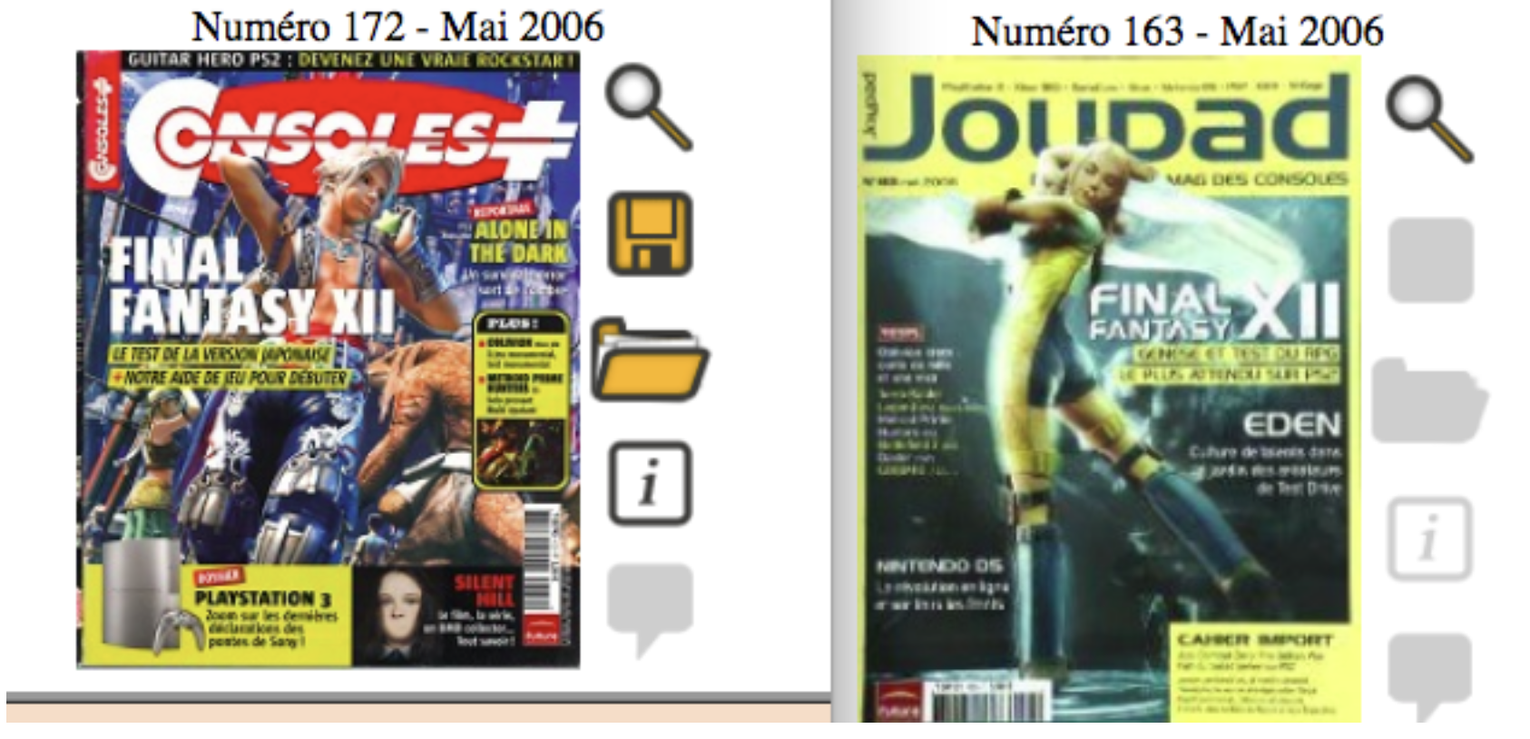
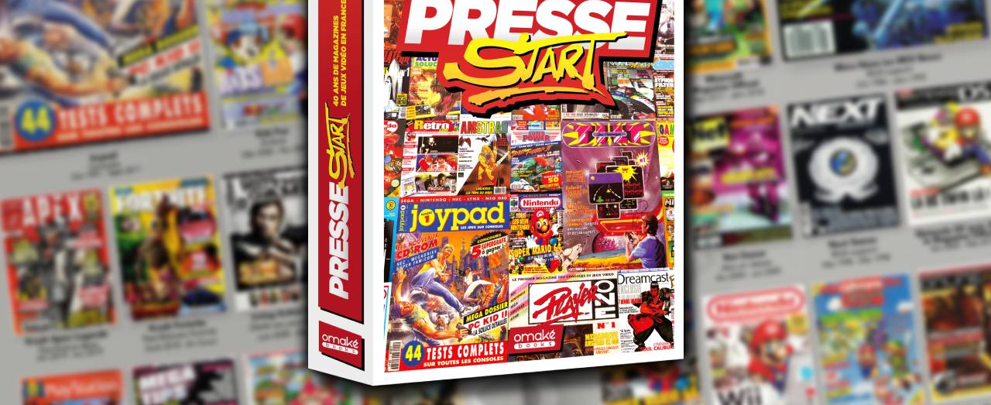




A former central actor in french video game press
Covers of Consoles + and Joypad (both published by Future France) in May 2006, presenting the same game
Notes:
To understand this renewal, we must start with the publishing group Future France. From 1992 to 2012, this company—successively known as Edicorp, Future France, Yellow Media, and M.E.R.7—dominated the French video game press. By the mid-2000s, it had absorbed rivals like Joystick, Joypad, and Consoles +, achieving near-monopoly.

Slide 6
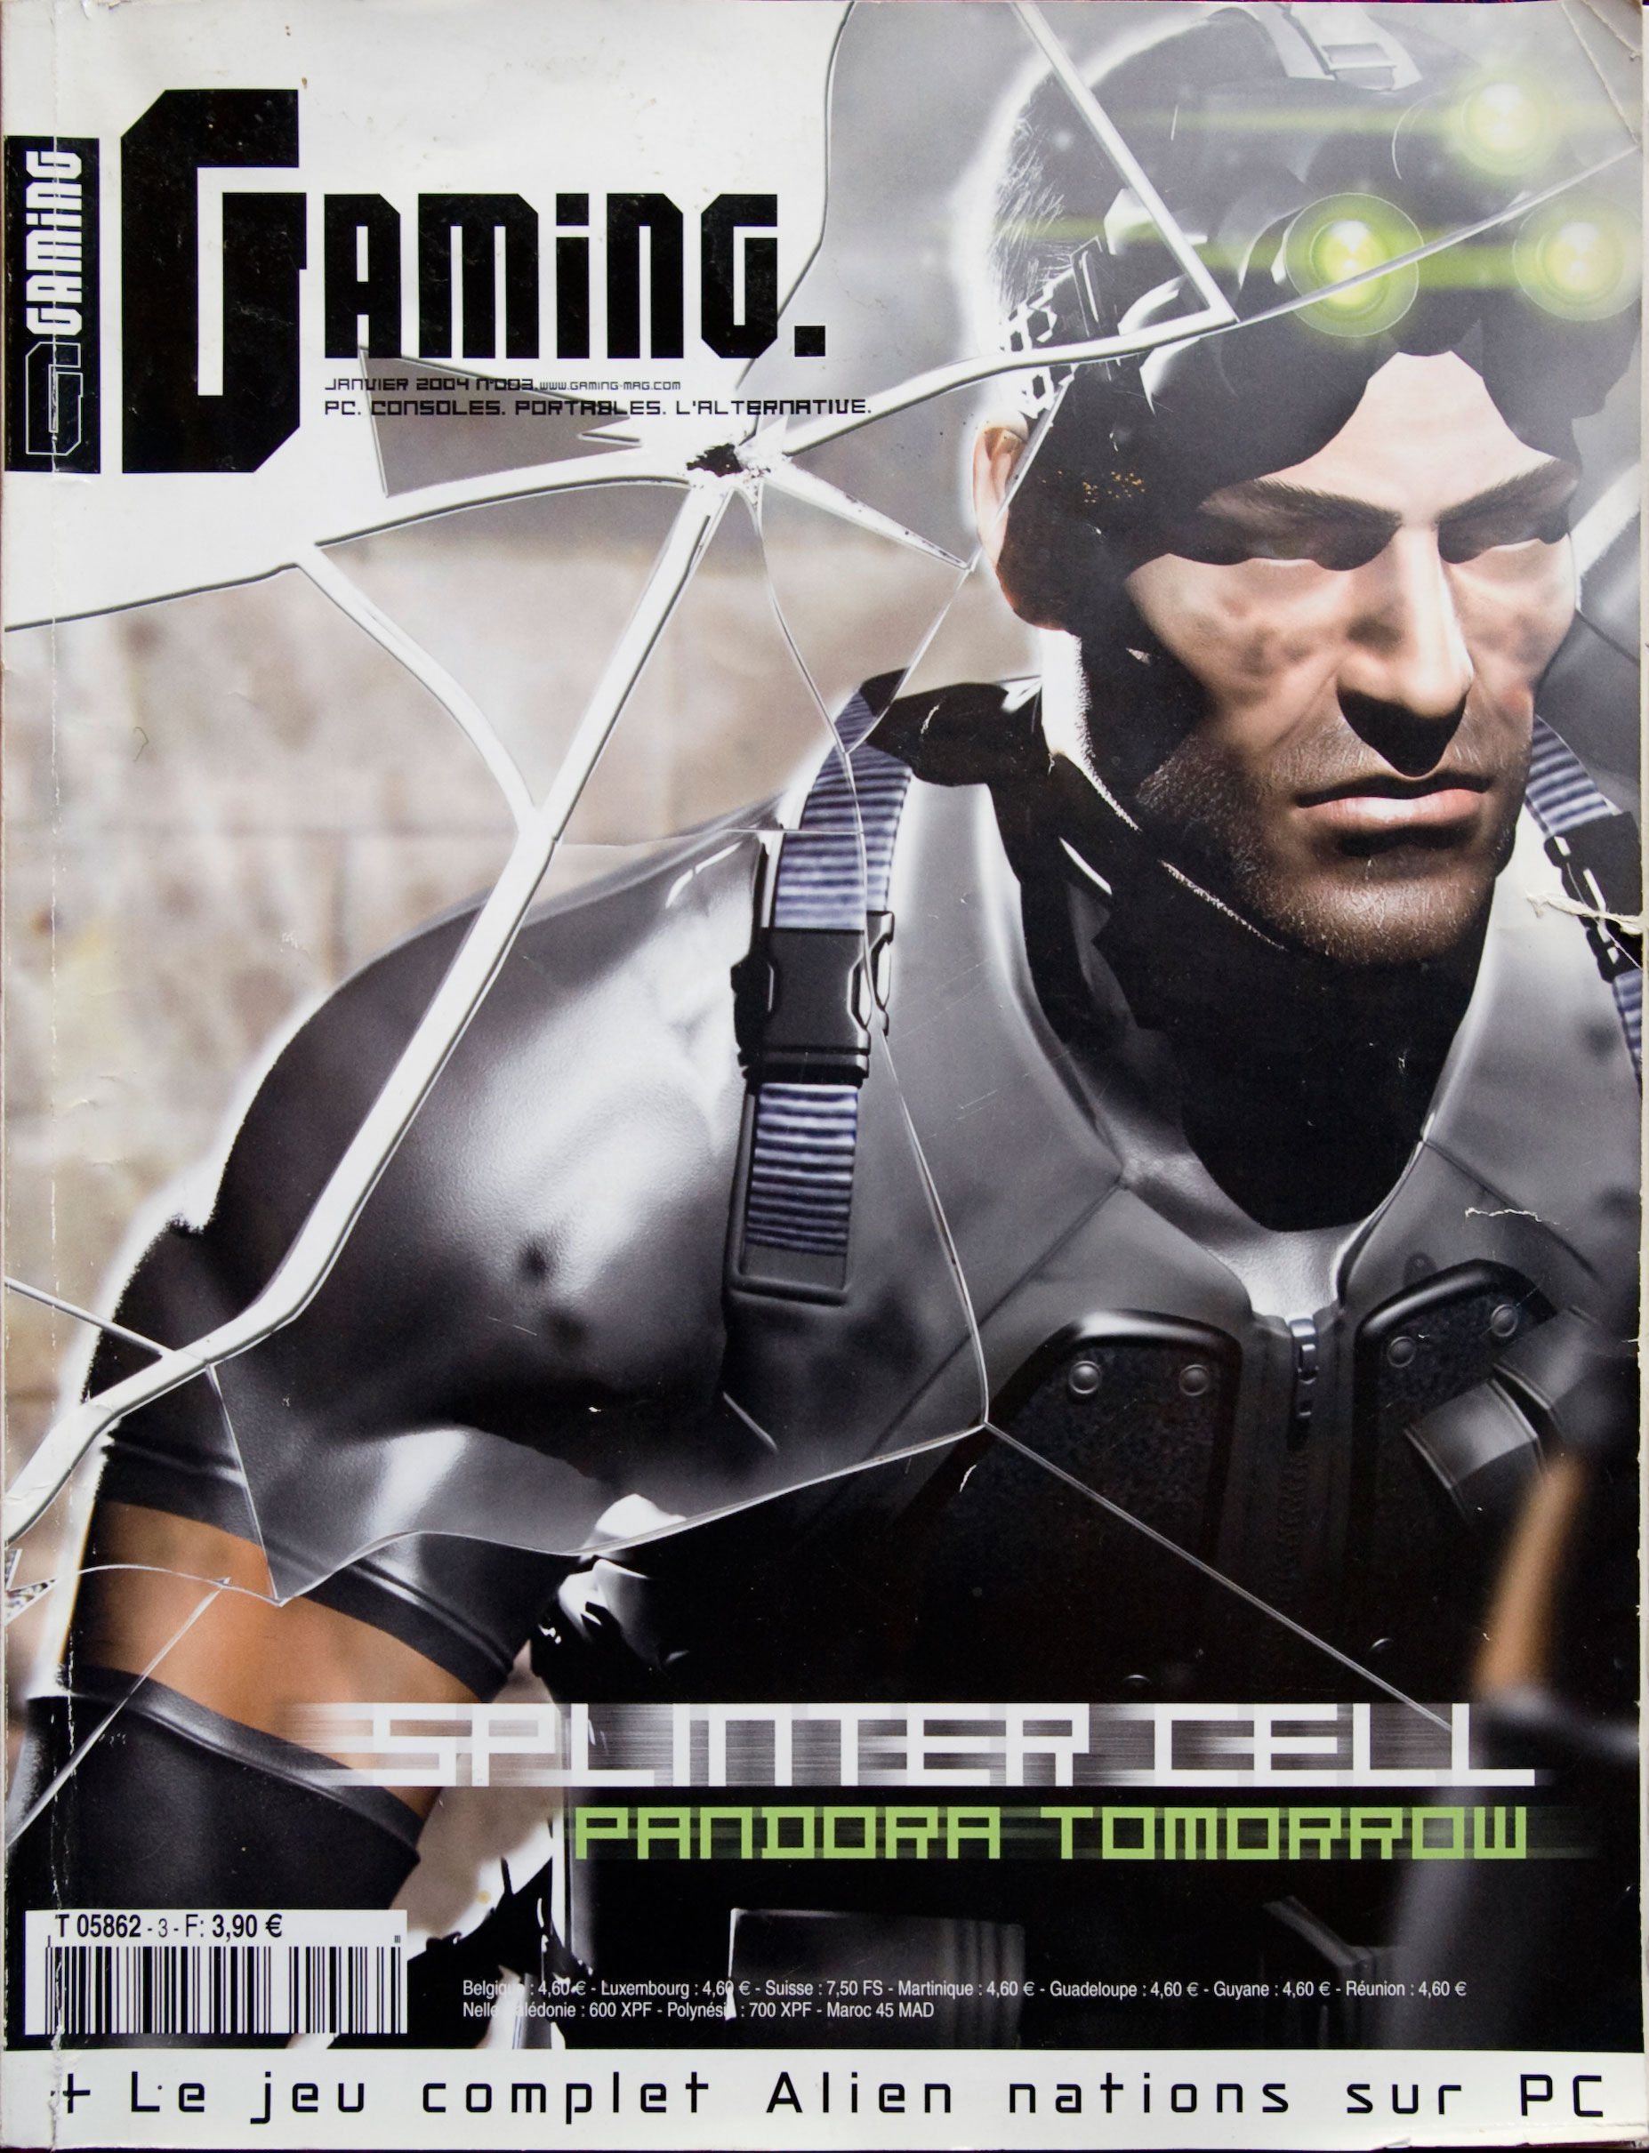



Independent Media Reborn from the ashes of Future France
Notes:
But this concentration led to homogenized content, marketing-driven policies, and the alienation of veteran journalists. Financial decline and failed digital ventures eventually caused its closure in 2012. Yet, this collapse became a turning point: disillusioned journalists founded Canard PC, Gameblog, and JV, ushering in a new era of pluralism and independence.

Slide 7
Media (format) | Launch date | Company | Main shareholders and/or founders at launch
Gaming (print) | November 2003 | Neo Publishing | Gondwana Invest, holding company of Olivier Scamps (former editor-in-chief of Joystick, Joypad and PlayStation Magazine)
Canard PC (print) | 26 November 2003 | Presse Non-Stop | Ivan Gaudé, Michaël Sarfati, Jérôme Darnaudet and Olivier Peron (all ex-Joystick)
Gameblog (web) | 20 February 2007 | Presse Start | Nourdin Nini, Julien Chièze, Julien Hubert, Angel Davila, Grégory Szriftgiser and Arnaud Chaudron (all ex-Joypad/Joystick/PlayStation Magazine)
VideoGamer (print) | December 2012 | Nickel Media | Didier Macia (co-founder of Edicorp Publications, former publishing director of PC Jeux and Xbox, the official magazine)
JV (print) | November 2013 | Wildfire Media | Bruno Pennes (ex-JVN.com)
Jeux Vidéo News (print) | July 2014 | Nickel Media | Didier Macia (see VideoGamer)
The Game (print) | August 2014 | Link Digital Spirit | Jean-François Morisse, Brice N’Guessan, Laurent Guillemaîn (all ex-Future), Alain Georges (LVA Publishing, specialized in automobiles)
Notes:
These new outlets used tone as both an aesthetic and ethical stance. Irony, informality, and appeals to independence became tools to signal authenticity and regain credibility. Canard PC and Gaming presented themselves as antidotes to corporate uniformity, reclaiming the spontaneity and humor of 1990s magazines.

Slide 8
Launch editorials
“We know that some of you are happy to find us all in the same place again… Well, let us tell you that all the happiness is ours: we’re so glad to be back with you, and to get back into it! Of course, we can’t change who we are… So we’ve kept the silly jokes, the fiery speeches, the desire to have fun while still being at least somewhat serious when needed… and in terms of format, a more ‘print-like’ approach, avoiding long pages of scrolling text, for instance (because we hate that).” Gambelog, 22nd february 2007
“Normally, this is the part of the editorial where we’re supposed to write something like: ‘yes, but not a magazine like the others, blah blah blah, new ideas, blah blah blah, a different way of talking about video games, blah blah blah, new sections, blah blah blah.’ So let’s just admit it. Anyway, since you’re already reading these lines, why try to sell you our stuff with that kind of cliché?” Gaming, November 2003
Notes:
Gameblog went further, promoting a “return to spirit” through podcasts, videos, and self-referential humor, cultivating proximity with readers and reinforcing the image of journalists as passionate, autonomous creators.

Slide 9
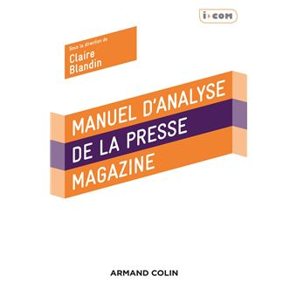

“We’re not journalists, we’re passionate kids”
“At Joystick in the late 1990s, the motto was more like: ‘we don’t claim to be journalists,’ because journalists were the ones talking nonsense about video games. Our stance was more along the lines of: ‘we’re brats, we do whatever we feel like, and you can follow us if you want.’” (Interview with Ivan Gaudé, publishing director of Canard PC and former deputy editor-in-chief of Joystick; Blandin, 2018: 285).
“What I held against [the magazine Tilt] was that it was made more by journalists than by true enthusiasts. This lack of passion was particularly noticeable in the reviews, which were far from reaching the standards I expected.” (Demoly, 2018: 75).
Notes:
Independence also took an institutional form: new publishing cooperatives guaranteed journalists’ control over editorial content. This blend of professional rigor and amateur passion re-legitimized the field, transforming tone into a strategy of differentiation and healing after years of industrial domination.

Slide 10

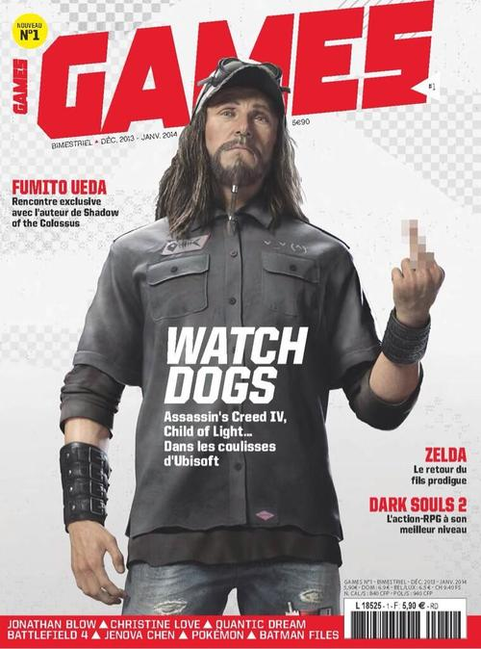
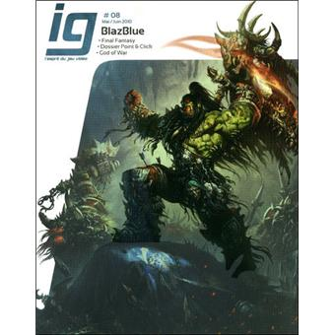
Notes:
Parallel projects—IG, Icare Magazine, and Games—continued this reinvention. Some embraced humor and nostalgia; others preferred analytical, auteurist approaches. Despite their diversity, all defined themselves against Future France, making independence and originality the new foundations of legitimacy. The crisis thus catalyzed a shared awareness of how economic models and editorial freedom are interlinked, marking the emergence of a “post-Future” identity for French video game journalism.

Slide 11
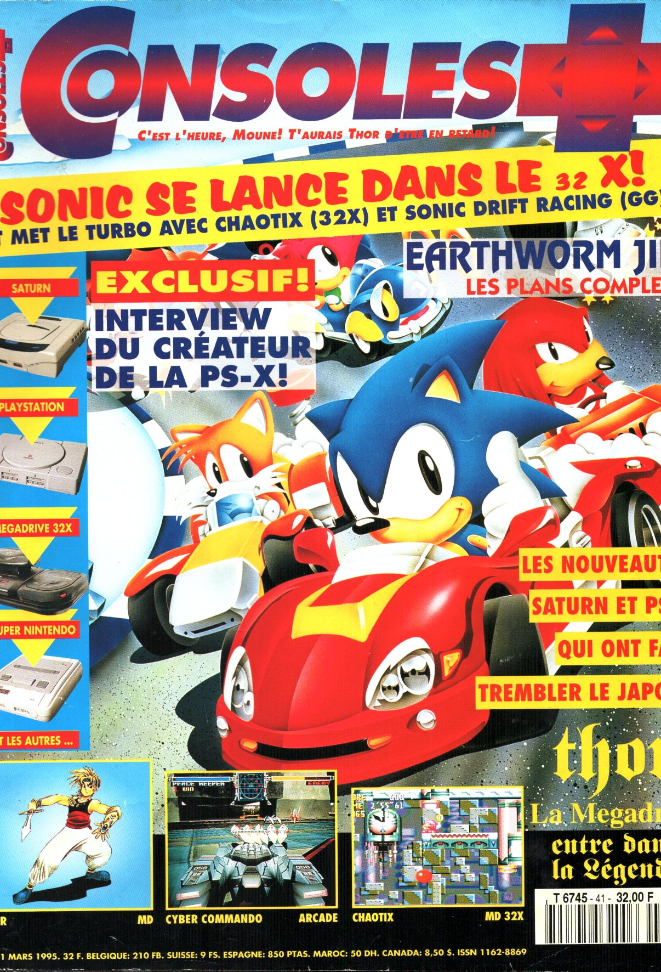
Explicit critics towards video game industry
“Sega was oddly very discreet about the 32X. Tom Kalinske [President of Sega of America, maker of the console] barely agreed to admit, grudgingly, that sales of the miracle add-on had fallen short of expectations (understand: ‘we really crashed hard’). The small number of titles shown at this trade show does not bode well for an improvement in sales anytime soon. [...] Officially, the machine is simply postponed to 1996. Tell me, Mr. Kalinske, are you sure this isn’t a premature burial?” “Sega contre Sony. La Guerre des prix !”, Player One, n° 54, p. 44, june 1995.
“The malicious will say that [Consoles + editor-in-chief] A.H.L. and I were dozing in the front row, in front of the podium where all the members of the Sony team took turns. We absolutely deny these rumors of being ‘good spirits’! Admittedly, [...] we sometimes closed our eyes during the speeches, listening with only one ear… but beware! Of our four ‘gamer’ eyes, we always had at least two ears open!” “Sony à l’assaut des jeux vidéo”, Consoles +, n° 41, p. 82, mars 1995.
Notes:
Let’s turn to how these magazines engage critically with the video game industry. Trade shows such as E3 are typically dominated by marketing discourse, yet French journalists have long used irony and skepticism to distance themselves from that spectacle. Even in the so-called golden age of the press, coverage often combined enthusiasm with doubt—testing promises against reality and exposing corporate language.

Slide 12
Explicit critics towards video game industry
“I want to remind everyone that it is universally agreed that the main problem with the company [Atari] has always been its inability to communicate. As for me, in two years of writing for ST Magazine, I received only one press release from Atari—and that was for the PC release of Tempest 2000. Enough said.” DE MAUPEOU Godefroy, “Atari : ce qui s’est réellement passé́ !”, ST Magazine, n° 112, p. 16, january 1996.
“Of course, these figures, like all official figures, are probably rigged: it’s the rule in the industry; true results are rarely disclosed.” HUYGHUES-LACOUR Alain, “Duel à trois”, Consoles +, n° 79, p. 7, august 1998.
Notes:
Journalists frequently staged themselves as resistant interlocutors, struggling to obtain reliable information. For instance, ST Magazine complained of Atari’s silence, identifying with frustrated readers, while Consoles + mocked inflated sales figures and exaggerated claims from console manufacturers.

Slide 13
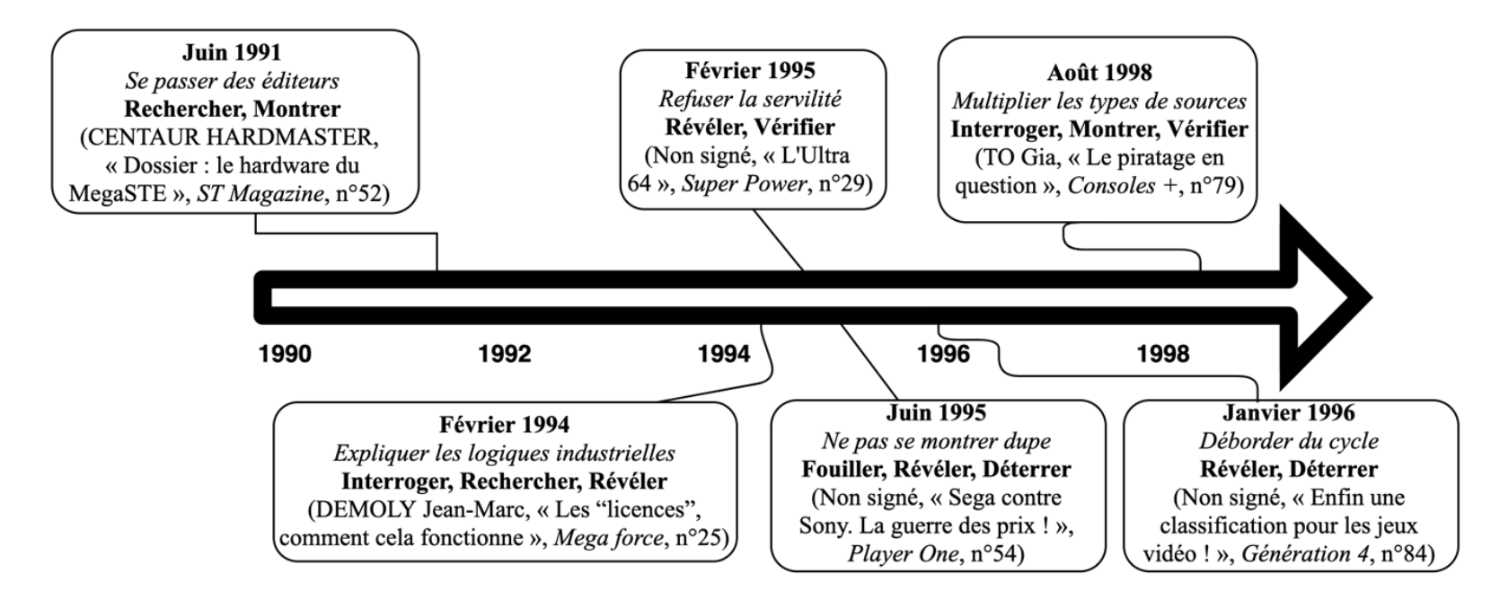
Critical distance and resistances : first appearances
June 1991 Doing without publishers Research, Show (CENTAUR HARDMASTER, “Feature: The MegaSTE Hardware,” ST Magazine, no. 52)
August 1998 Multiplying types of sources Question, Show, Verify (TO Gia, “Piracy in question,” Consoles +, no. 79)
February 1995 Rejecting servility Reveal, Verify (Unsigned, “The Ultra 64,” Super Power, no. 29)
February 1994 Explaining industrial logics Question, Research, Reveal (DEMOLY Jean-Marc, “Licenses: How it works,” Mega Force, no. 25)
June 1995 Not being fooled Dig, Reveal, Unearth (Unsigned, “Sega versus Sony: The price war!,” Player One, no. 54)
January 1996 Going beyond the production cycle Reveal, Unearth (Unsigned, “At last, a classification system for video games!,” Génération 4, no. 84)
Notes:
Such writing established credibility not through closeness to the industry, but through investigative techniques: verifying statements, revealing inconsistencies, and framing access as critical rather than promotional.
This ironic and investigative tone helped rebuild trust with readers, turning skepticism into a shared value. Even within a media ecosystem economically dependent on publishers, these gestures of defiance reaffirmed the journalist’s dual role—maintaining both contact and distance from the field. In short, they subverted promotional logic from within, transforming insider knowledge into a tool of critical authority.

Slide 14
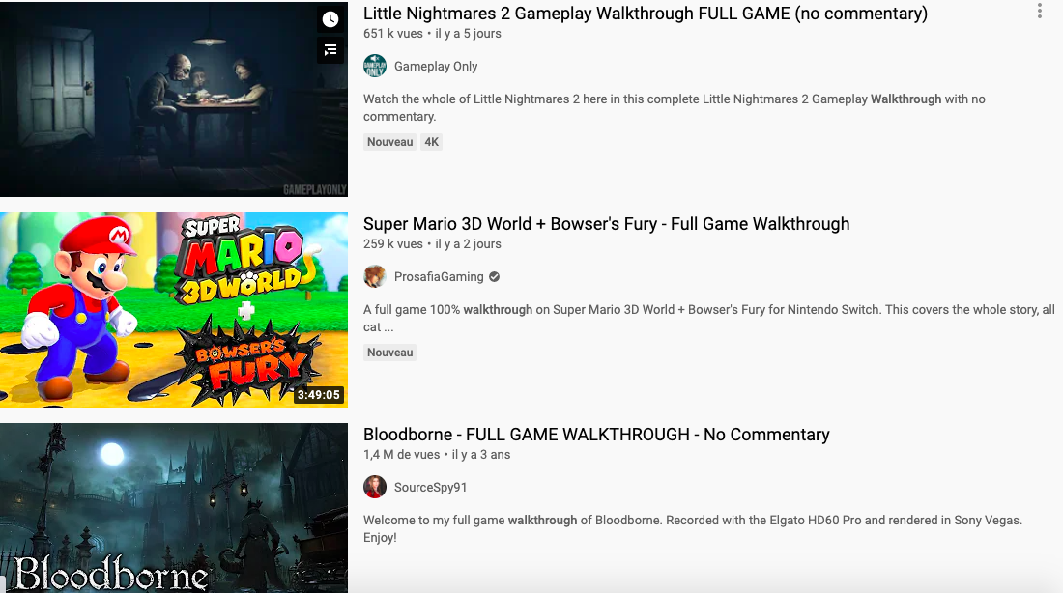
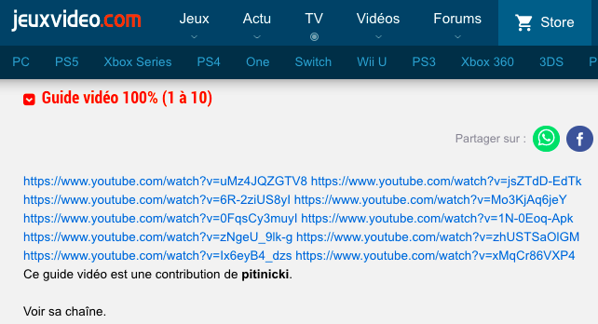
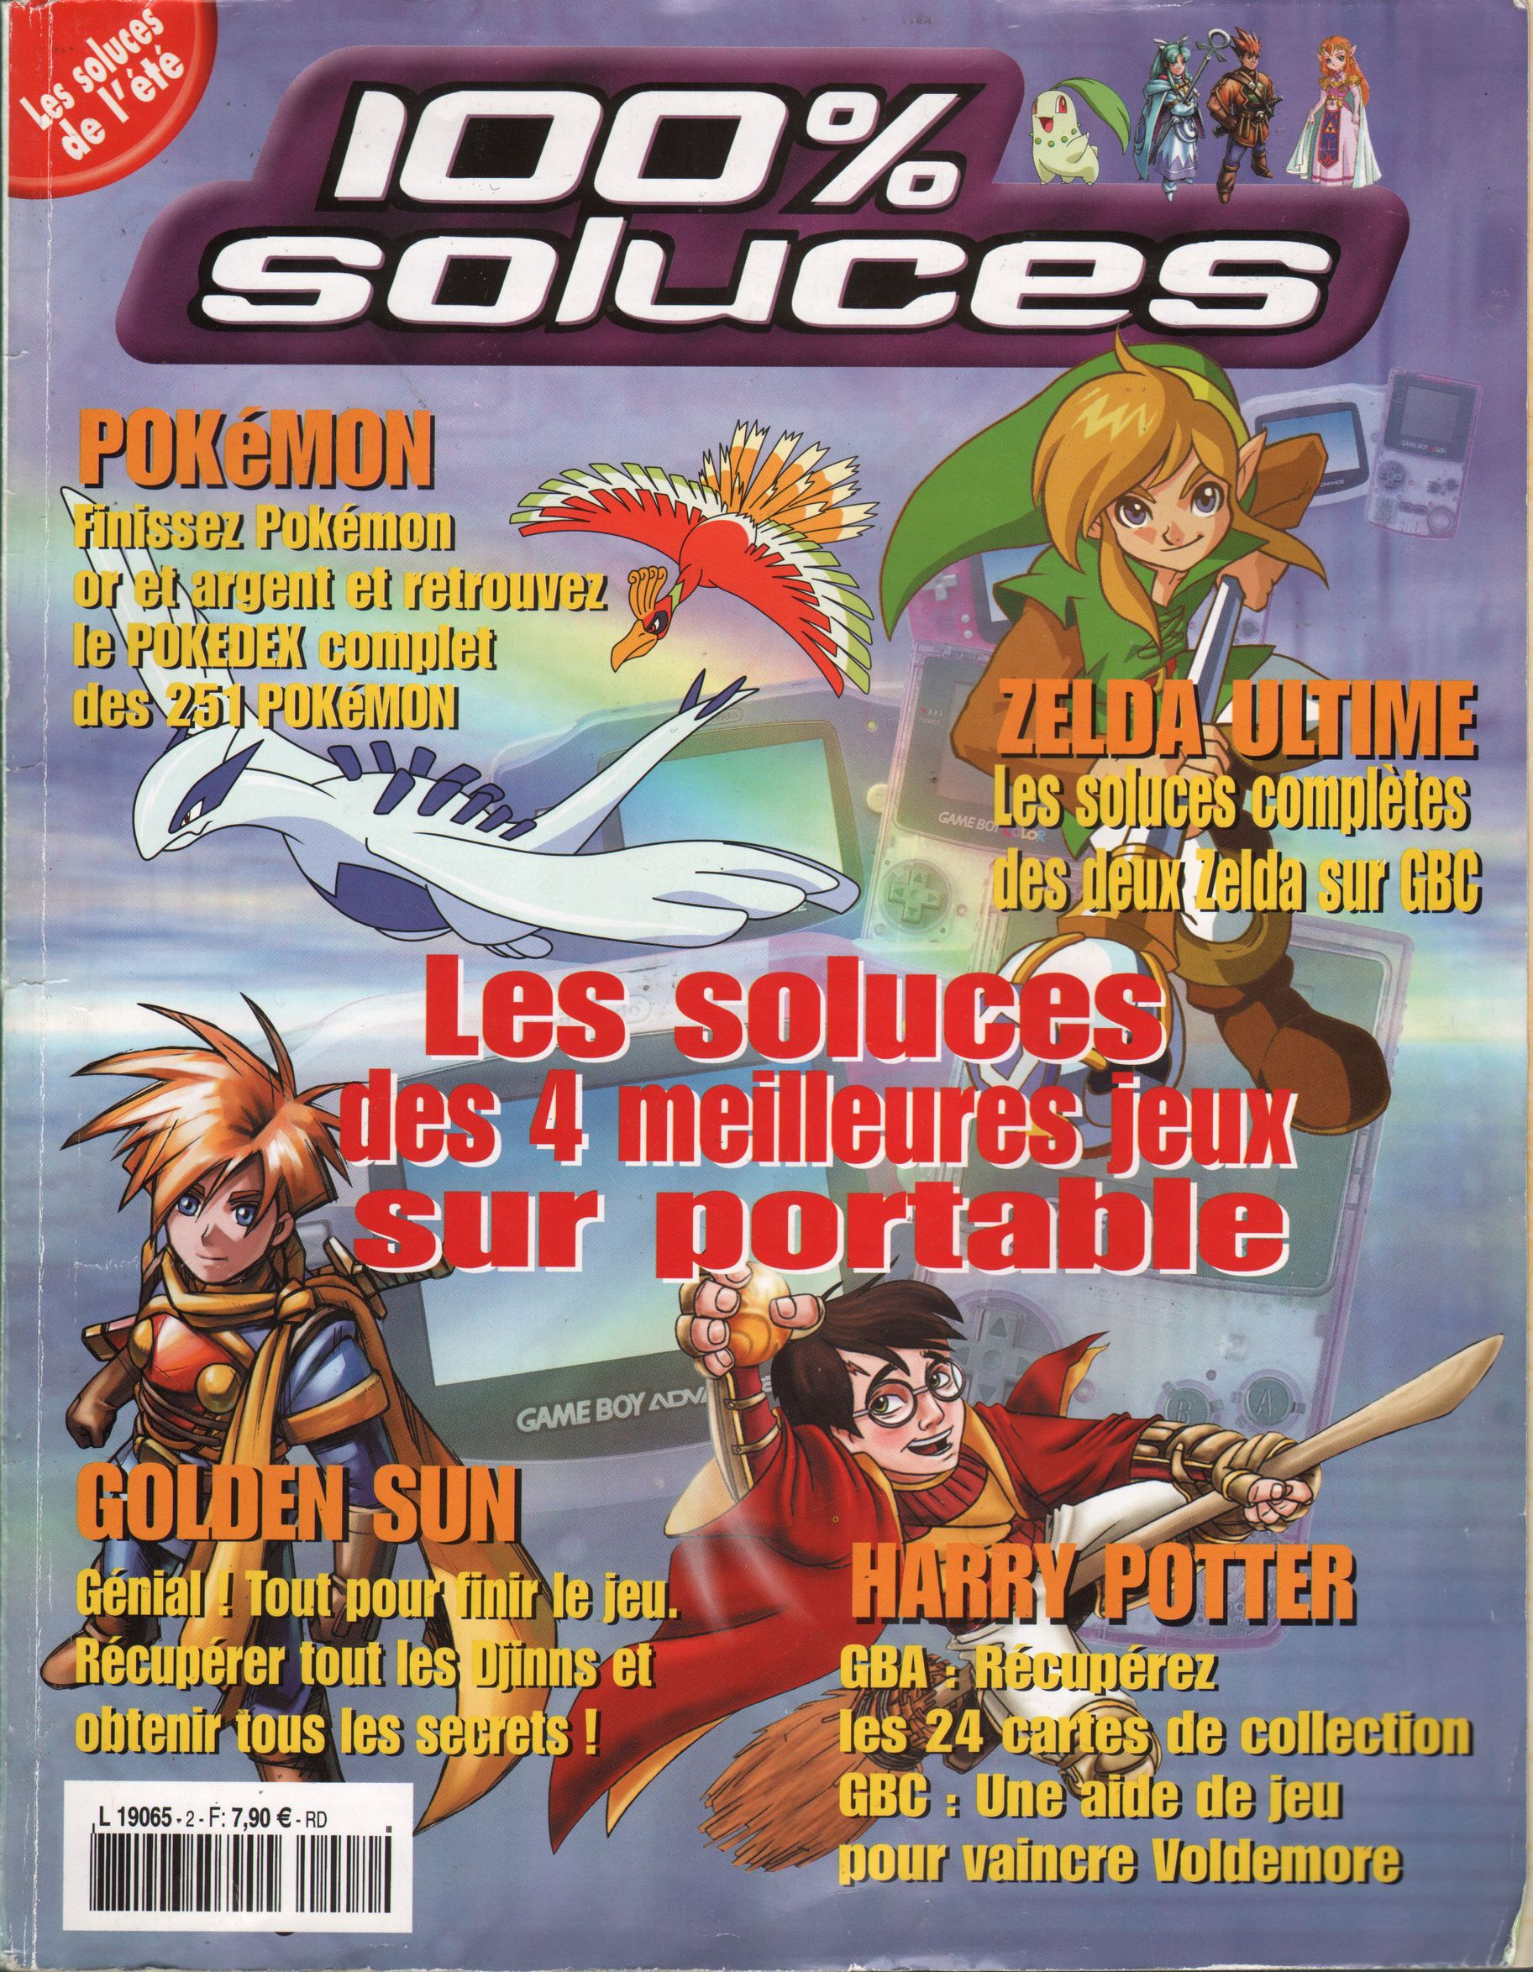
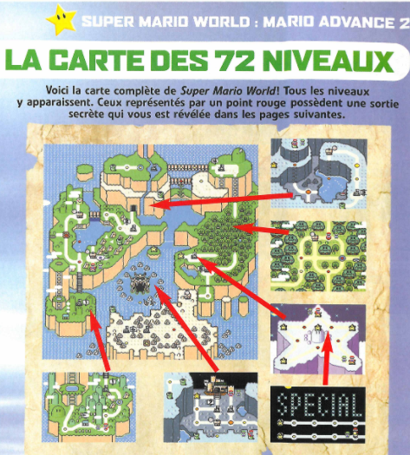
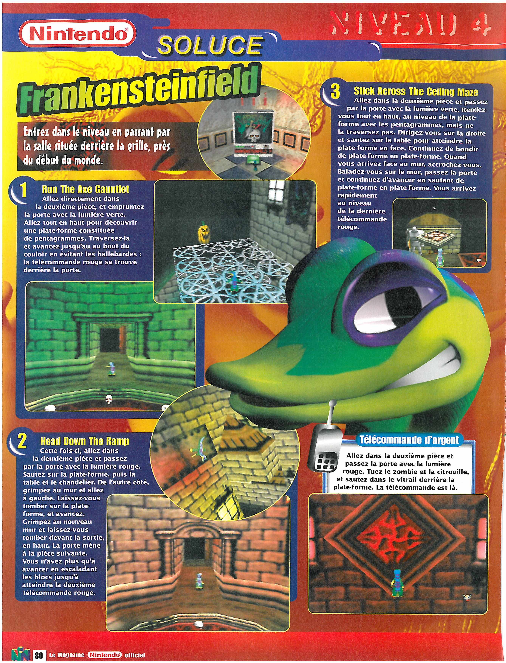
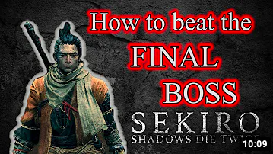
An Adaptive Role: The Decline of Walkthroughs
“I’ve never liked walkthroughs. I did the one for Final Fantasy VIII, at the very start of my career. I clearly understood that it wasn’t something that interested me, actually. I’m not interested in telling people how to finish a game. [...]. In terms of writing, it’s… it’s… I don’t know how to say this politely. It’s crystal-clear, let’s say, there’s no style, no desire. That’s it, it’s like a video game review that just talks about the graphics, the animation, and the sound—nothing very interesting.” (Interview on December 21, 2017, with Daniel Andreyev, independent journalist for Gamekult, Slate, Le Monde “Pixels”, etc.)
The democratization of “psychomotor and specific gaming capital” (Dozo and Krywicki, 2022, following Consalvo, 2007), once monopolized by specialized magazines.
Notes:
Finally, French video game journalists have redefined their mission by moving away from exhaustive, low-value content toward targeted, high-value coverage.
In the 1990s, walkthroughs and game guides were central to magazines’ appeal, even if considered minor journalism.

Slide 15
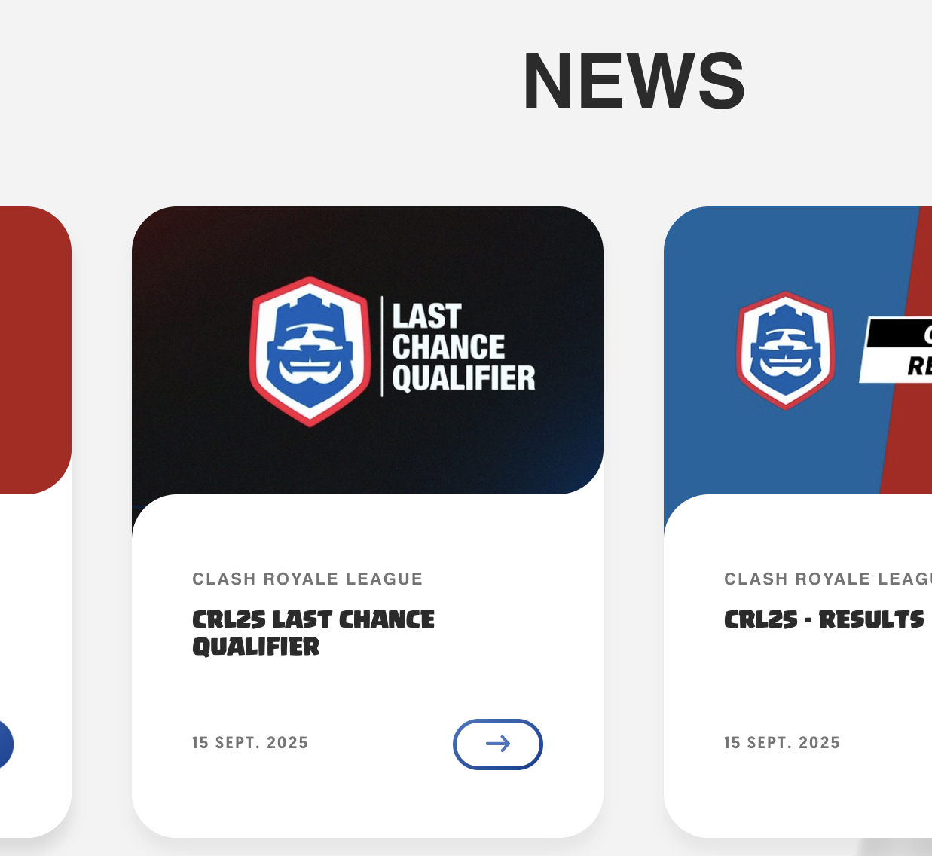
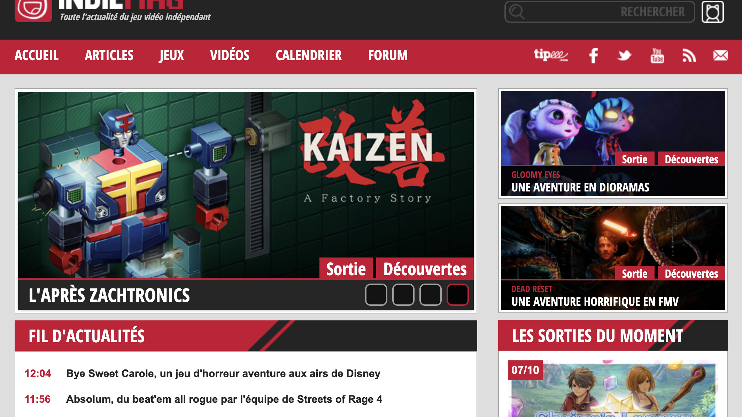
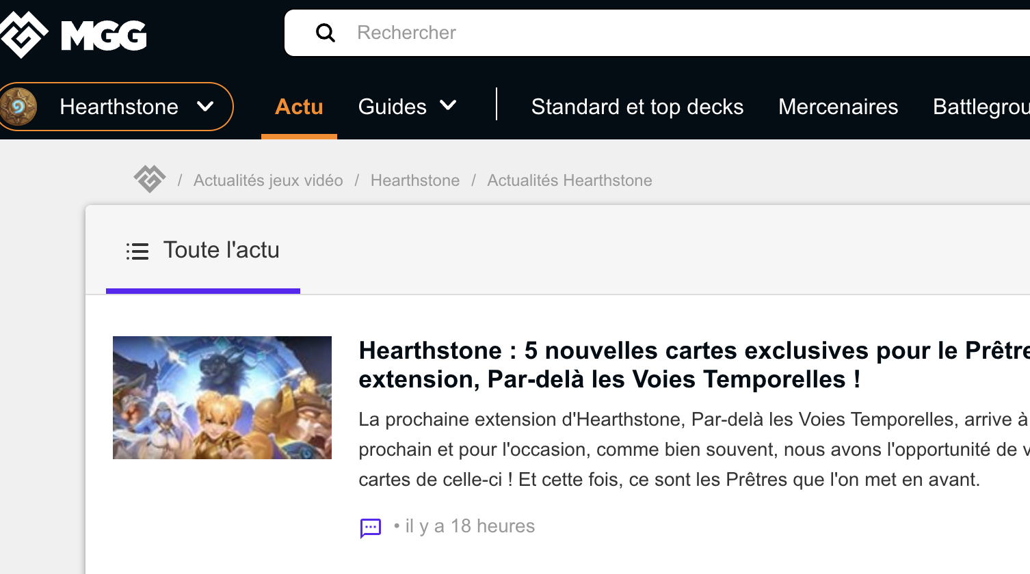
Hyper-specialized media despecializE SPECIALIZED journalists
From left to right : esport.clashroyale.com (Clash Royale), Indiemag.fr (Indie video games), Millenium (Hearthstone)
Notes:
With the rise of YouTube and Twitch, however, such expertise has been democratized. Thousands of creators now provide free, specialized content, rendering magazine guides obsolete. In a wayn these hyper-specialized medias despecialize, I would say, the specialized journalists

Slide 16

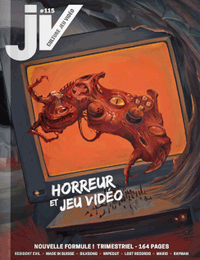
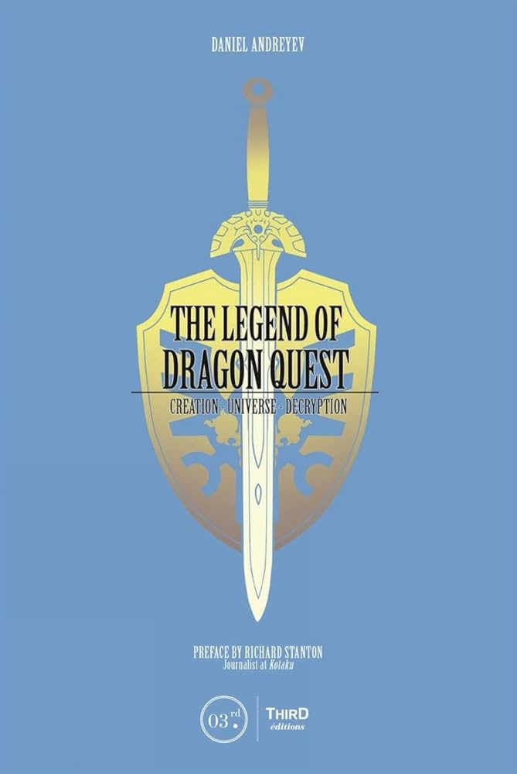
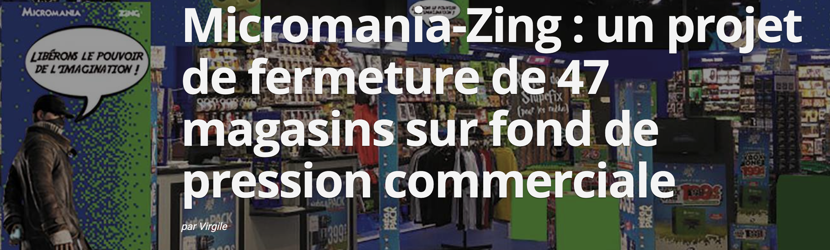
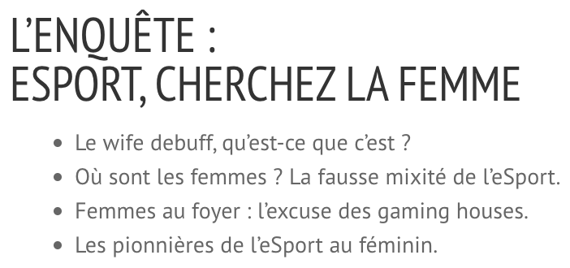

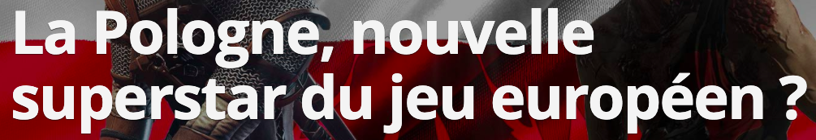
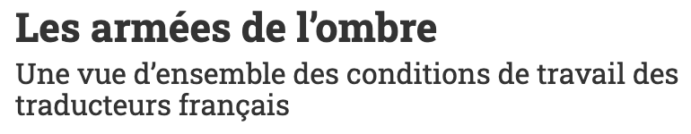



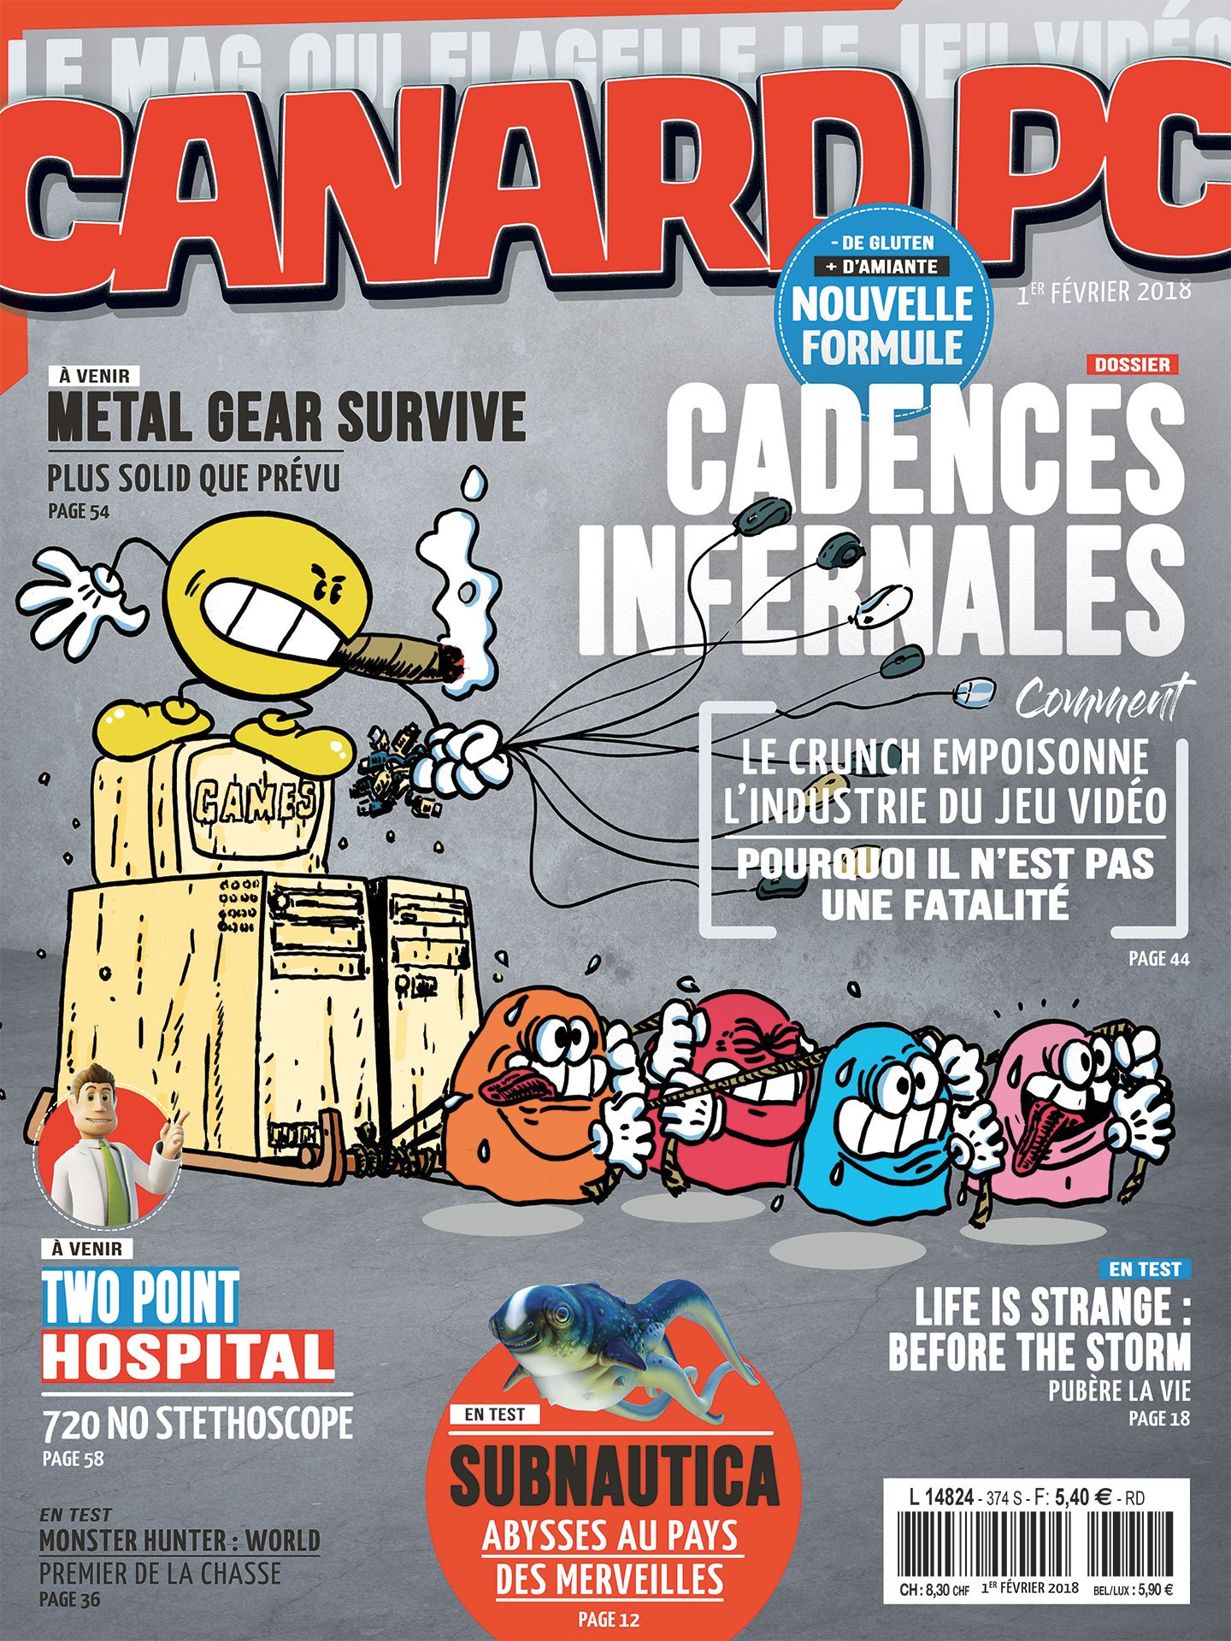
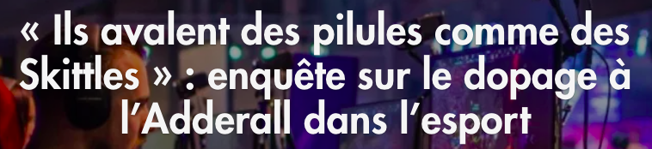
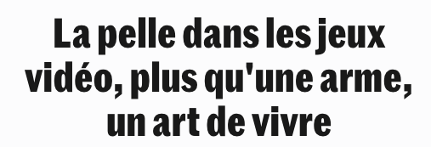
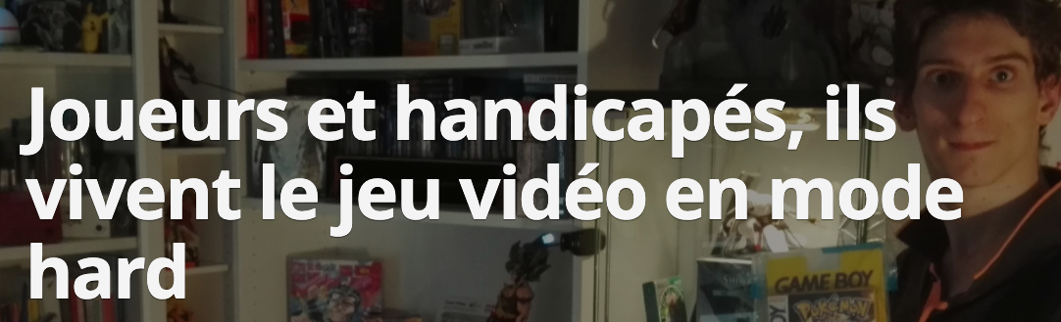
Editorial variety as a path for survival
Notes:
This forced professional journalists to adapt. Rather than compete on gameplay expertise, they invested in analysis, investigation, and historical contextualization—areas where journalistic methods offer added value.
Magazines and sites began publishing long-form investigations, creative profiles, and critical essays situating games within their social and economic contexts. This shift mirrors a broader trend toward “slow journalism”: fewer articles, more depth, and an emphasis on interpretation over information.

Slide 17
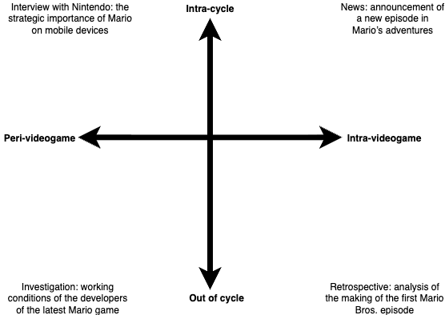
Providing some “journalistic Added value” (Ahva & Heikkila, 2010)
“For example, if you write an article about Nintendo Labo [a Nintendo video game sold with cardboard accessories you assemble yourself] just to say, ‘Here’s what it is,’ that’s informative, but it has no added value — you’re just repeating what Nintendo announced, the same as everyone else. An article with added value would be one that explains Nintendo’s reasoning behind it, or offers a retrospective on their more unusual accessories, or does a report or investigation on how these cardboard pieces, these atypical gaming accessories, are produced... It’s about creating information, intelligence, understanding — bringing something new.” (Interview from January 19, 2018, with William Audureau, then a journalist for Le Monde’s “Pixels” section.)
Low added value
No added value
Moderate added value
Strong added value
Krywicki, 2024
“We reworked Total Jeux Vidéo so that it would be more analytical. I can’t keep running after previews, reviews, and news. News has no real value, previews neither — and on top of that, we don’t even get them at the right time, which makes it absurd. What I can do is take a step back. [...] Take some distance, try to approach things differently in order to bring added value that’s specific to [our magazine]: interviews, perspective, analysis...” (Interview from November 7, 2021, with Christophe Collet, deputy editor-in-chief of Total Jeux Vidéo.)
Notes:
Through this reorientation, video game journalists have reaffirmed their legitimacy as mediators, historians, and cultural critics—roles that differentiate them from influencers or streamers. This adaptation transformed a structural crisis into an opportunity for reinvention.
The trajectory of the French video game press shows that crises can be productive moments of re-foundation. The collapse of the Future France model paved the way for a journalism that is more independent, reader-supported, and investigative.
By redefining their ethos—through narrative renewal, critical distance, and selective high-value coverage—journalists reclaimed symbolic authority within a field often seen as marginal. The pursuit of added value became both an editorial compass and an economic necessity.

Slide 18

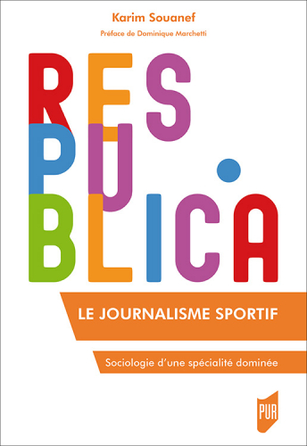
What about other fields ?
Sports Journalism in French Academic Literature
Often described as a “journalism apart”, marked by:
Close proximity to the sports world
Ongoing suspicion about its legitimacy
Historically understudied or treated as minor (Guillauma, 1988; Charon, 1991; Balle, 1994)
Characterized by:
A tendency toward the spectacular and exceptional (Attali, 2018)
Dependence on industrial partners (Ohl, 2000)
Production of information with “a role apart” (Leseney & Pallix, 1984)
However, this marginality has also fostered:
A hybrid professional identity, blending journalistic ethics with the moral universe of sport
Collective mobilization that strengthened its professional recognition (Souanef, 2013)
Notes:
This transformation also resonates beyond the video game press. Similar evolutions have occurred in other specialized fields like sports or technology journalism, where digital democratization disrupted monopolies on expertise. In all these cases, professionals responded not by abandoning passion, but by integrating it within a renewed ethos of autonomy—balancing proximity to their subjects with critical distance.
The French video game press thus offers a broader lesson: in times of technological and economic upheaval, credibility and sustainability can emerge not from resistance to change, but from the creative reinvention of journalistic purpose.

Slide 19
Bibliography
Ahva, L., & Heikkila, H. (2010). From credibility to relevance: Towards a sociology of journalism’s “added value”. Journalism
Practice, 4.
Carlson, R. (2009). Too Human versus the enthusiast press: Video game journalists as mediators of commodity value. Transformative Works and Cultures, 2.
Consalvo, M. (2007). Cheating: Gaining Advantage in Videogames. MIT Press.
Deuze, M. (2005). What is journalism? Professional identity and ideology of journalists reconsidered. Journalism, 6(4), 442–464.
Hellmueller, L., Vos, T. P., & Poepsel, M. A. (2013). Shifting journalistic capital? Journalism Studies, 14(3), 287–304.
Nieborg, D., & Sihvonen, T. (2009). The new gatekeepers: The occupational ideology of game journalism. In Breaking New Ground: Innovation in Games, Play, Practice and Theory (Proceedings of DiGRA 2009).
Perreault, G., & Vos, T. P. (2018). The GamerGate controversy and journalistic paradigm maintenance. Journalism, 19(4), 553–569.
Schaffar, A., & Körber, C. (2013). A sleepy change: Media and the digital vale of tears. Medien & Zeit, 2, 8–23.
Sonnac, N. (2009). L’économie de la presse : vers un nouveau modèle d’affaires. Les Cahiers du journalisme, 20, 22–43.

